Slide 1
Ghana Maternity Ward Partnership
Bridgeport Rotary Presentation
December 3, 2024

Slide 2
The humanitarian need…
Perinatal and maternal mortality is a serious problem in Ghana
Save and improve the lives of women and children in the Volta Region of Ghana
Serve more women, decongest outpatient area, reduce infection, decrease mortality rates, and create a healing environment for mothers and babies
Ensure women receive scans and malaria treatment as well as minor necessary surgeries
Reduce high risk births and improve the health for thousands of women and children for decades to come

Slide 3
The market town of Dzemeni…

Slide 4
On the shores of Lake Volta…

Slide 5
Many women and infants travel to this market town…

Slide 6
Market in Dzemeni, on the shores of Lake Volta…

Slide 7
Children taught the basics…

Slide 8
Video…best overall video on Dzemeni and the humanitarian need (approx. 5 mins.)
https://vimeo.com/379480559

Slide 9
GMWP - Ghana Maternity Ward Partnership
GMWP created in 2017 by First Presbyterian Church of Fairfield
Sole purpose to raise the funds to build and equip new maternity ward in Ghana
Partnership, in addition to FPC of Fairfield, included:
Individual donors
Other local CT churches
Presbyterian Women’s (organization within Presbyterian Church, USA)
Evangelical Presbyterian Church Ghana
Phase 1 – Construction ($100K), Phase 2- Medical Equip. ($50K)

Slide 10
Local chiefs donated land for the new maternity ward

Slide 11
Celebration for the initial ground-breaking…

Slide 12
Early in the construction phase…

Slide 13
Early construction progress…

Slide 14
Construction progress…

Slide 15
Construction inspection by EPCG leadership…

Slide 16
New water supply/holding tanks…

Slide 17
Engagement of Rotary Clubs of Ho and Bridgeport…focused on medical equipment…
Met with and engaged the Rotary Club of Ho (Ghana) in 2019
Engaged Rotary Club of Bridgeport soon after via Jatin Mehta and Bill Hass
Rotary Club of Ho agreed to be sponsoring club and Bridgeport the hosting club
Jatin Mehta was instrumental in developing the RI Grant strategy and coaching the Ho Club in the completion of the RI Grant application
Initial donations from First Presbyterian Church, Rotary Clubs of Ho and Bridgeport, along with District and Global matching…$53K was made available for the medical equipment

Slide 18
Medical equipment procured and stored by Rotary Club of Ho…
Stored at the infirmary of a local school owned and operated by a Ho Rotarian
Equipment included:
Delivery beds
Incubator
Sterilizer
Laptop
Heat lamps
Vaccines refrigerator
Radiant heaters
Hematology machine
Printers

Slide 19
Meeting with Rotary Club of Ho leadership…

Slide 20
Equipment stored locally until ready for installation…

Slide 21
Creative storage to minimize additional costs…

Slide 22
Creative storage to minimize costs…

Slide 23
Newly installed and operational equipment…

Slide 24
On-site visit to storage location to confirm inventory…

Slide 25
Newly installed and operational equipment…

Slide 26
Newly installed and operational equipment…

Slide 27
Dedication and commissioning of the new maternity ward in Dzemeni…

Slide 28
Dedication and ribbon-cutting…Rotary Club of Ho…

Slide 29
Rotary Club of Ho leadership at dedication and commissioning ceremony…

Slide 30
Dedication plaque from Ho Rotary Club…

Slide 31
Medical staff at the new clinic…

Slide 32
Video – a walk-thru of the existing clinic and new maternity ward…(approx. 4 mins.)
https://share.icloud.com/photos/02ei82rJpi8CyP_dpT94DROHA

Slide 33
New maternity ward is fully operational…
June deliveries – 11
July deliveries – 18
August deliveries – 20
September deliveries – 17
October deliveries – 19+
Approximately 200 prenatal visits per month

Slide 34
Fist baby delivered on June 5, 2024…

Slide 35
Strong global relationships established … Rotary Clubs of Bridgeport and Ho…
Ho Rotary Club Presidents… Alphonse Makafui Dzakpasu and Eric Botey
Trust and respect achieved
Ongoing communications with Rotarians in Ho
Ho members are young, entrepreneurial, creative and passionate, with a strong “get it done” attitude

Slide 36
Rotary Club of Ho President Alphonse Makafui Dzakpasu with Bill Hass…

Slide 37
Alignment with Rotary Club of Ho with long-terms relationships established…

Slide 38
Gifts from the Rotary Club of Ho…

Slide 39
Gifts from the Rotary Club of Bridgeport…

Slide 40
Bill and John…ready to go home…

Slide 41
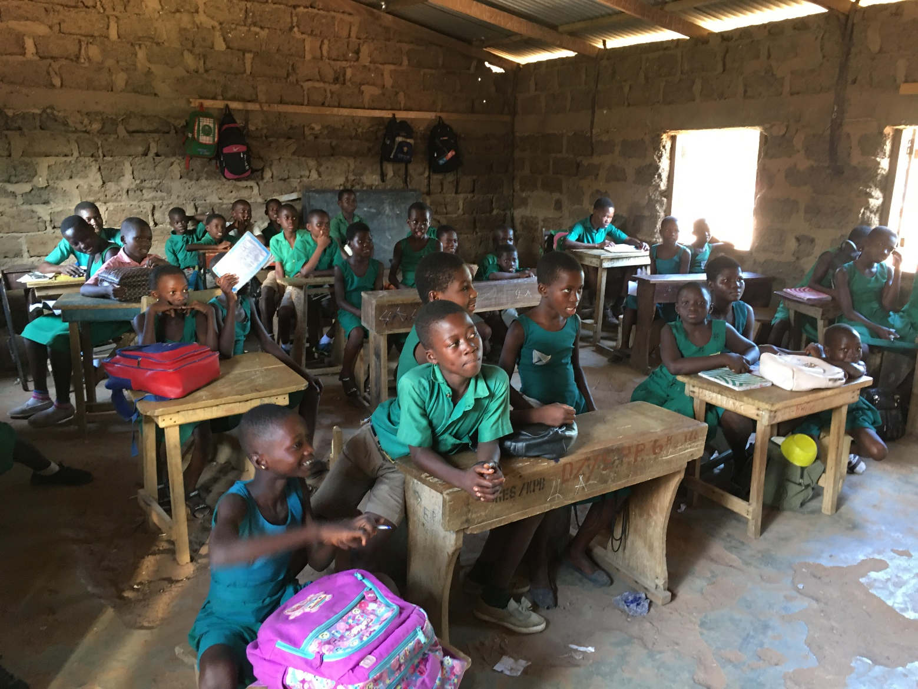
Questions?

Slide 42
Presentation of Dedication Plaque to Rotary Club of Bridgeport…
Kim McGinnis, President

