Slide 1
Scam Alert Update 2024
What to Look For…
How to Protect Yourself
A Presentation by Christopher Gallo
Forensic Accountant

Slide 2
What are Fraud Criminals/Scammers Trying to Do?
Steal Your Money
or
Steal Your Sensitive Information,
Which Leads to Your Money!
Notes:
ok

Slide 3
Big Question #1
Is It Time to Stop Writing Checks,
Since Check Fraud is the Most Common Scam?
* * * * * * * * *
Many Retailers are No Longer accepting Checks at the store!
Notes:
ok

Slide 4
Big Question #1 - Continued
Who Has the Liability for an Altered Check?
- You as the Check Writer?
- The Bank where the Check was Drawn?
- The Business who Cashes the Check?
→ Your Best Protection use Electronic Payments
Notes:
Show article….CT Post Sunday, July 28, 2024
Checks written are down from 17B in 2000 to 3B today.
Yet Check Fraud has Tripled in the last 4 Years. This is a Generational Trend!

Slide 5
Fake Check Scams
Did someone send you a check and ask for some money back? Maybe…
You’ve won a prize→ told to send back taxes & fees.
You’ve been paid as a “secret shopper” → told to wire back money.
You’ve sold an item online → the buyer overpays & asks you to send them the overpayment.
These are all SCAMS!
Notes:
ok

Slide 6
Fake Check Scams
But…there’s money in my account…how is this a fake?
Banks are Required by Law to make deposited funds available quickly.
But it may take several days for the Bank to determine the check was bad.
By that point, the scammer has your money, and you have to repay the bank for depositing a “bad” check.
Just because a check clears does not mean it is good.
A tough lesson!!
Notes:
ok

Slide 7
Fake Check Scams
What Should You Do?
Be wary. Talk to someone you trust before you act.
Talk to your bank.
Never take a check for more than your selling price.
Never send money back to someone who sent you a check.
Tell the Federal Trade Commission if you’ve seen this scam:
    www.ftc.gov/complaint
Notes:
ok

Slide 8
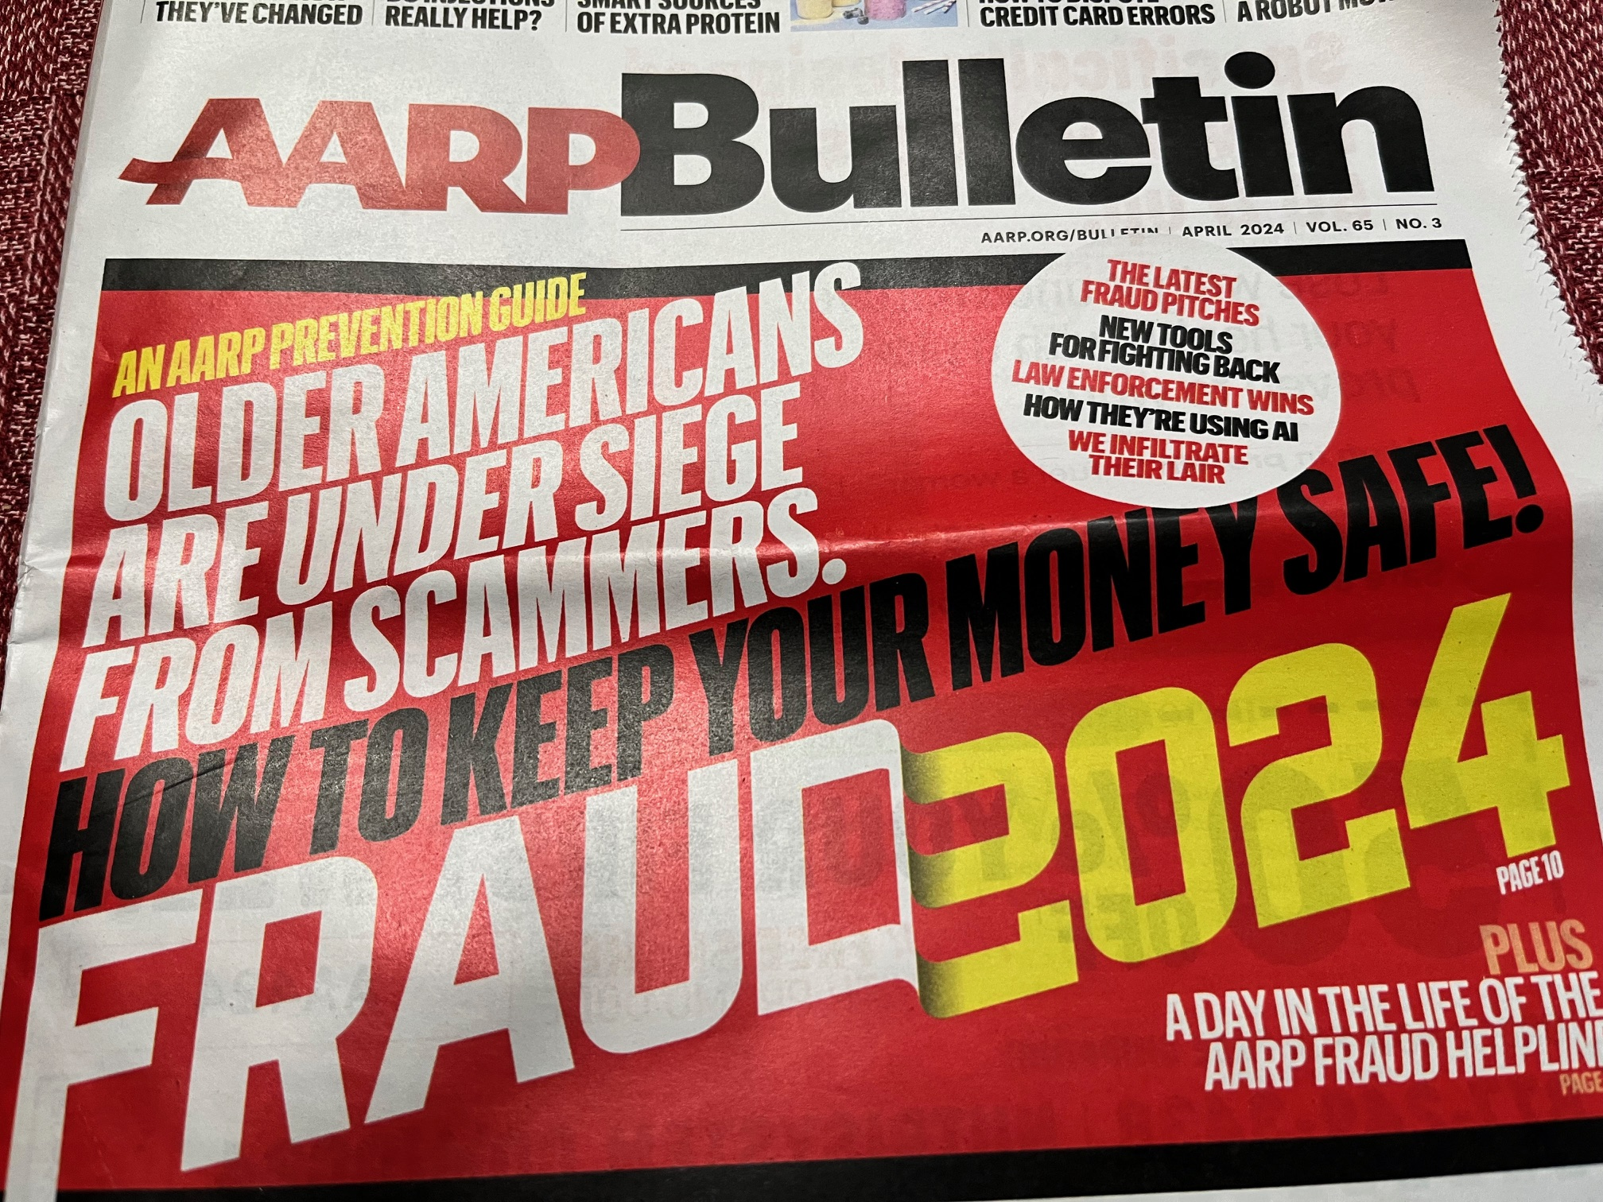
Notes:
ok

Slide 9
AARP’s Six Fast-Growing Scams
Check Cooking
Voiceprinting
Celebrity Impersonation
Multi-Stage Grandparent Scams
Delayed-Action Sweepstakes
Paris Olympic Scams
Notes:
ok

Slide 10
Check Cooking
Check washing has been a BIG thing in recent years:
  Thieves steal paper checks from Post Office blue mailboxes
  Use chemicals (nail polisher remover) to wash ink off (leaving signature)
  Fill in Payee and Amount they want
Now…it’s check cooking:
  Take a digital photo of a stolen check & use photo-editing software to alter the check payee and amount
  It looks very real (including watermark, etc.)
  The “new” check then gets deposited via bank’s mobile app
How to Avoid this → Drop off mail inside the Post Office
→ Monitor bank account activity frequently!
Notes:
ok

Slide 11
Our Club’s Stolen Check Issue
What I did to fix our problem:
Called our bank
Opened new account
Put stop payment on stolen check
Gave list of unpaid checks to the bank
Left money in account to cover only those checks
Reconcile account monthly
Continue to monitor account activity, frequently
Prosecute the perpetrator???
Notes:
ok

Slide 12
Voiceprinting
Thieves can use a recording of your voice to generate a “deepfake” version that impersonates you
They will contact your financial institutions to request that funds be transferred to an account they control
How to Avoid this → Be careful who you speak with on phone
I NEVER answer a phone call from a number I don’t know!!
Notes:
ok

Slide 13
Celebrity Impersonation
Social media chats with celebrities were common during pandemic
Now…Someone pretending to be a celebrity or their manger reaches out to you:
  “Star” would like to speak with you
  Gradually the talk turns to how the celebrity needs a loan due to <whatever>
How to Avoid this → Be extremely skeptical
→ Is this really likely?
→ It’s more likely a scam
Notes:
ok

Slide 14
Multi-Stage Grandparent Scams
This is a new version of the classic grandparent scam
  Imposter pretends to be a grandchild in trouble who needs instant money for: Bail, a Car Repair, or something else
Now…Scammers set up a call center with youths who make calls. (They will give you a “Case Number” as well)
When you call the “Authority”, they ask for “Case Number”
A subtle psychological trick to make it seem more credible
Scammer may send Courier to pick up the cash at your Home
How to Avoid this → Hang up when you get this type of call
→ Then call/text the family to verify
Notes:
ok

Slide 15
Delayed-Action Sweepstakes
Instead of asking for fees or payment of taxes on your winnings..
Now…they ask for personal information to “validate” who you are in order to set up the payout
Use this information to take small amounts out of your account to see if you notice the fraudulent activity
Then…obtain credit cards and lines of credit in your name, which lead to bigger paydays for the scammers
How to Avoid this → Reality…there are few large cash prizes
→ Just hang up
→ Never give out your personal information
Notes:
skip

Slide 16
Paris Olympic Scams
An old scam, but now your friend is in Paris!
A friend’s email account gets hacked; you get a message from your “Friend”
  “Hey guys, I’m in Paris and my wallet’s been stolen.
  Can you help me? Please send me a gift card or Venmo deposit.”
How to Avoid this → Resist the urge to react immediately
→ Contact your friend via text or phone
Notes:
skip

Slide 17
What You Can do Today to be Safer Tomorrow
Use different passwords for each financial account.
Periodically revise passwords on your financial accounts→ Use Strong passwords
Sign out of financial apps on your phone (e.g. credit cards, banks, Venmo, Zelle)
Use Multi-factor Identification→ One-time passcode sent to your phone.
Be skeptical whenever contacted by someone you don’t know
  Criminals use friendliness, emotion & compassion to persuade you
Be aware of what you share and where you share it.
What’s in Your wallet? (don’t carry all Credit Cards, SS card, Medicare card)
Routinely monitor your credit report:
  Go to AnnualCreditReport.com, or call 877.322.8228 for your free credit report
Keep social media account settings on “Private”
Add AARP Fraud Helpline to your contacts” 877.908.3360
Notes:
ok

Slide 18
Big Question #2
When is the Last Time you Changed Your
Important Passwords??
Notes:
ok

Slide 19
How to Create Strong Passwords You’ll Remember
Use Maximum # of Characters allowed by Combining 2 easy to remember Passwords.
Mix Upper & Lower Cases; Use Numbers & Symbols:
  s=$, a=@, l=!, e=3,o=0, i=1, b=6, g=9; w=\/\/; m=/\/\
Use a Phrase only You know.
Avoid Personal Information, eg…Street address, Mom’s maiden name.
Convert Phrase or Song title to Acronyms:
  Colour My World by Chicago
    C0!0ur/\/\yW0r!d6yCh1c@90
Use a password manager.
Notes:
ok

Slide 20
Top 5 Threats
Identity Theft
Unwanted Calls
Imposter Scams
Shopping Scams
Phishing Scams
Notes:
ok

Slide 21
Big Question #3
Have you Been a Victim of Identity Theft?
Notes:
ok

Slide 22
What is Identity Theft?
Obtaining someone’s personal information to steal their money.
How Much is Being Stolen?
Estimates of losses in 2023 are HUGE…Billions of $$$!
Notes:
ok

Slide 23
How Does Identity Theft Happen?
Schemes to obtain Your personal information:
  Social Security number
  Bank account number
  Peer-to-peer payment apps, such as Zelle, Venmo, PayPal
  Passwords for financial accounts
E-mails with links to malware
Calls, texts or emails that spoof government agencies, a delivery service or your bank
Social media is fertile ground for scammers!!
Notes:
ok

Slide 24
Big Question #4
Is that Phone Call about a Problem with your Bank Account Real?
If you are worried, call your bank.
Remember, bank accounts have different (and fewer) protections than credit cards…so if you move your money out of the bank, you won’t get it back.
Notes:
ok

Slide 25
Is there really a problem with your Credit Card?
Phone call: “Your credit card has been charged in error. Give me the account number and I’ll fix it for you.”
Text or Email: Looks like a legitimate company → “Your credit card information needs to be updated ASAP because it’s been compromised.”
Never respond to these types of unsolicited calls.
  If there is a real problem, you will get a letter.
How to avoid: Look at all credit card statements, monthly!
  If something looks strange…call the credit card company.
Notes:
ok

Slide 26
Signs Your Identity has been Stolen
Accounts on your credit report that you don’t recognize.
  Free credit reports → www.AnnualCreditReport.com
Unfamiliar transactions on credit cards, bank statement.
  Look at all statements regularly & frequently.
  Get text alerts for all credit card transactions.
IRS says it received more than one tax return from you.
  Notice from IRS re: an employer that you don’t know.
  1099 received from a source you don’t know.
Notes:
ok

Slide 27
If Your Identity has been Stolen
Don’t be ashamed if you are a victim!!
Help someone else from becoming a victim!!
* * * * * * * * * * * * * * * * *
  Don’t Wait!!
  Call your bank
  Report it & get help → www.IdentityTheft.gov
  Report it→ www.ReportFraud.ftc.gov
  Call National Elder Fraud Hotline:(833) FRAUD11 (833.372.8311)
  Call the IRS: 800.829.1040, if it’s tax-related.
  Call me!
Notes:
ok

Slide 28
Unwanted Phone Calls…What Should You Do?
What I do when I get a call from a number I do not recognize → I don’t answer it!
  Let it go to voicemail. Return the call if they leave a message
But I know that number!
  Don’t assume the call is coming from the number shown in caller ID.
  Phone Numbers can be easily faked or spoofed.
  Hang up if the caller starts asking strange questions…it’s a scam!
Hang Up & Call the Number you Know
→ Not the Number the Caller gave you to Call
No one will be upset. Trust me on this!!
Notes:
ok

Slide 29
How to Block Calls on Your Landline
Dial *60 on your phone…
  Message will walk you through how to block a number
To block the most recent call, dial #01#
To block another number, dial #, then the number, then #
To block your number from Caller ID, dial *67 before each call.
Go Online to the National Do Not Call Registry (it’s free!): → www.donotcall.gov
After 31 days, report unwanted calls to: → www.donotcall.gov/report
Notes:
skip

Slide 30
If you Keep getting Robocalls on your Landline
Dial *69 to find out who called you, then Block it!
Dial *57 to trace harassing calls and report it to the police
Notes:
skip

Slide 31
How to Block People on Your Cellphones
Go to “Settings” then “Phone”
  Then, turn on the setting for “Silence Unknown Callers”
  All calls from anyone not in your Contacts will be sent to Voicemail
Open “Recent Calls”
  Click on the “i” button next to the phone number
  Scroll down and click on “Block Caller”
Notes:
skip

Slide 32
Imposter Scams
Notes:
ok

Slide 33
Grandparent Scams
This scam targets seniors; attacks your emotions.
You get a call: “Grandma, I need money for <whatever>”
How it works…
  They ask for money (cash/gift card) & say “Please, don’t tell Anyone!”
  They do everything to keep you on the phone. “This is really Urgent!”
  They count on you losing your cool and doing what they say.
  They may even come to your home to pick up the cash or gift card.
  (Do you have outside cameras around your home?)
Either way…if you do what they ask, your money is gone!!
Notes:
ok

Slide 34
What Can You Do …What Should You Do?
Stop!! Think about it! Does this Really Happen?
  Highly Unlikely!!
Your First Action Should Be: Disengage from the Caller!
Then…Check it out.
  Call the person or someone in their family or a friend to verify!
  Then, call the Police!!
DO NOT EXPECT anyone at the bank to help!
Later…Share your story with those you trust/friends!
  It may save them from becoming a victim!
Notes:
ok

Slide 35
Be Aware…AI is Making it easier for Scammers!
It only takes a few seconds of a recorded voice for a cybercriminal to clone it, and make you think it is someone you know.
Example:
  “Hi, you’ve reached Chris! Please leave a message.” Is plenty!
What can you do to prevent this?
  Remove personal information from the Internet
  Don’t post videos to social media
  If you get a call from a number you don’t recognize, wait for the caller to speak first to see if there’s a human there. If not, hang up. Better yet…don’t answer.
Notes:
ok

Slide 36
Shopping Scams
So many of them!
  Porch package thieves
  Mailbox thefts
  Gift card payment scams
  Package delivery scams
  Online shopping scams
Notes:
ok

Slide 37
How to Thwart Porch Pirates
This is a HUGE problem!
49 million Americans had a package stolen last year.
What can you do:
  Require signature upon delivery for important items.
  Sign up for text notifications & tracking information.
  Have package delivered to your office, a neighbor’s, the back door, or held for delivery.
  Install motion activated lights & cameras outside your house.
Notes:
ok

Slide 38
A Few Thoughts Regarding Stolen Mail
Concerned about delivery of your U.S. mail?
  Signup Online for Informed Delivery at www.USPS.com
Mailbox Thieves target the Blue Collection Boxes at the end of the day.
  What can you do?
    Don’t put mail into the Blue Box after last collection time or on Sundays (usually no pickups).
    Hand your mail directly to your carrier.
    Drop off your mail inside the Post Office.
Notes:
ok

Slide 39
Gi ft Card Payment Scams – What to Watch For
Directed to purchase gift cards as payment.
Told to share the numbers on the back of the card. Don’t!!
How to protect yourself...
  Remember…gift cards are for gifts not to pay a bill!
  Hang Up from the scammer immediately!
Why scammers love gift cards…
  Gifts cards can be purchased anywhere.
  They are virtually untraceable & easily converted into cash.
  There is little recourse for recovery!
Notes:
ok

Slide 40
Package Delivery Scam Warning Signs
“There’s a problem with your delivery…You need to fix it NOW!”
Question #1 – are you really expecting a delivery?
  But…It looks like it’s from Amazon, FedEx, or UPS & has a tracking code.
Call the legitimate customer service number found online, not the “Customer Service” number they give you!!
Check tracking number online to verify delivery was attempted.
If they send you a Text that says: “Click on this link”→ Don’t!
  It’s likely malicious software (Malware), or a Phishing scheme.
Notes:
ok

Slide 41
How to Avoid Losing $$ to an Online Shopping Scam
Scammers use texts & social media to sell items at a deep discount (is the price too good to be true?), and direct you to their website which looks real but is bogus. So…
Don't use debit cards. Credit cards are safer for online transactions. You have more protection against fraud and card theft.
Don't save your payment info to your device → you are more vulnerable to being swiped.
Use a VPN. A virtual private network hides your location and web browsing from snoopers.
Notes:
ok

Slide 42
Phishing Scams
This is what a Phishing Scam email looks like:
“We suspect an unauthorized transaction in your account. To ensure your account is not compromised, please log in to your online banking profile below to review your account activity.”
Don’t do it!!
  You are being targeted to provide personal information like your Social Security number, bank account information, credit card numbers, passwords, or other sensitive information.
Notes:
skip

Slide 43
How to Avoid Other Common Scams
Important things you Need to do often:
  Carefully review your monthly Credit Card statements.
    Look for small $$ charges
    Charges for subscriptions and services you didn’t sign up for
  Look at unusual or unrecognized activity in bank or investment account statements.
Protect your emails:
  Do not open links and attachments in unsolicited emails.
  Safeguard your personal information if you don’t know the sender.
  Always use a trusted antivirus program on all your devices.
Notes:
skip

Slide 44
Thank You for listening!
Remember…With a modest investment of your time, you can be secure!
If you are having an issue/need help…call me
203.895.1454
or email me
christophergallocpa@gmail.com

