Slide 1
The Rotary Club of Bridgeport’s Global Grants
International Service
Jatin Mehta
2/20/23

Slide 2
What is a Global Grant?
Rotary Foundation + two different Clubs in two different Countries work jointly
Seven areas of Focus
Large Amount – impact over longer period
Power of Rotary

Slide 3
The Bridgeport Rotary Club Global Grants Approved during 2018-23
Notes:
Bill Haas + local church; Peter Rosell now in Zurich

Slide 4
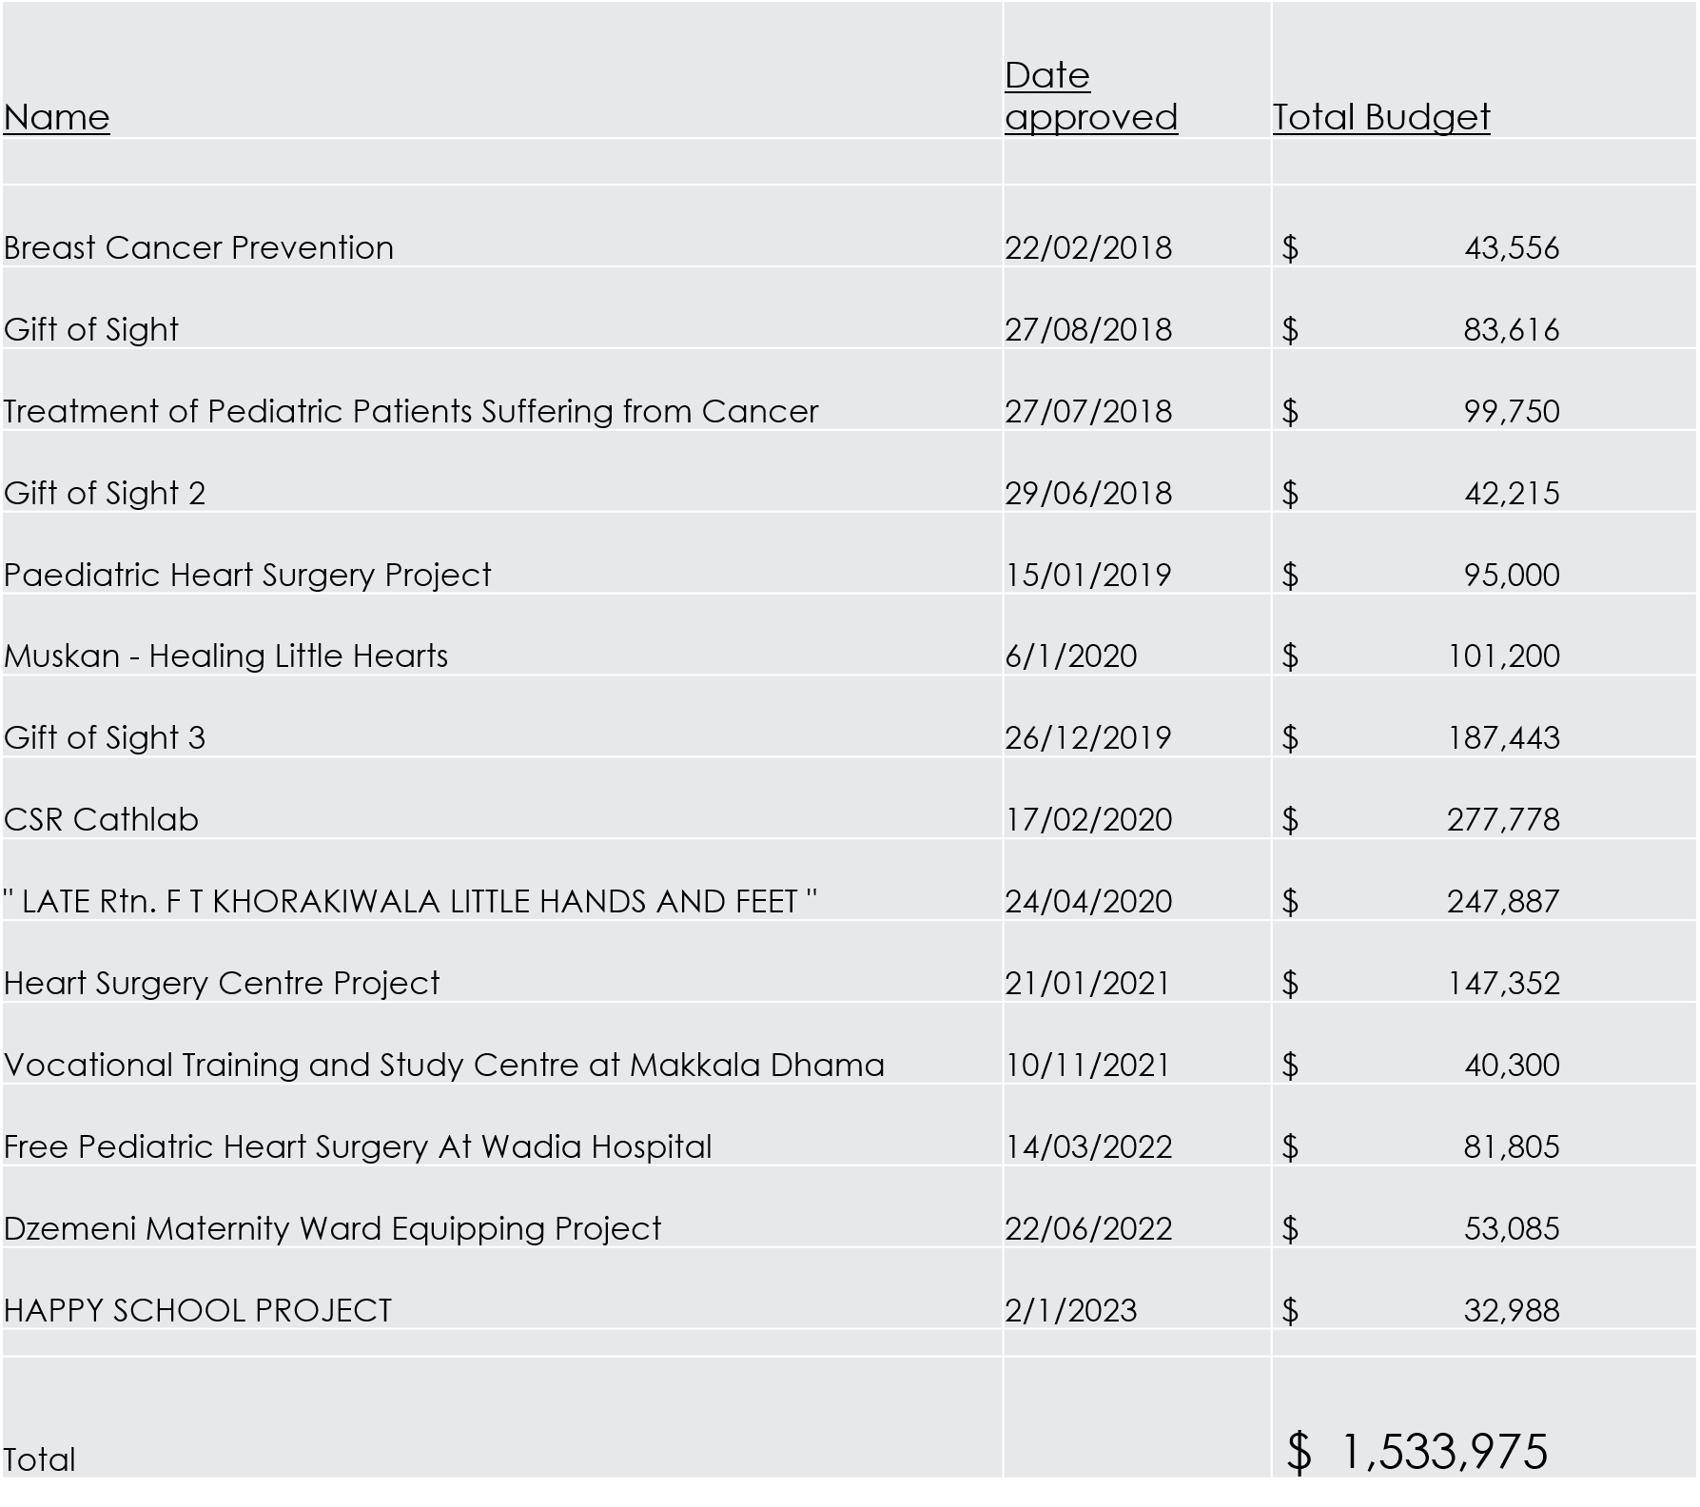

Slide 5
The Bridgeport Rotary Grants Pending Current Application for GG
Late Rotarian F.T. Khorakiwala Little Hands & Feet project- 2
Total Budget: $334,146
Date: 5/21/23
Treat childhood limbs birth defect deformities
Largest GG to date
Notes:
Largest ever for our Club

Slide 6
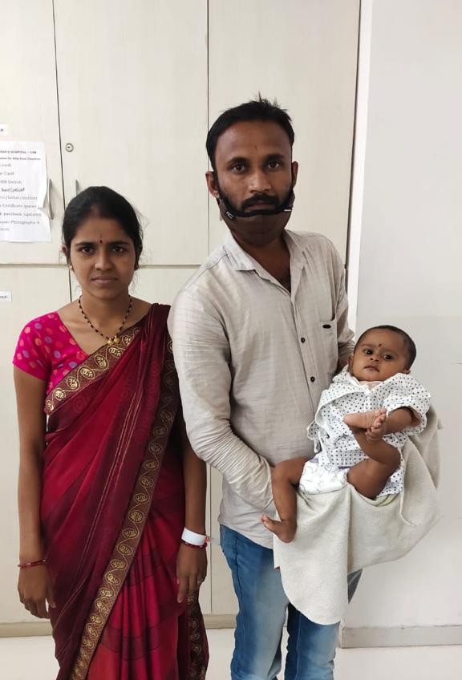
Muskan Touching Little Hearts…
Pediatric Open-Heart Surgeries
At no cost to patient families
113 Congenital Heart Disease Patients
Serving the very underprivileged
Total Cost: $101,200

Slide 7
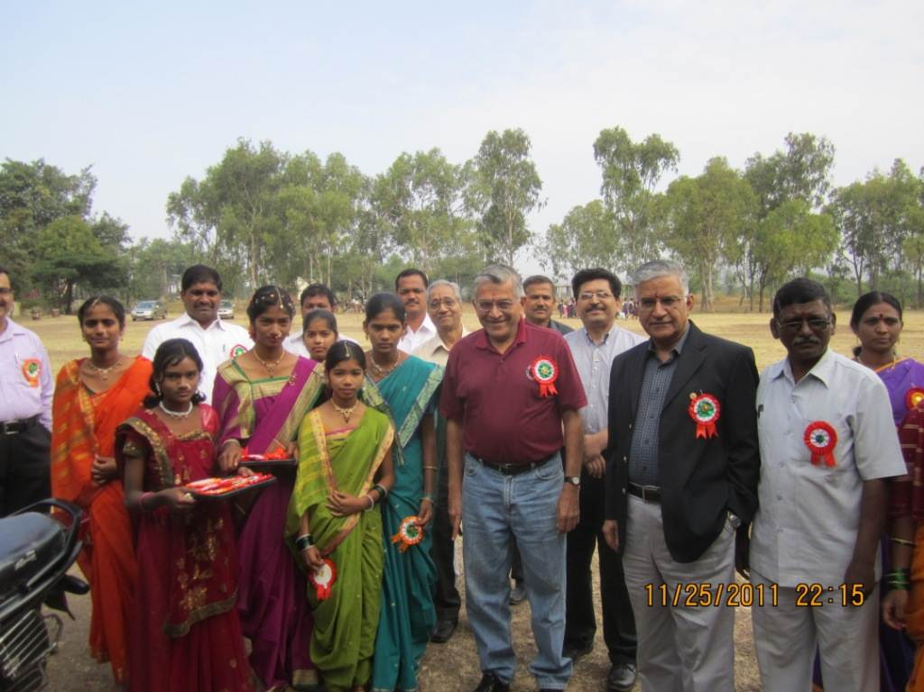
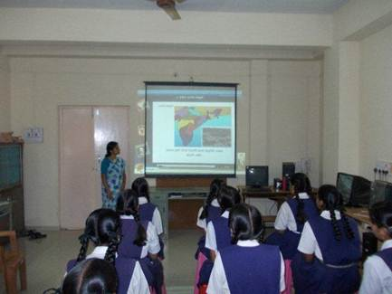
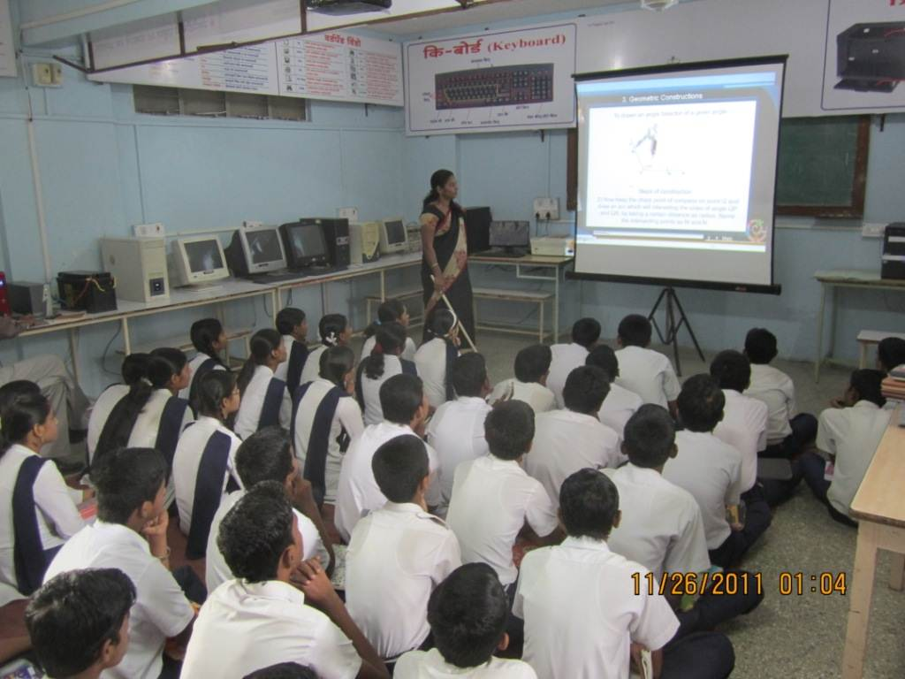
Distance learning In india

Slide 8
Happy Schools, Pune India – 2023 GG
Objective: Provide necessary Educational Tools to needy Schools
E.g.: Science Lab equipment; e Learning kits; furniture;
Train the teachers
Location: Near Pune, India
Date Approved 2/1/23
Total Cost: $32,988

Slide 9
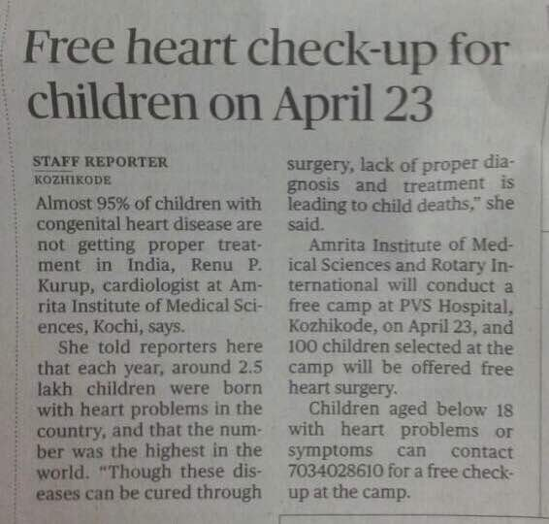
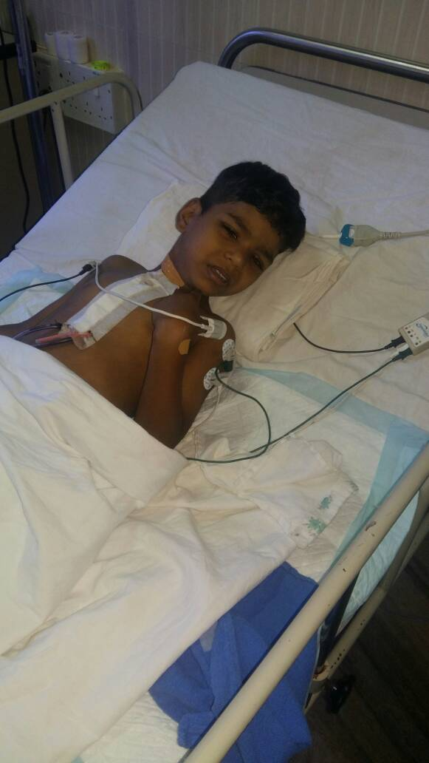
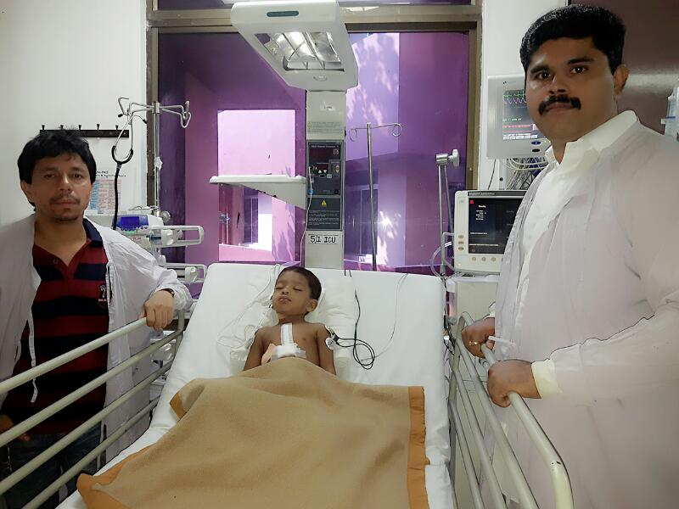
India pediatric heart surgeries grant

Slide 10
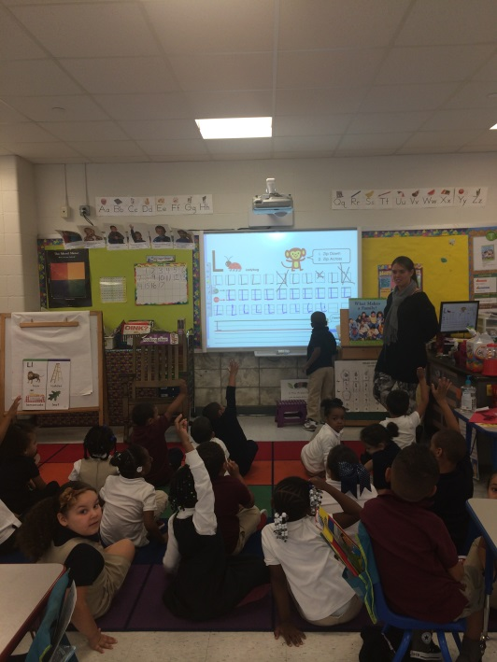
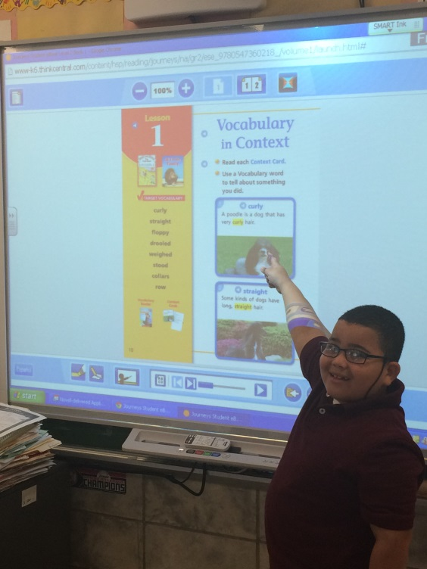
Wilbur Cross School Student Achievement Grant
Working in partnership with other area Rotary Clubs,
Rotary District 7980 and The Rotary Foundation we
purchased and installed “Smart Boards” in
21 classrooms at Wilbur Cross School,
bringing the 21st Century to their students.

Slide 11
Thank you for supporting the Rotary Foundation!
Unparalleled Success – We are a leader in the District!
Fantastic Support from the Indian Community here and abroad
We, as Rotarians, should support The Rotary Foundation
International Service is most rewarding, serving communities with needs beyond our wildest dreams

