Slide 1
Lynda Hammond, District Grants Chair
Rotary Club of Orange
Notes:
Review of handout

Slide 2
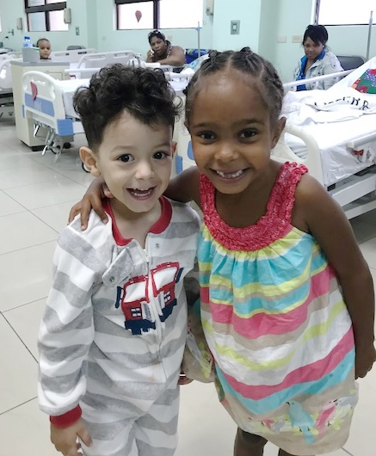
Thank You!
Notes:
Review of handout

Slide 3
D7980 TRF Program DDF Budget 2018-19
30 | District Managed Grants @$2,500 | $74,507
24 | RYLA Scholarships | $3,000
5 | World Affairs Scholarships | $2,500
2 | Global Scholarships | $30,000
1 | Vocational Training Team | $15,000
6 | Humanitarian Global Grants @$10,000 | $60,000
Notes:
1. Spending Plan form completion

Slide 4
District Managed Grants
Update 24 Oct. 2018
30 | Humanitarian Projects @ $2500 | $51,407 $74,507
24 | RYLA Scholarships @ $125 Limited to 2 per club | $2,000 $3,000
5 | World Affairs Scholarships @ $500 limit 1 per club | $2,500

Slide 5
District Managed Humanitarian Grants Rules 2018-19
Max $2500 DDF match / grant/ club
Max $5000 per club during a Rotary year
Max $7500 per project with 2 or more partnering clubs
Max 2 DMGs per year: 1st half, 2nd half (January)

Slide 6
DMG - Commonly Made Errors
Conflict of Interest Benefiting non-profit who is a Rotarian cannot participate as a member of the DMG committee or have control over the disbursement of the grant funds.

Slide 7
DMG - Commonly Made Errors
Grant funds must be under the direct control of the Rotary Club. Not the benefiting non-profit or cooperating organization.

Slide 8
DMG - Commonly Made Errors
ANY change in the scope of the DMG project MUST be approved by the Grants Committee before proceeding.

Slide 9
DMG - Commonly Made Errors
Final Reports must reflect the project objectives & budget as stated in the DMG application.

Slide 10
DMG – Reminders
Expenses incurred prior to the approval date will not be considered part of the project, therefore they will not be funded!

Slide 11
DMG – Reminders
Family members of Rotarians may NOT be awarded a Youth or Global Scholarship – IRS Rules.

Slide 12
DMG – Reminders
All projects must be completed by September 15th, 2019. The final report must be filed within 60 days or by September 30, 2019 whichever is sooner.

Slide 13
Avoid the melt down!

Slide 14
DMG– How to apply!
Download DMG Instructions & Application- www.rotary7980.org (2018-19)
Download District 7980 Youth Scholarship -RYLA or WAS -Application- www.rotary7980.org (2018-19).
Completed application is submitted to Lynda Hammond, District Grants Chair at lynda.hammond1@sbcglobal.net
Notes:
Form Handout

Slide 15
Global Grants Scholarships
Nancy Riella, President
Rotary Club of Colchester
District 7980 Global & Peace Scholarship Chair
Notes:
Review of handout

Slide 16
Global Grants Scholarships
The purpose of the Global Grant Scholarship is to foster international understanding through graduate study in a foreign university with a concentration in one or more of Rotary International's Six Areas of Focus.
2018-19 Two GG Scholarships Available @ $30K each
NO COST TO THE CLUB!

Slide 17
Global Grants Scholarships
Candidates must apply through, be interviewed by, and be endorsed by a District 7980 Rotary Club prior to being interviewed by the District Scholarship Committee.
The final decision regarding Global Grant Scholarship recipients is made by The Rotary Foundation. Sponsoring clubs will be responsible for submitting Global Grant Scholarship to TRF, and when approved be responsible for financial stewardship.
Notes:
Contact local RC 2. Complete District 7980 Scholarship application on website.

Slide 18
Global Grants Scholarships
Deadline for applications to the District Scholarship Committee: January 30, 2019. Clubs will determine dates for applications to their local scholarship committee. District interviews will be held in mid February 2018.
Applications can be found on the Rotary District 7980 website. Please call me at 860.334.9433 (my cell) or e-mail me at: nriella@riellalepak.com with any questions.
Notes:
Contact local RC 2. Complete District 7980 Scholarship application on website.

Slide 19
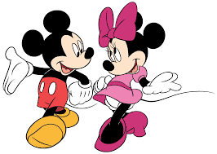
Grant Management – On Line
Coming Soon!

Slide 20
District 7980 Rotarians
Together WE change and save lives everyday!

