Slide 1
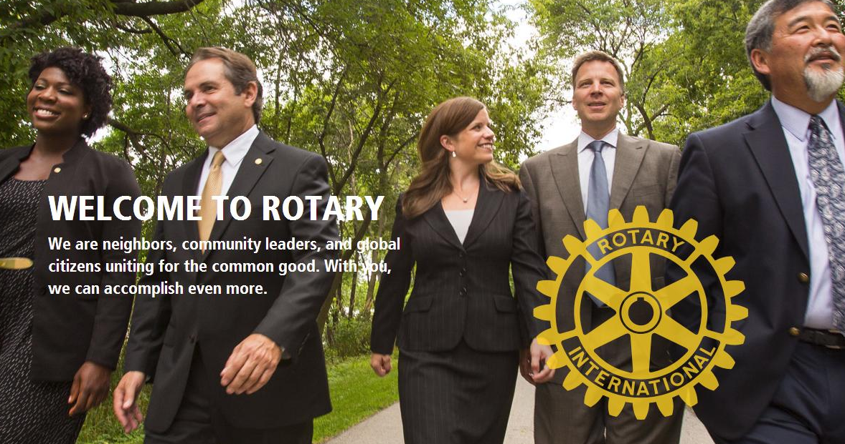
Together Let’s Grow Rotary!
2022-23 Logo & Theme
Title Page Option

Slide 2
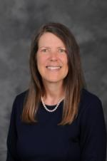
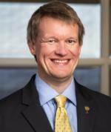
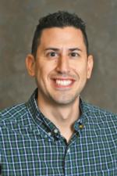
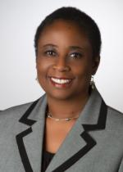
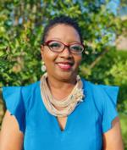
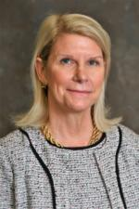
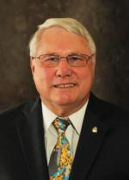
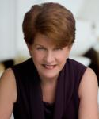
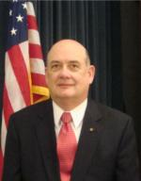
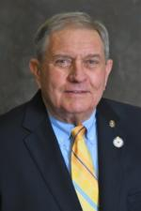
Meet The D-7770 2022-23 Membership Team
Alison Hamilton
Andrew Folks
Dan Ciuffreda
Dr. Benetta Bell
Brenda Austin
Angela Drake
Gary Bradham
Mary Jo Romeo
Mark McCain
David Tirard
Bob Gross
Title Page Option

Slide 3
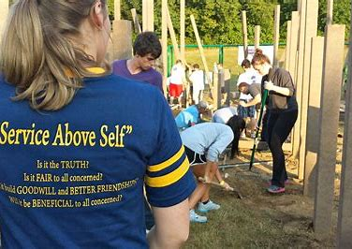
MEMBERSHIP
Membership is who we are, Service is what we do.

Slide 4
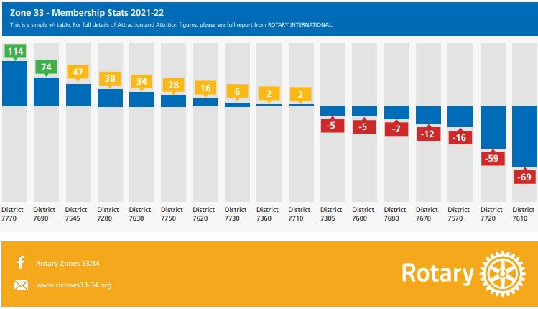
Look Who’s Leading The Pack In Zone 33
Zone 33 Newsletter Mobilize Membership February 2022

Slide 5
Intentional Growth Strategies & Discover Rotary
Strategy
Team
Plan
Growth Culture
Discovery Rotary
Strategy
Team
Plan
Culture
Discover Rotary

Slide 6
Rotary Club Membership Team
Team Leader/Chair
New Member Orientation
New Member Mentor
Engagement/Retention
Leads Management
Discover Rotary
Find the Spark Plugs and put them on the Membership Team

Slide 7
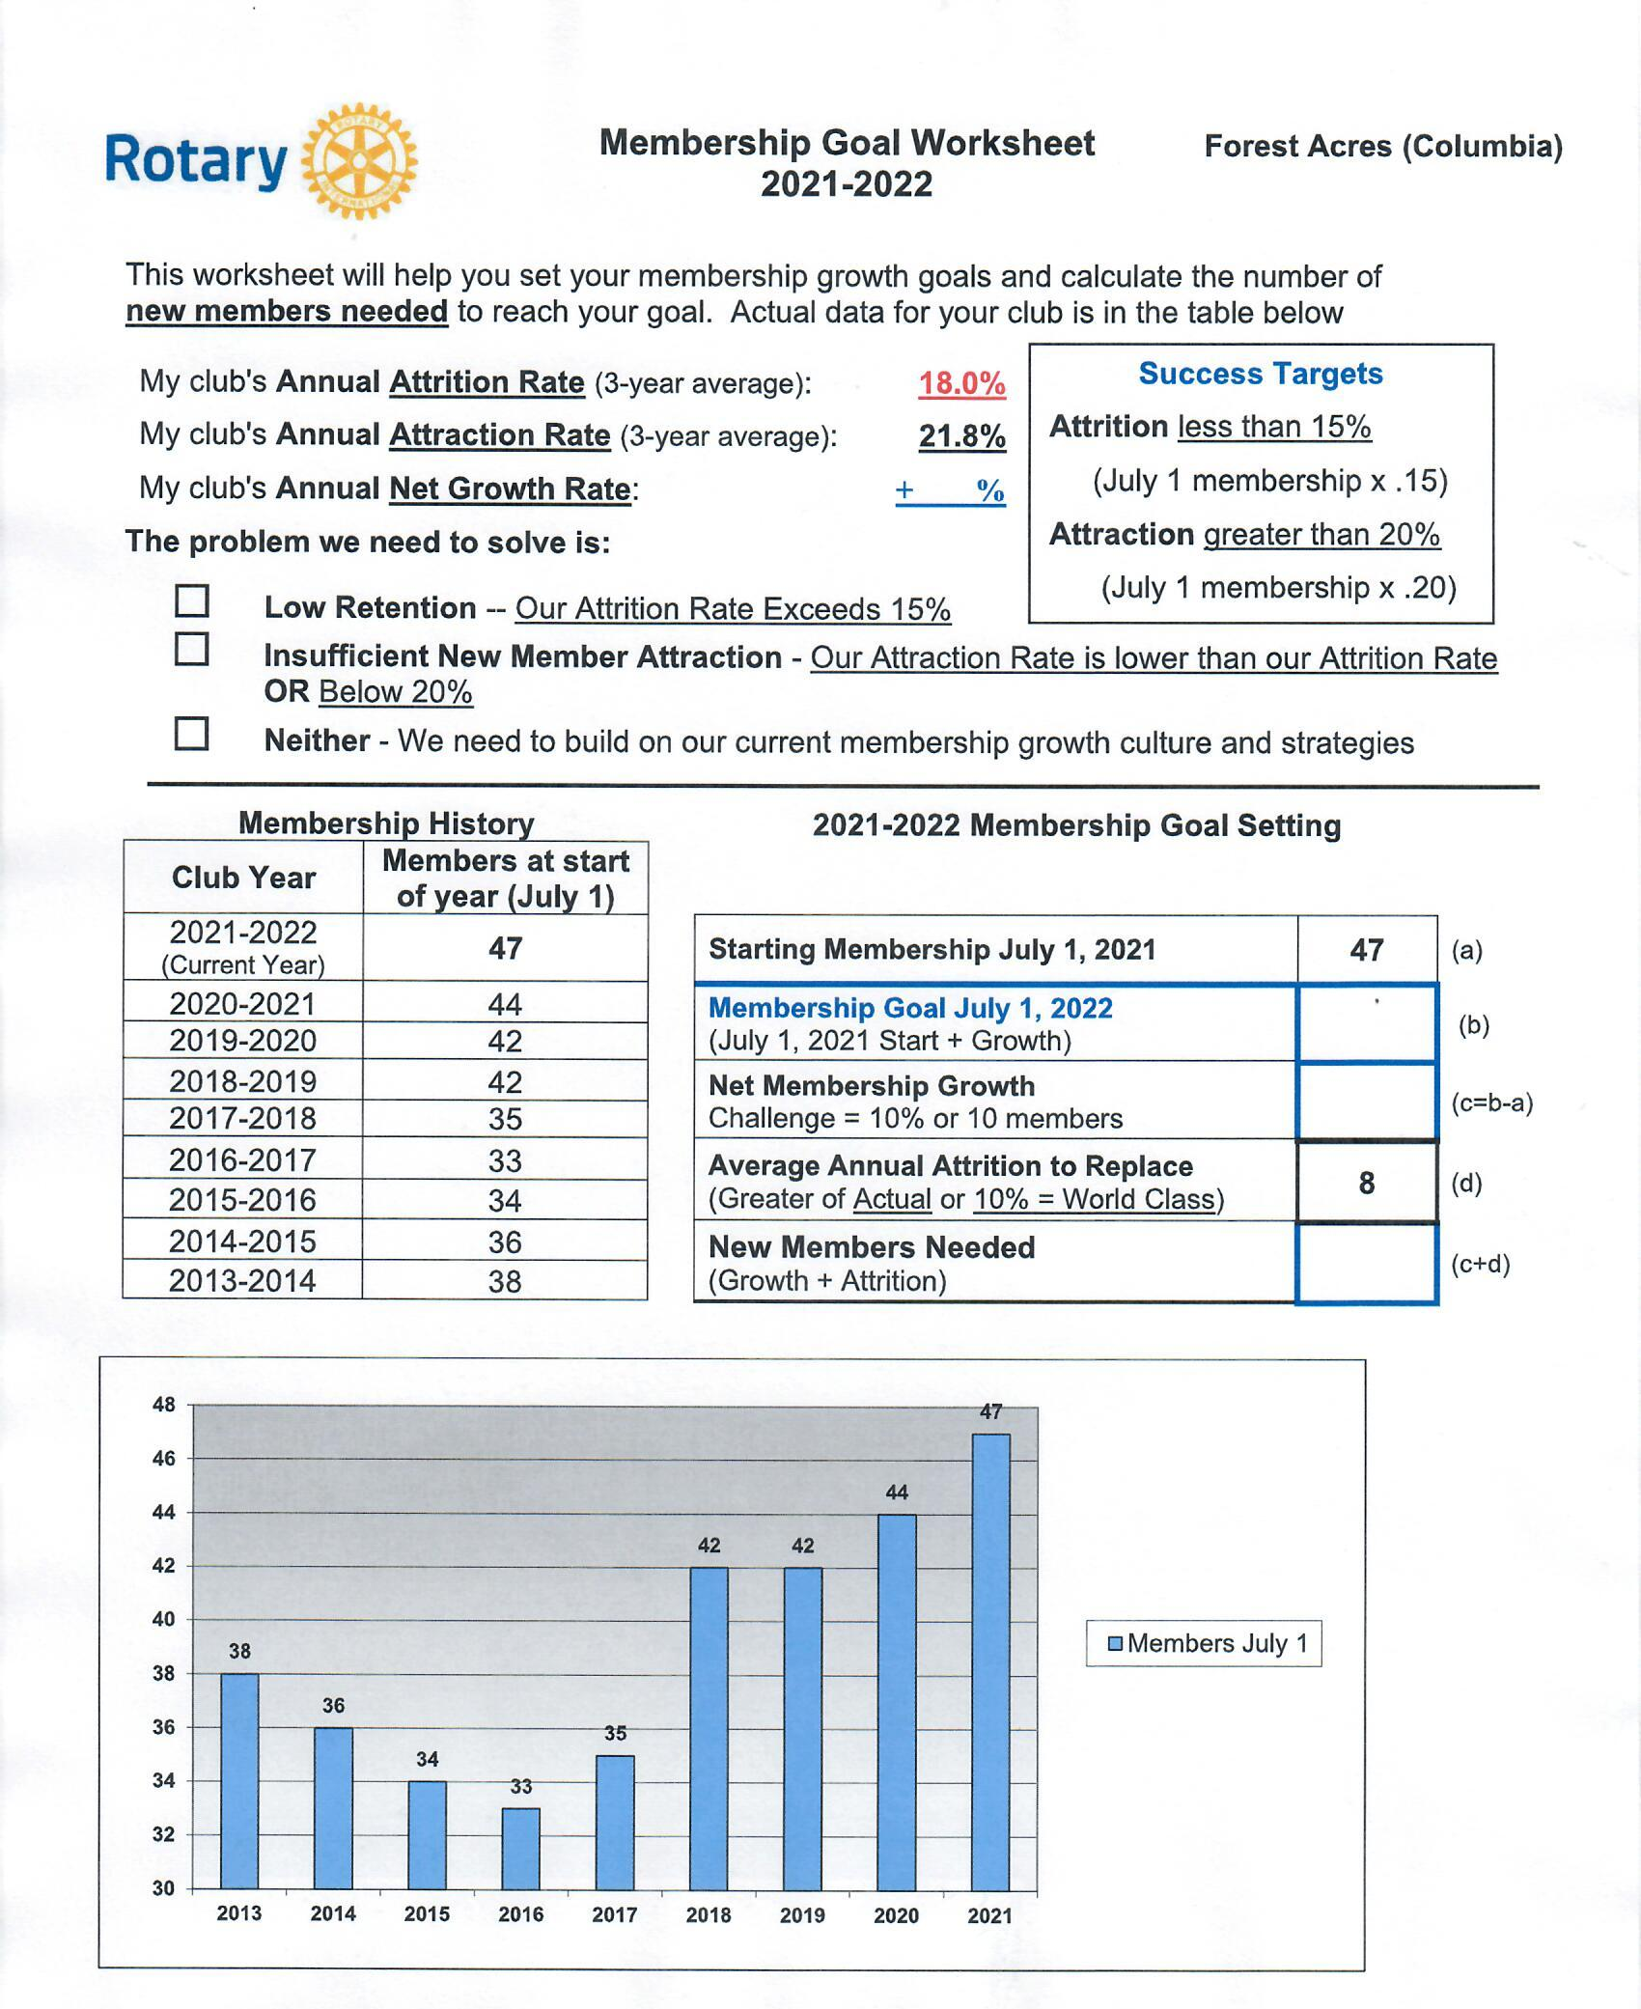
Club Membership Growth Plan
Membership Goal Worksheet
Growth Goal of 5%
Plan is due May 31
Plan Template & Sample in Toolbox

Slide 8
Ideas To Celebrate Membership & New Club Development
Speakers
“What Is Your Why?”
“Who Do You Know?”
Membership Moments
Social Event
Diversity, Equity & Inclusion
Membership Quiz
Discover Rotary
Bring a Guest Day

Slide 9
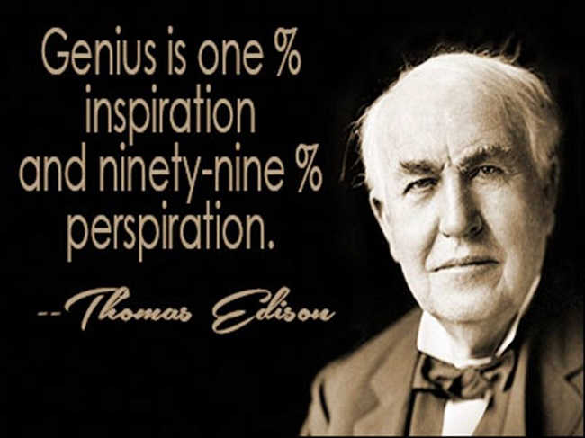
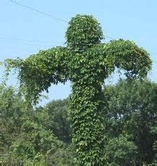
Developing Strong Growth Culture
Inspiration
3 E’s of Membership
Energy, Excitement, Enthusiasm
Leading Change
Complacency
Club Health Check
Kudzu of Complacency

Slide 10
Discover Rotary
Still the Gold Standard
Informal, informative talk
Better understanding of Rotary
Great recruitment tool

Slide 11
Why People Join Rotary
Community Service
Friendship & Fellowship
Professional Development
Why People Leave Clubs
Cost and Time
Unmet Expectations
Club Environment

Slide 12
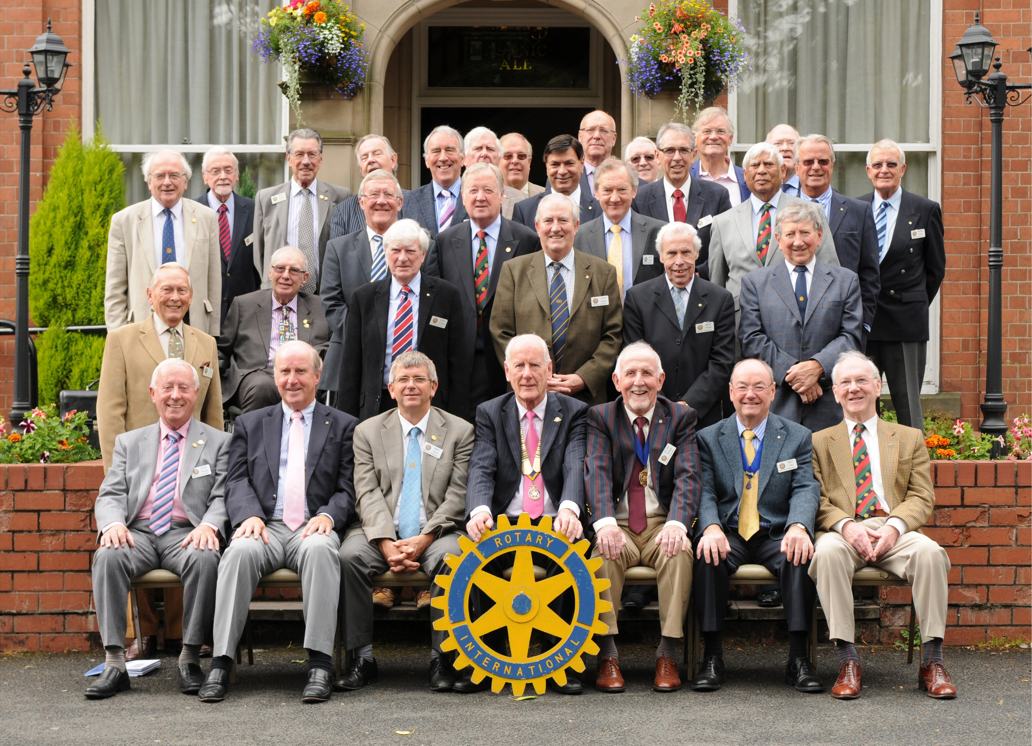
What’s wrong with this picture?

Slide 13
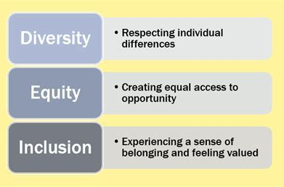
Diversity, Equity & Inclusion
Club Environment
Unmet Expectations

Slide 14
The Most Important Three-Letter Word: Membership?
Hint: It starts with the letter A

Slide 15
Rotary Clubs tap into less than 0.1% of the
surrounding geographic area.

Slide 16
What Is Your Why….or WTI
WHAT is your why?
TELL a prospective member
INVITE then to a club event

Slide 17
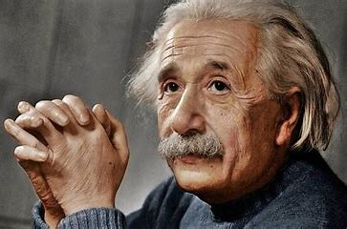
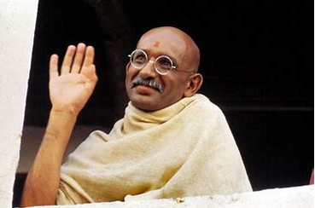
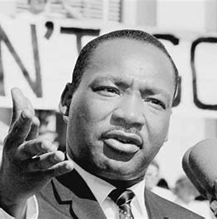
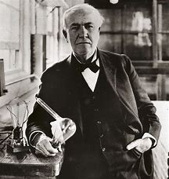
Here’s To The Crazy Ones…Think Different
RI Zone 33 Mobilize Membership 2021

Slide 18
Think Different: Innovative Club & Member Options
Satellite
Passport
Cause-Based
Service-Based
Alumni-Based
Interest-Based
Motorcycle
Golfing
E-Clubs
Family
Business
E-Member
Service-Only
Associate/Trial
Young Professionals
R-85 & R-35

Slide 19
“Leaders are visionaries with a poorly developed sense of fear, and no concept of the odds against them. They make the impossible happen.” Robert Jarvik

Slide 20
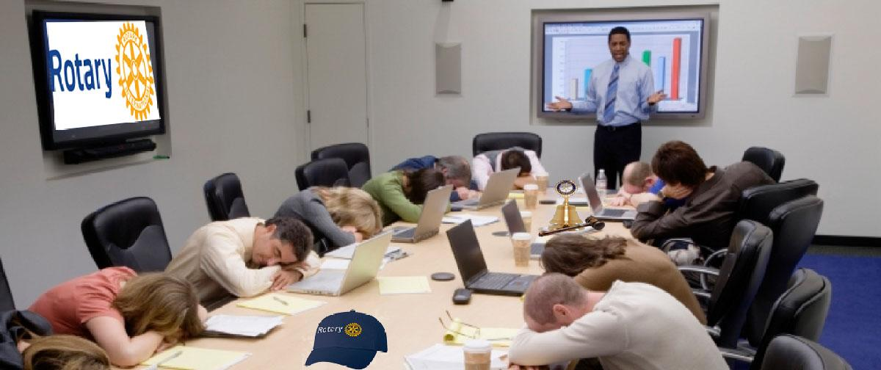
Many Thanks! Questions?

