Slide 1
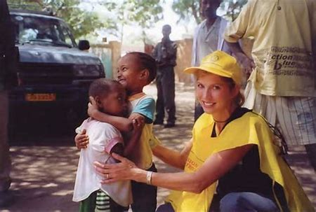
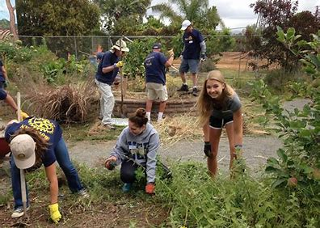
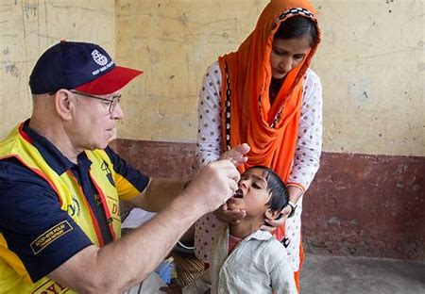
Welcome to Discover Rotary
We are people of action
Notes:
Hello, we are delighted to welcome you to Discover Rotary. I am Sandy Olson of the Rotary Club of Forest Acres and it is an honor for me to be with you to talk about how Rotary makes a difference in people’s lives around the world and right here at home. We’ll begin with introductions.

Slide 2
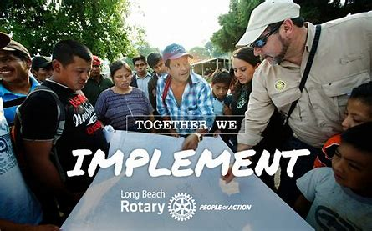
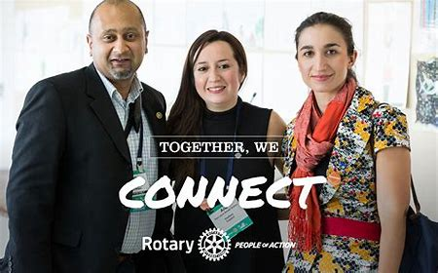
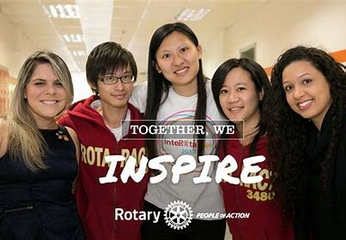
What Is Rotary?
People Of Action
Notes:
Rotary is an international membership organization that does service.
We are a global network of business and professional leaders
We do humanitarian service
We encourage high ethical standards
We strive for goodwill and peace in the world
1.2 million of us in 35,000 clubs in over 200 countries around the world
Motto: Service Above Self. Put simply, Rotary is where neighbors, friends and problem solvers share ideas and take action to create lasting change.

Slide 3
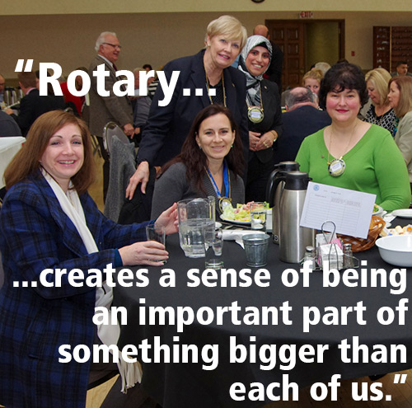
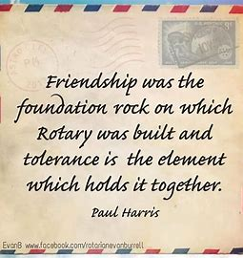
The best way to find yourself is to lose yourself in the service of others.
Notes:
In Rotary we are an important part of something much bigger than ourselves. We accomplish so much more by being a Rotarian.

Slide 4
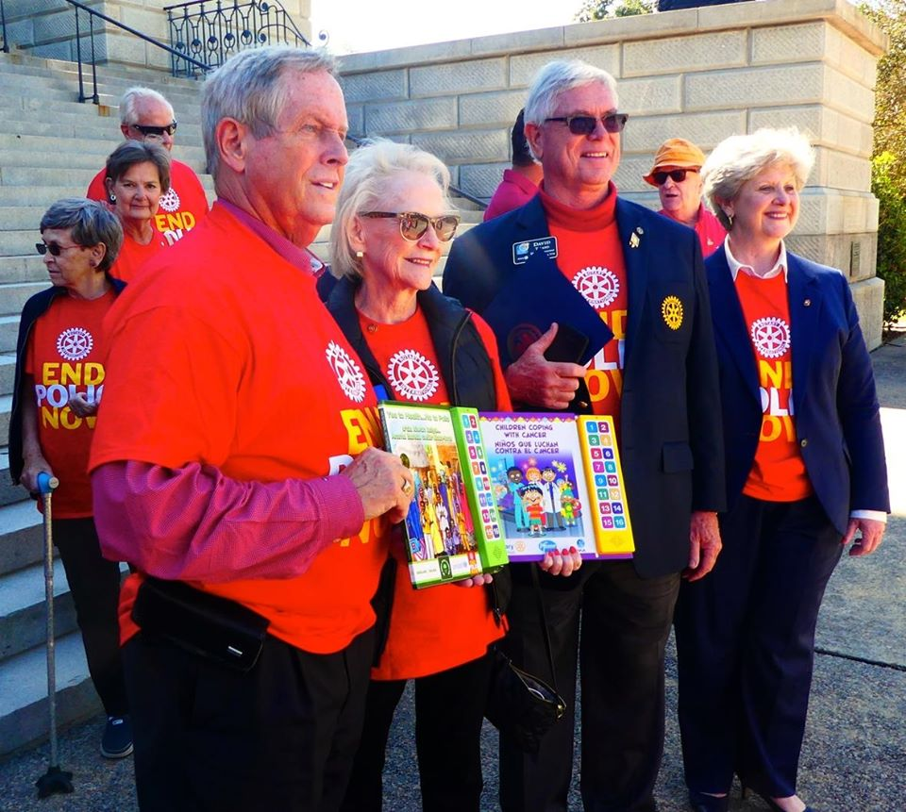
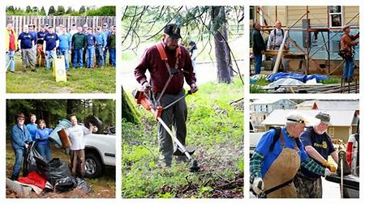
$200 Million and 16 Million Volunteer Hours
Notes:
Rotarians are people of action because we are guided by a strong vision. Together, we see a world where people unite and take action to create lasting change – across the globe, in our communities, and in ourselves. Our Rotary International President is Mark Maloney from Decatur, AL. Each year, Rotary members invest more than $200 million and 16 million volunteer hours to promote peace, fight disease, provide clean water, save mothers and children, support education and grow local economies.

Slide 5
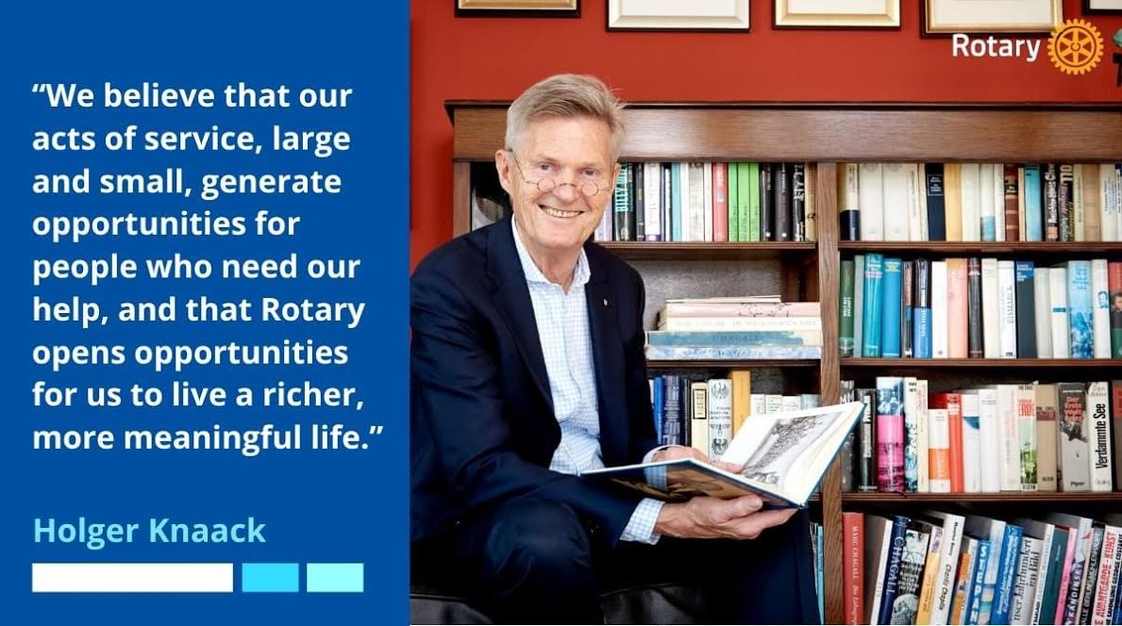
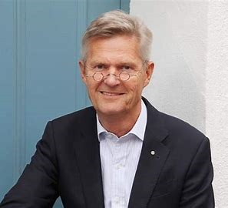
“Rotary is not just a club that you join; it is an invitation to endless opportunities.
It is up to us to remake Rotary for these new times – to wholeheartedly embrace ideas, energy and commitment of young people eager to find an outlet for idealism.”
Notes:
Holger Knaack is our RI President for 2020-21 and he is from Germany. The RI theme for this year is Rotary Opens Opportunities and President Knaack believes that Rotary is not just a club you join but an invitation to endless opportunities.

Slide 6
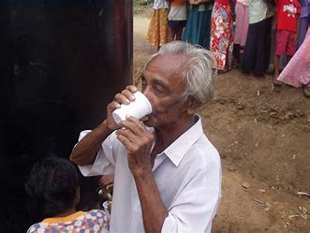
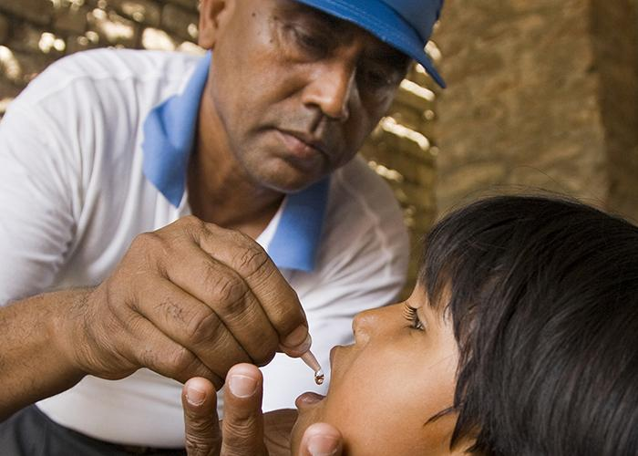
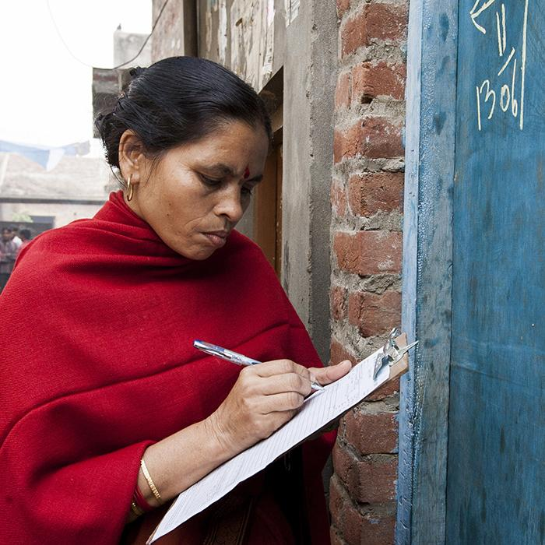
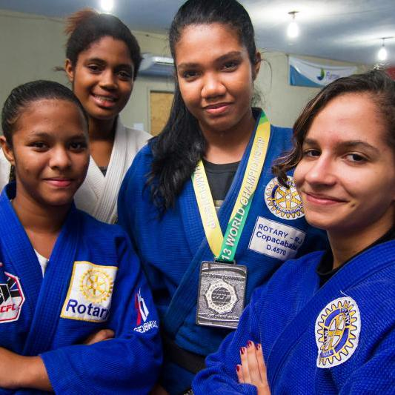
Together We:
Promote Peace
Transform
Save Lives
Fight Hunger
Mentor
Learn
Inspire
End Polio
Empower
Connect
Notes:
To answer the question what is Rotary? We are the most financially sound, largest most powerful membership organization whose logo is recognized in more countries than any other logo in the world. Every minute of every day, we feed, we house, we vaccinate, educate, advocate, comfort and provide a variety of services. This is Rotary!

Slide 7
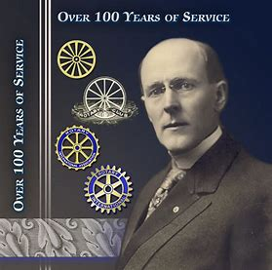
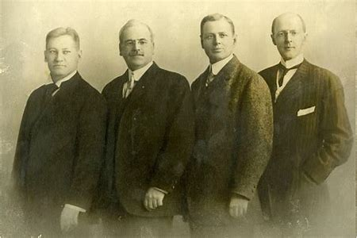
How Rotary Got Started
The first Rotary Club was organized in 1905, by Chicago Attorney Paul P. Harris
The original four member club met for fellowship in rotation at member’s offices…thus the name ROTARY
Their first community service project – a public toilet outside the Chicago City Hall
Paul Harris
People Of Action
From left: Gustavus Loehr, Silvester Schiele, Hiram Shorey and Paul Harris.
Notes:
Great history in how Rotary got started. Paul Harris an attorney in Chicago gathered some friends in 1905 for fellowship and it grew from there. Their first reason for being was FELLOWSHIP.

Slide 8
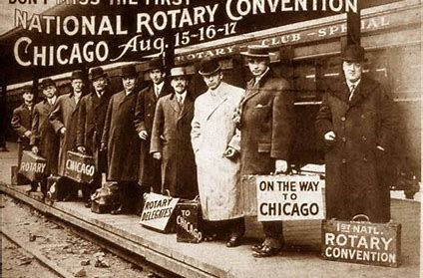
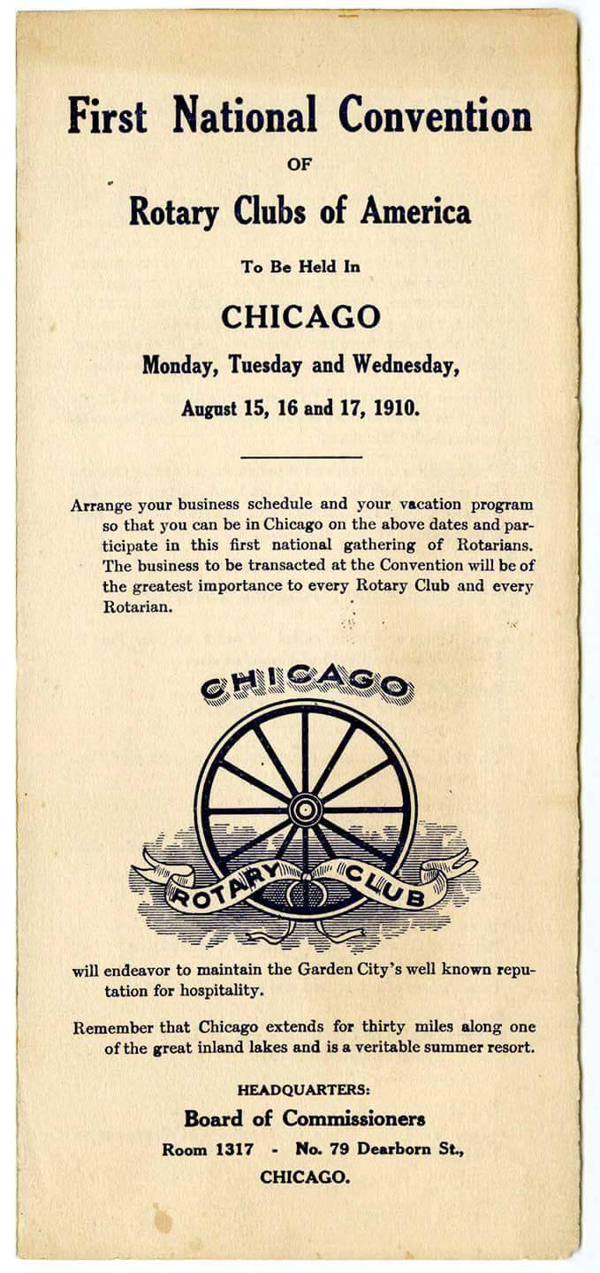
Notes:
The first national Rotary convention was held in Chicago in 1910. See how the Rotary logo has evolved over the years.

Slide 9
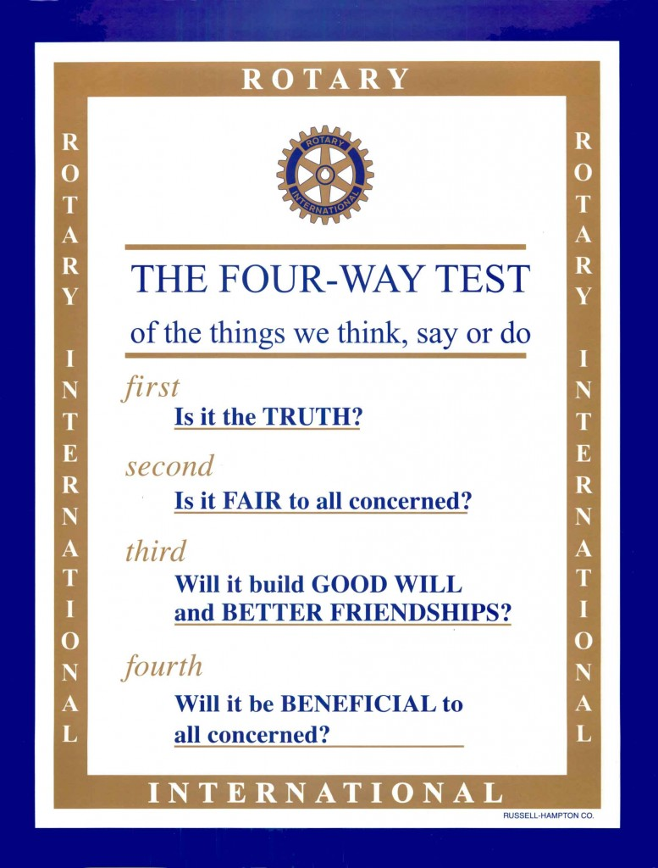
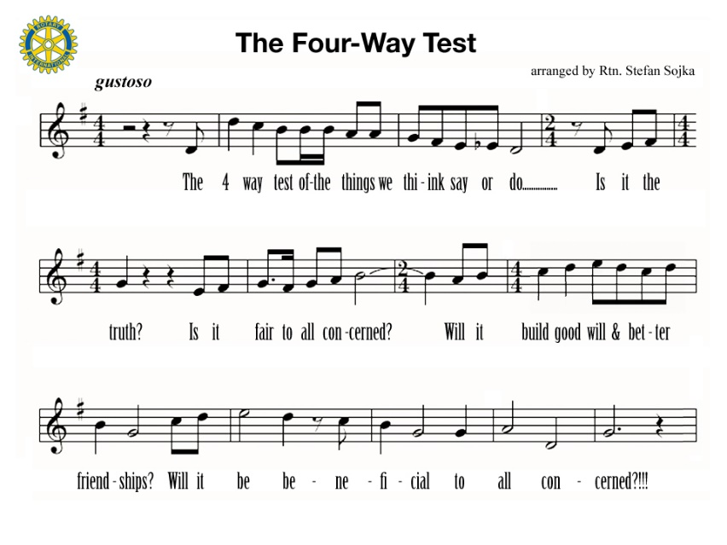
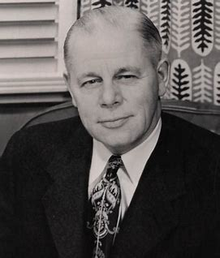
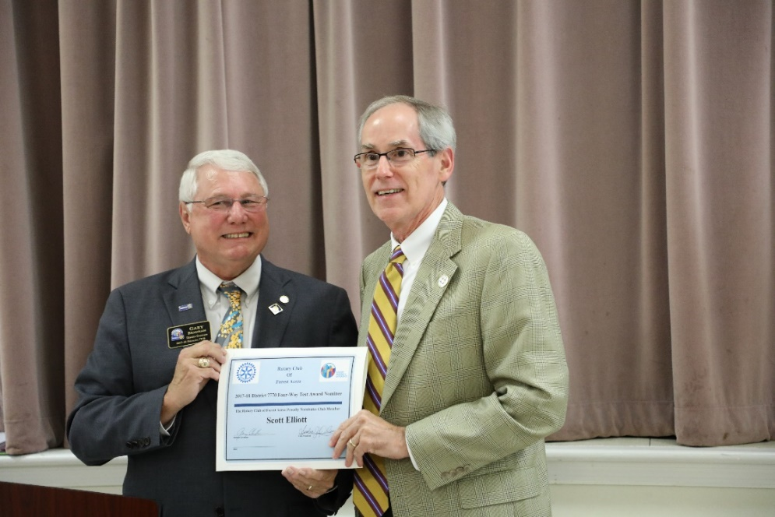
Herbert Taylor
District Governor Gary Bradham (2017-18) presents Four Way Test Award To Scott Elliott, Forest Acres Rotary Club.
Fifth: Is It Fun?
Notes:
The Four Way Test is used by Rotarians world-wide as a moral code for personal and business relationships. It can be applied to almost any aspect of life. It was developed by Herbert J. Taylor in 1932 to save the Aluminum Products Distribution Company from bankruptcy. It was later adopted by RI. Rotarians always known for their sense of humor some Rotarians have added a fifth question: Is it Fun? I certainly never realized there was a song written about the Four Way Test.

Slide 10
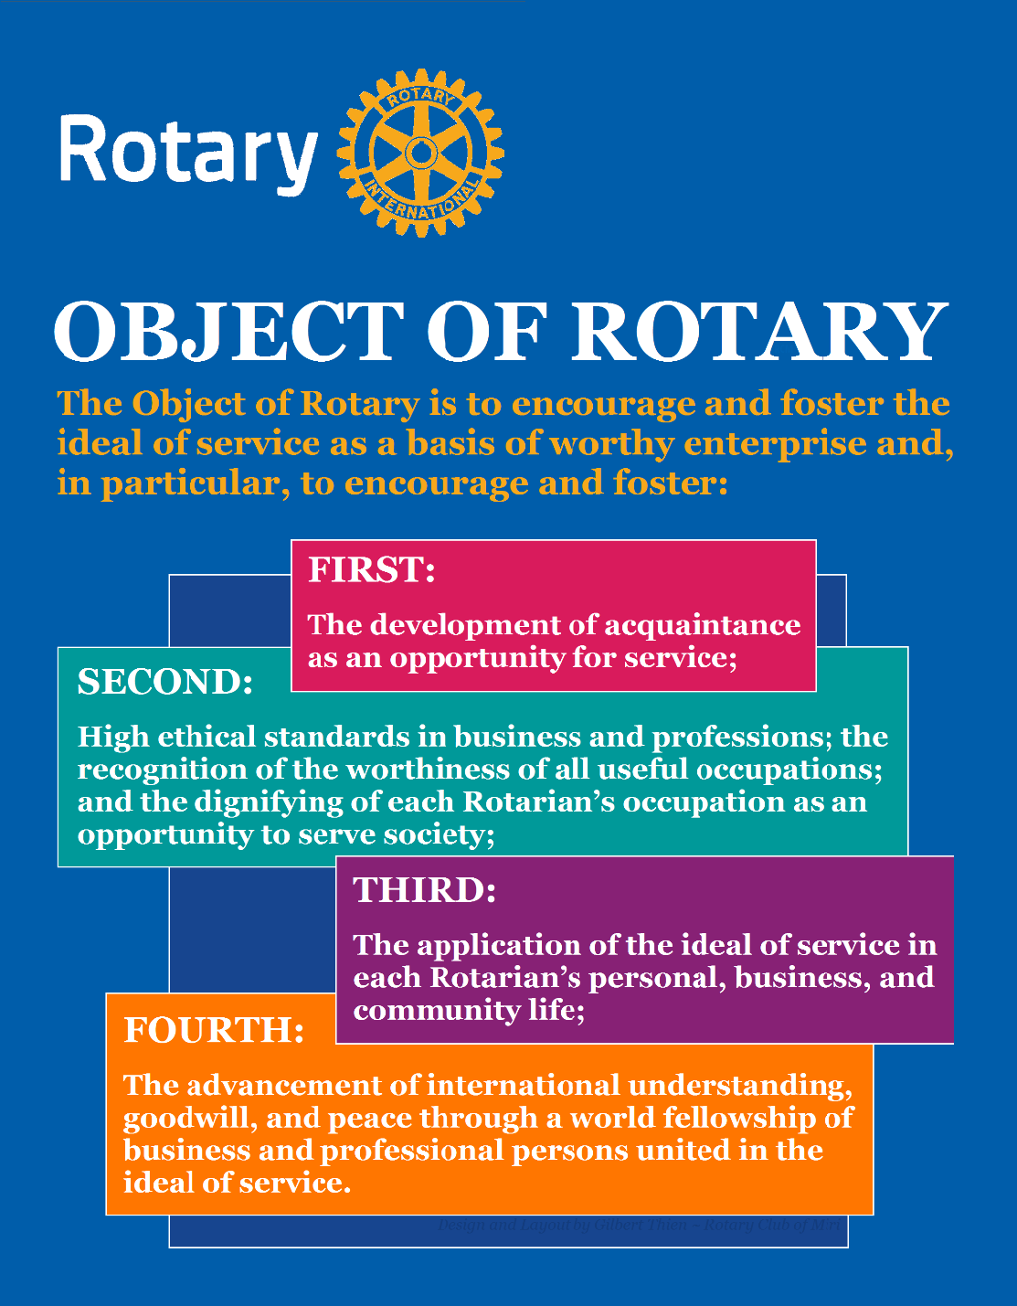
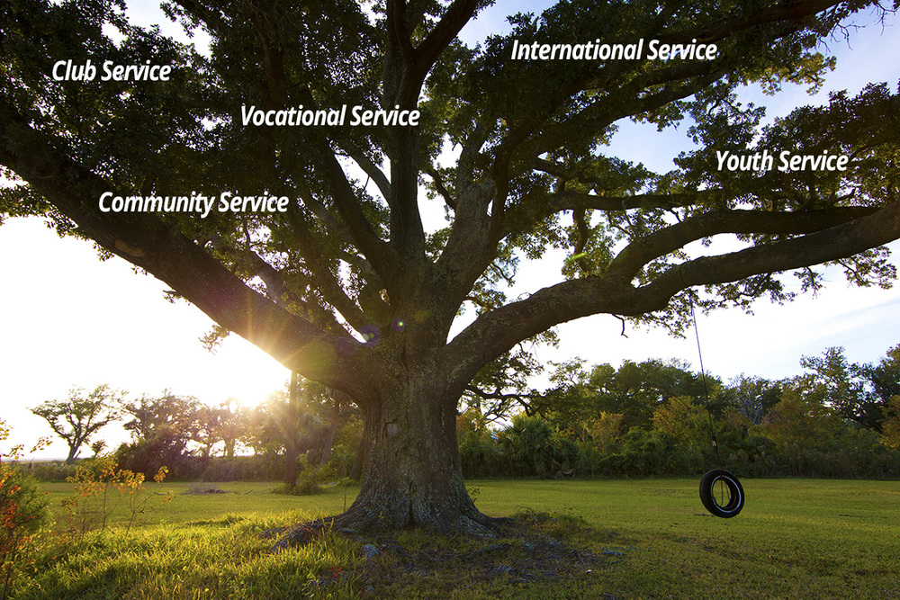
Five Avenues of Service
The Object of Rotary comes to life through Five Avenues of Service
Notes:
The Object of Rotary places great value on service, friendships and high ethical standards. Our occupations and professional skills help us to increase cultural understanding, goodwill and peace through community service. The Object of Rotary comes to life through Five Avenues of Service which are the branches of a deeply rooted membership organization and they are: Club Service, Vocational Service, Community Service, International Service and Youth Service. This is how we reach out and make a difference in people’s lives around the world and right here at home.

Slide 11
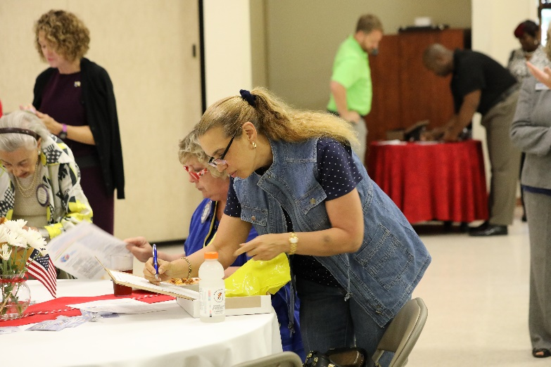
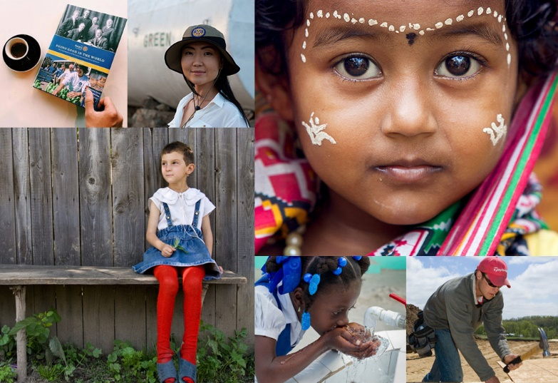
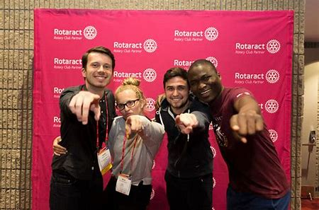
Five Avenues of Service In Action
Club Service
Vocational Service
Community Service
International Service
Youth Service
Notes:
Here are the five avenues of service in action:
Club Service: A vibrant Rotary Club is characterized by strong leadership, fellowship and membership growth
Vocational Service: Putting our skills and expertise to work for Rotary
Community Service: Responding to the needs of our local communities
International Service: Improving the lives of people around the world.
Youth Service: Developing future Rotarians through leadership development programs

Slide 12
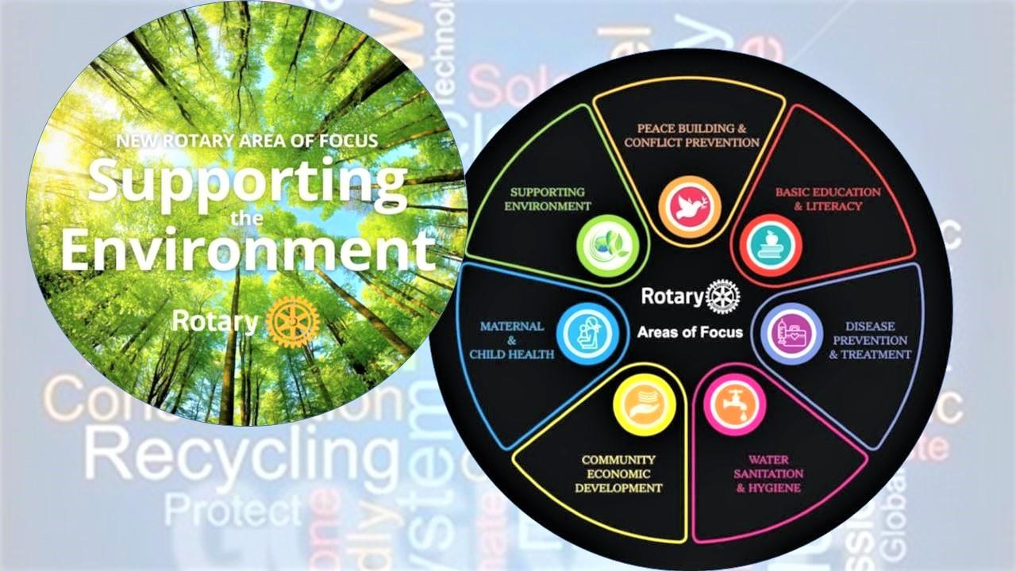
Notes:
In the past Rotary has had Six Areas of Focus. Recently we’ve added a new one…Supporting the Environment.

Slide 13
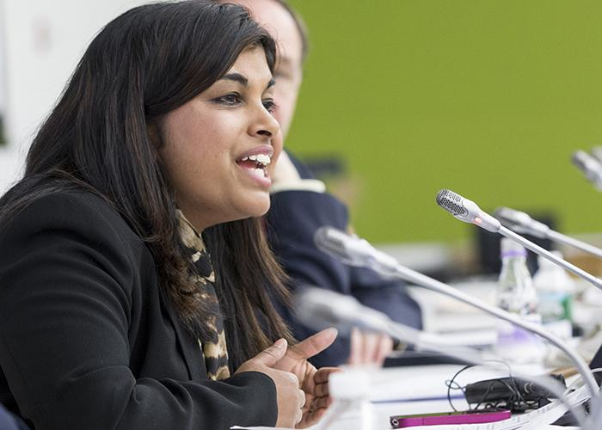
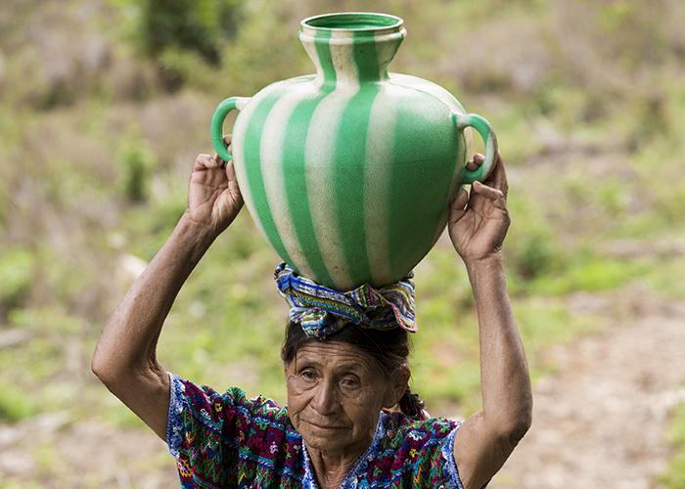
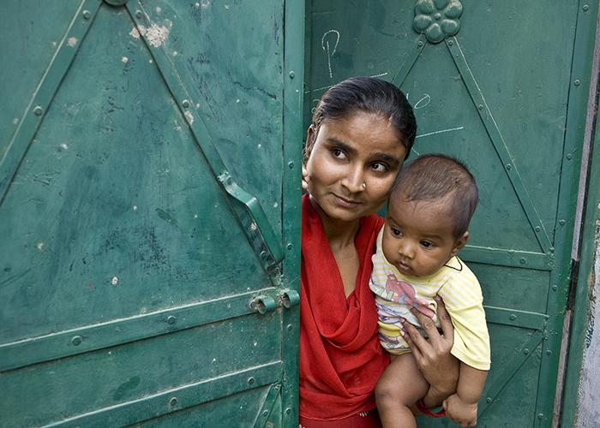
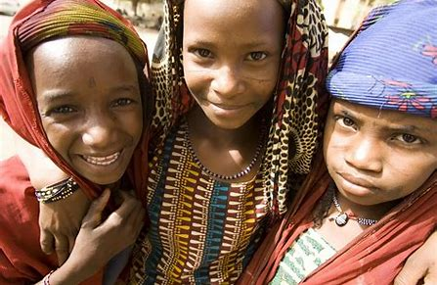
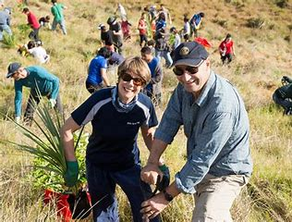
Seven Areas of Focus
Water, Sanitation &
Hygiene
Maternal & Child Health
Peacebuilding & Conflict
Prevention
Disease Prevention &
Treatment
Basic Education & Literacy
Community & Economic Dev.
Support The Environment
Notes:
Our 7 Areas of Focus build international relationships, improve lives, create a better world, support peace and end polio forever. All critical humanitarian causes Rotarians have been working on for many years. They include peacebuilding and conflict prevention, disease prevention and treatment, water, sanitation and hygiene, maternal and child health, basic education and literacy, community & economic development and the newest focus, supporting the environment.

Slide 14
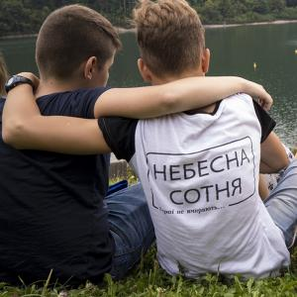
Peace & Conflict Prevention
70 Million People Displaced…
Half are children
Rotarians refuse to accept conflict
as a ways of life
Notes:
Today over 70 million people are displaced as a result of conflict, violence, persecution, and human rights violations. Half of them are children. Rotarians refuse to accept conflict as a way of life. Rotary encourages conversations to foster understanding within and across cultures. We train adults and young leaders to prevent and mediate conflict and help refugees who have fled dangerous areas.

Slide 15
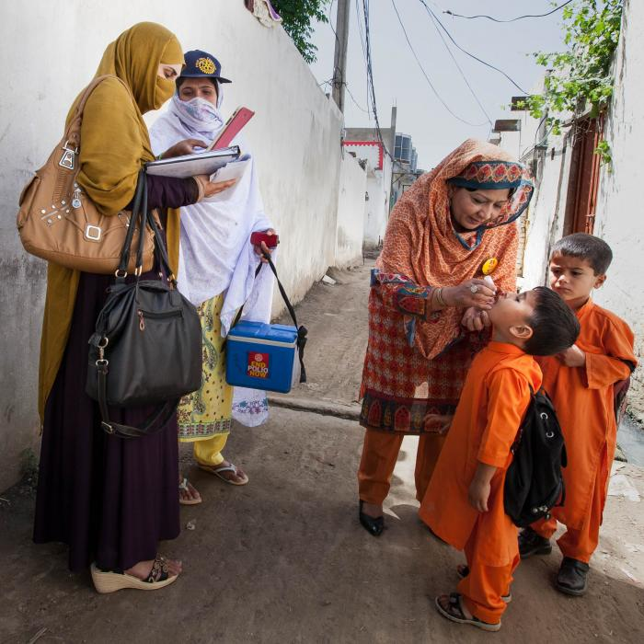
Fighting Disease
99.9% reduction in polio cases since our program started in 1985,
$60 million in grants was given last year to fight disease.
Notes:
Rotarians educate and equip communities to stop the spread of life-threatening diseases like polio, malaria, HIV/AIDS, Alzheimer’s, multiple sclerosis, diabetes and Ebola. We improve and expand access to low-cost and free health care in developing areas.

Slide 16
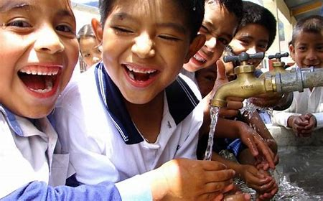
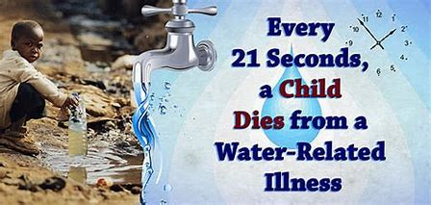
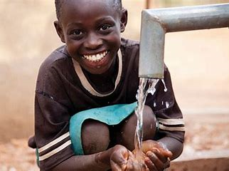
Water & Sanitation
$24 is all it takes to provide one person with safe water.
110 schools in Ghana have better sanitation and hygiene thanks to the Rotary-US Agency for International Development (USAID) partnership.
Notes:
Clean water, sanitation, and hygiene education are basic necessities for a healthy environment and a productive life. Rotary has been involved in water and sanitation projects from the Philippines to Tanzania, India and Guatamala. We don’t just build wells and walk away. We share our expertise with community leaders and educators to make sure our projects succeed long-term.

Slide 17
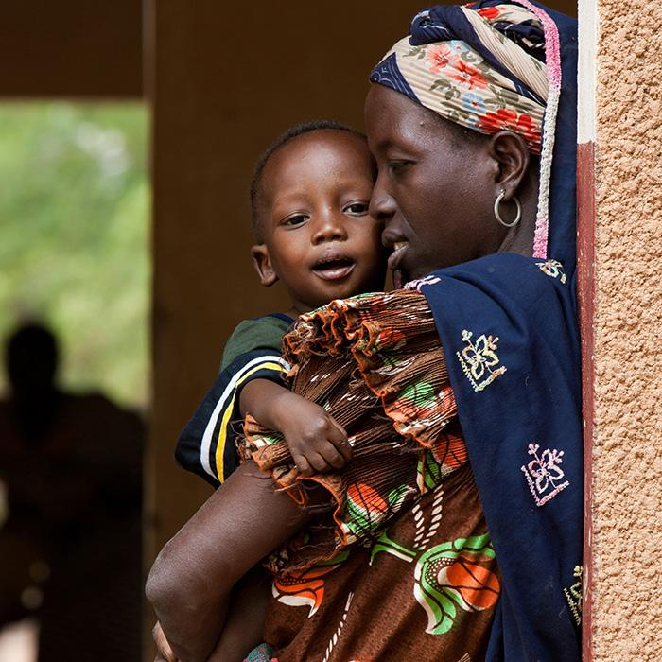
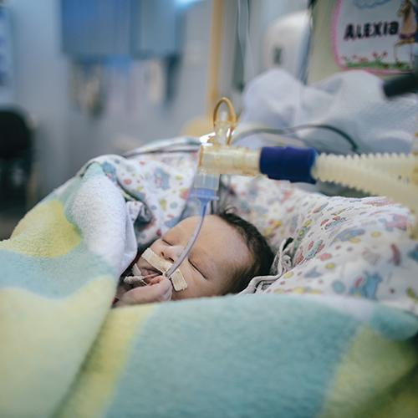
Saving Mothers and Children
6 Million Children Under The Age Of Five Die Each Year Because Of Malnutrition
Notes:
We expand access to quality care so mothers and children everywhere can have the same opportunities for a healthy future. An estimated 6 million children under the age of five die each year because of malnutrition, inadequate health care and poor sanitation – all of which can be prevented.

Slide 18
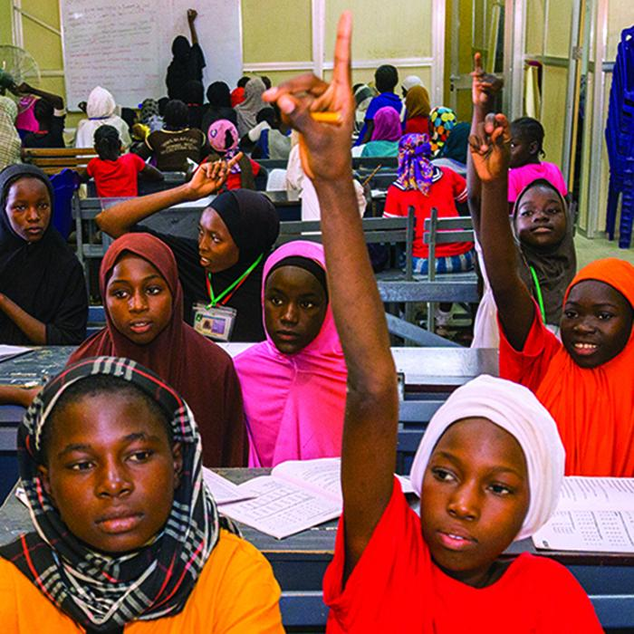
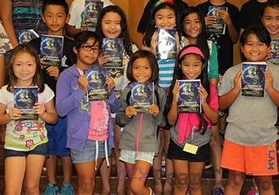
Supporting Education
More than 775 million over the age of 15 are illiterate.
Notes:
More that 775 million people over the age of 15 are illiterate. Our goal is to strengthen the capacity of communities to support basic education and literacy, reduce gender disparity in education, and increase adult literacy.

Slide 19
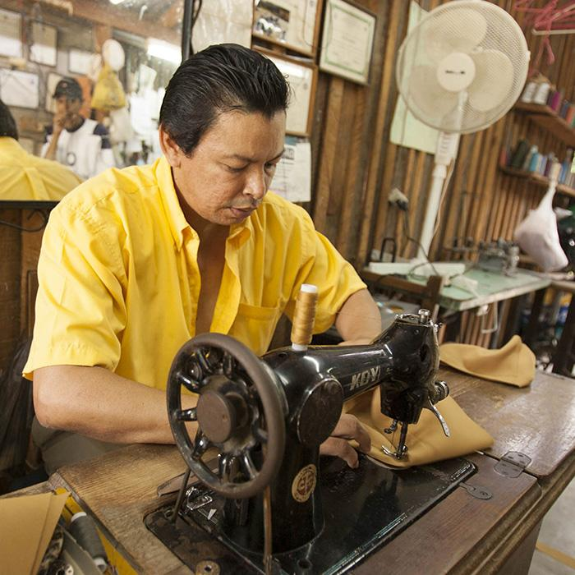
Growing Local Economies
Nearly 800 million live on less than $1.90 a day.
Last year Rotary spent $9.2 million to grow local economies.
Notes:
Rotarians carry out service projects that enhance economic and community development and create opportunities for decent and productive work for young and old. Entrepreneurs use microloans to become street venders, rickshaw drivers, weavers and tailors.

Slide 20
Supporting The Environment
Notes:
Rotary has long supported activities that sustain the environment. In the past five years, we have allocated $18 million to such projects through global grants tied to other areas of focus. Adding the environment as a 7th area of focus formalizes our long-time community efforts and gives Rotary members more ways to increase global impact and extend our reach.

Slide 21
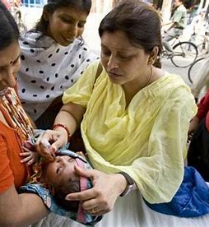
Rotary is easy to understand…
Just Remember Four – Five - Six
The Four Way Test (What we live by)
The Five Avenues of Service (How we serve)
The Seven Areas of Focus (Issues we address)
Notes:
Rotary is easy to understand. Just remember four, five, seven. The Four-Way Test (what we live by), The Five Avenues of Service (how we serve) and The Seven Areas of Focus (issues we address) all intended the improve the lives of people around the world and right here at home.

Slide 22
Since it was founded more than 100 years ago the Rotary Foundation has spent more than $4 billion on life-changing, sustainable projects.
Notes:
At the 1917 convention, outgoing RI President Arch Klumph proposed setting up an endowment “for the purpose of doing good in the world.” That one idea, and an initial contribution of $26.50 set in motion a powerful force that has transformed millions of lives around the globe. Arch Klumph planted a seed and thanks to his vision, staunch advocacy and the extraordinary generosity of Rotarians worldwide, the Rotary Foundation has become one of the world’s leading humanitarian foundations.

Slide 23
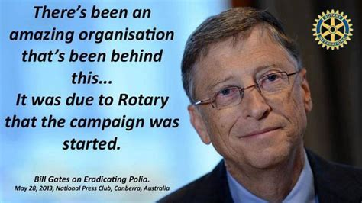
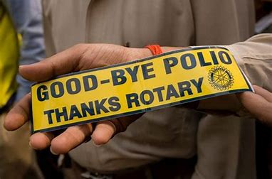
Over 2.5 billion children have been immunized against polio.
Rotarians have contributed $1.9 billion and countless volunteer hours.
There has been a 99.9% reduction of polio cases worldwide.
Notes:
The Rotary Foundation is well known for its work to end polio in the world. Polio Plus was launched in 1985 and has reached a 99.9% reduction in the number of Polio cases worldwide. We are now working on the final countries: Pakistan, Afghanistan and Nigeria. In 2017 Rotary committed to raise $50 million per year with every dollar to be matched with two additional dollars from the Bill and Melinda Gates Foundation bringing the total to $450 million. At last year’s Rotary International Convention Bill Gates announced he will extend the 2-to-1 match for the next three years which will add up to an additional $450 million to fight polio. We have been successful in eradicating polio in 122 countries around the world.

Slide 24
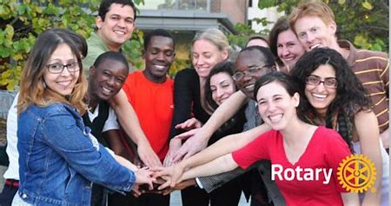
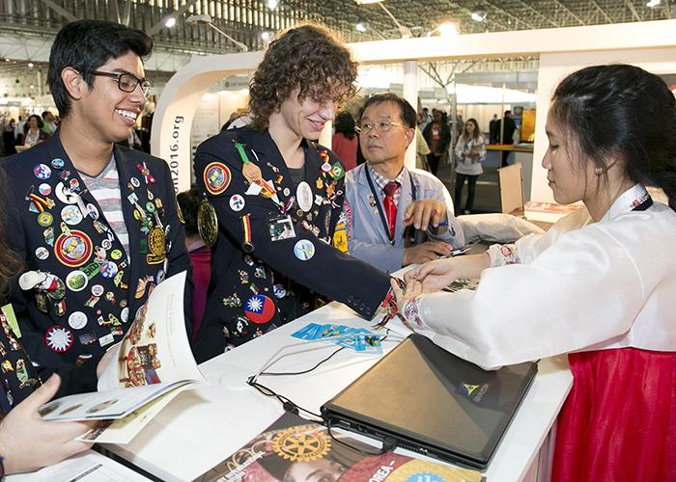
Youth Programs
Rotary Youth Exchange
Rotary Youth Leadership Awards (RYLA)
Rotary Peace Fellowships
Grants & Scholarships
Rotaract Clubs
Interact Clubs
Notes:
Rotary believes in developing the next generation of leaders. Our programs help young people build leadership skills, expand education and learn the value of service. There are several programs available from Youth Exchange to Rotary Peace Fellowships, grants and scholarships. Rotaract Clubs promote leadership, professional development and service for people of all ages. Interact Clubs bring people ages 12-18 together to develop leadership skills and learn about the world through service projects and activities.

Slide 25
RI District 7770
79 Clubs and 3,500 Members
2020-21 District Governor Pauline Levesque
Myrtle Beach Rotary Club
Notes:
District 7770 is one of the largest and most effective districts in the Rotary world. It is made up of 25 eastern counties of SC. Today District 7770 has 79 clubs with approximately 5,000 Rotarians. The District’s website offers an interactive map that will help you located a Rotary Club in your area. Pauline Levesque from the Rotary Club of Myrtle Beach is District Governor for 2020-21.

Slide 26
Notes:
Clubs in District 7770 are well known for the community service work they do:
Donating bicycles to the local police dept for Christmas gifts
Building nature trails
We donate blood
We build homes
We give generously to community service organizations and projects
And build safe stairways

Slide 27
Notes:
The Cart Fund was started right here in District 7770 to help fight Alzheimer’s Disease
We do a variety of literacy projects
And sponsor free community festivals
We stock food pantries to help feed the hungry
And develop tomorrow’s leaders

Slide 28
F
U
N
D
R
A
I
S
I
N
G
P
R
O
J
E
C
T
S
Notes:
District 7770 Rotary Clubs raise thousands of dollars each year from sponsoring golf tournaments to symphony events, wild game dinners, festivals, boots & BBQ, bocce ball bash, parking cars at USC football home games and OctoberFest events.

Slide 29
Notes:
We have great club meetings and speakers. And while we work very hard on our projects and fundraisers…

Slide 30
Hula Hoops to the Blues Brothers & Sisters!
Our Clubs Have Great Fun Together
Notes:
We also know how to have fun! From the Blues Brothers and Sisters and Hoola Hoops to a Chorus Line!

Slide 31
Why Join Rotary?
Friendship, camaraderie and fun
Give back to community
Be part of something larger than yourself
Professional networking
Leadership training
Personal growth and recognition
…..to name just a few of the reasons millions of people around the globe have joined Rotary for 115 years.
(February 23, 1905 – February 23, 2020)
Notes:
There are many good reasons to join Rotary. Life-long friends, making the community a better place, being part of something larger than yourself, networking, leadership and personal growth. These are just a few of the reasons why millions of people have joined Rotary over the past 115 year. In February Rotary celebrated its 115th anniversary.

Slide 32
How to Join
Membership is by invitation from a Rotarian
Cost of quarterly membership ranges from $50-$175
Submit a membership application
You are inducted into the club and introduced to the membership
Your New Member Mentor will assist & guide you
You complete new member orientation & training
You become quickly involved in club activities & events
You consider leadership positions in the club
Notes:
Rotary starts with an invitation to join a club. Cost for quarterly membership ranges from $50-$175 per quarter depending on the club. This covers RI, District and Club dues, a subscription to the Rotarian Magazine and club meeting meals.

Slide 33
What are the benefits of joining Rotary
Fellowship & life-long friendships
Network & business development
Leadership opportunities
Mentors to assist with professional development
Give back to the community
Be part of something bigger than self
The Rotarian Magazine
Travel opportunities
Notes:
The benefits of joining Rotary are many and range from fellowship and life-long friends to leadership opportunities and giving back to the community. There are many travel opportunities. Last year’s Rotary International Convention was in Hamburg, Germany. This years was to be in Honolulu, Hawaii until it had to be cancelled due to COVID-19. Next year’s will be in Taiwan.

Slide 34
Notes:
Eugene Newsom gives a great answer to the question of Why join Rotary? Building your business is a good reason for joining but it cannot be the only reason. While he said this 93 years ago in 1927…it is still true today. We are looking for members who want to make a difference in people’s lives…people who will offer their time, talent and resources to further Rotary’s causes.

Slide 35
“If you have the love of your fellow men in your heart, my friend, you are a potential Rotarian.”
Paul Harris who organized the first Rotary Club in 1905
Notes:
Paul Harris said it best in describing what it takes to be a Rotarian when he said, “if you have the love of your fellow men in your heart, my friend, you are a potential Rotarian.”

Slide 36
Thanks for your interest in Rotary
You Too Can Be A Rotary Hero!
Notes:
A great quote to end our session today comes from Harriet Tubman…Every great dream begins with a dreamer, always remember you have within you the strength, the patience and the passion to reach for the stars to change the world. Rotary has been doing this for 115 years, is it time for you to put your passion to work as a Rotarian?

