Slide 1
DISTRICT MEMBERSHIP PLAN 2013-14
Part I
“Membership as a PRIORITY”
Gary Bradham, Chair
sgcb@earthlink.net
843-458-0947
Notes:
This should be an interactive session … discussion, questions, brainstorming.

Slide 2
Membership Plan Goals
Recruit new members (Net + 1; extra point for net 5% ^ min. + 2)
Retain current members (At least 90% ...
“busy Rotarians are happy Rotarians”; Share the Value of Rotary)
Create new participation opportunities
(e-Member Classification; New Generation; Fun Family-Friendly events; Consider Rotarian Family Members; & Increase Value of Rotary)
Notes:
Goals that
- Bring in those who share the values of Rotary
- Encouraging active engagement & hands-on participation in all aspects of Rotary
- Variety of new opportunities that promote the Value of Rotary
Why use goals? SMART (Specific, Measurable, Achievable, Relevant and Timely)
If someone can’t come to our clubs that meet at a certain places at a certain time, in a certain location, do we let them walk away or look for opportunities to refer to other clubs, start new clubs or programs ; or suggest to clubs other ways to improve participation such as, evening events or earlier starts, on-line participation through video taping weekly meetings.
Other ideas to improve participation?

Slide 3
“Turning Around Membership Numbers”
“Back-to-Basics”
Make Membership a PRIORITY!
Make Membership a CLUB & Individual member responsibility.
Survey your members to determine needs & benefits
Use District tools & an annual calendar of activities
Pursue New Generation & Rotarian Family Members
(need a balance of members who engage Rotary)
Partner with PR & Information Committee
It’s a process … recruitment events; networking / social media; orientation; training opportunities; “red badge” Programs; participating in service projects; “fun focused” meetings, socials & family events
Notes:
Ask them to:
- Lead by example & bring a new member in to your club … usually only 15% - 25% have actually brought in a member. It is a rewarding task.
- Get the club and members engaged. Select a committee that is enthuastic, knowledgeable, and out going to spearhead membership.
- It can be productive and fun to get all members engaged. This year’s goal is for every club to get 25% of the current members to bring in a new member candidate by the end of the second quarter of the Rotary year. Then close the deal before the end of the third quarter
- Suggest some form of organized membership operation and use some form of recruitment event.

Slide 4
Make Membership a “PRIORITY”
P… make the offer PERSONAL!
R … use a RECRUITMENT Process!
I … INITATE a Club Survey!
O … ORIENTATION a “two way street”!
R … RETENTION offers “biggest bang” but is hardest to do!
(Engage Members: Busy Rotarians = happy Rotarians; Active Community Service; & Add Value)
I … New Members are an INDIVIDUAL Rotarian’s Responsibility
T … THINK “outside the box” to enhance participation opportunities!
(Video tape weekly meetings; “after-hours” meetings & fireside chats; special membership gatherings; Focus on New Generation; Don’t overlook Family Members & use e-member process)
Y … YOU must engage Rotary to change lives!

Slide 5
Expand Participation Options
Add Value to Rotary by Offering:
New Active Member Classification, members remain on club’s rolls but attend meetings on-line
Focus on New Generation & family of Rotarians
“Fun” club formats
Think “Outside the box” for new avenues of participation
Why: Membership still heading in the wrong direction!
Notes:
In order for Rotary to survive in the years ahead, we must identify new ways for individuals to obtain the Rotary experience.
We need to grow membership to achieve service projects and increase the funding needed to support both local and international service projects, health and education, and achieve
world peace.
Can you think of other ways we can expand participation?
So in my mind, Membership is the critical issue and glue that holds Rotary’s future.

Slide 6
Best Practices Doug Roderick, Co-chair Recruiting
What Attracts New Members to Our Clubs & Rotary?
What Makes a Good Membership Program
Effective Ways to Engage Members in Rotary?

Slide 7
Summary
Membership must be an Individual member, Club, & District Priority
“Back to Basics” focusing on activities that enhance the Value of Rotary & “Rotary experience”
Offer e-Member Classification and focus on New Generation as other alternatives to participate
Together “We” can “turn-around” the
membership numbers in District 7770
Notes:
Why must membership programs be improved?
to drive future programs and funding and improve the “health” of Rotary in general
Rotary is the premier service organization in the world today. The fact that you are a leader in Rotary shows that you care if Rotary survives in the years ahead. When your term as President and / or AG is up, you want to be able to look back and see that through your efforts you left Rotary in better shape than you found it.

Slide 8
Part II a: Retention Survey Frank Carll, Co-chair Retention
Review Process
Review Results
Key is to develop programs for your club (its not a one size fits all), depends on your members needs
Use an “Exit Survey” with those members who choose to leave

Slide 9
District 7770 Survey 2013
Frank Carll 9/13/2013

Slide 10
Why do people join Rotary?
Why do people stay in Rotary?
Why do people leave Rotary?

Slide 11
Goals For The Survey
Anonymous
Low Cost
Easy Collection of Data
Easy Tabulation
Easy Publication
All Clubs Participate
At least 50% response

Slide 12
What is the makeup of our fellow Rotarians?

Slide 13
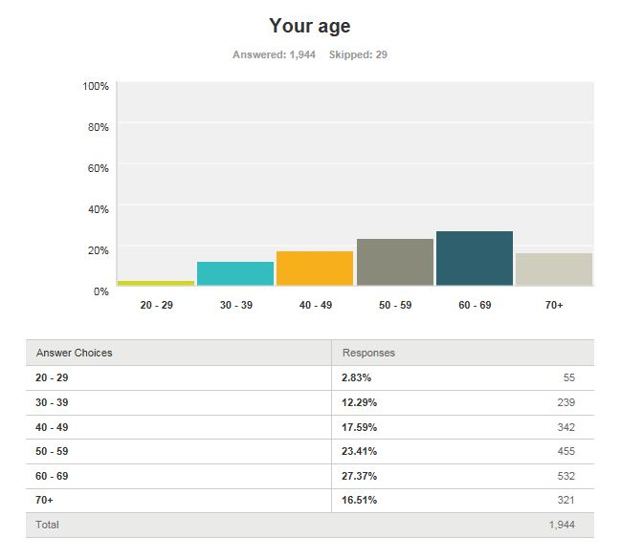

Slide 14
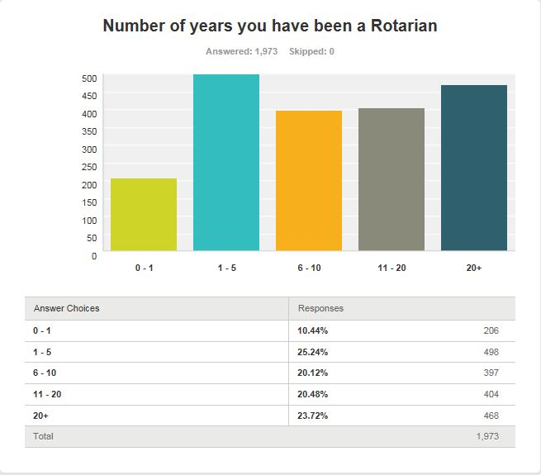

Slide 15
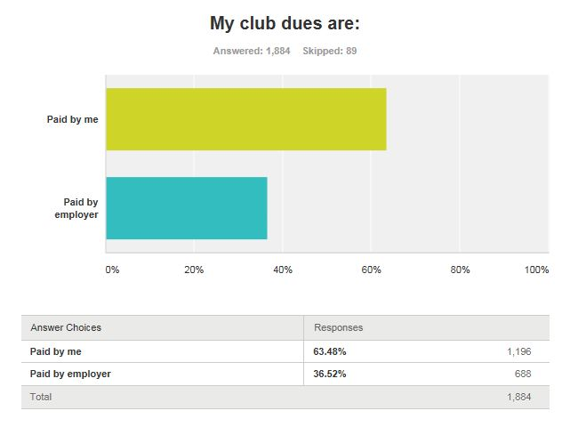

Slide 16
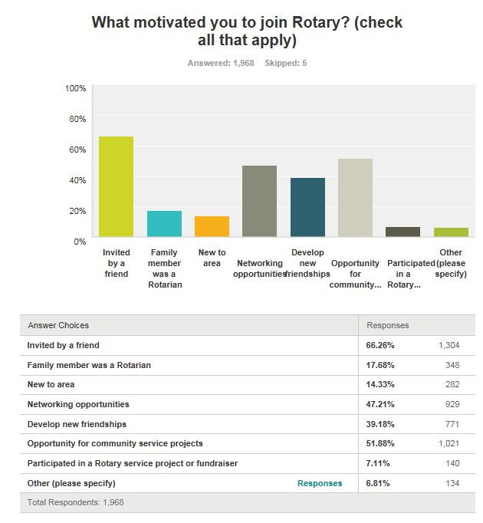
Notes:
#1 Invited by friend, #2 Community Service Projects, #3 Networking

Slide 17
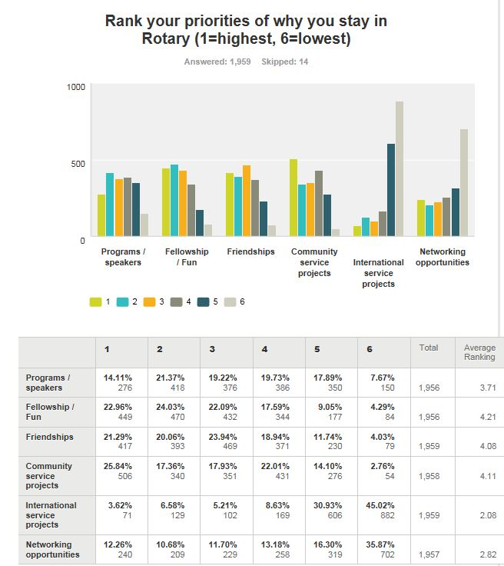
Notes:
#1 Fellowship / Fun, #2 Community Service Projects, #3 Friendship

Slide 18
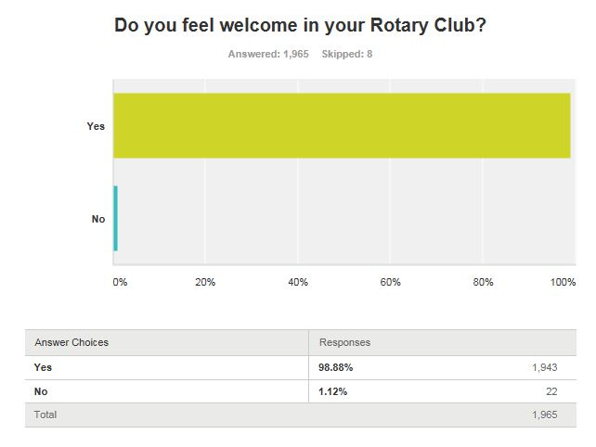
Notes:
Doing a great job

Slide 19
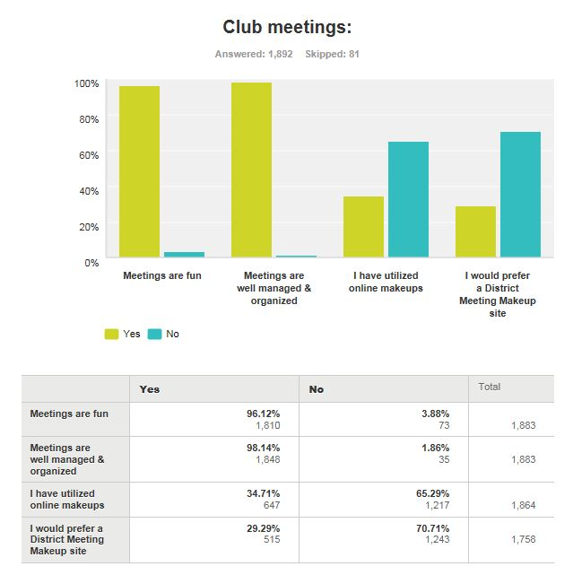

Slide 20
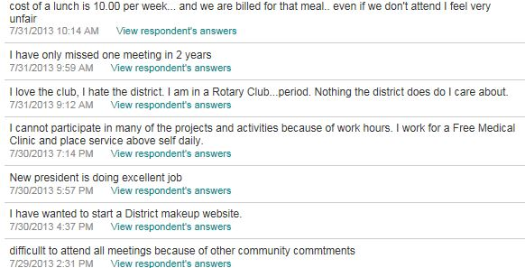
Meeting Comments

Slide 21
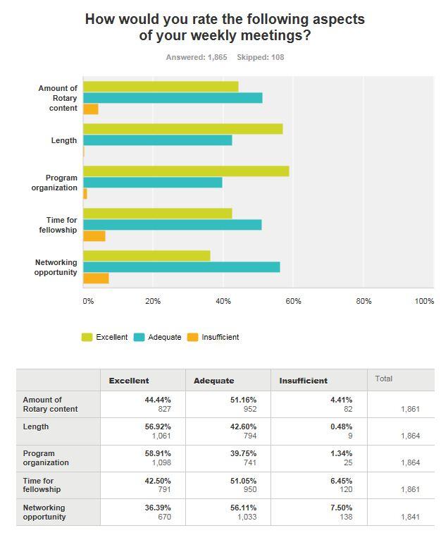

Slide 22
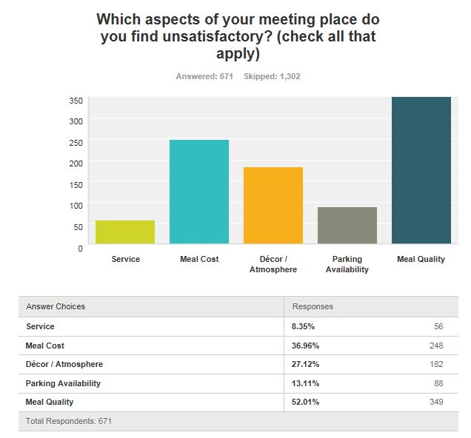
Notes:
Need to improve Meal Quality. Clubs need to pay attention to Meal Cost.

Slide 23
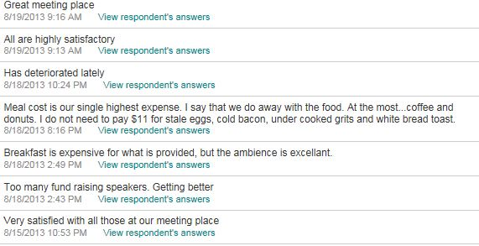
Meeting Place Comments

Slide 24
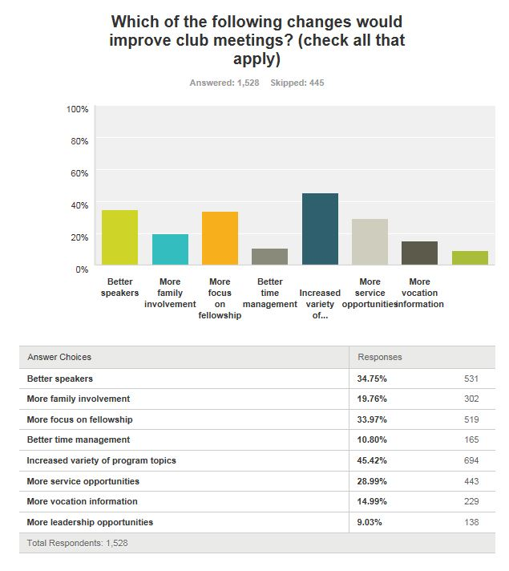
Notes:
Increased variety of program topics and better speakers

Slide 25
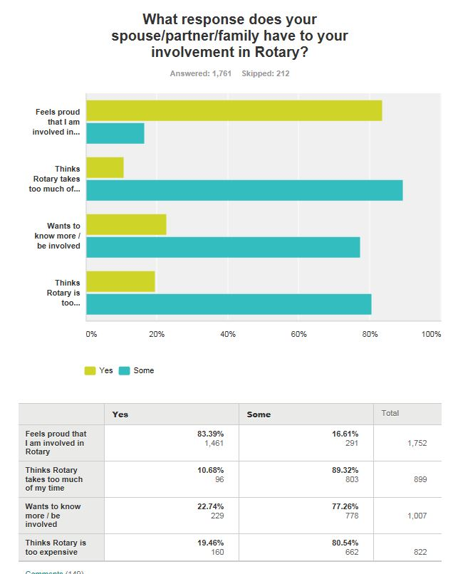
Notes:
Need to work on getting Family Members to understand the benefits of Rotary.

Slide 26
Why do people leave Rotary?

Slide 27
Resigning Questionnaire
Notes:
Have to encourage all clubs to get their members to take the “exit interview.”

Slide 28
e-Member Classification Terry Moore, Co-chair New Ideas Part II b – Retention & Recruitment tool
Approved 3rd Qtr. (2012-13) - Club’s option
Attend meetings “on-line” at any RI approved e-Club or free District video taped meetings
Base Dues on cost components of RI & District fees, (Magazine & Insurance costs, & major social activities, about $300 per year, plus Foundation donation)
Good tool for community servants or spouses to get involved w/ Rotary
Notes:
Here is a new way our District has identified to provide local leadership another Club avenue to allow new or weary current members to continue to participate in Rotary.

Slide 29
e-Member Process
“Vetted” / “sponsored” thru club recruiting as sub-set of Active Membership
# capped by 10% classification rule
Attend meetings “on-line”, send attendance slips to club secretary
Socials, Training, and / or Service Projects conducted with the club to achieve the whole “Rotary experience”
Remain on club’s membership rolls & counts toward club goals
Results to-date

Slide 30
Authorized Attendance Sites
www.District 7770.org (Taped Club Meeting links)
www.rotaryeclubcarolinas.com
Zone Model eClubs
Rotary eClub of Southwest USA Arizona
Rotary eClub of Latin America
Rotary eClub of London Centenary
Rotary eClub of Southeast USA & Caribbean
Rotary eClub of Taiwan
Rotary eClub of Finland & Greece
District Model eClubs
Rotary eClub of District 5450 Colorado; District 7150 New York; District 7890 Connecticut
Rotary eClub of District 3310 Singapore; District 3450 Hong Kong; 4500 Brazil

Slide 31
Part III: Recruiting Generation X… why & how
CHRIS DAVIDSON
Rotary Club of Newport News, VA

Slide 32
Perception is…
"Rotary is an old boys club"
"Rotary is only for business people"
"Rotary is not very diverse"
"Rotary isn't much fun"
"Rotary must invite you to participate"
"Rotarians care about the community"
"Rotarians are honest"
"Rotarians are social and outgoing"
"Rotarians are leaders"
"Many would consider Rotary, if asked"

