Slide 1
FOUNDATION PARTICIPATION
KEYS TO SUCCESS
1.) LEADERSHIP: ESTABLISH & COMMUNICATE YOUR PLAN
2.) THEME: “DEVELOPING A CULTURE OF PARTICIPATION”
3.) ESENTIAL CONCEPT: CLUB GOALS VERSUS INDIVIDUAL MANDATES
4.) PREREQUSITES: PROFICIENT IN DISTRICT 7770 WEBSITE/DATABASE &
ROTARY INTERNATIONAL WEBSITE INCLUDING REGISTRATION ON “MEMBERS ACCESS.” USE DISTRICT WEBSITE WWW.ROTARY7770.ORG AS ENTRANCE PORTAL.

Slide 2
FOUNDATION PARTICIPATION
METHODS: HOW SUCCESFUL CLUBS ACHIEVE
1.) SET “EXPECTATION” @ CLUB ASSEMBLY & DURING MEMBER ORIENTATION
2.) ADD TO MONTHLY, QUARTERLY, SEMI-ANNUAL INVOICES
3.) ASSIGN ALL/OR MATCH PART OF “INITIATION FEE”
4.) DEDICATED OR PERCENTAGE OF FUNDRAISER
5.) WATER RESOURCES OR OTHER MATCHING GRANT CONTRIBUTION
6.) INVEST IN FOUNDATION SEMINAR & OTHER DISTRICT INCENTIVES
7.) FOUNDATION FAIRY – REQUIRES EFFORT & PARTICIPATION

Slide 3
FOUNDATION PARTICIPATION
ITEM 1: CLUB MEETS ITS POLIO ERADICATION & ANNUAL PROGRAMS FUND GOALS
TOOLS:
1.) CLUB GOAL FORM – TURN IN TODAY
2.) “ZERO CLUB PLEDGE CARD” – NO $0 CLUBS AS OF JULY 1, 2011 - HANDOUT
3.) WATER RESOURCES FLIER – ALSO MEETS “INTERNATIONAL SERVICE PROJECT REQUIREMENT IN “AVENUES OF SERVICE SECTION” - HANDOUT
3.) FOUNDATION TRANSMITTAL REPORT (DISTRICT DATABASE) – USE THIS FORM
FOR ANNUAL PROGRAMS FUNDS & POLIO BY INDIVIDUAL MEMBER
4.) MONTHLY CONTRIBUTION REPORT (MCR) – FOUND ON “MEMBERS ACCESS”

Slide 4
Name ____________________________________
Rotary Club of _____________________________
I hereby pledge early to make my first 2010 - 2011 contribution to The Rotary Foundation by July 15, 2011.
And … I will ask the same of 5 other Rotarians. This will be a key to the start of a successful year.
Your Pledge to be collected now. Please extend the opportunity to others when you get home
Rick Moore
Foundation Chair
P.O. Box 22795
Charleston, SC 29413-2795

Slide 5
Rotary District 7770 Club -- Andrews (6222)
Remit TO: The ROTARY FOUNDATION
14280 Collections Center Drive
Chicago, IL 60693
MEMBERID | AMT CONTRIB | MEMBER NAME | SUST MEMB
1509465 | $100.00 | Branyon, Joe T.
6908393 | $100.00 | Bryant, Wesley P
2341864 | $100.00 | Hemingway, Alex S.
710726 | $100.00 | Hemingway, Henry E Jr
6963088 | $100.00 | Lesesne, Bonnea D
6870835 | $100.00 | Leslie, Jeff
1977027 | $100.00 | Morris, William C. Jr.
6544997 | $100.00 | Nicholson, Nick
877910 | $100.00 | Smith, Arthur W.
6870837 | $100.00 | Trapp, Robert L
5865517 | $100.00 | Vermeland, Robbie
Club #6222 |  | Contribution By Andrews Club
11 Active Members |  |  | 11 / 100.0%
TOTAL AMT: | $1,100.00
Please make your check payable to: The Rotary Foundation
And, TRF, please send a contribution receipt to all donors.
Contributions Designation (only check one):
[ ] Annual Fund | [ ] World Fund | [ ] for Grant#: ___________
[ ] PolioPlus
Please mail check and this document to:
The ROTARY FOUNDATION
14280 Collections Center Drive
Chicago, IL 60693
--Submitted by--
Secretary of Rotary Club: Nicholson, Nick (1385000)
Home Email: cpaboss@aol.com
Home Phone:

Slide 6
SEE EXAMPLE NEXT PAGE

Slide 7
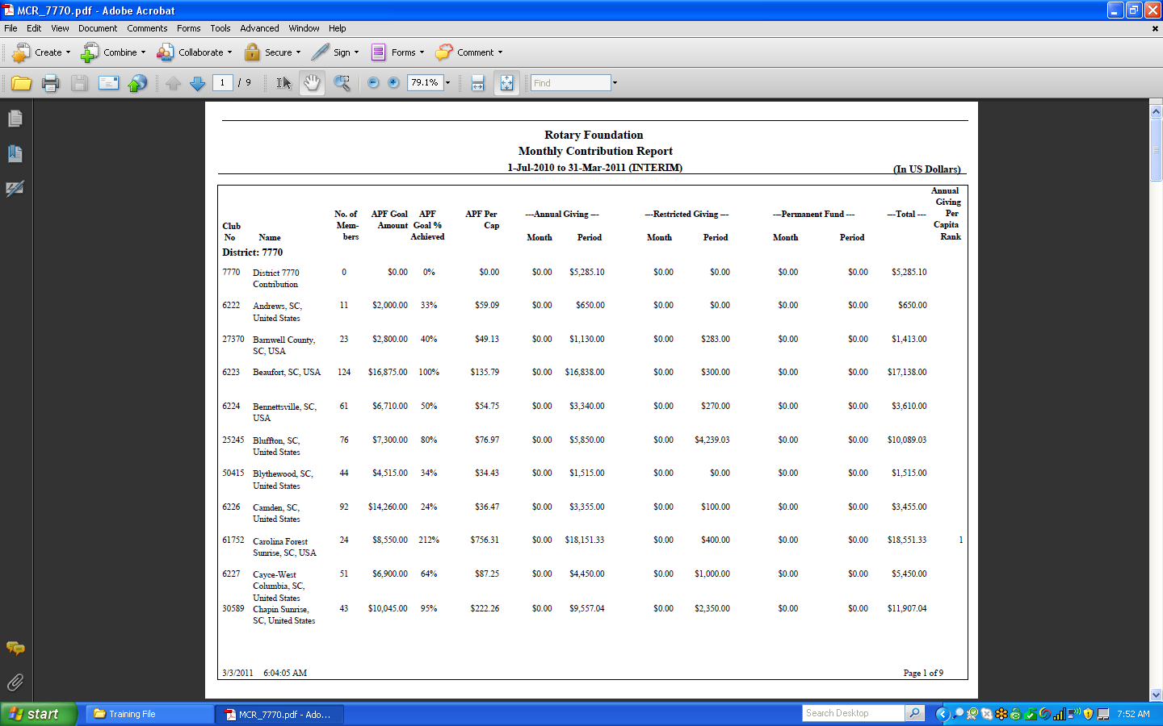

Slide 8
FOUNDATION PARTICIPATION
ITEM 2: CLUB SUBMITS 50% OF ITS ANNUAL GIVING GOAL BY 12.1.11
TOOLS & TIMING:
1.) “ZERO CLUB CARD” – PRIOR TO JULY 1, 2011
2.) SUBMIT 25% BY SEPTEMBER 30, 2011
3.) SUBMIT 50% BY DECEMBER 1, 2011
4.) SUBMIT 75% BY MARCH 31, 2012
5.) SUBMIT TOTAL BY JUNE 1, 2012
6.) WATER RESOURCES OR OTHER MATCHING GRANT CONTRIBUTION 7.) INVEST IN FOUNDATION SEMINAR & OTHER DISTRICT INCENTIVES 8.) FOUNDATION FAIRY – REQUIRES EFFORT & PARTICIPATION
9.) USE TRF TRANSMITTAL FORM GIVING EACH MEMBER CREDIT
10.) TRACK PROGRESS ON MCR

Slide 9
FOUNDATION PARTICIPATION
ITEM 3: CLUB HAS EVERY MEMBER MAKE AN ANNUAL PROGRAM FUND CONTRIBUTION DURING THE YEAR (EREY) ACHIVING $100 PER CAPITA
TOOLS:
1.) MONTHLY, QUARTERLY, SEMI-ANNUAL MEMBER CONTRIBUTIONS
2.) WATER RESOURCES OR OTHER MATCHING GRANT CONTRIBUTION 3.) INVEST IN FOUNDATION SEMINAR & OTHER DISTRICT INCENTIVES 4.) FOUNDATION FAIRY – REQUIRES EFFORT & PARTICIPATION
5.) USE TRF TRANSMITTAL FORM GIVING EACH MEMBER CREDIT
6.) TRACK PROGRESS ON EREY REPORT FOUND ON “MEMBERS ACCESS”

Slide 10
SEE EXAMPLE NEXT PAGE

Slide 11
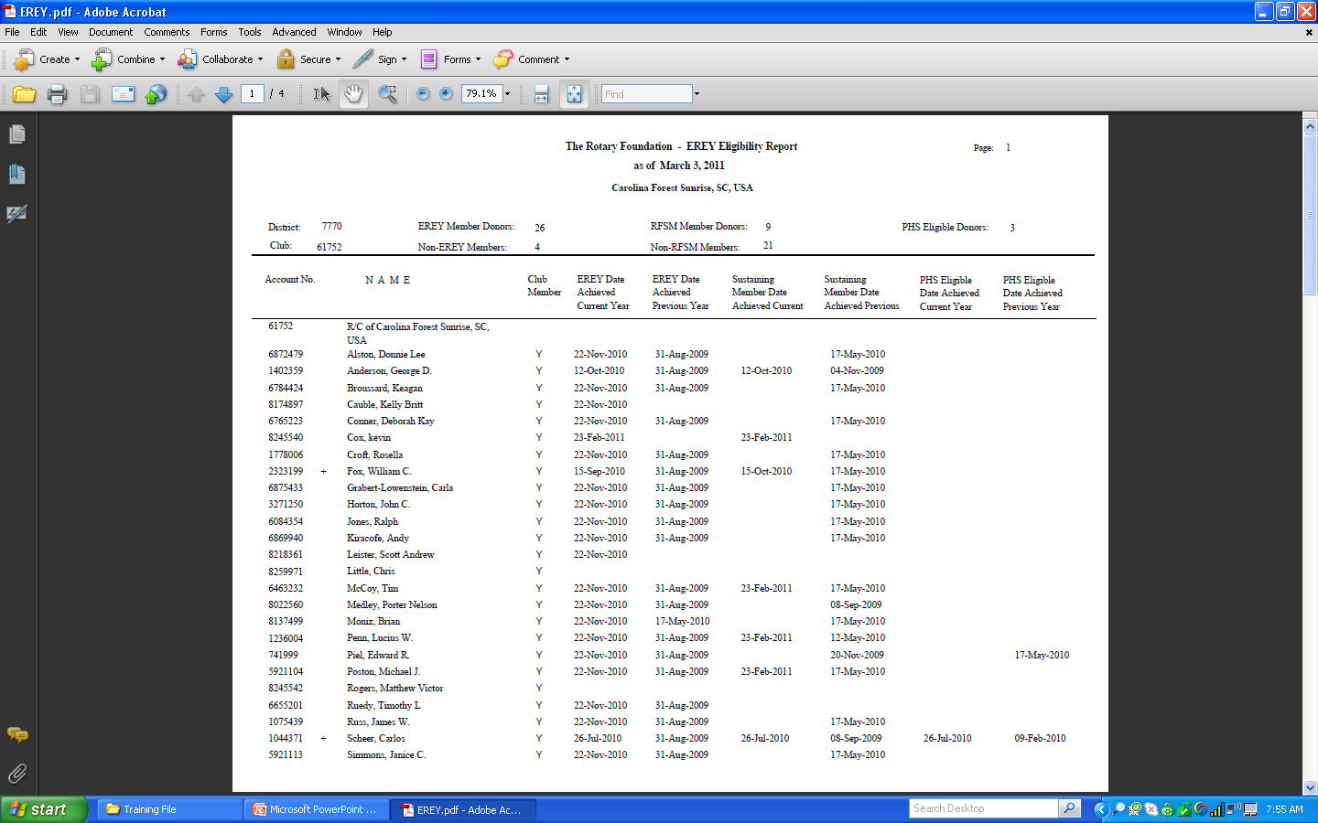

Slide 12
FOUNDATION PARTICIPATION
ITEM 4: CLUB ACHIEVES 100% SUSTAINING MEMBER STATUS – EACH MEMBER IS CREDITED WITH $100 IN FOUNDATION DONATION TO ANNUAL PROGRAMS FUND (DOES NOT INCLUDE POLIO CONTRIBUTIONS)
TOOLS:
1.) MONTHLY, QUARTERLY, SEMI-ANNUAL MEMBER CONTRIBUTIONS
2.) WATER RESOURCES OR OTHER MATCHING GRANT CONTRIBUTION 3.) INVEST IN FOUNDATION SEMINAR & OTHER DISTRICT INCENTIVES 4.) FOUNDATION FAIRY – REQUIRES EFFORT & PARTICIPATION
5.) USE TRF TRANSMITTAL FORM GIVING EACH MEMBER CREDIT
6.) TRACK PROGRESS ON EREY REPORT FOUND ON “MEMBERS ACCESS”

Slide 13
FOUNDATION PARTICIPATION
ITEM 5: CLUB SECURES AT LEAST ONE NEW PAUL HARRIS SOCIETY MEMBER OR PHS RENEWAL (MEMBER CAN DESIGNATE FUNDS TO APF OR POLIO). PHS MEMBERS DONATE $1,00 ANNUALLY TO THE ROTARY FOUNDATION.
TOOLS:
1.) MONTHLY, QUARTERLY, SEMI-ANNUAL MEMBER CONTRIBUTIONS
2.) TRF DIRECT BROCHURE
3.) PAUL HARRIS SOCIETY BROCHURE
4.) PAUL HARRIS SOCIETY APPLICATION

Slide 16
APPLICATION ON DISTRICT DATABASE

Slide 17
FOUNDATION PARTICIPATION
ITEM 6: CLUB ACHIEVES “STAR CLUB” STATUS – STAR CLUBS BEGIN WITH $200 PER CAPITA AND WE HAVE HAD AS HIGH AS AN EIGHT STAR CLUB!
TOOLS:
1.) MONTHLY, QUARTERLY, SEMI-ANNUAL MEMBER CONTRIBUTIONS
2.) WATER RESOURCES OR OTHER MATCHING GRANT CONTRIBUTION 3.) INVEST IN FOUNDATION SEMINAR & OTHER DISTRICT INCENTIVES 4.) FOUNDATION FAIRY – REQUIRES EFFORT & PARTICIPATION
5.) USE TRF TRANSMITTAL FORM GIVING EACH MEMBER CREDIT
6.) TRACK PROGRESS ON MCR FOUND ON “MEMBERS ACCESS”

Slide 18
FOUNDATION PARTICIPATION
ITEM 7: CLUB SECURES A NEW BENEFACTOR OR BEQUEST SOCIETY MEMBER. DONATIONS ARE PLACED INTO THE “PERMANENT FUND.” ESTABLISHED IN 1982, THE CURRENT VALUE (INCLUDING EXPECTANCIES) IS $625.7 MILLION WITH A TARGET OF 1 BILLION BY 2025
TOOLS:
1.) BENEFACTOR APPLICATION – DONATIONS OF $1,000 OR MORE
2.) BEQUEST SOCIETY APPLICATION – DONATIONS OF $10,000 OR MORE

Slide 21
FOUNDATION PARTICIPATION
ITEM 8: CLUB ACHIEVES/MAINTAINS 100% PAUL HARRIS FELLOW CLUB STATUS
WORLDWIDE LESS THAN 4% OF ALL ROTARY CLUBS ACHIEVE THIS LEVEL WE CURRENTLY HAVE (27) “100% PAUL HARRIS FELLOW CLUBS” WITH (5) MORE IN THE LOOP! OUR LONG RANGE GOAL IS TO BECOME A “100% PAUL HARRIS FELLOW DISTRICT (CURRENTLY 1 IN THE WORLD). CLUBS CAN USE CASH, POINTS AND/OR A COMBINATION OF BOTH TO ACCOMPHLISH THIS TASK
TOOLS:
1.) CLUB RECOGNITION SUMMARY (CRS) AVAILABLE ON “MEMBERS ACCESS”
2.) RECOGNITION ANS TRANSFER FORM

Slide 22
SEE EXAMPLE NEXT PAGE

Slide 23
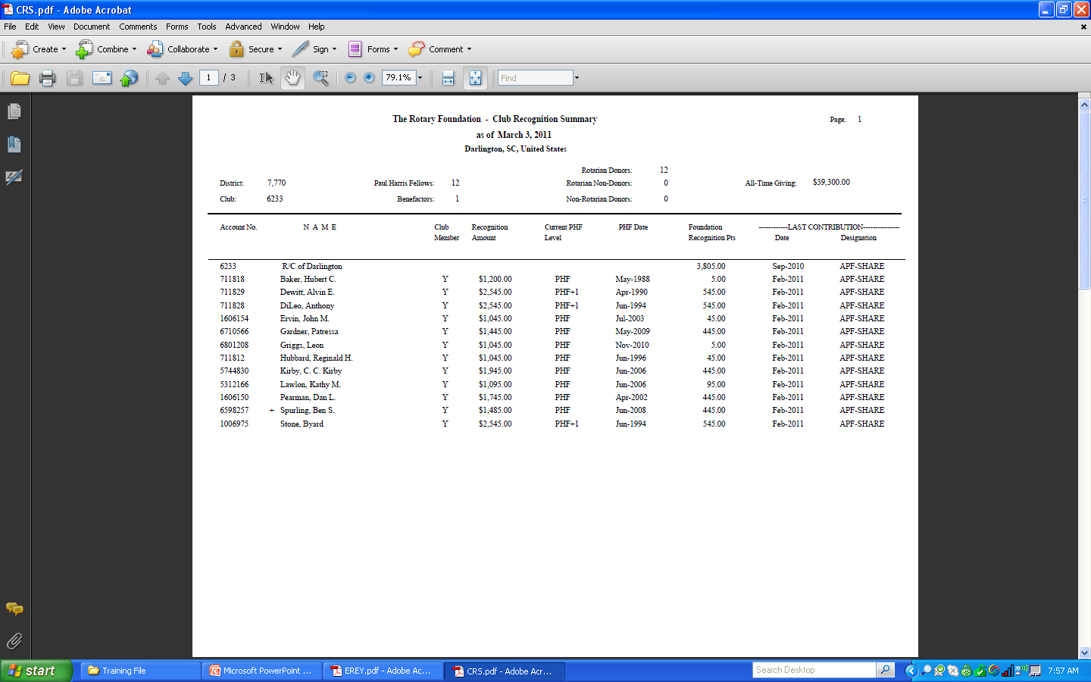

Slide 25
FOUNDATION PARTICIPATION
Major Donor: The Rotary Foundation recognizes couples or individuals whose combined personal outright or cumulative giving has reached $10,000. All outright contributions made to the Foundation are included in this total, regardless of the gift designation. Donors may elect to receive a crystal recognition piece and a Major Donor lapel pin or pendant. Recognition items commemorate giving at each recognition level:
LEVELS:
Level One - $10,000 Level Two - $25,000 Level Three - $50,000 Level Four - $100,000 Level Five - $500,000 Level Six - $1,000,000
Arch C. Klumph Society
Donors whose cumulative gifts total $250,000 or more will become members of the Arch C. Klumph Society and have their photos displayed permanently in the Arch C. Klumph Gallery at RI headquarters.
CONTACTS: Ione Cockrell – District Major Gifts Chair
Ione@Ionecockrell.com or 803.254.4899
Jackie McGuire – RI Major Gifts Officer
Jackie.mcguire@rotary.org or 847.866.4450
Rick Moore – District Foundation Chair
Rick@Rotary7770.org or 843.696.3795
DOCUMENTS: Club Recognition Summary (CRS)

Slide 26
DISTRICT 7770’S CORE VALUES
1.) BUILD “EREY” CLUBS: 87.3% IN ROTARY YEAR 2009 – 2010
2.) MOVE FORWARD INTO “SUSTAINING MEMBER CLUBS:” 31.7% IN 2009 – 2010
3.) ADD “PAUL HARRIS SOCIETY MEMBERS”: (170 IN 09/10) - (154 YTD IN 10/11) – 60 CLUBS
4.) DEVELOP “STAR CLUBS:” (25) IN 2009/2010 – 31.6% OF TOTAL CLUBS
5.) “PARTICIPATE” IN “WATER RESOURCES OR OTHER MATCHING GRANTS:” (35 YTD)
6.) “100% PHF CLUBS” BUILD STONG FOUNDATION FOR FUTURE DEVELOPMENT
7.) “MATCHING POINTS” (DISTRICT & RI) PROVIDE ADDED INCENTIVE
8.) “DISTRICT ACTIVITIES & FOUNDATION FUNDRAISERS”
9.) “PARTICIPATE” ON THE RECEIVING SIDE THROUGH DISTRICT SIMPLIFIED GRANTS
SUPPORT DATA AVAILABLE ON DISTRICT DATABASE UNDER “FILES & FORMS TAB”

