Slide 1
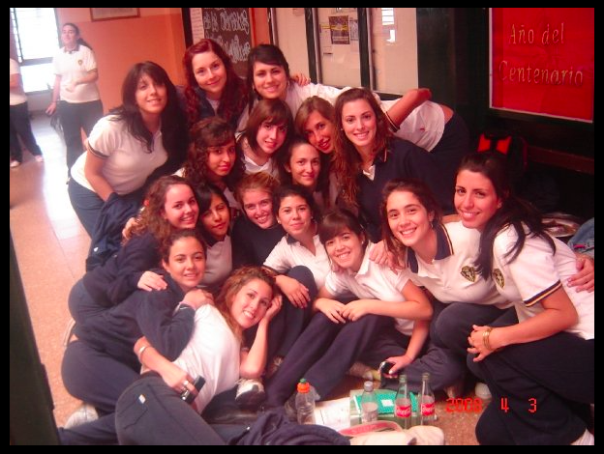

Slide 3
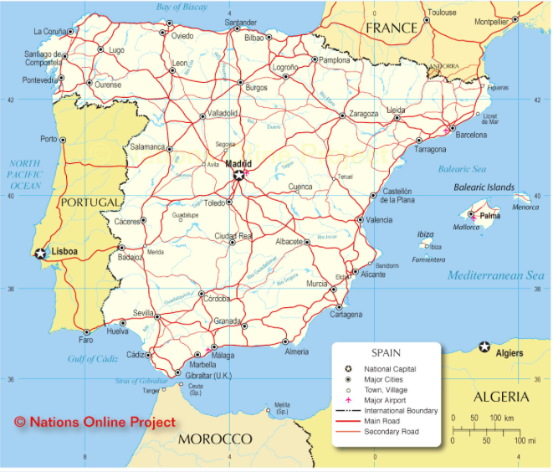

Slide 4
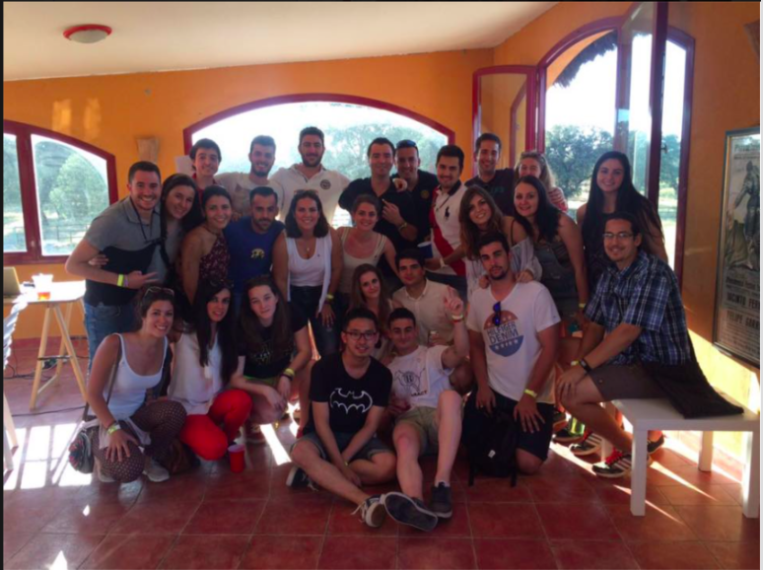

Slide 5
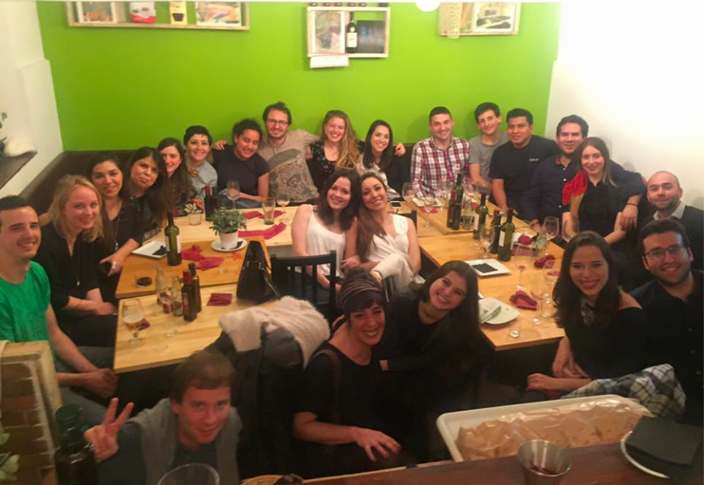

Slide 6
"It is not enough to teach our young people to be successful[…]so they can realize their ambitions, so they can earn good livings, so they can accumulate the material things that this society bestows. Those are worthwhile goals. But it is not enough to progress as individuals while our friends and neighbors are left behind."~Cesar Chavez

