Slide 1
THE ROTARY FOUNDATION
100 YEARS OF
ROTARY SERVING HUMANITY

Slide 2
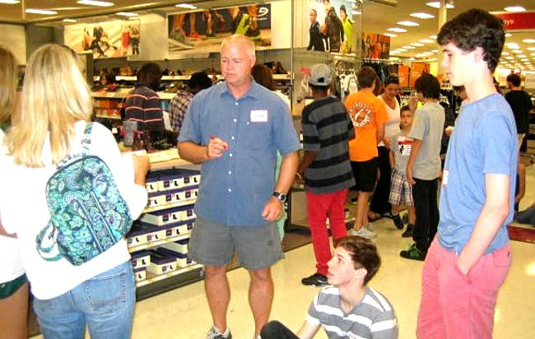
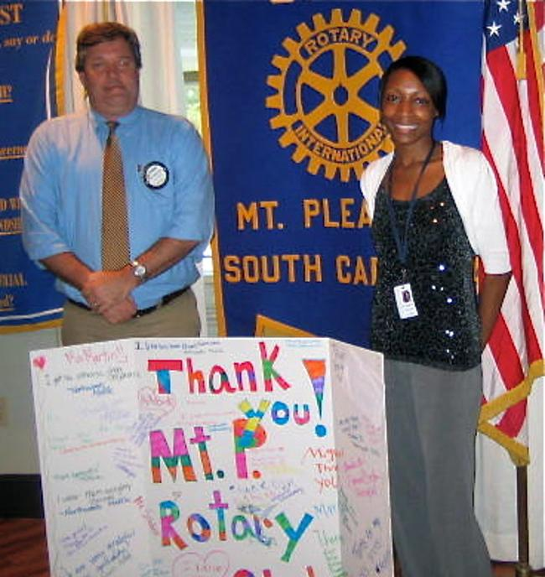
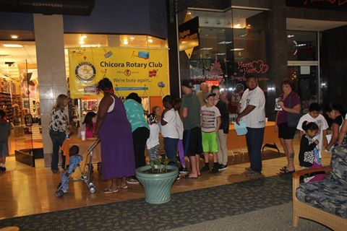

Slide 3
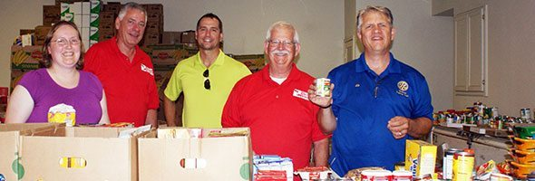
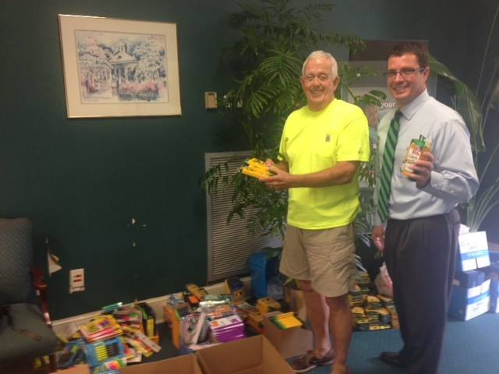
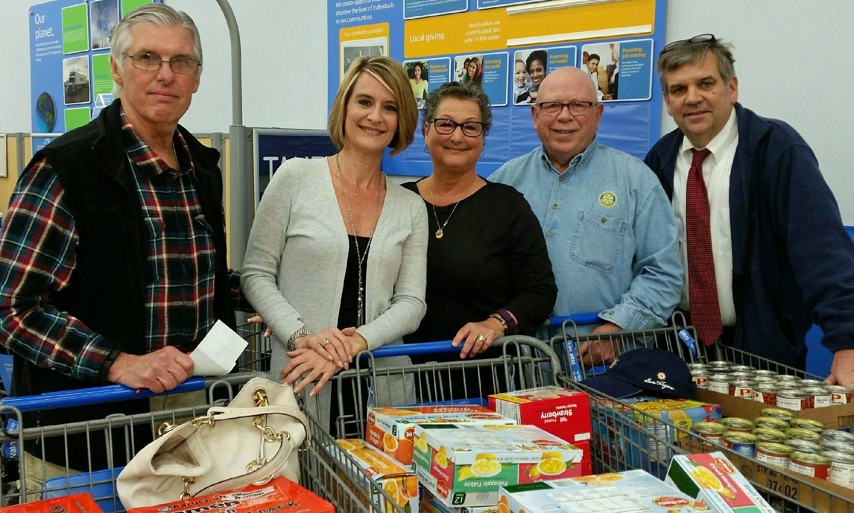
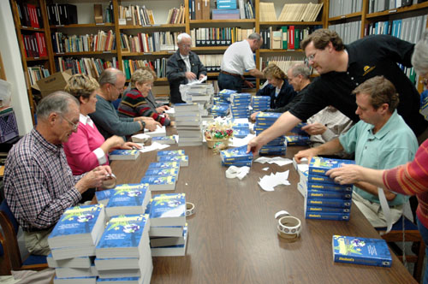

Slide 4
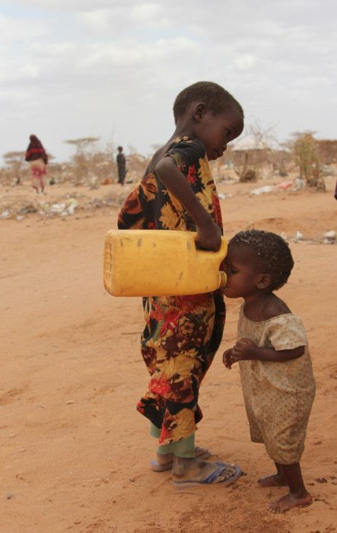

Slide 5
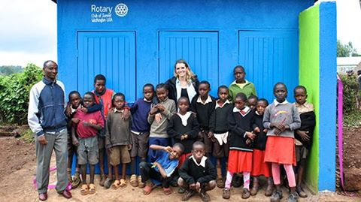
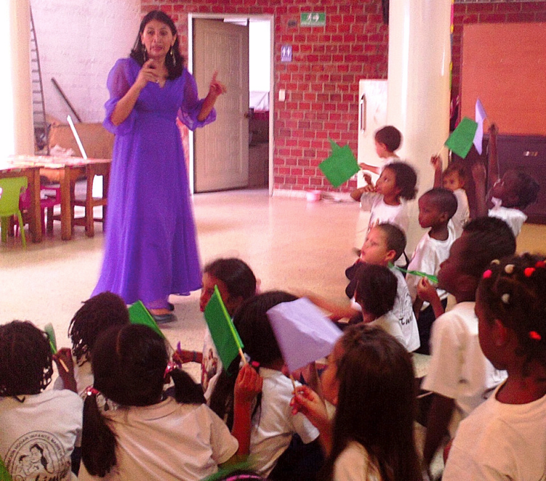

Slide 6
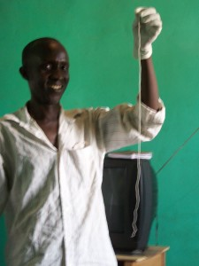

Slide 7
WAYS TO GIVE
PAUL HARRIS FELLOW $1,000
PAUL HARRIS SOCIETY $1000 A YEAR
MAJOR DONOR $10,000+ (ONE TIME OR OVER 3 YEARS)
BENEFACTOR $1,000 *
BEQUEST SOCIETY $10,000 + *
* PART OF YOUR LEGACY TO ROTARY

Slide 8
