Slide 1
Public Image

Slide 2
Mary Gasque mary@gasque.com 803.791.0952/O 803.553.0020/C

Slide 3
Public Image Mission To ensure the District communicates both internally and externally, to coordinate district-wide communication efforts, and to train and encourage clubs in effective communication methods.

Slide 4
Three legged stool Enhance public image & awareness Support & strengthen clubs Focus and increase humanitarian service

Slide 5
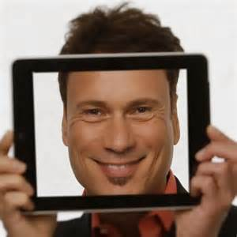
Rotary’s Public Image begins with you

Slide 6
Communications Committee
Website

Slide 7
Communications Committee
Social Media –
FB
LinkedIn
Instagram, Snapchat, Flickr
Twitter
Youtube

Slide 8
Communications Committee
Email/Texting

Slide 9
Communications Committee
Media –
Radio
TV
Print – local newspapers/business magazines
Billboard
Handshake

Slide 10
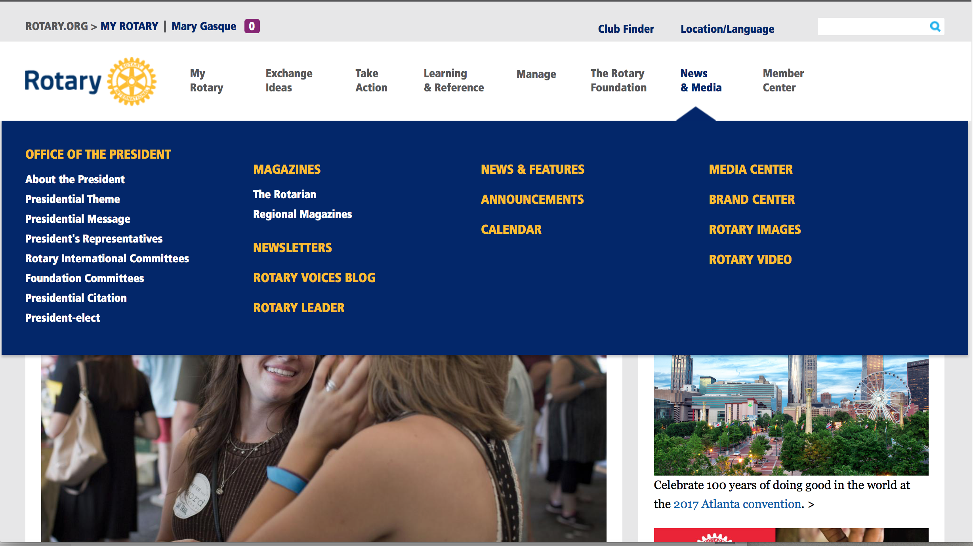
Website
Rotary.org, My Rotary, News & Media, Brand Center

Slide 11
Website
Meeting place, date and time
Club Leadership
Speakers
Projects w/photos
Links to FB, LinkedIn, Instagram,
Twitter

Slide 12
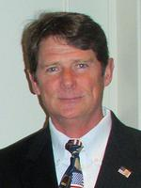
Terry Moore Summerville Evening Club Email: tr_moore@bellsouth.net Office: 843-297-6691 Home: 843-821-1436 Cell: 843-297-6691

Slide 13
Candeavor Project Doing Good 2323 Broadway Oakland, CA 94612 Email: sales@candeavor.com Phone: +1 (510) 516-4889

Slide 14
Facebook
Meeting place, date and time
Speakers or videos of speakers
Projects w/photos of club members
Post between 1pm – 4pm, weekdays

Slide 15
Facebook Do’s/Don’t
Don’t post personal information (email/phone numbers) without members permission
Don’t post photos of members children without permission
Do have members “Like” the page
Do have members invite friends to like the page
Do tag photos

Slide 16
District FB Page https://www.facebook.com/rotary7770/
Like this page!

Slide 17
LinkedIn – Business Networking

Slide 18
Twitter – Limited space, good for quick blips about your club Be sure to link with FB page

Slide 19
Instagram-Online mobile photo-sharing, video-sharing, and social networking service that enables users to share photos/videos. (Snapchat, Flickr)

Slide 20
YouTube

Slide 21
Email/Texting – great way to keep members informed of meeting dates, speakers, special projects, etc. Some clubs have replaced the weekly bulletin with weekly emails.

Slide 22
Media List of media reps from radio stations, newspapers, local business publications, TV stations and billboard companies.

Slide 23
Media Press Releases: always include the five “W” – who, what, where, when & why. Be sure to include photos.

Slide 24
Media Most radio, tv & cable stations will do PSA .

Slide 25
Media Lamar Outdoor Advertising will also do billboards (you only pay for vinyl/labor, around $250.)

Slide 26
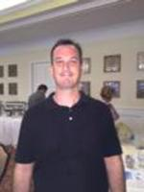
District Newsletter Send information on projects, awards, important speakers, anything newsworthly to: Patrick Quilter

Slide 27
Website
Social Media
Email/Texting
Media
Invite a friend

Slide 32
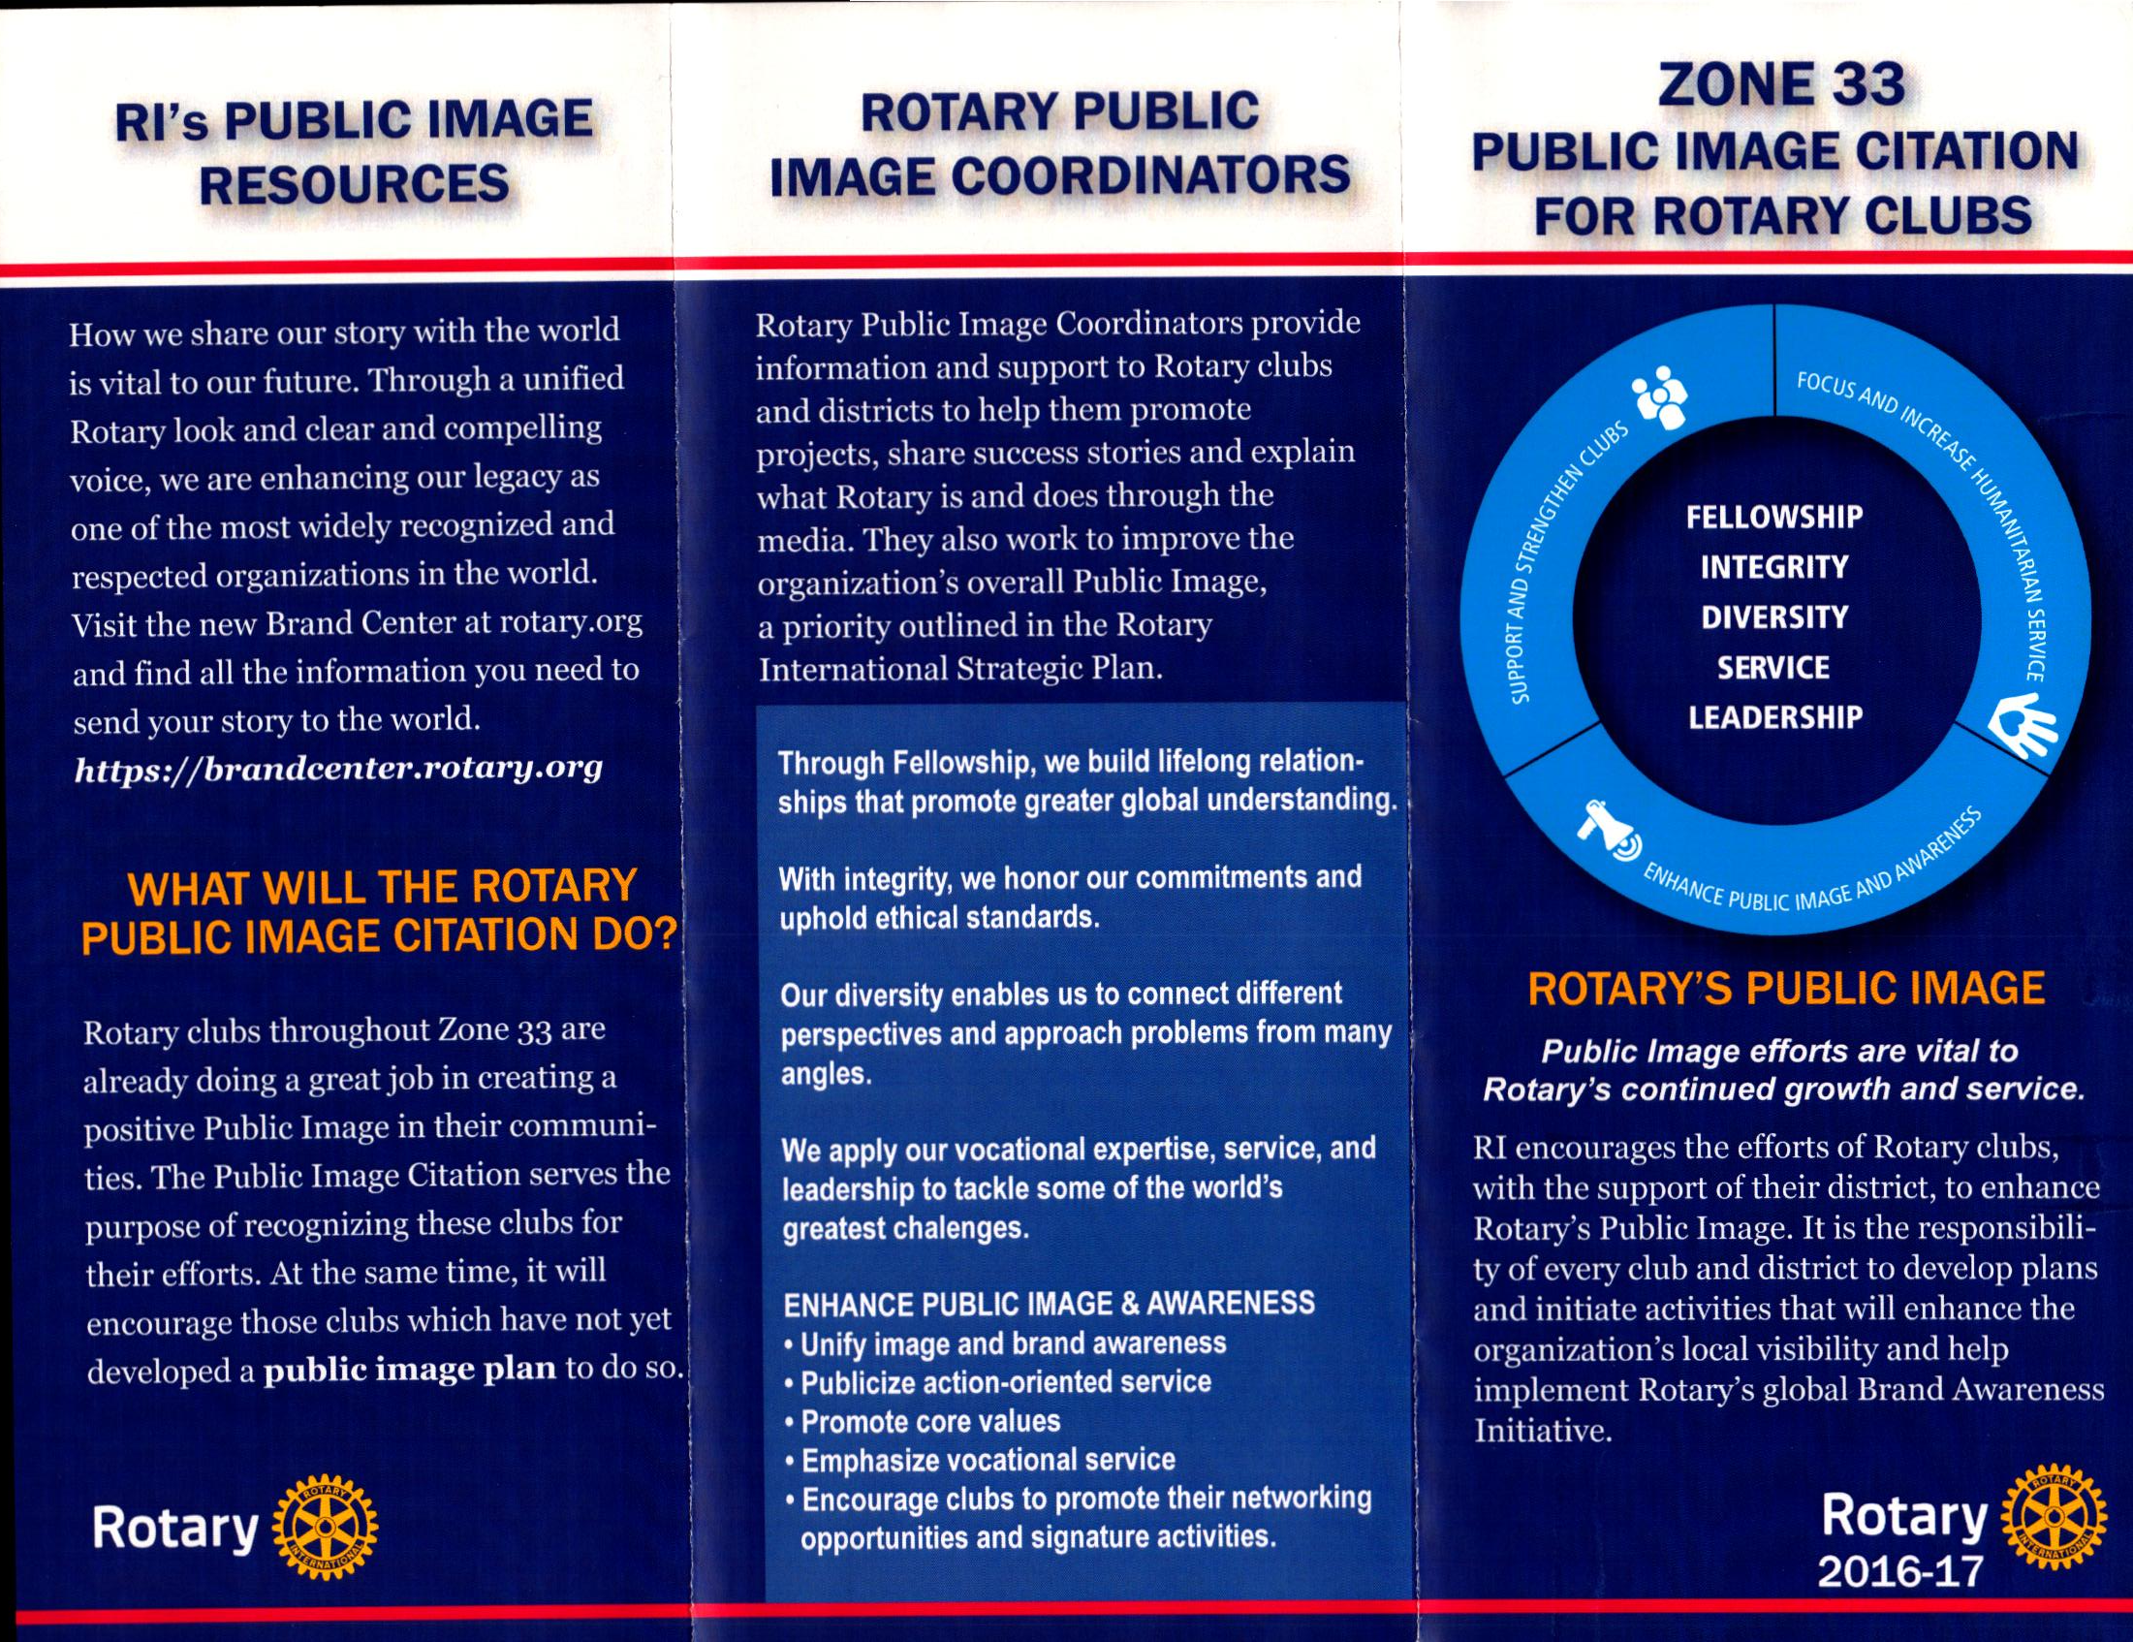
Zone 33 Public Image Citation

Slide 33
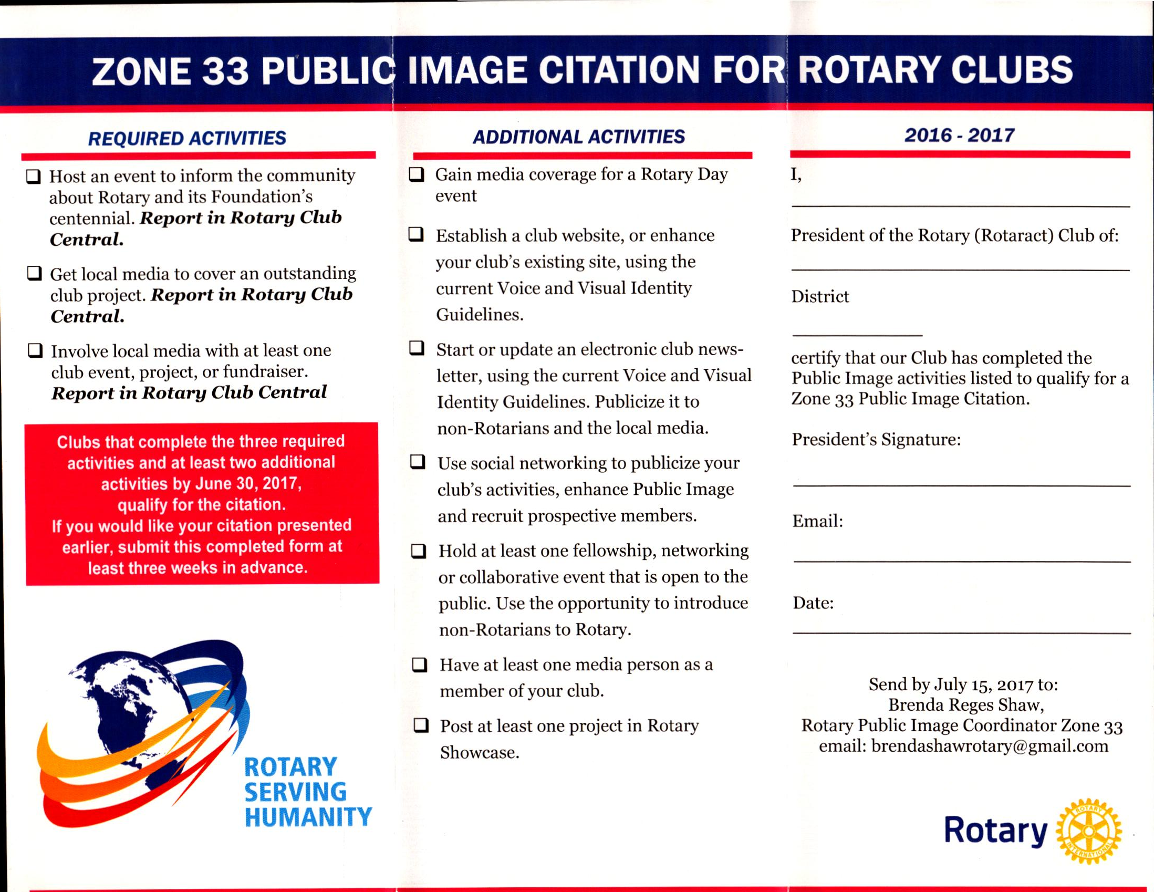
Zone 33 Public Image Citation

