Slide 1
PolioPlus Global Update
Polio Update 2013
Notes:
This presentation will provide an overview of the current status of global polio eradication and highlights the role that each of you plays in Rotary’s PolioPlus program. It is an exciting time in the global effort to eradicate polio but much work in fundraising, advocacy and raising awareness remains to be done before we reach the goal of a polio-free world.

Slide 2
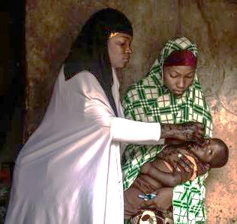
Global Update
What is Polio?
Achievements & Challenges
What needs to be done
Funding Requirements
Rotary’s Role
Notes:
First, I’ll talk briefly about polio itself, recent achievements and challenges, and what still needs to be done. Then I’ll turn it over to Chair Mike who will talk about the funding requirements and your roles in the effort.

Slide 3
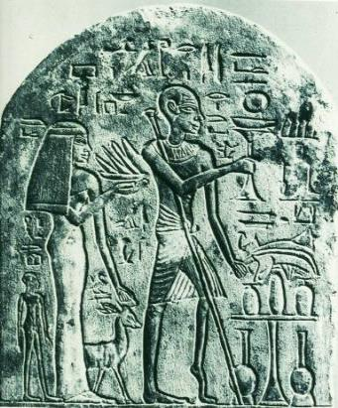
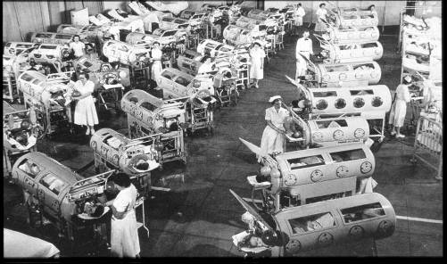
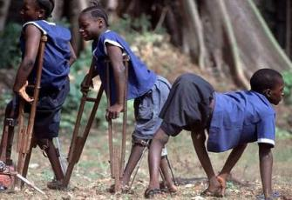
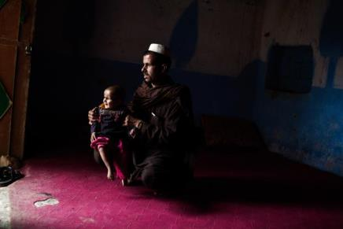
Polio Across the Centuries
What is polio?
Notes:
3
Polio is an ancient disease. It is an intestinal virus that is mostly spread from person-to-person contact, especially where hygiene is poor. It can cause irreversible paralysis, and sometimes death. It strikes mainly children under the age of 5.
On the far left, this picture of an Egyptian stele from around 1580 BC depicts a priest with polio.
The middle photo is of a polio ward in the United States in the 1950s—the height of the epidemic in this country. These iron lungs were used for those whose lungs were paralyzed by polio. In 1952 polio struck a new victim every 10 minutes. Nearly 58,000 people contracted polio in that year.
The picture of children in blue clothing shows that the wild poliovirus still paralyzed children in Africa until very recently.
And the bottom photo is the face of polio today; paralyzing the world’s most vulnerable children living in the most challenging of circumstances in Pakistan and Afghanistan.

Slide 4






Partners
GOVERNMENTS
OF THE WORLD
Notes:
The Global Polio Eradication Initiative partners include WHO, UNICEF, the US Centers for Disease Control and Prevention and the Gates Foundation. And equally as important are the governments of the world-both donor and polio-affected and high risk, whose support and leadership is needed to carry out polio immunization activities.

Slide 5
Global update: Wild poliovirus, 1985-2015
2 Polio Endemic countries
3 Polio Endemic countries
125 Polio Endemic countries
2014
2015
1988
Last Polio Case in Nigeria & Africa
Last type 2 polio in the world
Last Polio Case in India
Notes:
In 1988, when the World Health Assembly adopted the resolution to eradicate polio, there were 125 polio-endemic countries and 350,000 cases of polio.
By 2014, only three countries had never stopped the transmission of the wild poliovirus.
The last case of type to polio was in 1999
The last case of polio in India was in 2011
The last case in Nigeria and the African continent was 2014
In 2015, only two countries, Pakistan and Afghanistan are endemic for the wild poliovirus.
5

Slide 6
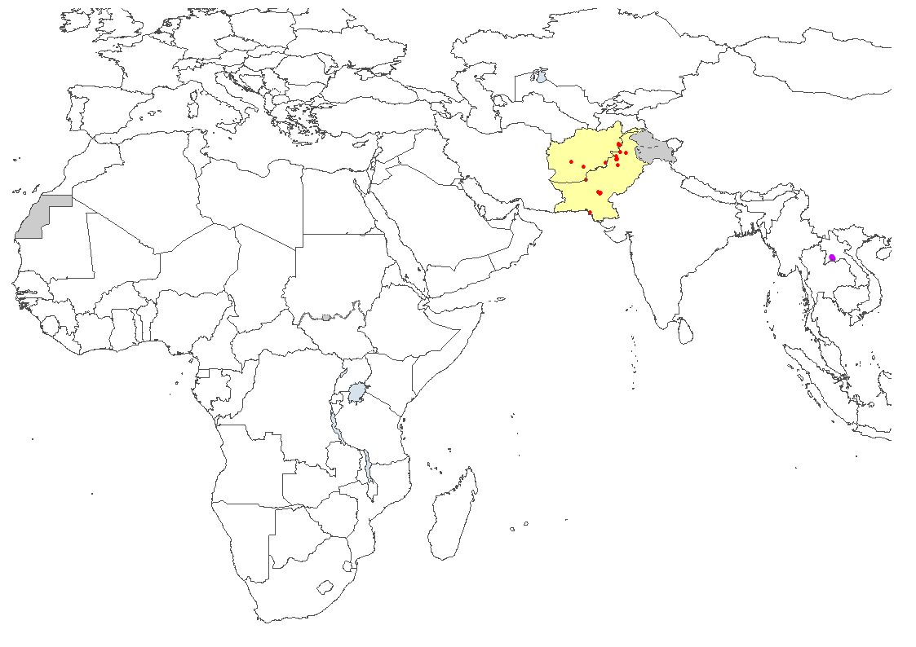
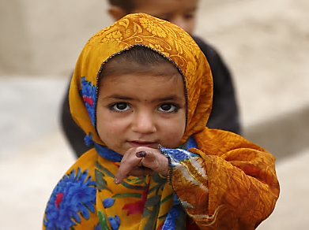
Wild Poliovirus Previous 6 Months
Only Afghanistan and Pakistan have reported cases in 2016
Wild poliovirus type 1
Endemic country
Notes:
As of today, there are 13 cases of polio in Pakistan and 6 cases of polio in Afghanistan. Pakistan is now the single largest threat to polio eradication, but has the plans in place to get back on track and interrupt transmission. This includes a swift and effective response to vaccinate displaced children; strong Emergency Operations Centers; and a robust plan based on lessons learned accessing populations in insecure areas, engaging communities, and adding other health interventions to vaccination campaigns.
Afghanistan continues to have persistent low-level transmission in an unpredictable security environment. The country is taking additional measures to enhance surveillance, including the expansion of environmental surveillance; to vaccinate children in transit and at border crossings with a focus on missed children; and to engage community health workers.
In addition, Pakistan and Afghanistan are collaborating on cross-border activities given the very long and porous border between the two countries.

Slide 7
Recent Achievements

Slide 8
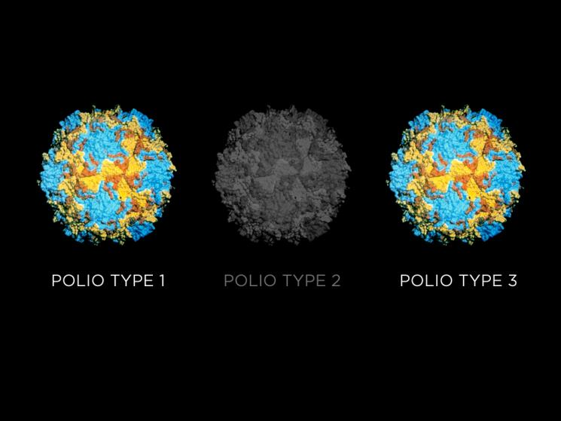
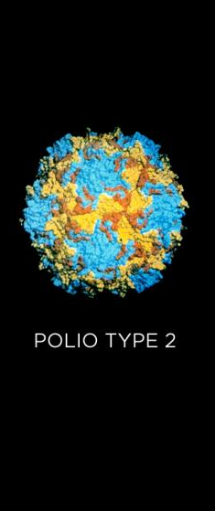
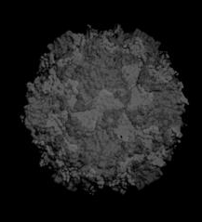
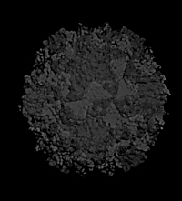


Notes:
There is a lot to celebrate in the progress of polio eradication.
In 1985 three types of poliovirus paralyzed children in over 125 countries, but we’ve greatly reduced those numbers. The first piece of good news is that the type 2 wild poliovirus [click] paralyzed its last victim in India in 1999 and has been certified eradicated. And for the first time in history there has not been type 3 poliovirus [click] anywhere in the world for almost three years. This focuses our efforts on type 1 poliovirus.

Slide 9

Withdrawal of Type Two Oral Polio Vaccine
Switch from tri-valent OPV to bi-valent OPV
Notes:
Over a two week period in April, 155 countries switched from using the trivalent oral polio vaccine which addresses all three types of polio to the bi-valent vaccine that addresses only types 1 and 3 polio because type 2 polio has been certified eradicated.
This was the largest globally synchronized switch of a vaccine in history.
This is also the first step towards withdrawing all oral polio vaccine after the certification of the eradication of all polioviruses.

Slide 10
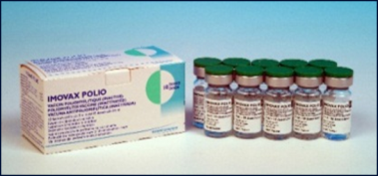
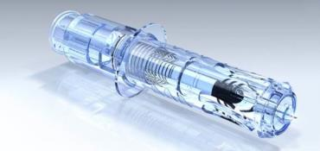

The Introduction of IPV
Inactivated Polio Vaccine (IPV)
will supplement
Oral Polio Vaccine (OPV)
Oral Polio Vaccine
(OPV)
Notes:
In addition, one dose of inactivated polio vaccine-- or IPV – was introduced into routine immunization systems in the most at-risk and populous countries to help boost the immunity of children and increase the efficacy of the oral polio vaccine prior to the switch.
There is also limited use of IPV during national immunization days, along with oral polio vaccine, in key areas.

Slide 11
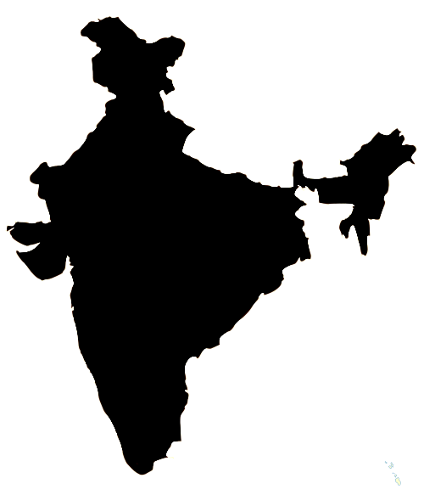

The Broader Benefits of Polio Eradication
The polio eradication program is strengthening routine immunization around the world, particularly in conflict zones and fragile states. For example:
In Bihar, India, polio efforts helped boost routine immunization coverage from 31% in 2004 to over 80% in 2013.
In Somalia, GPEI funds have helped revamp the cold chain system that supports polio and measles immunization.
Notes:
Another achievement has been the documenting what might be called the “plus” in PolioPlus, that is the broader benefits of the Global Polio Eradication to routine immunize systems.
For example, in India….and in Somalia…

Slide 12
Challenges
Notes:
Progress however, is not without it’s challenges…

Slide 13
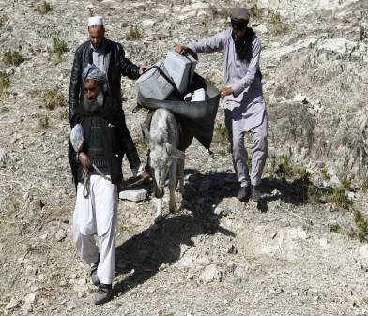
Fragile Progress
Continuing detection of wild and circulating vaccine-derived polio in children and the environment
Persisting pockets of missed children in conflict countries and geographically remote areas
Maintaining political commitment
Securing financial resources
Sustaining progress to-date
Notes:
In fact, progress is fragile as the virus continues to circulate in key reservoir areas. An “all out” effort is underway to reach all children, including those that continue to be missed, and to maintain political commitment and financial support in the face of a waning disease, not only to sustain progress to date, but to finally eradicate polio. Failure to do so will result in up to 200,000 new cases every year within the next 10 years.

Slide 14
What Still Needs to be Done?
Notes:
This is an important question, and one that you may be asked to answer. This was addressed in an article in the July issue of the Rotarian magazine which is included in your materials. Even though only two countries remain endemic, as we say, polio is only a plane ride away, so to protect the gains we have made and finally eradicate this crippling disease, polio immunization activities will need to continue and even intensify.
So what are we talking about?

Slide 15
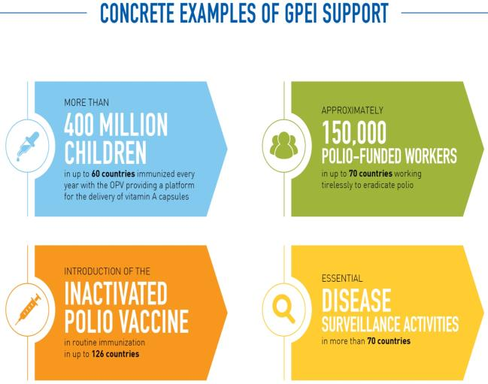
Polio Immunization Campaigns & Surveillance Continues/Intensifies
Notes:
Over the next couple of years, hundreds of millions of children will continue to be immunized against polio to protect the gains we have made in up to 60 countries which requires over 150,000 polio workers all supported by the Global Polio Eradication Initiative.
In the absence of disease, methods to detect the disease are already intensifying by testing samples from people AND expanding activities to detect virus in sewer systems in an increasing number of high risk countries to be absolutely sure there is no poliovirus. If a virus is found in the sewage system, an expert committee of the partnership determines if an immunization response is needed.
And the strategy of introducing one dose of inactivated polio vaccine into routine immunization systems continues in order to boost immunity along with the use of oral polio vaccines during national immunization days.

Slide 16
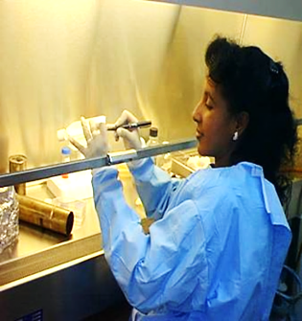
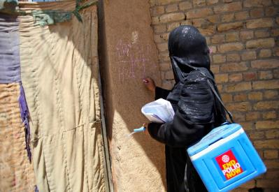
Planning for a Polio-free World
Maintaining and mainstreaming essential polio functions (e.g., immunization, surveillance)
Sharing knowledge and lessons learned from GPEI to improve child health globally
Transitioning polio capacities, infrastructure, and assets to support other public health priorities, where appropriate
Notes:
And finally, indicative of the progress that is being made is the work that must be done to plan for the end of polio. This is called “transition planning” and has three components:
maintaining and mainstreaming essential polio functions such as routine immunization against polio and disease surveillance activities
sharing the knowledge and lessons learned to improve child health globally such as reaching children in conflict and remote areas
transitioning the assets of the Global Polio Eradication Initiative such as the vast network of trained vaccinators and community mapping experts to support other health priorities.
As noted earlier, the polio eradication program has contributed to other health initiatives yet funding for polio will go away. The program must plan for a rational transition of the valuable assets such that they can continue to contribute to improving health where needed most.
Now I’ll turn it over to Mike to discuss the financial requirements moving forward and your roles.

Slide 17
Funding Requirements

Slide 18
Funding Requirements through 2019
Additional Resources:
US$ 1.5 B
Gap:
US$1.24 B
Pledged
US$1.56 B
Pledged &
Projected
US$ 3.1 B
Resources:
US$ 5.5 B
Confirmed
US$4.2 B
Pledged:
US$1.5 B
Requirements
Resources
Notes:
The Polio Eradication and Endgame Strategic Plan 2013-2018 had a budget of US$5.5 billion. A mid-term review carried out in 2015 indicated that more time was needed to complete eradication based on the epidemiology of the disease at that time. It was also determined that an additional US$1.5 billion in funding would be needed to finish the job.
This chart shows the amount of funds needed through 2019 to support the intensified activities required to stop transmission in Pakistan and Afghanistan, while sustaining the gains in polio free countries, especially those in Africa, which remain at highest risk.
As noted by Carol earlier, this includes the continued immunization of up to 400 million children annually; intensified disease surveillance activities in 70 countries; and the introduction of inactivated polio vaccine.
And while significant funding is confirmed and pledged, there remains a gap of US$1.24 billion. Rotary, meaning you here today and others, and our partners, are working diligently with governments– including those of polio affected countries, the general public and the private sector including private philanthropists– to secure the needed funds to finish polio once and for all.

Slide 19
Your Role
Notes:
Rotary’s role in the Global Polio Eradication Initiative is fundraising, advocacy, raising awareness and grassroots participation. All of these topics will be discussed in further details throughout the seminar, so I’ll briefly touch on them this morning.

Slide 20
Fundraise
Notes:
The End Polio Now Zone Coordinators have as their primary responsibility raising funds for Rotary’s PolioPlus program through the End Polio Now: Make History Today campaign.

Slide 21
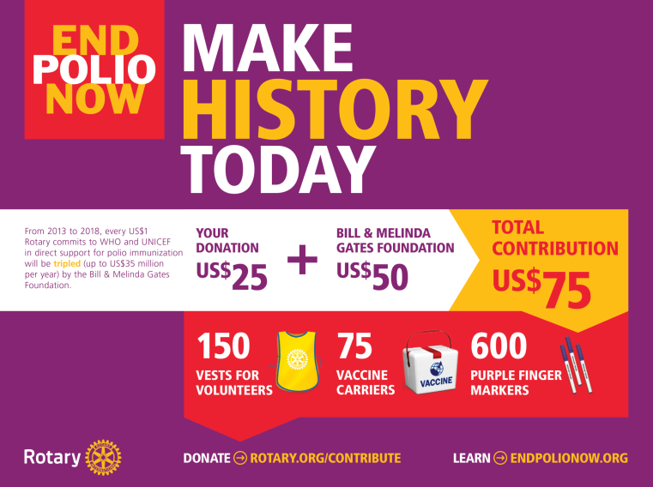
Notes:
Thanks to our continued relationship with the Gates Foundation, every US$1 dollar that Rotary commits to polio eradication (up to US$35 million per year) will be matched by US$2 dollars from the Gates Foundation. This means that each year that Rotary commits US$35 million to polio eradication efforts, the Gates Foundation will contribute US$70 million to PolioPlus. This means contributions to Rotary’s PolioPlus program will have three times the impact.
Rotary’s fundraising, paired with continued advocacy to donor governments will help secure the financial resources necessary for the success of the Polio Eradication and Endgame Strategic Plan.

Slide 22
District goal =
20% of DDF
Goal 2016-17:
US$45 million
Club goal = US$2650
Notes:
Contributions of cash and District Designated Funds will help meet the goals of our fundraising campaign. Contributions to PolioPlus qualify for Paul Harris Fellow and Major Donor recognition.
Districts that annually give 20% or more of their DDF to PolioPlus will receive certificates of appreciation, and districts that give 20% of their DDF, dating back to 2013-14 until polio eradication is certified will be recognized on a plaque at Rotary world headquarters.
And exceptionally this year, clubs contributions of US$2650 or more to PolioPlus is included as one of the activities to receive the Presidential Citation.
We also have a special PolioPlus fundraising goal for the Centennial year of US$45 million that Stephanie will talk about later.

Slide 23
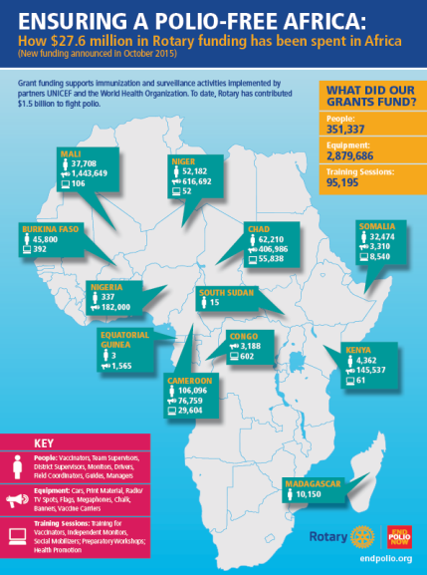
Where the Money Goes
Notes:
I am often asked, and you may receive similar questions, about what Rotary is funding with the money we raise. This info graphic from last October shows the distribution of Polio Plus grants made to WHO and UNICEF. Note that none of the countries are endemic for polio, but are still carrying out polio immunization activities to protect their children from polio as the virus continues to circulate in Pakistan and Afghanistan. Also note that there is no funding for vaccine. Our funding goes to support the activities and people needed to implement polio immunization campaigns including item such as vehicles, cold boxes, megaphones, trained vaccinators, and campaign monitors.

Slide 24
Where the Money Goes
Rotary Polio Grants - Top 10 recipients
US$ millions
 | Recipient | WHO | UNICEF | Other | TOTAL
1 | Nigeria | $ 76 | $ 117 | $ 27 | $ 220
2 | India | 74 | 87 | 15 | 176
3 | WHO-AFRO | 174 |  |  | 174
4 | Pakistan | 61 | 60 | 5 | 126
5 | Afghanistan | 29 | 57 |  | 86
6 | Sudan | 36 | 37 |  | 73
7 | WHO-EMRO | 50 |  |  | 50
8 | DR Congo | 13 | 26 |  | 39
9 | WHO-Core | 33 |  |  | 33
10 | Chad | 19 | 14 |  | 33
Notes:
This chart reflects the top 10 recipients of PolioPlus grants. You can see here that our funds are going to the highest priority endemic and at risk countries and regions.

Slide 25
Advocate
Notes:
Our National Advocacy Advisors and National PolioPlus Committee Chairs, have the responsibility to advocate to governments for funding and political support for polio eradication. We will later explore the connection between fundraising and advocacy.

Slide 26
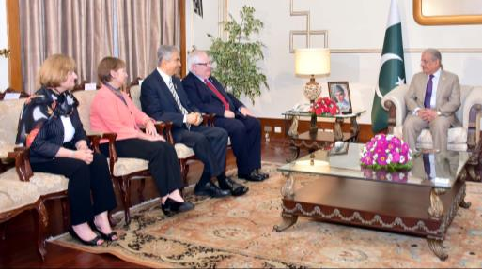
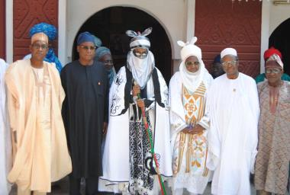
Polio Affected & High Risk Countries
Notes:
Political commitment is essential to achieving a polio-free world. Polio eradication must be a priority in polio-affected and high risk countries, and governments must be held accountable. The countries which have performed the best are those with ownership of their own programs. India and Nigeria provide great, recent examples of such ownership. And Pakistan has significantly increased its commitment and oversight. This is reflected in the fact that Nigeria has not reported a case of polio since July 2014, and a more than 80% decline in polio incidence in Pakistan in 2015.

Slide 27
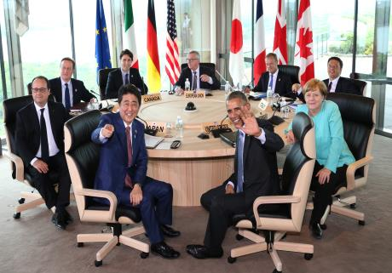
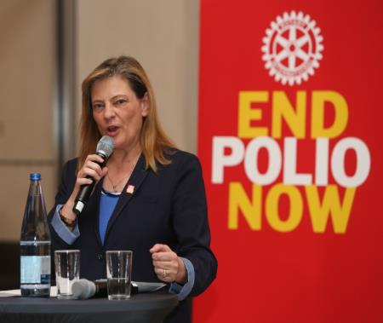
Donor Countries
Notes:
We live in a world where every day brings a new crisis. Maintaining focus on the opportunity to rid the world of one of the most devastating diseases is critical to achieving the goal of a polio-free world.
The outcomes of our joint advocacy efforts with our partners have resulted in strong statements and financial support for polio eradication. For example:
G7 leaders reaffirmed their commitment to reaching polio eradication targets at their most recent meeting.
And Germany for the first time ever made a financial commitment to Pakistan. While Germany has been a long-time supporter of polio eradication efforts, intense advocacy efforts with Members of Parliament and government officials led by our National Advocacy Advisor in Germany resulted in support for Pakistan.

Slide 28
Raise Awareness
Notes:
And finally, raising awareness is the responsibility of everyone. We’re seeing more media coverage, more support and increasing recognition of our efforts in the fight to end polio.

Slide 29
Communications Strategy
Traditional Media (News)
Digital Media
Celebrity Engagement
Special Events
Notes:
We coordinate our messaging across our various channels to give our stories the most impact.
This includes the news media, digital media (including social media and paid online advertising), the engagement of our celebrity ambassadors, coordination
across Rotary-owned media as well, and special events—such as World Polio Day which we will hear about later in the program. It is our collective responsibility to tell our story wherever and whenever possible.

Slide 30
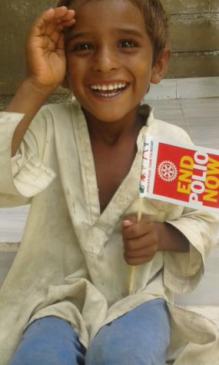
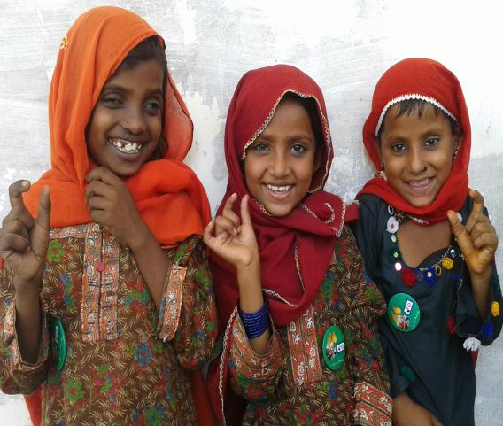
Thank you!
Notes:
Thank you, that concludes our formal presentation. Yes, we are this close to eradicating polio, but there is much more work to be done before we can claim victory. I thank each and everyone of you for what you have done and what you have committed to do in your respective roles. Let’s End Polio Now!
Carol and I, and any other member of the staff will be please to answer any questions you may have.

