Slide 1
Membership!

Slide 2
NUMBERS*!@#
https://www.dropbox.com/s/1lvufj029ri6x7e/rotary.mov?dl=0
Notes:
For Years Rotary International has pushed NUMBERS and of course the District Leaders have responded by pushing numbers to club leaders – I cannot imagine this will change – BUT let’s consider the state of our club first – all the new members in the world will not help if your club is too expensive, or just down right dysfunctional – so let’s first look at your club, begin the fun of improving it and then bring in the new folks – Let’s take a peek at a club and see what we think.

Slide 3
Change?
https://www.dropbox.com/s/1lvufj029ri6x7e/rotary.mov?dl=0
Notes:
So, do you see room for improvement? They certainly enjoy each other and sounds like they are interested in helping with their community – but some times that is not enough – seems like the sergeant at arms was never given a List of Things to Put Out for each Meeting – maybe no one told him exactly what his job entails?
An Agenda might help the president and perhaps time management skills? I am sure you see MANY ideas to change – it is easy – when it is not your club. We think we are too busy to take a few meetings to take a careful look at our clubs and start a plan for change

Slide 4
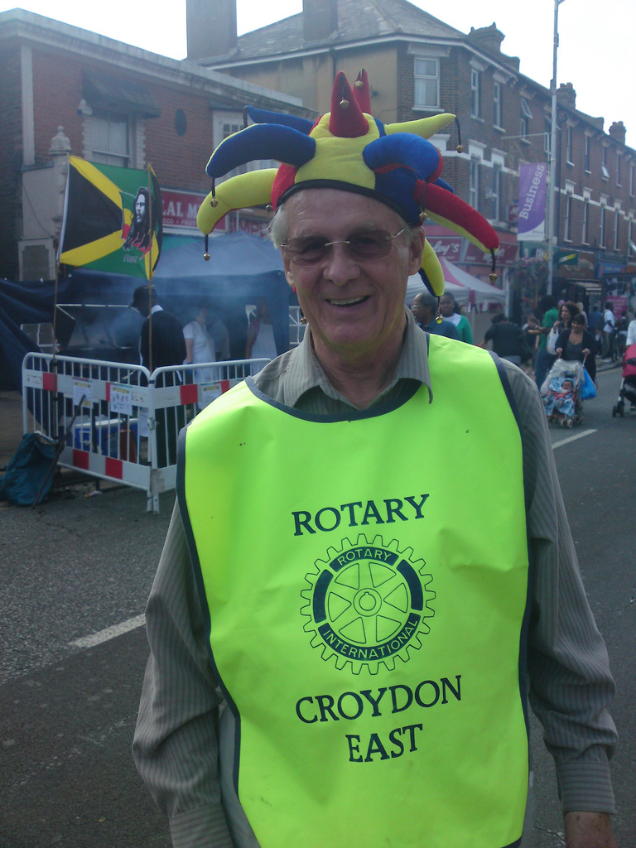
Notes:
Change is usually not easy and for Rotary Clubs. Change Slowly and gets lots of buy in – one way to get buy in is to survey the members. You can take a meeting and do a paper survey or you can use a free survey tool, like survey money to survey online and then use a meeting to talk about the results and choose items that most agree upon.

Slide 5
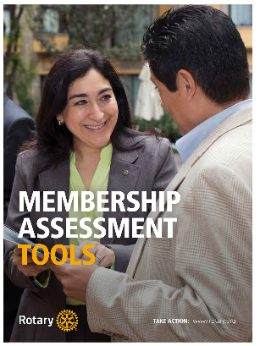
Shop.Rotary.org
Membership Assessment Tools
$3.75
Or download from Rotary.org – Document Center 801 en
Notes:
This book of ideas has several surveys including an exit survey – may be nice to know exactly WHY folks are leaving? They are short and you can modify them to fit your own club

Slide 6
Rotary Rally
Bring a Friend to Rotary
Notes:
Once you have a change plan in place and are beginning to implement the first few items, now is the time to plan for your Rotary Rally or Bring a friend to Rotary.
Choose a date at least 4 weeks in the future and contact an awesome speaker – choose a topic that might benefit business or choose to explain WHY Rotary? Then use the Membership assessment tool to help you identify classifications that your club is missing. There are several great surveys for your club to determine strengths and interests of club members, classifications and an exercise to identify missing classifications.
While classifications no longer hold the critical place their used to – it is still important to have a diverse club to better serve your community and the world.

Slide 7
What Are We Missing?
Insurance Agent
Funeral Director
Veterinarian
Pharmacist
Notes:
Your membership committee should create most of this list ahead of time – use the yellow pages if you blank on more classifications
Then play, WHO KNOWS A
Who knows an insurance agent? Put the Rotarian’s name and the name of the guest on the chart.

Slide 8
What Are We Missing?
Insurance Agent
Sam Claims – Robert Rotarian
Funeral Director
Betty Bereaved - Rosie Rotarian
Veterinarian
Pharmacist
Notes:
Invite these folks to your Rally – you might even create a “business card” invitation to hand as a reminder – follow up the week before to remind prospect of the meeting.

Slide 9
Notes:
Create a Club Brochure if you do not already have one as well as a What’s Rotary with our basic tenants in it – we even include CART
Make special name tags for guest so they realize you expected them and give them the items you have prepared.

Slide 10
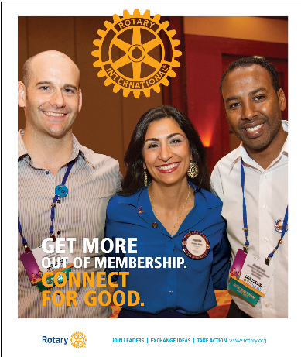
Notes:
Perhaps even print or purchase Connect for Good an informational piece found on Rotary.org – documents or Shop.Rotary.org
You might even collect recent copies of the Rotarian to put on tables and encourage guest to take them.

Slide 11
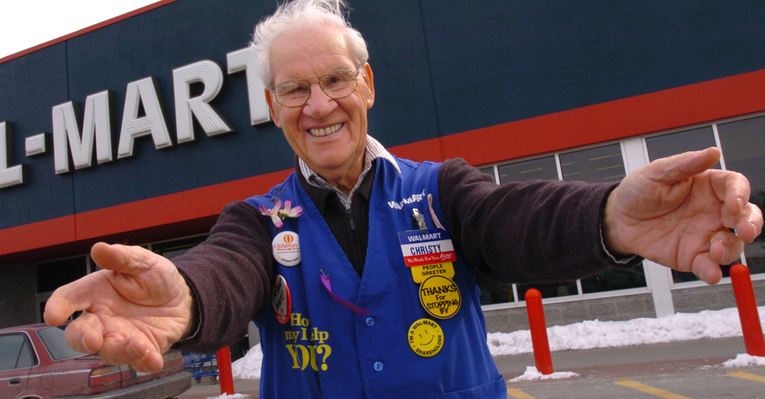
Notes:
Double up on the greeters and ask members to SHoW UP ON time! The guests will be on time – or better yet – go get your guest!
Have a stellar program and Have FUN!.

Slide 12
Thank You
Notes:
Remember to thank your guests for coming – verbally and follow up with a postcard or a card – it is easy to customize these for your club – someone in your club can probably make these for you

Slide 13
Notes:
Personally follow up with each guest – invite them for coffee and answer any questions – THEN MAKE THE ASK!
You might want to try this intentional recruiting program twice a year.

Slide 14
Billi Black
DG15-16@Rotary7670.orh

