Slide 1
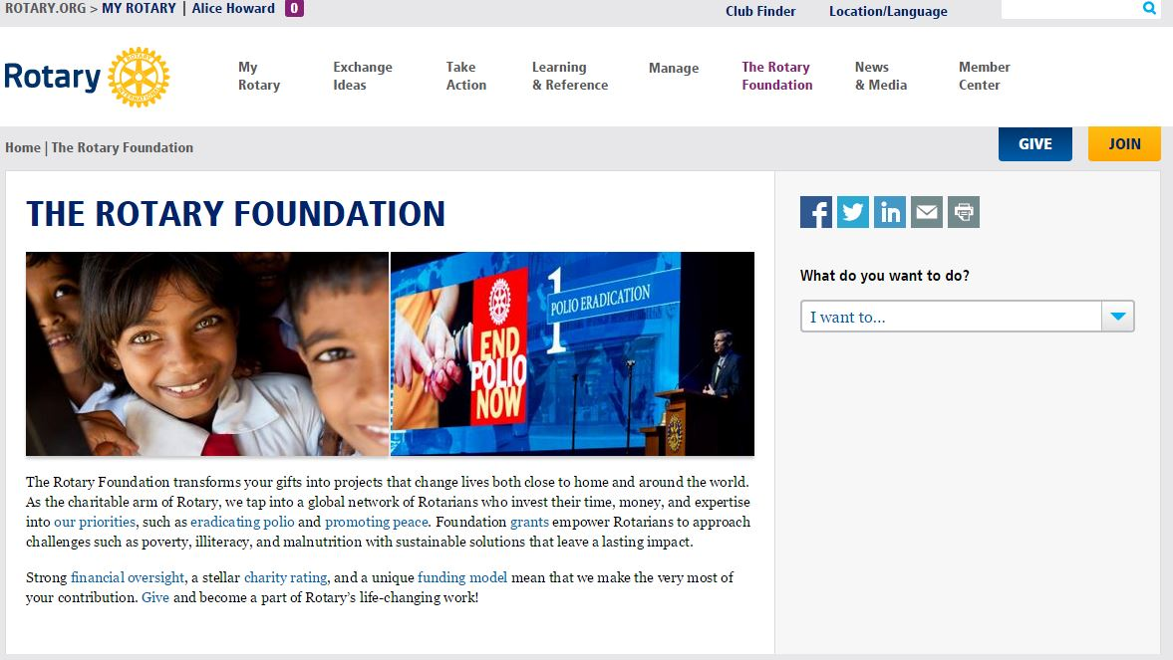
RI Web Site – go to Foundation

Slide 2
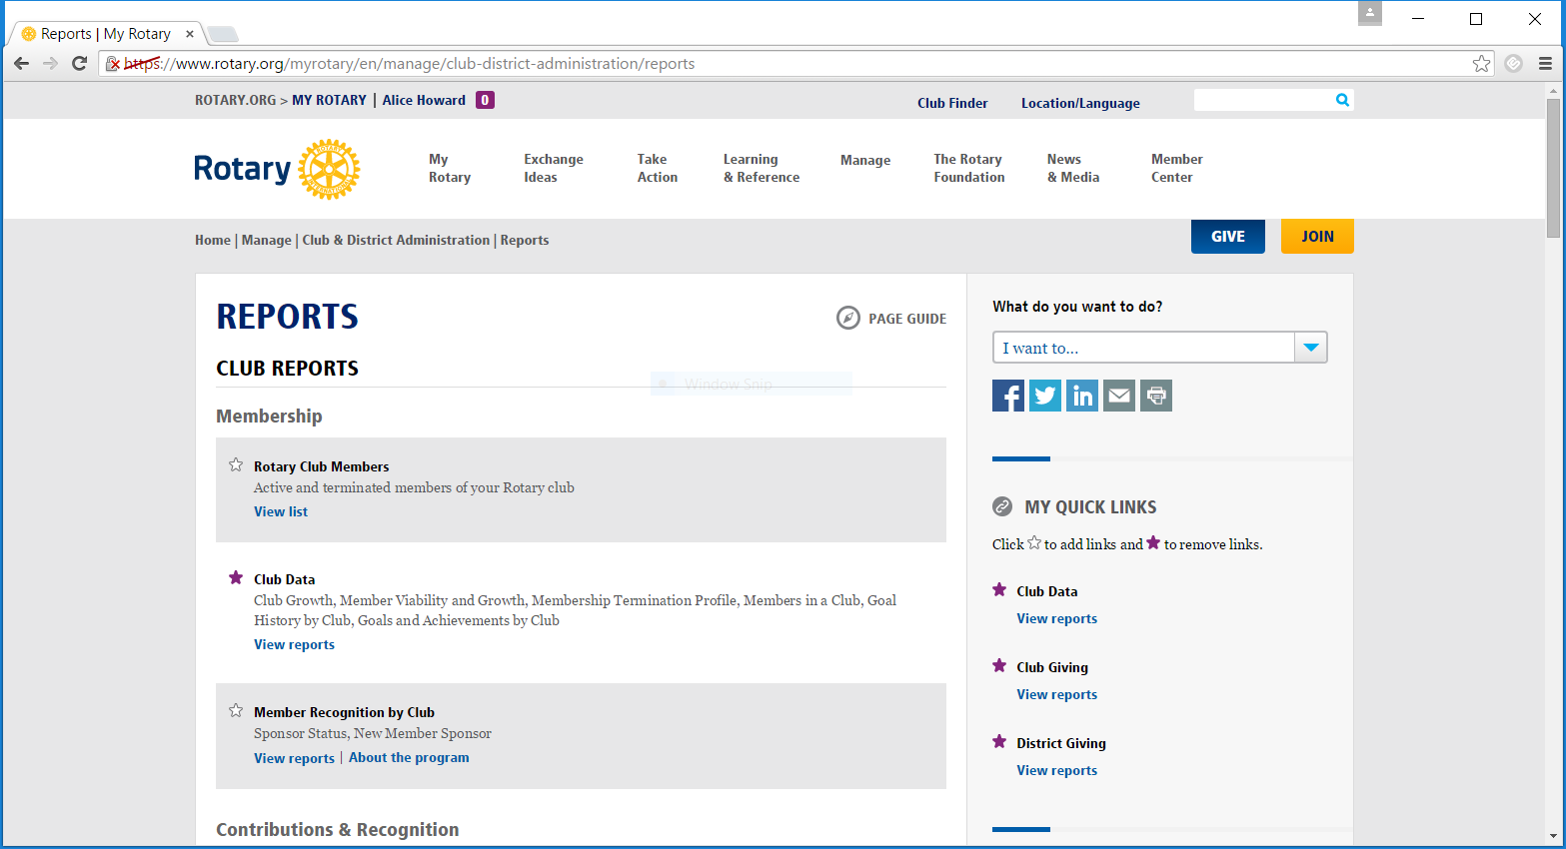
RI Web Site-go to Reports
Notes:
Can set up where you have quick links on the right for your club and District ; I can get you Area clubs’ individual reports, just let me know how often you want until we set up otherwise

Slide 3
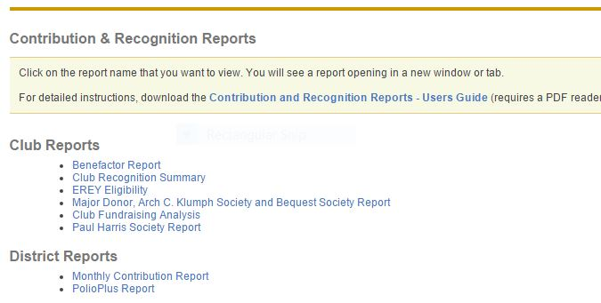
RI Web Site-List of reports for your Club and District Reports
Notes:
Ask AGs what each means do they know?

Slide 4
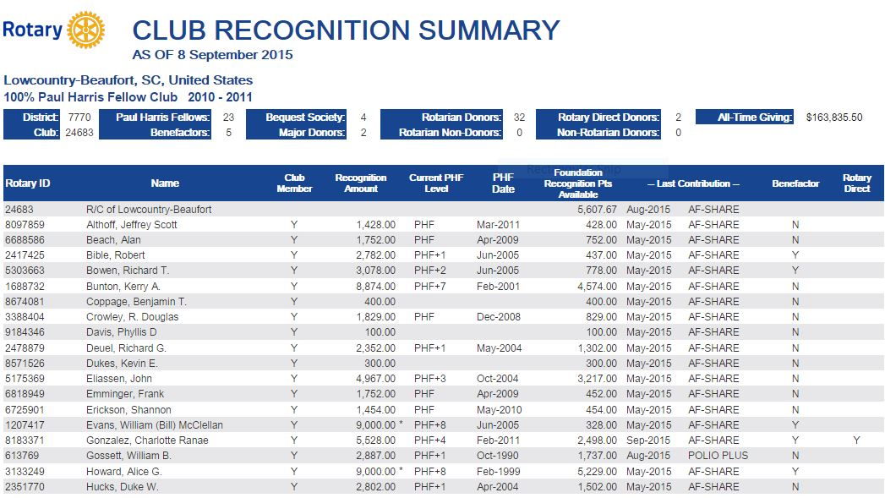
RI Web Site – Club Recognition Summary (CRS)
Notes:
Encourage Foundation chairs to get comfortable with this report-they can call me with questions and I can get report to you

Slide 5
RI Site-Individual Rotary Foundation Contribution Form
Notes:
Adobe fillable form on RI site

Slide 6
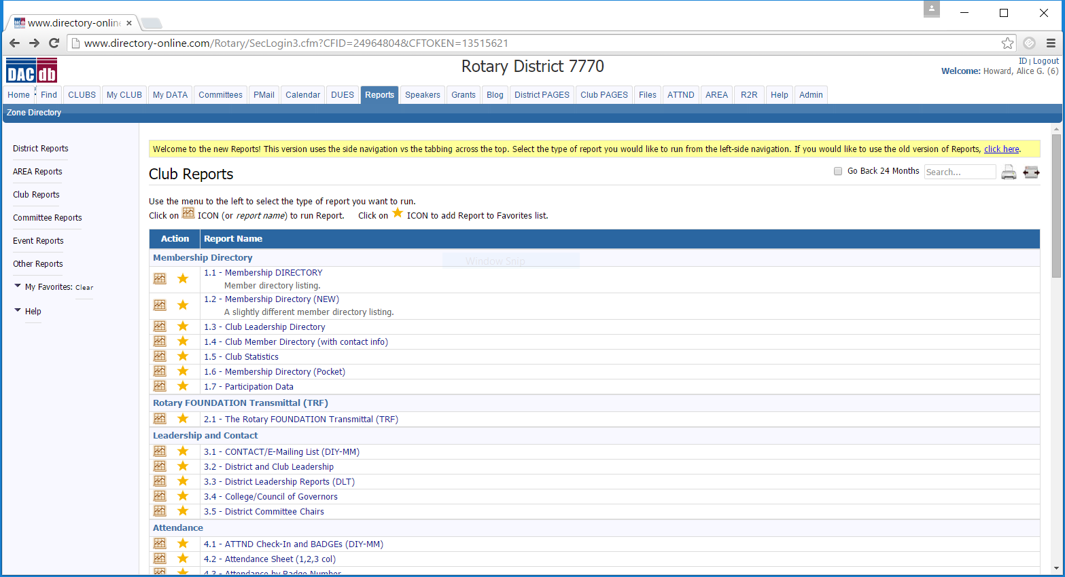
District Data base site- Club Reports-go to Rotary Transmittal Form (TRF) for each club
Notes:
Foundation chairs do this, just have treasurer cut the check

Slide 7
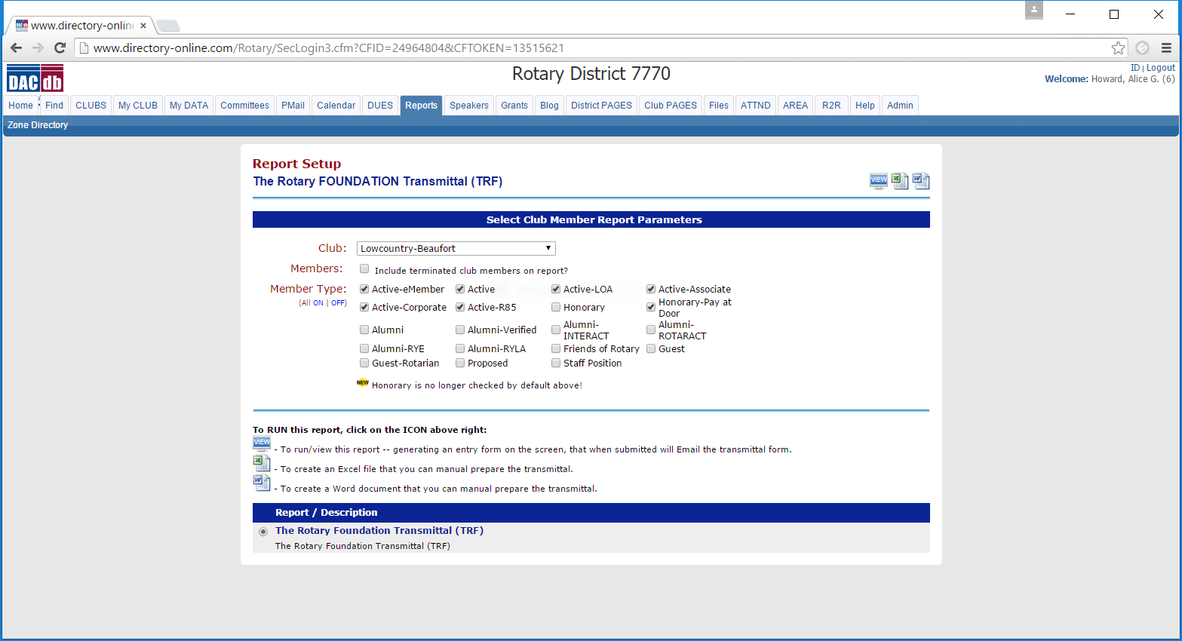
District Data Base-TRF set up
Notes:
Foundation chairs – best if they do for the club and get check from Treasurer; options to do in Word or Excel

Slide 8
Questions? Alice Howard (843) 271-0550 cell (843) 524-0783 home howardag@hargray.com

