Slide 1
ROTARY FOUNDATION
BASICS
Notes:
Welcome Message

Slide 2

Areas Of Focus
Peace and conflict prevention/resolution
Disease prevention and treatment
Water and sanitation
Maternal and child health
Basic education and literacy
Economic and community development
Notes:
The six areas of focus reflect critical humanitarian issues and needs being addressed by Rotarians worldwide.
They align Rotary with other international development efforts and advance the Foundation’s mission. Each of the areas listed has specific goals that are outlined in the corresponding area of focus policy statement.
Peace and conflict prevention/resolution
Disease prevention and treatment
Water and sanitation
Maternal and child health
Basic education and literacy
Economic and community development

Slide 3

Features Of A District Grant
Single block grant awarded annually for club and district projects
Local or international activities
Local decision-making with broader guidelines
Smaller activities and projects
Notes:
District grants are single, annual block grants made to districts in amounts up to 50 percent of their District Designated Fund (DDF).
The district grant can fund multiple club and district projects, which may be local or international.
District grants allow local decision making, with minimal restrictions, for smaller-scale activities and projects.

Slide 4

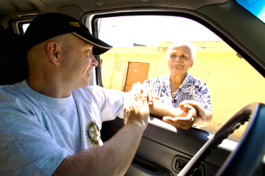
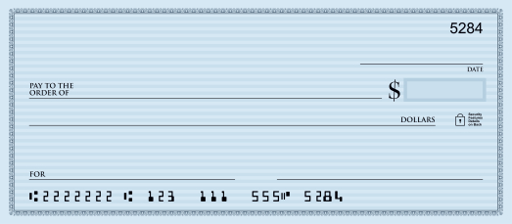
District Grant Activities
Tomorrow
Some Worthy Cause
$$$
A Generous Amount
My Conscience
A. Rotarian
Notes:
Activities funded by district grants must:
Include active Rotarian participation – not just write a check
Adhere to stewardship guidelines
Demonstrate cultural sensitivity
Be consistent with the mission of The Rotary Foundation (but they need not be related to an area of focus)
ASK: What types of projects or activities do you think are possible when using The Rotary Foundation mission as a guide?

Slide 5

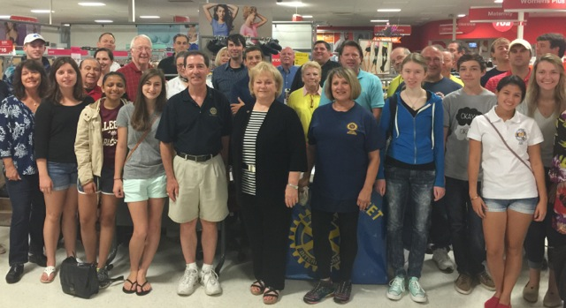
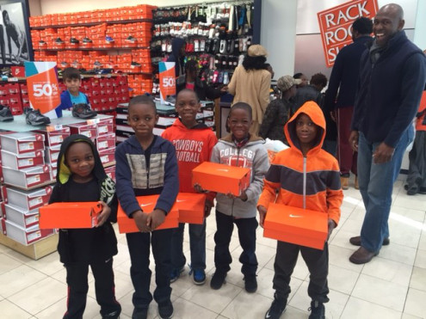
Use Of A District Grant
Notes:
Happy Feet done by 30 of your Clubs with District Grants – 3 pictures

Slide 6

Global Grants
Align with an area of focus
Respond to a community need
Include active community and Rotarian participation
Strengthen knowledge, skills, resources
Have long-term, sustainable benefits
Have measurable results
Have a budget of at least $30,000
Notes:
Global grants fund large-scale projects and activities that:
Align with an area of focus
Respond to a need the benefiting community has identified
Include the active participation of the benefiting community
Include the active participation of Rotarians
Strengthen local knowledge, skills, and resources
Are designed to enable the benefiting community to address its own needs after the Rotary club or district has concluded its work
Have measurable results
The minimum grant award is $15,000 (for a total budget of at least $30,000). The DDF allocation is matched 100 percent, and cash is matched at 50 percent from the World Fund. A global grant project is sponsored by a host club in the project country and a club outside the project country.

Slide 7
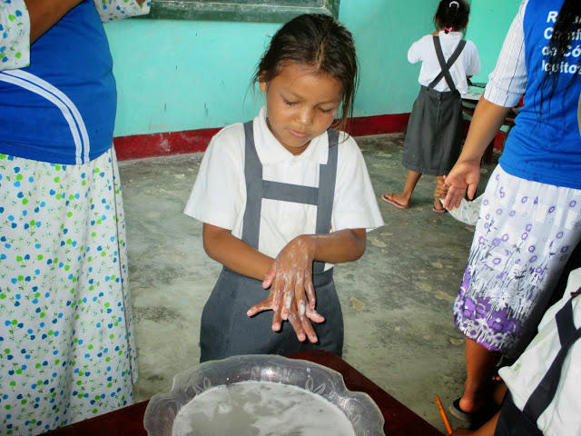
Disease Prevention
Notes:
Disease Prevention – D7770 project in Peru

Slide 8
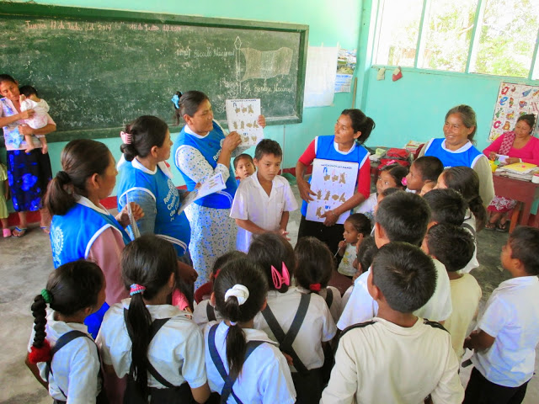
Mothers and Children
District 7770 Project in Peru
Notes:
Mothers and Children – D7770 project in Peru.

Slide 9
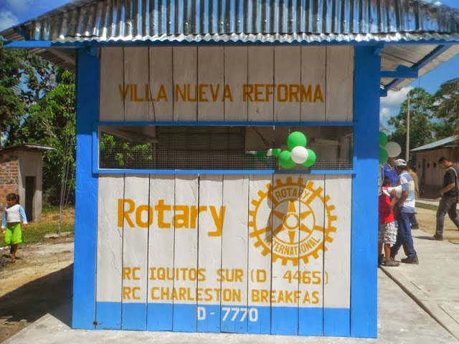
Water Project in Peru
Notes:
Water Project in Peru

Slide 10
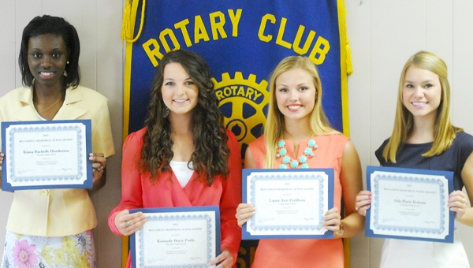
Scholarships
Scholarships funded by Global and District Grants
Notes:
Under the new grant model, Rotary continues promoting peace through education.
Clubs and districts have more flexibility in sponsoring international and local scholars through global grants and district grants.

Slide 11
Global Grant Scholarships
Graduate level
Study periods of 1-4 years
Alignment with the areas of focus
  Previous work, volunteer, and study experience
  Academic program
  Future career plans (immediate and long-range)
Host and international sponsors
Budget: $30,000 minimum, maximum $50,000
Notes:
Global grants can fund scholarships for career-minded professionals for one to four years of graduate-level study in the areas of focus.
The scholars’ previous work, volunteer, and study experience must strongly relate to the selected area of focus; the scholars’ academic program must strongly relate to the selected area of focus; and the scholars’ future career plans, both immediately after the scholarship period and in the long term, must strongly relate to the selected area of focus.
A host sponsor and international sponsor work together to identify the scholar and submit the application.
The minimum budget for global grants is $30,000.
Global grant scholarship applications undergo an intense review process. Not all applications are approved because, often, applications do not align with an area of focus.

Slide 12
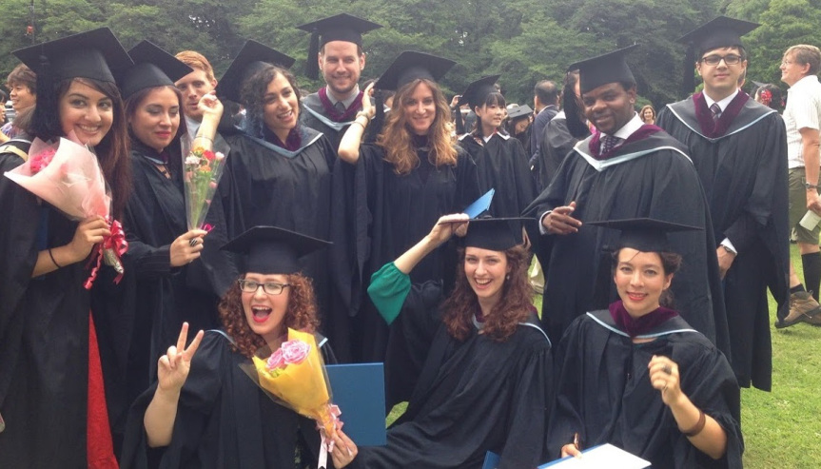
Rotary Peace Centers
Notes:
The Rotary Peace Centers program is Rotary’s premier educational program and a top priority for achieving the Foundation’s mission of world understanding and peace.
Up to 100 Rotary Peace Fellows are selected annually for master’s degree programs in international relations, peace studies, conflict resolution, and related subjects, or for a three-month professional certificate program.

Slide 13
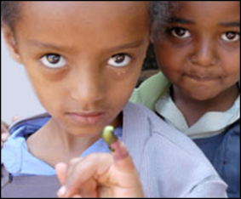
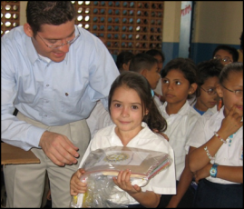
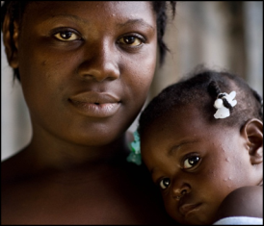
Supporting The Rotary Foundation
PolioPlus Fund
End Polio Now
Annual Fund
For Support Today
Endowment Fund
To Secure Tomorrow
Notes:
Rotarians support our Foundation through:
The PolioPlus Fund, dedicated to global polio eradication
The Annual Fund, primary source of funding for Foundation grants and activities
The Endowment Fund, which supports the Foundation in perpetuity

Slide 14
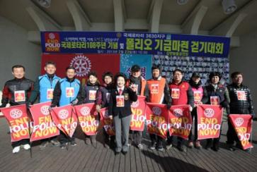

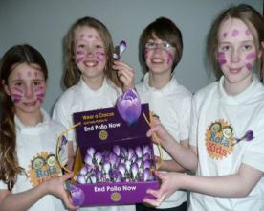
End Polio Now; Make History Today
Notes:
Rotary’s own financial support for PolioPlus will be magnified by an agreement with the Bill & Melinda Gates Foundation.
From 2013 to 2018, every $1 that Rotary commits in direct support of polio immunization (up to $35 million per year) will be matched by an additional $2 from the Gates Foundation. This means contributions to Rotary’s PolioPlus program will have three times the impact.

Slide 15

Annual Fund
Primary funding source for Foundation grants and activities
Supports local and international grants through the SHARE system
Contributions are credited to donor’s club and applied to club’s goal
Notes:
Contributions to the Annual Fund support local and international grants and activities through the SHARE system.
Contributions are credited to the individual donor and the donor’s club and counted toward the club’s and district’s Annual Fund goals.

Slide 16
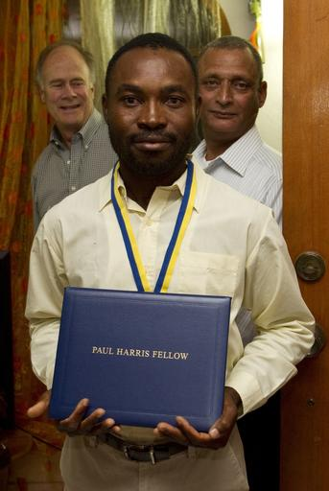

Paul Harris Fellow
A person who contributes $1,000 or in whose
name $1,000 is contributed
Notes:
By making a gift of $1,000, a donor becomes a Paul Harris Fellow or can have another person honored as a Paul Harris Fellow.
Recognition consists of a certificate and lapel pin. Optional Paul Harris Fellow medallions are available for purchase.
Lapel pins are given in recognition of multiple Paul Harris Fellows — those who make contributions of $2,000 to $9,999. Based on their Paul Harris Fellow level, recipients may receive pins with simulated sapphire (blue) or ruby (red) stones.

Slide 17
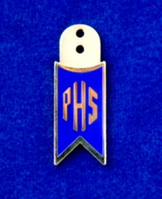
Paul Harris Society Member
Contributes $1,000 each year to the Annual Fund, PolioPlus, or approved grants
Notes:
Named after Rotary’s founder, the Paul Harris Society recognizes those who annually contribute $1,000 or more to the Annual Fund, PolioPlus, or an approved Foundation grant.
The Paul Harris Society was created in 1999 by Past District Governor Wayne Cusick from District 5340. Cusick realized that giving $1,000 annually to the Foundation was not possible for every Rotarian, but many could be encouraged to contribute at this level or above. This idea gained momentum and quickly spread to other districts throughout the world.
Although the Paul Harris Society was originally administered by districts, the Foundation’s Trustees adopted the Society as an official recognition program of The Rotary Foundation in 2013.

Slide 18

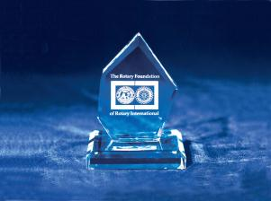
Bequest Society
Provision in estate plan totaling $10,000+
Examples: living will, life insurance policy
Notes:
Couples or individuals who have made commitments in their estate plans that total $10,000 or more are invited to join the Bequest Society.
Donors may elect to receive an engraved crystal recognition piece and a Diamond Circle pin commemorating the commitment at each recognition level:
$10,000 to $24,999.99 — Level 1
$25,000 to $49,999.99 — Level 2
$50,000 to $99,999.99 — Level 3
$100,000 to $249,999.99 — Level 4
$250,000 to $499,999.99 — Level 5
$500,000 to $999,999.99 — Level 6
$1,000,000 and above — Level 7
Rotarians can also complete the Bequest Society membership card at Rotary.org.

Slide 19
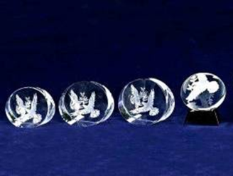
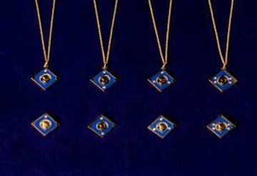
Major Donor
Personal outright or cumulative gifts of
$10,000+
Cash, life income agreements, bequests, real estate, or securities
Notes:
Donors can become Major Donors through outright or cumulative contributions of $10,000 or more to The Rotary Foundation.
They may elect to receive crystal recognition pieces and Major Donor lapel pins or pendants.
Major Donor recognition levels:
Level 1 $10,000 to $24,999.99
Level 2 $25,000 to $49,999.99
Level 3 $50,000 to $99,999.99
Level 4 $100,000 to $249,999.99

Slide 20
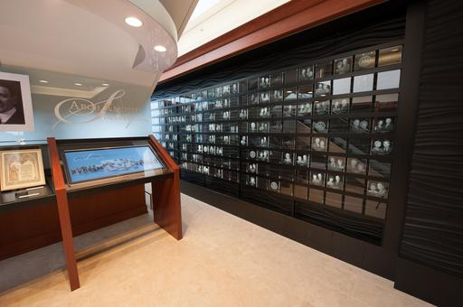
Arch Klumph Society
Trustees Circle $250,000+
Chair’s Circle $500,000+
Foundation Circle $1 million+
Notes:
Donors who contribute $250,000 or more to the Foundation either as a one-time gift or over a number of years become members of the Arch Klumph Society.
Each receives a certificate, a crystal recognition piece, and a lapel pin or pendant. Their portraits are displayed in the interactive Arch Klumph Gallery. A traveling kiosk showing the gallery is displayed at each International Assembly and Rotary International Convention.
Arch Klumph Society recognition levels:
Trustees Circle $250,000 to $499,999.99
Chair’s Circle $500,000 to $999,999.99
Foundation Circle $1 million or more

Slide 21
2016-2017 Rotary Foundation Goals District 7770
Total Giving Goal $1,000,000
Annual Fund Giving Goal $200/Capita
100% EREY Giving Goal 80 (Every Club)
100% Sustaining Member Clubs 80 (Every Club)
New Major Donors 32 (2 per Area)
New Paul Harris Society Members 48 (3 per Area)
New Bequest Society Members 48 (3 per Area)
New Benefactors 160 (10 per Area)
End Polio Now Goal(Club Contributions) $100,000
Notes:
Rotary alumni are individuals who have experienced Rotary through various programs, including these listed on the slide.

Slide 22
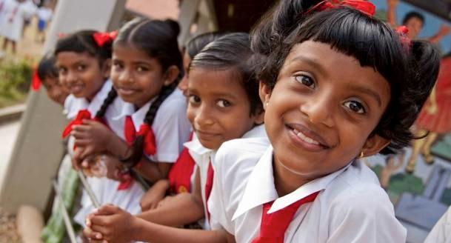
Every Rotarian, Every Year
  100% Member Participation
Notes:
The Every Rotarian, Every Year effort encourages Rotarians to participate in their Foundation by volunteering for service activities and contributing to the Annual Fund each year.
Contributions to the Annual Fund support the Foundation’s grants and programs through the SHARE system. Contributions are credited to the individual donor and the donor’s club, and they are counted toward the club’s and district’s Annual Fund goals.

Slide 23
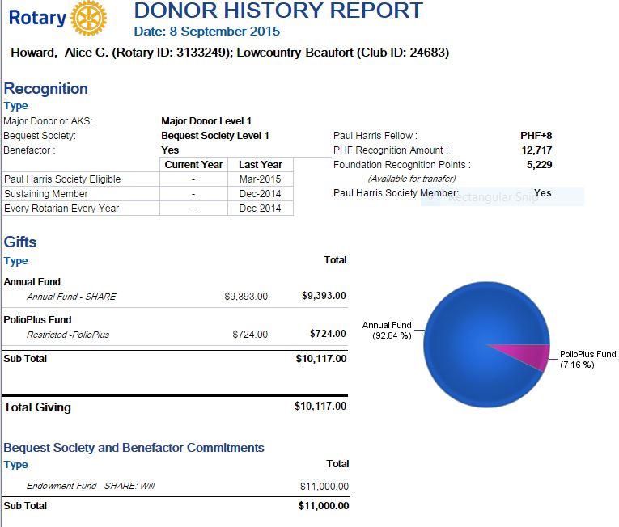
Individual Donor History Report
Encourage members to check their report for accuracy; if there are problems, let you know. Only they can see the dollars donated.
Notes:
Show your members how to access their individual donor history report during November Foundation month so they can track their goals and points.

Slide 24
Club Banner Recognitions
100% Foundation Giving Average of $100 and 100% members
minimum $25 per member
100% Paul Harris Fellow Every active member must be a PHF Club at given point in time
100% EREY Club $100 per capita and minimum $25 per member to Annual Fund
Top Three per Capita in AF Top three clubs in District 7770
100% Paul Harris Society Every member contributes $1000
Notes:
Foundation giving banner requires 100% participation with every active dues paying member contributing some amount to any/all designations including AF, Polio Plus, global grant and Endowment Fund during Rotary year.

Slide 25

Email: Contact.center@rotary.org
District Foundation Chair Lou Mello
LouMello9@gmail.com
Annual Giving Chair Alice Howard
howardag@hargray.com
Notes:
Ask for questions from participants. Review contact information.

