Slide 1
Rotary Foundation Ambassadorial Global Grant Scholarships
District 7770

Slide 2
What is an Ambassadorial Global Grant Scholar?
Funded by District Designated Funds and RI World Fund match – minimal club funding.
Our district funds ONE YEAR OF GRADUATE STUDY outside the United States.
Global grant scholars are individuals who are pursuing a career in one of the Six Areas of Focus.
Candidates’ graduate-level educational goals must support this career interest.
Candidate must not be lineal descendant of active Rotarian (member within last 3 years)

Slide 3
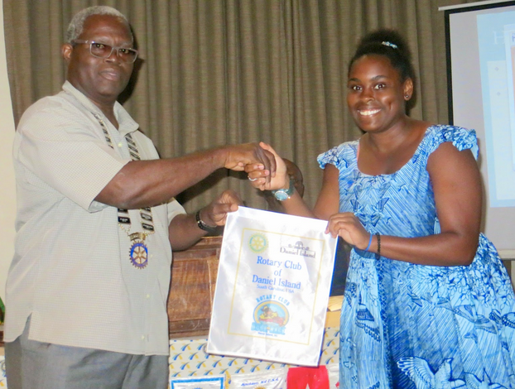
Important Features of the
Global Scholar Program
Areas of Focus
Sustainability
Measurability
Grant Budget
Timeline

Slide 4
Rotary’s Six Areas of Focus
Global grants have Six Areas of Focus, which are based upon the principle ideas of The Rotary Foundation mission statement. Scholar applications must show a strong match with one or more of these:
Peace and conflict prevention/resolution
Disease prevention and treatment
Water and sanitation
Maternal and child health
Basic education and literacy
Economic and community development

Slide 5
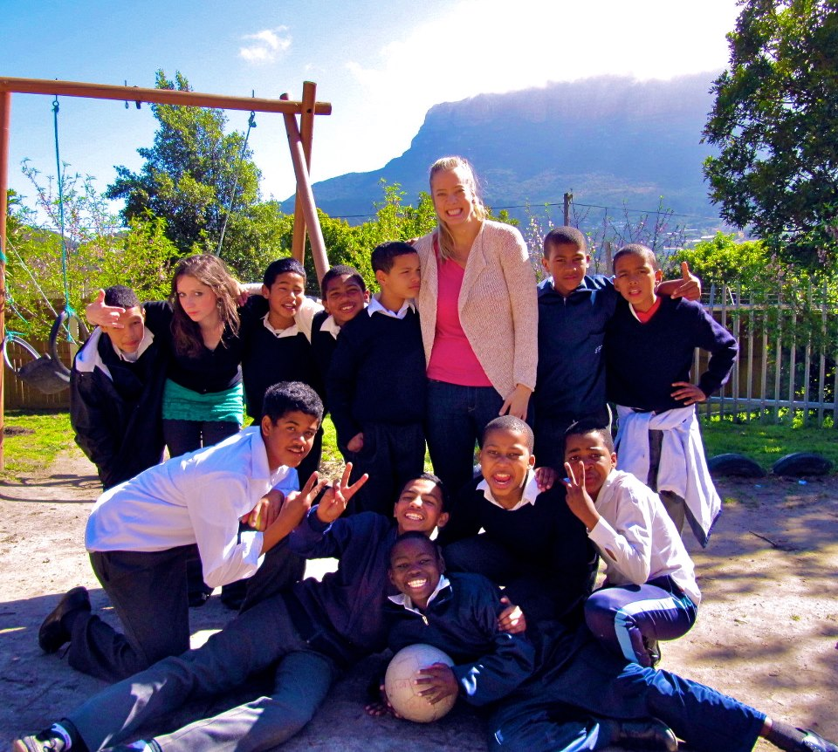
Sustainability and Global Scholars
The Foundation expects that, as a result of receiving a global grant, a scholar will have a sustainable impact to their Area of Focus need through their professional life’s work.

Slide 6
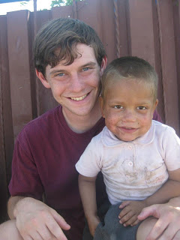
Measurability
The Rotary Foundation relies on scholars to report on the impact of their activities.
Each scholar prepares an interim
District Report 2 months after arrival,
and a Final Report, which includes
expense reports and information on the grant recipient’s time abroad and how the experience will further the scholar’s goals.

Slide 7
Ambassadorial Global Grant Scholarship Budgets
Cost proposal must meet the minimum $30,000 Grant requirement, and the scholarship amount is capped at $50,000.
Includes: Tuition
Room
Board
Books
Local travel
Visa, Inoculations, etc.
Language training if required
A local service project in the country of destination can be included to meet the $30,000 minimum.

Slide 8
Timeline
Fall-1st QTR 2016-Seek eligible applicants and assist them to prepare their applications
April 1, 2017 – Applications/materials should be turned in to sponsor clubs
June 1, 2017– Applications / materials / club endorsement due to District 7770 Global Grant Committee
August, 2017– District interviews / applicant selection
June 2018-District enters online applications with RI
August/September 2018 – Applicants begin study abroad

Slide 9
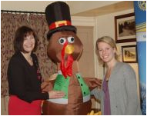
Sponsor Club Involvement
Local Rotary Clubs and Candidates partner for the application
Assist applicants in preparing their application
Submit applications to the
District by June 1, 2017
Invite candidates to your club
Sponsor clubs help candidates to
prepare for their interviews

Slide 10
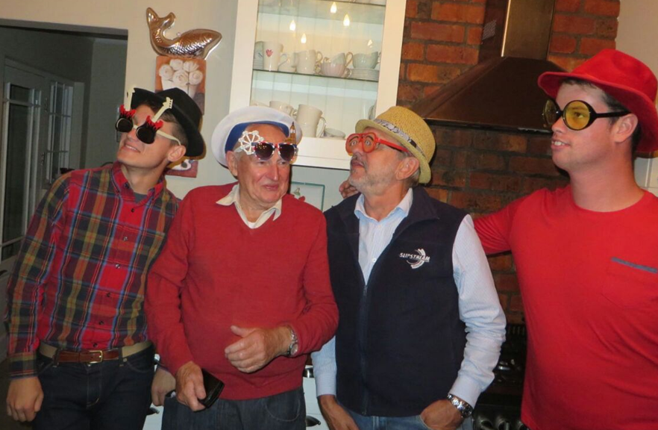
The Scholar’s Year Abroad
Presentations to area Rotary clubs
Get involved in Host Rotary Club service projects, meetings, District Conference
Fulfill scholarly activities, including 2 reports required
Keep a blog and stay in touch with sponsor club
Make new friends!
Tell us about it when
they come home!

Slide 11
Questions?
If you have additional questions
or need more information,
Beth Wingard
bethwngrd@gmail.com
Lou Mello
LouMello9@gmail.com
Ann-Marie Quinn
annmarie.quinn@gmail.com

