Slide 1
ROTARY FOUNDATION AND GRANTS
Notes:
100 Year Anniversary

Slide 2
District Foundation Goals 2017-18
Total Giving Goal: $1,100,000
Annual Fund Giving Goal: $216/Capita
100% EREY Clubs 80 (Every Club)
100% Sustaining Member Clubs: 80 (Every Club)
End Polio Now Goal (Club Contributions) $120,000
Notes:
2017-18 Goals

Slide 3
District Foundation Goals 2017-18
New Major Donors 32 (2 per Area)
New Paul Harris Society Members 48 (3 per Area)
New Bequest Society Members 48 (3 per Area)
New Benefactors 160 (10 per Area)

Slide 4
Club Banner Recognition
100% Paul Harris Fellow Every active member must be a PHF Club at given point in time
100% EREY Club $100 per capita and minimum $25 per member to Annual Fund
Top Three per Capita in AF Top three clubs in District 7770
100% Paul Harris Society Every member contributes $1000

Slide 5
Annual Giving
Alice Howard

Slide 6
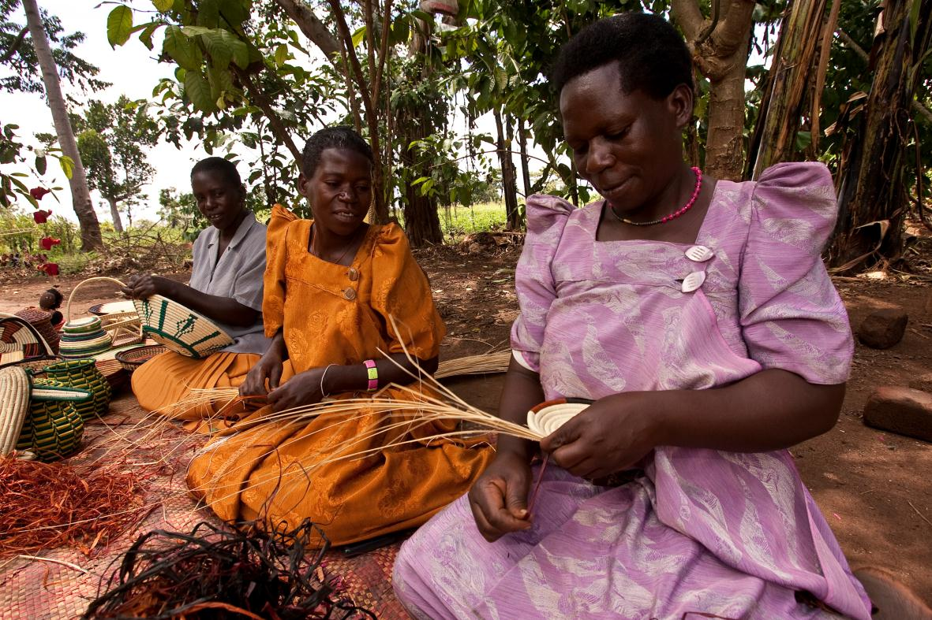
Rotary Grants
District grants
Global grants
District Grants Chair Bob Gross
Global Grants Chair Rick Moore
Notes:
The Rotary Foundation offers grants that support a wide variety of projects, scholarships, and training that Rotarians are doing around the world. There are two types of grants available: district grants and global grants.

Slide 7
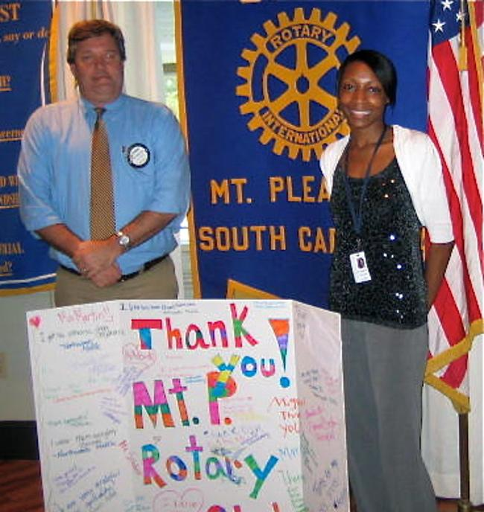
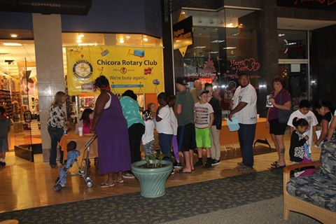
District Grants
Small-scale, short-term
Local or international activities
Aligned with the Foundation’s mission
Single grant awarded annually
District match up to $2600
Notes:
District grants fund small-scale, short-term activities that address needs in your community and communities abroad. Each district chooses which activities it will fund with these grants. You can use district grants to fund a variety of district and club projects and activities.
You have a lot of freedom to customize your service projects. There aren’t many restrictions, as long as your district grant supports the mission of The Rotary Foundation, which is to enable Rotarians to advance world understanding, goodwill, and peace through the improvement of health, the support of education, and the alleviation of poverty. Districts must be qualified before they can administer district grants.
Districts may use up to 50 percent of their District Designated Fund to receive one district grant annually. This percentage is calculated based on the amount of DDF generated from a district’s Annual Fund giving three years prior, including Endowment Fund earnings. You aren’t required to request the full amount available.
Districts receive this funding as a lump sum and then distribute it to their clubs.

Slide 8
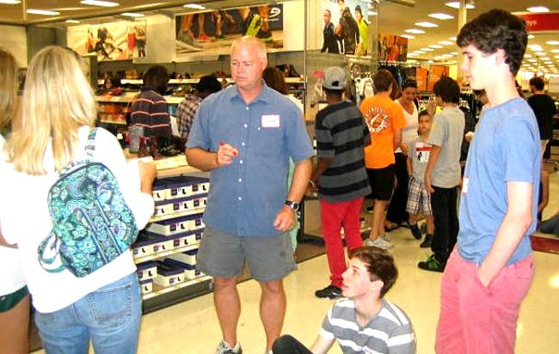
District Grants

Slide 9
Areas of Focus
Peace and conflict prevention/resolution
Disease prevention and treatment
Water and sanitation
Maternal and child health
Basic education and literacy
Economic and community development
Notes:
We have identified specific causes to target to maximize our local and global impact. Through global grants we help clubs focus their service efforts in the following areas:
Peace and conflict prevention/resolution
Disease prevention and treatment
Water and sanitation
Maternal and child health
Basic education and literacy
Economic and community development

Slide 10
District Qualifications
District leaders complete qualification process online annually
Agree to implement MOU
Conduct grant management seminars for clubs
Rotary District 7770 District Grant
CLUB MEMORANDUM OF UNDERSTANDING – ROTARY YEAR 2017 - 18
This document is the official Memorandum of Understanding (MOU) provided by Rotary District 7770 for Clubs participating in the District Grant Program. It is an agreement between the Club and District 7770 explaining what measures the Club will undertake to ensure proper implementation of District Grant activities and management of Rotary Foundation Grants funds. By authorizing this document, the Club agrees that it will comply with all Foundation requirements.
MISSION STATEMENT
District 7770’s Grant Committee exists to assist our 80 Clubs in reaching a full level of active participation within the numerous Local and International Grants offered by the Rotary Foundation.
TERMS AND CONDITIONS
Terms of Qualification
Upon successful completion of the qualification requirements, the Club will receive qualified status for a period of one year.
By entering into this Agreement and receiving Rotary Foundation grant funds, the Club understands and confirms that the Club, as an entity, is responsible for the use of grant funds, regardless of which individual(s) or group controlled the funds.
The Club must cooperate with all District and TRF audits.
District 7770 requires Clubs to provide a 1:1 Match up to the Annual Maximum established by the District Governor and District Foundation Chair prior to each grant cycle.
Club Leadership Responsibilities for Qualification
Club must appoint a member to manage Club qualification and ensure that stewardship measures and proper grant management practices are implemented for all TRF grants.
Club must establish a succession plan for the transfer of grant records to ensure retention of information and documentation.
Two Club Members (preferably including the President-Elect) MUST attend the Grant Management Training Seminar arranged by the District.
Notes:
Districts must become qualified in order to receive grant funding from The Rotary Foundation. The online qualification process helps ensure that your district understands your financial responsibilities, including stewardship, and is prepared to take them on. Qualification must be completed each year.
Becoming qualified is simple. Your district governor, governor-elect, and Rotary Foundation chair should:
Read through the district qualification memorandum of understanding (MOU) on the grants application tool, answer a series of questions, and agree to the MOU
Conduct grant management seminars for clubs

Slide 11
Club Qualifications
Agree to implement the club MOU
Send 2 members (President, Foundation Chair) to grant management session at the Fall Foundation, Membership, Public Image Seminar.
Be an EREY Club, Every Rotarian Every Year by May 15, 2017
Notes:
Clubs that want to apply for global grants must also be qualified. Districts are responsible for qualifying their clubs each year. To become qualified, your president and president-elect must:
Agree to implement the club qualification MOU
Send at least one club member to a grant management seminar held by your district
Complete any additional steps that your district requires
Your club must qualify each year if you plan to apply for global grants.

Slide 12
District Grants
This is a return of 50% of the money that we send to the Foundation
Application
Use WORD format
Section 1(A) Description – BE BRIEF – one short paragraph should suffice. What are you going to do? That’s it.
Section 1(B) Active Rotarian Involvement very important – no check stroking.
Sections 2-3-4 Dates – cannot begin before July 1, 2017; end by April 30 if possible.
Sections 5-6 – Be sure monies match - $2600 maximum district grant; project can be more than $5200 but match is limited to $2600.Club Agreement – be sure to check box ☑
Submit by MAY 15 DEADLINE electronically to Bobgross.rotary7770@gmail.com
Bob will acknowledge receipt of your application. If you don’t get an acknowledgement, he didn’t get it. Call him.
The District Grants Committee will review all applications and Bob will get back to you by mid-May with TENTATIVE approval.
Once the District approves the applications, RI must approve them. We will submit them to RI and we should hear from them by mid-June. Bob will notify you when your application is finally approved. Do not begin your project before receiving THIS approval.
Checks will be distributed at the District Foundation Workshop, normally in September. If you need your check sooner, let us know and we will get you your check.

Slide 13
District Global Grant
Rhetta Guthrie

Slide 14
Global Grants
Large, long-term projects
Sustainable, measurable outcomes
Alignment with areas of focus
International partnership
World Fund match
Minimum $30,000
Club funds matched 50%
District Funds matched 100%
A club contribution of $10,000 = $35,000
Notes:
Global grants support large international activities with sustainable, measurable outcomes in Rotary’s areas of focus. A key feature of global grants is partnership, between the district or club where the activity is carried out and a district or club in another country. Both sponsors must be qualified before they can submit an application.
The minimum budget for a global grant activity is $30,000. The Foundation’s World Fund provides a minimum of $15,000 and maximum of $200,000. Clubs and districts contribute District Designated Funds (DDF) and/or cash contributions that the World Fund matches. DDF is matched at 100% and cash is matched at 50%.

Slide 15
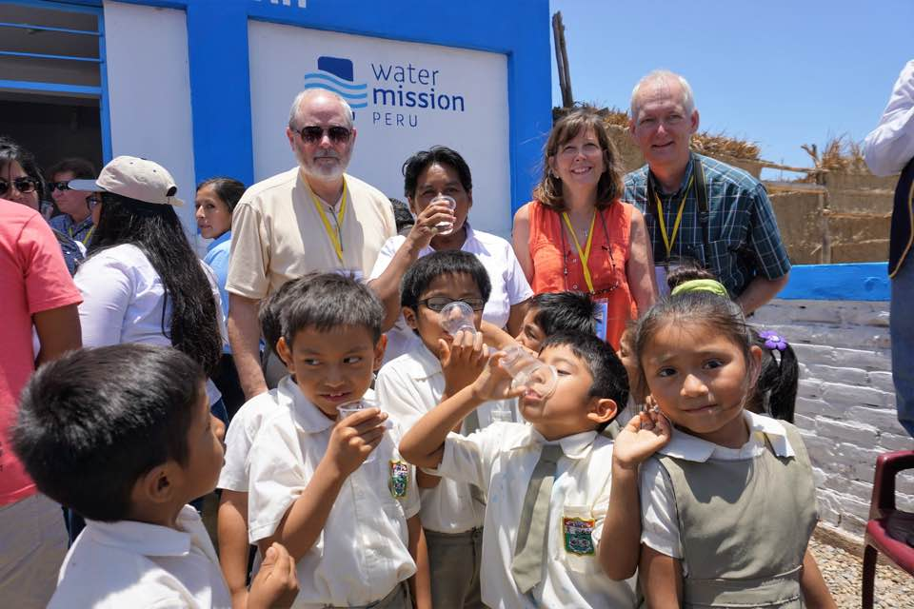
Global Grant Peru
Notes:
Through a Rotary global grant, Rotarians in Bluffton provided a water system through Water Missions to Peru

Slide 16
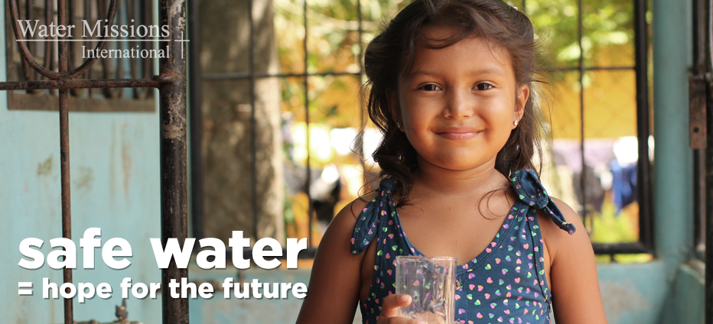
District Global Grant
District 7770 donates over $100,000 for clean drinking water.
Notes:
District Water Grant

Slide 17
Global Ambassadorial Scholarships
Graduate level
Study periods of 1-4 years
Alignment with the areas of focus
Previous work, volunteer, and study experience
Academic program
Future career plans (immediate and long-range)
Host and international sponsors
Budget: $30,000 minimum, maximum $50,000
Notes:
Global grants can fund scholarships for career-minded professionals for one to four years of graduate-level study in the areas of focus.
The scholars’ previous work, volunteer, and study experience must strongly relate to the selected area of focus; the scholars’ academic program must strongly relate to the selected area of focus; and the scholars’ future career plans, both immediately after the scholarship period and in the long term, must strongly relate to the selected area of focus.
A host sponsor and international sponsor work together to identify the scholar and submit the application.
The minimum budget for global grants is $30,000.

Slide 18
Global Ambassadorial Scholarships
Scholars 2017-18
Chelsea Roland
Ellis Flock
Catherine Glen
Scholars 2018-19
Morgan Larimer
Justin Skinner
Trish Elsie
Seek qualified applicants Fall 2016 and 1st Quarter 2017
Sponsor clubs screen and select applicants January - April 2017
Applicants submit application to sponsoring Rotary Club April 1, 2017
Sponsor clubs submit applications to District Scholarship Committee June 1, 2017
Interviews – August 25, 2017

Slide 19
Global Ambassadorial Scholarships
Global Ambassadorial Scholarship Team
Ann-Marie Quinn
Lou Mello
Beth Wingard

Slide 20
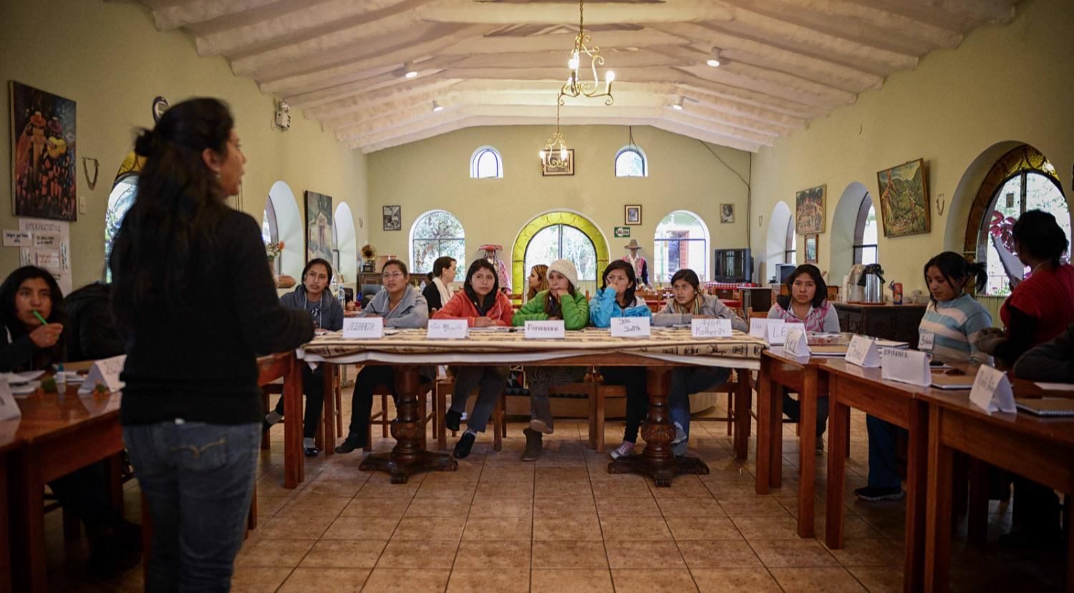
GLOBAL GRANT VOCATIONAL TRAINING TEAM
Aligns with one of the six areas of focus
Measurable impact on communities in need
Training that is essential to ongoing effort
2 Members Rotarian or Non Rotarians with at least 2 years of professional experience in the designated areas of focus
A Rotarian leader with expertise in the area of focus, international experience, and general Rotary knowledge
Notes:
Using Global Grants, you can support vocational training that aligns with one or more of the six areas of focus, have a measurable impact on communities in need, and provide training that is essential to ongoing efforts. The teams must consist of at least two members (either Rotarians or non-Rotarians) with at least two years of professional experience in the designated areas of focus and a Rotarian leader who has expertise in the area of focus, international experience, and general Rotary knowledge. In certain cases, the Foundation may grant permission to designate a non-Rotarian as team leader. There are no restrictions on the age of participants. Global Grant VTTs may also be a component of a larger humanitarian project.
Global Grant VTTs are funded using cash and/or District Designated Fund contributions from the Grant sponsors and are matched by the World Fund, allowing Clubs and Districts greater leverage on their contributions.

Slide 21
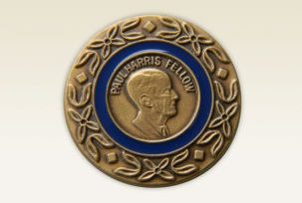
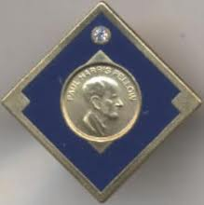
Opportunities to Give
Paul Harris Fellow $1,000
Paul Harris Society $1,000 a yr
Major Donor $10,000 and up
Arch Klumph $250,000

Slide 22
Paul Harris Society
Kathleen Mahoney

Slide 23
Opportunities to Give
Paul Harris Fellow $1,000
Paul Harris Society $1,000 a yr
Major Donor $10,000 and up
Arch Klumph $250,000

Slide 24
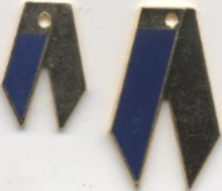
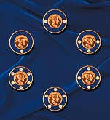
A few more opportunities to give
Benefactor – Pledge $1,000 Bequest Society – Pledge $10,000 & Up

Slide 25
Major Donor Bequest Benefactor
Anne Walker

Slide 26
End Polio Now

Slide 27
End Polio Now
Bernie Riedel
ARRFC

Slide 28
The Rotary Foundation Team 2017-18
DISTRICT FOUNDATION CHAIR – SANDEE BROOKS
DISTRICT GRANTS – BOB GROSS
COMMITTEE MEMBERS
DEBORAH BURT
DAVID TIRARD
RETTA GUTHRIE
GLOBAL GRANTS – RICK MOORE
GRANTS CLOSING REPORTS – PAULINE LEVESQUE
ANNUAL GIVING – ALICE HOWARD
Notes:
Mahoney, Kathleen Gayle
Burkett, Tiffany M.
Moore, Richard C. Jr.
Walker, S. Anne
Brooks, Sandee L.
Howard, Alice G.
Levesque, Pauline B.
Mense, Jeffrey L.
Quinn, Ann-Marie
Sentivan, Jane
Gross, Robert G.

Slide 29
The Rotary Foundation Team 2017-18
MAJOR GIFTS – ANNE WALKER
PAUL HARRIS SOCIETY – KATHLEEN MAHONEY
END POLIO NOW – BERNIE RIEDEL
DISTRICT AMBASSIDORIAL SCHOLAR TEAM
ANN MARIE QUINN – CHAIR
LOU MELLO – CO-CHAIR
BETH WINGARD
DISTRICT ALUMNI CHAIR – JIM DEAS
TRF STEWARDSHIP – JEFF MENSE
PEACE SCHOLAR CHAIR – TIFFANY BURKETT
ASSISTANT REGIONAL FOUNDATION COORDINATOR – BERNIE RIEDEL

Slide 30
Rotary Club Central
www.rotary.org/myrotary

Slide 33
Area Foundation Meetings
TRAINING SESSIONS WITH
ASSISTANT GOVERNORS
PRESIDENTS
FOUNDATION CHAIRS
TRAINING ON THE RI DATABASE
FIRST QUARTER OF THE ROTARY YEAR

Slide 34
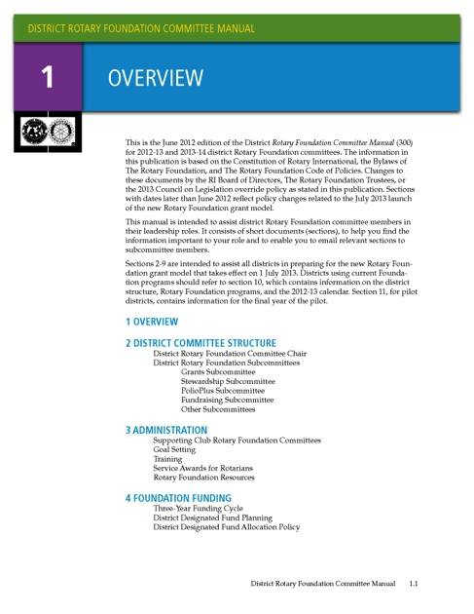
RESOURCES
www.rotary.org/myrotary/grants
Learning center
Training materials
District Database – Files – Foundation Grants MOU and Applications
Notes:
We have a number of resources available to help you take full advantage of grant opportunities.
Rotary’s website has a wealth of general and detailed information about grants.
The learning center offers training resources to help you apply for Foundation grants.
Our training manuals can help you successfully participate in grants, especially:
District Rotary Foundation Committee Manual
District Rotary Foundation Seminar Manual
Grant Management Manual and the accompanying leader’s guide

