Slide 1
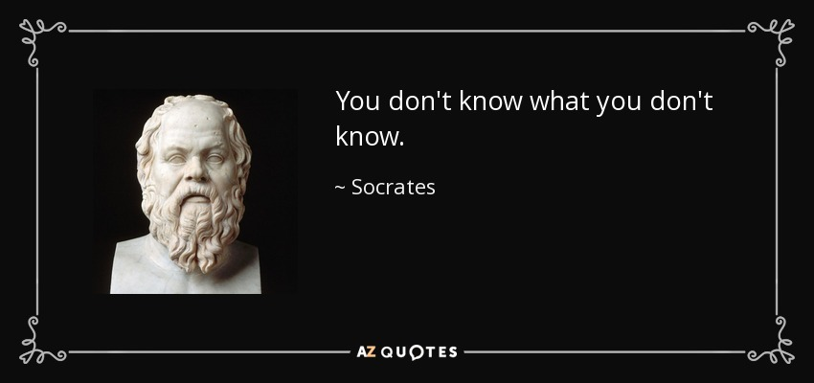
You Don’t Know What You Don’t Know April - June
2024 PETS TRAINING
A. L. Hough-Everage, Assistant Governor, Area 15

Slide 2
2024 – 2025 Rotary International Theme
President-elect Stephanie Urchick says, “Members create that magic with every project completed, every dollar donated, and every new member of Rotary.”

Slide 3
K-W-L Chart
Designed to activate prior knowledge, promote higher-order questioning, and engage learners in metacognition.

Slide 4
History of Rotary
1905 February 23 Rotary started with the vision of one man —
Paul Harris. The Chicago attorney formed the Rotary Club of
Chicago so professionals with diverse backgrounds could
exchange ideas and form meaningful, lifelong friendships.
“Whatever Rotary may mean to us, to the world it will be known by the results it achieves.” Paul Harris, Founder

Slide 5
First Four Rotarians: (L-R) Gustavus Loehr, Silvester Schiele, Hiram E. Shorey, Paul P. Harris.

Slide 6
1907 Chicago – first Rotary public service project
The Rotary Club of Chicago met with civic organizations to discuss the need for comfort stations (public toilets) to improve sanitation in the city.

Slide 7
Guiding Principles:
developed over the years to provide Rotarians with a strong, common purpose and direction
serve as foundation for relationships with each other and action we take in the world

Slide 8
Object of Rotary: Encourage and foster ideal of service as basis of worthy enterprise
FIRST: The development of acquaintance as an opportunity for service;
SECOND: High ethical standards in business and professions; the recognition of the worthiness of all useful occupations; and the dignifying of each Rotarian’s occupation as an opportunity to serve society;

Slide 9
Object of Rotary: Encourage and foster ideal of service as basis of worthy enterprise
THIRD: The application of the ideal of service in each Rotarian’s personal, business, and community life;
FOURTH: The advancement of international understanding, goodwill, and peace through a world fellowship of business and professional persons united in the ideal of service.

Slide 10
The Four-Way Test
Nonpartisan and nonsectarian ethical guide for Rotarians to use for their personal and professional relationships. Translated into more than 100 languages; Rotarians recite it at club meetings: Of the things we think, say or do…
Is it the TRUTH?
Is it FAIR to all concerned?
Will it build GOODWILL and BETTER FRIENDSHIPS?
Will it be BENEFICIAL to all concerned?

Slide 11
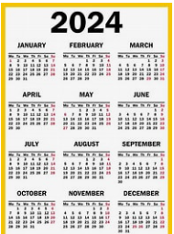
What Can You Do Now?

Slide 12
How to Prepare Before You Take Office
Planning before you take office is crucial to achieving the objectives you set out for your club. As president-elect, you work with your AG and incoming leadership team to set annual goals that support your club’s strategic plan. You should:
Take online courses for club president in the Learning Center
Assess your club’s strengths, weaknesses, opportunities, and risks in order to set goals

Slide 13
How to Prepare
Develop an action plan for your annual goals, which support long-term achievements
Appoint committee chairs
Ensure continuity in leadership and service projects
Attend presidents-elect training seminar
Attend district training assembly

Slide 14
Set Password for YOUR DACdb account
DACdb Usage:
You may only access DACdb and DACdb systems with your own user account and credentials. Sharing of accounts and credentials is not allowed.
District leadership may only use this database to mass contact Rotarians within the DISTRICT for Rotary-related purposes.
Club leadership may only use this database to mass contact Rotarians within their CLUB for Rotary-related purposes.

Slide 15
Create YOUR MyRotary Account
Go to my.rotary.org | Select Register | Create an Account |
Click Continue
2. Activate Your Account | Add Password & security question |
Click Continue | If email address matches existing record, no
further steps.
Verify Member Status (only required if you email address
doesn't match one in our records)

Slide 16
Set Long Term Goals
Club Leadership Citation Form
Read it, use it to plan and set goals, and review it often!
Avenues of Service
Membership
Rotary Foundation
Leadership Development
Public Image

Slide 17
Document Accomplishment of Long Term Goals – Rotary Club of Year

Slide 18
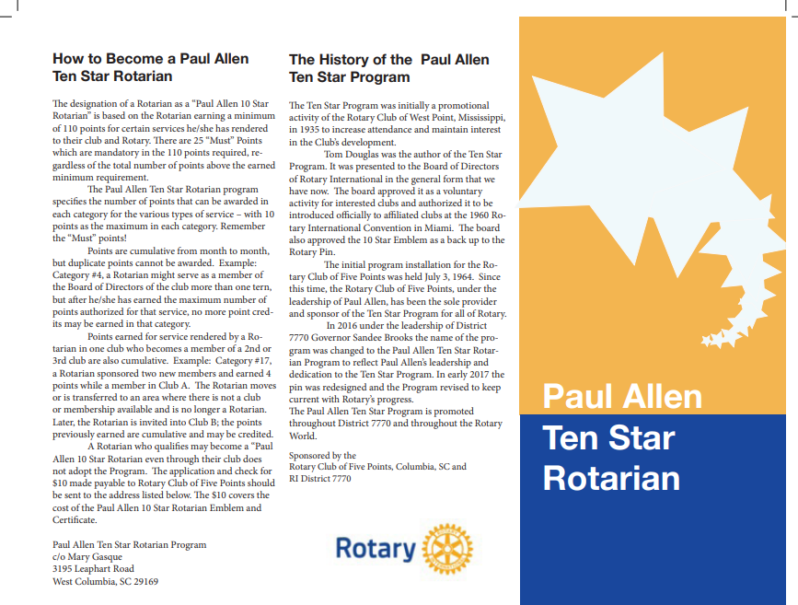
Club Rotarians Can Become Stars

Slide 19
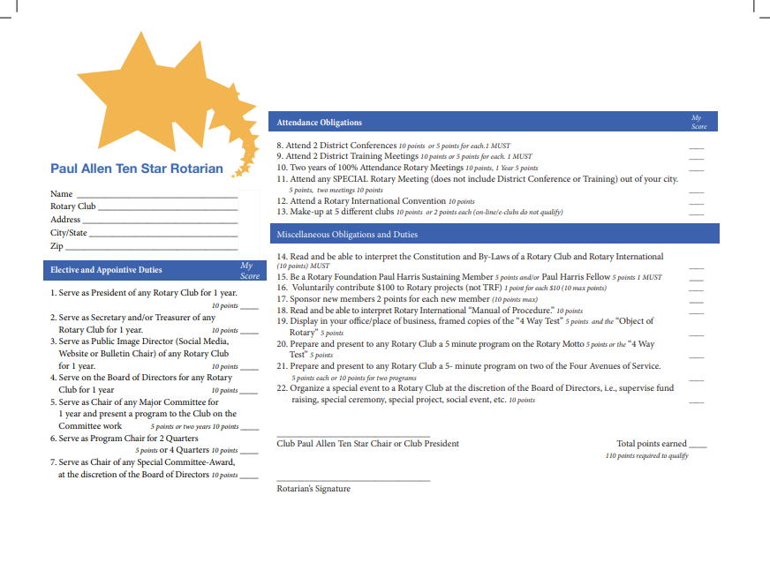
Paul Allen Ten Star Rotarian Application

Slide 20
Stories in Rotary’s History
Polio project in Phillipines jump starts End Polio Now
Gender-based qualification to join Rotary
U. S. Supreme Court rules in Rotary case
Women become charter members of a Rotary Club
First female Rotary Club president elected
Council on Legislation eliminates gender-based qualification
First woman serves as Rotary International Vice-President
First woman president of Rotary lnternational elected

Slide 21
Polio Eradication – Rotary’s Top Priority
1979 - Rotary began the fight against polio with a project to immunize 6 million children in the Philippines.
The effort’s success led to Rotary making polio eradication its top priority.
*Today, polio remains endemic in only two countries — down from 125 in 1988.

Slide 22
Gender-Based Qualification
1983 – 1986 In a lawsuit filed by the Duarte club, the California
Superior Court in 1983 ruled in favor of Rotary
International, upholding gender-based
qualification for membership in California
Rotary clubs.

Slide 23
Gender-Based Qualification
1986: Reversed the lower court's decision, preventing the
enforcement of the provision in California.
The California Supreme Court refused to hear the case, and it was appealed to the U.S. Supreme Court.

Slide 24
U. S. Supreme Court ruling
1987: On 4 May, the U.S. Supreme Court ruled that Rotary clubs may not exclude women from membership on the basis of gender. Rotary issued a policy statement that any Rotary club in the United States could admit qualified women into membership.
1987: On 28 May, the Rotary Club of Marin Sunrise, California (formerly Larkspur Landing), was chartered. It became the first club after the U.S. Supreme Court ruling to have women as charter members.

Slide 25
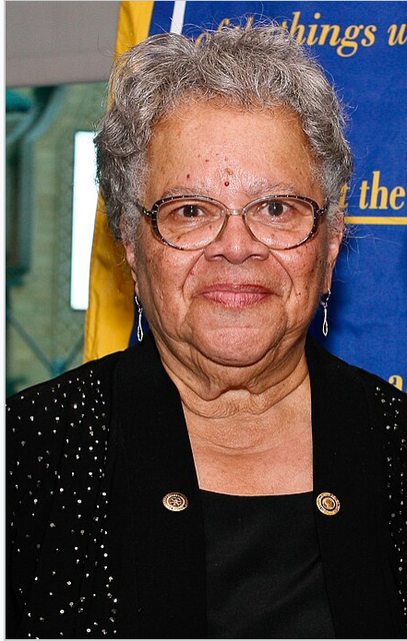
First Female Rotary Club President – Rotary Club of Duarte, California - 1987
Dr. Sylvia Whitlock (D5300)
became a district governor
in 2012-2013.

Slide 26
Elimination of Requirement to Limit Membership to Men
1989: At its first meeting after the 1987 U.S. Supreme Court
decision, the Council on Legislation votes to eliminate the
requirement in the RI Constitution that membership in
Rotary clubs be limited to men. Women are welcomed into
Rotary clubs around the world.

Slide 27
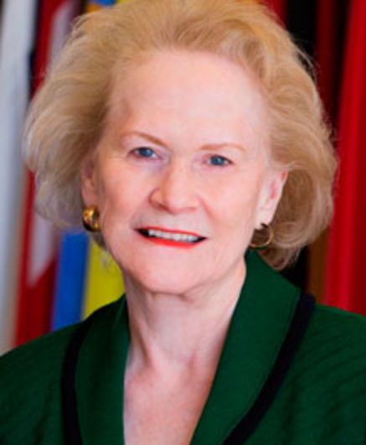
First Woman to Serve as RI Vice President
2013: Dr. Anne L. Matthews (D7770) began her term

Slide 28
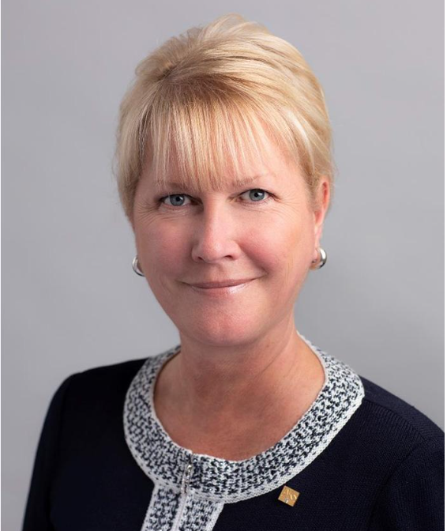
First Female President of RI – Rotary Club of Windsor-Roseland, Ontario, Canada
2022: Jennifer Jones, Doctor of Laws (LL.D.), (D7475)

Slide 29
We are People of Action
1.4 million: Neighbors, friends, and leaders volunteer
skills and resources to solve issues and address community needs.
47 million: Approximately 47 million volunteer hours each year
$333 million: Awarded for global service initiatives in 2020-21
Sustainable projects

Slide 30
April 2024: Maternal and Child Health Month
2025-2026 Rotary Peace Fellowship applications due between February and 15 May; selectees will be notified in November

Slide 31
Global Grant Project for 2024 – due NLT May 15, 2024
Global grants can fund:
Humanitarian projects
Scholarships for graduate-level academic studies
Vocational training teams - groups of professionals who travel abroad either to teach local professionals about their field or to learn more about it themselves

Slide 32
District Grant Project for 2024 – due NLT May 15, 2024 – available for local service projects

Slide 33
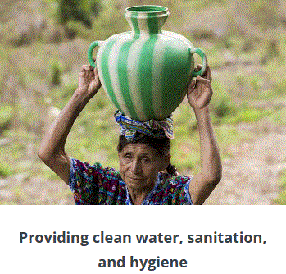
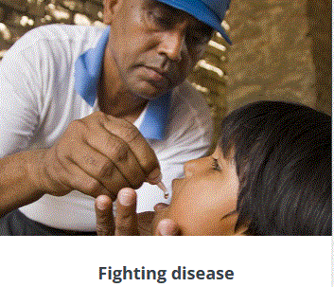
Our Causes: Rotary is dedicated to causes that build international relationships, improve lives, and create a better world to support our peace efforts and end polio forever. Seven Areas of Focus

Slide 34
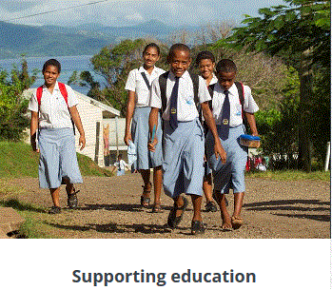
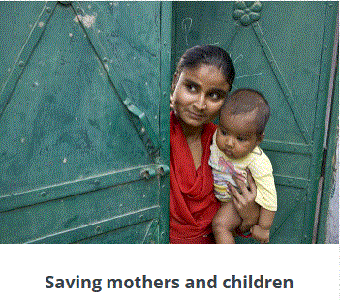
Rotary International Areas of Focus

Slide 35
Requirement: Verify that Club is in Good Standing
Reach EREY and 100% sustaining member status: Every Rotarian contributes at least $25 to Annual Fund yearly with $100 per capita during Rotary year = 100% Club banner
Club will reach membership goals
Rotary District 7770 semi-annual dues

Slide 36
Foundation Annual Programs Fund: Includes SHARE, the World Fund, and our areas of focus funds.

Slide 37
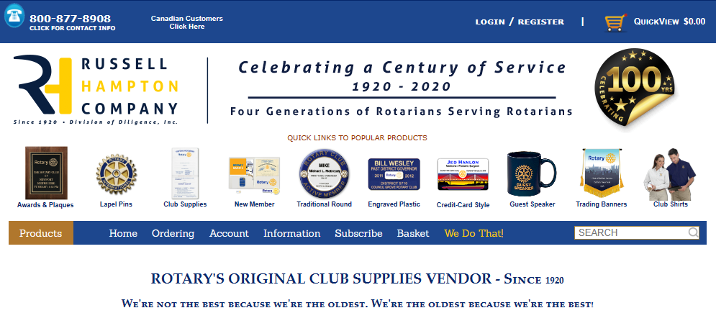
May 2024: Youth Service Month
Plan end-of-year social and installation event
Order club awards or pins

Slide 38
May 15 Due Date
Reach EREY status to be eligible for 2024-25 District and Global Grants.
District Grant project applications for 2024-25 due to the District Grants Committee
Be current on RI and District dues to be eligible for 2024-25 District and Global Grants.

Slide 39
May 2024: Youth Service Month
Presidents-Elect Attend PETS and District Assembly to hold office of Club President
Submit Leadership Citation to AG by 5/15/25
Submit Public Image Citation to District PI Chair by 5/15/25
Submit final Foundation Annual Programs Fund to Foundation by 5/15/24
Attend the Rotary International Convention in Singapore on May 24-29, 2024

Slide 40
June 1 Due Date
• Applications for Global Ambassadorial Scholarships are due to the district
• District submits final 2023-24 District Grant reports to the Rotary Foundation
• District submits District Block Grant 2024-25 application to the Rotary Foundation

Slide 41
June 2024: Rotary Fellowship Month
• Hold joint meeting with current & new officers & board to assure a smooth transition
• Presidential Citation for 2023-24 due 6/30/24, in Rotary Club Central
• Assist the President-Elect plan Club Assembly prior to PE taking office on July 1, 2024.

Slide 42
June 2024: Rotary Fellowship Month
• District Governor Installation 6/29/24, in Columbia.
• Child Protection Policy due to AG by June 30, 2024.
• 2024-25 club goals due Rotary Club Central no later than 7/1/24.
• Semi-Annual Rotary International Dues NLT 7/1/24

Slide 43
US Volunteer Rate 2021 by Age, 2/23/24 Volunteering in America: New U.S. Census Bureau, AmeriCorps Research
National Demographics
While formal volunteering rates dropped from 2019 to 2021 in every demographic group, informal helping rates largely remained steady.
Trends in formal volunteering 2019-2021:
The rate drop was substantially larger for women (8 percentage points) than men (5 percentage points) but women continued to volunteer at a higher rate.

Slide 44
US Volunteer Rate 2021 by Age, 2/23/24 Volunteering in America: New U.S. Census Bureau, AmeriCorps Research
Generation X (ages 41 to 56 in 2021) had the highest rate of all generations.
People ages 16-17 had the highest rate of all age groups at 28%, followed by people ages 45 to 54 at 27%.
Parents with children under 18 formally volunteered at a higher rate (30%) than those without children in their household (21%).

Slide 45
US Volunteer Rate 2021 by Age, 2/23/24 Volunteering in America: New U.S. Census Bureau, AmeriCorps Research
Many helped informally:
Baby boomers, born 1946 – 1964, had the highest rate (59%) of all generations
Veterans helped their neighbors at a rate of 59%, 8 percentage points higher than nonveterans.
People with children under age 18 helped at a higher rate (58%) than those without children in their household (49%).

Slide 46
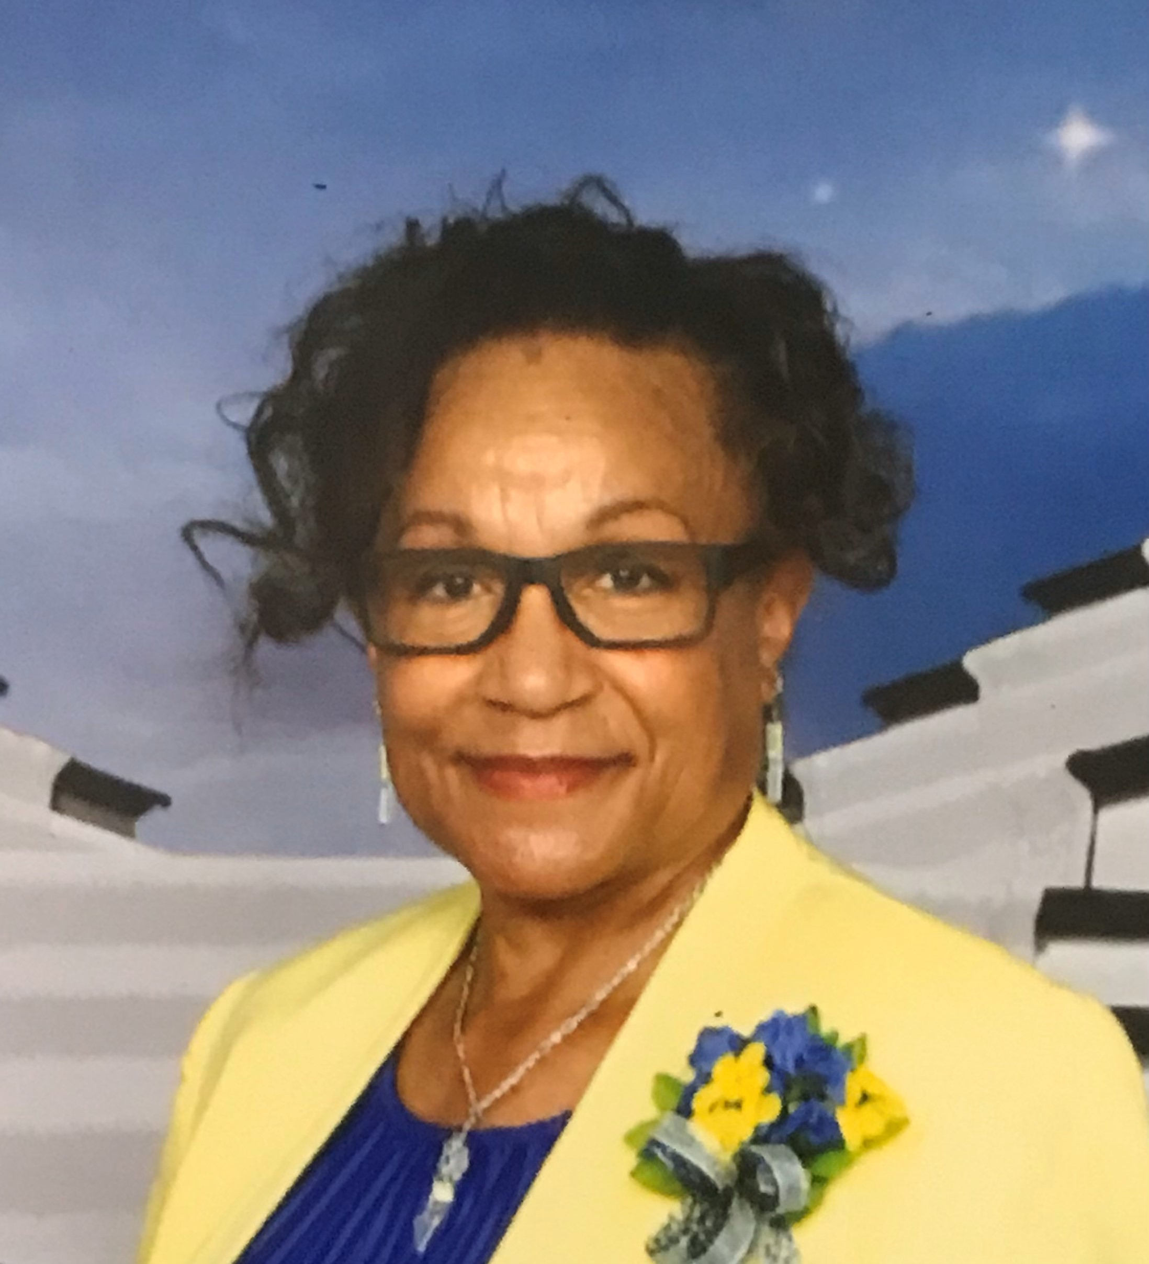
Thank you!
Dr. Hough-Everage
aka Hough (Huff)
Rotary Club of Cheraw
doc.ed.alh@gmail.com

