Slide 1
Rotarians Against Human Trafficking
RAHT
Human trafficking involves the recruitment, transportation, transfer, harboring of persons through force, coercion or fraud for the purpose of exploitation.

Slide 2
VISION
To establish the framework for a sustainable District-wide program training Rotarians to recognize human trafficking in their community. Working in compliance with state guidelines, Rotarians will be empowered to take the first step in preventing Human Trafficking, and challenged to promote awareness of Human Trafficking

Slide 3
Train a facilitator
Assign an Ambassador
Present a training

Slide 4
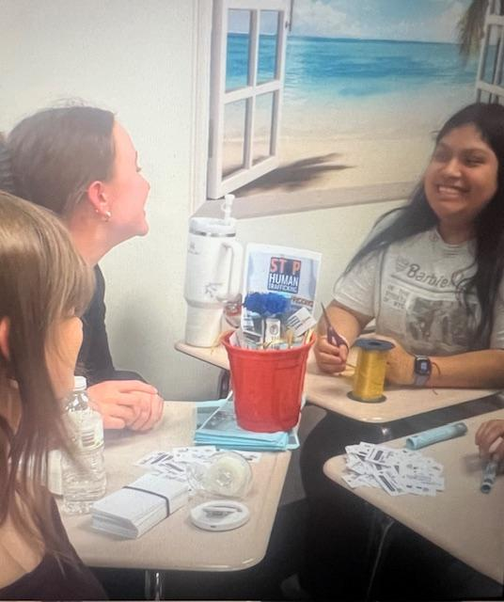
Connect with RAHT
Connect us with an Ambassador from your Club
RAHT will Connect you with:
Educational information
Posters/flyers/key fobs for dissemination
Ideas for creating awareness in your community
Assistance with fundraisers
Connect you with resources in your area
Sign up for our newsletter and Connect with RAHT
Email: Rahtinfo@gmail.com
Facebook:RotariansAgainstHumanTrafficking
Website coming soon!

