Slide 1
DACdb: A Few of My Favorite Things
Eric Davis, Vista Night Club
Title Page Option

Slide 2
HELP!!!
Support Tab
  Top left of the screen
  6th tab from the left
Knowledge Base
  Click the orange button (middle of page – CLICK HERE to…visit the Knowledge Base)
  Search for a topic (type the topic into the search box at the top of the page)
Phone or Ticket Support
  Click the orange button (middle of page – CLICK HERE to submit a Support Ticket)
  Click light blue button (upper right – Create a Support Ticket)

Slide 3
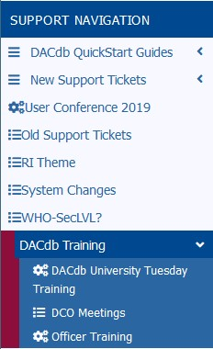
Free TRaining
Support Tab
  Top left of the screen
  6th tab from the left
Left Side Menu
  Choose DACdb Training, then DACdb University Tuesday Training
  View Leadership Training Parts 1-7
  View Officer Training (Secretary Training)

Slide 4


search
Home Tab
  Top left of the screen
  1st tab on the left
Left Side Menu - District Shortcuts
  Choose the magnifying glass icon (1st icon on the left)
  Enter a member name or partial name
  Enter part of a club name
  Enter a combination of those

Slide 5

Club list
Home Tab
  Top left of the screen
  1st tab on the left
Left Side Menu - District Shortcuts
  Choose the organization chart icon (2nd icon from the left)
  Click on the Area column heading to re-order clubs alphabetically within Area
  Click on club name (in blue) to navigate to that club

Slide 6
files
Home Tab
  Top left of the screen
  1st tab on the left
Left Side Menu - District Shortcuts
  Choose the file folder icon (3rd icon from the left)
  Reference everything here!
  Presents a list of folders that one can navigate

Slide 7
QUESTIONS

