Slide 1

Pets – DISTRICT 7000
Alicia Pijal-Avila
Senior Officer
Club & District Support-Americas

Slide 2
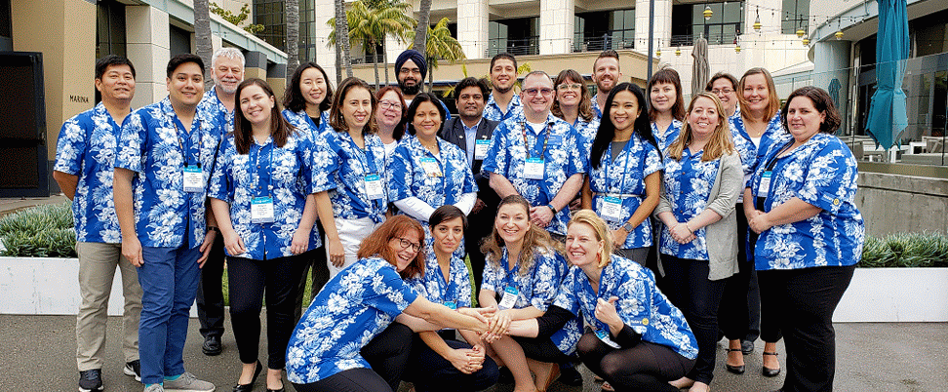
Club & district Support (CDS)
Your Key Contact

Slide 3
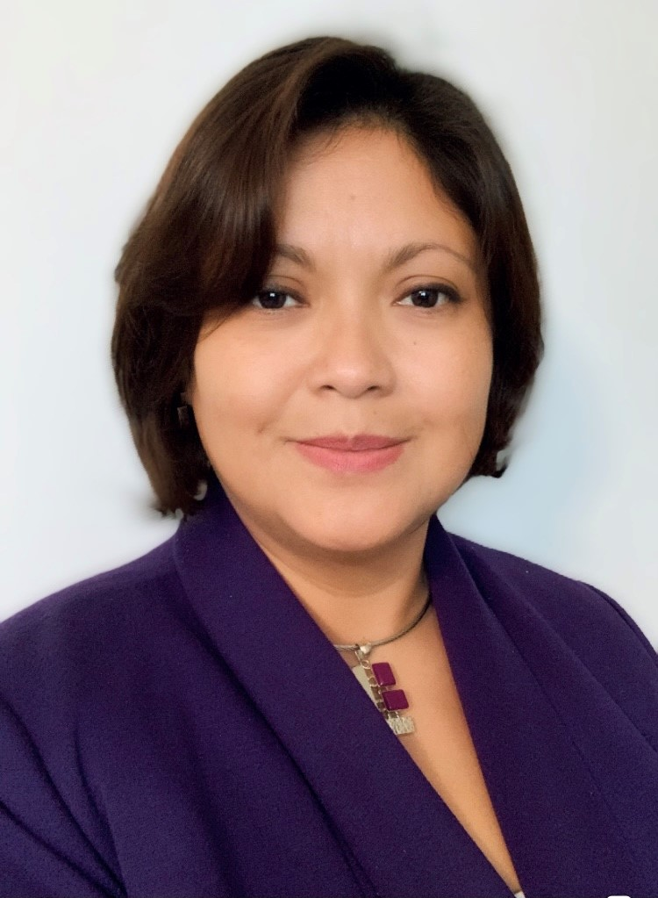
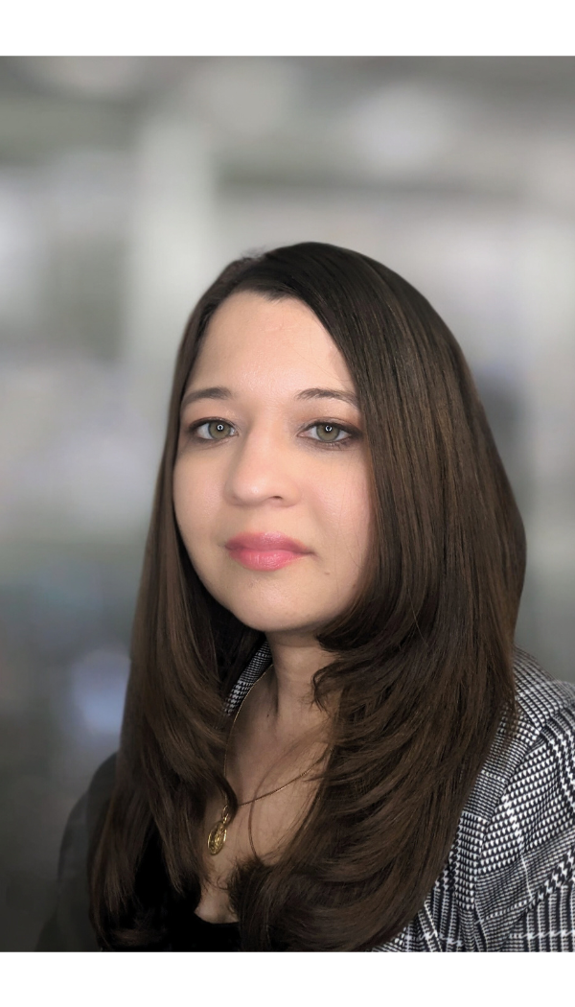
YOUR CLUB AND DISTRIC SUPPORT TEAM
Districts: 6890-7030, 7670-7770
Alicia Pijal-Avila
Sonia romo
Alicia.Pijal-Avila@rotary.org
1(847) 866-3487
Sonia.Romo@rotary.org
1(847) 866-3486
Senior Officer
Associate Officer

Slide 4
How We Work Together
POLICY
ADMIN
RESOURCES

Slide 5
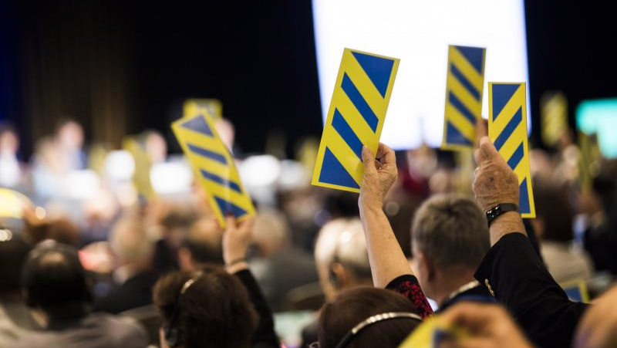
POLICY & PROCEDURE
Advising on Rotary’s governance documents

Slide 6

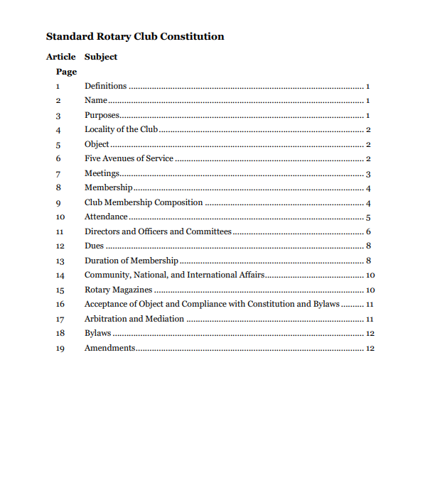
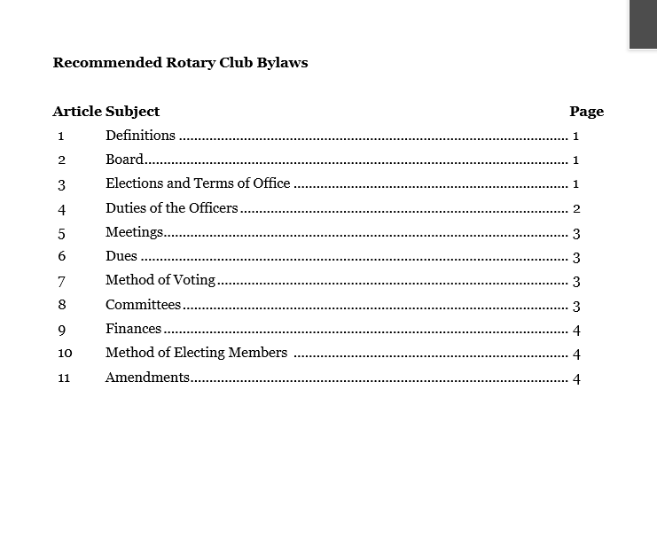
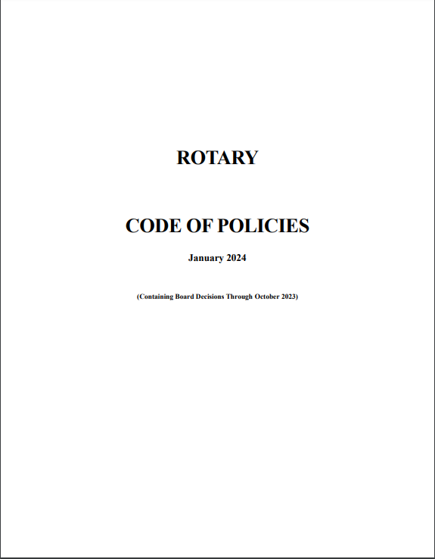
Rotary’s Governance Documents

Slide 7
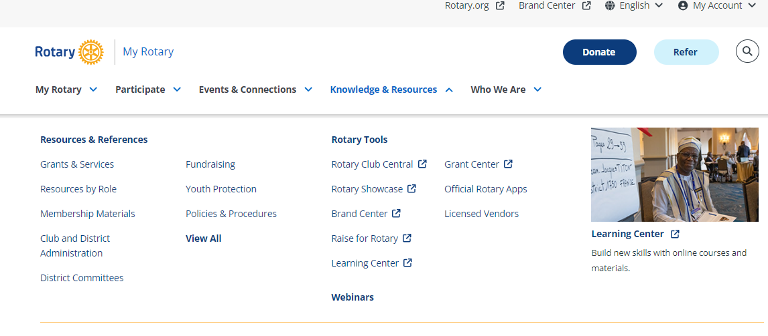
Rotary’s Governance Documents

Slide 8
WHY DOES IT MATTER?
PROTECT: clubs, individuals, brand
PREPARE: for conflict, complaints, disputes
PAVE THE WAY: for opportunity, growth, new ideas

Slide 9
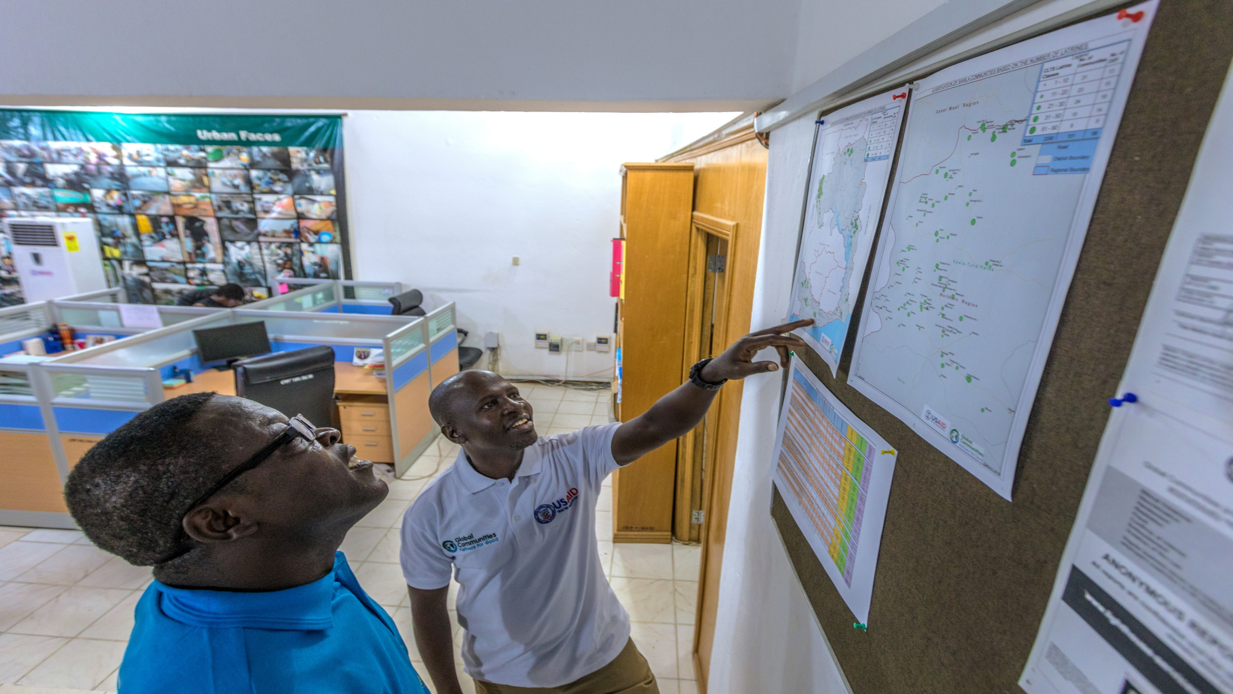
Administration
Facilitating effective club and district operations

Slide 10
What’s Common?
Chartering new Rotary clubs
New satellite club admissions
Chartering new Rotaract clubs
Club name changes
Club mergers
Club terminations

Slide 11

Resources
Connecting you to what you need to succeed

Slide 12
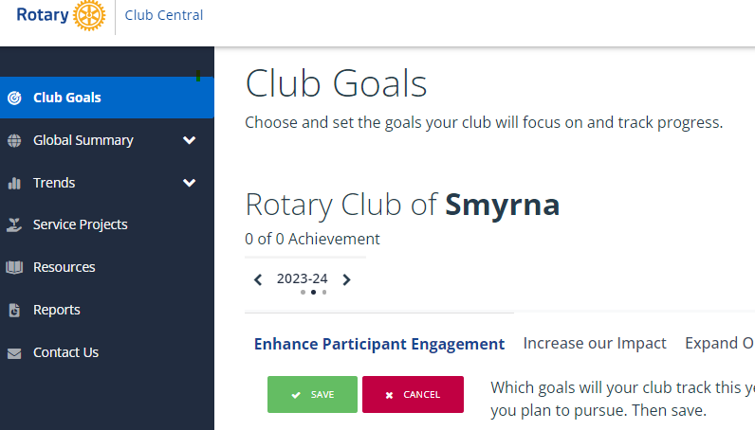
subhead
Rotary Club Central
Set goals, track progress, explore data and trends, manage project activities, and more

Slide 13
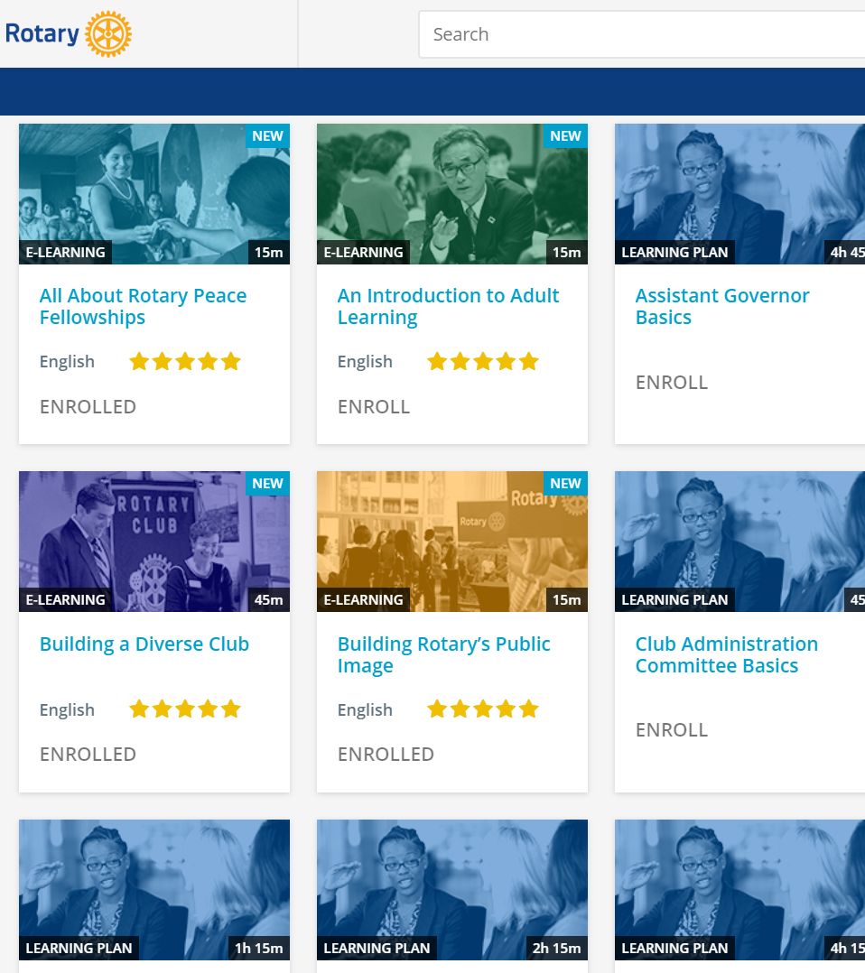
subhead
Learning Center
Take advantage of a wealth of training materials designed to help you learn new skills and enhance your leadership experience

Slide 14

subhead
BRAND Center
Tell the story of Rotary and how we are people of action in your community and around the world

Slide 15
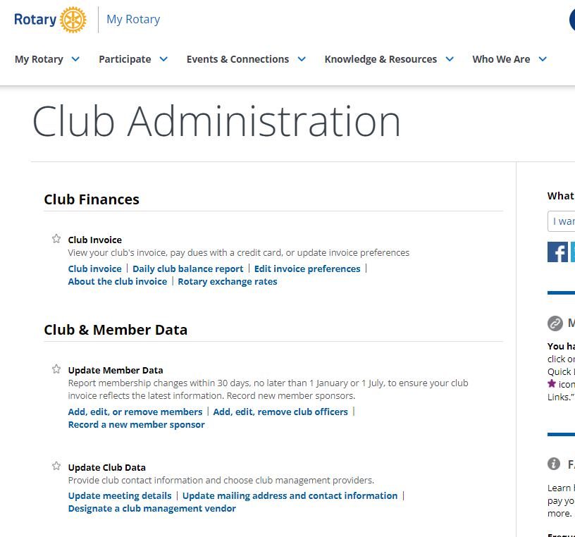
subhead
Club administration
Access your club invoice and update your members and club data

Slide 16
Online resources

Slide 17
Other resources for district 7770
Staff member | Department | Functions
Jose Gonzalez jose.gonzalez@rotary.org +1-847-425-5615 | Membership | Provides support on membership strategies and reports
Laura Ovalle laura.ovalle@rotary.org +1-847-866-4497 | Finance / Club invoice | Manages matters related to club invoice
Renee Reiling renee.reiling@rotary.org +1-847-424-5206 | Grants | Handles topics and questions related to grants
Data@rotary.org | Data Department | Helps update members and club information, and access to My Rotary account
RotarySupportCenter@rotary.org +1-866-976-8279 | Rotary Support Center | Manages general questions about Rotary International, contributions to The Rotary Foundation, and information available in My Rotary
riawards@rotary.org | RI Awards / Recognitions | Provides information regarding recognitions, and the Club Excellence Award (known before as the Rotary Citation)

Slide 18
QUESTIONS?

Slide 19
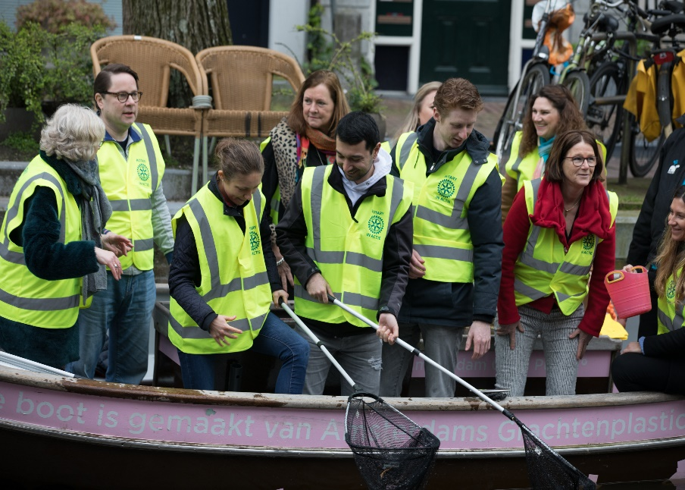
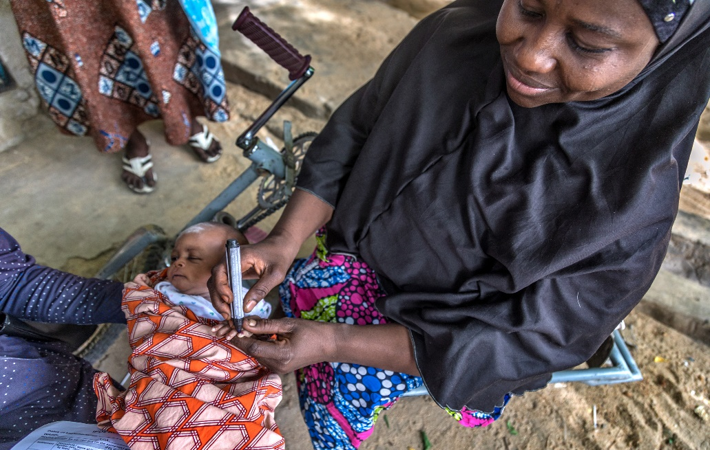

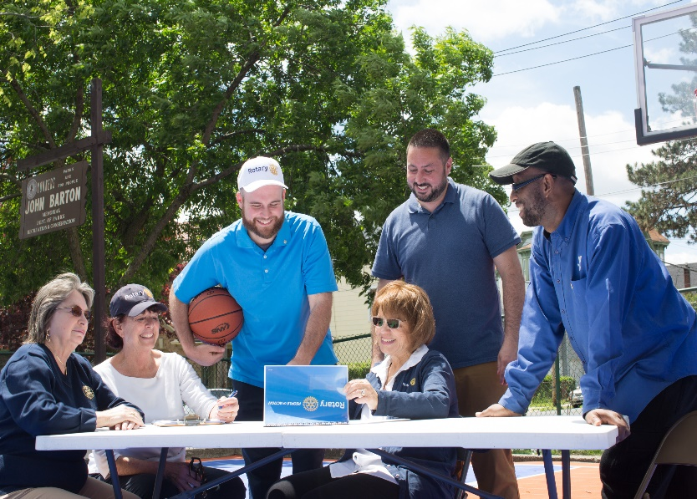



THANK YOU!
www.rotary.org/cds
CDSTheAmericas

