Slide 1

The Power of
Public Image
(PR, Advertising and Marketing)

Slide 2
Hi,
I’m Ken Gasque
Your District 7770 Public Image Chair

Slide 3
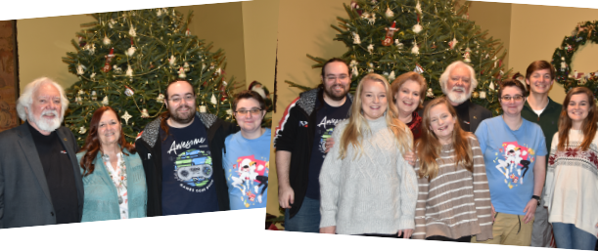
Notes:
This is part of my family. Recently we had a family and friends gathering for a birthday. I announced that my wife Mary was going to be a Rotary District Governor. Everyone was impressed. Then my grand daughter, 30 years old, asked, “What is Rotary.” There were twenty people in the room and
None of them knew anything about Rotary. We explained and told them about a few projects including End Polio. We may have a prospect or two.

Slide 4
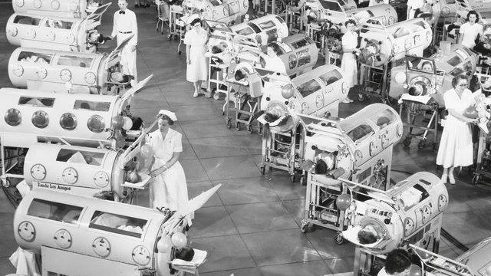
Notes:
The next day I received this photo from a family friend who was at the party with a note… “Thank you for what you and Mary and Rotary are doing! In case you don’t know these are iron lungs used in the 1950’s to treat people with polio.

Slide 5

As Public Image Chairs our objective is to…

Slide 6


make sure people know we exist.

Slide 7

What is our Strategic Plan?
Two words…
Notes:
Plans are worthless, but planning is everything. Dwight D. Eisenhower

Slide 8
Create Awareness!
Notes:
Plans are worthless, but planning is everything. Dwight D. Eisenhower

Slide 9
Four Takeaways
• Create Awareness
• Order Tee Shirts
• Get the Most Out of Social Media
• Use AI for Better Communication Faster

Slide 10
Public Image Is Powerful.

Slide 11
It creates perceptions and your perceptions are reality.

Slide 12
Perception is reality.

Slide 13
Look for opportunities
ASK if you can help
ASK if they want to join you and help

Slide 15
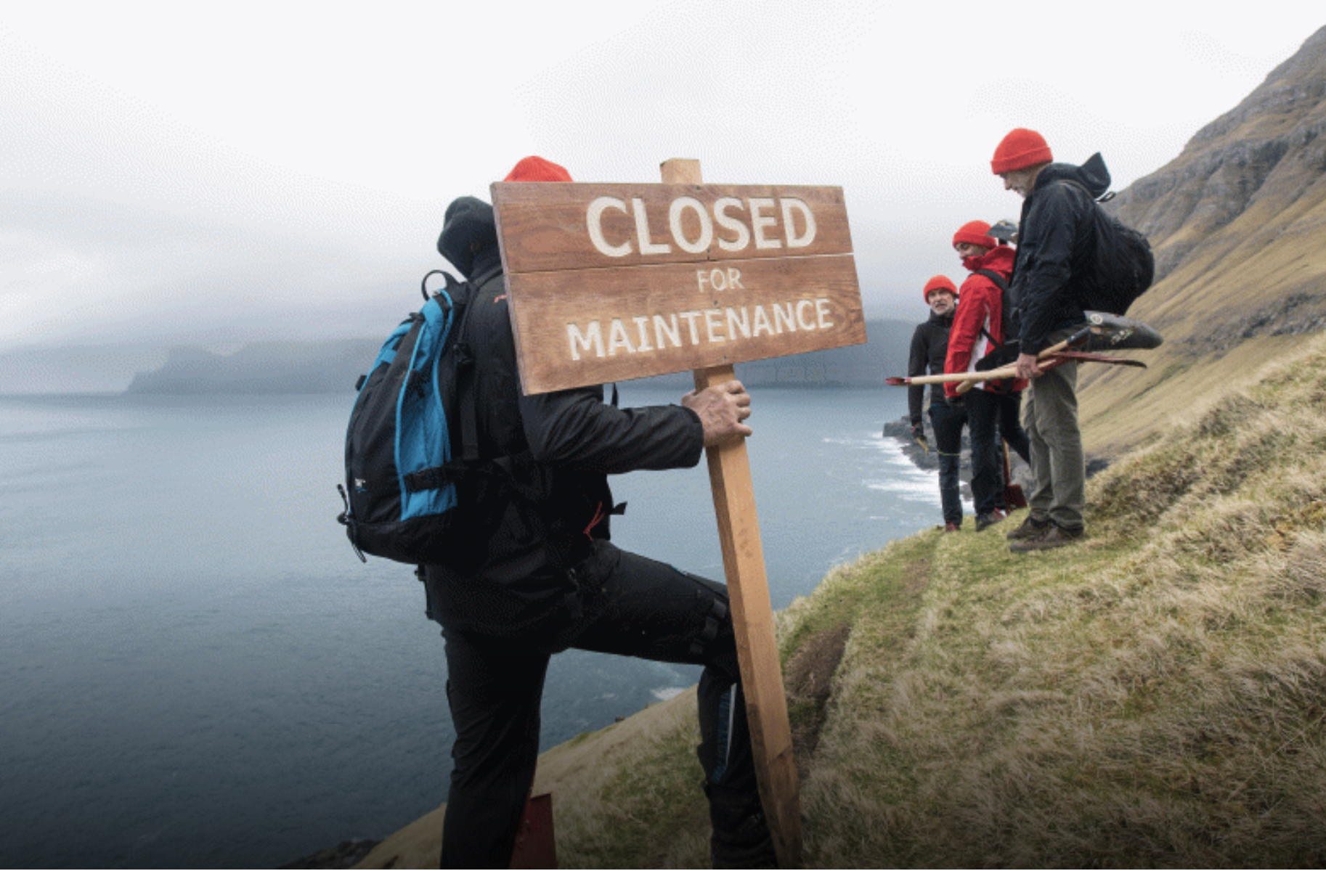
Faroe Island

Slide 16
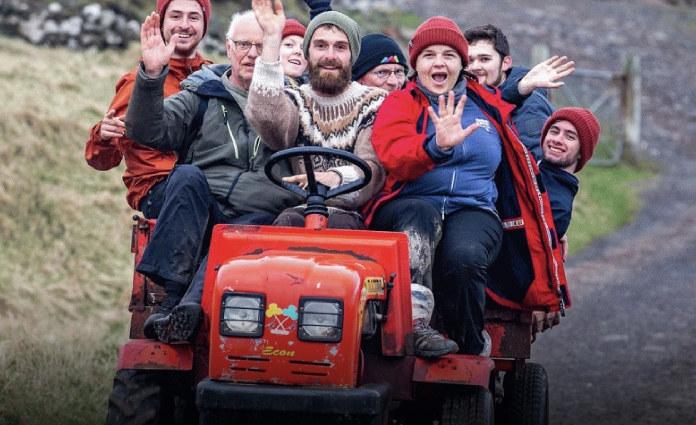

Slide 17
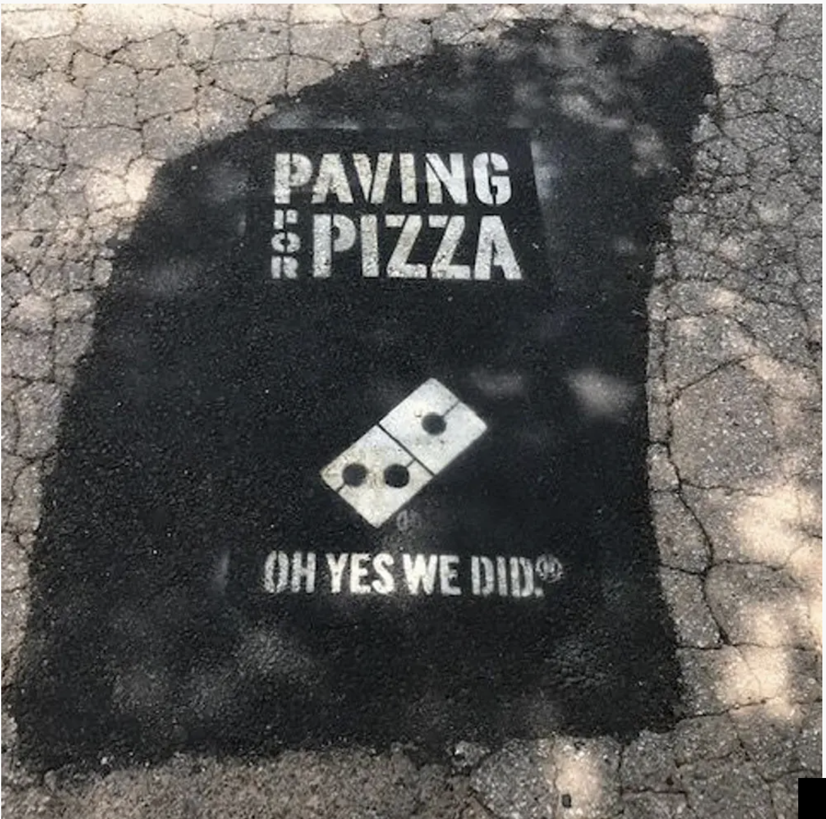
Domino’s Pizza

Slide 18

Fredrick the Great

Slide 19
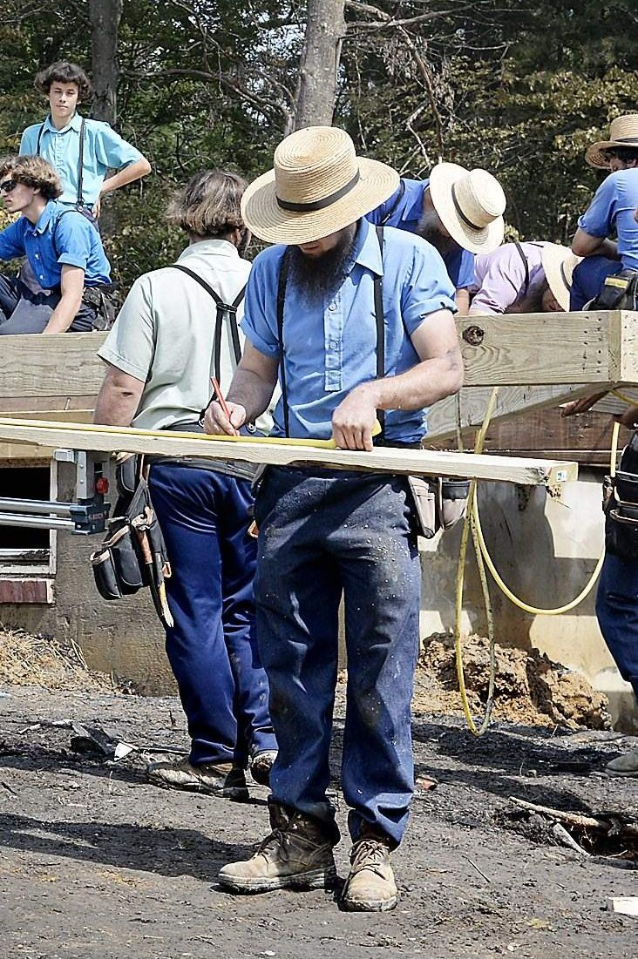
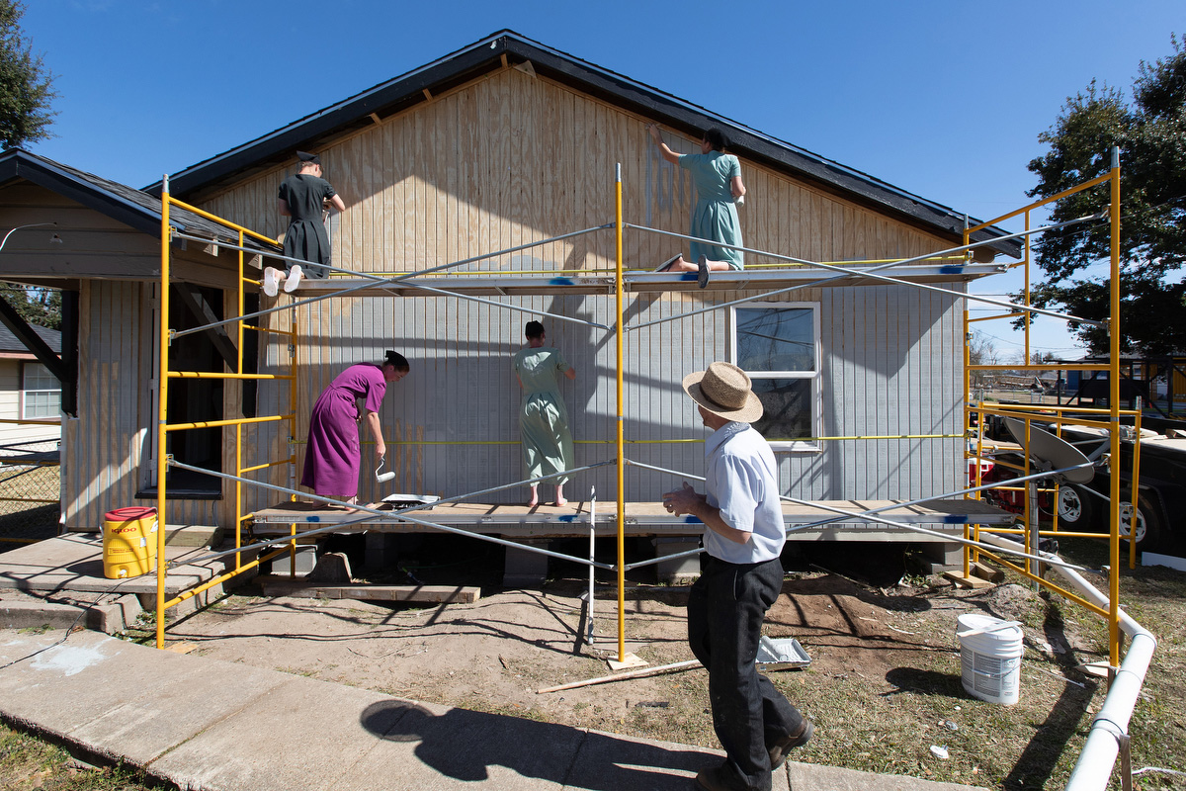
Hurricane Hugo

Slide 20
Public Image Is Powerful.

Slide 21
It creates perceptions,
And your perception is your reality.

Slide 22
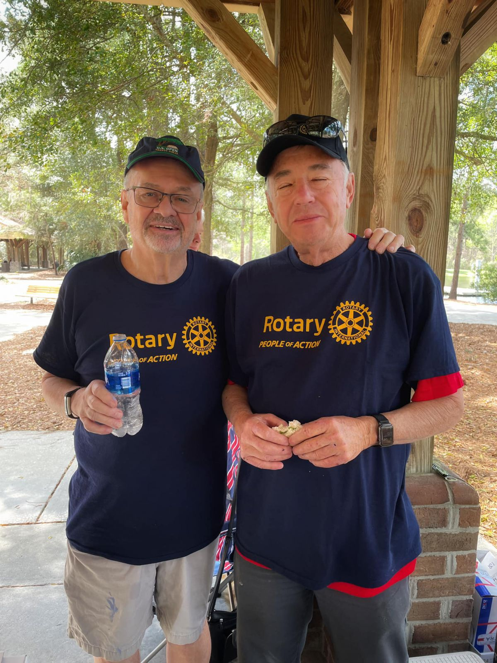
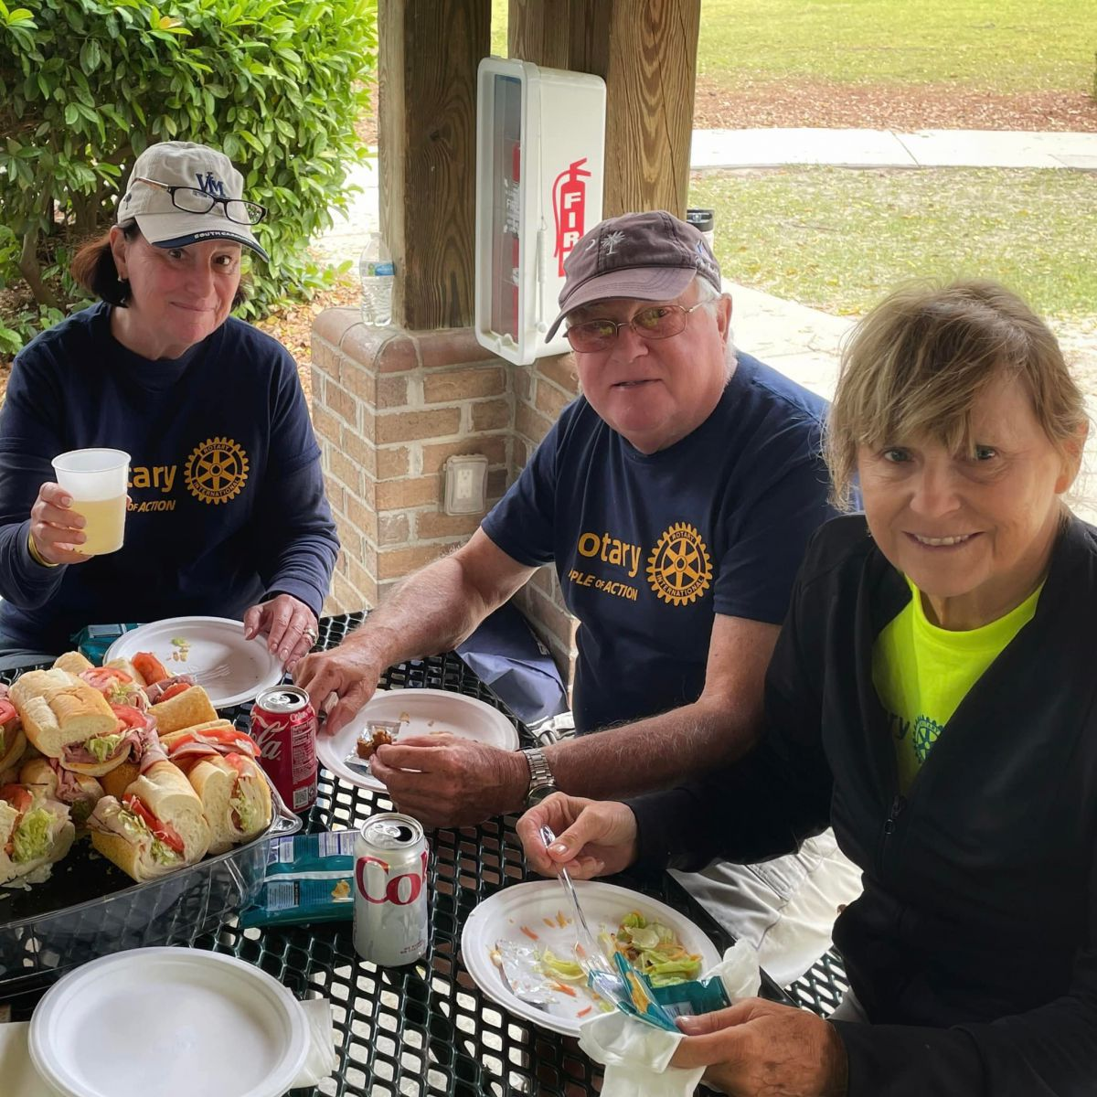
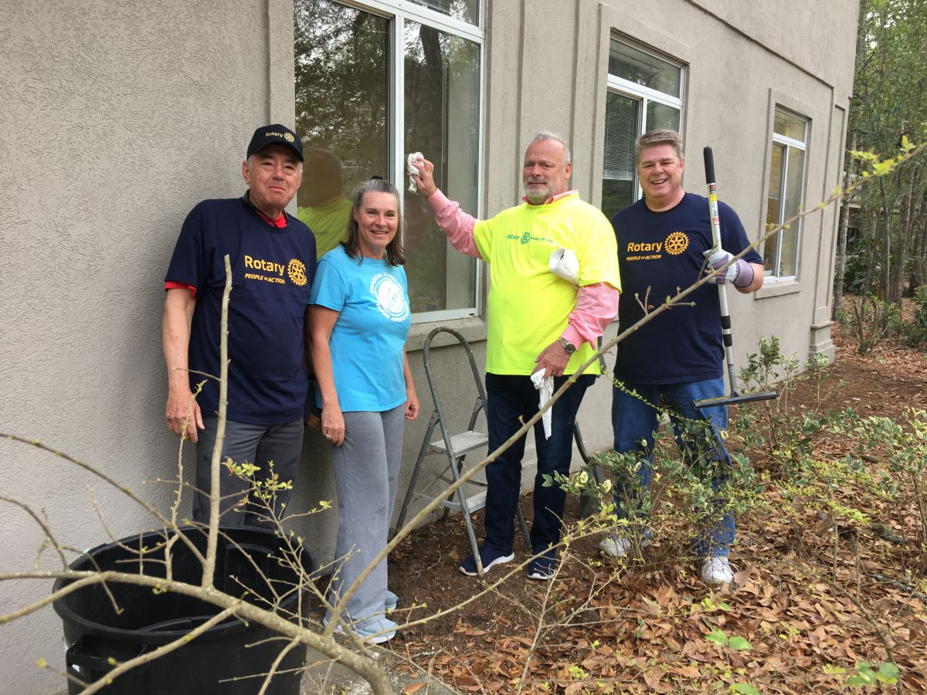

Slide 23
Public Image is about creating awareness for Rotary.
It’s easy! Wear a tee shirt.

Slide 24
An aside
Rotary is good for your health wbur.org/onpoint.2022/12/20

Slide 25
An aside
Why Americans are spending less time with friends — and what to do about it. wbur.org/onpoint.2022/12/20

Slide 26
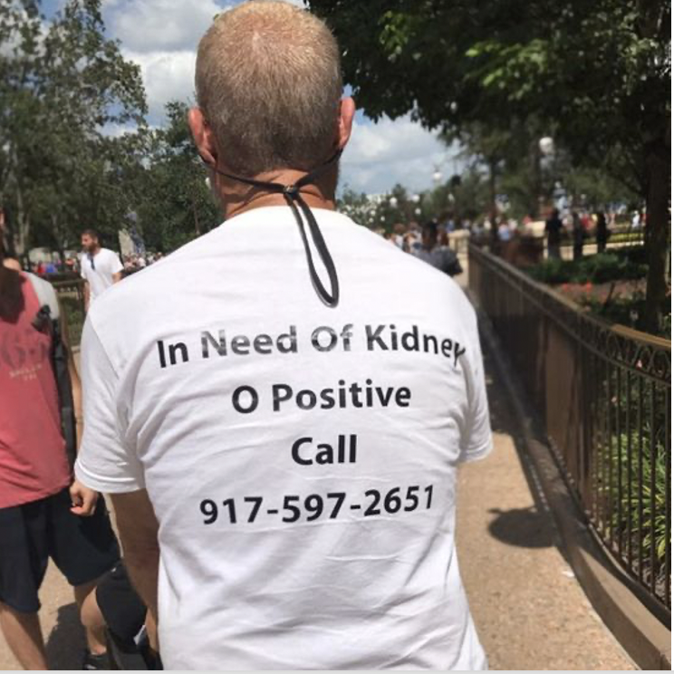
Don’t underestimate the
power of a tee shirt.

Slide 27
In need of a kidney…
advertise… Duh!

Slide 28
Ron Leibowitz tired after
4 years waiting for a
kidney and decided to
Advertise.

Slide 29
January 22, 2018,
Ron got a new kidney.

Slide 30
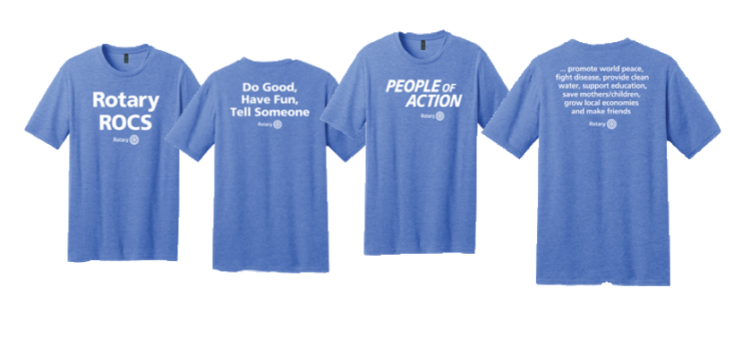
First thing
Buy Tee Shirts

Slide 31
You need a PI Team.

Slide 32

You will need.
A photographer,

Slide 33
You will need.
A social media diva,

Slide 34
A social media diva,
It would be even better to have several social media contributors…

Slide 35
You will need.
A traditional media person,

Slide 36
You will need.
And a webmaster

Slide 37
Put your PI Team together now.

Slide 38
Put your PI Team together now.
Before July 1.

Slide 39
You need a PI Plan.

Slide 40
AI can help!

Slide 41
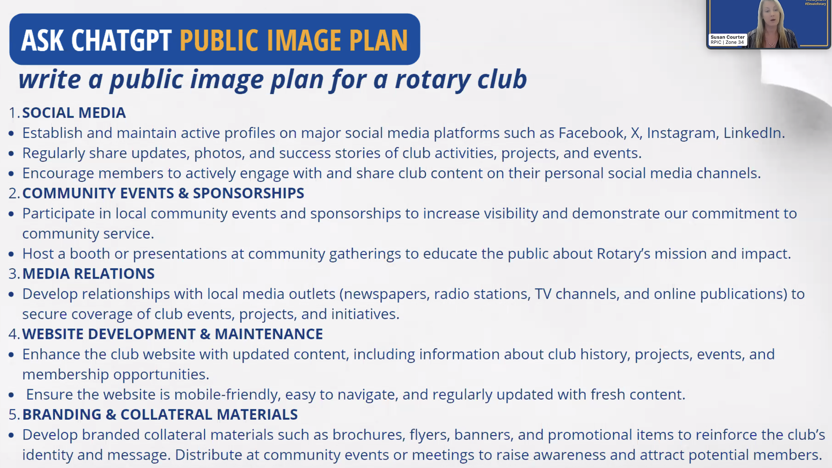

Slide 42

And a Social Media Plan
FaceBook, LinkedIn, X, Instagram, Tic Toc, and Pinterest

Slide 43
A Social Media Plan Suggestion…
1. Post often
2. Post before, during and after an event
3. Do multiple posts about the same event

Slide 44
AI can help create content for endless posts.

Slide 45
Some # suggestions
#District7770SpringAssembly
#RotaryPeopleofAction
#Rotary
#Rotaryiswhereeverybodyknowyourname
#Rotarylearning
#PublicImageispowerful

Slide 46
#RotaryInternationalDistrict7770
Go to this page and LIKE IT

Slide 47
Four Takeaways
• Create Awareness
• Order Tee Shirts
• Get the Most Out of Social Media
• Use AI for Better Communication Faster

Slide 48
PI Resources
• www.elevaterotary.org
• Public Image Workshop, May 8, 6pm presented by Rotary Zone 33/34 go to www.elevaterotary.org to register
• Rotary Zones 33/34 Public Image Webinar Series Archives … Everything you ever wanted to know about Public Image but were afraid to ask.

Slide 49
Questions?
Ken Gasque
ken@gasque.com
803 553-0010

