Slide 1
District 7770 Treasurer Training
Dues, Dues and More Dues
Deb Walworth
District 7770 Treasurer
dwalworthcpa@comcast.net
843.701.0450

Slide 2
Club Invoice (RI)
SAR (Semi-Annual Report)
Rotary International emails or mails a copy of the Club Invoice to every club officer in July and January.
To ensure that emails from Rotary are not rejected or filtered as spam, add ri.clubfinance@rotary.org to your approved email contacts.
If your club has not received an invoice by the beginning of February or August, email data@rotary.org to request a replacement. Include your club name and number and delivery address or fax number. Club dues still must be paid even if you have not received the invoice.
Or officers can sign-on to My Rotary to view Club Invoice
The Basis for RI dues is membership on Database as of 12/31 & 6/30

Slide 3
Invoices (RI & District)
Club Invoice (RI)
  Due:
    July 1st
    January 1st
    The amount due is not adjustable!!!
District Invoice
  Due:
    October 1st
    April 1st
    The amount is based on the RI invoice 3 months earlier and is not adjustable!

Slide 4
RI Dues Invoice 2023/2024:
Report should agree with Club’s membership as reported on the District Database.
  Rotary International Dues: $37.50 per member* (July & January) $71
  Rotarian Magazine: $6.00 per member (July & January) $12
  RI Directors & Officers Insurance: $1.09 per member * (July)
  RI General Liability Insurance: $3.73 per member * (July)
  Council on Legislation: $1.00 per member (July)
* Dues increase next year and insurance amounts change slightly, each year
  RI Dues per year: $92.82

Slide 5
District 7770 Dues 2023/2024:
District 7770 Dues: $21.00 per member Oct & Apr
$42 for the year

Slide 6
Payment Methods
  Credit card online for RI Dues
  Check or draft accompanied by the detached bottom portion of the invoice
    Mailed to RI 14255 Collections Center Dr. Chicago, IL 60693
  Wire transfer
Failure to RI pay dues on a timely basis will cause
  Loss of a Club’s Charter
  Incur expenses related to be reinstated
  As of 1 January 2015, clubs that have not paid their Rotary dues within four months of the date on the invoice will be terminated.
    Clubs will then have five months to fulfill the reinstatement requirements.

Slide 7
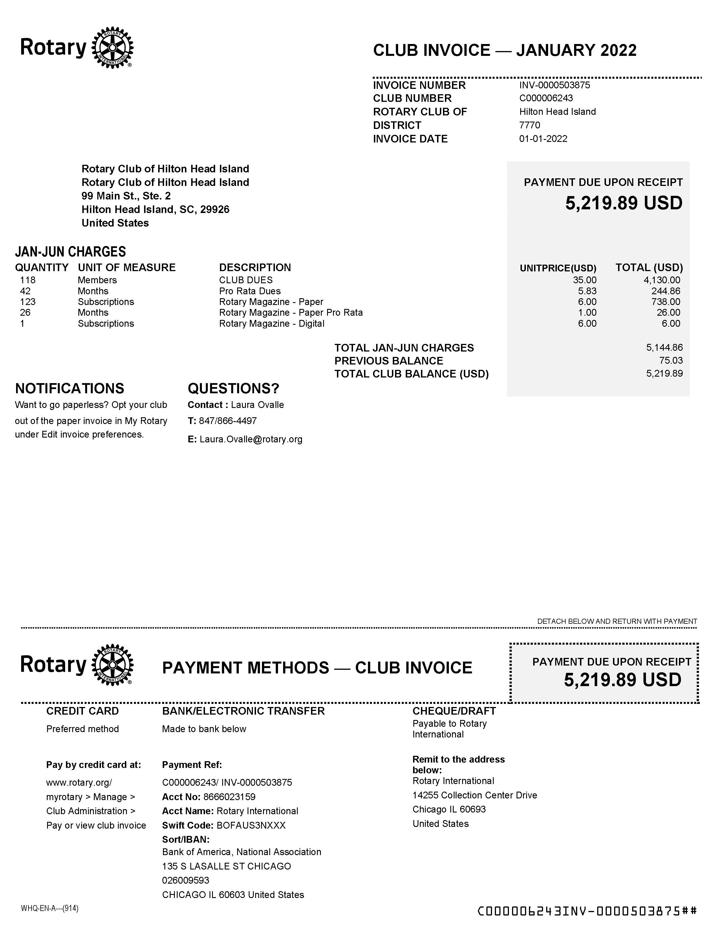

Slide 8
Club Invoice (District 7770)
Emailed to Club President and Treasurer or Designated Person
  October 1st
  April 1st
  Important to have the correct email addresses in the District Data Base
  If email addresses are not on file, update them in DACdb
  Accurate Database!!!!
$21 per member or $42 annually
Amount cannot be changed. It is matching what comes from RI Database.
  Keep database accurate for District & RI Dues membership count
Dues are payable on:
  October 1st
  April 1st

Slide 9
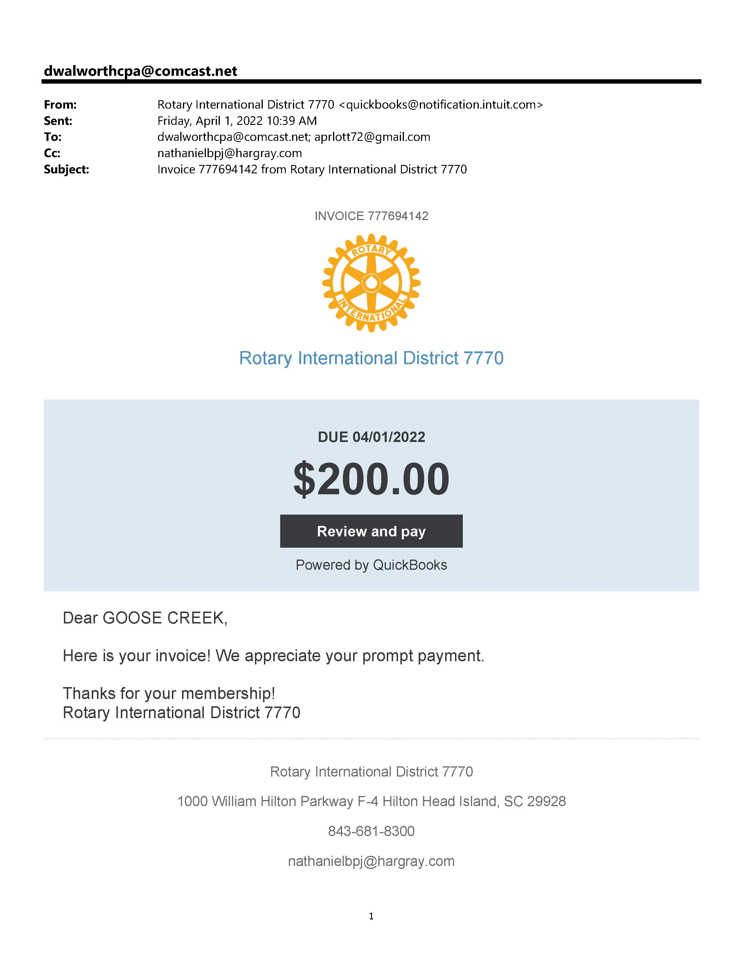

Slide 10
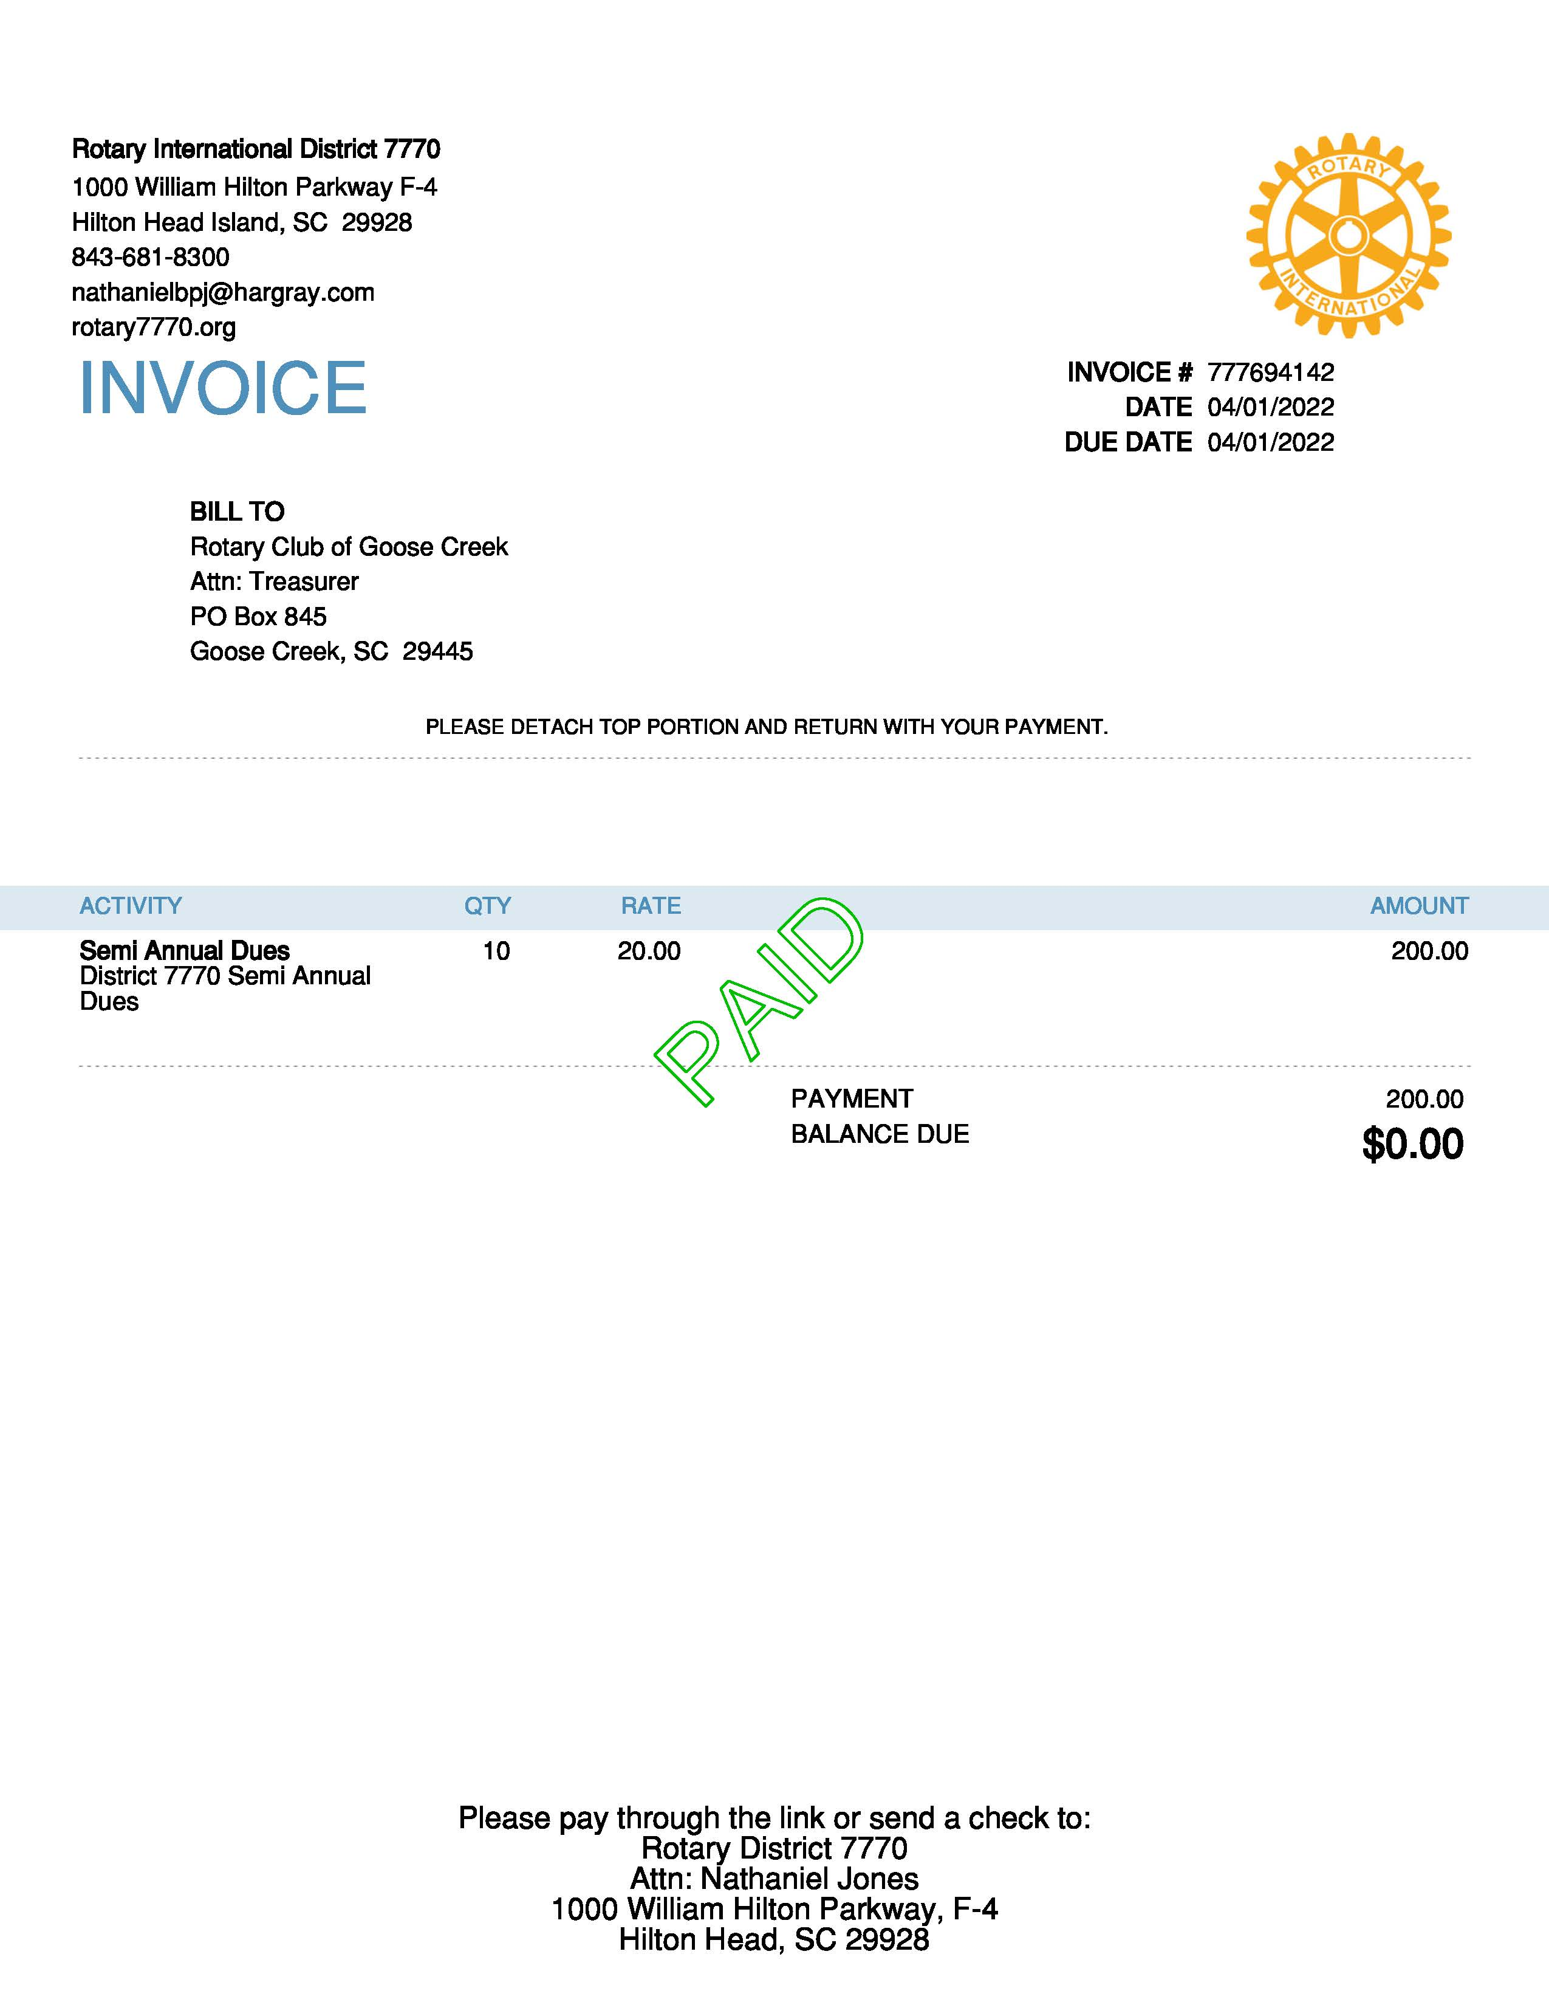

Slide 11
Payments made by:
  ACH – preferred method
    Use QuickBooks link
      Routing and Account Number
    Check
    mailed to District 7770 Treasurer – Deb Walworth
    1000 William Hilton Parkway, F-4 Hilton Head Island, SC 29928
  If Invoice not paid after 14 days you get a reminder from QuickBooks.
  30 days after the due date a reminder will be emailed to President, Treasurer and Assistant Governor
  60 Days after the due date a reminder will be emailed to President, Treasurer, Assistant Governor and District Governor

Slide 12
Summary of Dues and fees 2023/2024:
RI Dues annually $92.82/member
District 7770 Dues annually $42.00/member
Membership Summit $45.00/ attendee
Foundation Seminar $40/attendee in the past
Spring Assembly $45/attendee in the past
Training for PETS $250 in 2023 do not know cost for Feb 2024

Slide 13
IRS Form Filing
Each Club is to file a 990, 990-N or 990-EZ
Prior to November 15th

Slide 14
State of SC filing
Some Rotary Clubs file the 990-N, 990-EZ or 990 with the IRS, but fail to file with the State of SC.
By November 15 each year you are required to renew your status with the SC Secretary of State as a Public Charity.
When you renew, you must either submit an Annual Financial Report if you file the 990-N with the IRS (which is found on the Secretary of State Web Site), or submit a copy of the 990-EZ or 990 along with the renewal.

Slide 15
Financial Assessment
One Page Form to be completed annually
Assessment for club year ending June 30th
Due to District Treasurer by October 15th
  Mail or Scan with requested attachments

Slide 16
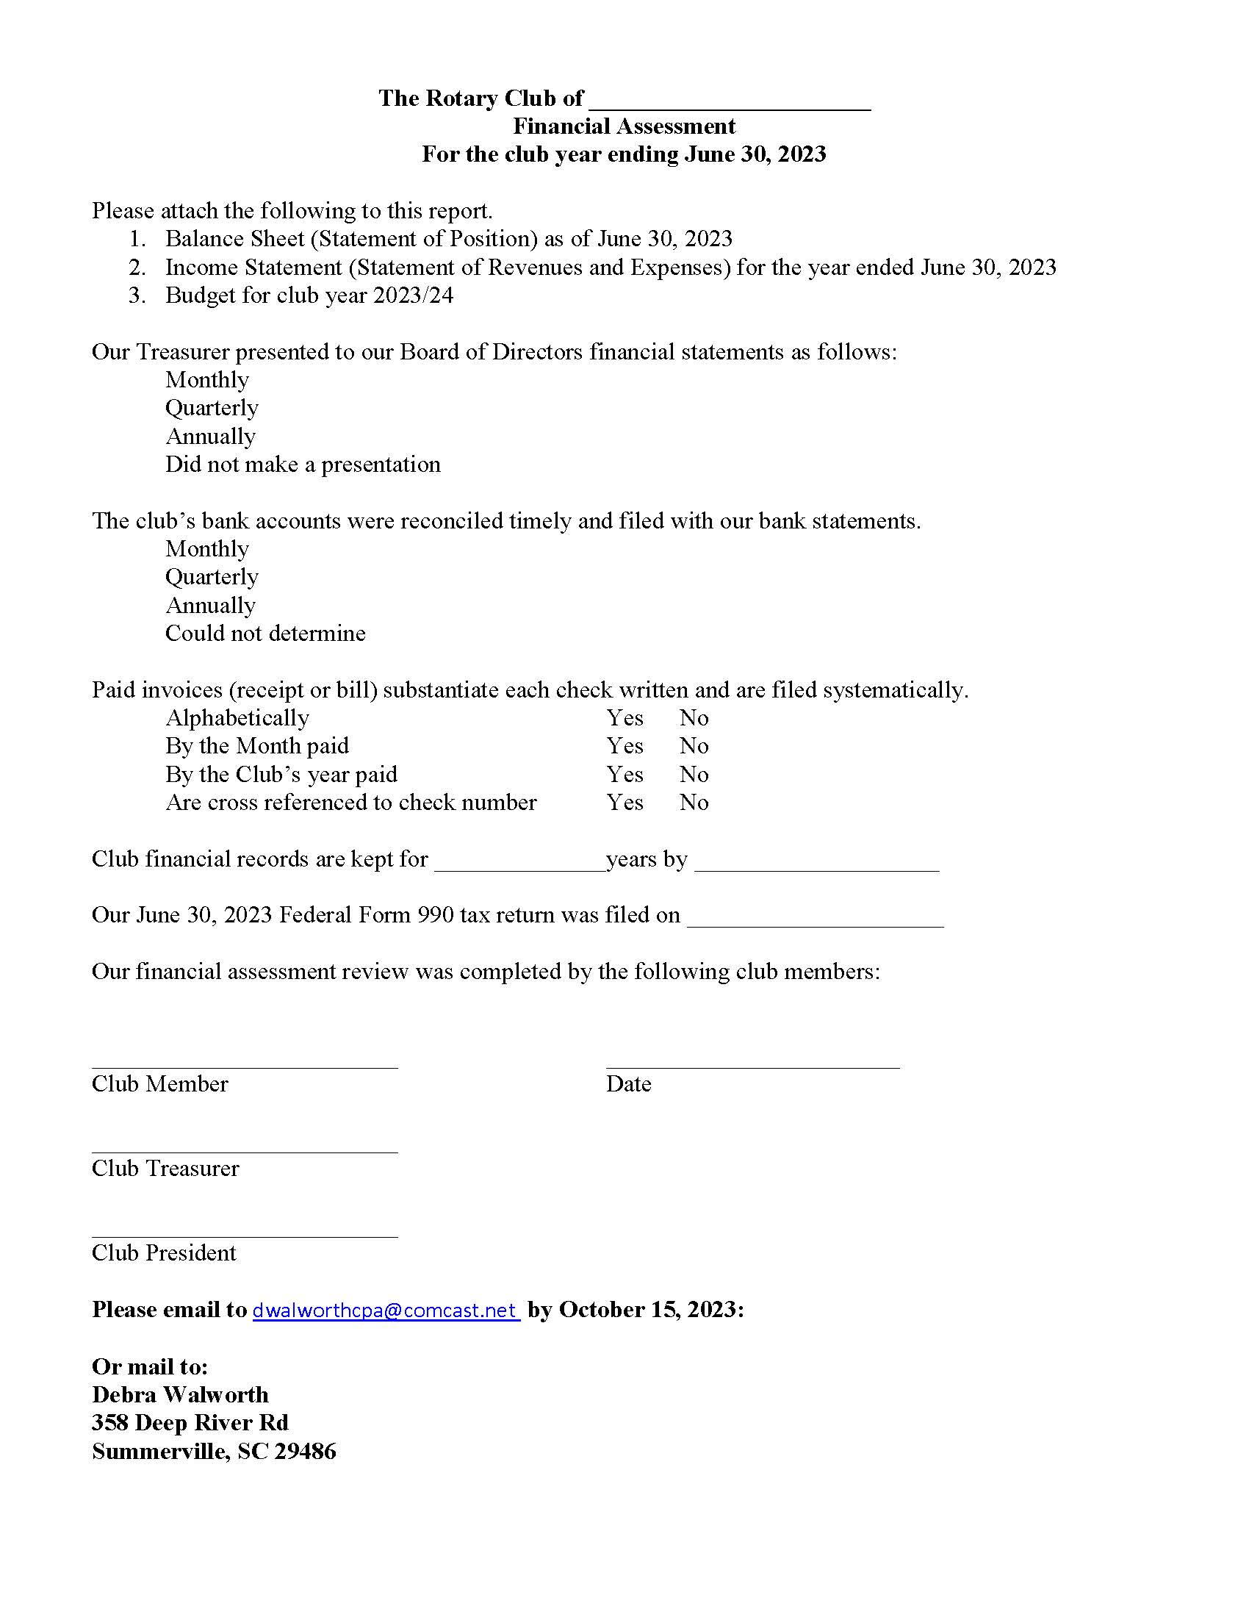


Slide 17
Database
Request all club presidents update information in both the RI Database and DACdb
  Mailing address
  Email address
Provide District Treasurer the email address of club president & treasurer and/or check signers - confirm contact information is up to date.

Slide 18
IRS Tax Designation
501(c)4 vs 501(c)3
District 7770 is a 501(c)4
Your club is a 501(c)4
  Your club may have a separate charitable foundation if it has applied for and received the 501(c)3 designation. The actual Rotary Club is still a 501(c)4. You will have 2 form 990s to file.

Slide 19
Operating vs. Project/Fundraising accounts
Most clubs have separate bank accounts for operating funds and project funds. The treasurer helps the incoming president create the budget for the next fiscal year.
You may want to create your budget in 2 parts:
Operating budget
Projects budget

Slide 20
The Operating Budget includes income from dues and expenses such as dues to RI and District Dues and training, a PO Box and website if you have them, meals for speakers, pins and membership supplies and any other expenses to operate your club.
The Project Budget includes income from fundraisers and income from the District Grant.
The expenses for the Project budget are the costs of putting on the fundraiser and the money you spend to do your projects.

Slide 21
Excel file in DACdb Budgeting your Dues

