Slide 1
The Rotary Foundation
Spring Assembly, April 2023
District 7770

Slide 2
Paul Walter Rotary Club of Hilton Head Island
Email: paulwalter.d7770@gmail.com
m: 843.301.8878

Slide 3
The Rotary Foundation
(TRF)
Major Gifts
Bequest Society
Benefactors

Slide 4
Major Donor
recognizes individuals or couples whose combined giving has reached $10,000, regardless of the gift designation. This recognition level can be achieved only through personal contributions and not through recognition points.

Slide 5
Major Donor
Level Range
Level 1
$10,000 to $24,999
Level 2
2 $25,000 to $49,999
Level 3
$50,000 to $99,999
Level 4
$100,000 to $249,999

Slide 6
Arch Klumph Society
Donors who contribute $250,000 or more become members of the Arch Klumph Society.
Arch Klumph Society members are listed in the Major Donor, Arch Klumph Society, and Bequest Society Report.

Slide 7
Arch Klumph Society
Donors Levels
Trustees Circle
$250,000 to $499,999
Chair’s Circle
$500,000 to $999,999
Foundation Circle
$1 million to $2,499,999
Platinum Trustees Circle
$2.5 million to $4,999,999
Platinum Chair’s Circle
$5 million to $9,999,999
Platinum Foundation Circle
$10 million and above

Slide 8
Benefactor
an individual who notifies The Rotary Foundation of a commitment for future gifts to the Endowment of $1,000 or who makes an outright gift of $1,000 or more to the Endowment.

Slide 9
Bequest Society
Individuals or couples who notify The Rotary Foundation of their commitment to include future gifts to the Foundation of $10,000 or more in their estate plans are invited to join the Bequest Society.

Slide 10
Bequest Society
level of giving includes the benefits of the preceding levels:
$10,000 A Bequest Society pin and an exclusive art piece suitable for framing
$25,000 A Rotary’s Promise crystal and a named endowed fund
$50,000 Separate named endowed funds
$100,000 A customized Rotary’s Promise crystal
$250,000 Posthumous induction into the Arch Klumph Society
$500,000 Special seating and registration benefits at the Rotary International Convention

Slide 11
Legacy Society
Individuals or couples who substantiate future gifts to the Endowment of $1 million or more are invited to join the Legacy Society.

Slide 12
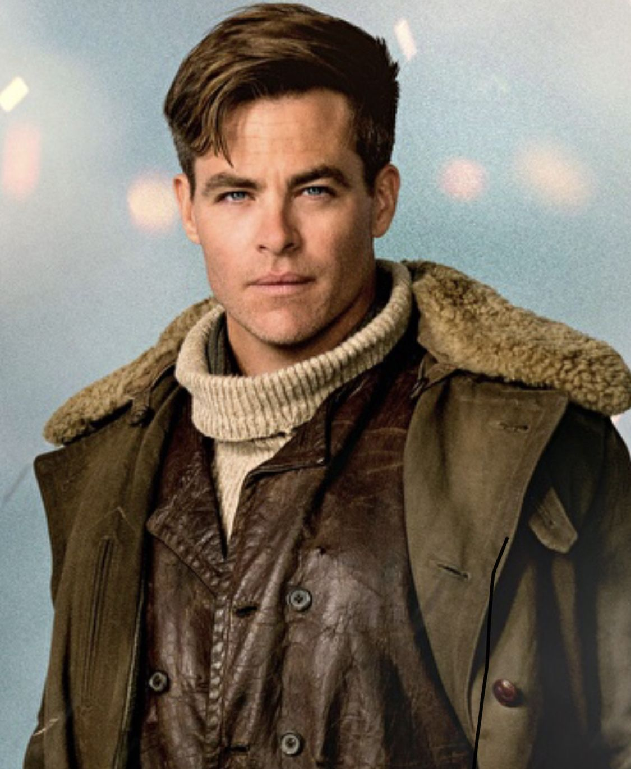

Slide 14
The Rotary Foundation
Reports
Donor History Report
Club Fundraising Analysis
Club Recognition Summary
District Fundraising Profile
Major Donor and Bequest Society Report
Paul Harris Fellow and Benefactor Report

Slide 15
WHERE TO DIRECT QUESTIONS
Call +1-866-976-8279 or email rotarysupportcenter@rotary.org to check on contributions and recognition points, find information about grants, and ask questions.
The Rotary Foundation
14280 Collections Center Drive
Chicago, IL 60693
+1-866-976-8279
rotarysupportcenter@rotary.org

Slide 16
District 7770 Foundation Chair
Contact me for help navigating your way with Bequest Society, Benefactors & Major Gifts
Paul Walter
paulwalter.d7770@gmail.com
m: 843.301.8878

Slide 17
The Rotary Foundation
Contact Senior Major Gifts Officer,
Carl Davis for help navigating your way with Bequest Society, Benefactors & Major Gifts
Carl W Davis
carl.davis@rotary.org
m: 773.949.5243
o: 847.424.5343

