Slide 1
District 7770
PolioPlus Society

Slide 2
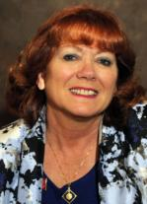
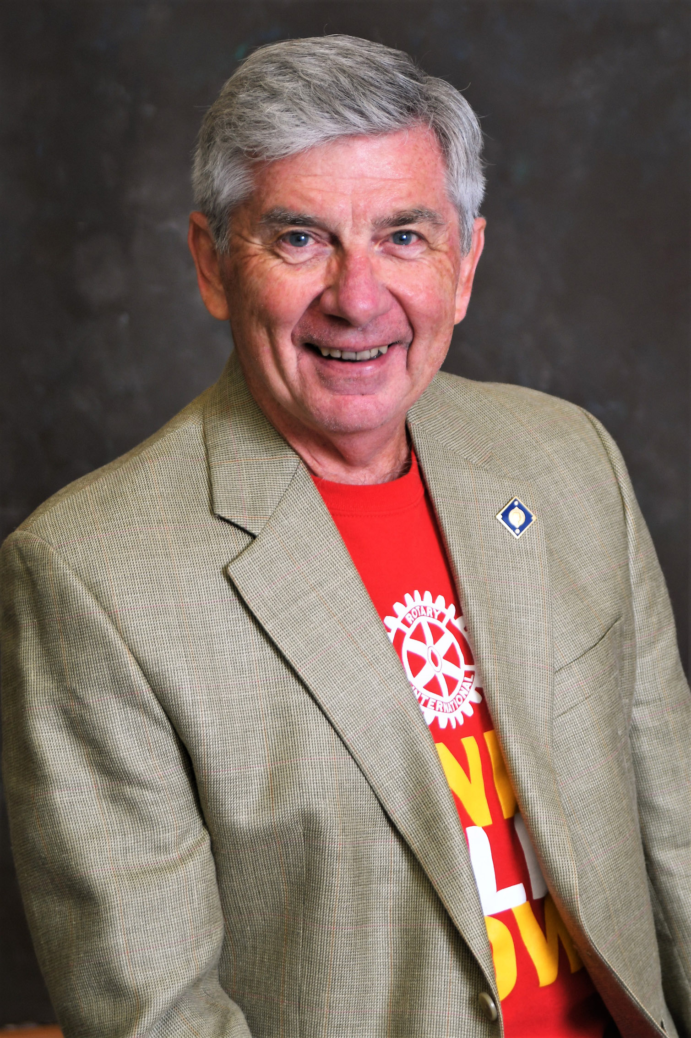
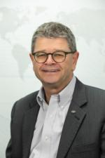
Contact Information
Sandee Brooks
PolioPlus Co-Chair
BrooksRambo@Gmail.Com
843-290-3054
Bernie Riedel
PolioPlus Co-Chair & Z33 EPNC
Bernie@RiedelComputers.Com
843-816-4450
Christian Brutzer
PolioPlus Team Member
cbroo@Hotmail.Com
914-473-9445

Slide 3
PolioPlus Society
Background / Facts
1985
1,000 children a day were getting Polio
And Polio became Rotary’s #1 priority
Last Year
30 children in the world
got the Wild Polio Virus

Slide 4
PolioPlus Society
Background / Facts
Every year approximately
400,000,000
children receive the Polio vaccine
For every $ we give to the PolioPlus fund, the Gates Foundation
Matches it 2 to 1

Slide 5
PolioPlus Society
Background / Facts
Smallpox was the first and only human disease to be eradicated from the world
Polio will be the second!

Slide 6
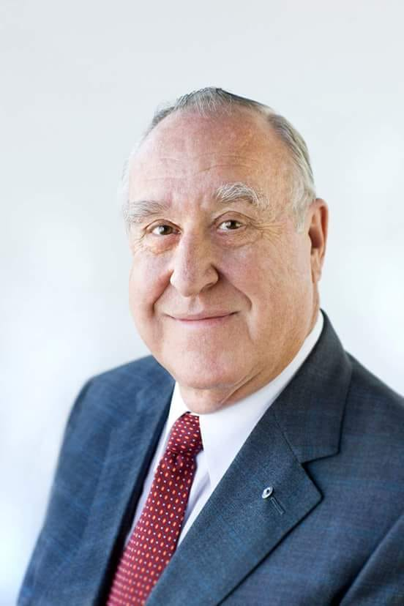
PolioPlus Society
Background / Facts
“We made a promise to the children of the world to give them a world free from Polio… and We Rotarians keep are promises”!
John Germ, Past RI President, and Past Chair of the Trustees of The Rotary Foundation

Slide 7
PolioPlus Society
Annual Pledge
$100 minimum annually
Rotary Direct (recurring)
EndPolio.org/donate
Check

Slide 8
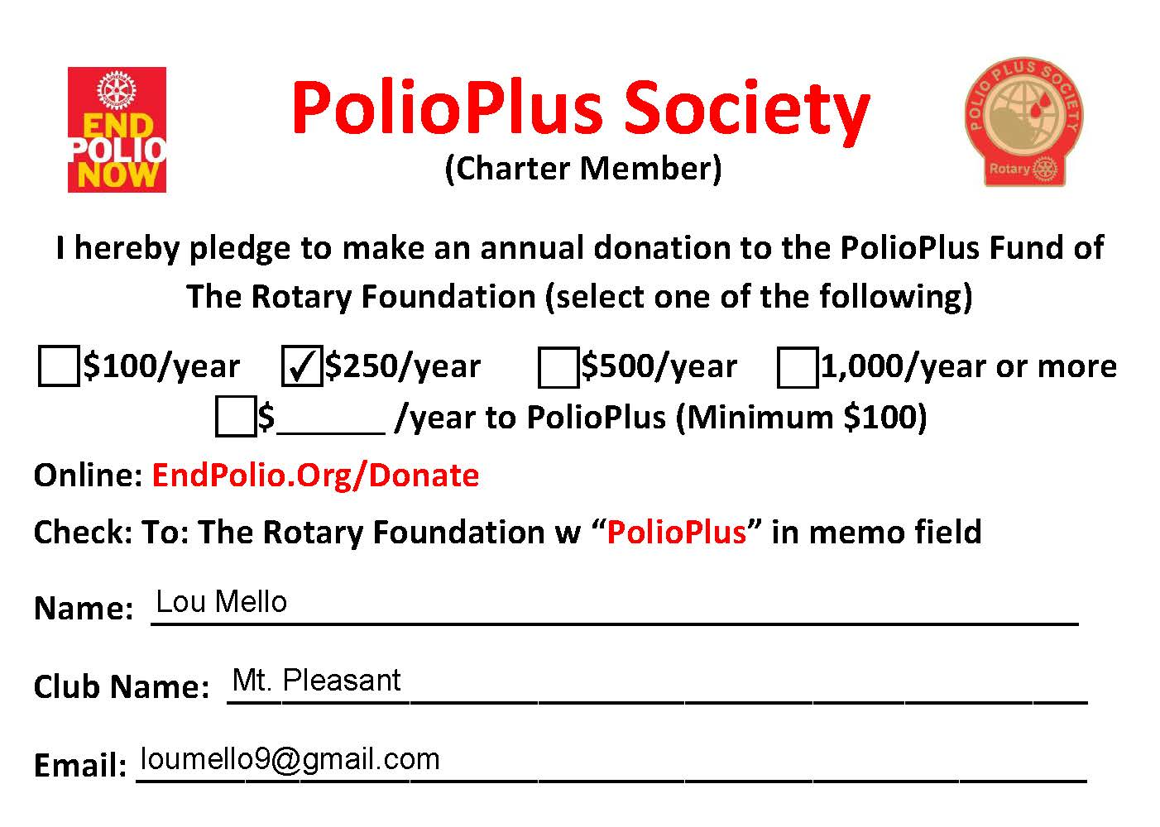

Slide 9
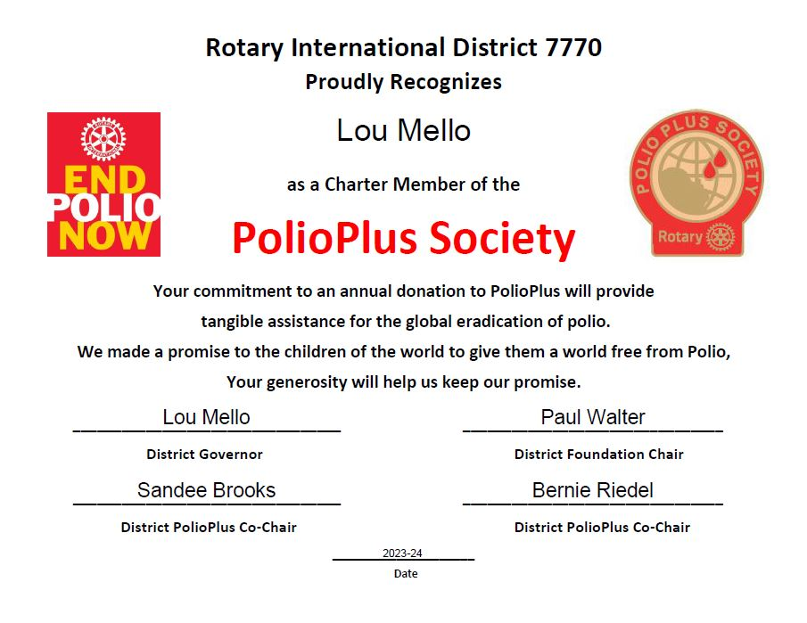
Certificate

Slide 10
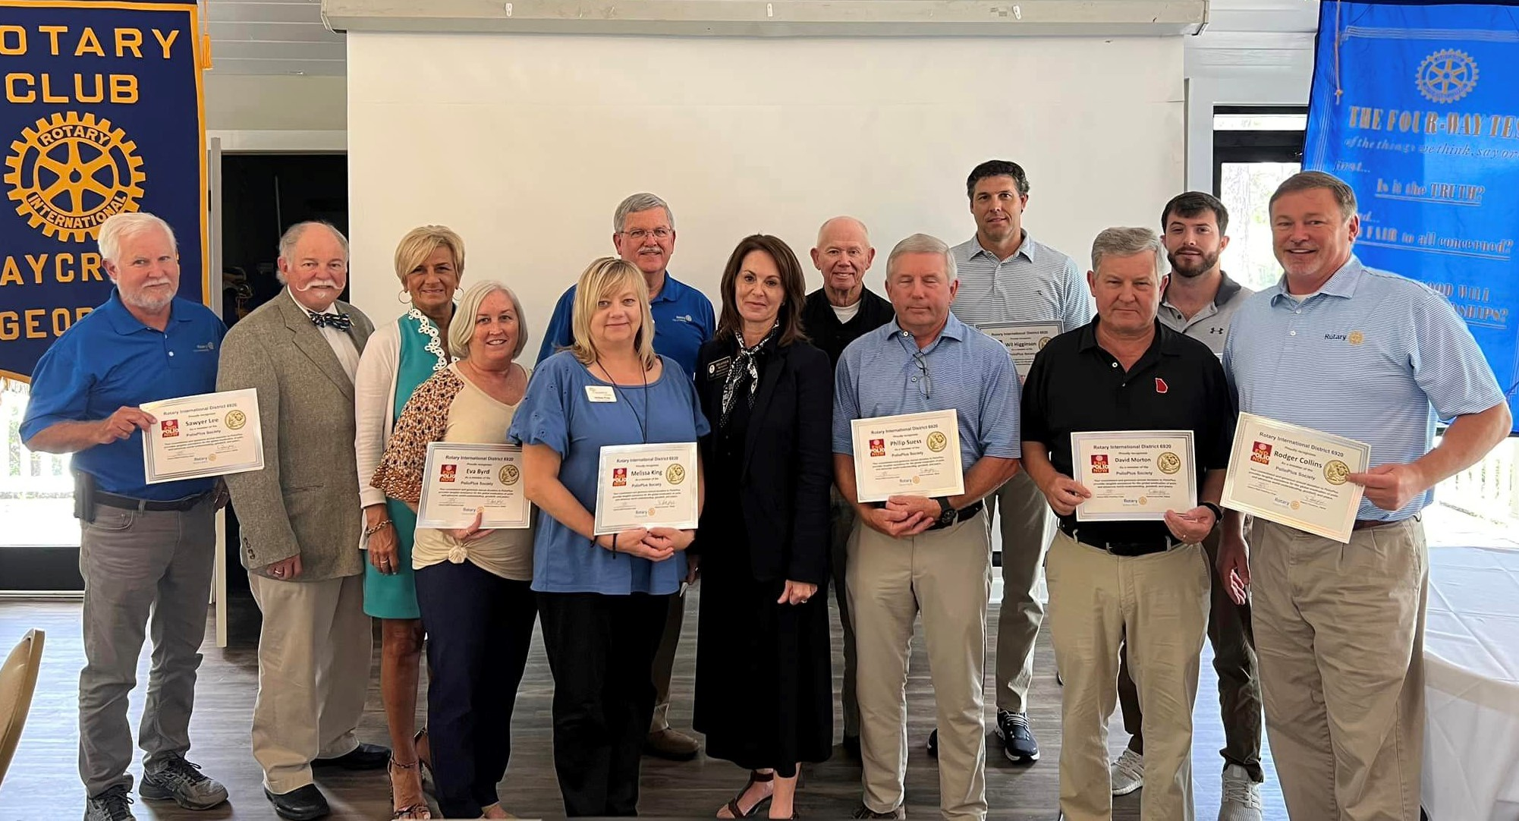
Recognition

Slide 11
Recognition

Slide 12
Return Completed
PolioPlus Pledge Cards
(By Email, Text or US Mail)
To:
Sandee Brooks
BrooksRambo@Gmail.Com
843-290-3054
105 Shoreline Drive
Hilton Head Island, SC 29928

Slide 13
Why
We Give
Notes:
Les Wright
Les Wright - Today, in some nameless village a child greeted the new day unaware that during the night polio passed him over because he was immunized.

Slide 14
