Slide 1


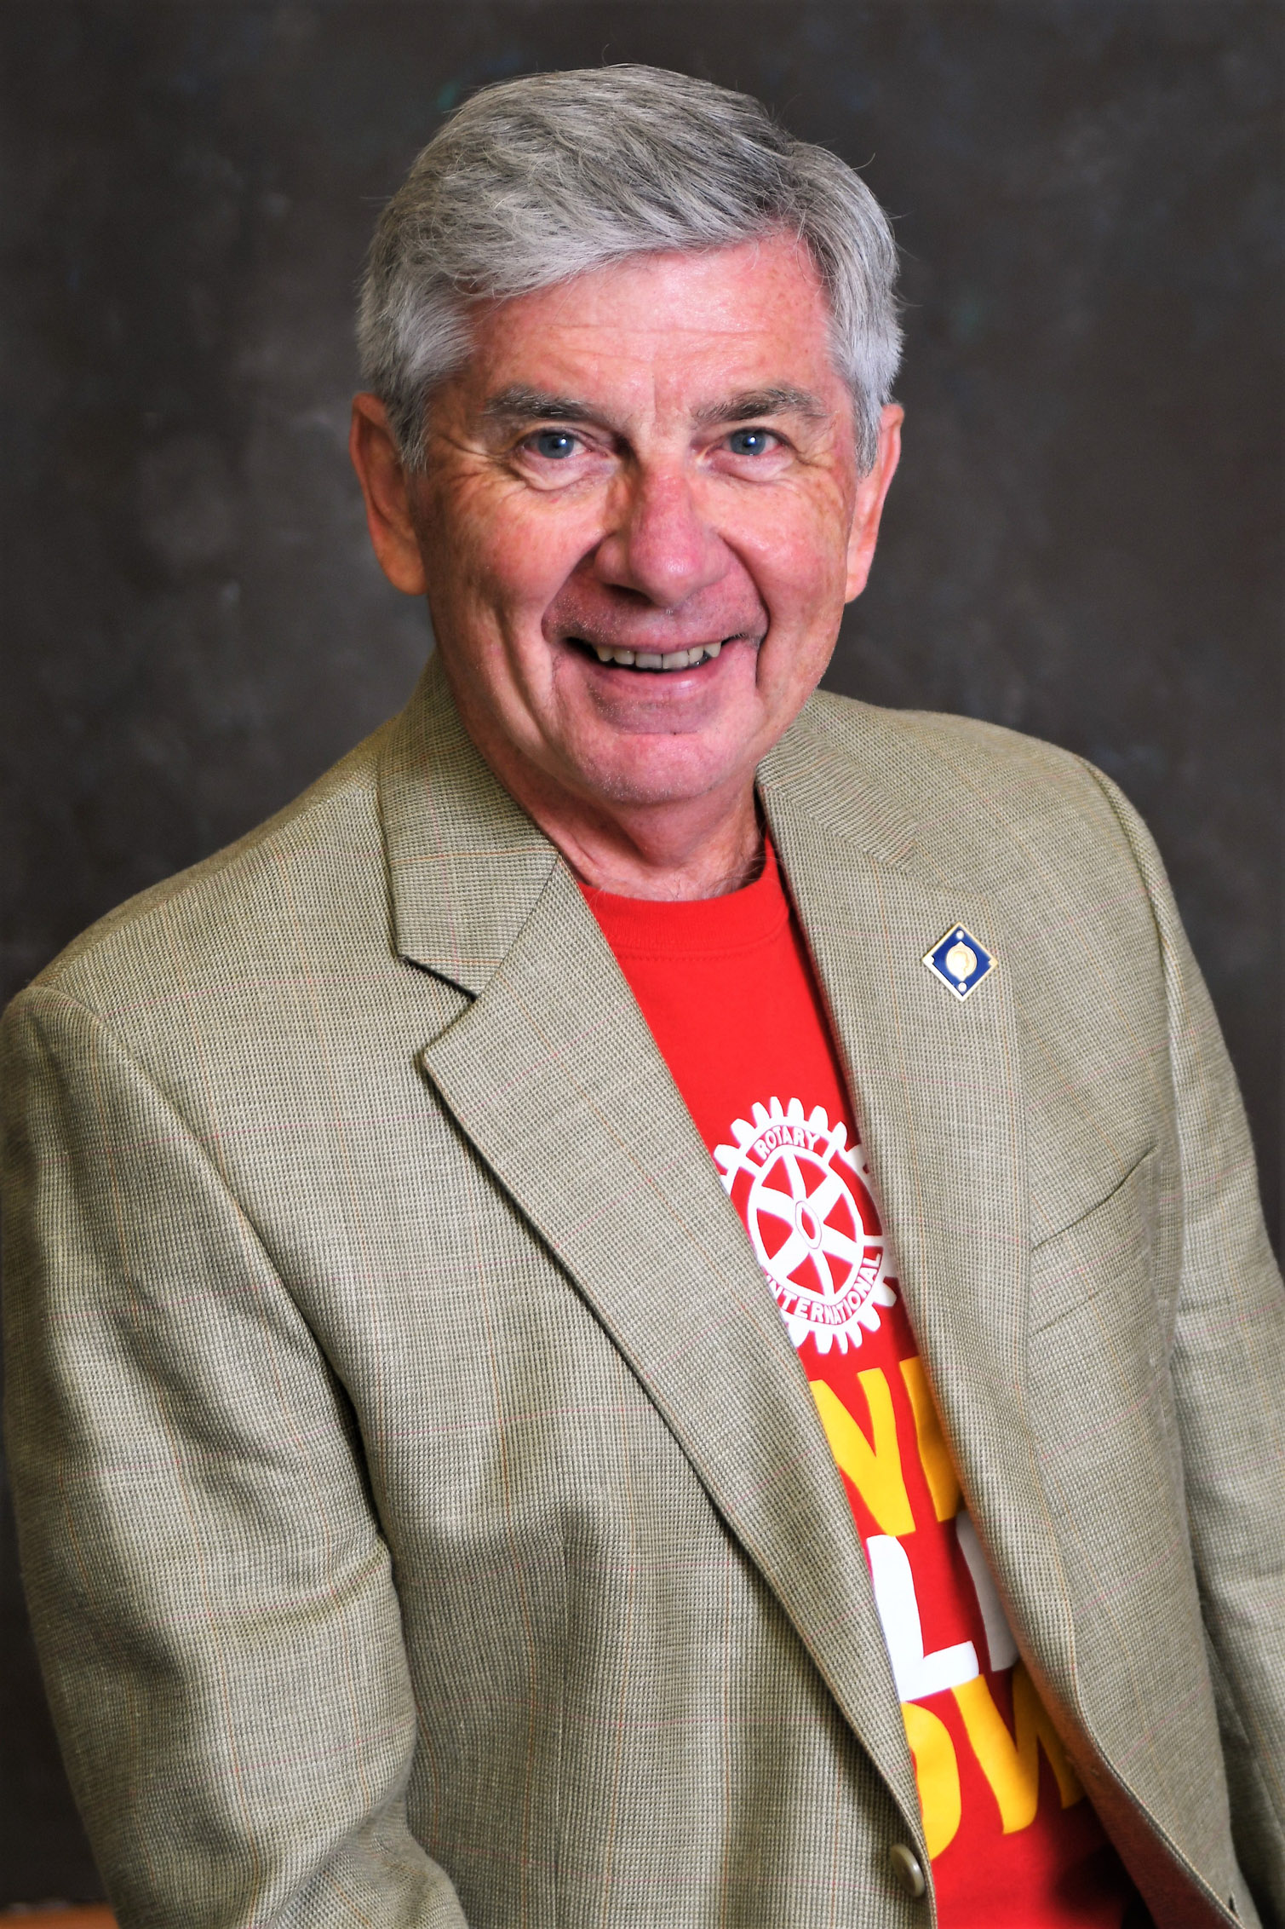
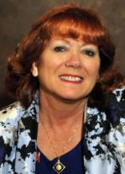
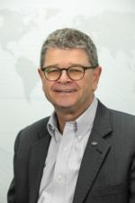
District 7770
Spring Training
Polio
Bernie Riedel
PolioPlus Co-Chair
Zone 33 EPNC
Sandee Brooks
PolioPlus Co-Chair
Christian Brutzer
PolioPlus Team Member

Slide 2



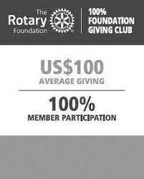

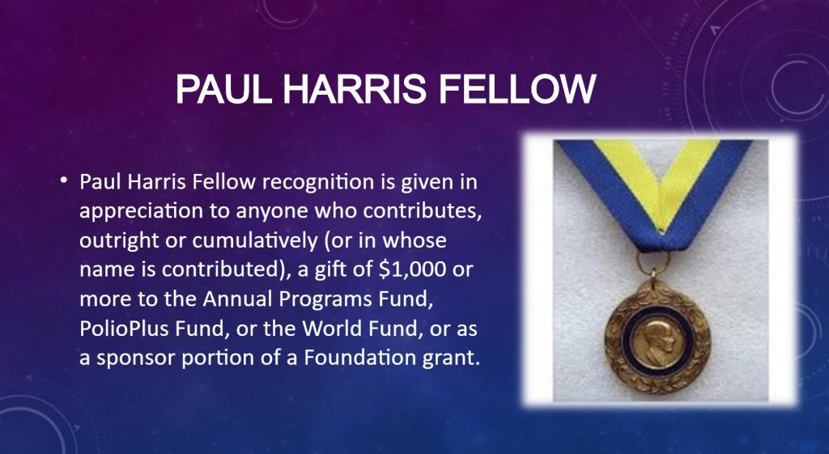



Annual Fund Giving
(Programs / Recognitions)

Slide 3
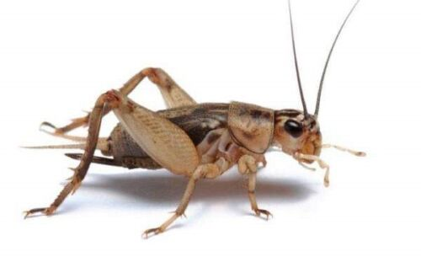
Polio Fund Giving
(Programs / Recognitions)

Slide 4
District 7770
Annual Fund Giving
Donor Participation %
2021-22
108%

Slide 5
District 7770
Polio Giving
Donor Participation %
2021-22
23%
(74% of Total Polio Giving)

Slide 6

Polio Fund Giving

Slide 7
PolioPlus Society
Pledge
$100 minimum annually
Rotary Direct (recurring)
EndPolio.org/donate
Check (To The Rotary Foundation
with PolioPlus in the Memo)

Slide 8




Slide 9

Certificate

Slide 10
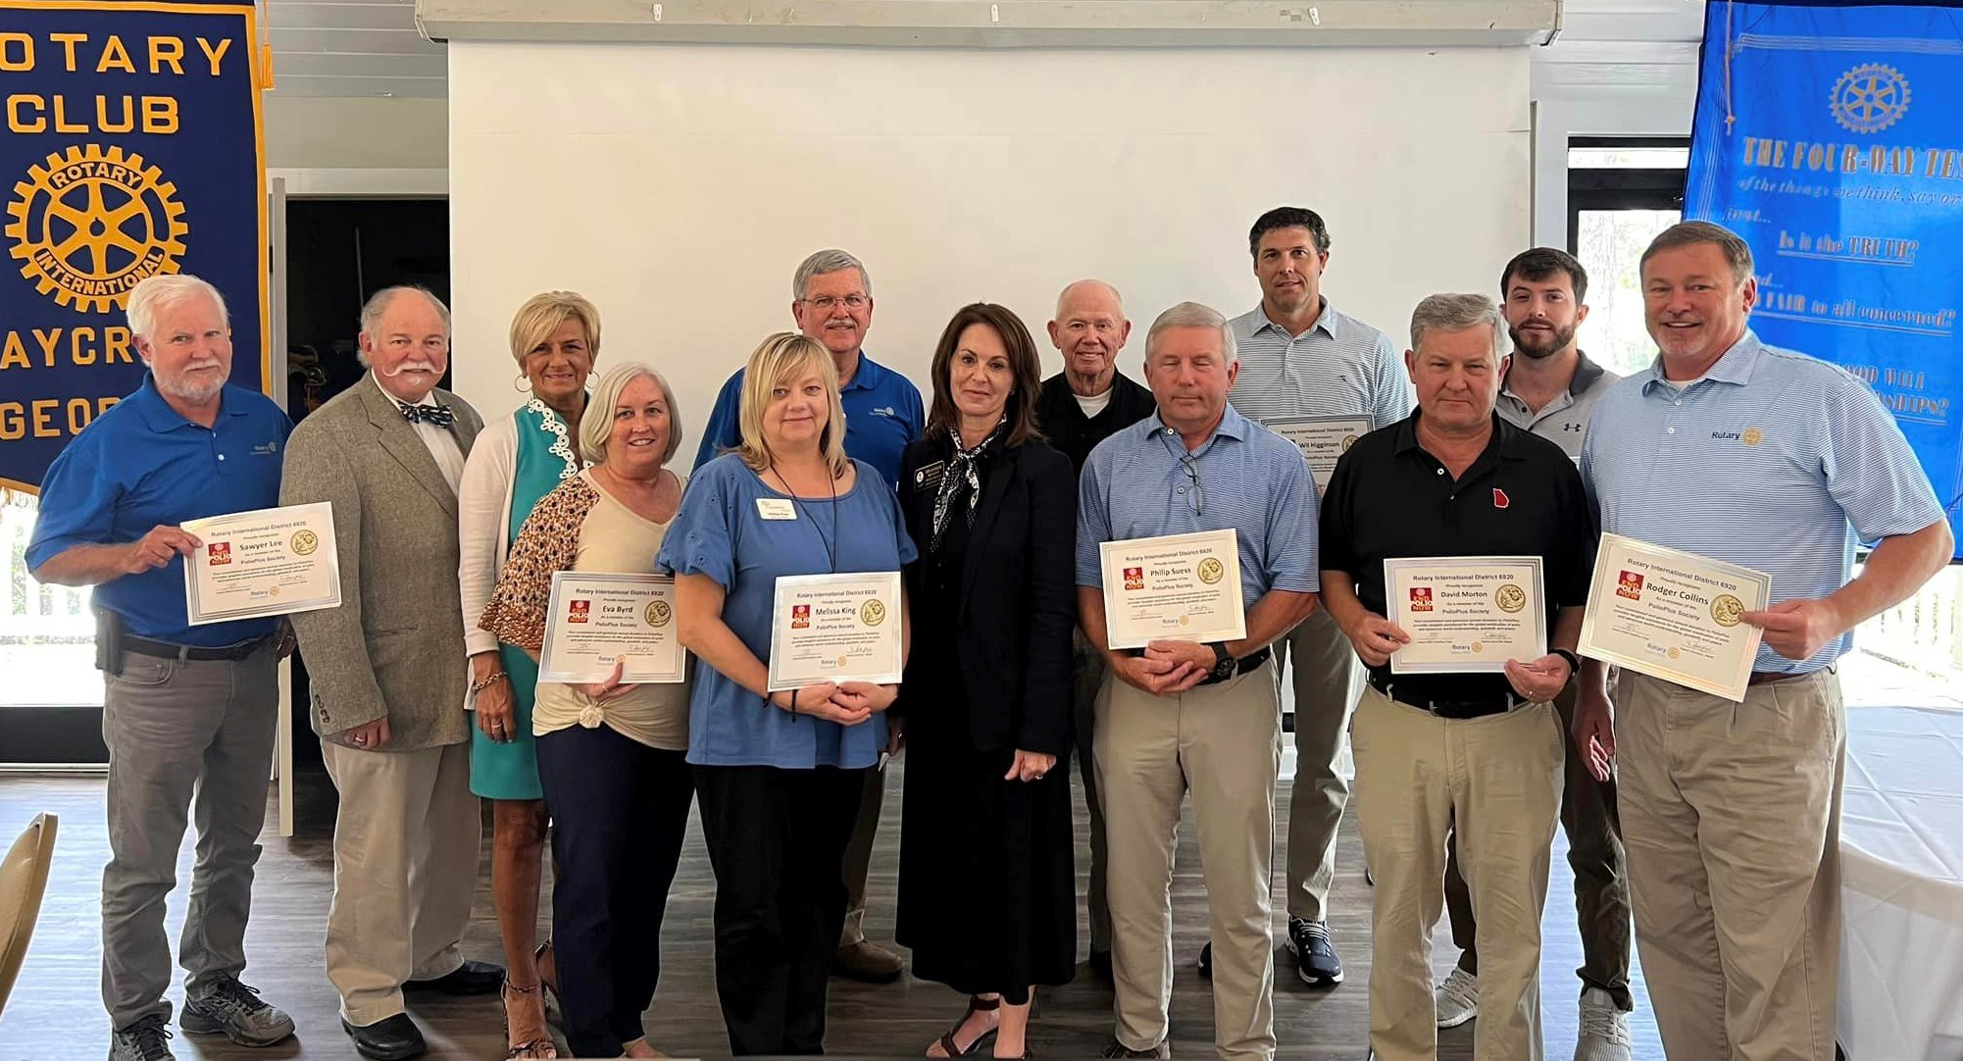
Recognition

Slide 11
Now What?
Join the PPS (Fill out the card)
Spread the word to your club members:
Need a speaker? Sandee, Bernie, Christian
Utilize PowerPoint & Talking Points
Take PPS cards, Email - Text - Mail back to: Sandee Brooks
105 Shoreline Drive
Hilton Head Island, SC 29928
BrooksRambo@Gmail.Com 843-290-3054

Slide 12
Questions

Slide 13
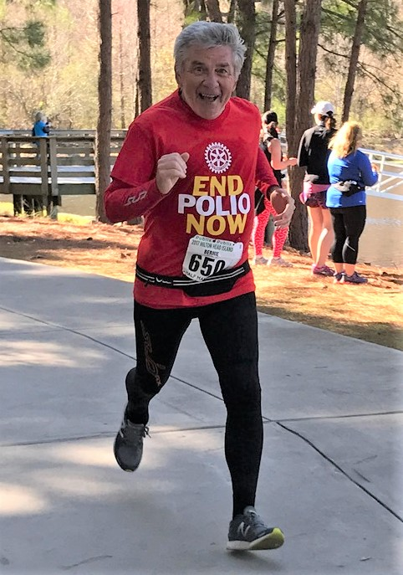
Run with Bernie
2023-24
Notes:
Les Wright
Les Wright - Today, in some nameless village a child greeted the new day unaware that during the night polio passed him over because he was immunized.

Slide 14
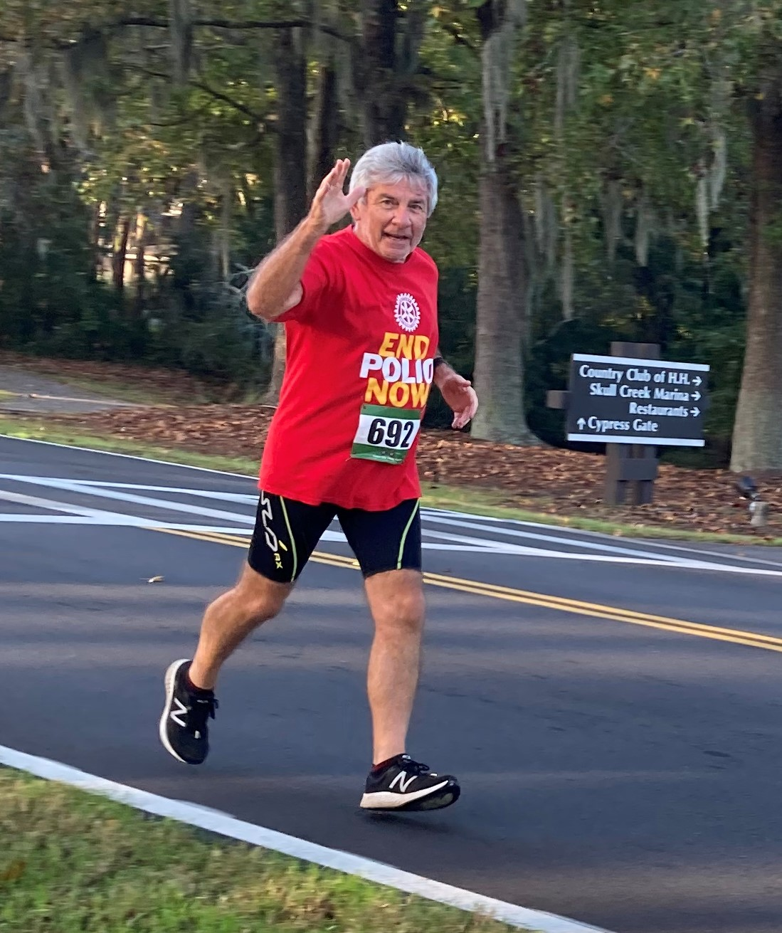
Run with Bernie
Walk/Run/Bike/Swim/Row
(Everything Counts)
July 1, 2023
to
October 24, 2023
Notes:
Les Wright
Les Wright - Today, in some nameless village a child greeted the new day unaware that during the night polio passed him over because he was immunized.

Slide 15
Run with Bernie
(July 1, 2023 to October 24, 2023)
Goals
Raise $’s and Awareness
Achieve Your Club Polio Goal
Have FUN!
Just Maybe Get a Bit Healthier
Notes:
Les Wright
Les Wright - Today, in some nameless village a child greeted the new day unaware that during the night polio passed him over because he was immunized.

Slide 16
Run with Bernie
Start a Team
Rotarians, Family, Friends, Neighbors, (Anywhere in the World)!
Get $ Pledges or Contributions
Get $ Matches!
Track Miles & $’s - Monthly
Create Awareness - Photos, Team, Social Media
Have FUN
Notes:
Les Wright
Les Wright - Today, in some nameless village a child greeted the new day unaware that during the night polio passed him over because he was immunized.

Slide 17
Run with Bernie
Available Forms
Team Captain Summary Form
Team Member Mileage Form
Donor Pledge Form
PolioPlus Society Form
Notes:
Les Wright
Les Wright - Today, in some nameless village a child greeted the new day unaware that during the night polio passed him over because he was immunized.

Slide 18

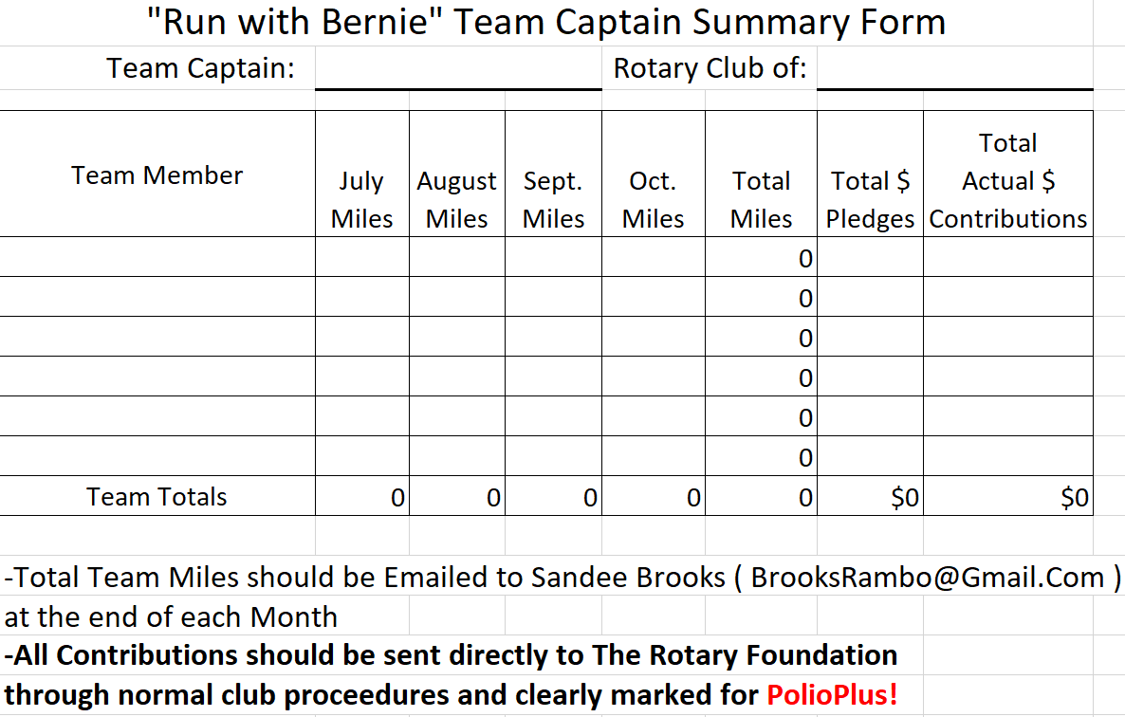
Run with Bernie
Team Captain Summary
Notes:
Les Wright
Les Wright - Today, in some nameless village a child greeted the new day unaware that during the night polio passed him over because he was immunized.

Slide 19
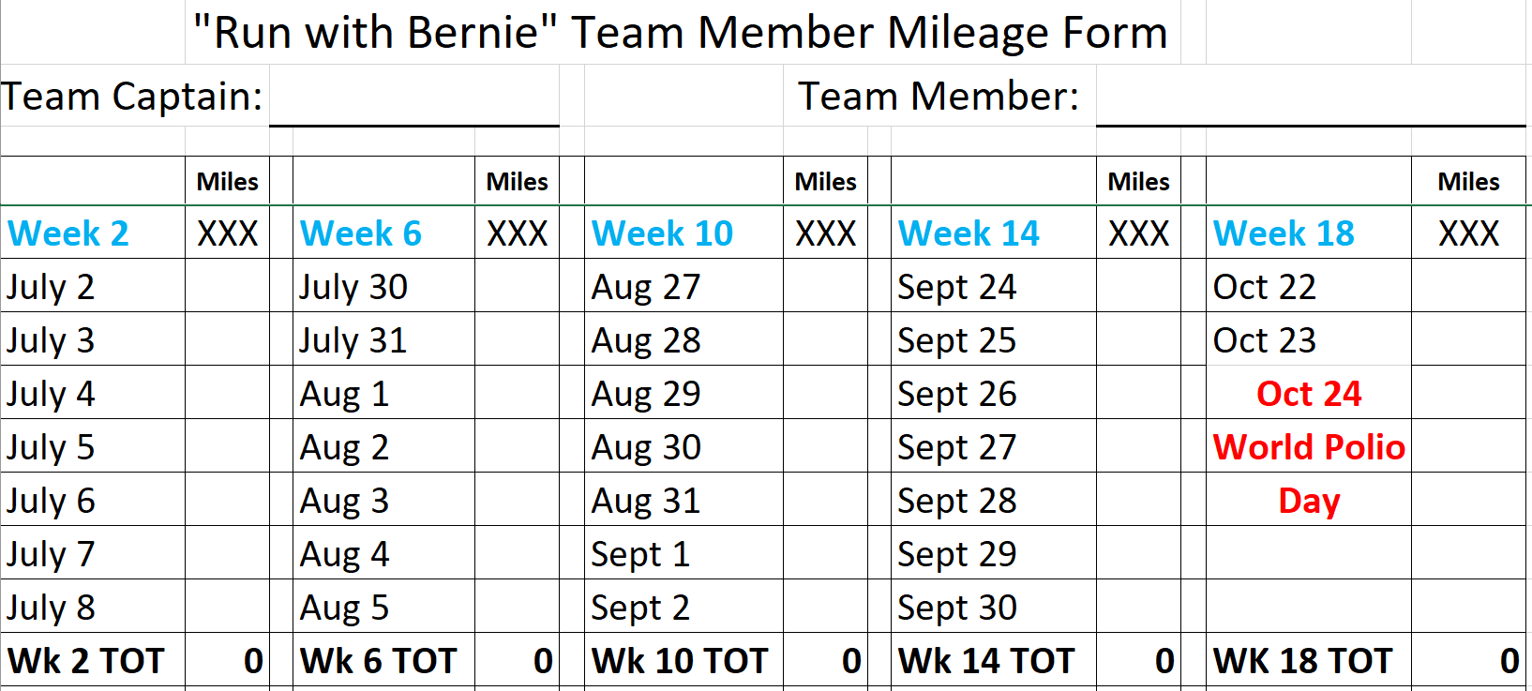
Run with Bernie
Notes:
Les Wright
Les Wright - Today, in some nameless village a child greeted the new day unaware that during the night polio passed him over because he was immunized.

Slide 20
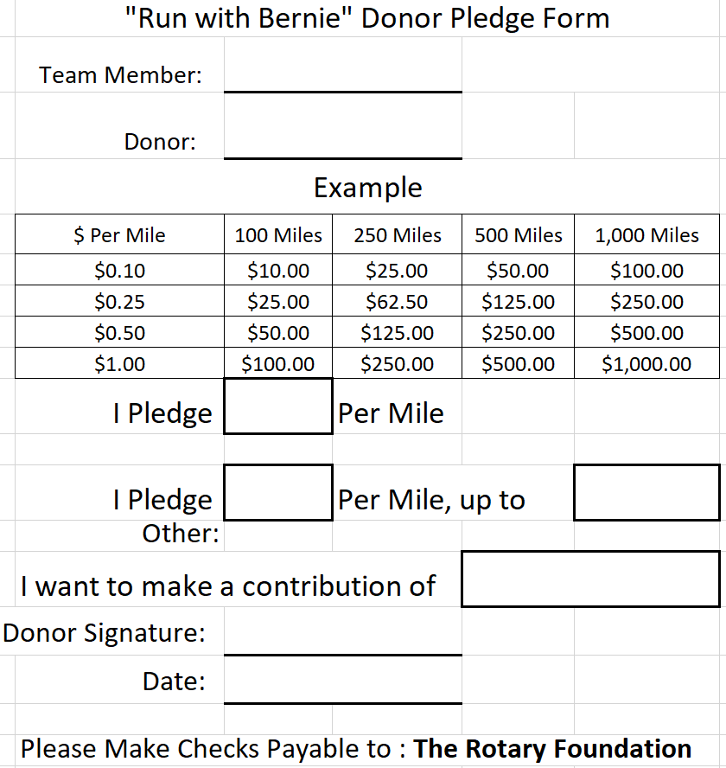
Run with Bernie
Notes:
Les Wright
Les Wright - Today, in some nameless village a child greeted the new day unaware that during the night polio passed him over because he was immunized.

Slide 21
Questions

Slide 22
Contact Information
Sandee Brooks
BrooksRambo@Gmail.Com
843-290-3054
Christian Brutzer
cbroo@Hotmail.Com
914-473-9445
Bernie Riedel
Bernie@RiedelComputers.Com
843-816-4450

Slide 23
Why
We Give
Notes:
Les Wright
Les Wright - Today, in some nameless village a child greeted the new day unaware that during the night polio passed him over because he was immunized.

Slide 24
