Slide 1
Creating Strong Grow Culture: Ignite the Sparks

Slide 2
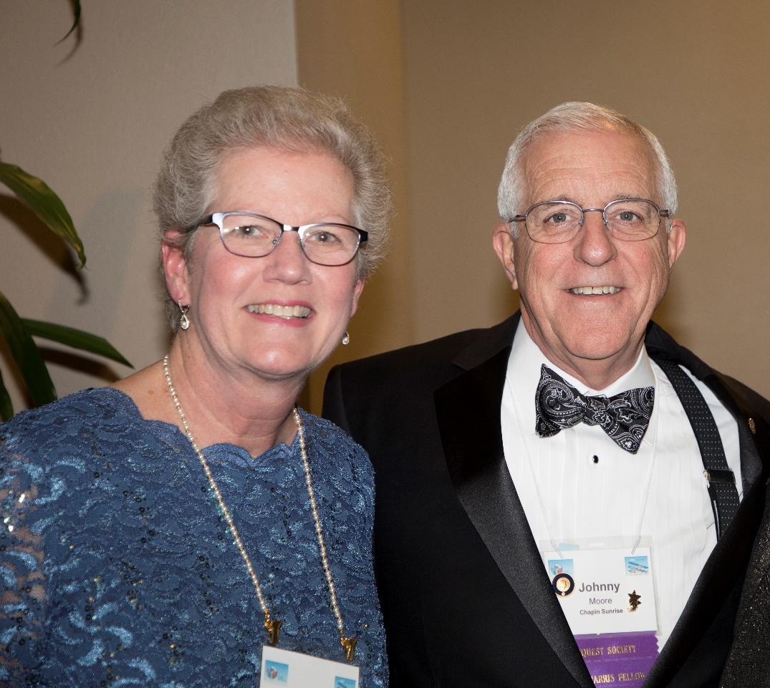
Welcome Past District Governor Johnny Moore (2019-20) & Susan.

Slide 3
Why Do Members Leave?
How Do We Build A Growth Culture?

Slide 4
Death by PowerPoint

Slide 5
Death by PowerPoint

Slide 6
Why Do Members Leave?

Slide 7
How Do We Build a Growth Culture

Slide 8
Building a Strong Growth Culture
“The #1 reason for membership decline is club culture.”
People leave club due to:
Cost & Time
Club Environment
Unmet Expectations
RI President 2023-25

Slide 9
In Building Strong Growth Culture
Leading Change

Slide 10
As Club Leaders We are
Change Leaders
Club To Change Strategy
Members To Change Behavior

Slide 11
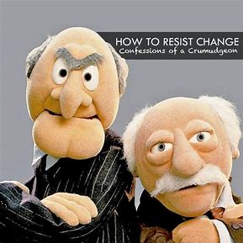
What Are Some Obstacles We Might Face?

Slide 12
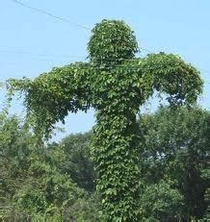
There Is No Place For Complacency In Rotary

Slide 13
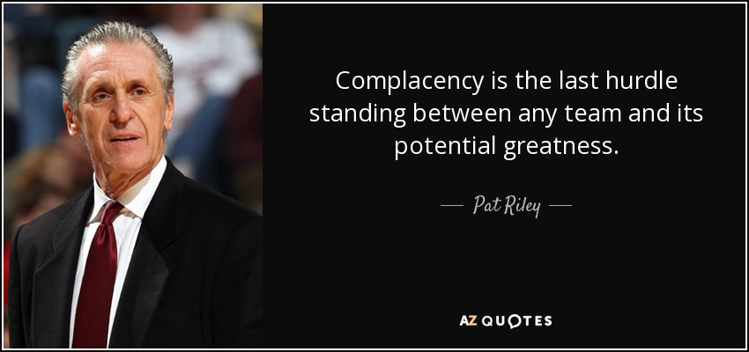

Slide 14
The Three E’s
Enthusiasm
Energy
Excitement

Slide 15
Finding Value in the Rotary Experience
“When people find value in the Rotary experience, that’s what keeps them coming back.”

Slide 16
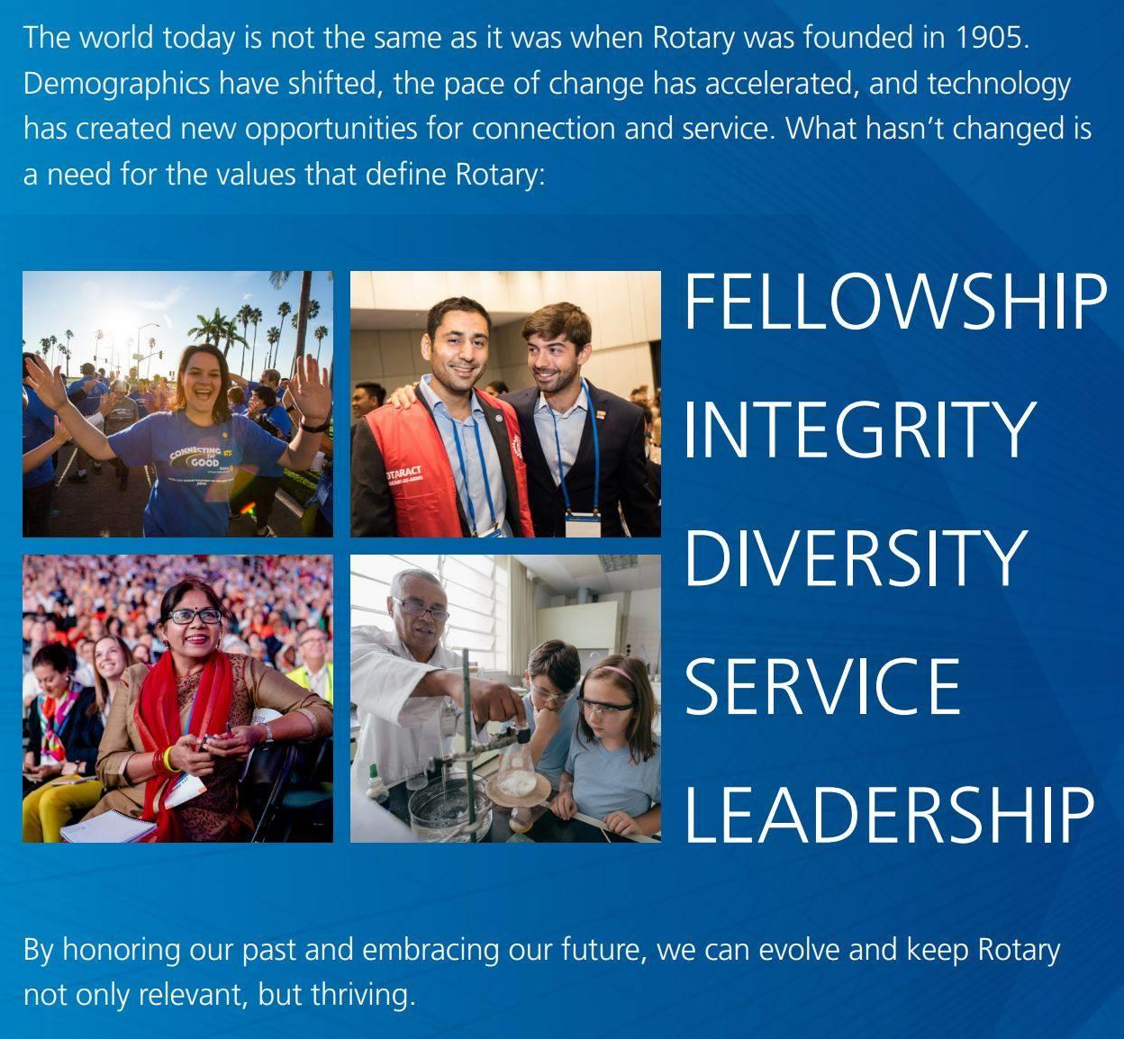
Finding Value in the Rotary Experience

Slide 17
“Leaders are visionaries with a poorly developed sense of fear, and no concept of the odds against them. They make the impossible happen.”
Robert Jarvik

