Slide 1

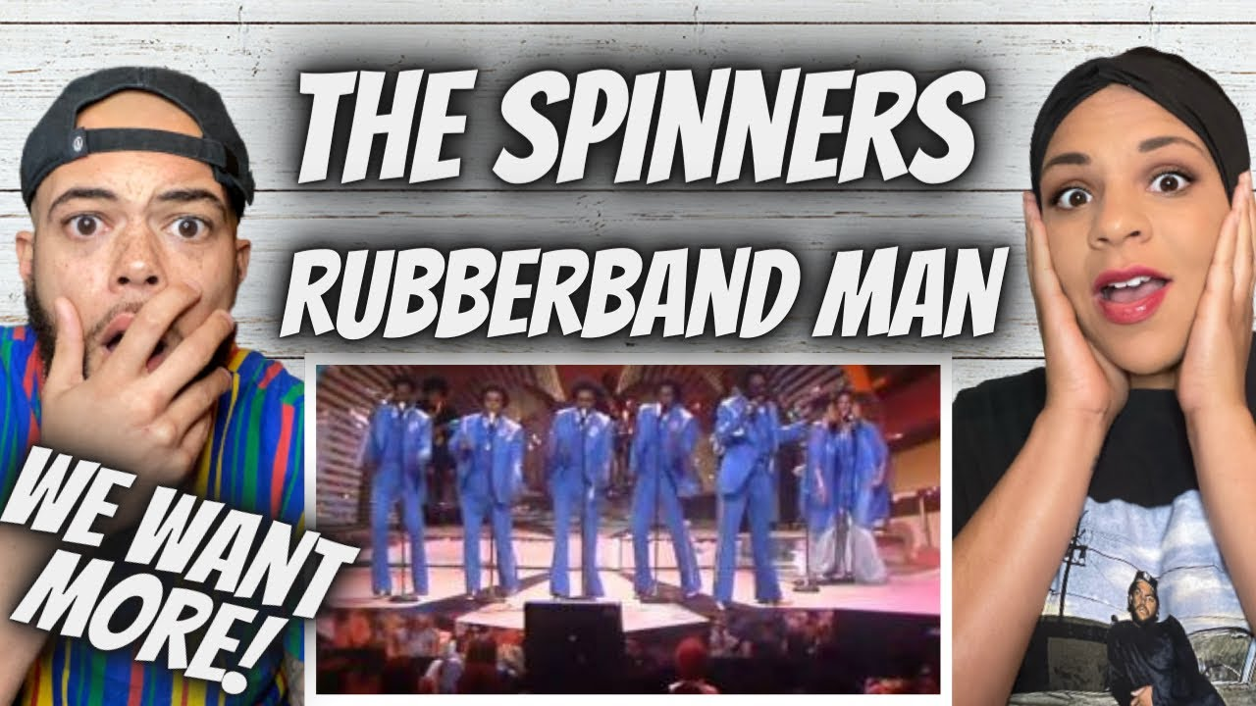

Let’s Get Growing Innovatively!
Meet the Rubber Band Man
Title Page Option

Slide 2


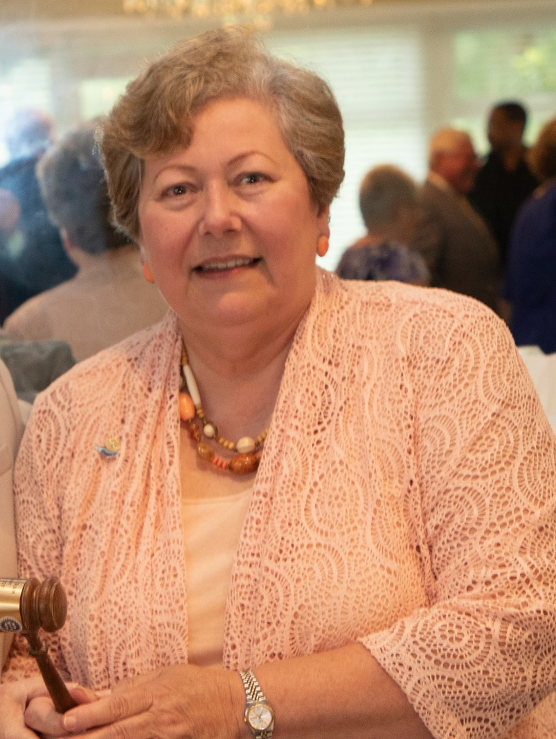
ROTARY IS A GIFT
Let’s Get Innovative
District 7770 Spring Training Assembly 4-21-23
Title Page Option

Slide 3
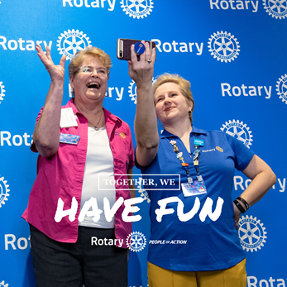
Fun
Rotary is…
Flexible
Changes Lives
Builds Friendships
What Else?
Title Page Option

Slide 4
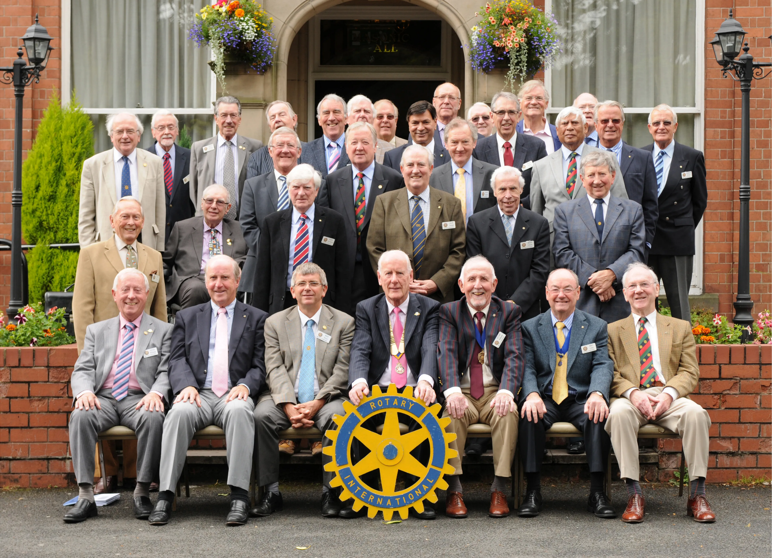
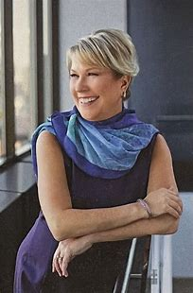
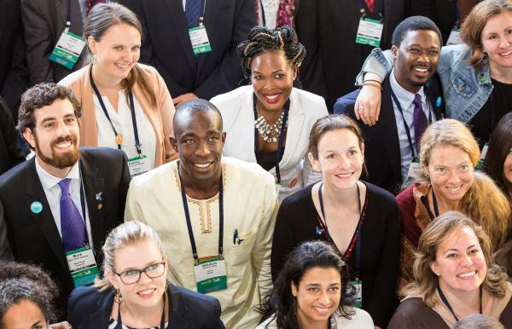
IT’S A NEW DAY
Traditional Rotary
Flexible Rotary
Meets
Title Page Option

Slide 5


Let’s Get Innovative
What is a take-home you hope to get?
When we ask clubs to be innovative, what are we asking them to do?
Describe some resistance/push-back we might get.
Title Page Option

Slide 6

Rotary Club Anytown USA Video
Could this be your club?
Title Page Option

Slide 7


Imagine Becoming Innovative
Title Page Option

Slide 8

Rotary Club Options
Traditional
Innovative Club Options
E-Club
Affinity
Mission
Companion
Satellite
Impact
Cause-based
Interest-based
Rotaract
Title Page Option

Slide 9

Innovative Club Options/Break-out Session
Group Discussion & Report
Title Page Option

Slide 10

Flexible Membership Options
Active & Honorary
R-85
R-35 Young Professional
Business
E-Member
Family
Associate
Title Page Option

Slide 11

Flexible Membership Options
Break-Out Session
Title Page Option

Slide 12
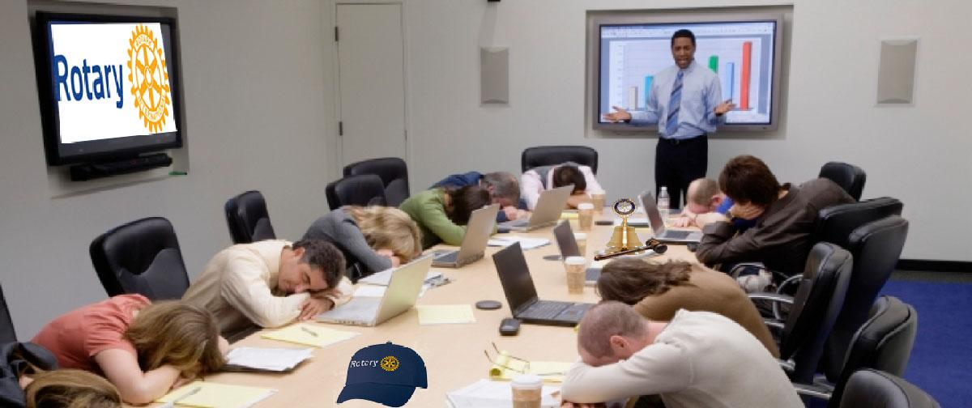
THAT’S A WRAP!
Title Page Option

