Slide 1
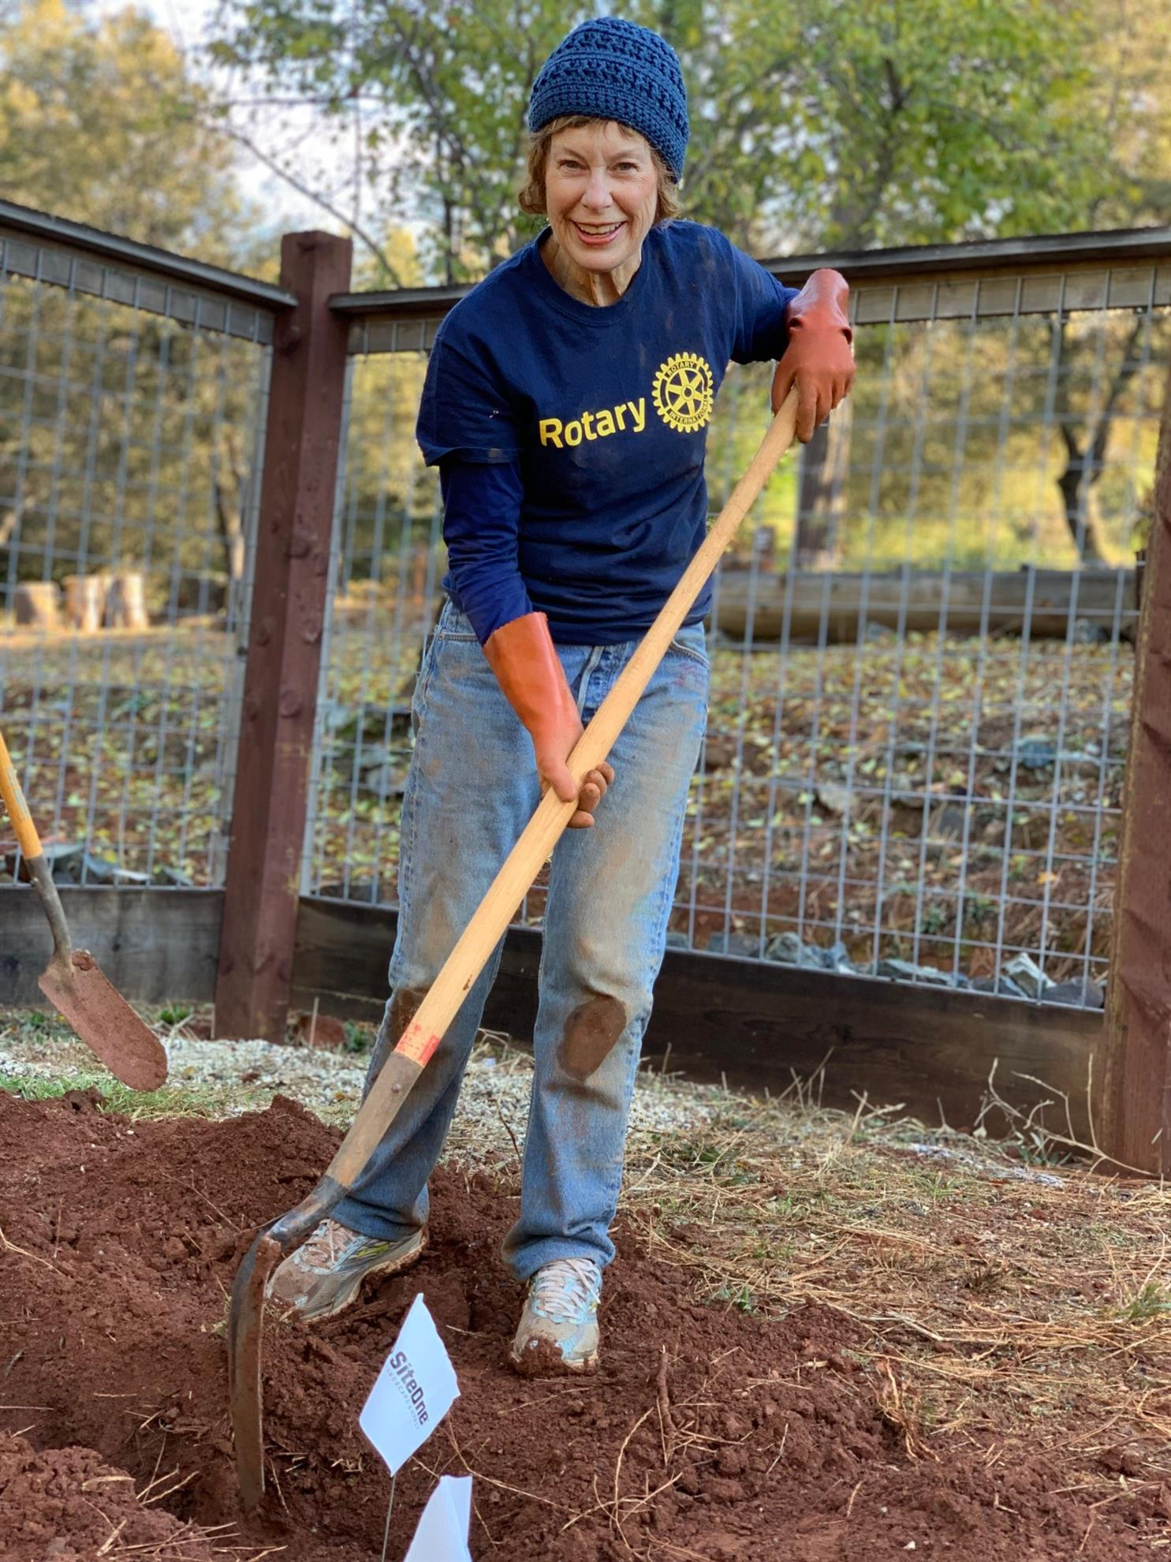
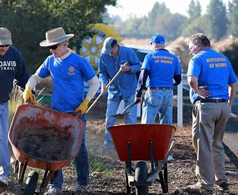
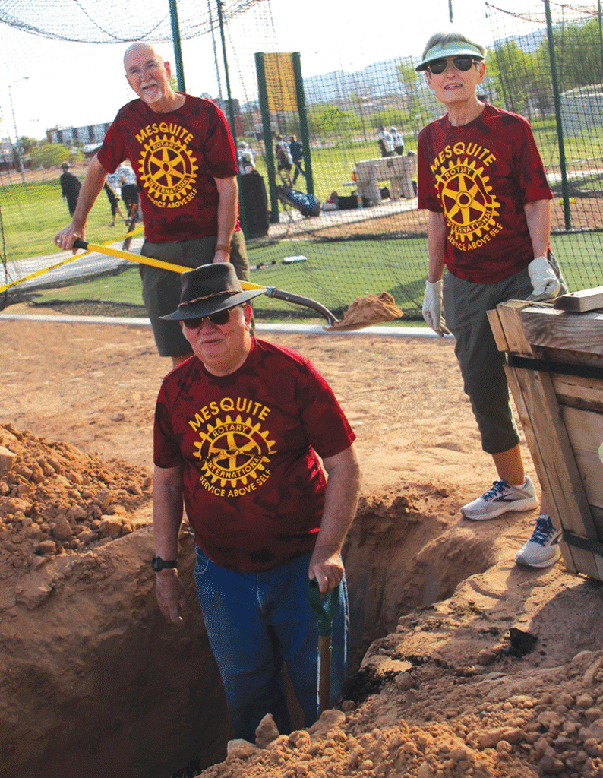
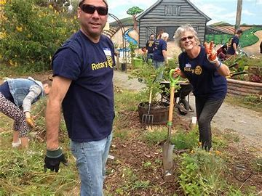
“Let’s Get Growing”
Digging Deep Into Membership Growth
Title Page Option

Slide 2

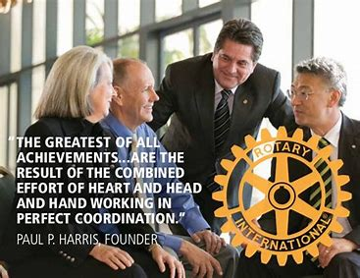
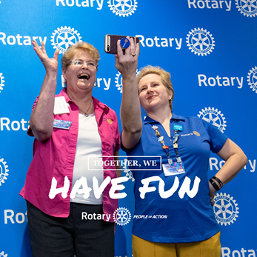

Sending A Clear Membership Message
Let’s Get Membership Right…
Grow Moderately & Consistently 5%
Innovative To Remain Relevant
Attrition is Real
Title Page Option

Slide 3

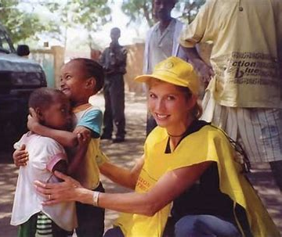

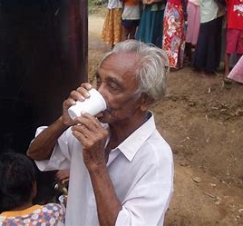



Why Is Membership Growth Important?
Title Page Option

Slide 4
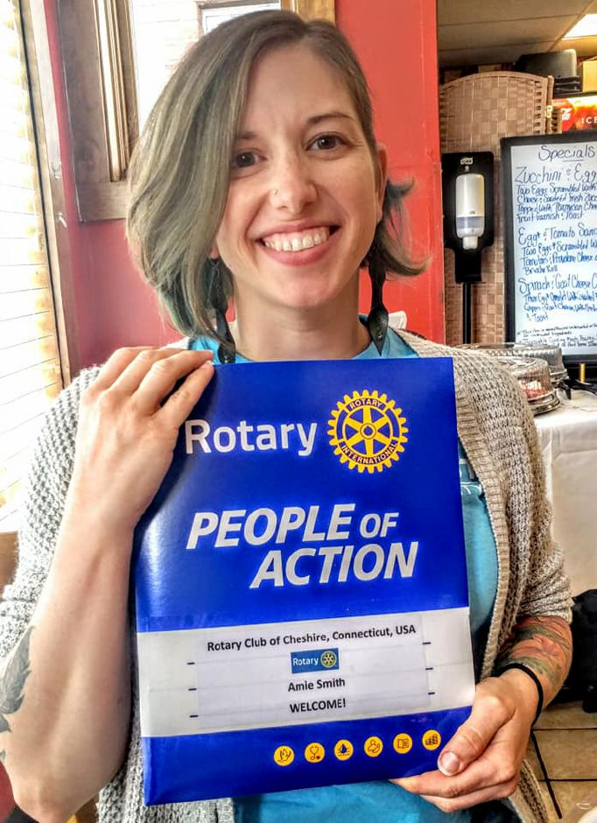
Discussion Time
What are some obstacles that make it difficult to grow membership?
What can we do to eliminate those obstacles?
What are some ways to encourage members to reach out and invite a prospective member?
Title Page Option

Slide 5

Intentional Growth Strategies
Written Strategy Statement
“Our club is committed to grow membership moderately & consistently every year by 5%.”
Membership Team
Membership Plan
Strong Growth Culture
Discover Rotary
Title Page Option

Slide 6
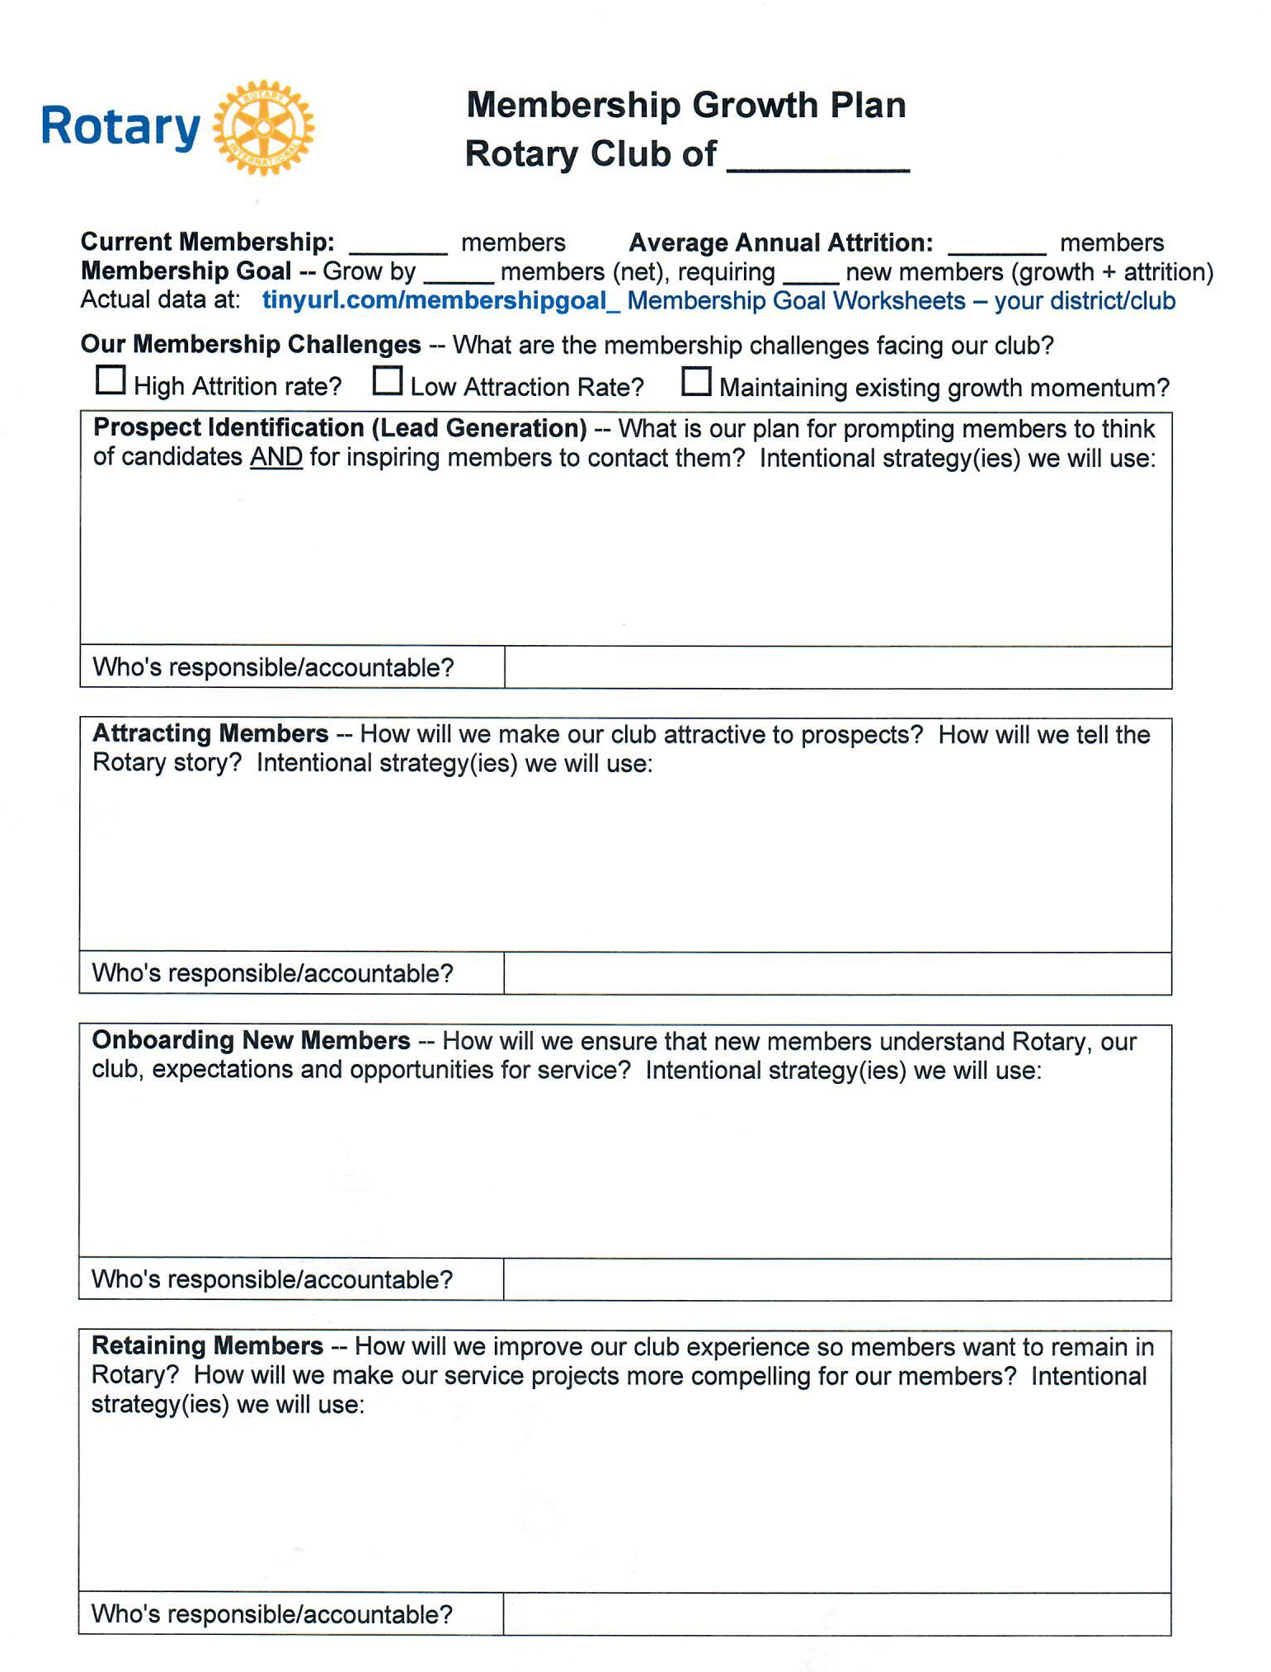
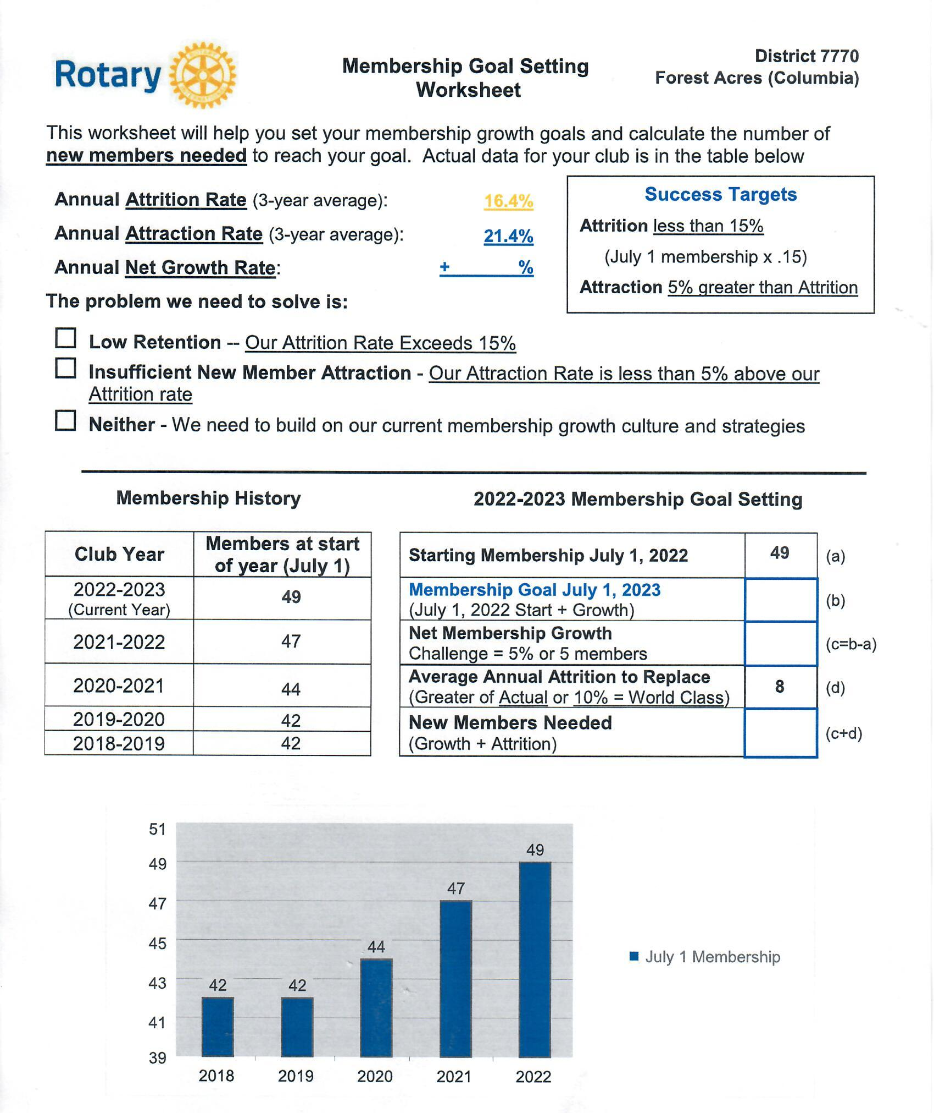
Two Important Tools For Setting Growth Goal
Membership Plan Due May 31
Title Page Option

Slide 7
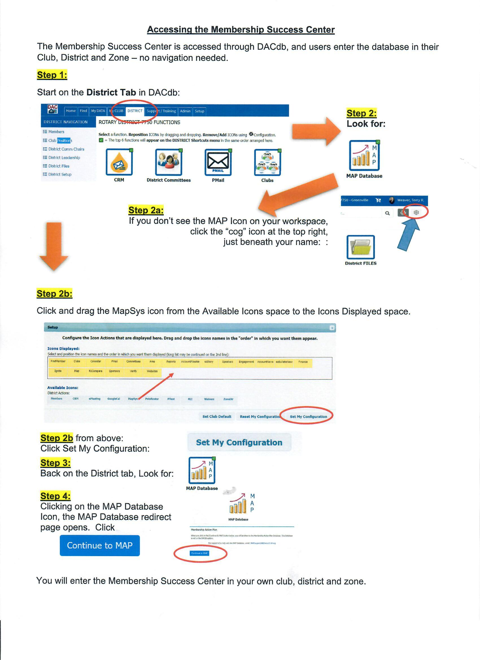

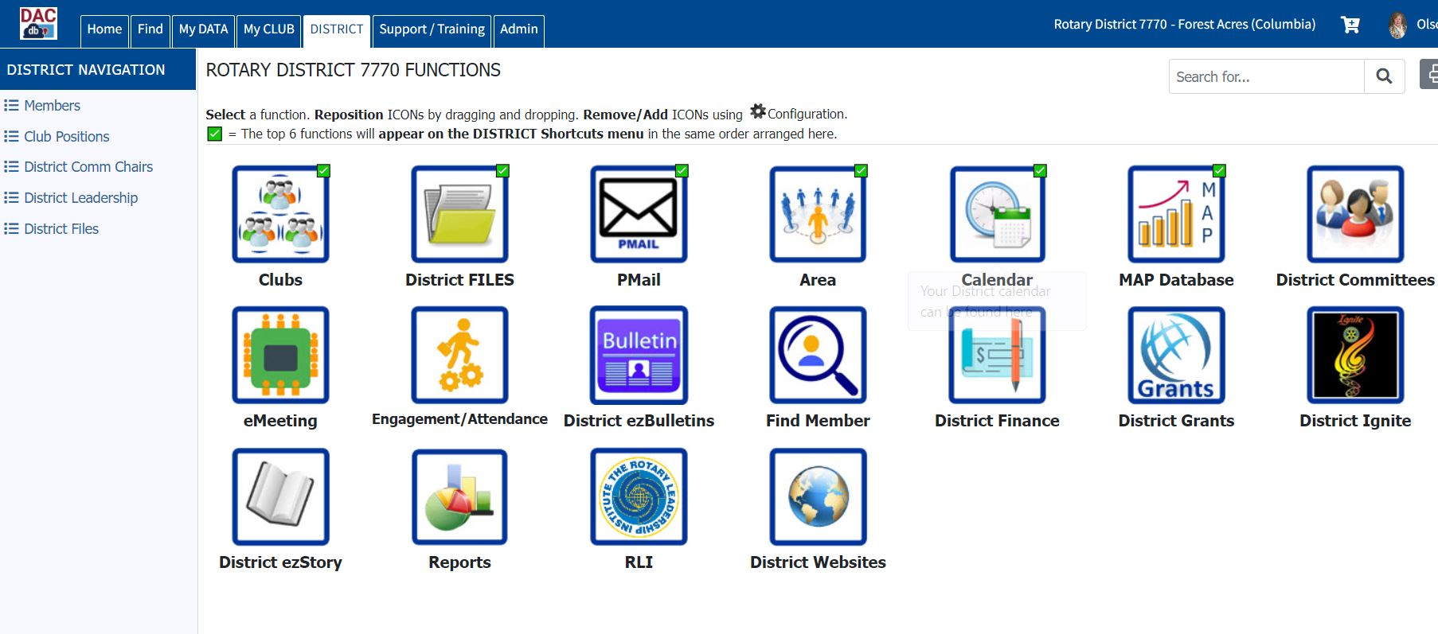
Rotary Membership Action Plan Success Center
Title Page Option

Slide 8


Discover Rotary: The Gold Standard For Growing Membership
Introduction to Rotary
Small group meeting
No more than 3-5 prospects
No more than 2-3 club members
Conducted multiple times
Title Page Option

Slide 9

Follow The Discover Rotary Recipe for Success
Planning Ahead
Set date, time, location
Hold members accountable
Confirm attendance
Day of Event
Sign in sheet
Introductions
Rotary overview
Title Page Option

Slide 10
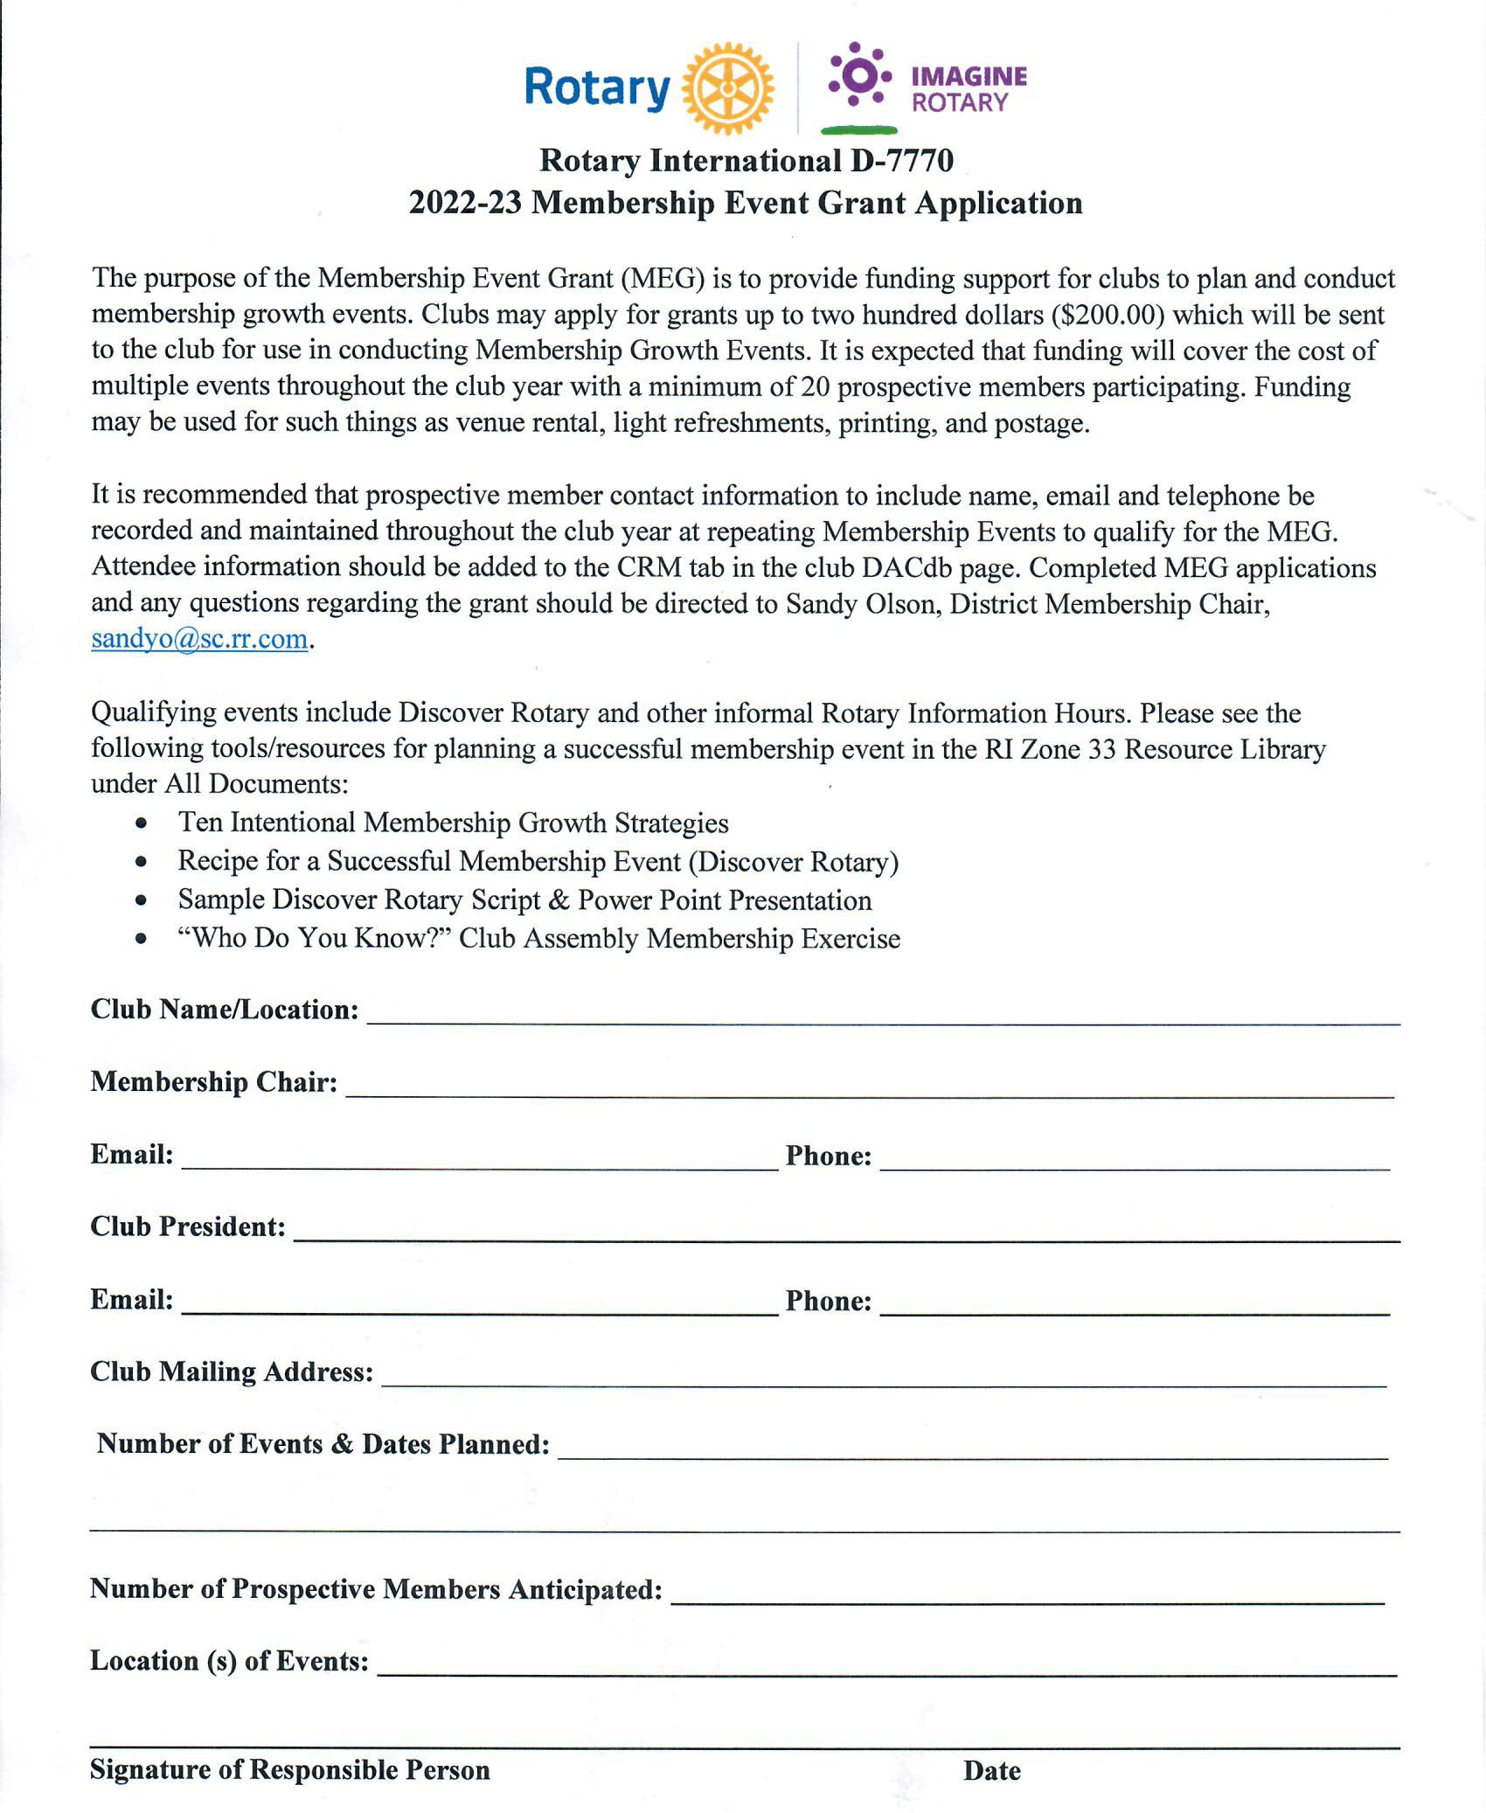
Follow The Discover Rotary Recipe for Success
Membership Event Grant (MEG)
Title Page Option

Slide 11


Rotary Club Compare
Keeping the good ship Rotary afloat
What is it?
Why is it important?
How does it apply to me?
How do I access it?
Title Page Option

Slide 12
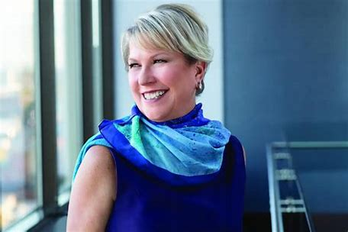
Easy 5-Step Process To Welcome A New Club Member
Discover Rotary
Induction
Mentor
Orientation & Training
Engagement
Review Your Club’s Application Process: Streamline

Slide 13
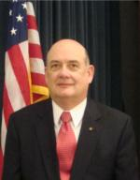

Manage Your Leads
This is Mark McCain, District Leads Manager
When he emails you a lead, please FOLLOW UP!

Slide 14
Leading Change
“Leaders are visionaries with a poorly developed sense of fear, and no concept of the odds against them. They make the impossible happen.”
Robert Jarvik

