Slide 1
Creating Strong Growth Culture: Ignite the Sparks

Slide 2
Why Do Members Leave?

Slide 3
What Does a Growth Culture Look Like?

Slide 4
How Do We Build a Growth Culture

Slide 5
Building a Strong Growth Culture
“The #1 reason for membership decline is club culture.”
People leave club due to:
Cost & Time
Club Environment
Unmet Expectations
RI President 2023-25

Slide 6
In Building Strong Growth Culture
Leading Change

Slide 7
As Club Leaders We are
Change Leaders
Club To Change Strategy
Members To Change Behavior

Slide 8
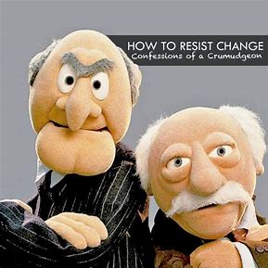
What Are Some Obstacles We Might Face?

Slide 9
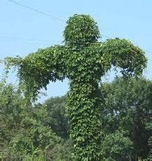
There Is No Place For Complacency In Rotary

Slide 10
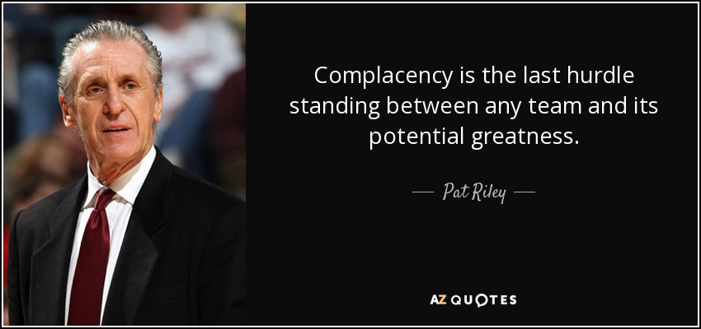

Slide 11
The Three E’s
Enthusiasm
Energy
Excitement

Slide 12
Finding Value in the Rotary Experience
“When people find value in the Rotary experience, that’s what keeps them coming back.”

Slide 13
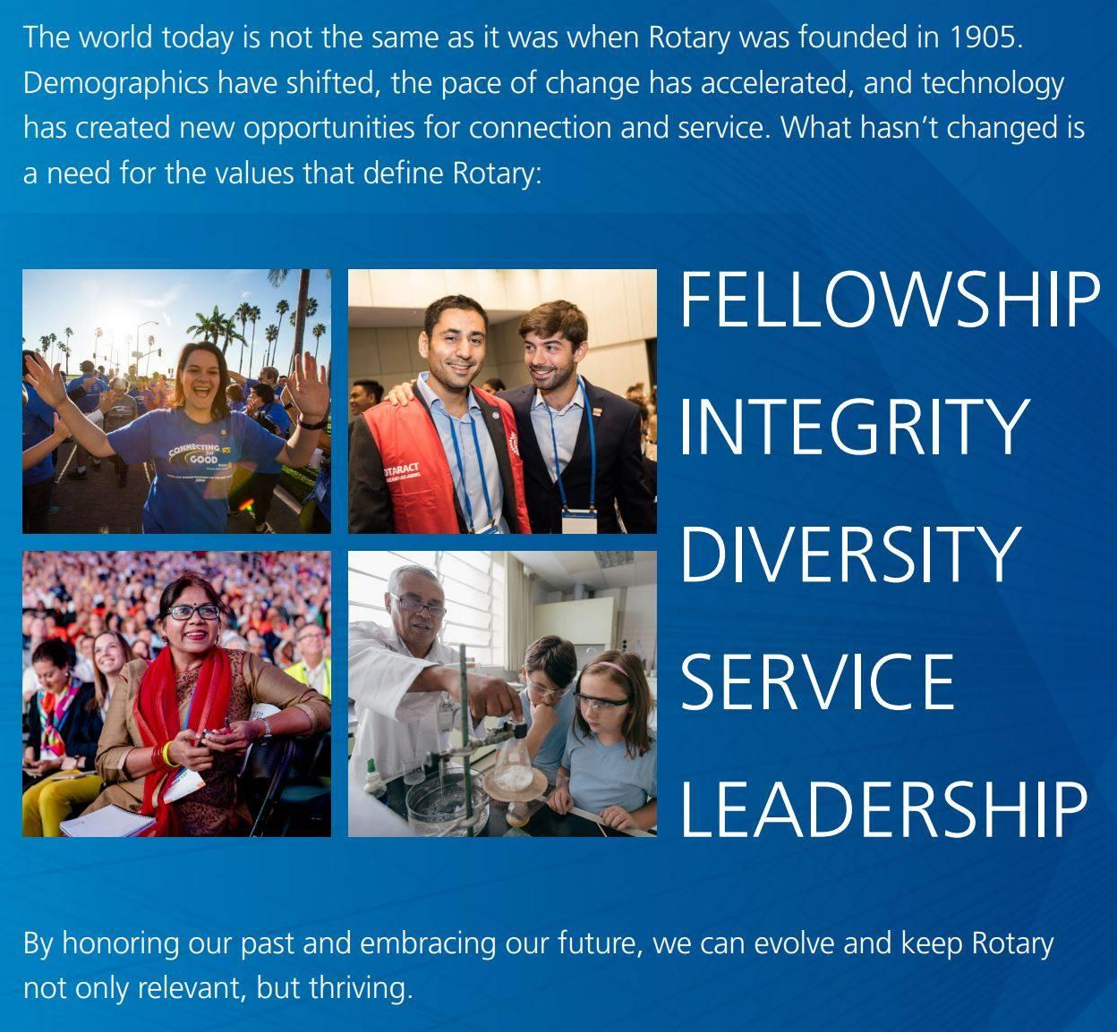
Finding Value in the Rotary Experience

Slide 14
“Leaders are visionaries with a poorly developed sense of fear, and no concept of the odds against them. They make the impossible happen.”
Robert Jarvik

