Slide 1
BRANDING
A logo is NOT a brand.
A brand is an experience that exists in the mind of the consumer.
A logo is part of that experience.
Rotary International wants you to use the Rotary logo in a consistent manner.

Slide 2

I would like to thank John Tabor of Rotary Club of Charlotte in District 7680 for letting me use his presentation on Branding.

Slide 3
brandcenter.rotary.org

Slide 4
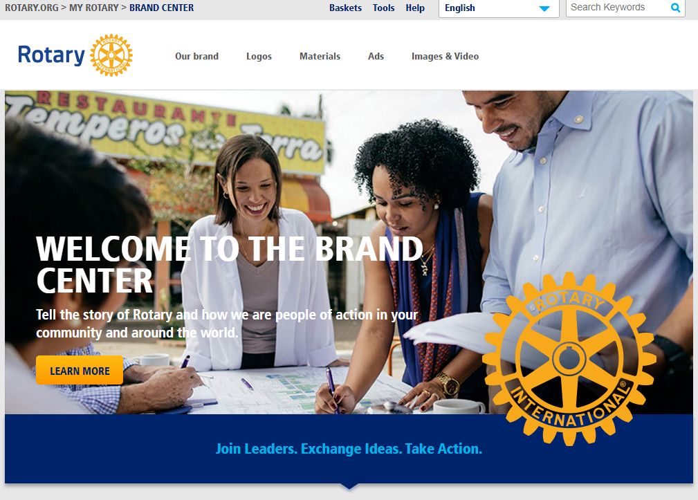
Rotary brand
https://brandcenter.rotary.org/en-GB
Everything is there!!
Everything!!

Slide 5

Rotary brand

Slide 6

Rotary brand

Slide 7

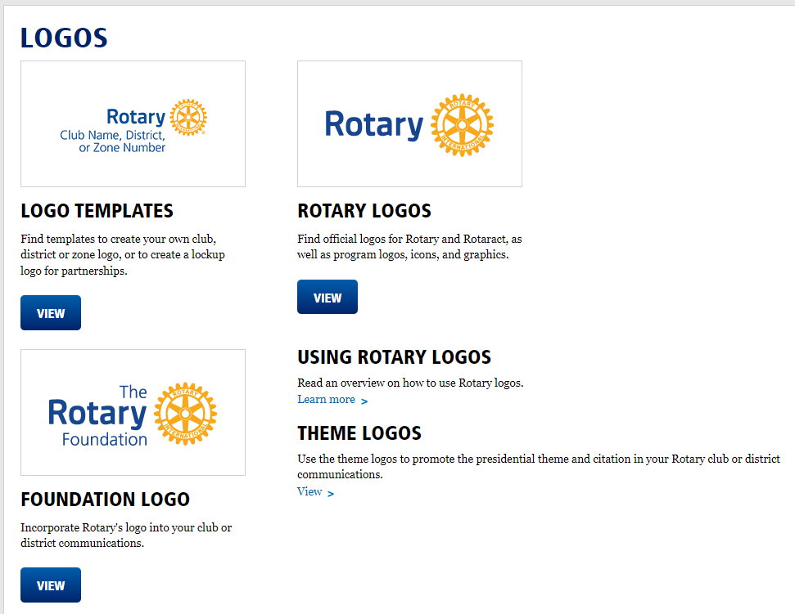
Rotary brand

Slide 8

One Voice, Every Club - Your Logos
Title Page Option
Notes:
At the end of this presentation, you’ll learn
-Why its important to use our logos correctly
-How to use our logos correctly
-Resources to effectively use our logos correctly in your club

Slide 9



Rotary international logos
Masterbrand Signature
Mark of Excellence
Masterbrand Signature Simplified
Notes:
Let’s start with some terminology.
This is Rotary’s logo, or what is referred to as the Masterbrand Signature. It consists of the word Rotary and the Rotary wheel. Below the MBS is the simplified logo. Either of these logos can be used as our Rotary logo.
Then, there’s the Mark of Excellence, which is the Rotary wheel on its own. It is always used in combination with the Masterbrand Signature, and is always depicted much larger than the Masterbrand Signature. Please notice that we don’t offer the simplified logo as the mark of excellence.
These elements are the base of Rotary’s visual identity. Every club, district, and program is to use the Masterbrand Signature its visual identity.
The logo cannot be manipulated. You wouldn’t manipulate any other brand’s logo.

Slide 10
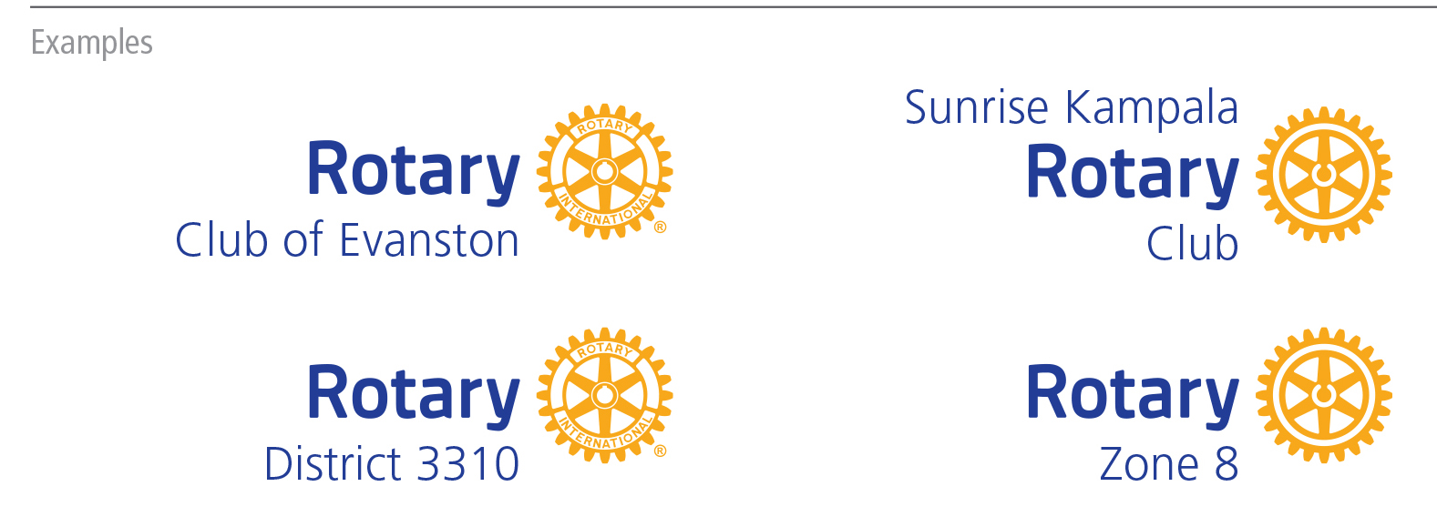
CLUB, DISTRICT, & ZONE LOGOS
Notes:
Only Rotary International can use the Masterbrand Signature on its own. Clubs, districts, multi-districts and zones can only use the Rotary logo with their club, district, or zone name. This applies to Rotary, Rotaract and Interact clubs.

Slide 11




lockups

Slide 12


BRANDS: THEN and NOW
2013
Rotary

Slide 13










NO, No, NO
Notes:
The use of various colors, fonts, and sizes, along with the alteration of the Mark of Excellence is a problem. There is no cohesion or unity. Perhaps all of these programs are part of a larger network, but it’s really hard to tell. And that can cause a potential member, donor or partner to doubt if we are an organization they can trust –- to join, to donate money to, or partner with.
We need our rules when it comes to our logos so we can share a consistent story and message.

Slide 14

Rotary brand

Slide 15

Theme for this year

