Slide 1

The Power of
Public Image
(PR, Advertising and Marketing)

Slide 2
Hi,
I’m Ken Gasque
Your District 7770 Public Image Chair

Slide 3
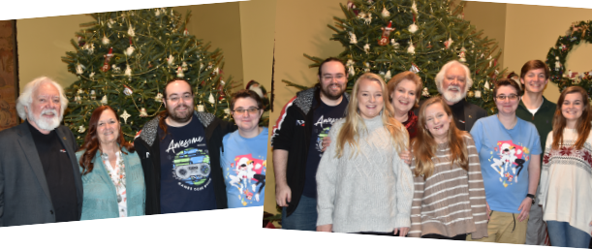
Notes:
This is part of my family. Recently we had a family and friends gathering for a birthday. I announced that my wife Mary was going to be a Rotary District Governor. Everyone was impressed. Then my grand daughter, 30 years old, asked, “What is Rotary.” There were twenty people in the room and
None of them knew anything about Rotary. We explained and told them about a few projects including End Polio. We may have a prospect or two.

Slide 4
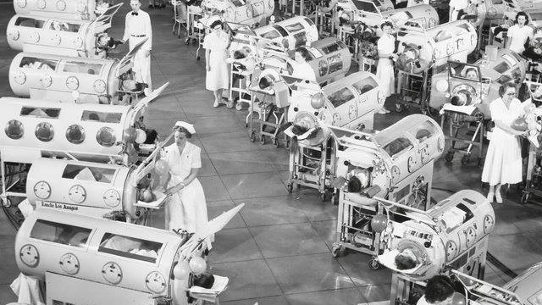
Notes:
The next day I received this photo from a family friend who was at the party with a note… “Thank you for what you and Mary and Rotary are doing! In case you don’t know these are iron lungs used in the 1950’s to treat people with polio.

Slide 5

As Public Image Chairs our objective is to create awareness for Rotary.

Slide 6


The first step in growing
Membership and Foundation is making sure people know we exist.

Slide 7

What is our Strategic Plan?
Two words…
Create Awareness!
Notes:
Plans are worthless, but planning is everything. Dwight D. Eisenhower

Slide 8
Three Takeaways
Look for opportunities
Order Tee Shirts
Publish Rotary Community Report

Slide 9
Public Image Is Powerful.

Slide 10
It creates your perceptions and your perceptions are reality.

Slide 11
Look for opportunities
ASK if you can help
ASK if they want to join you and help

Slide 13
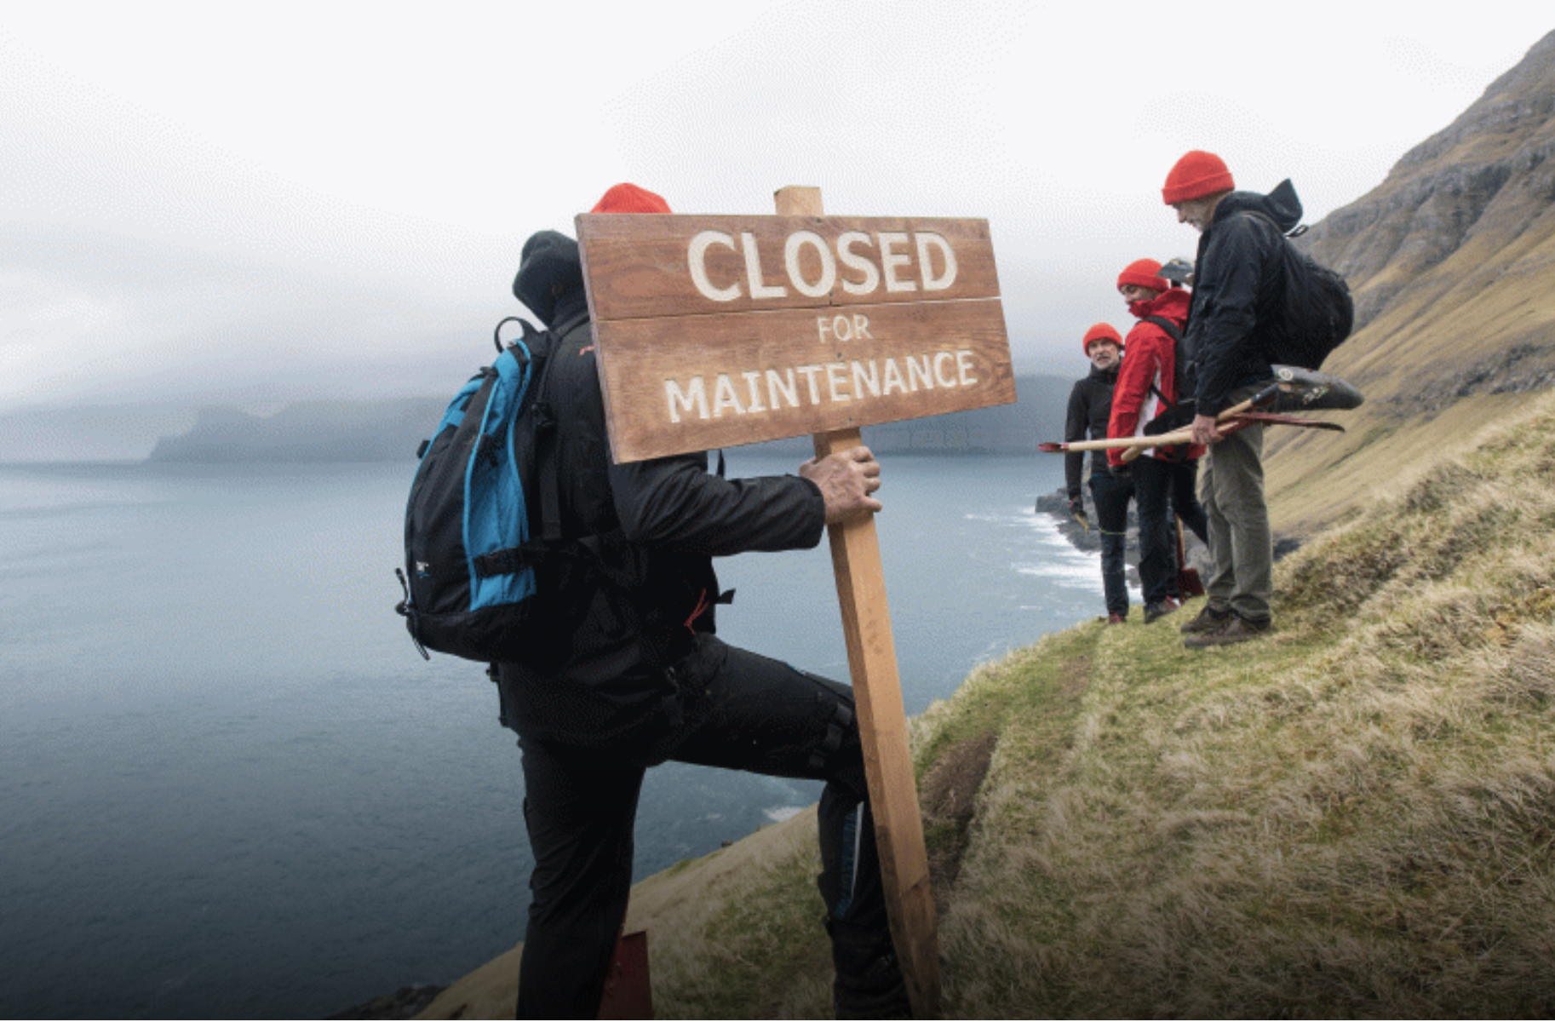
Faroe Island

Slide 14
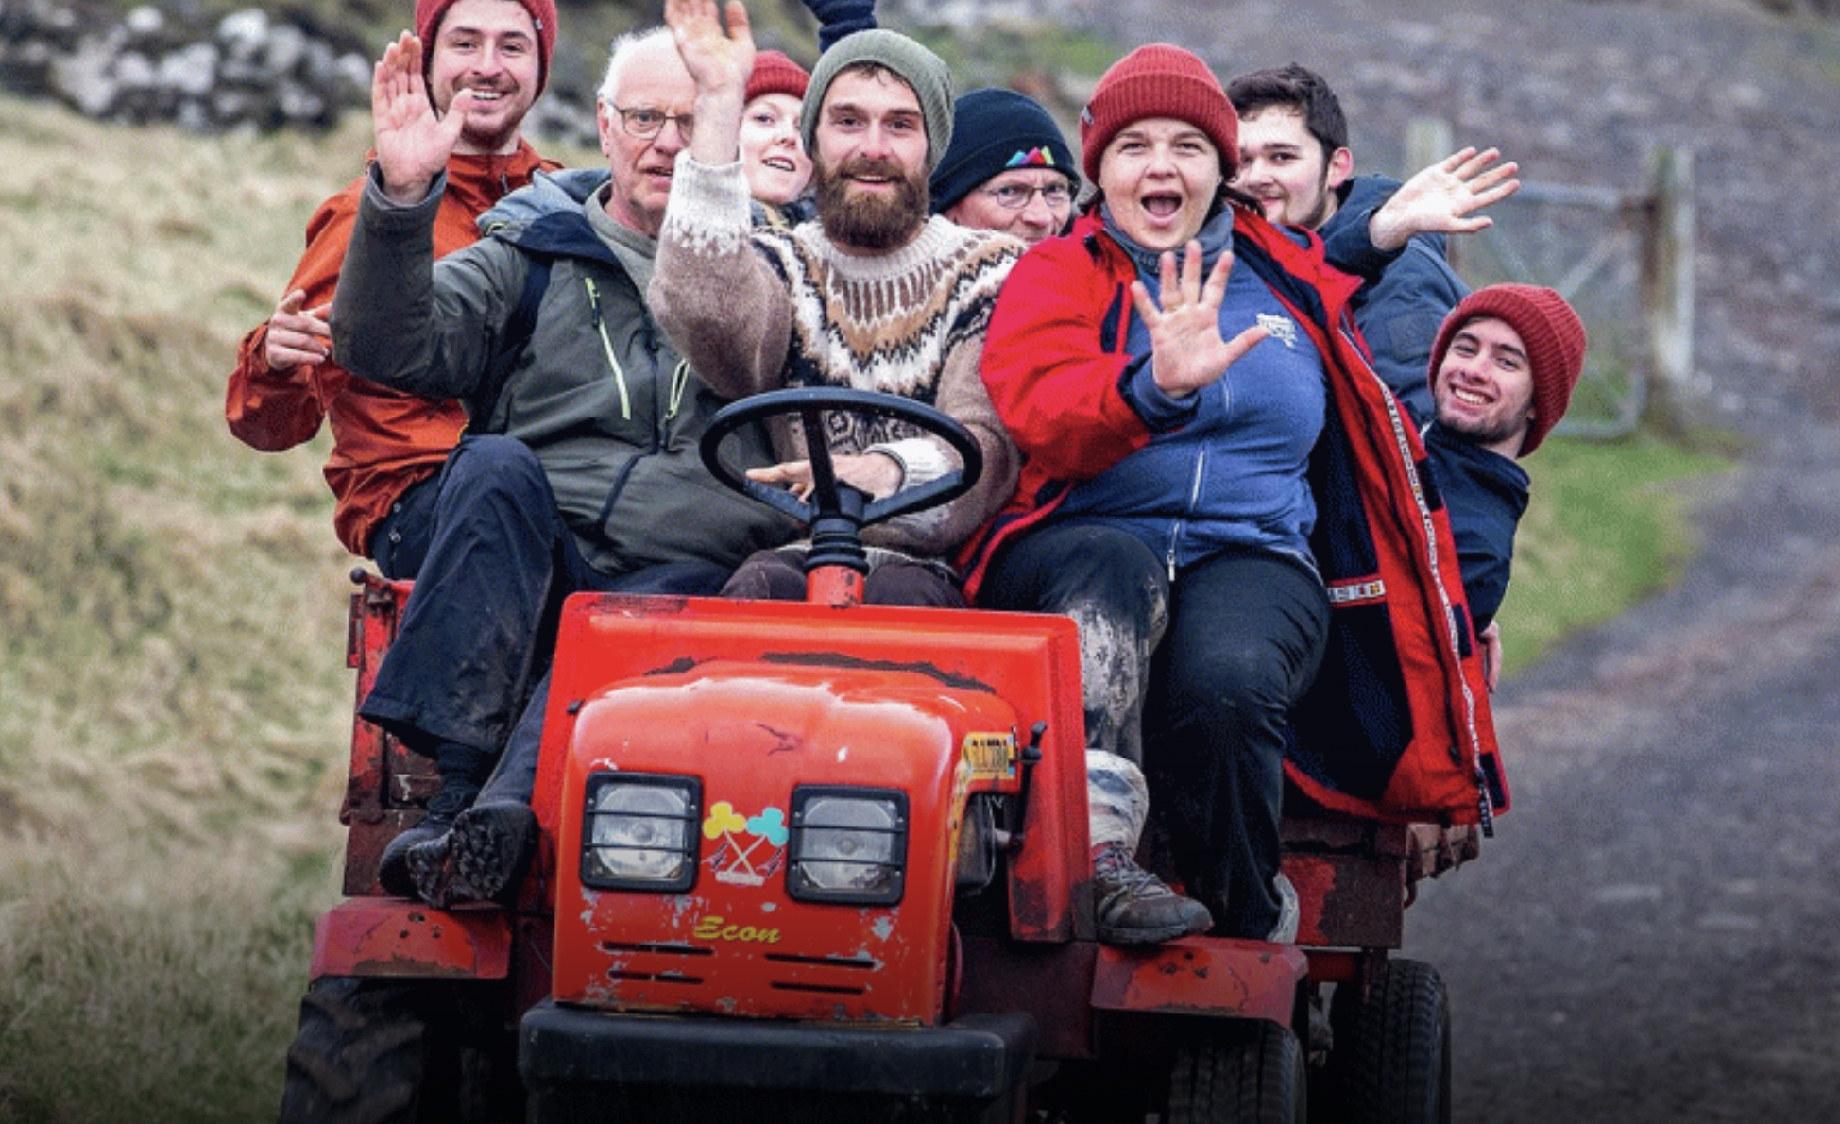

Slide 15
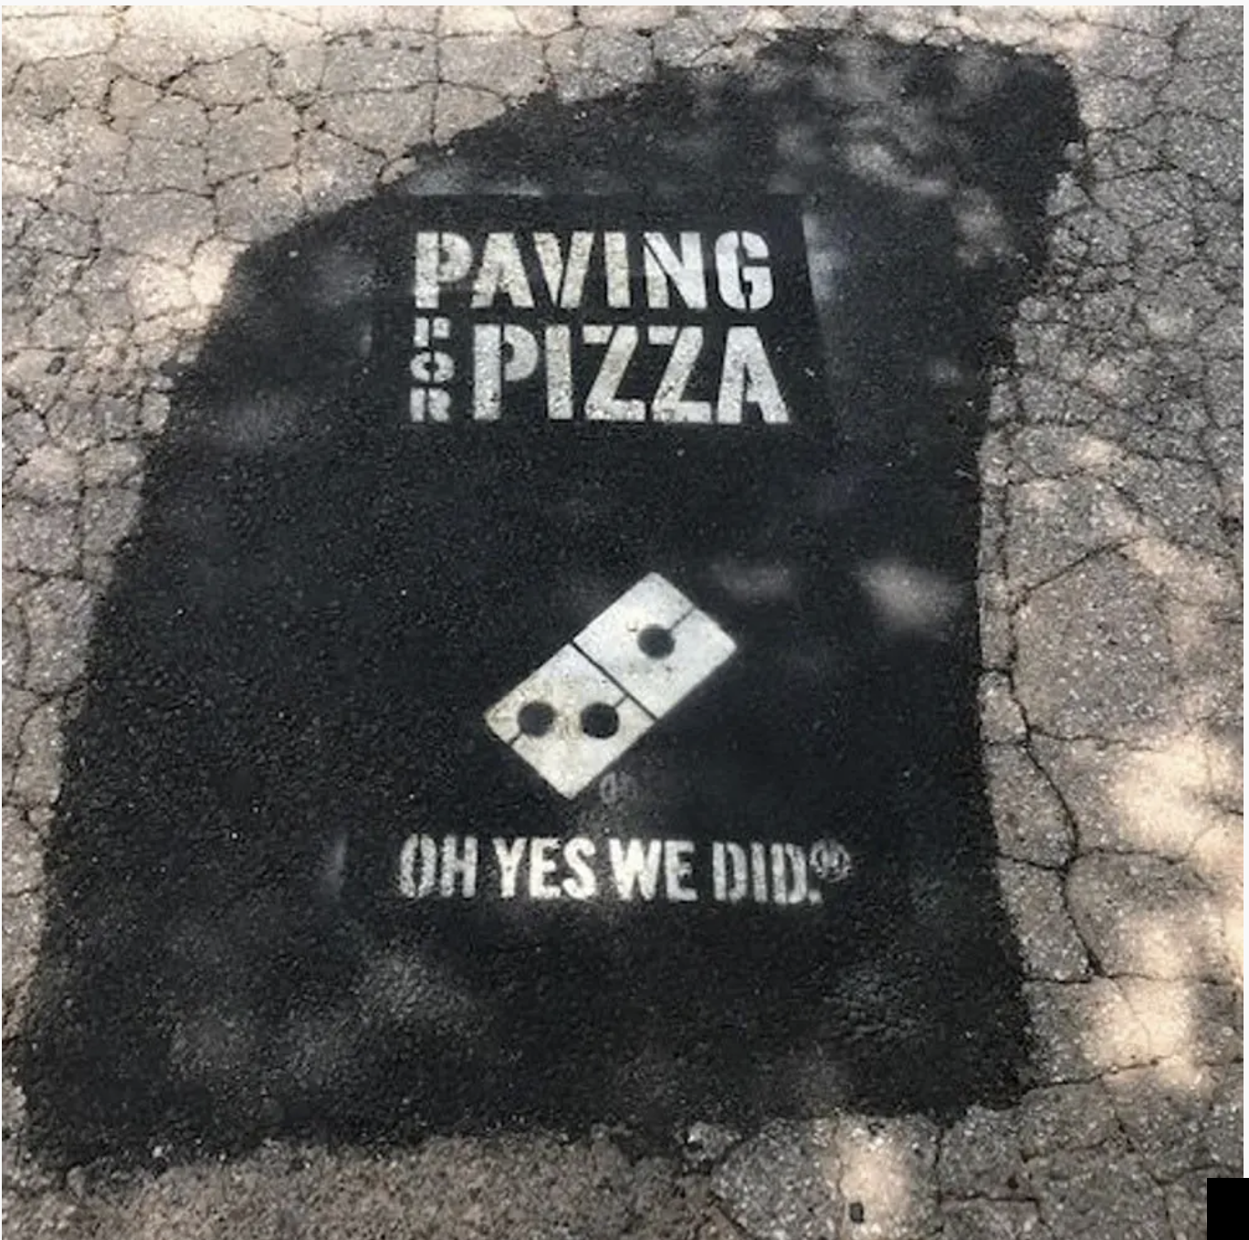
Domino’s Pizza

Slide 16

Fredrick the Great

Slide 17
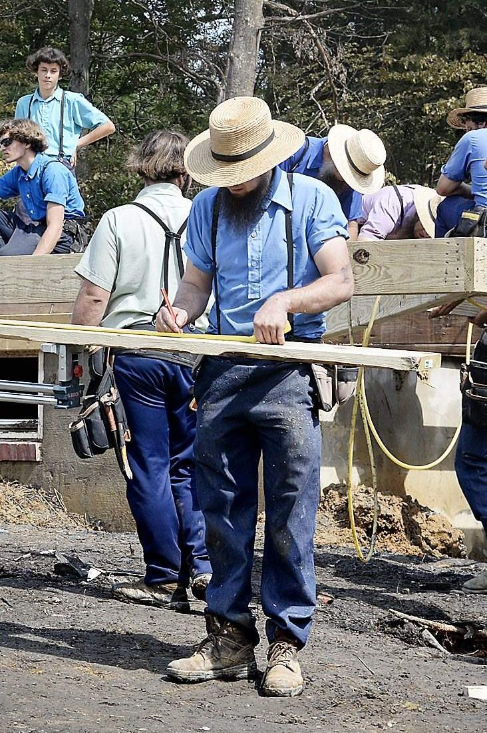
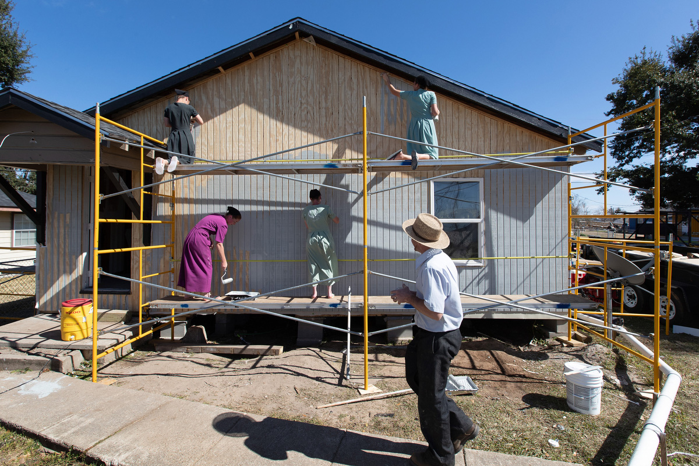
Hurricane Hugo

Slide 18
Public Image Is Powerful.

Slide 19
It creates perceptions,
And your perception is your reality.

Slide 20
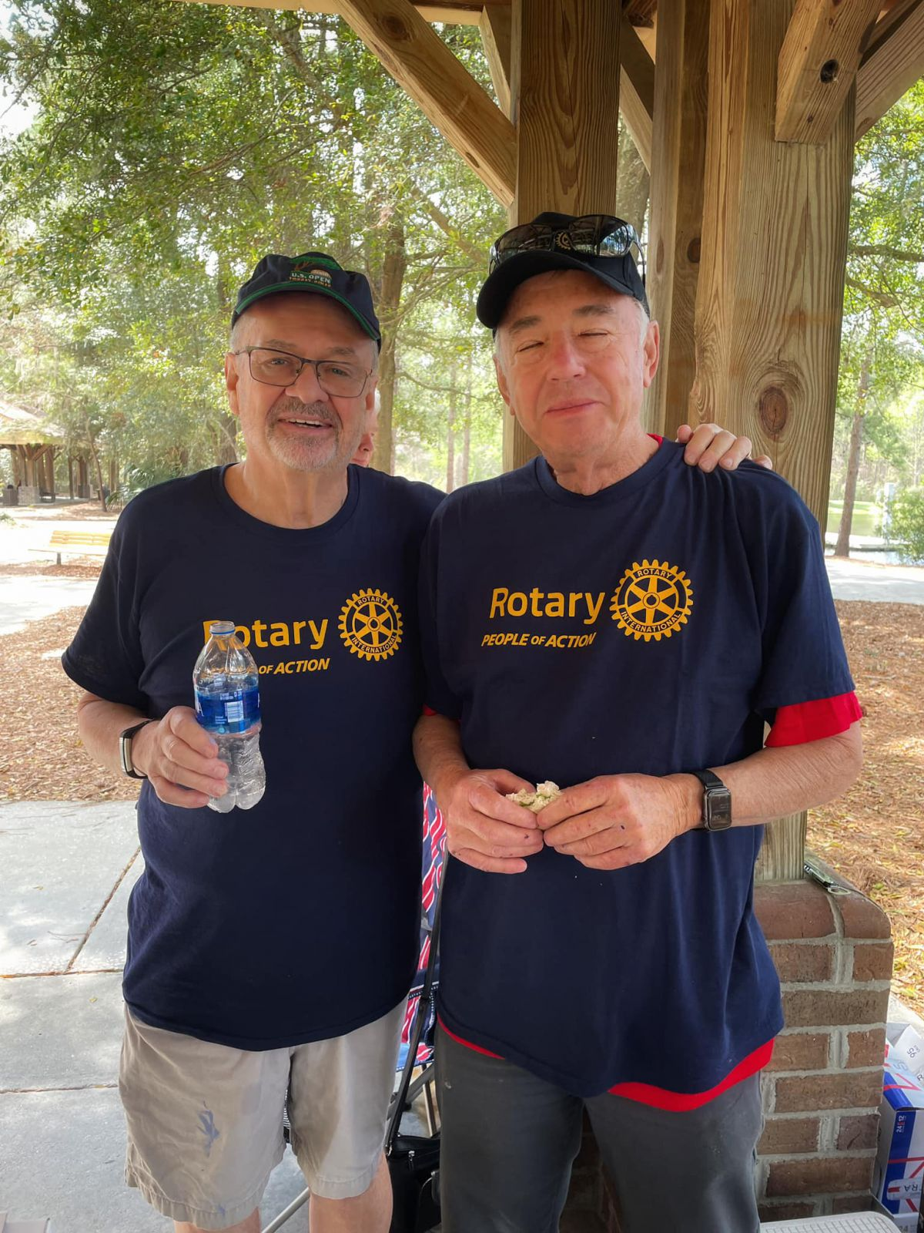
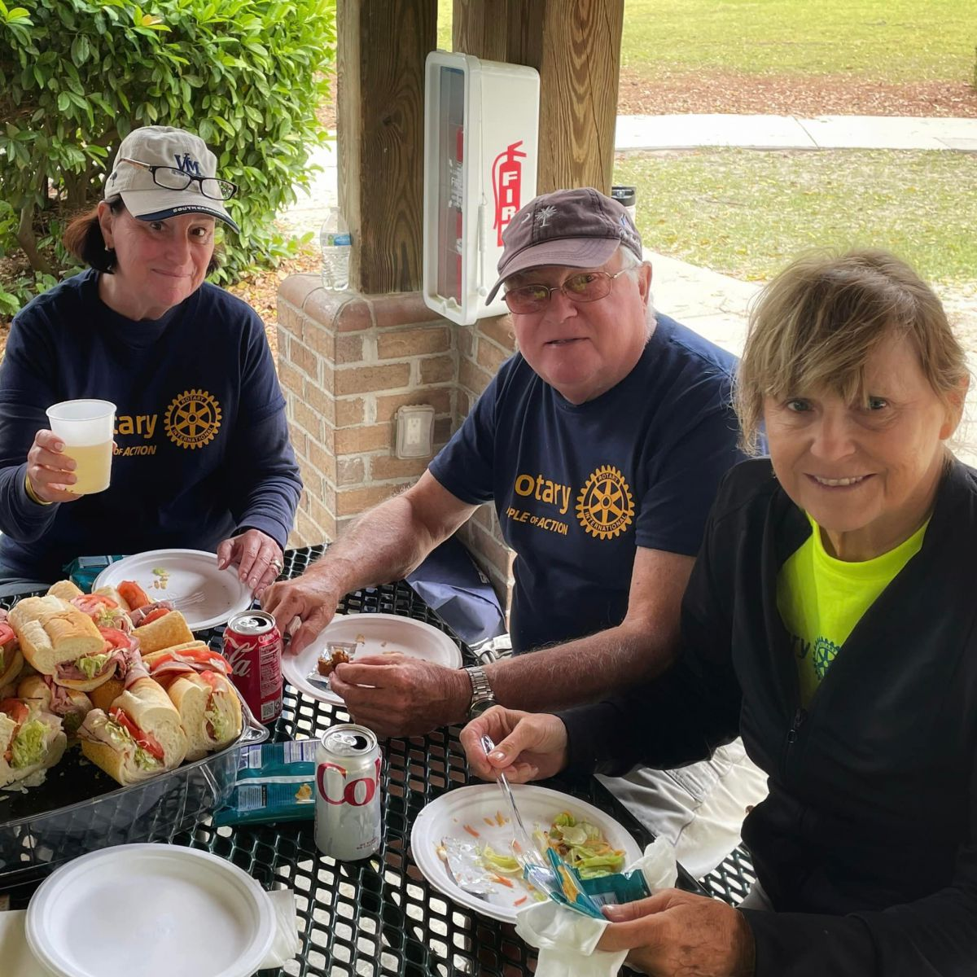
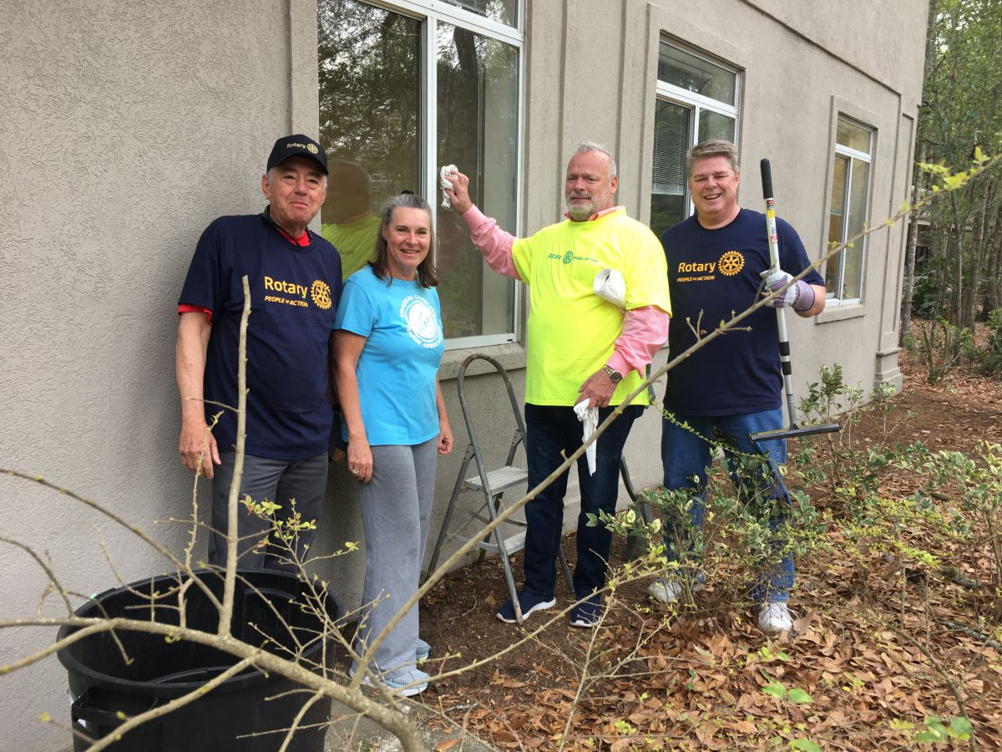

Slide 21
Public Image is about creating awareness for Rotary.
It’s easy! Wear a tee shirt.

Slide 22
An aside
Rotary is good for your health

Slide 23
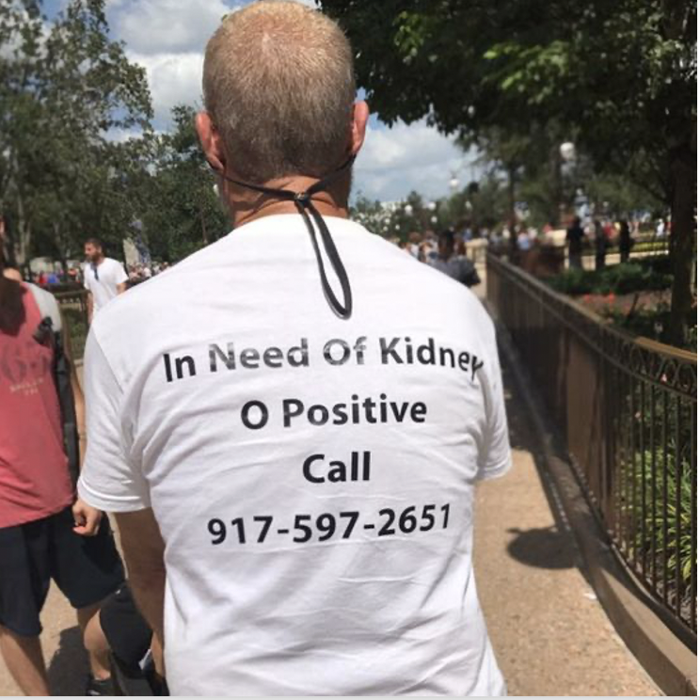
Don’t underestimate the power of
a tee shirt.

Slide 24
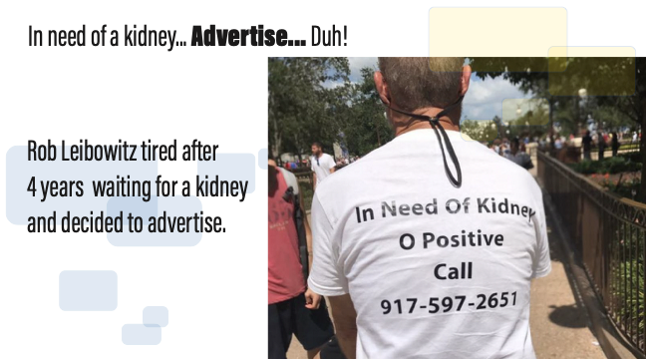

Slide 25
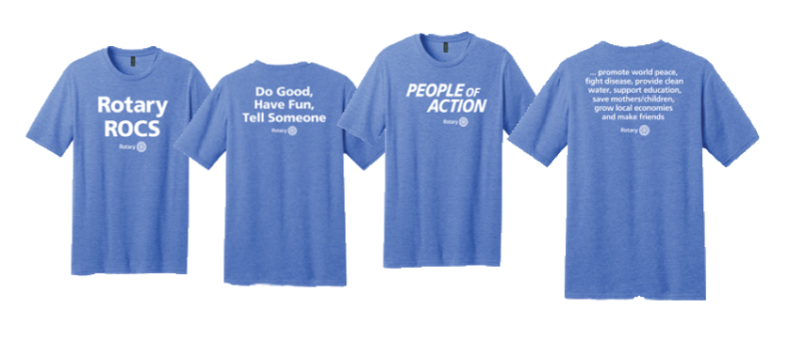
First thing
Buy Tee Shirts

Slide 26


Tee Shirt Contest.
Three Rules
• Make it creative
• Create awareness for your club or club’s project
• Use the Rotary logo (correctly)
Send photo of shirt to Ken@Gasque.com
Enter as many tee shirts as you like.

Slide 27
A full day of recognition for you and your club at Fall Training recognizing your club as the most creative in the district!

Slide 28
Public Image is about creating awareness for Rotary and you will need help.

Slide 29
You will need.
An iPhone photographer,

Slide 30
You will need.
A social media diva,

Slide 31
You will need.
A traditional media person,

Slide 32
You will need.
And someone to keep up with club activities & community opportunities

Slide 33
You will need.
An iPhone photographer,
A social media diva,
A traditional media person,
And someone to keep up with club activities & community opportunities

Slide 34

What if

Slide 35
We’re calling it
The Rotary
Community
Report

Slide 36
Takeaways
• Look for opportunities
• Create a tee shirt
• Create Rotary Community Report

Slide 37
Questions:
Ken Gasque
ken@gasque.com
803-791-0952

