Slide 1
PAUL HARRIS SOCIETY
Bringing positive change to communities around the world
Notes:
Rotary has a more than 100-year record of serving communities here at home and around the world. Your continued support of The Rotary Foundation brings lasting and positive change to communities in need and inspires others to join our efforts to do good in the world.

Slide 2
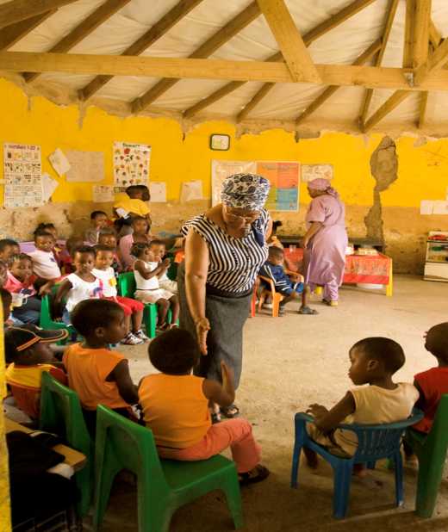
WHAT IS THE PAUL HARRIS SOCIETY?
Donors who elect to give US$1,000 every year
  Annual Fund
  PolioPlus Fund
  Approved Foundation grants
Notes:
Named after Rotary’s founder, the Paul Harris Society (PHS) recognizes Rotary members and friends of The Rotary Foundation who elect to give individual contributions of $1,000 or more each year to the Annual Fund, PolioPlus Fund, or approved Foundation global grants. This recognition was administered by districts until the Paul Harris Society became an official Rotary Foundation recognition program in July 2013. Its purpose is to identify, engage, and recognize members who have the ability and desire to make substantial annual gifts to help communities around the world.
The Paul Harris Society was created in 1999 by Past District Governor Wayne Cusick from District 5340. Cusick realized that giving US$1,000 annually to the Foundation was not possible for every Rotarian, but many could be encouraged to contribute at this level or above. He introduced the Paul Harris Society program to encourage and recognize these donors. The idea gained momentum and quickly spread to other districts throughout the world.

Slide 3

WHY JOIN THE PAUL HARRIS SOCIETY?
Doing so helps ensure the continued good work of Rotary members.
Notes:
The Rotary Foundation works to improve communities by putting grassroots expertise to work and forging lifelong partnerships in the process. Donations at the Paul Harris Society level are crucial in order for us to continue making a positive impact — from local projects to our continued efforts to rid the world of polio.
When you join the Paul Harris Society, you help support projects such as:
• Providing vocational training for teachers who are establishing an early childhood education center in South Africa
• Supplying water filters, toilet blocks, and hygiene training to prevent fluorosis in a community in India
• Funding a scholarship for a medical professional in Italy to research treatments that minimize mortality rates among premature babies
• Offering peace-building seminars to 200 teachers and 1,300 students in Uganda
• Distributing treated mosquito nets and offering medical services that help prevent malaria in Mali
And do not forget Rotary’s No. 1 priority: eliminating polio from the world. It takes .60 cents to vaccinate a child from polio. A PHS level contribution helps immunize over 1,600 children from polio.

Slide 4

IMPORTANT SOURCE OF FUNDING
7% of Rotarians give $1,000 or more to the Annual Fund
These donors represent about 45% of all Annual Fund giving
Notes:
Those who give at the Paul Harris Society level help provide the financial foundation for Rotary to fun projects where they are most needed.
Poll (audience shouts out answers call on participants):
How many Rotarians do you think give $1,000 or more to the Annual Fund in 2015-16?
Click one to reveal 7% of donors give $1,000 or more to the Annual Fund
What percentage of giving to the Annual Fund do you think these donors represent?
These donors represent about 45% of giving to the Annual Fund. 15% of all contributions come from PHS members. They have contributed over US$86 million since Rotary adopted the program.
These numbers show that donations at the PHS level provide vital momentum for the Foundation supported projects. It also shows that the PHS members are small, but a vibrant and growing community of donors.
(Optional: Share example of PHS impact in own district)

Slide 5
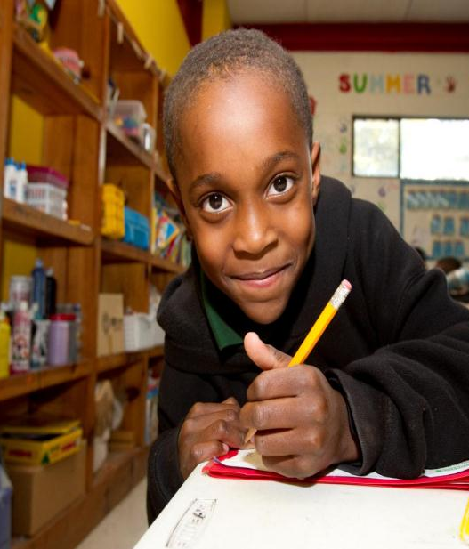
JOINING THE PAUL HARRIS SOCIETY
Become a member
  Join online.
  Complete the brochure
  Call the Rotary Support Center
Notes:
By joining the Paul Harris Society, you are electing to contribute at least $1,000 or more to the Annual Fund, PolioPlus, or an approved Foundation grant each year. You can join the Paul Harris Society without having any history of contributing US$1,000 or more to the approved funds and you do not need to make an immediate $1,000 contribution when you enroll.
You can fulfill your Paul Harris Society giving gradually over the Rotary year through any combination of giving to the Annual Fund, PolioPlus, or an approved Foundation grant. For example, making a monthly contribution of $85 through Rotary Direct to PolioPlus and the Annual Fund would amount to $1,000 in contributions in one year, and thus would honor your Paul Harris Society giving goal.
To join, you can:
Complete the online sign-up form found on the PHS page at rotary.org/paulharrissociety.
Contact Rotary’s Support Center at rotarysupportcenter@rotary.org or call 1-866-9ROTARY (976-8279).
Fill out the Paul Harris Society form and mail it to One Rotary Center or your international office.
Outside of North America, email or call the Rotary International office that serves your area, and ask to join.

Slide 6

ROTARY DIRECT
Recurring giving
  Choose your designation
  Set amount & frequency
    Monthly
    Quarterly
    Annually
  Enroll online: www.rotary.org/give
Notes:
Rotary Direct, Rotary’s recurring giving program, provides a safe, secure, and easy way to join the Paul Harris Society. It allows the Foundation to process a recurring contribution by charging a credit or debit card at the amount and frequency that are most convenient for you.
And you can enroll online, using any of 14 currencies, while preserving local tax benefits in most cases. For example, a Canadian Rotarian can donate via Rotary.org in Canadian dollars and receive a tax receipt from the Canadian Associate Foundation.
With recurring contributions of $1,000 annually, $85 per month, or $250 per quarter, Rotarians and friends can honor their Paul Harris Society membership easily and regularly.
Optional: Rotary’s website accepts online contributions in the following currencies: Argentine pesos (ARS), Australian dollars (AUD), British pounds (GBP), Canadian dollars (CAD), Danish kronen (DKK), euros (EUR), Japanese yen (JPY), New Zealand dollars (NZD), Norwegian kronen (NOK), South African rand (ZAR), Swedish kronor (SEK), Swiss francs (CHF), Indian rupees (INR) and United States dollars (USD). In most cases recurring giving can be set up in these currencies as well, check with the Support Center or the International Office that serves your area.

Slide 7

PAUL HARRIS SOCIETY RECOGNITION
Notes:
Members of the Paul Harris Society are eligible to receive wearable recognition to show their yearly commitment to Doing Good in the World. The chevrons can be worn with other pins, including the Paul Harris Fellow pin, Major Donor pin, Bequest Society pin, and Arch Klumph Society pin.
Rotary districts are encouraged to honor new members of the Paul Harris Society in a way that is appropriate in that culture and comfortable for each member. This can include presenting them with a certificate or insignia at a district or club event. Paul Harris Society coordinators and district leaders can order Paul Harris Society chevrons from The Rotary Foundation at no cost by writing to annualfund@rotary.org or contact the appropriate International Office that serves your area.

Slide 8
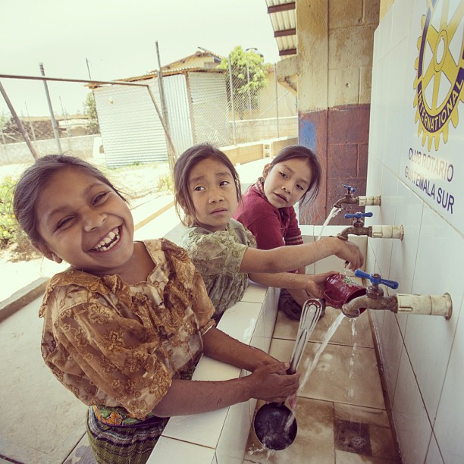
ESTABLISH A PAUL HARRIS SOCIETY
  Get support from district leadership
  Organize a team of PHS promoters
  Schedule charter events
  Make a personal ask
Notes:
If your district is in the process of establishing a Paul Harris Society, consider some of the following tactics:
Engage your district governor and other respected leaders, ask for their support
Identify a team of PHS advocates, perhaps Assistant Governors, and ask them to promote the Paul Harris Society during club visits
Schedule charter events to introduce members to the Paul Harris Society, use the PHS report to create your invite list
Have one-on-one conversations, or send personal letters, inviting members in your district to join the Paul Harris Society

Slide 9
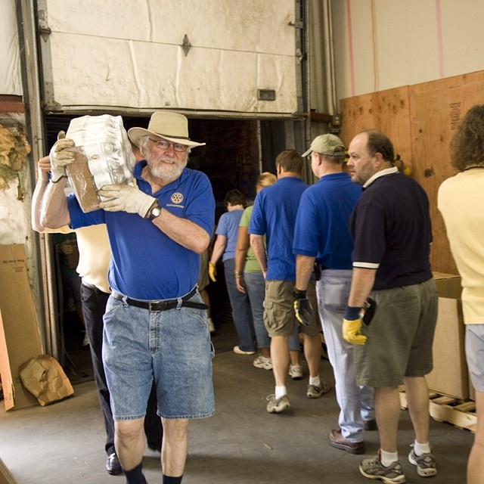
MAINTAIN A PAUL HARRIS SOCIETY
  Timely recognition
  Say “thank you”
  Continual promotion at club and district events
  Annual reminders
Notes:
After you’ve established a Paul Harris Society it’s important to maintain it by engaging the donors through:
Timely recognition for new members
Ongoing stewardship to all members – make sure to say thank you often!
Continual promotion to attract new donors
Recommend donors use Rotary Direct to promote an easy, flexible way to give regularly
For those who have chosen to join but have not yet given $1,000 by the end of the Rotary year it’s also helpful to remind them – with busy lives people may forget to give $1,000 by 30 June. Even if they are unable to give $1,000 that year, it’s nice to show that you remember them and want to connect.
Identify PHS champions and encourage them to share their stories to promote the society.

Slide 10

QUESTIONS?
Thank you for your time, commitment, and support.
Notes:
Thank you for trusting Rotary to use your contributions to make a lasting difference.

