Slide 1
Speak and Lead
A club president’s guide to reduce stress

Slide 2
Herman Dixon & Tom Ledbetter
A club president’s guide to reduce stress

Slide 3
Keep the focus forward
Always be honest.
Accept responsibility.
Control your tongue.
Keep commitments.
Focus on what you can control.
Debrief yourself.
Execute commitments.
Act on feedback.
Try new things.
Learn from mistakes.

Slide 4
You must have…
Mental Toughness
Intentional Mindset
Tenacity
High Energy
Eagle Eyes

Slide 5
It can make you feel…

Slide 6
As a President…
You will need to strive to address these 8 Leadership aspects to gain the success you desire for your club.

Slide 7
Just think…

Slide 8
Leading your club
Know where you need help and who you can utilize to help usher these
7 C’s into your operational needs.

Slide 9
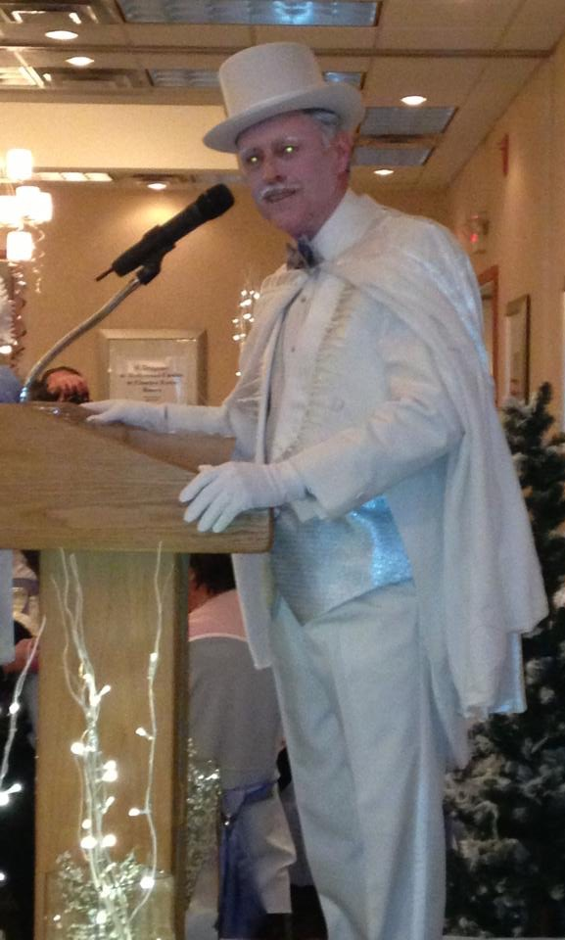
It’s very important…

Slide 10
Eight Presentation essentials for Club Leaders
Prepare well: Know your material, know your timing, know your objective
Speak in familiar terms: The audience needs to understand the content and the intent of the materials
Connecting with your audience: Their comfort with you is critical to their willingness to listen, to learn, and to leverage what you are saying

Slide 11
Eight Presentation Essentials continued
4) Don’t rush: Using a slower pace helps you in gathering and collating your thoughts; also allows the audience time to process and internalize what is being said
5) Listen well: Public speaking begins with listening…to gain insight before, during, and after speaking
6) Expect to adapt: Plan for the expected, prepare for the unexpected

Slide 12
Eight Presentation Essentials continued
7) Remain calm: A relaxed and self-assured demeanor is key to audience acceptance of your materials. Confidence is an extraordinary persuader.
8) Become a Subject Matter Expert (SME): Always learning, always inquiring, always inspiring

Slide 13
Call to action
Schedule yourself to present to your club at least twice before taking on your role on July1
Record these sessions (cell phone will do)
Do a self-evaluation of your practical skills
Identify one (1) improvement and achieve it

Slide 14
Summary
Leading is being a persuader…
A persuader is a being communicator…
A communicator is being a presenter.
Present Well!!!

