Slide 1
The Rotary Foundation
YOUR
Rotary Foundation
PDG Alex Wilkins
Major Gifts Chair
Sea Island Rotary Club
Wilkinsra@Gmail.com

Slide 2
The Rotary Foundation – The Funds:
Annual Fund
For support today
Endowment
Fund
To secure tomorrow
PolioPlus Fund
End Polio Now

Slide 3
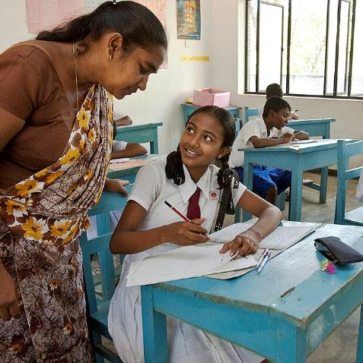
The Rotary Foundation - MY Rotary Foundation
Our Rotary Foundation is unique:
It belongs to Rotarians and is dedicated to furthering
Rotary Programs
that address the greatest needs around the world.

Slide 4
The Rotary Foundation
Why support The Rotary Foundation over other charities?
Our administration costs are very low
All projects are in the hands of Rotarians
We can decide where our projects are situated
Rotarians decide how the funds are spent
Donations can go to the area of focus of our choice
Our Gifts can be contributed in many ways

Slide 5
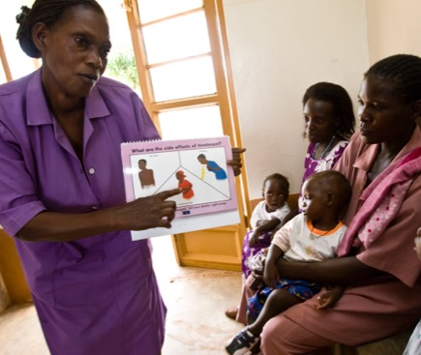
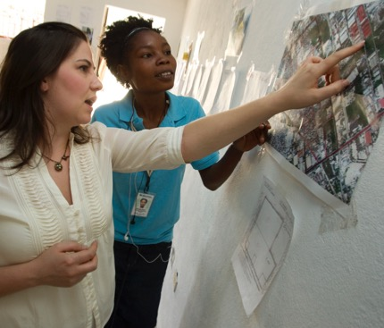
The importance of giving to Our Charity
What does the Foundation give us?
Support for our Humanitarian Projects
Providing Clean Water
Supporting Education
Fighting Disease
Saving Mothers and Children
Growing Local Economies
Promoting Peace
In International and Local Communities

Slide 6
The Rotary Foundation
Peacebuilding and Conflict Prevention
Disease Prevention and Treatment
Water Sanitation and Hygiene
Maternal and Child Health
Basic Education and Literacy
Community Economic Development
Environment

Slide 7
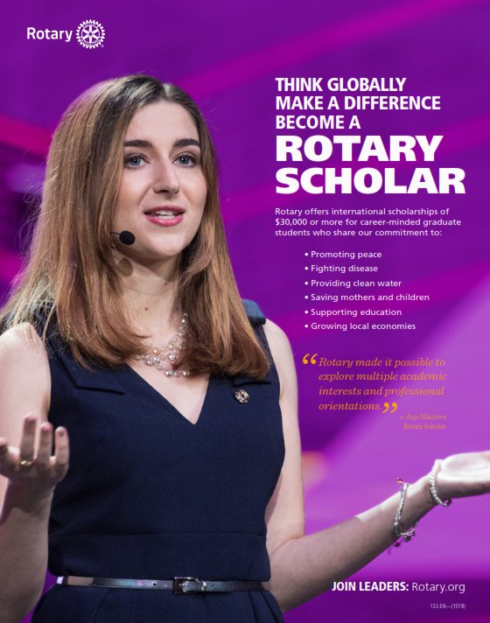
The importance of giving to Our Charity
What does the Foundation give us?
Funding for Rotary Scholars
350,000 Scholarships have been awarded
by Rotary
On average
$7.5million in Scholarships
are given out by Rotary each year

Slide 8
The Rotary Foundation
How can we Contribute?

Slide 9
Gifts
WHAT ARE THE GIFTS?
Every Rotarian Every Year (EREY)
Sustaining members (>$100 to the Annual Fund)
Paul Harris Fellows ($1,000)
Paul Harris Society Members ($1,000 per Year)
Benefactors ($1,000 to Endowment Fund)
Bequest Society (>$10,000 in estate plans)
Major Donors (>$10,000 outright or cumulative)
Arch Klumph Society (>$250,000 outright or cumulative)

Slide 10
Major Gifts
Paul Harris Society
Less than 3% of Rotarians contribute at or above the Paul Harris Society level, yet it represents over 19% of the Foundation’s Annual Fund contributions
$1000 Per
Year

Slide 11
Major Gifts
Major Donors
Major Donor Level 1 – $10,000 to $24,999
Major Donor Level 2 - $25,000 to $49,999
Major Donor Level 3 - $50,000 to $99,999
Major Donor Level 4 - $100,000 to $249,999
AKS Level 1 – Trustees Circle $250,000
AKS Level 2 – Chair’s Circle $500,000
AKS Level 3 – Foundation Circle $1,000,000
AKS Level 4 – Platinum Trustees Circle $2,500,000
AKS Level 5 – Platinum Chair’s Circle $5,000,000
AKS Level 6 – Platinum Foundation Circle $10,000,000

Slide 12
Endowments
Rotary Endowments - Giving for a lasting impact
A gift to Rotary’s endowment ensures a strong future for Our Foundation by providing a continuous stream of income that will fund Our programs in perpetuity.
Our gifts are invested, and the spendable earnings are
used to support the program you have designated.
Bequest Society
Notes:
I’m very pleased to state that your club has two Bequest Society members – Peter Phillips & Ian Graham

Slide 13
Endowments
Bequest Society
Bequest Society Level 1 – $10,000 to $24,999
Bequest Society Level 2 - $25,000 to $49,999
Bequest Society Level 3 - $50,000 to $99,999
Bequest Society Level 4 - $100,000 to $249,999
Bequest Society Level 5 - $250,000 to $499,999
Bequest Society Level 6 - $500,000 to $999,999
Legacy Society - $1,000,000 and more
Notes:
I’m very pleased to

Slide 14
The Rotary Foundation
How can I Help YOU
Strengthen
MY Rotary Foundation?

