Slide 1
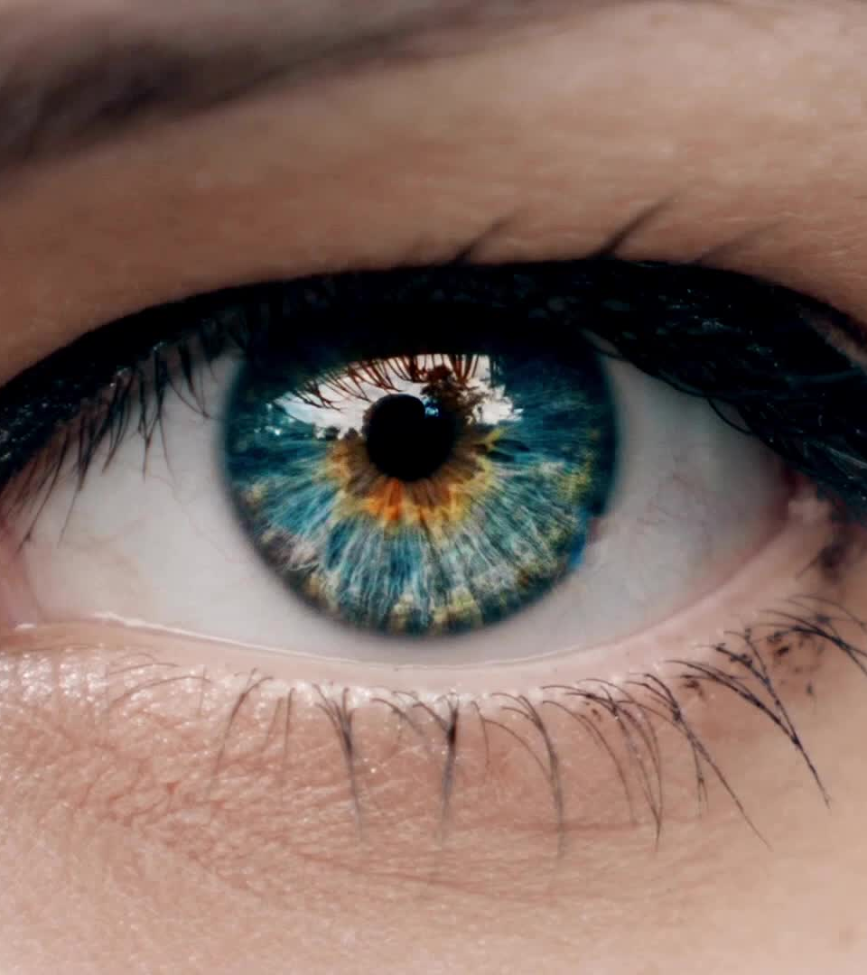
We buy with our eyes.
Basic Photography

Slide 2
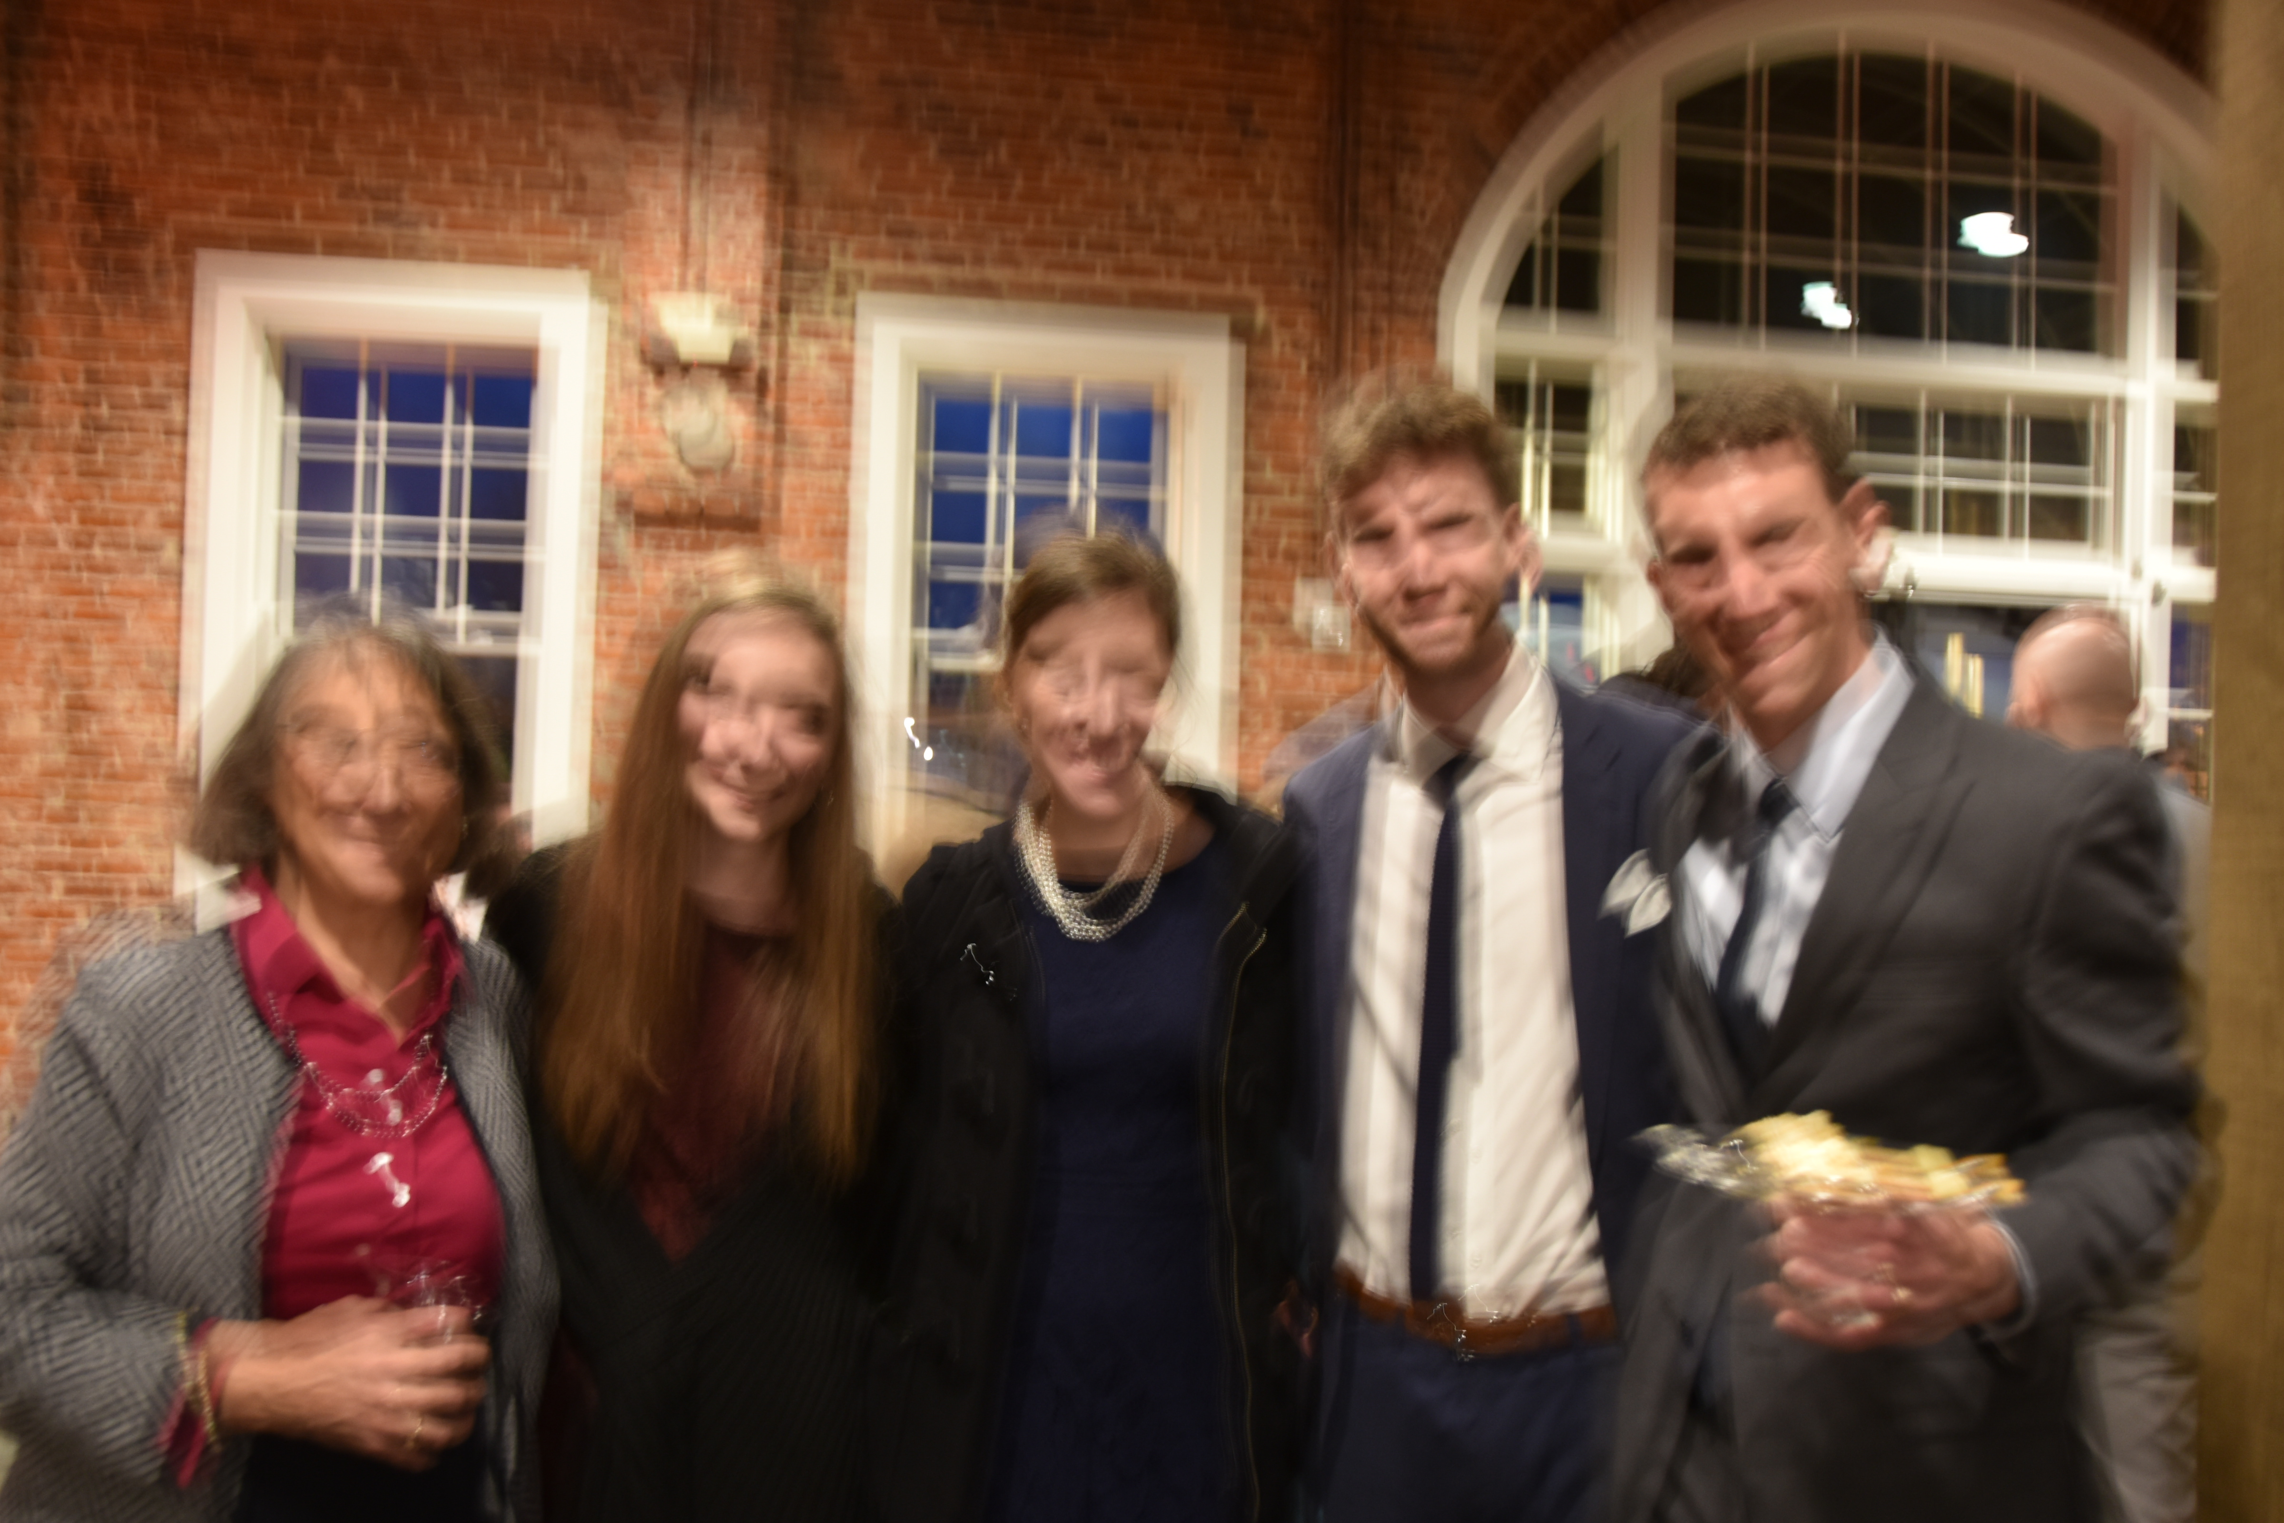
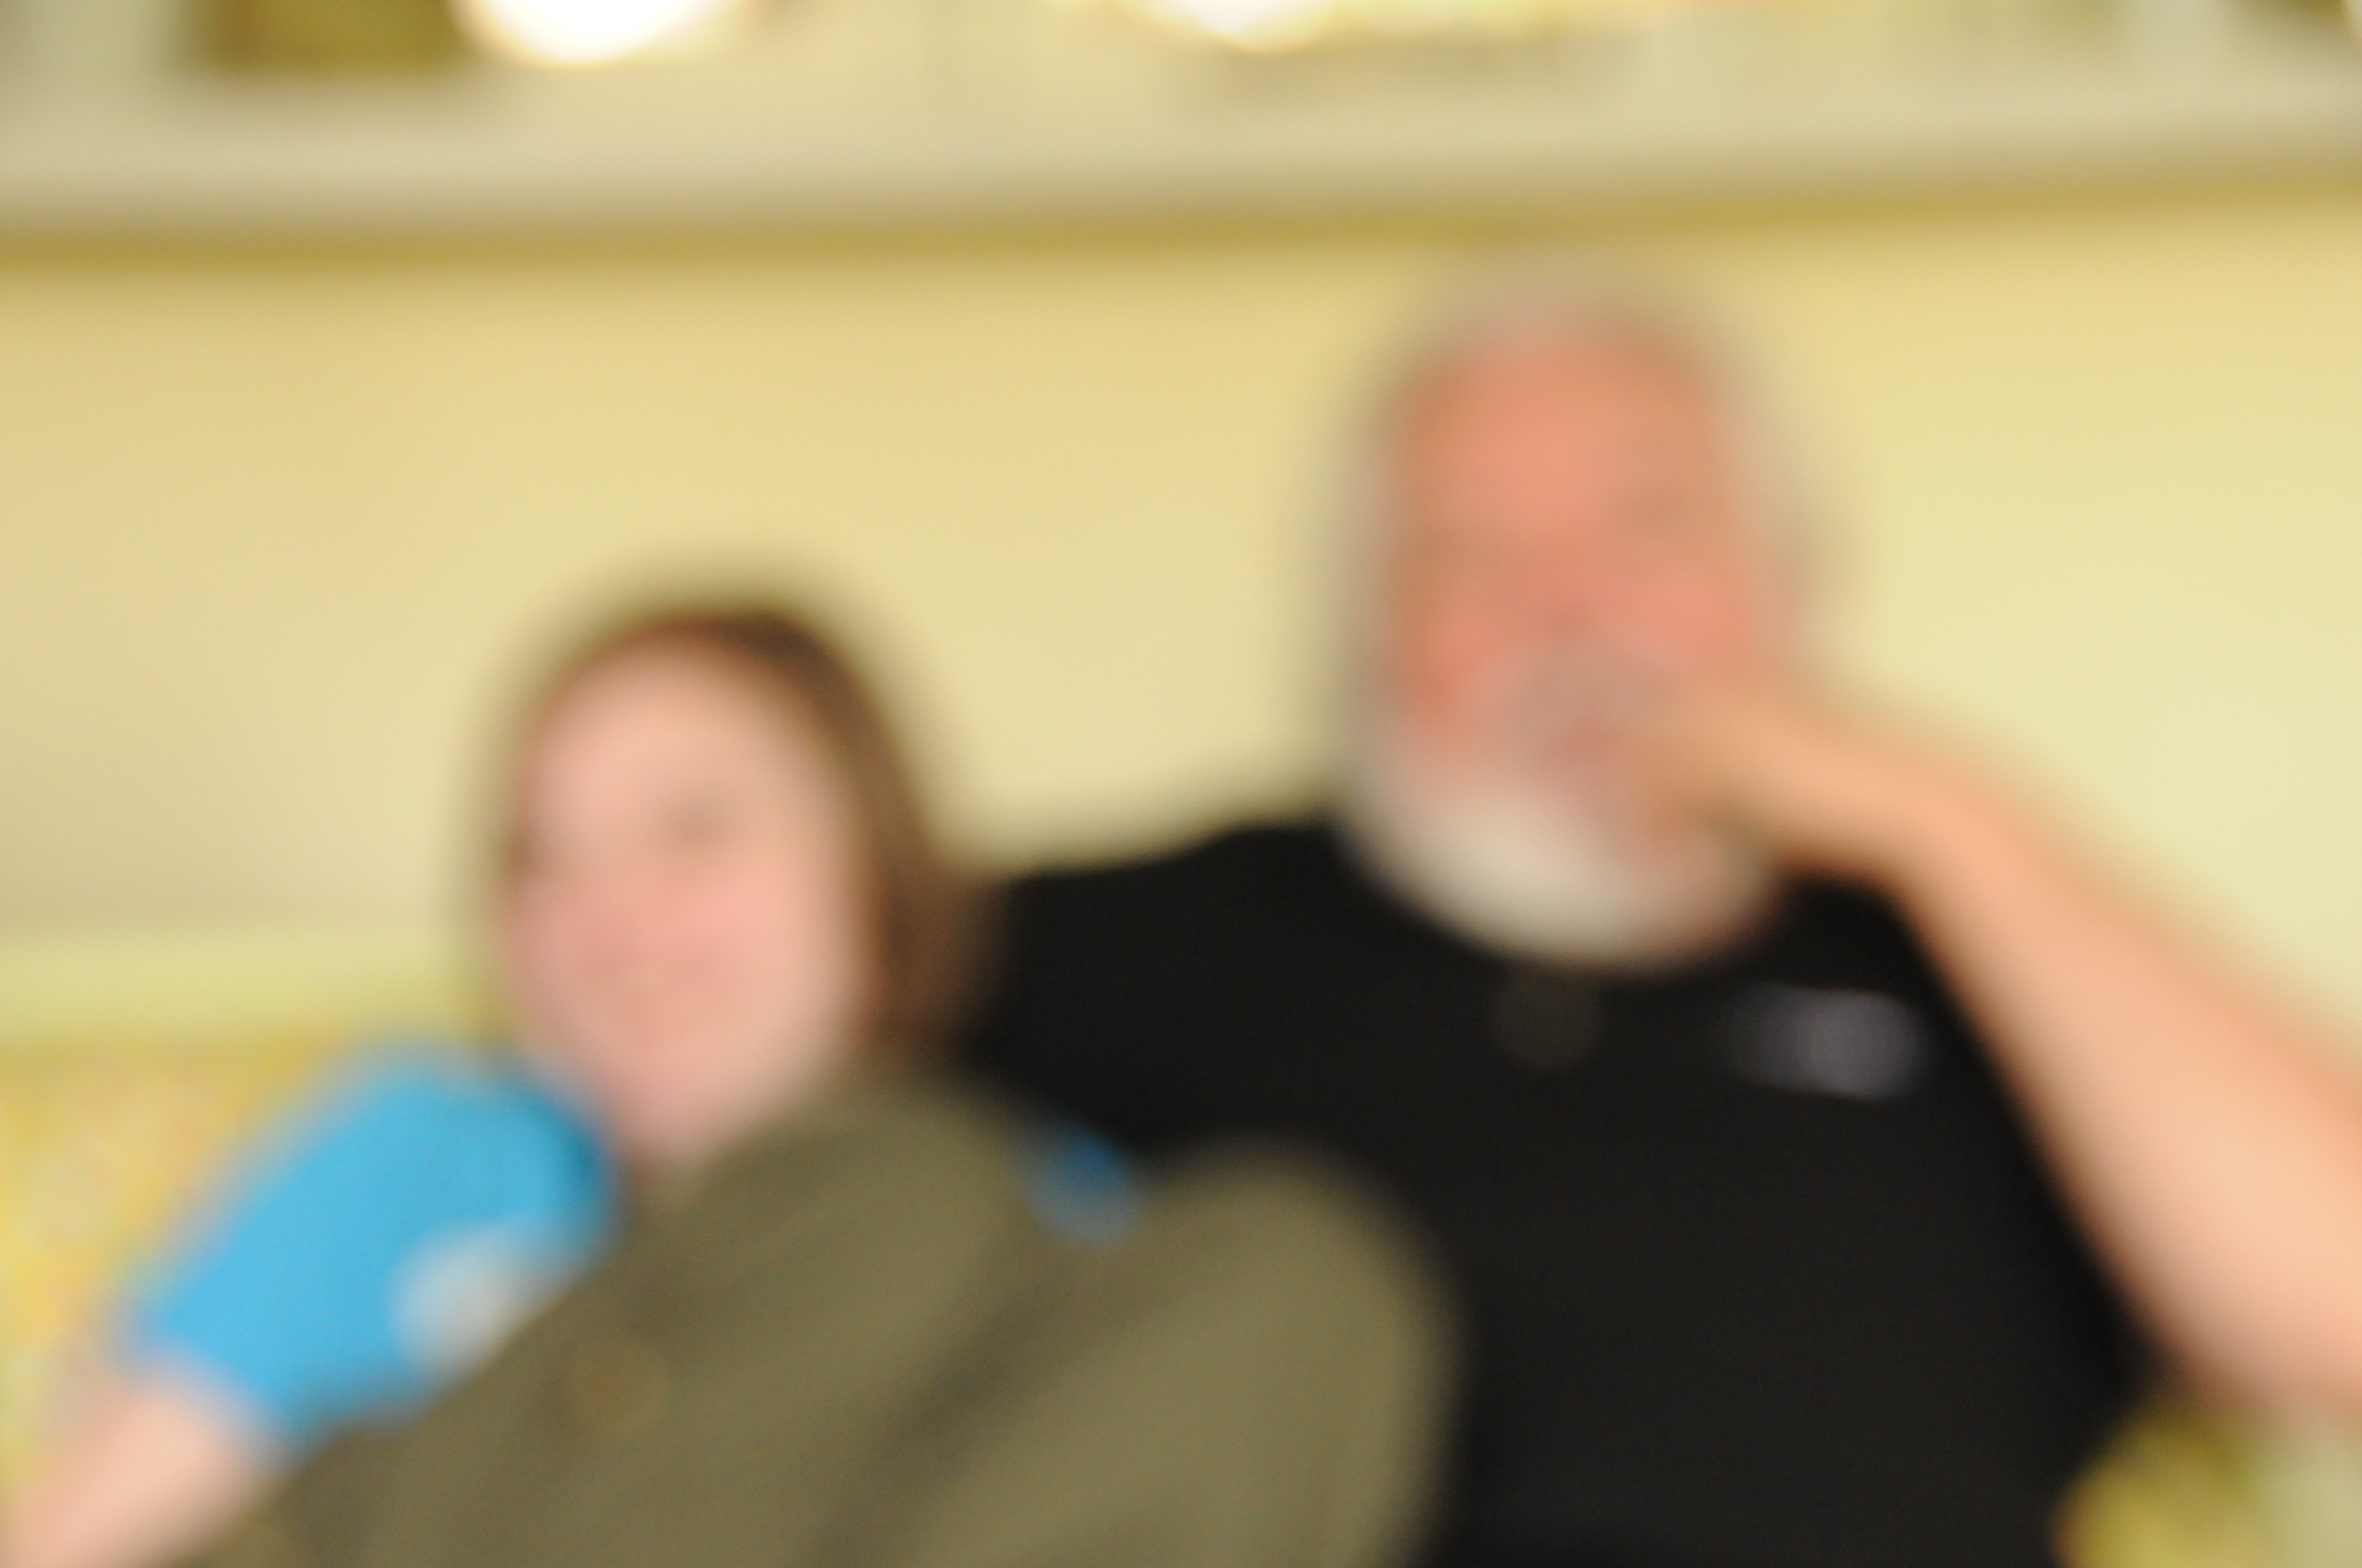
FOCUS
If it is not in focus we’re not interested. A mono pod can fix this. $16.95

Slide 4
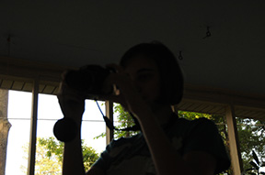
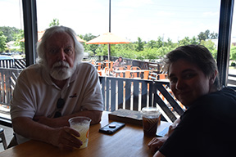
Light
Need you see more?

Slide 5
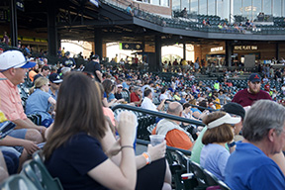
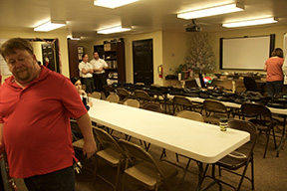
Composition

Slide 6
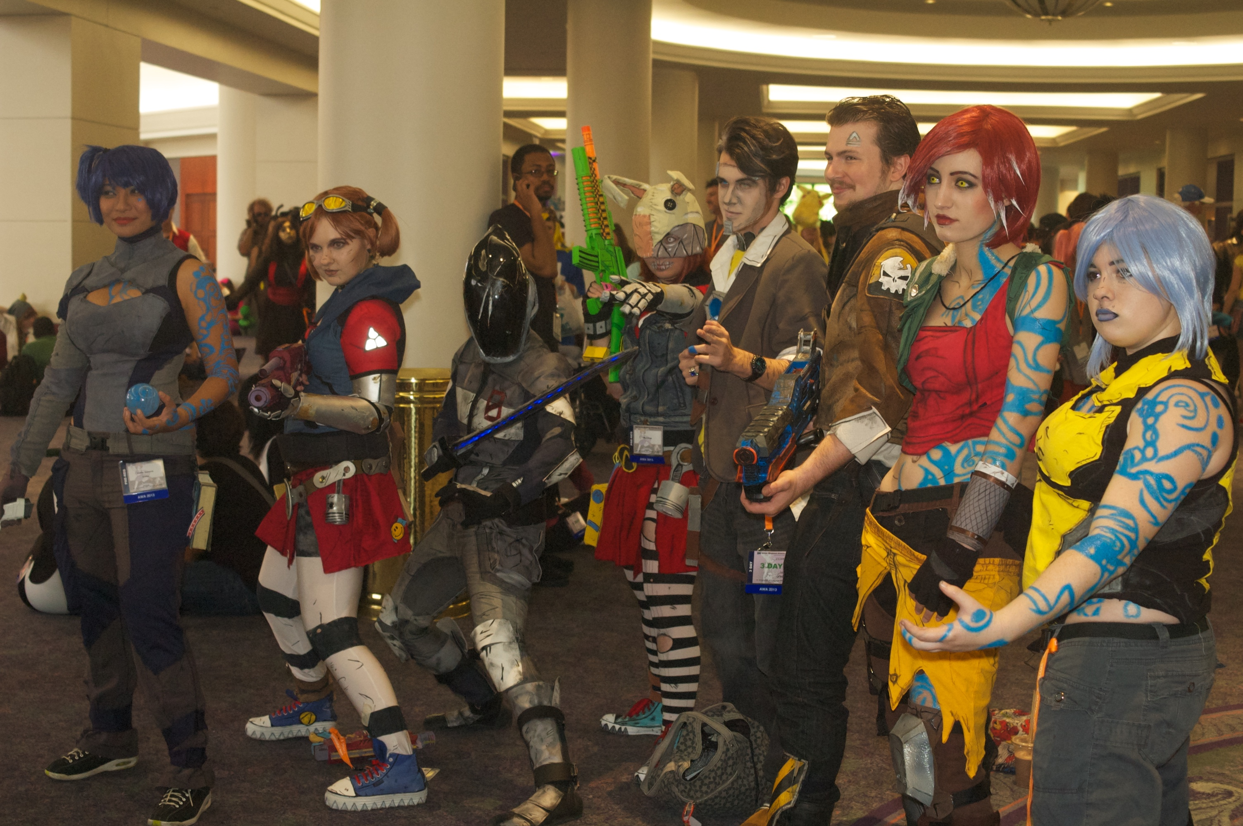
composition

Slide 11
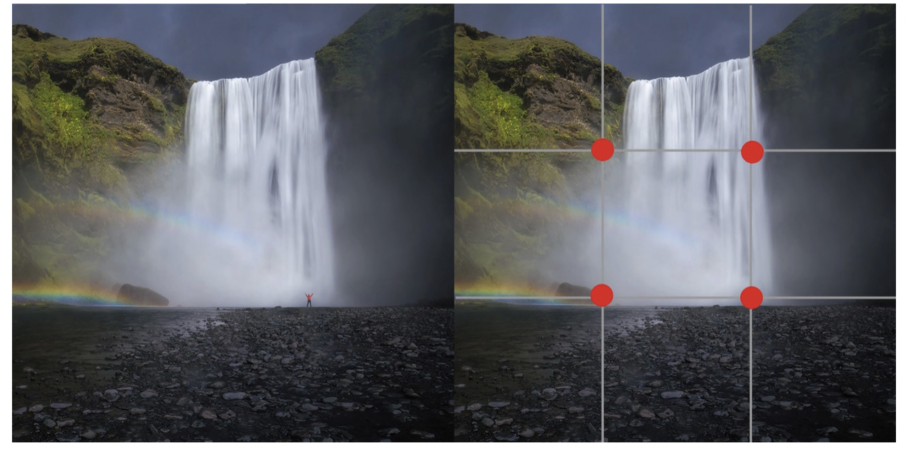
Composition
The Rule of Thirds

Slide 12
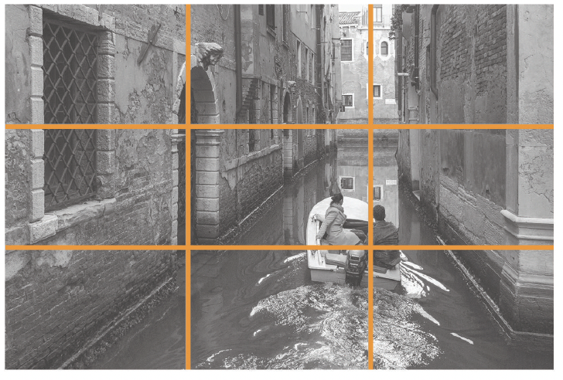
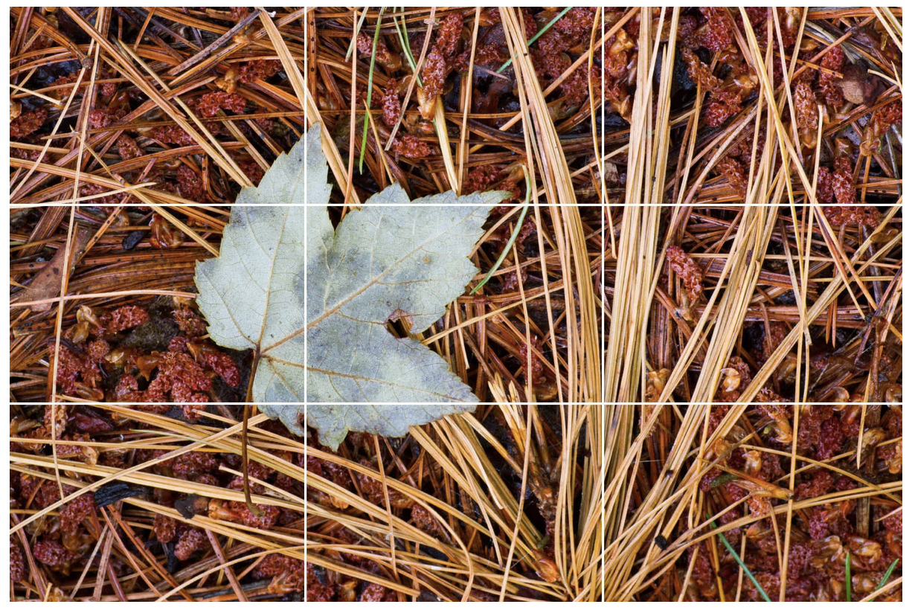
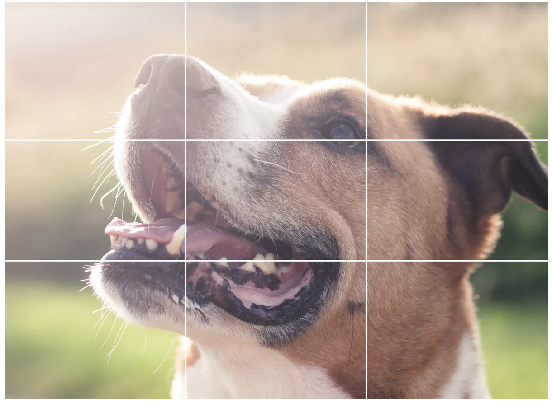

Slide 13
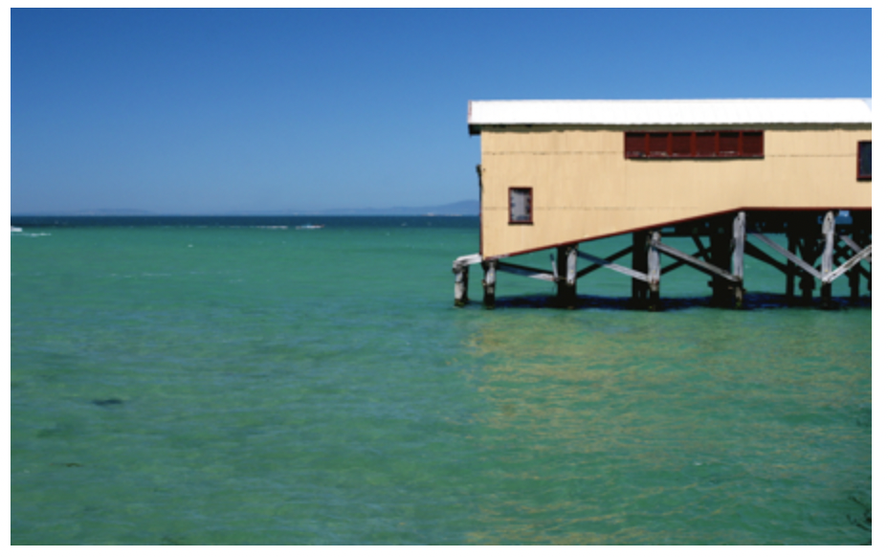

Slide 14
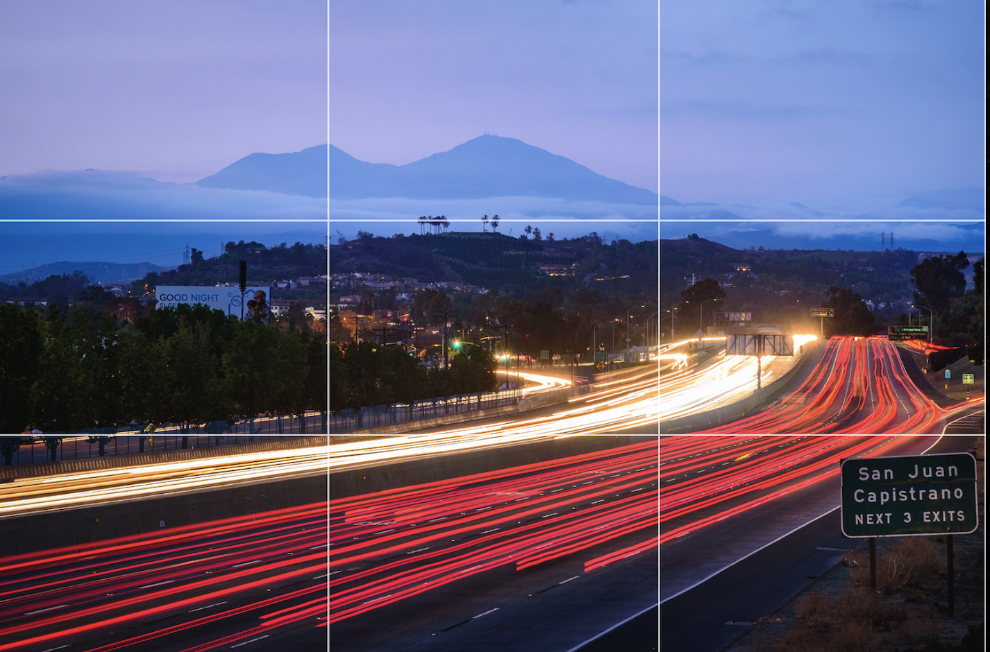

Slide 15
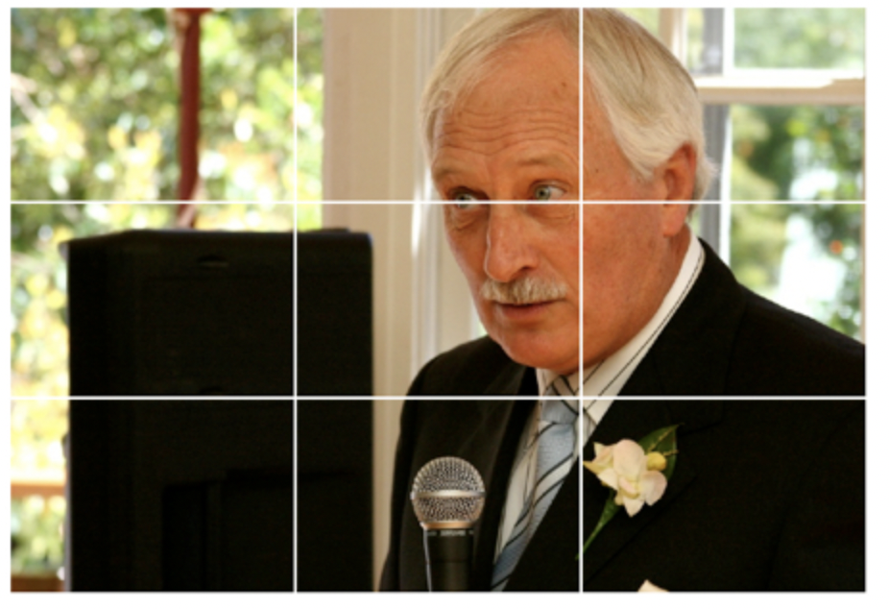

Slide 16
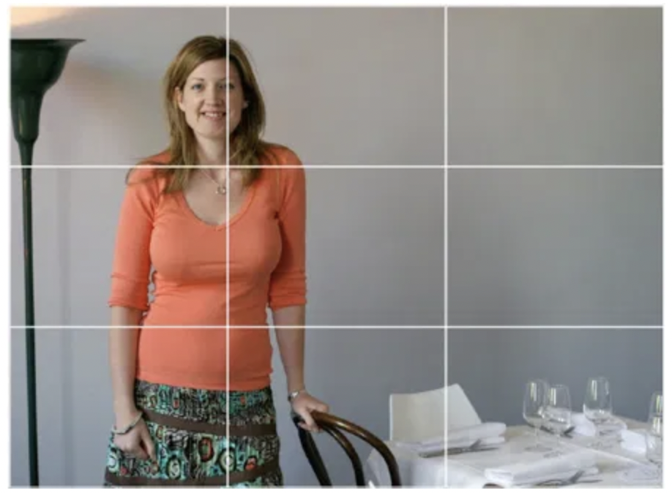

Slide 18
Check the background

Slide 21
Shoot more that you need and then some.

Slide 22
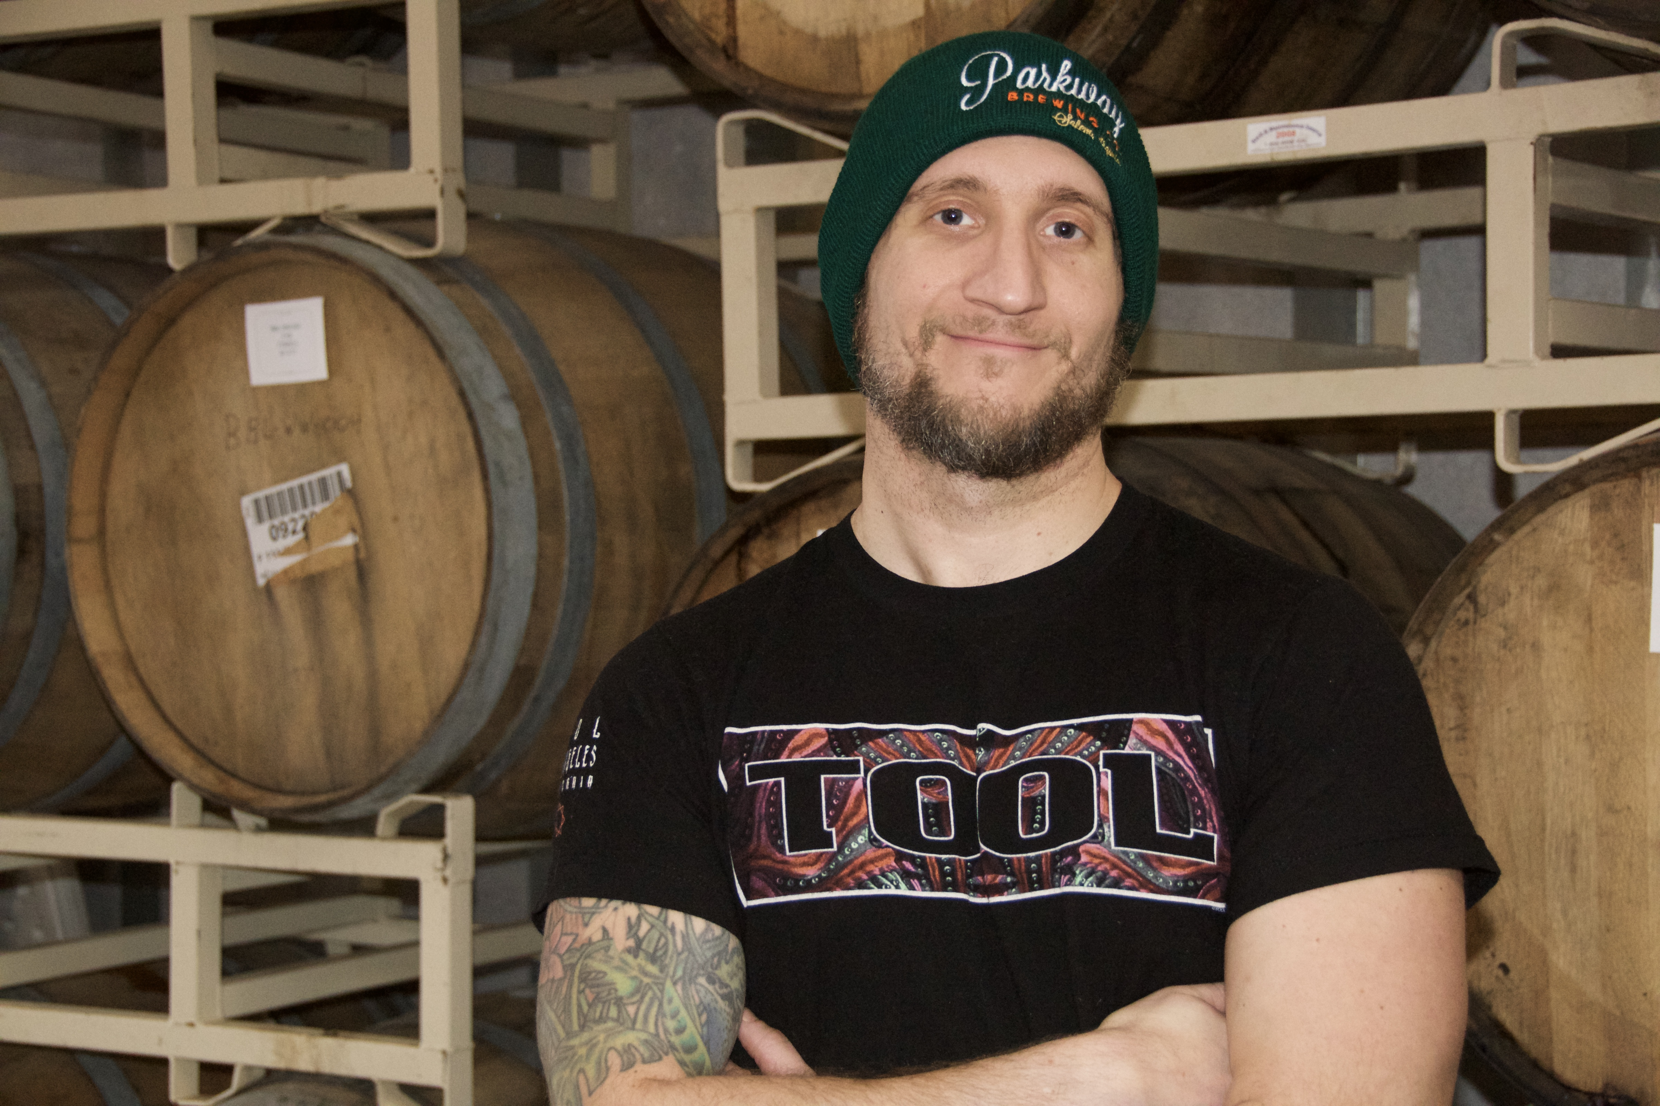

Slide 23
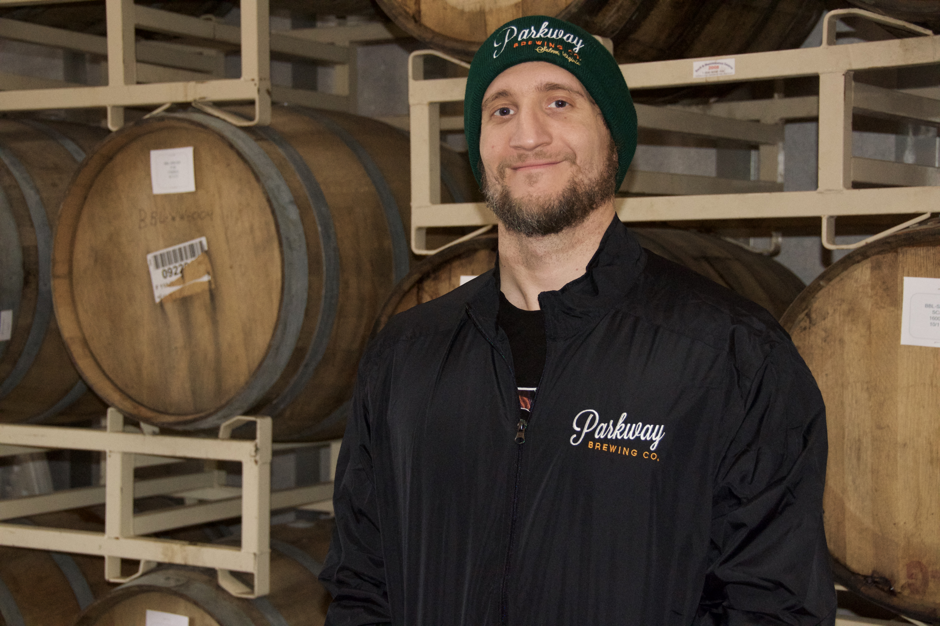

Slide 24
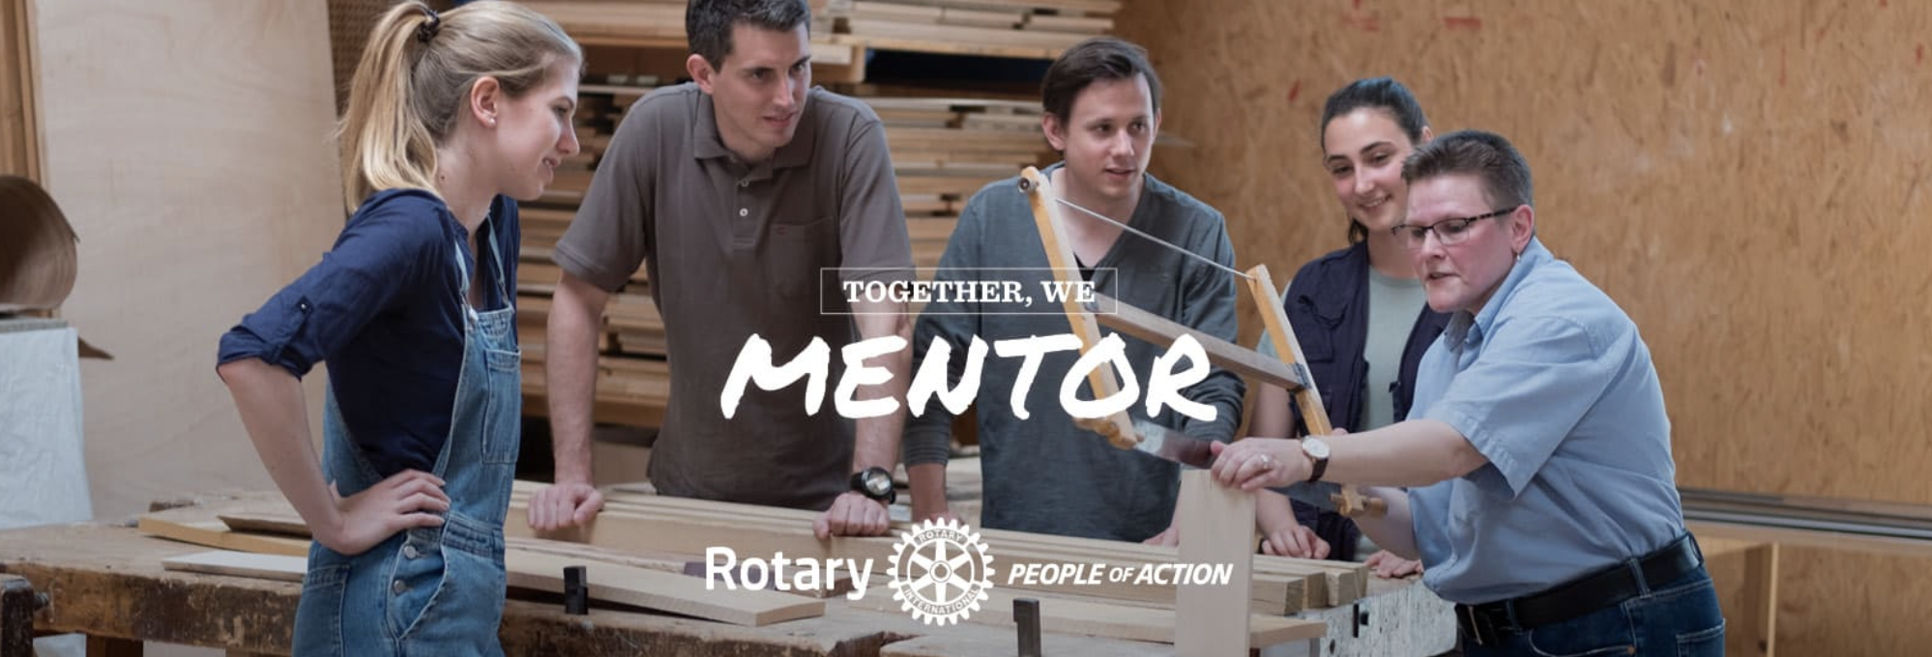
Study the pros

Slide 28
Shoot the activity

Slide 29
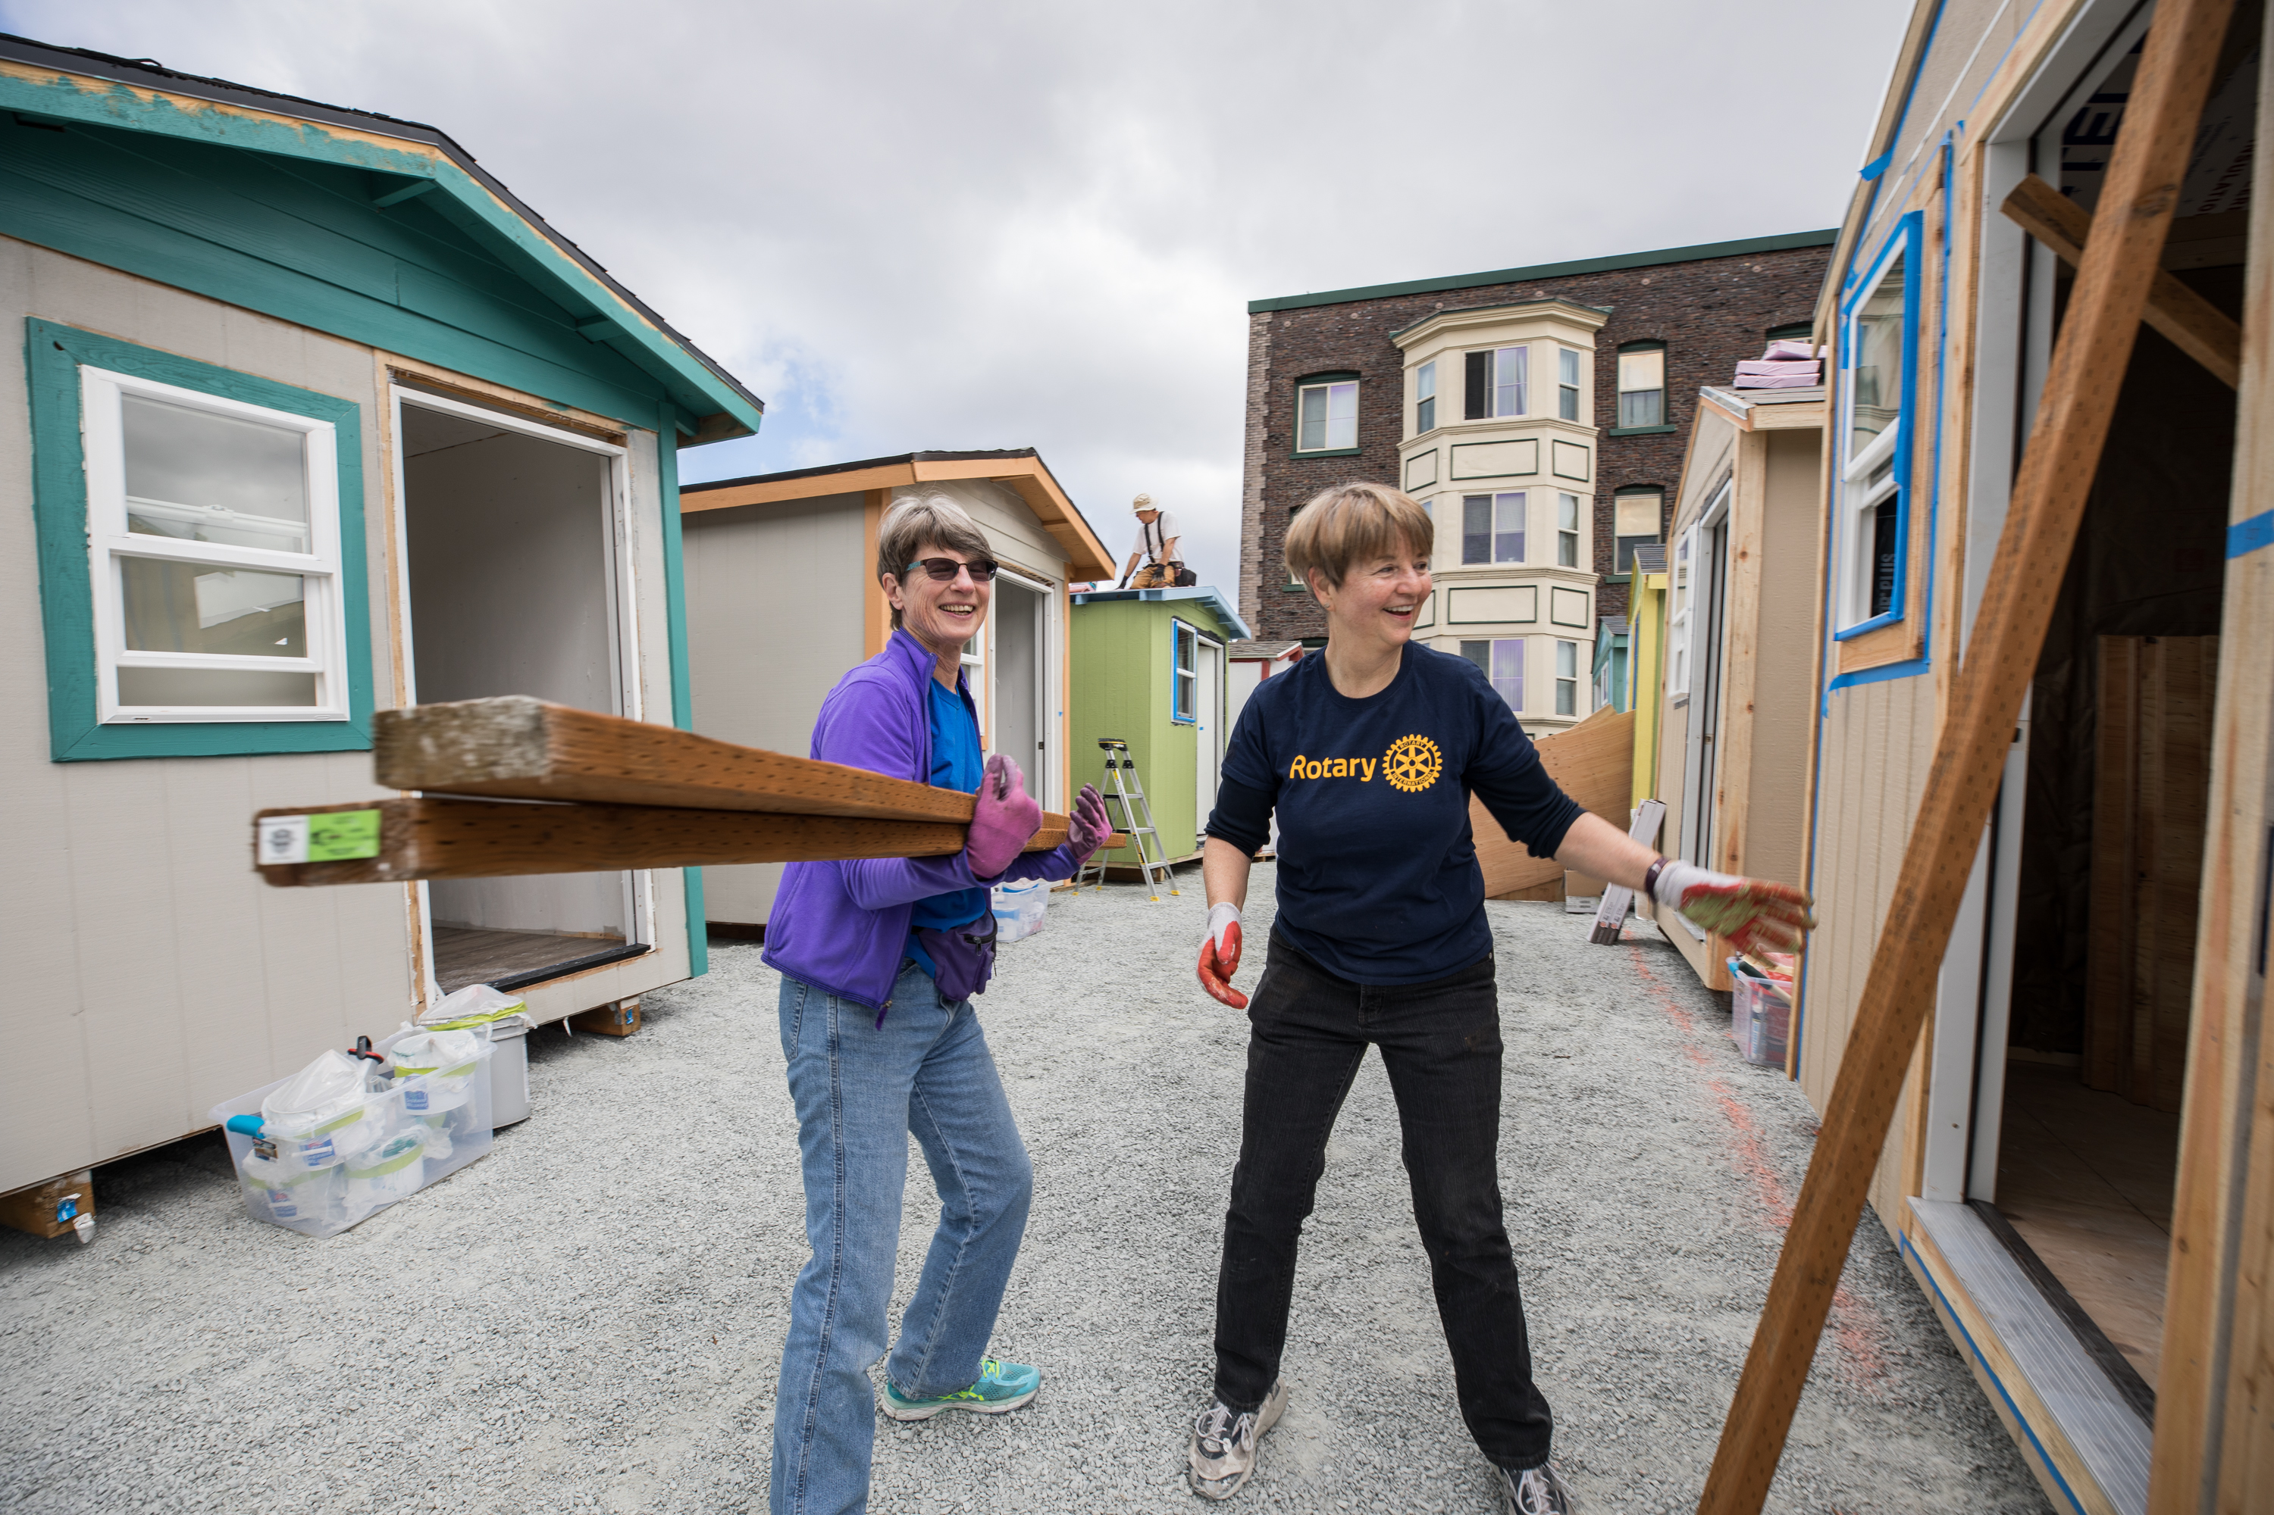

Slide 31
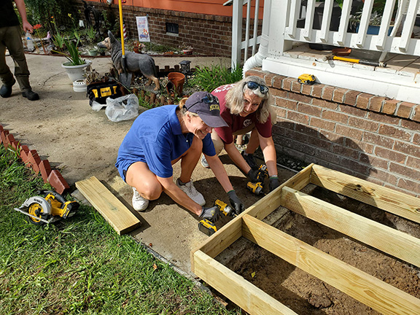

Slide 32
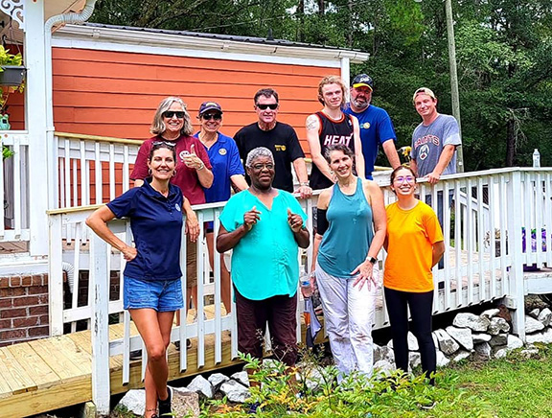

Slide 33
Is this the right or wrong Use of the rotary Logo?

Slide 34
And it helps if your subjects smiles!

Slide 35
Ask yourself “is this interesting?”

Slide 38
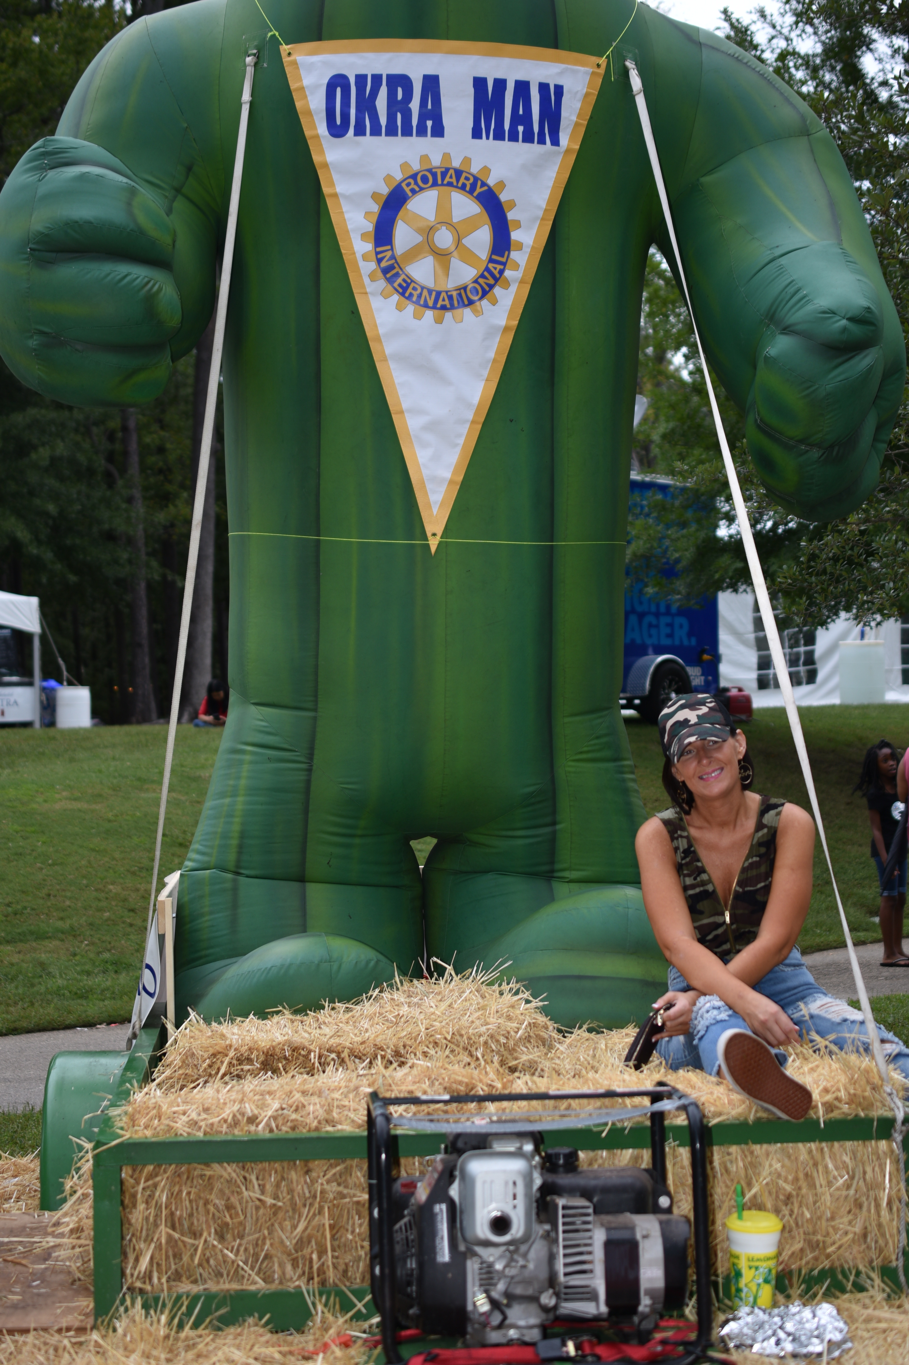
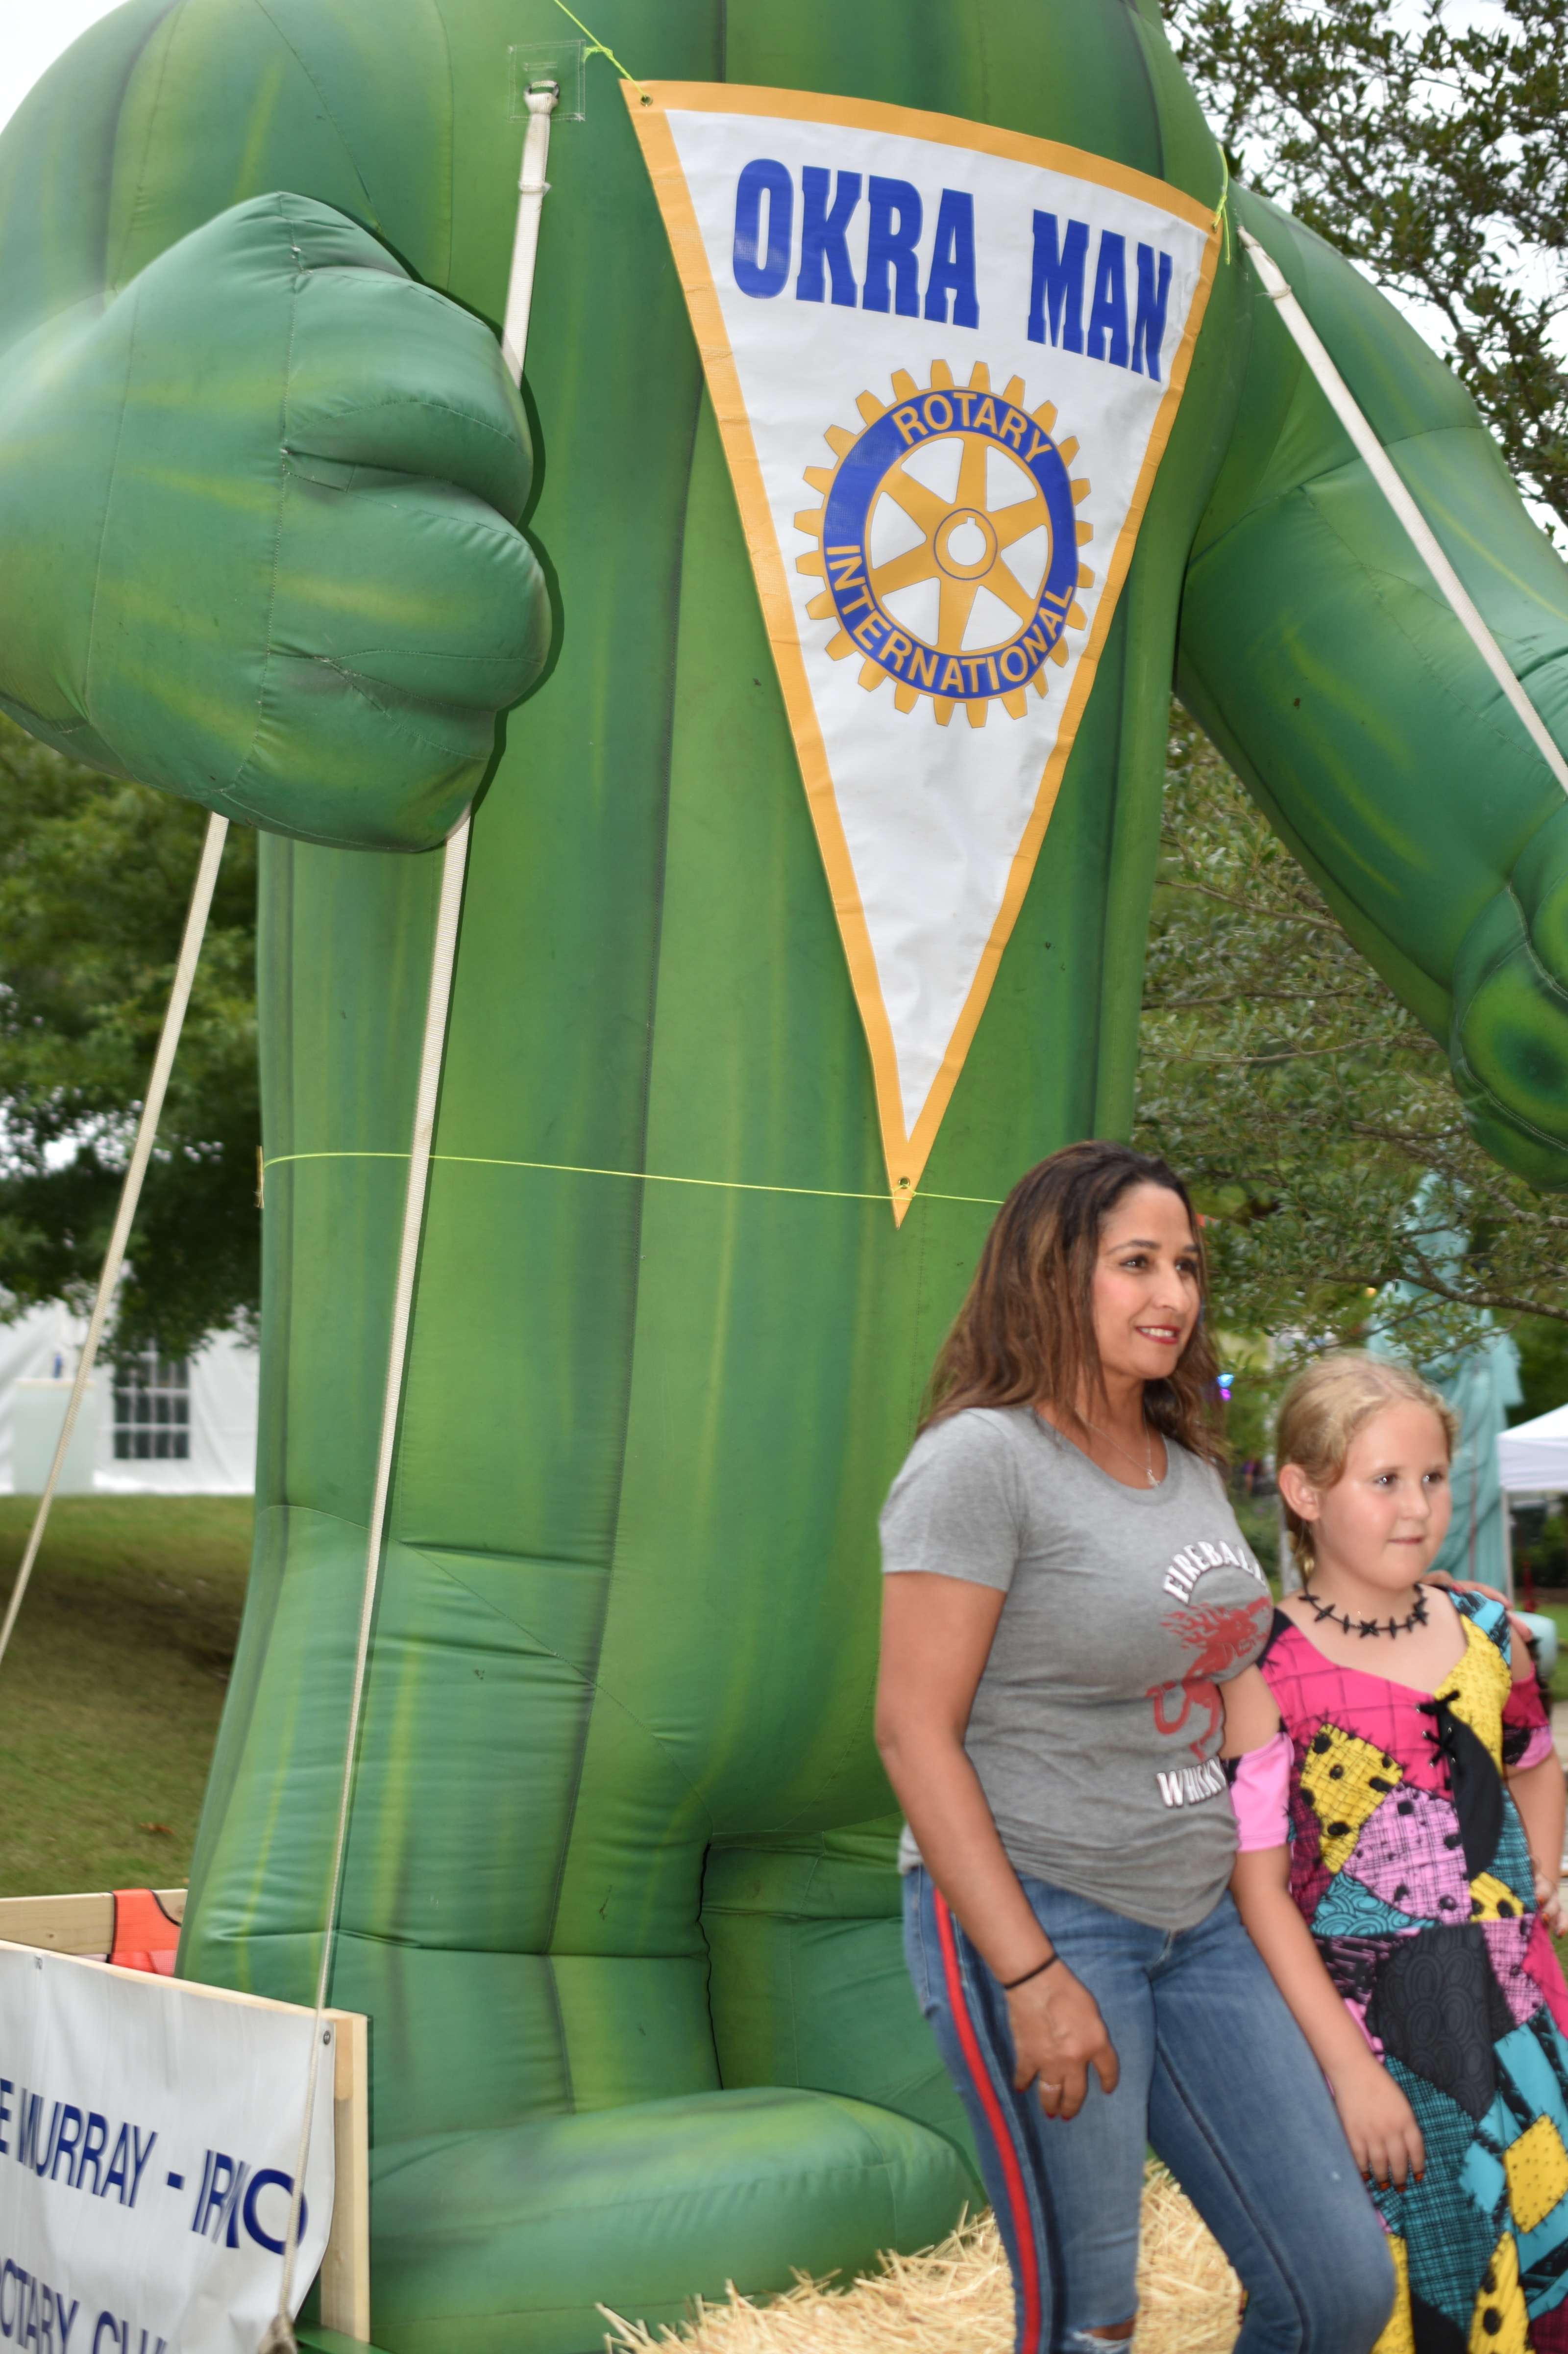

Slide 39
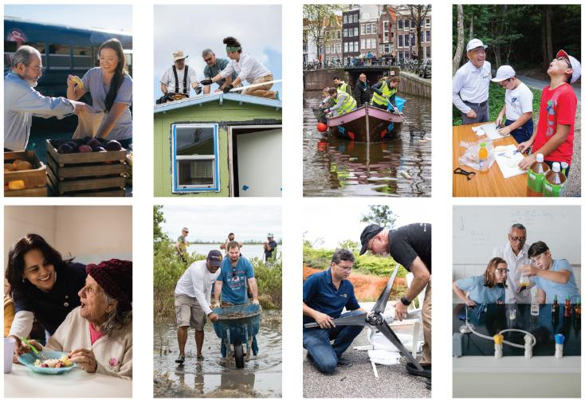
PHOTOS
Photos Use ACTION
Real-life, everyday moments
Displaying a sense of motion
Featuring just a few people that viewers can see well
Using warm lighting and natural colors
Representing the diversity of your club and community

Slide 40
PHOTOS
Rotary Suggests Examples to AVOID

Slide 41
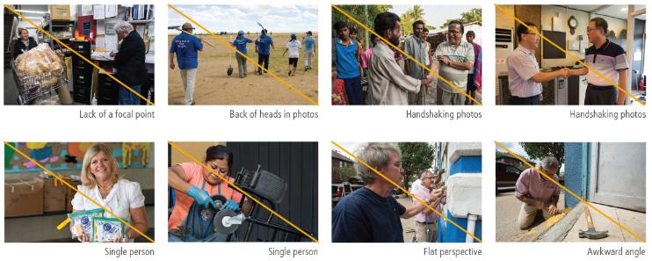
PHOTOS

