Slide 1
Agenda
Session 1
The Power of Public Image
Governor’s Awards
Photography tips
Writing your MarCom Plan
Session 2
How to write a press release that gets published
Social Media Tips and the District Newsletter
Writing your MarCom Plan

Slide 2
Agenda
Session 3
DACdb made simple
Using and not abusing the Rotary Logo
Writing your MarCom Plan

Slide 3




Slide 4
Don’t underestimate the power of simple tools.

Slide 5

The first thing you do at the start of your year is buy Tee Shirts for your entire club

Slide 6

Public Image
Training
September 23, 2022

Slide 7
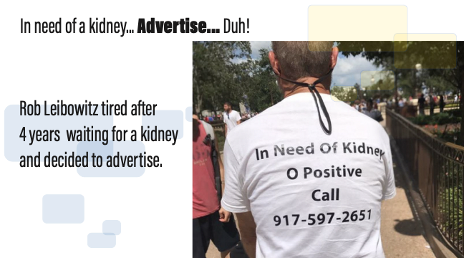

Slide 8

Hi,
I’m Ken Gasque
Your District 7770 Public Image Chair

Slide 9

My associate is Dawn Rochelle
Assistant Rotary Public Image Coordinator,
PDG D7730
Z33 Empowering Girls Ambassador
Rotary Club of Jacksonville (NC)

Slide 10

Three Take-Aways…

Slide 11
Increase Rotary Awareness

Slide 12

We buy with our eyes.
Notes:
We created this poster for our clients and for ourselves to help us stay focused. I think it applies for you too.

Slide 13
The Four Rules of Success

Slide 14

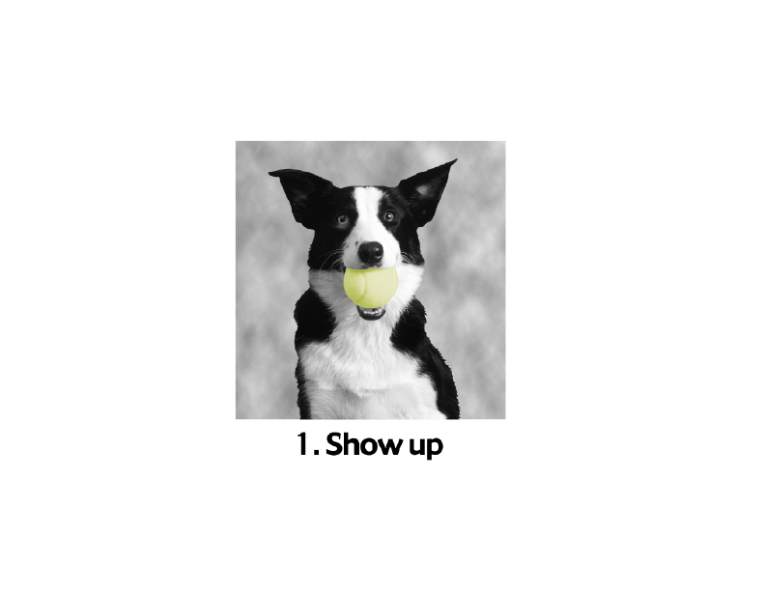
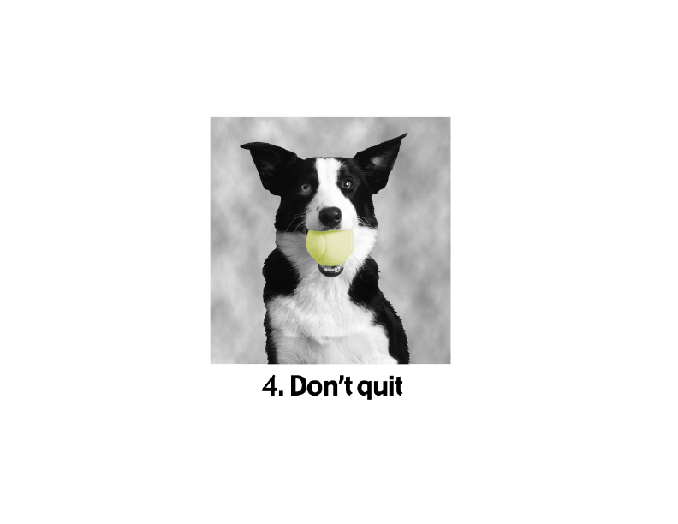
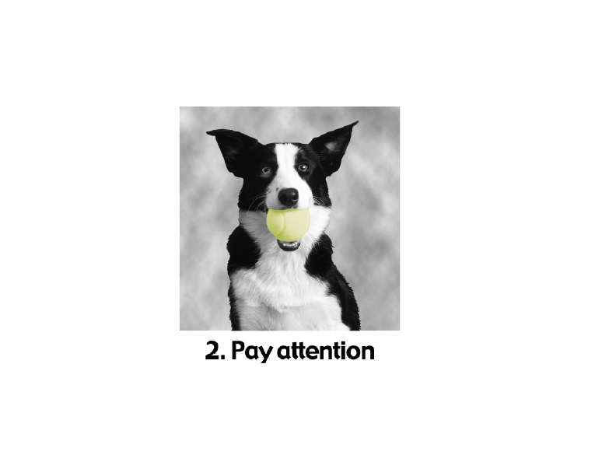
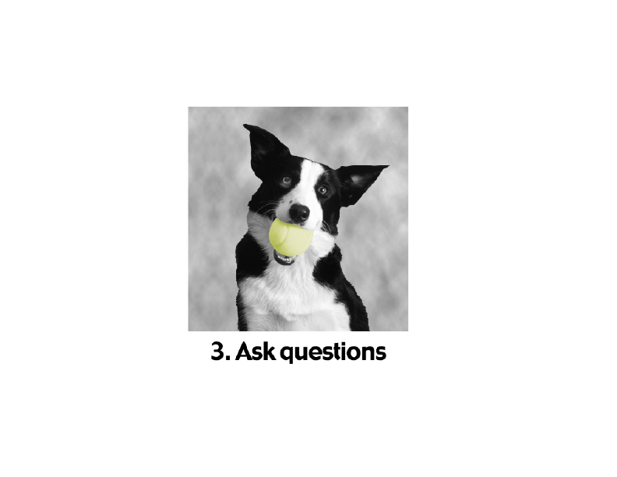
The Four Rules of Success

Slide 15
How many of you are in marketing or advertising?

Slide 16
A message for Presidents and Presidents Elects
I recommend that you ask your PI Chair to remain as PI Chair for a second year. They will become much more effective and have more fun. And the results will be impressive.

Slide 17
As Public Image Chairs our objective is to create awareness for Rotary.

Slide 18
How many of you have heard the old adage…
“Build a better mousetrap and ____ _____ ____ _ ____ __ ____ ____?

Slide 19
It may be an old adage, but it ain’t so.

Slide 20


The first step in growing
Membership and Foundation is making sure people know we exist.

Slide 21

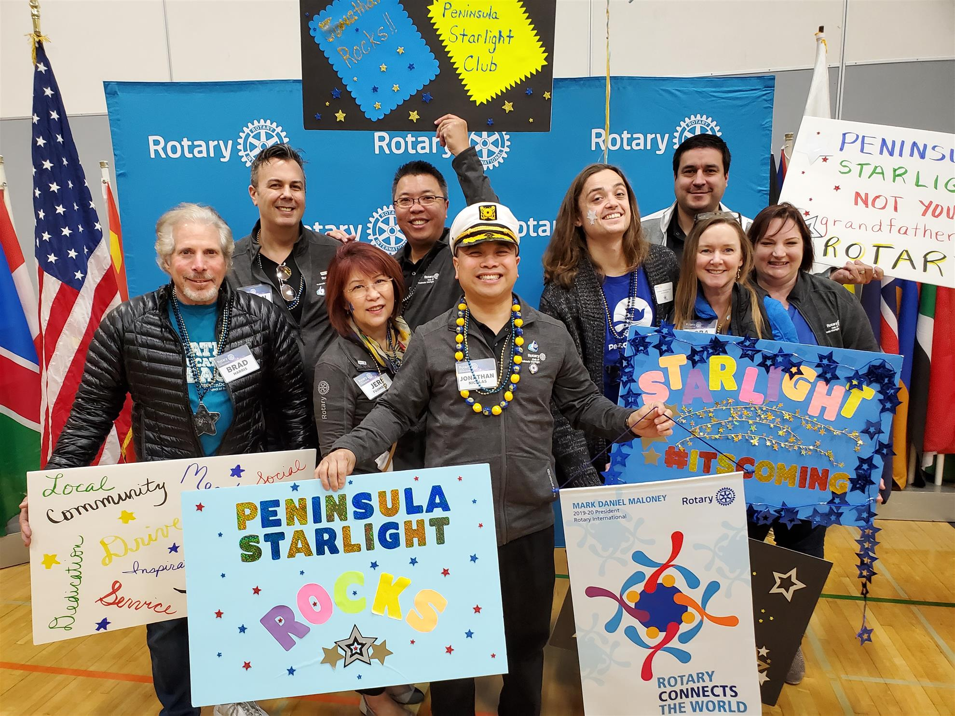
People have to see us working

Slide 22
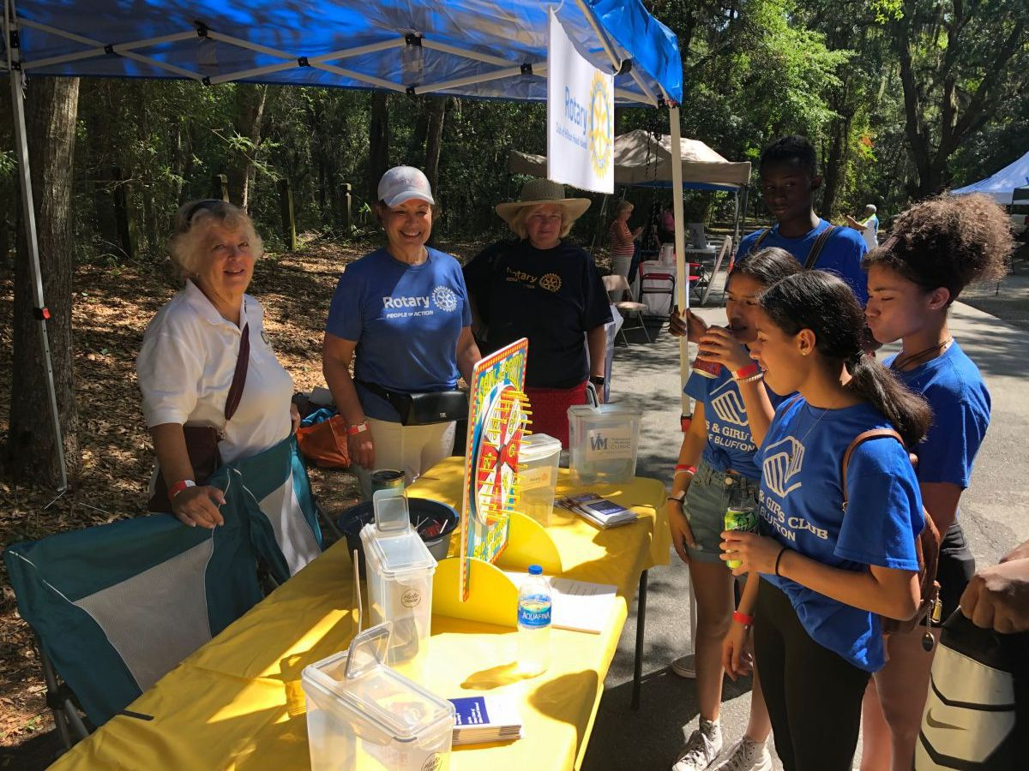
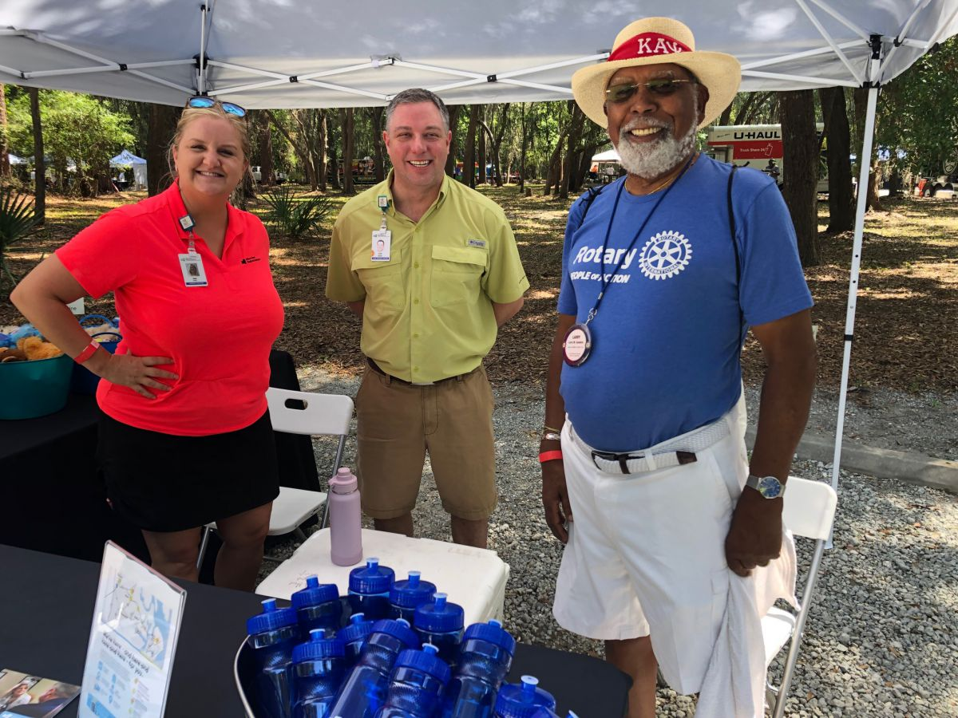
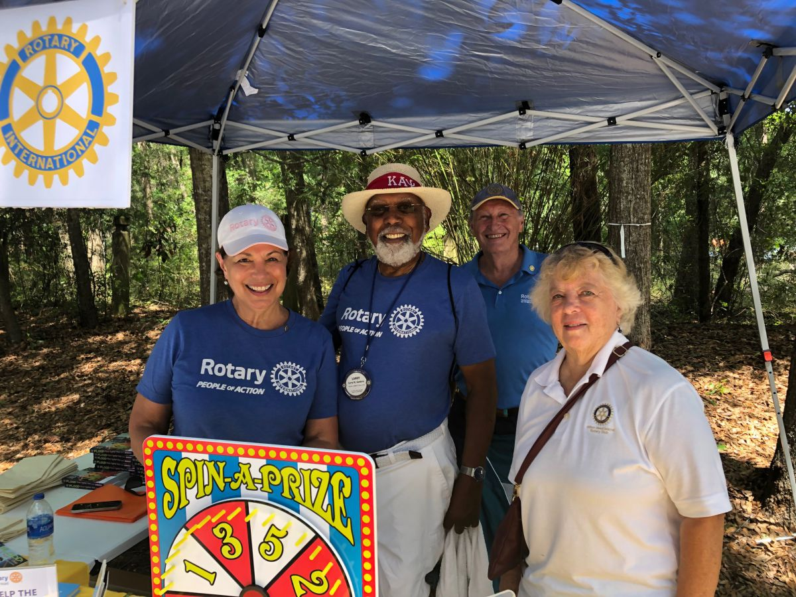
We have to be visible!

Slide 23
What is our Strategic Plan?
Two words…
Create Awareness!
Notes:
Plans are worthless, but planning is everything. Dwight D. Eisenhower

Slide 24
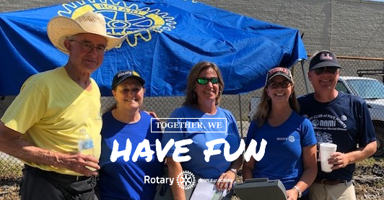
Do Good, Have Fun, Tell Someone
Notes:
This is not Rotary’s strategic plan but it is a successful plan. Having fun beats not having fun and it is a great strategy for membership. Plan to have fun.

Slide 25
The Three Elements of Rotary’s Strategic Plan
  Foundation–
    The Rotary Foundation transforms your gifts into service
  Membership—
  Sees a world where people unite and take action
  Public Image—
    Create awareness
Notes:
The Foundation is a unique feature of Rotary which sets us aside as a brand. It enables us to do good work.
Membership grows because people see the good work and the fun and want to be a part of it.
But Public Image guarantees that the good work and the fun are seen and noted. Public Image creates the desire for people to become a part of it.

Slide 26

Without Public Image it is like lighting a candle and placing it under a basket.
Notes:
We are admonished in Mathew 5:14-15
¹⁴ “You are the light of the world. A town built on a hill cannot be hidden.¹⁵ Neither do people light a lamp and put it under a bowl. Instead they put it on its stand, and it gives light to everyone in the house.

Slide 27

Getting Started
• Survey the situation
• Meet with your Foundation, Membership and discuss creating a document (digital brochure, email, or printed brochure) to distribute to your community to make sure your community knows what Rotary is doing!
Then sell ads to have it printed.

Slide 28

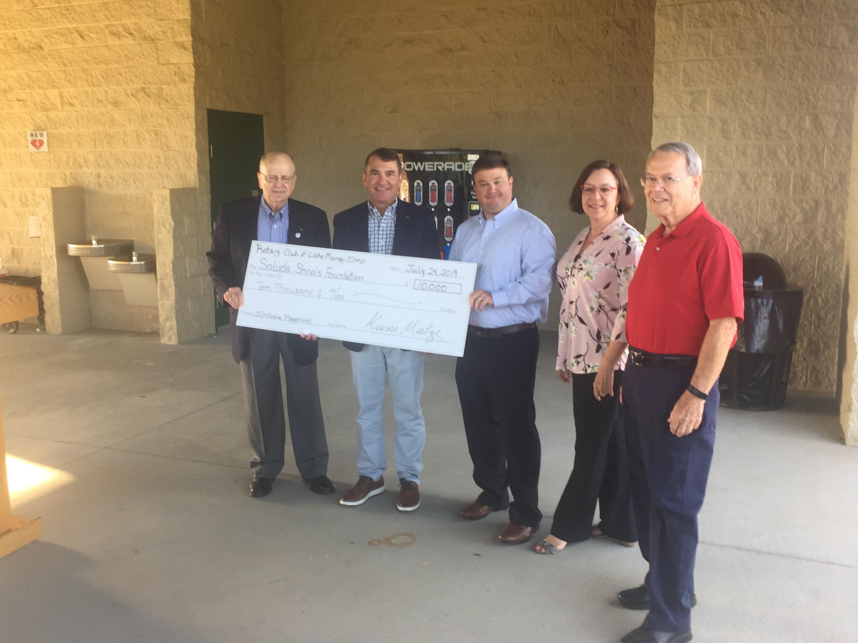
As Public Image you need to meet with your Foundation and Membership Chairs to know what is happening before it happens.
This is after it happens.
Notes:
Have a creative session. Listen!

Slide 29

Getting started.
Governor’s Award for PI
Awards for how well you created awareness for Rotary and your club.

Slide 30
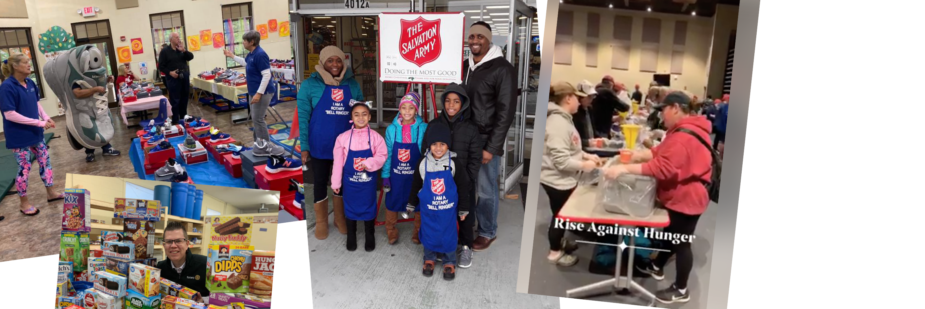
What are your club activities? Goals? And objectives?
Notes:
What projects are your club doing now? What have you seen that other clubs are doing. Can you steal the idea… it’s permitted. If it’s fun.

Slide 31


Have a calendar of all the events your Club will have in your year… fundraisers, parties, projects, presentations
Notes:
Planning may be worthless… according to Ike but if you and your Public Image chair are as busy as I think you will be planning goes a long way to getting things
Done and with a lot less comments… You had one job!

Slide 32
What are the best opportunities and the best events to attract the attention?
Notes:
Can you join in another community activity. Of course you can. You will make it better!

Slide 33

What are events that are taking place in your community in which you might participate…
Festivals, Craft Beer Celebrations, Car Shows, Coin Shows, Wildlife Expo, Sporting Events, Art Shows, etc.
Review the District Newsletter for ideas other clubs are doing and copy them!
Notes:
A small booth, some handouts, some tee shirts and a game of chance and you have a crowd.

Slide 34


Look for opportunities for Rotary to tell our story?

Slide 35
Be specific about what you wish to accomplish
Who do you want to reach? (Not everybody)
What do you want them to do?
What will determine a success? (Number of people reached? Amount of money raised? Number of new members recruited?)

Slide 36
Wicomicorotary.com
Write this down.
This is an incredible idea that really creates awareness!

Slide 37
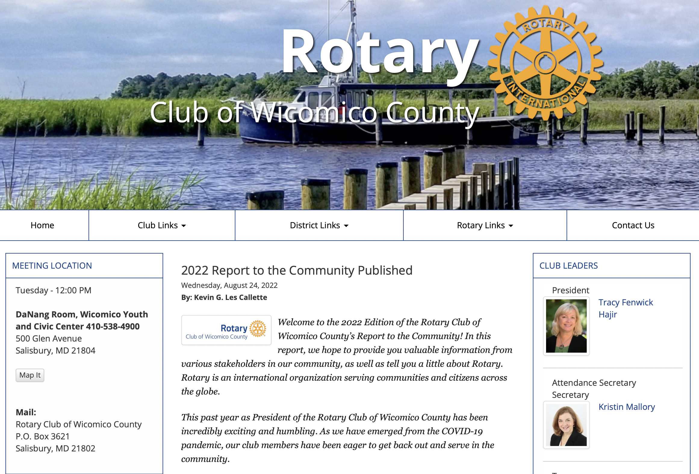

Slide 38


Slide 39
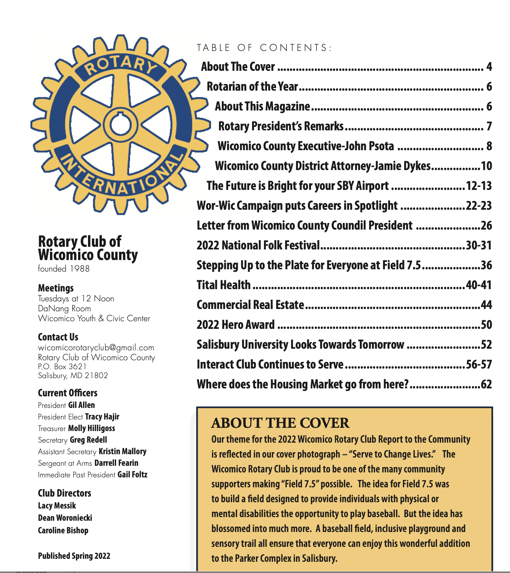
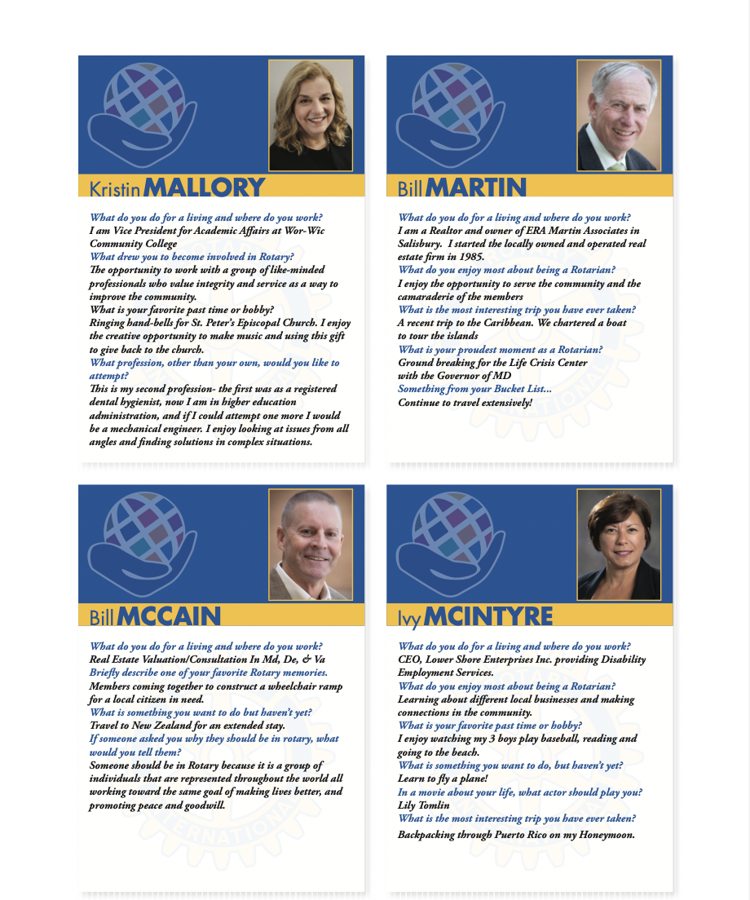

Slide 40
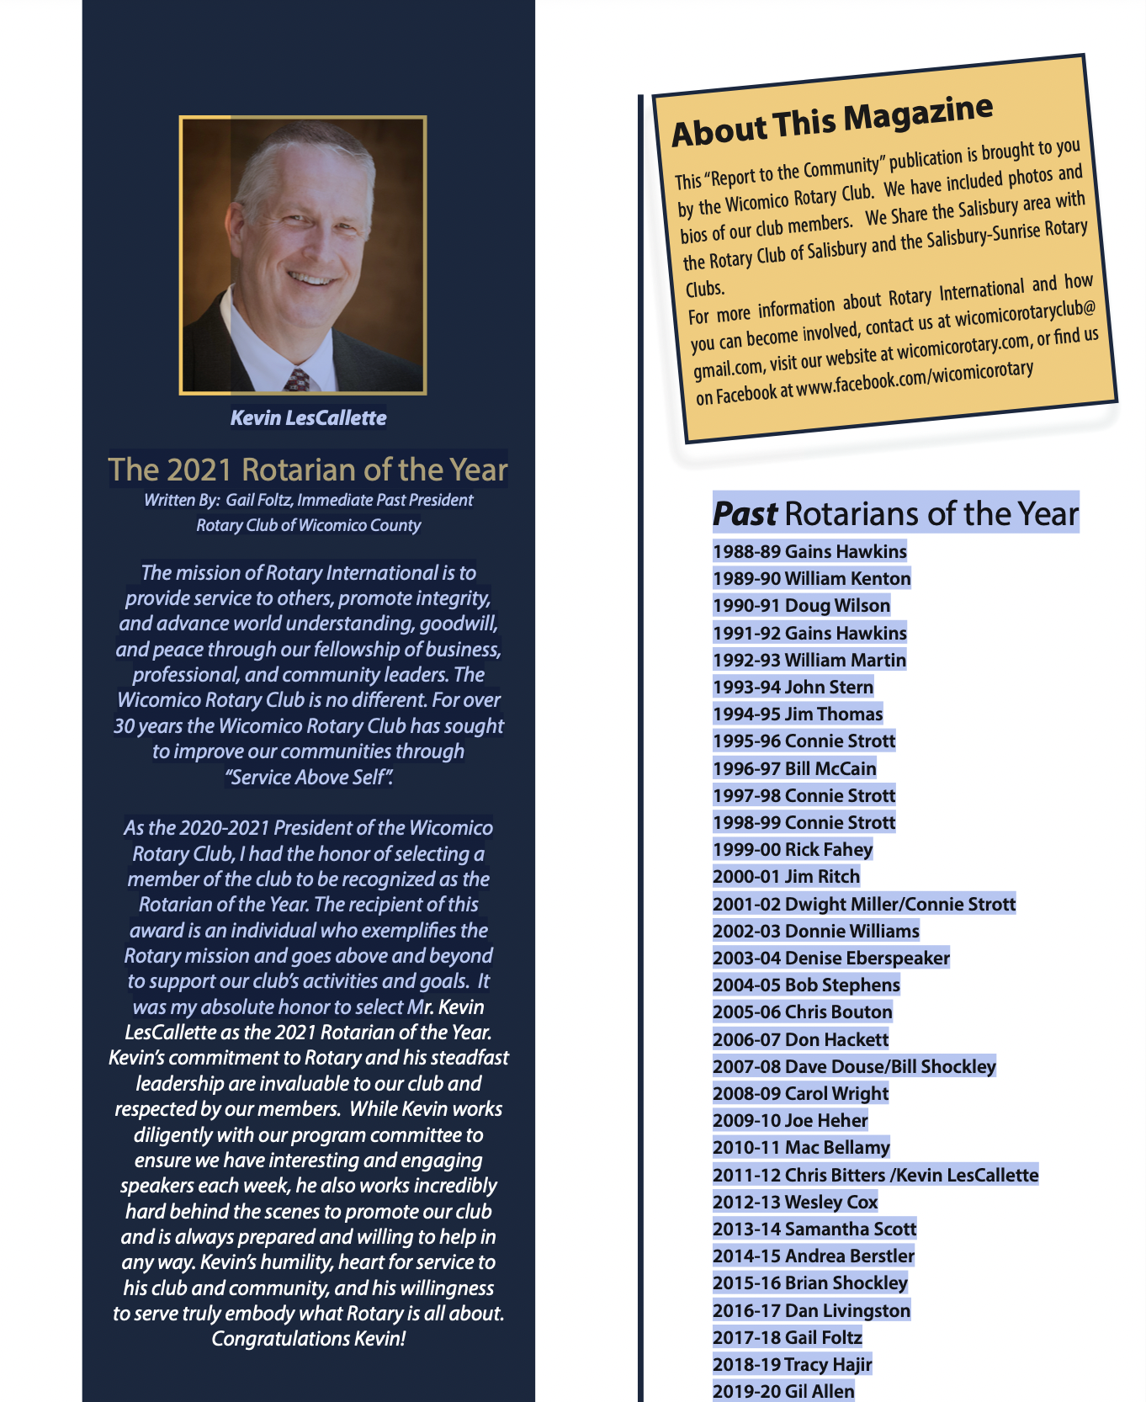


Slide 41

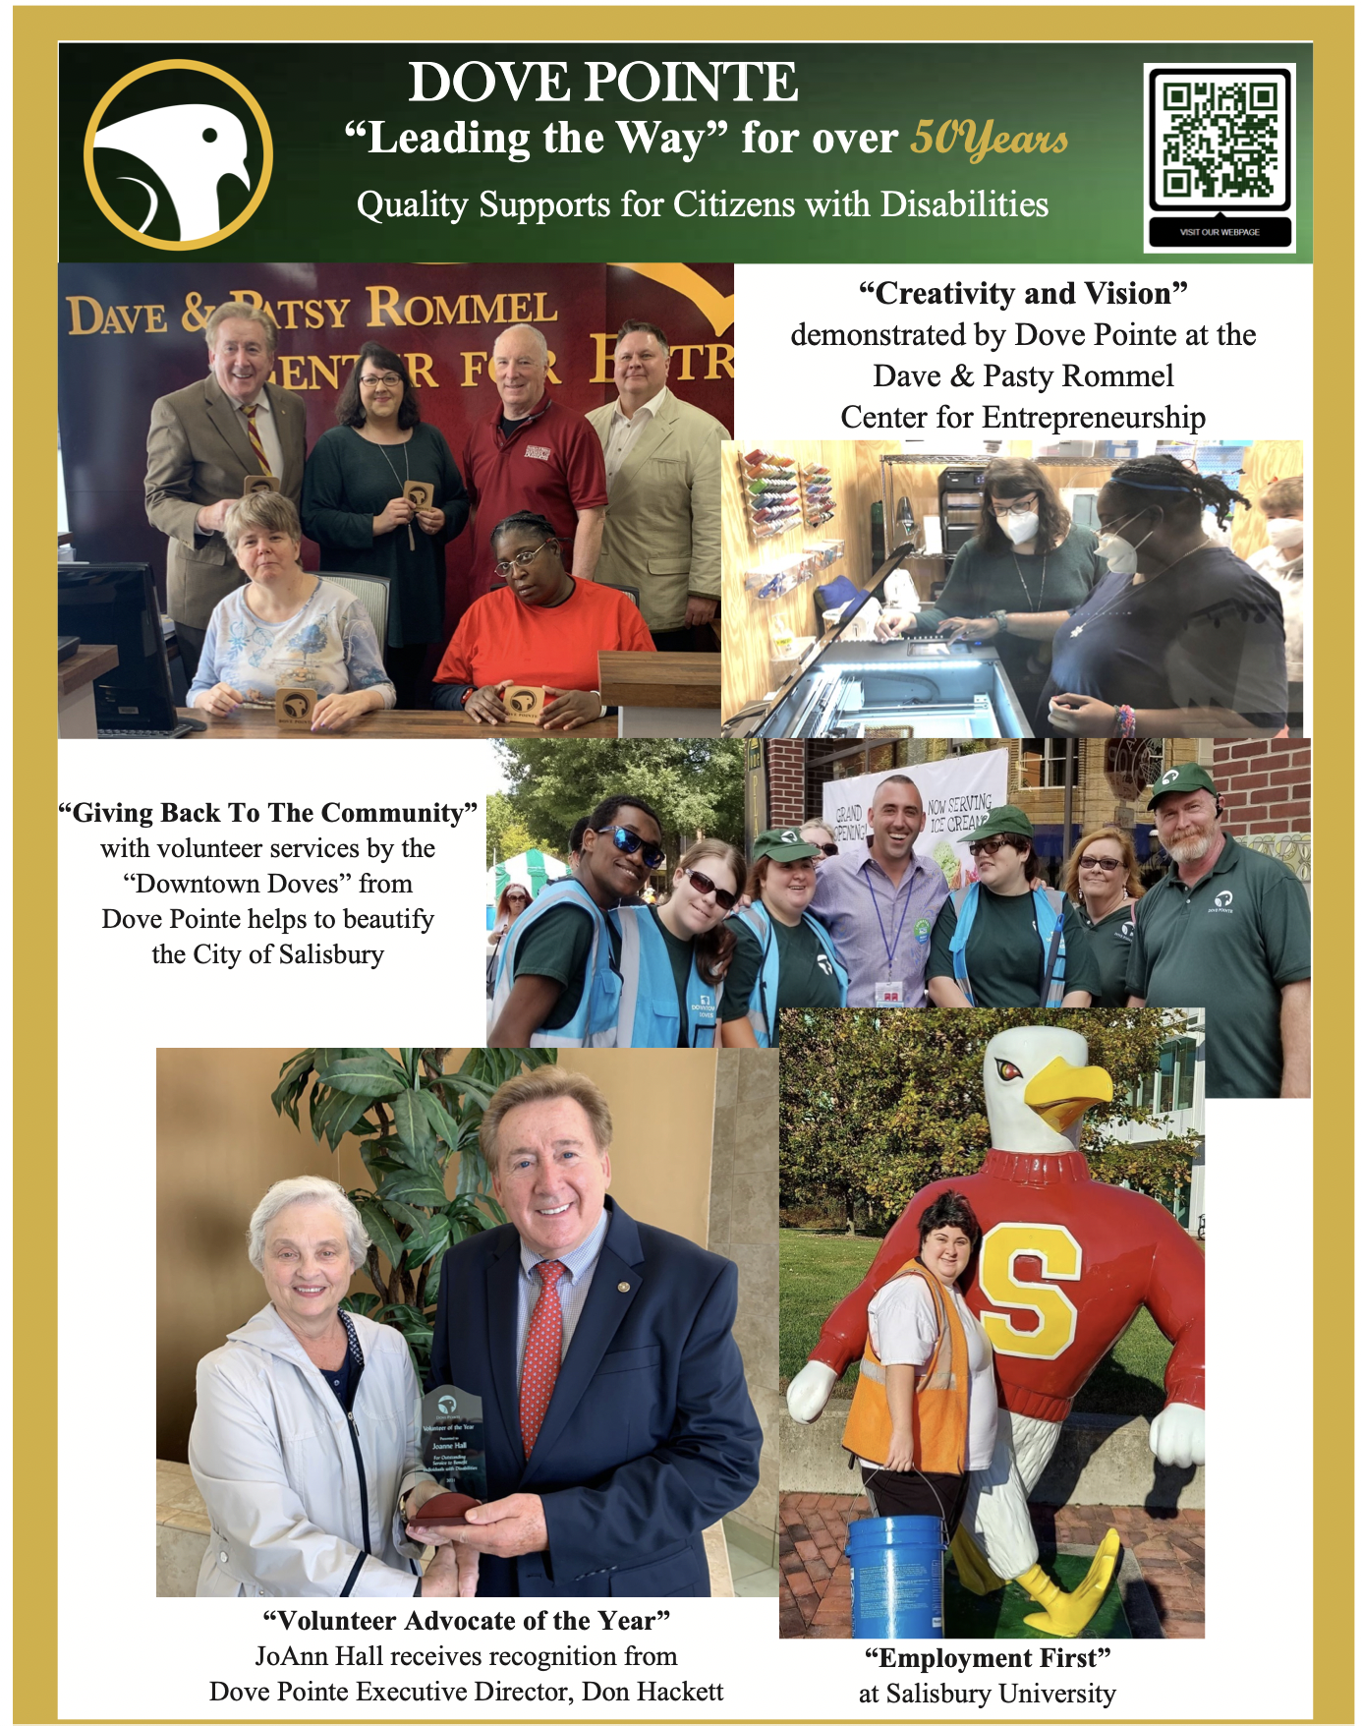

Slide 42

How can you promote Rotary’s story?
Guerilla tactics– Signs, Tee shirts, Banners,
Social Media– FaceBook,
Instagram, Twitter,
Pinterest, YouTube, etc.
Notes:
Guerilla tactics are fun. They are usually cheap. They are usually very creative. And if they are, they are very successful.
Reddit was founded by three students at University of Virginia in 2005. They had a budget of $500 and they spent it all on
Stickers. They knew their market and the rest is history. Reddit is now worth $20 billion.

Slide 43



Slide 44

Promoting Rotary…
Be innovative
My favorite tool—YouTube
  Video of Rotarian of the year • Video of projects
  Video of exceptional speakers • Video of Rotarians having fun!
Just make Rotary visible
Notes:
Everybody has a video camera in their pocket. Use it to make Rotary visible.

Slide 45
We buy with our eyes.
Notes:
This is true whether you are selling clothes or advertising.

Slide 46

Notes:
These graphics are parts of logos. Some you haven’t seen advertised in ten years but you still recall the company even though you are only
Seeing a portion of the logo. Let’s try it.

Slide 47
Do Good, Have Fun,
Tell Someone
#DoGoodHaveFunTellSomeone

Slide 48
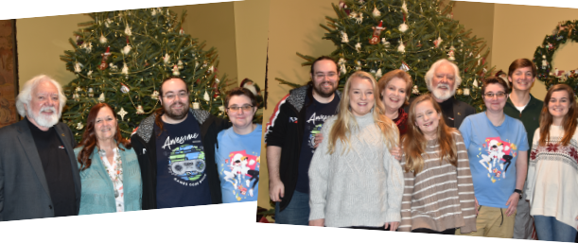
What is Rotary?
Notes:
This is part of my family. Recently we had a family and friends gathering for a birthday. I announced that my wife Mary was going to be a Rotary District Governor. Everyone was impressed. Then my grand daughter, 30 years old, asked, “What is Rotary.” There were twenty people in the room and
None of them knew anything about Rotary. We explained and told them about a few projects including End Polio. We may have a prospect or two.

Slide 49
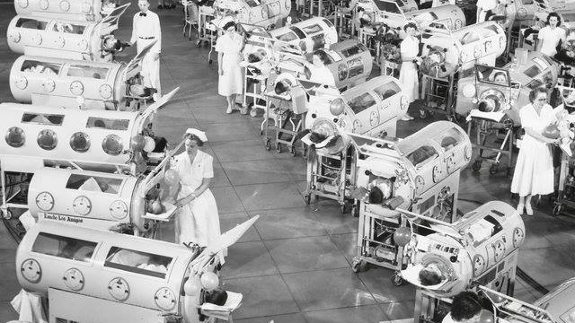
Notes:
The next day I received this photo from a family friend who was at the party with a note… “Thank you for what you and Mary and Rotary are doing! In case you don’t know these are iron lungs used in the 1950’s to treat people with polio.

Slide 50
Do Good, Have Fun,
Tell Someone
#DoGoodHaveFunTellSomeone
Notes:
Tell your family about Rotary. It’s a safe bet they don’t know much about it. And you might get a new member.

Slide 51
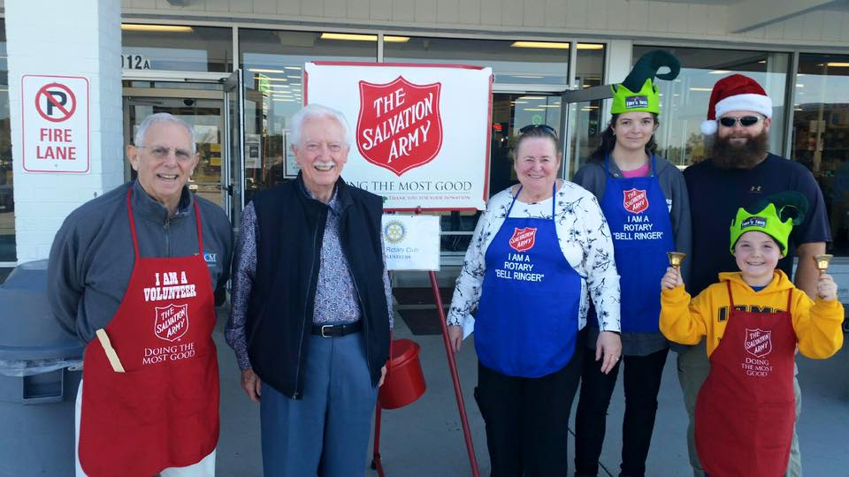
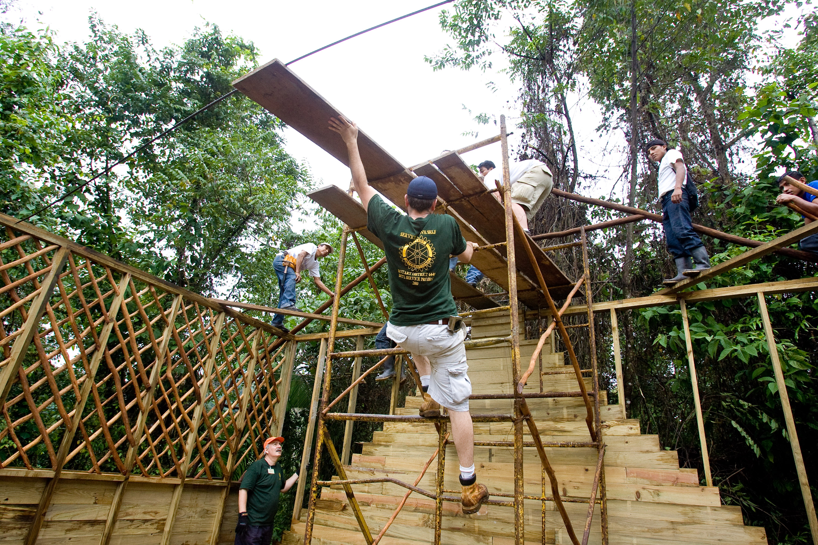
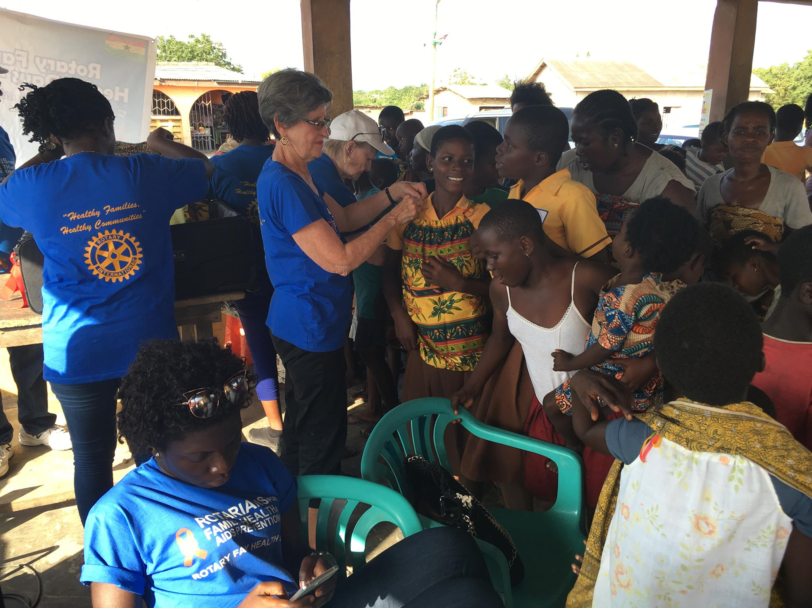
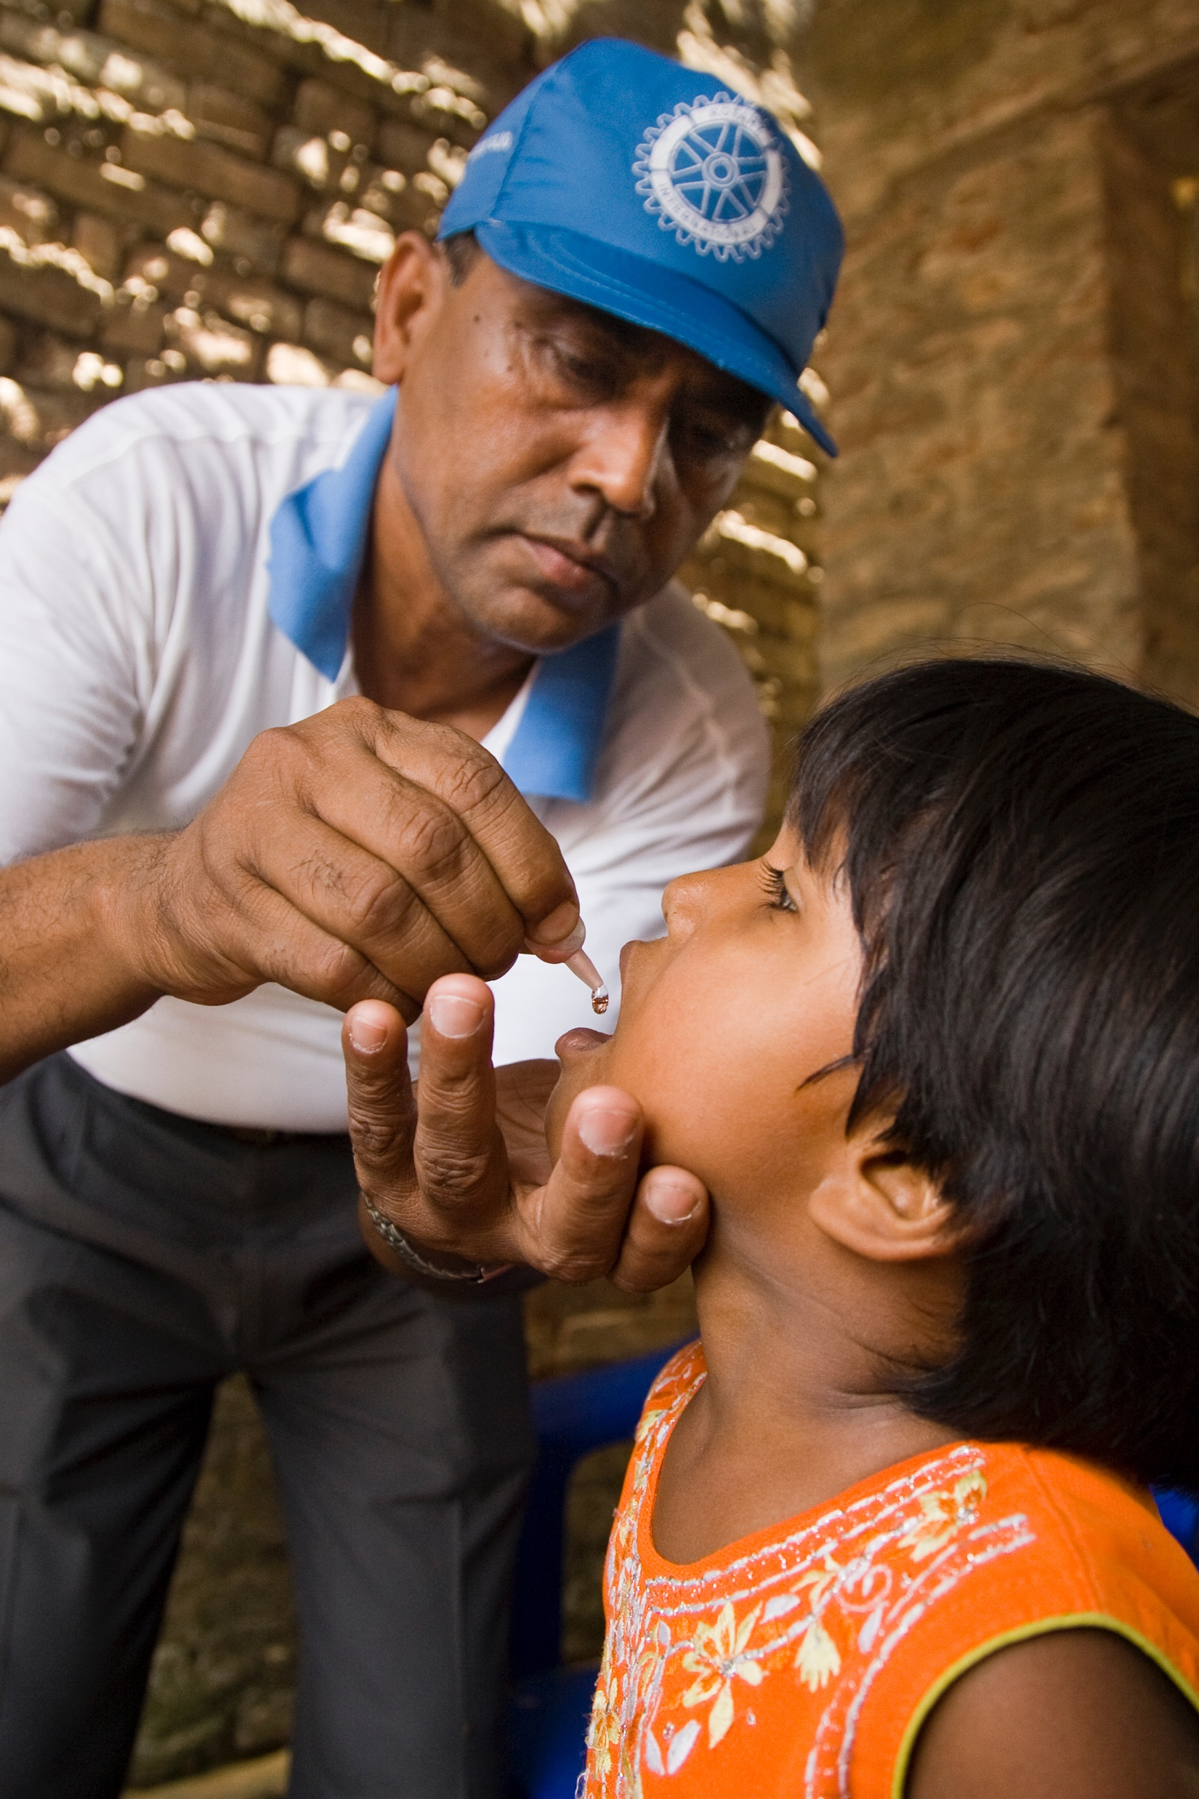
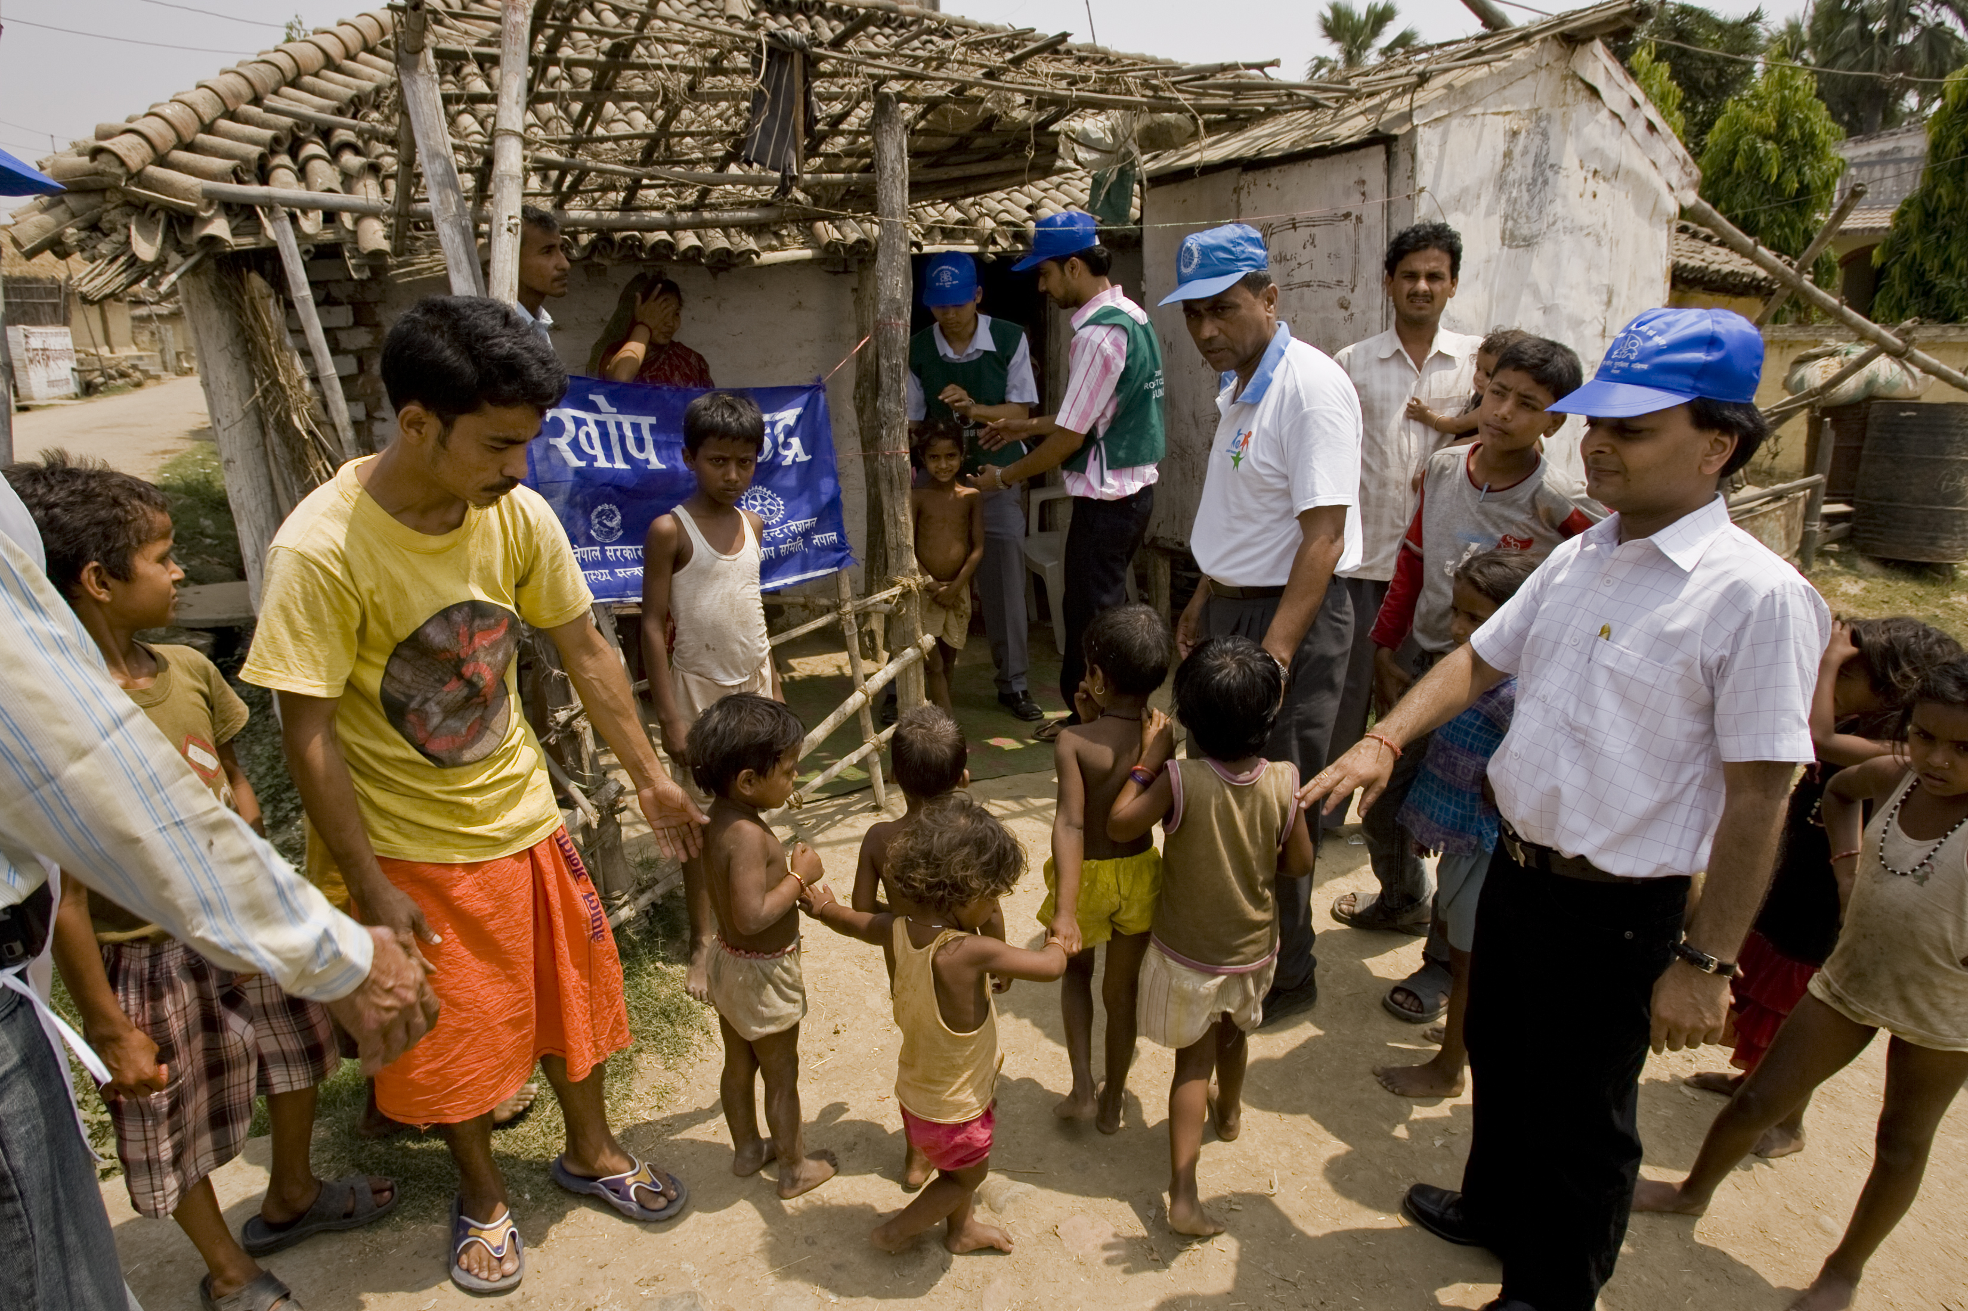
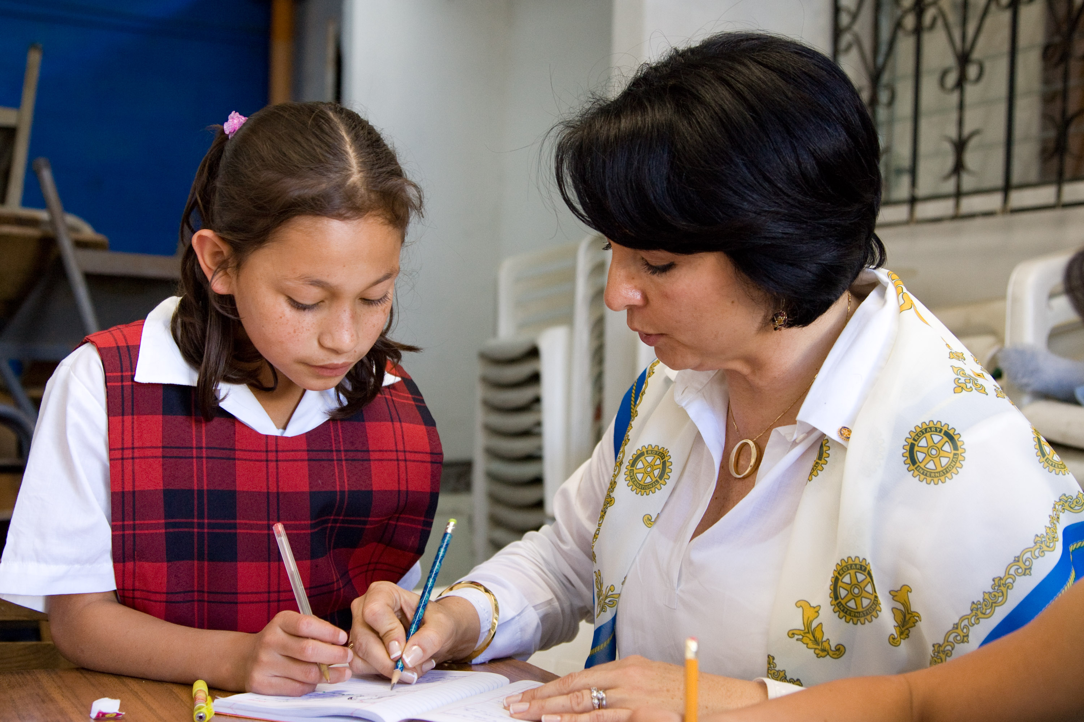
Notes:
Rotary projects are opportunities to show the world what Rotary is doing. Shirts, aprons, signs, stickers

Slide 52
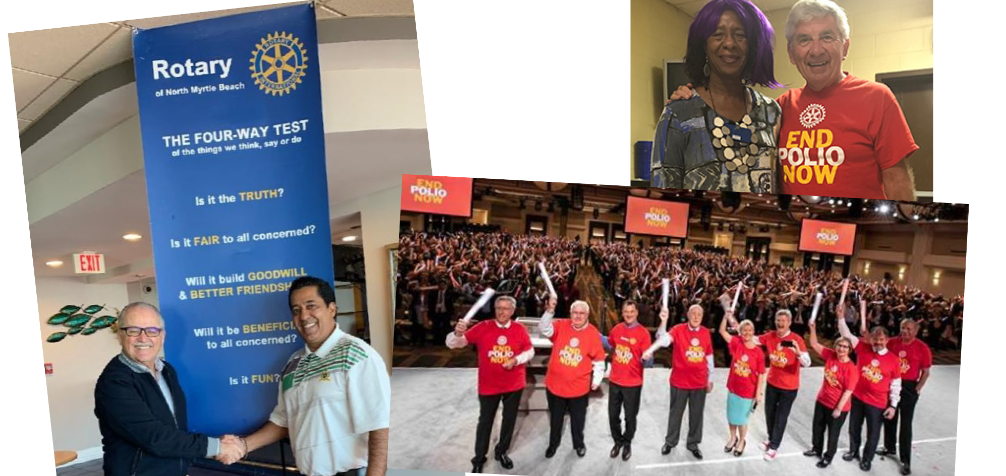

Slide 53
We buy with our eyes.

Slide 54
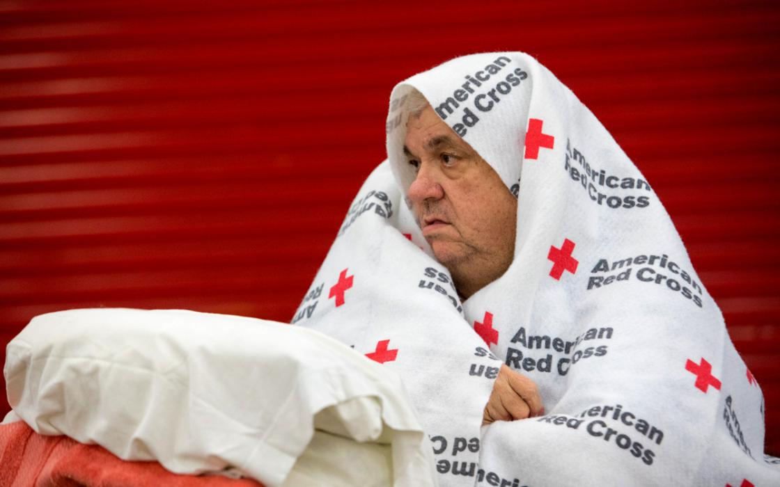

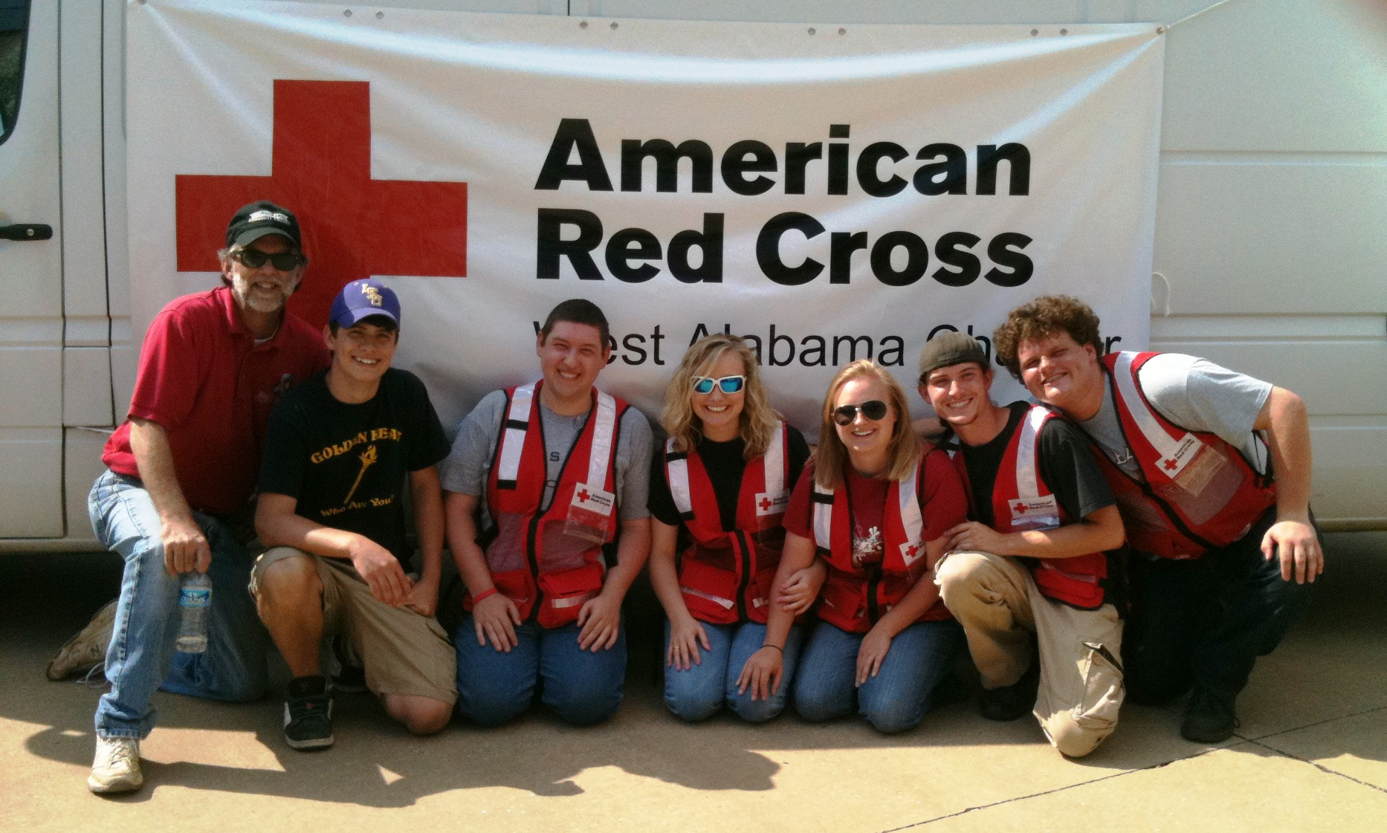
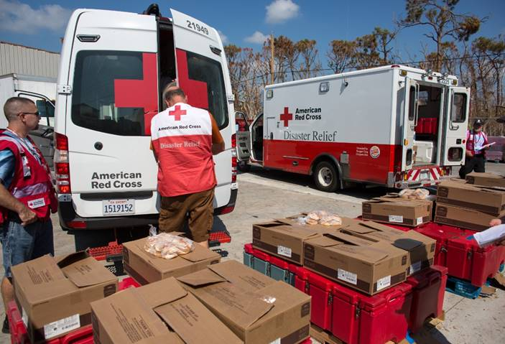
Notes:
The Red Cross understands. They brand everything. Shirts, vehicles, boxes, blankets, banners

Slide 55



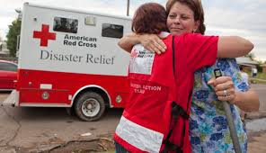

Slide 56
There are approximately 500,000 Red Cross volunteers, including FemaCorps and AmeriCorps members and 35,000 employees in 600 Chapters. They provide services all over the world.

Slide 57
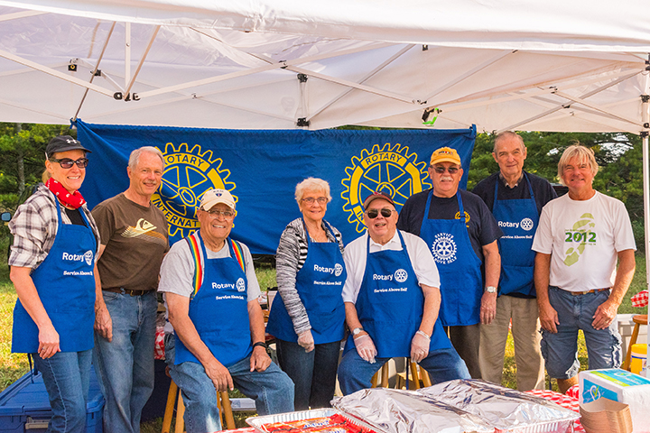

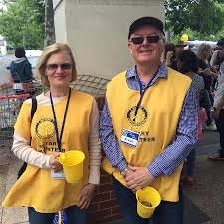
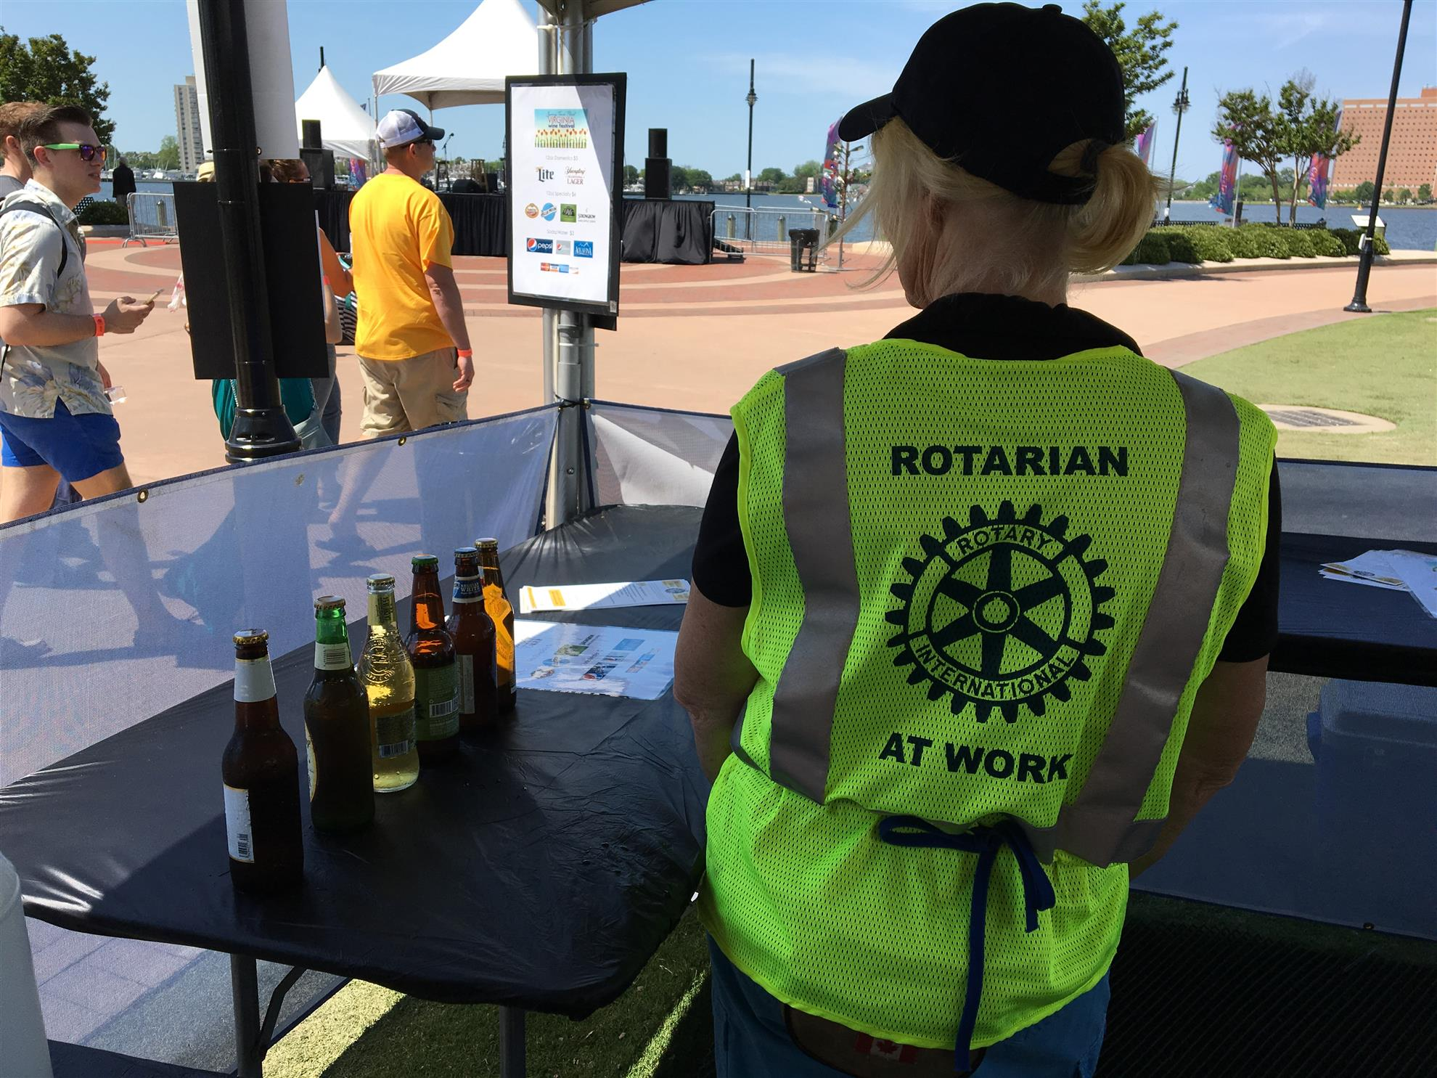


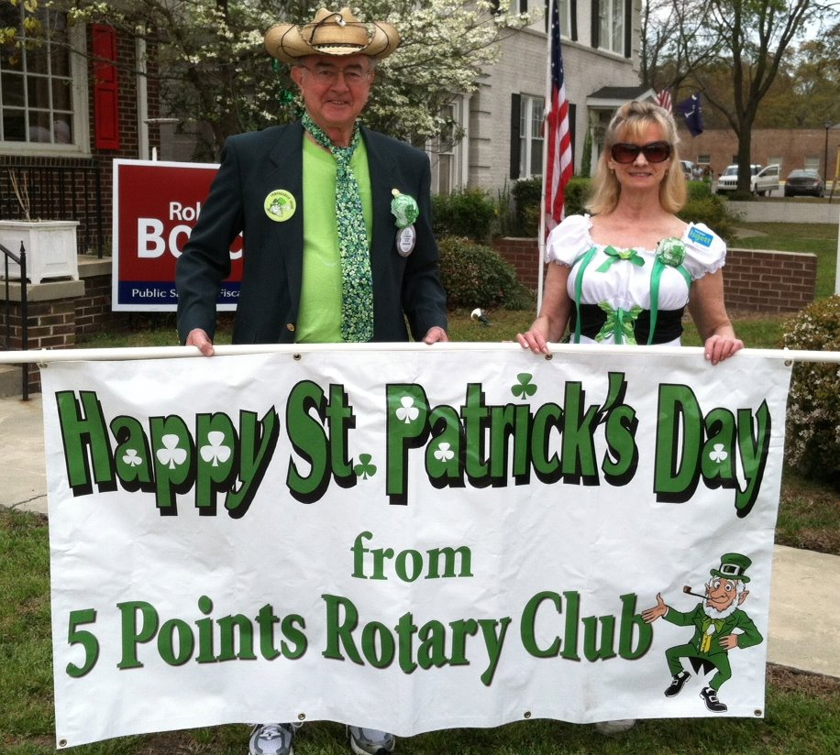

Notes:
Rotary brands everything too, but with a lot more fun and creativity. Look at what other clubs are doing… and steal the idea, they don’t care.

Slide 58
There are over 1,200,000 Rotarians in 35,000 clubs
in over 220 countries.
All we need to do is be more visible.
Notes:
Actually, I think there are over 1,400,000 Rotarians. Think how we can be more visible.

Slide 59
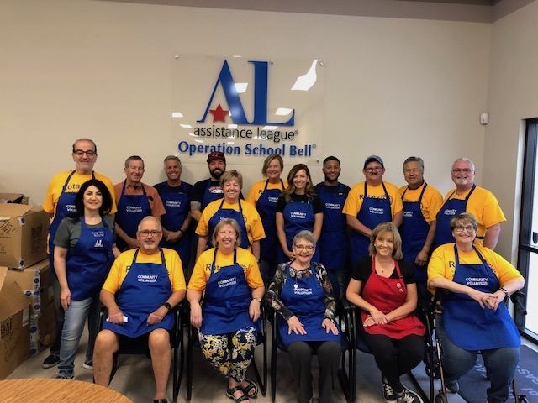
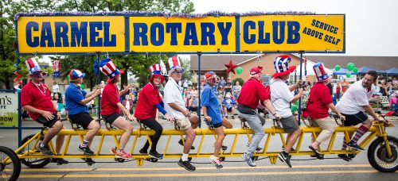
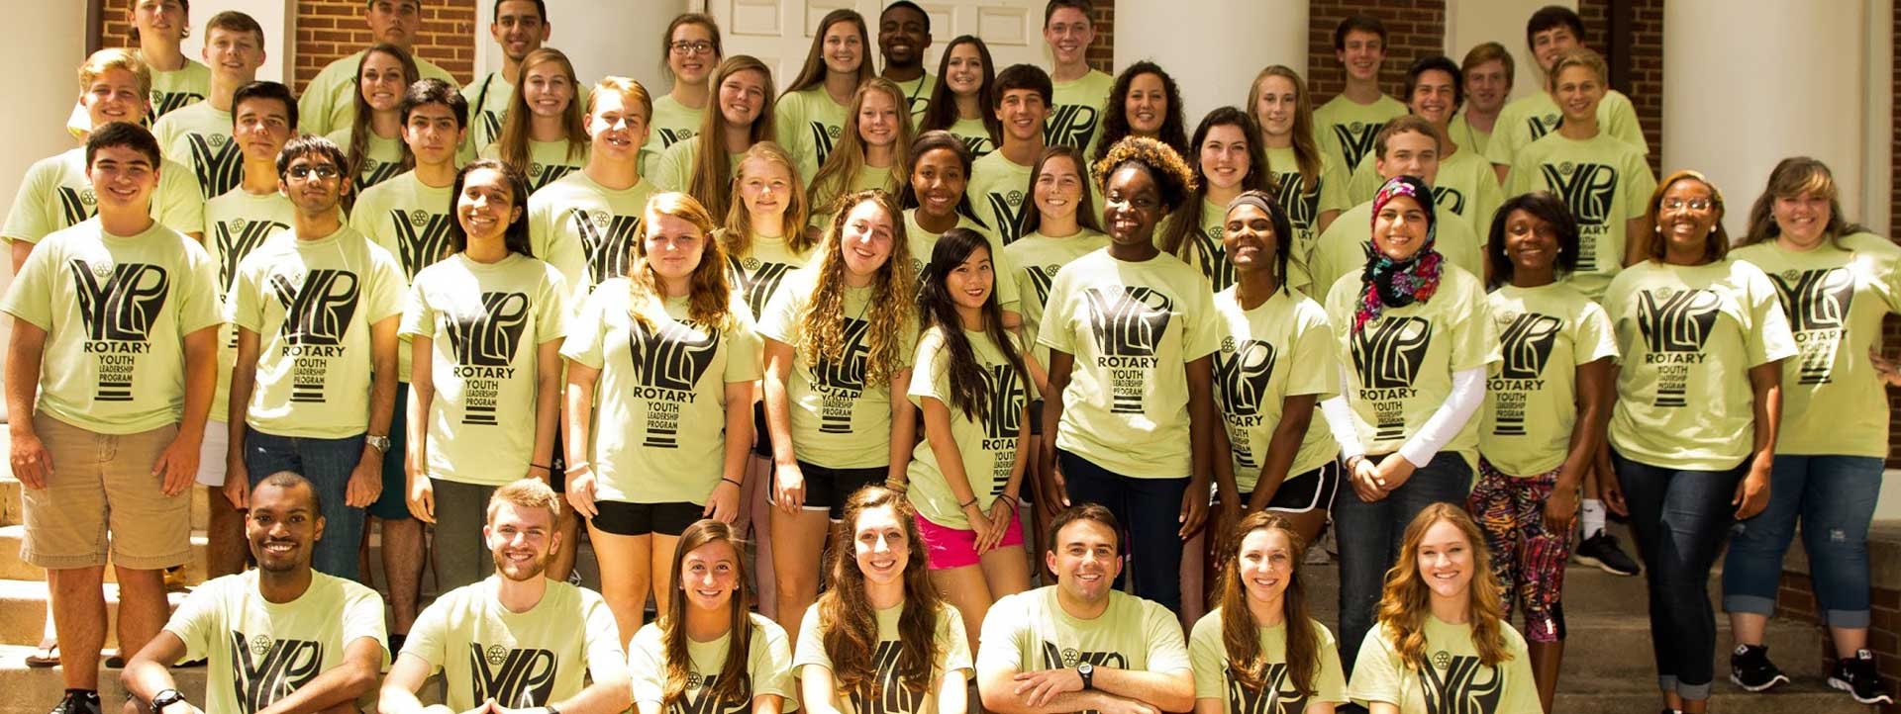
Notes:
It’s not hard to be seen

Slide 60
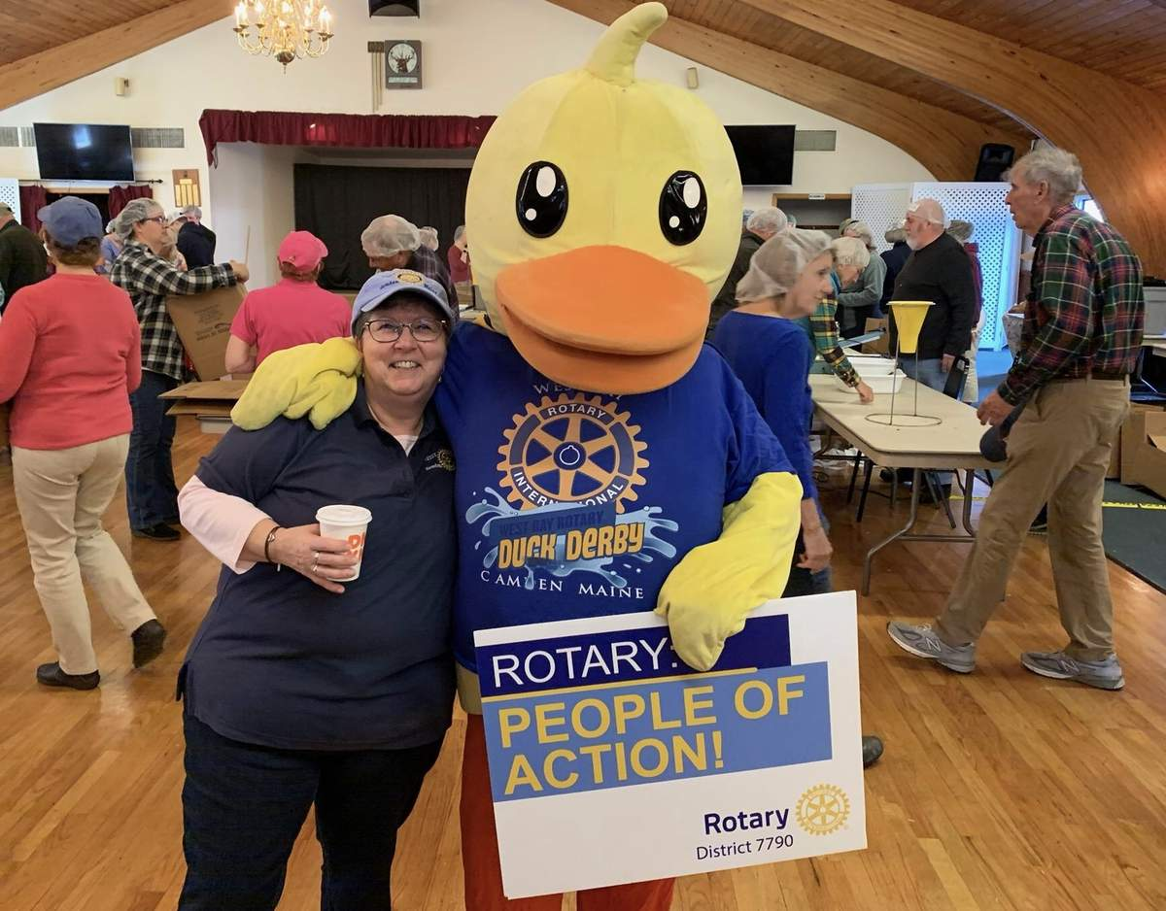

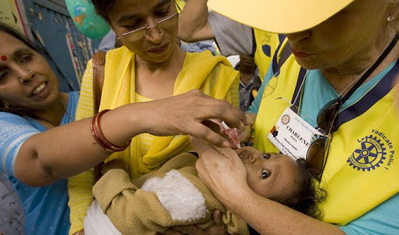

Slide 61
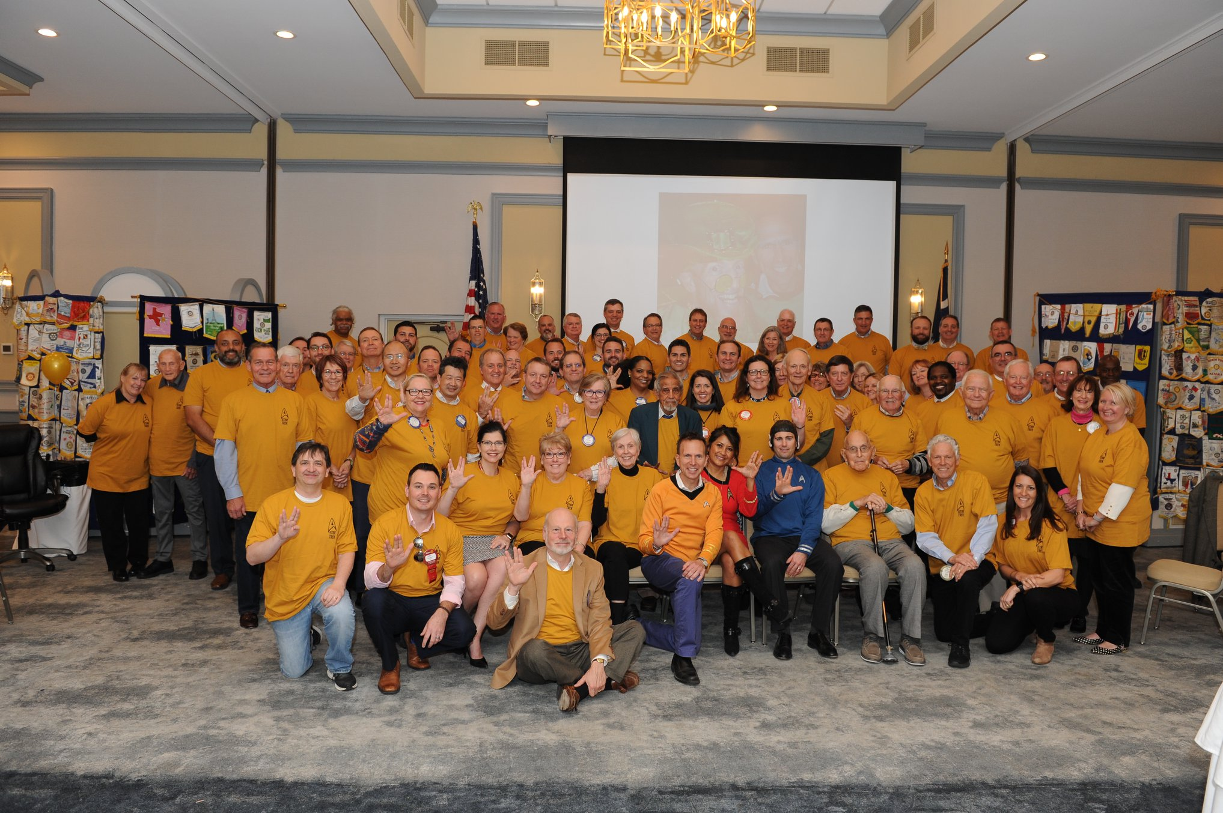
Now this is visible!
Notes:
I don’t remember who the club is but you will notice they are waring Star Trek Shirts and giving the Star Trek greeting…. Go forth and prosper?

Slide 62
We do a good job of doing good… we can do better at telling someone.

Slide 63
Do Good, Have Fun,
Tell Someone
#DoGoodHaveFunTellSomeone

Slide 64
Make sure you are seen!

Slide 65
Public Image Committee
Ken Gasque, Chair, ken@Gasque.com, 803.553.0010
Terry Moore, Website, DACdb, tr_moore@bellsouth.net
Joan Simpson Player, District Newsletter and Social Media joansp.rchhi@gmail.com
Ron Hill, Traditional Media
Sandee Brooks & Mary Gasque—End Polio/World Polio Day

Slide 66
The Four Rules of Success

Slide 67
Questions?

