Slide 1
Generating an EZ-Story
by Terry Moore
Tr_moore@bellsouth.net
C. 843.297.6691

Slide 2
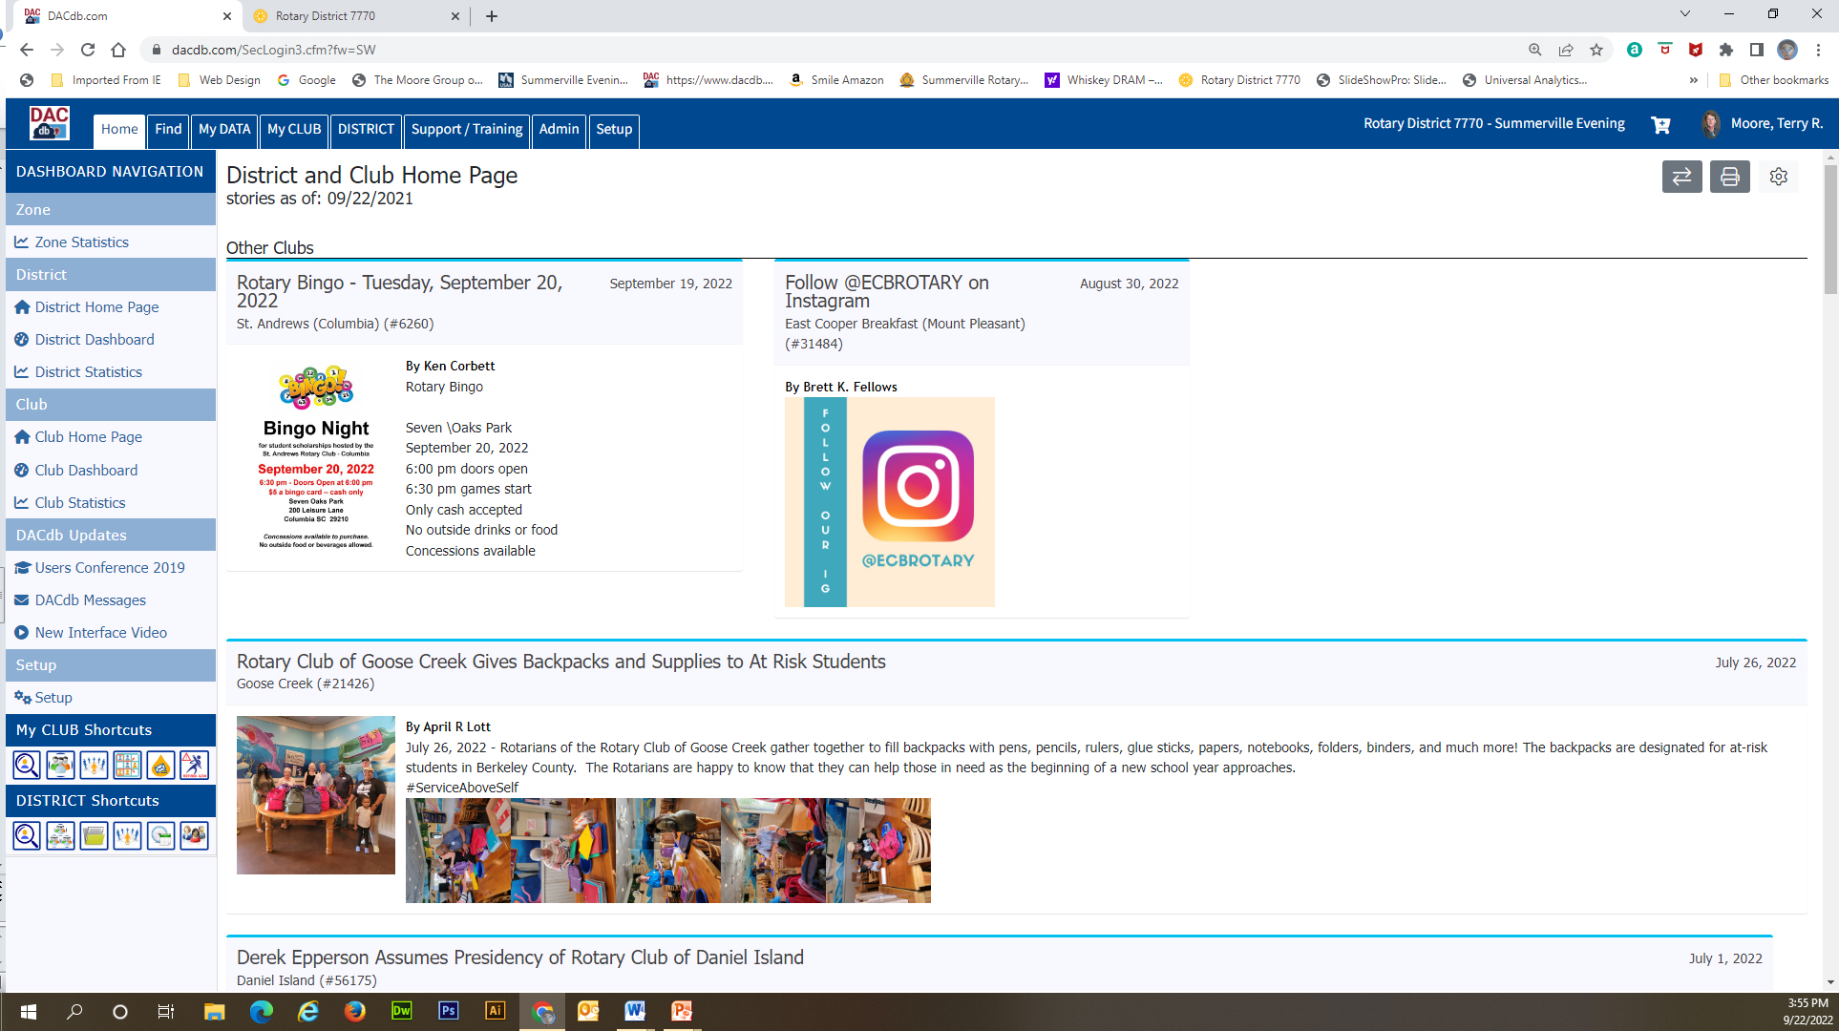
Create the EZ-Story – Front Page Story

Slide 3
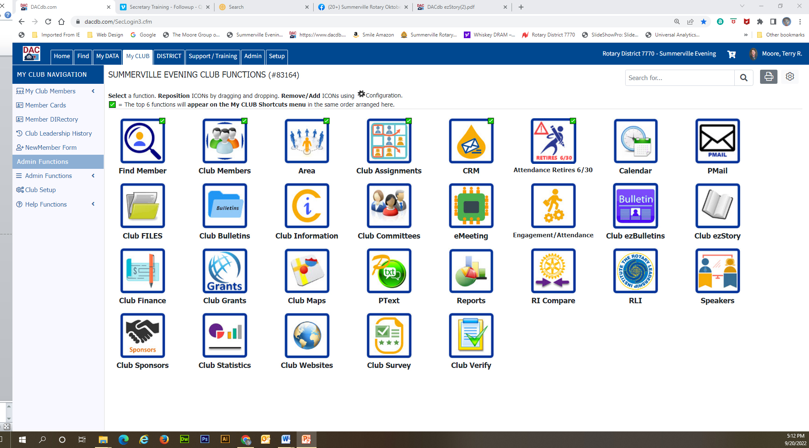
Create the EZ-Story

Slide 4
Create the EZ-Story

Slide 5
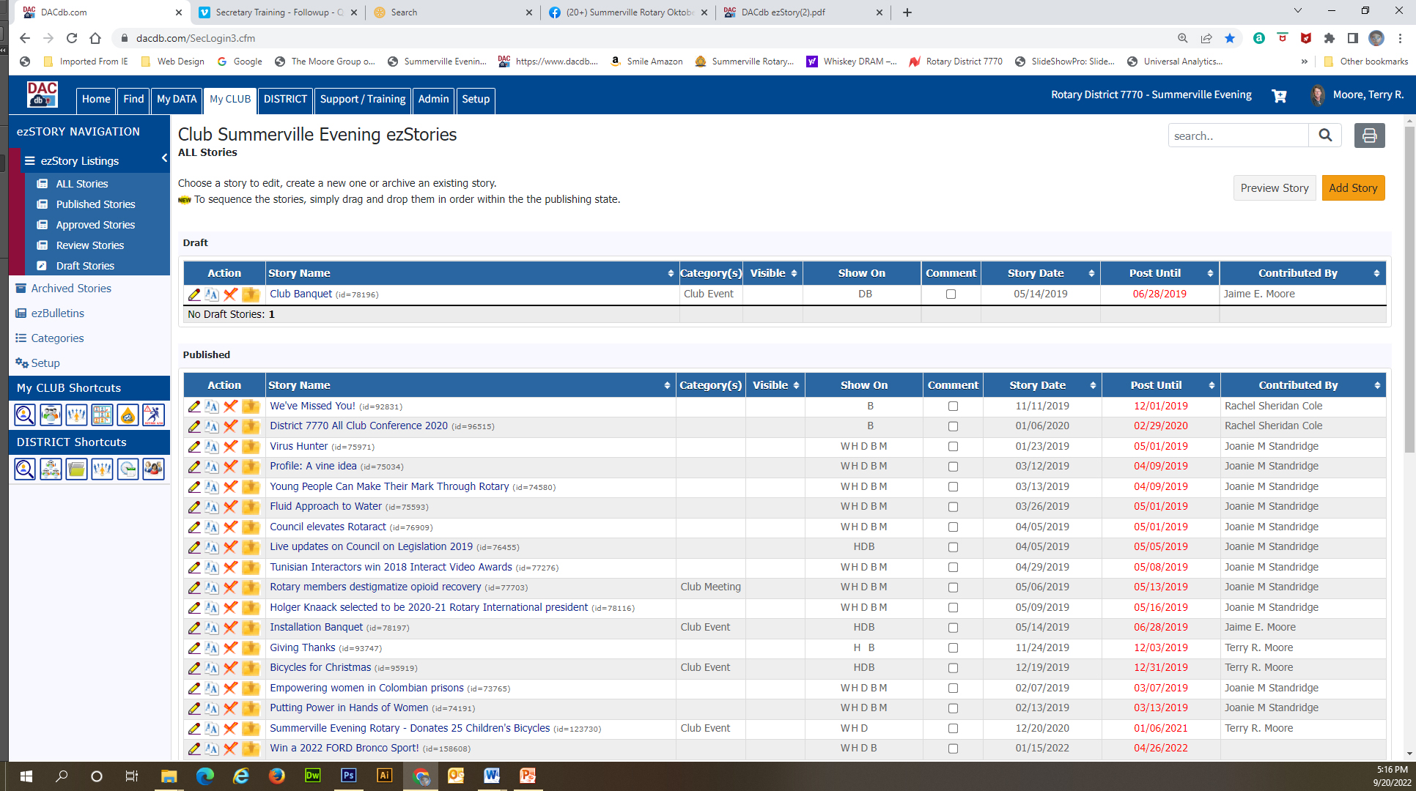
Add Story Button

Slide 6
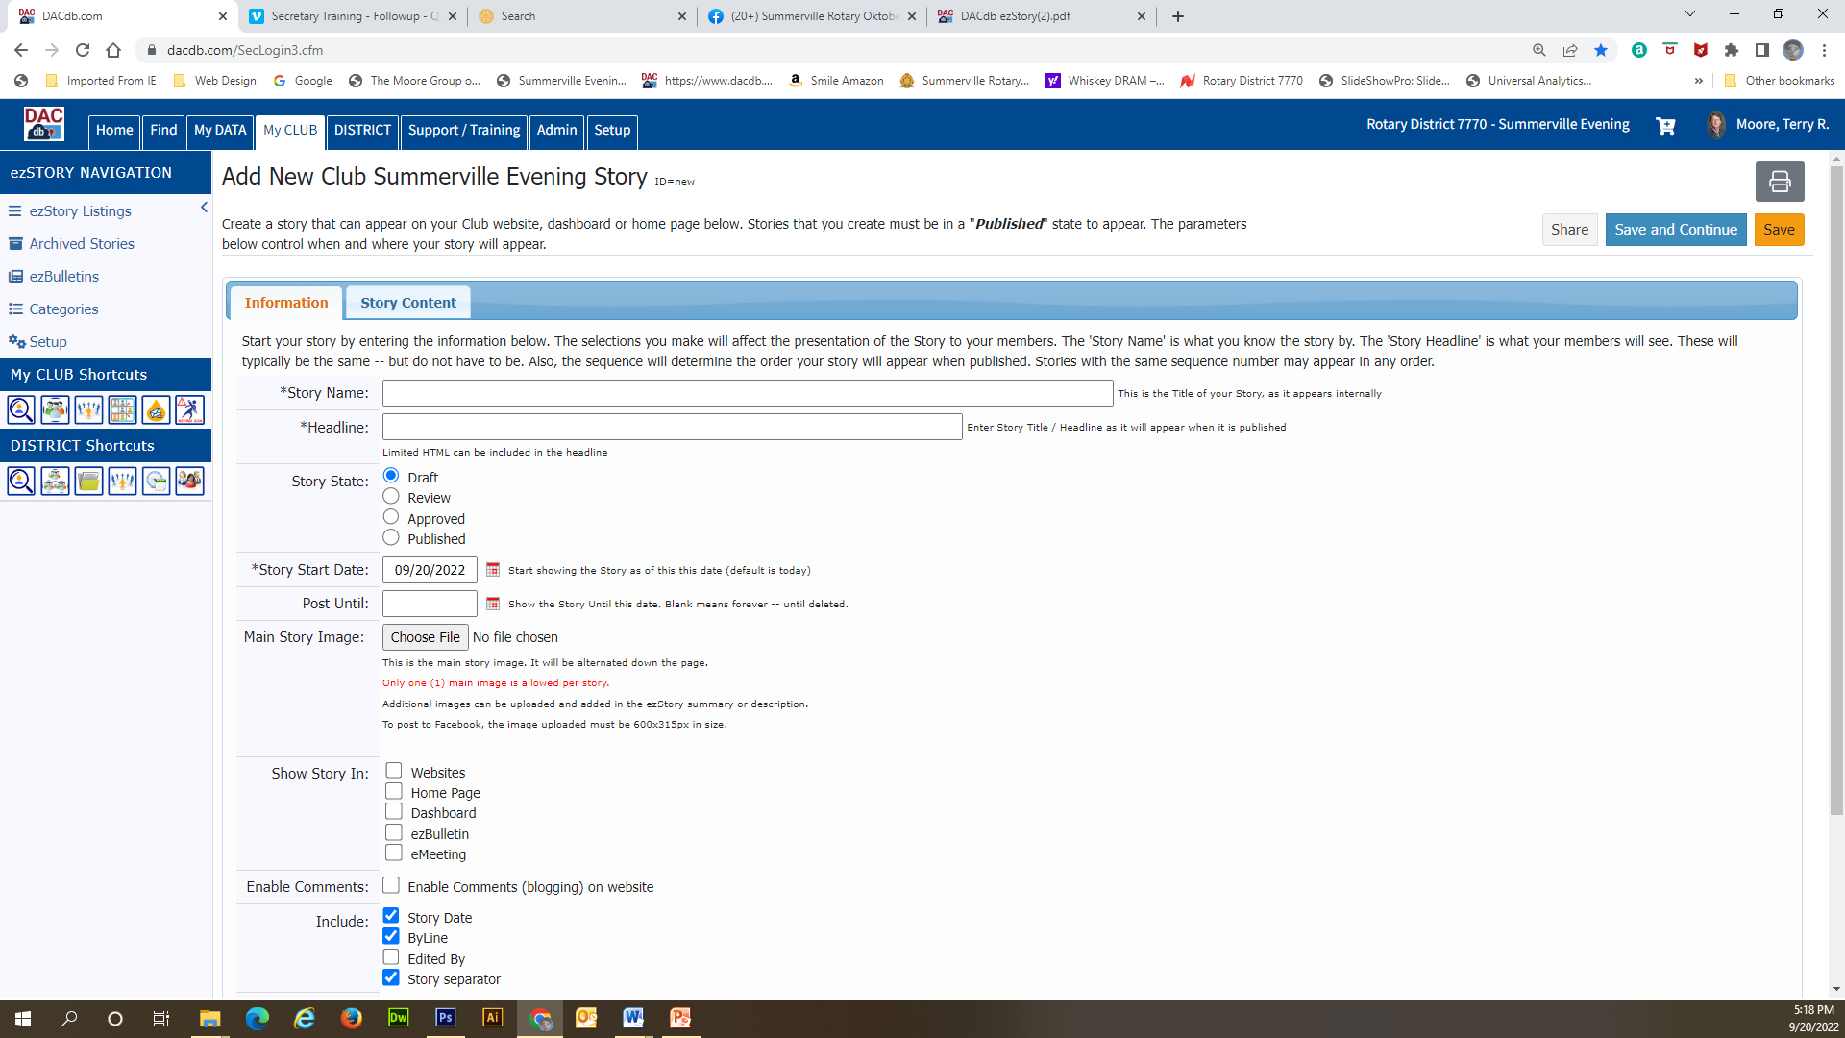
Story Title
Notes:
Headlines generator

Slide 7
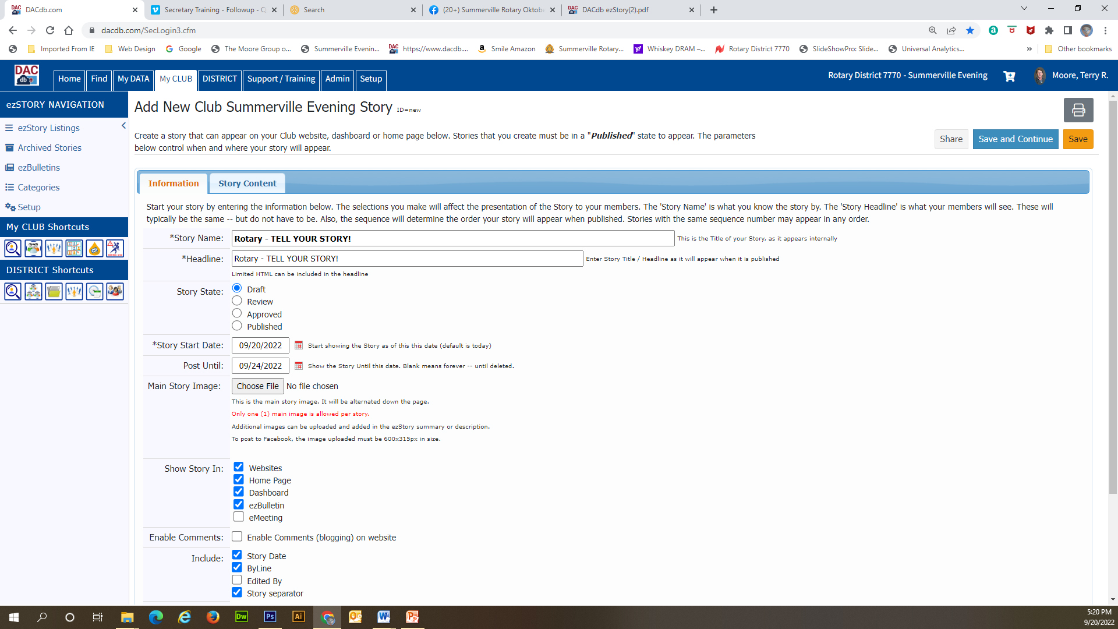
Story Name & Headline

Slide 8
Story Status and Start/END Date
Default is DRAFT and Start Date is
Today. PLEASE use an ending date.

Slide 9
Story Image – Only 1

Slide 10
Where to show the Story

Slide 11
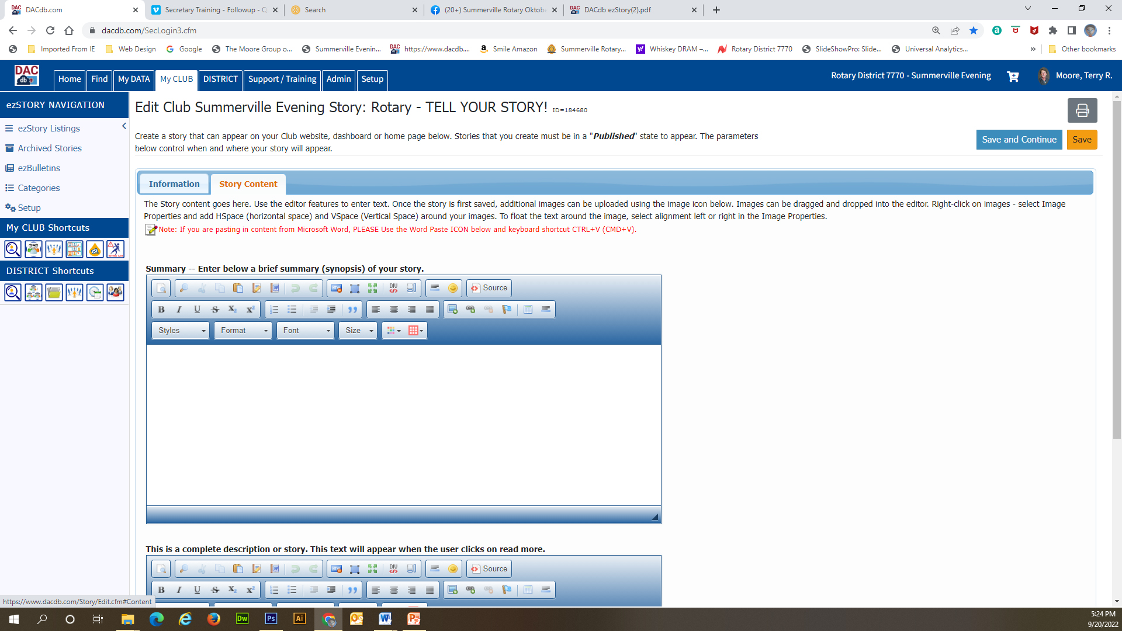
Summary or Complete Story
Short story. If you have to much
content the story will end and
A “READ MORE” will provide a
Link to the rest of the story.
The complete full story. Longer
with more details. Multiple
Photos or other advance
Formating.

Slide 12
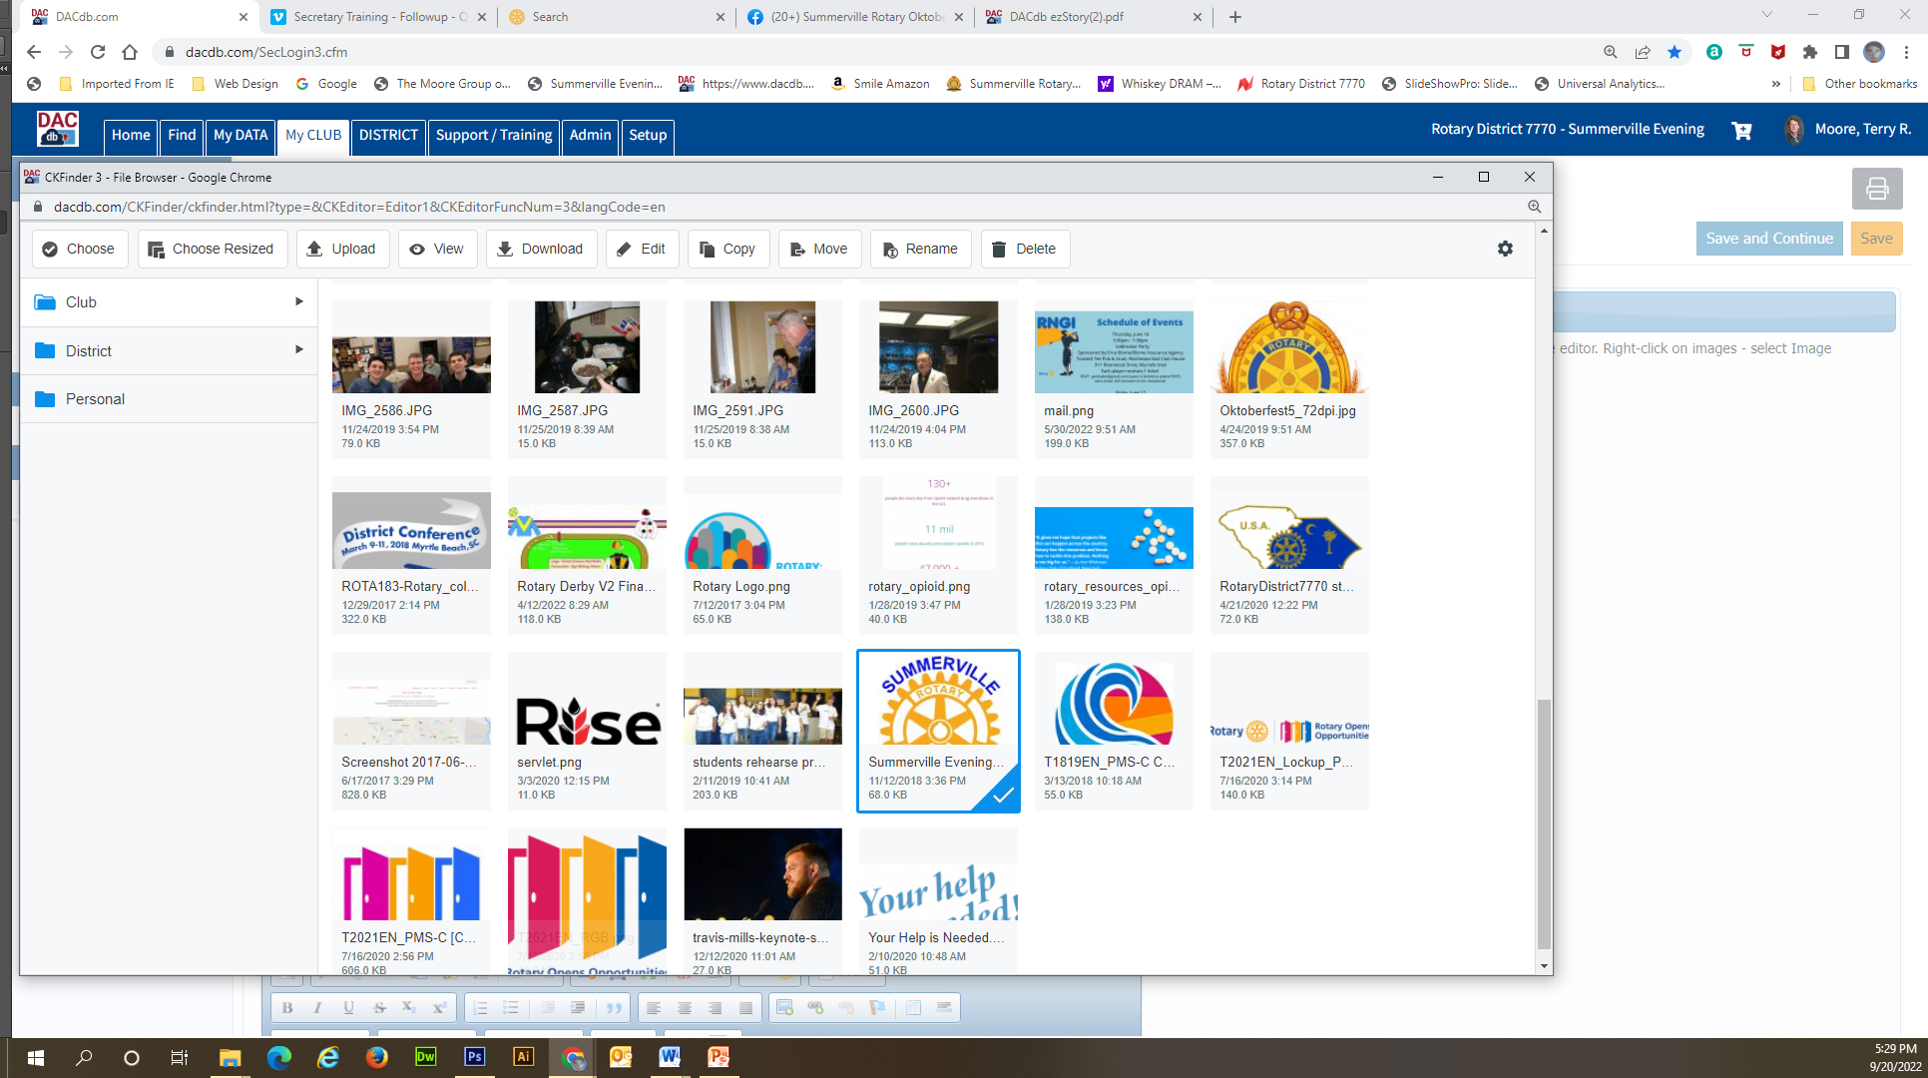

Slide 13
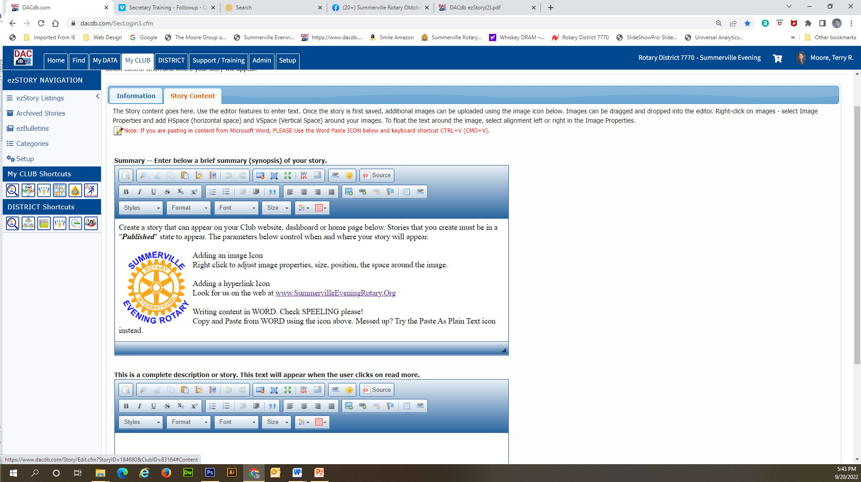
Paste for WORD
Add an Image
Add an Hyperlink

Slide 14
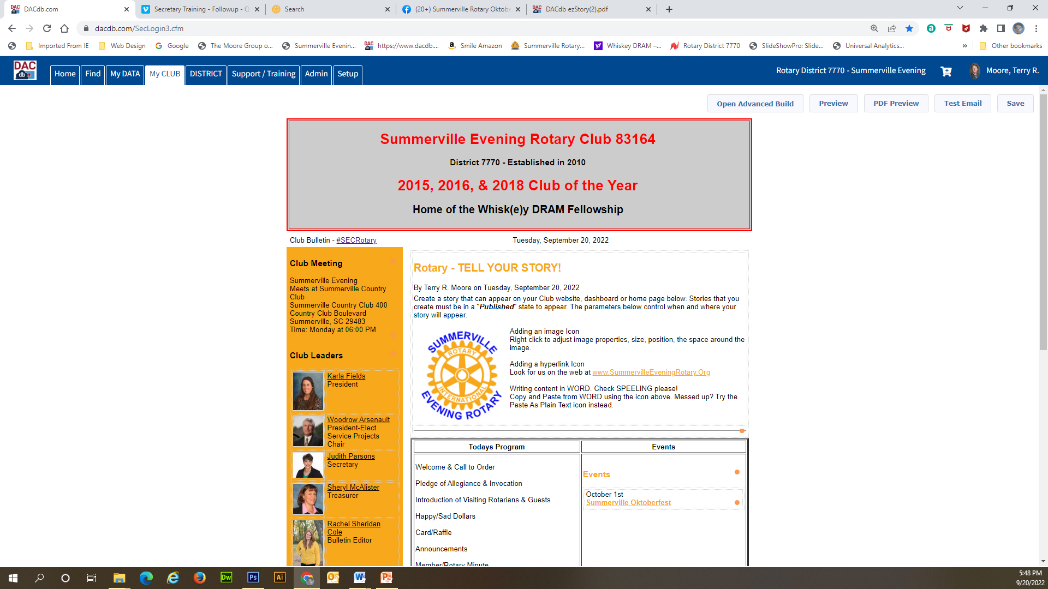

Slide 15
Questions
by Terry Moore
Tr_moore@bellsouth.net
C. 843.297.6691

