Slide 1
Polio
Polio Eradication is Rotary’s #1 Global Project.
Notes:
Do you know why Polio is Rotary’s Number One Priority?

Slide 2
Why Polio?
Rotary saw a need in 1985, PolioPlus launched.
Our goal of ridding the world of Polio is closer than ever.

Slide 3
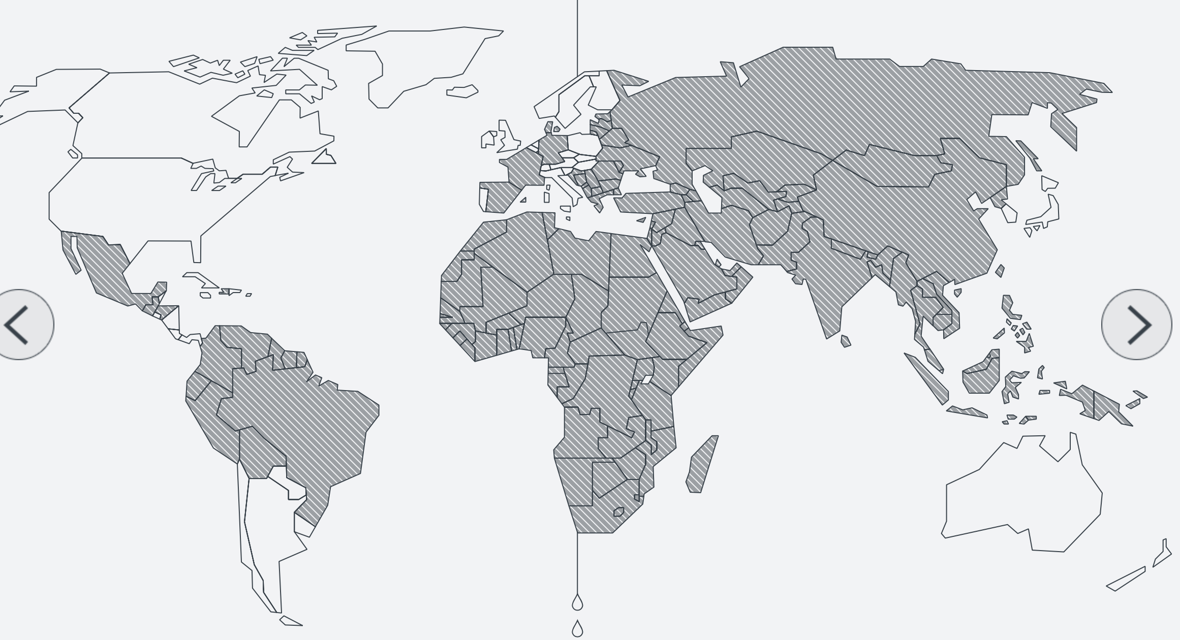
1988
Notes:
This is how the world looked in 1988

Slide 4
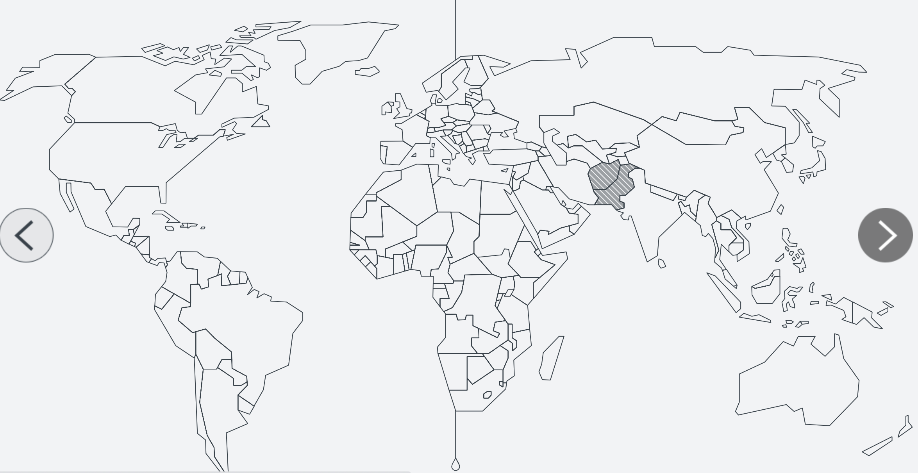
2022
Notes:
Only two counties remain endemic – Pakistan and Afghanistan

Slide 5
GPEI Global Polio
Eradication Initiative
1988 – 6 Partners
• Rotary International
WHO – World Health Organization
Unicef – United National International Children’s Emergency Fund

Slide 6
GPEI
1988 – 6 Partners
• CDC – Center for Disease Control
Bill and Melinda Gates Foundation
GAVI – Global Alliance for Vaccines and Immunizations

Slide 7
What is Polio?
Poliomyelitis, Poliovirus, infectious disease mainly affects children under the age of 5.
Spreads person to person, contaminated water.
No cure. Safe and effective vaccine – use to immunize over 2.5 billion children.

Slide 8
Polio Facts -
Wild Poliovirus (WPV) & Vaccine Derived Polio (cVDPV)
Two countries remain endemic
Every child is at risk
Three years without a live case of the Wild Poliovirus (WPV) to be declared Polio Free.

Slide 9
Rotary History
1894 – the first major documented polio outbreak in US - Vermont. 18 deaths, 132 cases of permanent paralysis.
1916 – NYC had an outbreak, 2,000+ died. 6,000 people across the US died, more paralyzed.
1979 – United States declared Polio Free

Slide 10
Polio Vaccine
Dr. Jonas Salk developed a “safe and effective” vaccine in 1955.
In 1961 the US government licenses the oral polio vaccine developed by Dr. Albert Sabin.
Oral vaccine is used today.

Slide 11
New Oral Polio Vaccine
nOPV2
• Genetically Stable
• Approved for Emergency Use
• Specifically approved for cVDP2 Outbreaks

Slide 12
Polio Free
In August 2020 Nigeria was declared Polio Free
African Continent (47 Countries)
Declared Wild Polio Virus Free

Slide 13
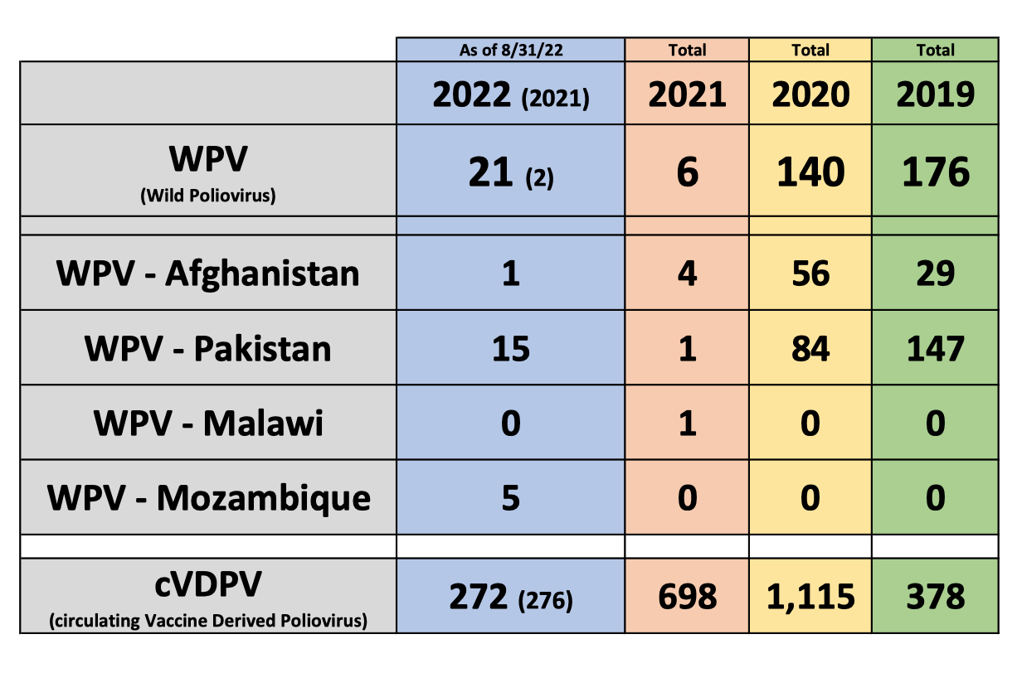
Current Status
Polio Virus

Slide 14
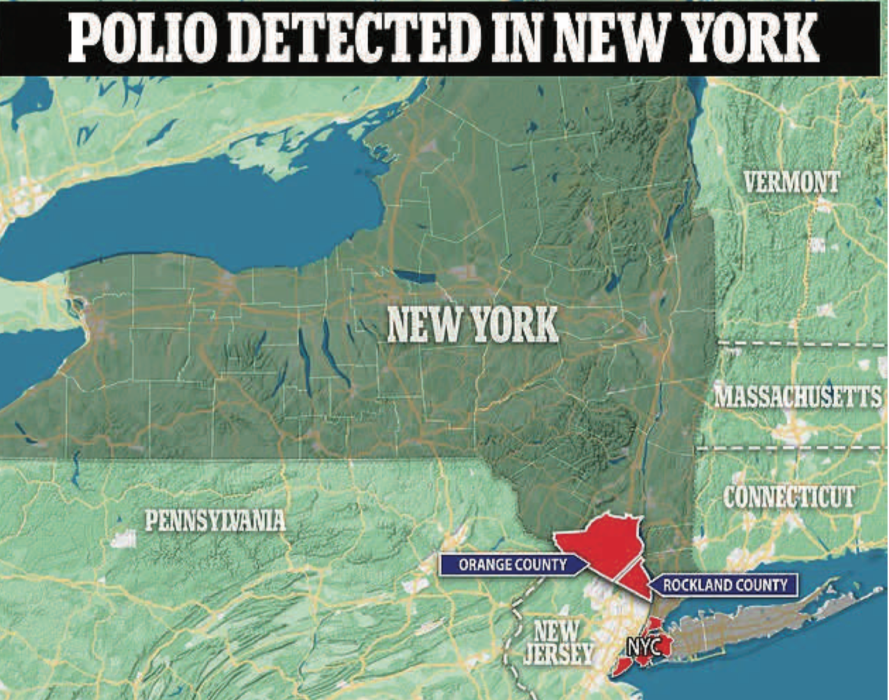
Let’s talk about NY
July
• July 21 2022 Case in Rockland County
• Young adult was not vaccinated
• Vaccine derived
• Polio virus has been detected in Wastewater in Orange County
Notes:
Oral Sabin vaccine uses a weakened form of the live virus to create immunity. Rockland County is vaccine resistant

Slide 15
The Miracle of the Match
July
Example:
Notes:
Rotarian Tommy and Chantal Bagwell will match 50%; World Fund matches 50% and Gates Foundation matches 2:1

Slide 16
Run with Bernie
Polio Challenge
July 1, 2022 – October 24, 2022
Walk/Run/Bike/Swim/Row-Just Move!
Bernie’s challenge – 1,000 miles

Slide 17
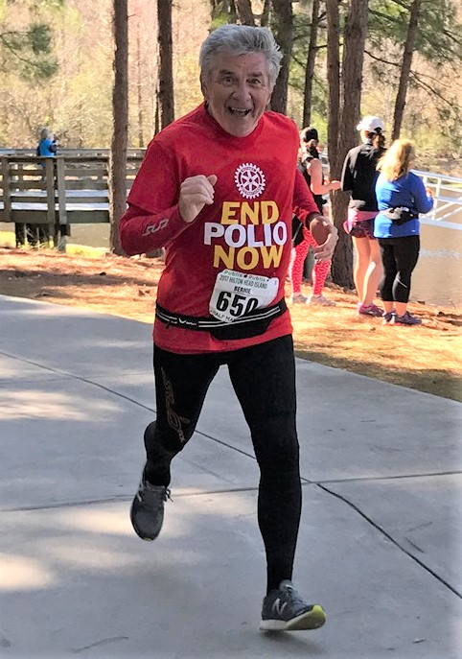
Run with Bernie
Polio Challenge 2021
$ 94,609.39
$189,218.78
22 Teams!
204 participants
55,568 Miles

Slide 18
Polio Eradication Strategy
Goal one:
Permanently eradicate The Wild Polio Virus
Goal two:
Stop Transmission of Vaccine-Derived poliovirus

Slide 19
Polio Eradication Time Line
2021
2022
2023
2024
2025
2026
Wider use of novel oral polio vaccine type 2
Interrupt transmission of wild poliovirus type 1 and report last isolate of circulating vaccine-derived poliovirus type 2
Certify the eradication of wild poliovirus type 1 and validate the absence of circulating vaccine derived poliovirus type 2
Wider use of novel oral polio vaccine type 2

Slide 20
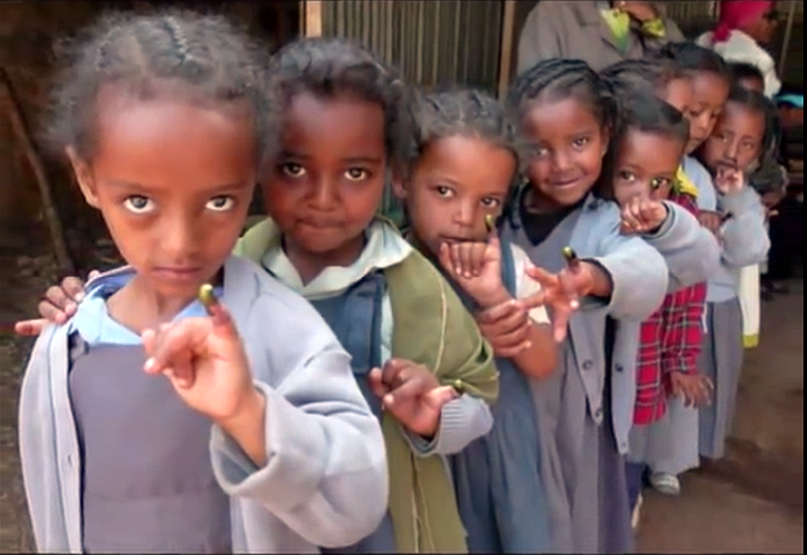
Why We Give

Slide 21
Polio Purple
Pinkie Promise
When children are vaccinated their pinkies are painted purple. This is one way we use to track who has been vaccinated.

Slide 22
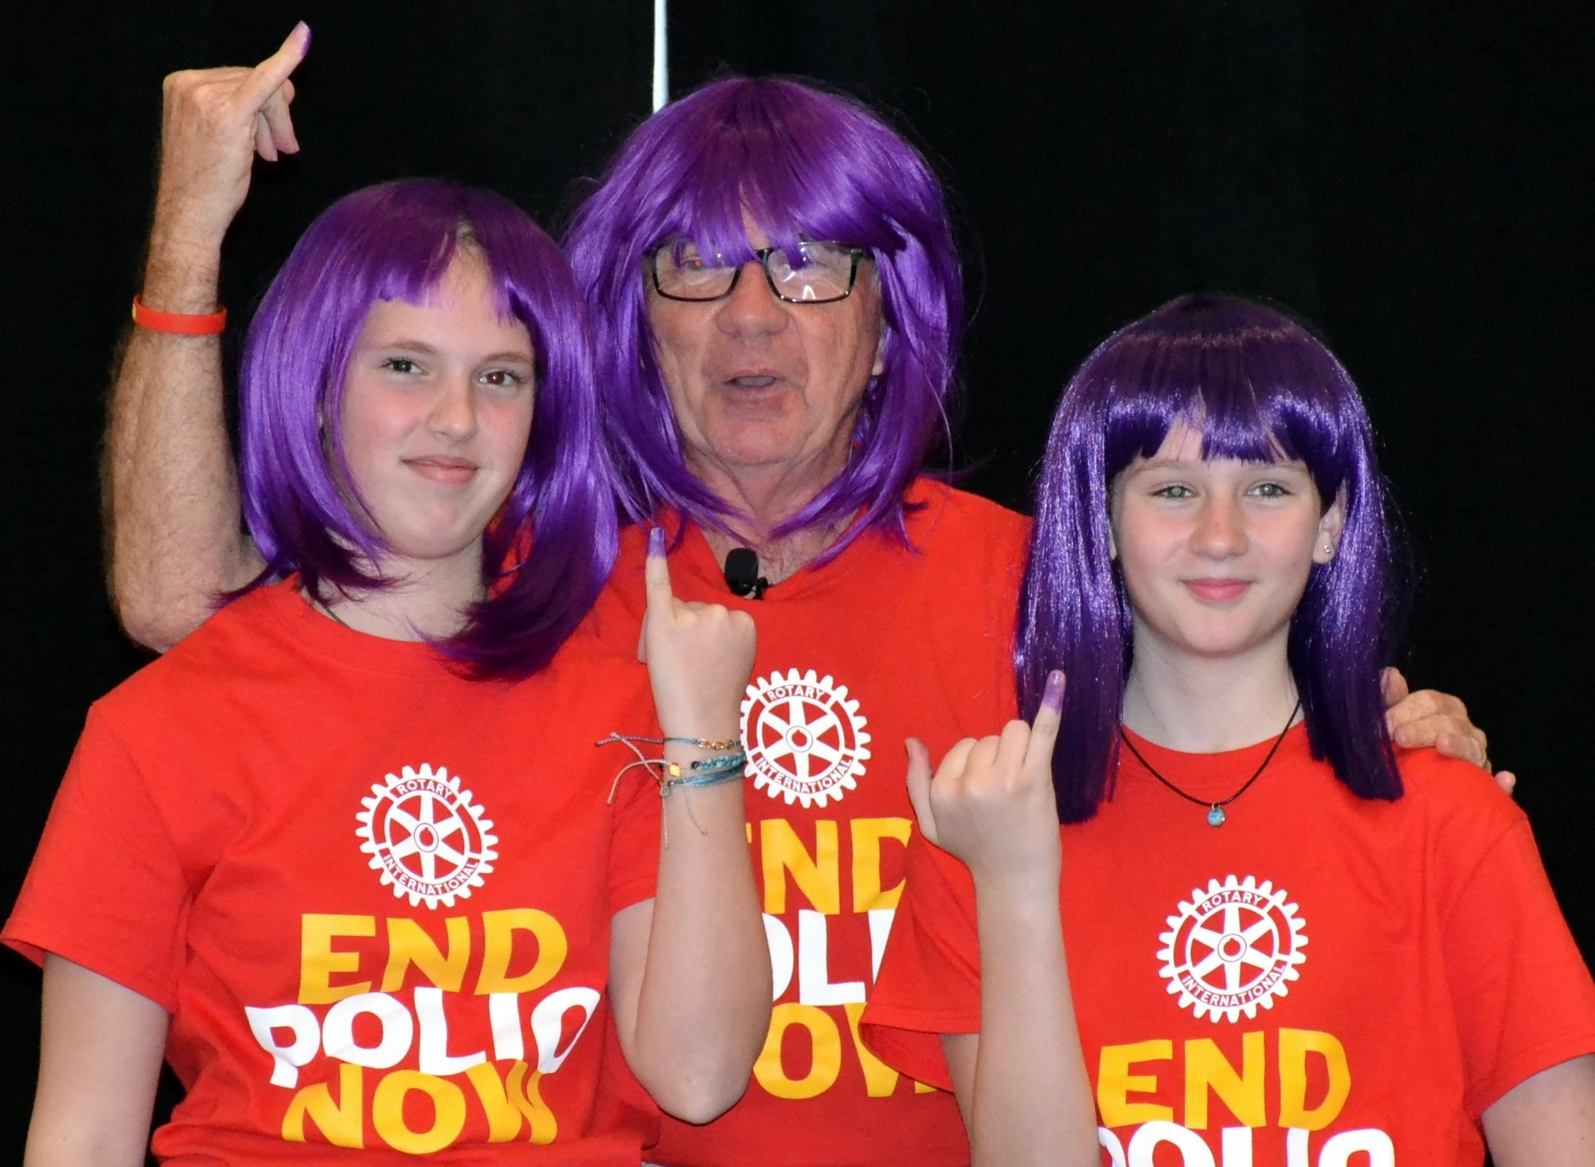
Purple Polio People Wig

Slide 23
Quote
“We have the ability to protect every last person, especially children from this entirely preventable disease.”
~ Anthony Lake,
Executive Director, UNICEF

Slide 24
References
https://www.endpolio.org/what-you-don-t-know-about-the-campaign-to-end-polio

