Slide 1
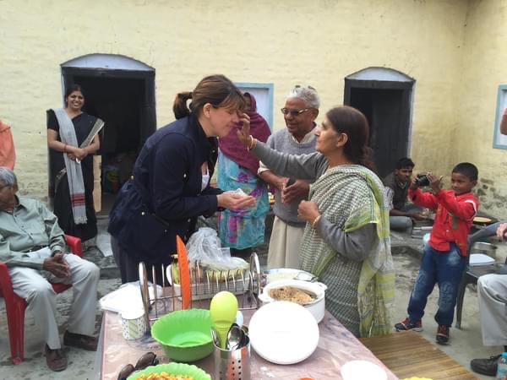
Finding My Seat at the Table
Z33 ARPIC Dawn Rochelle, PDG D7730
Z33 Empowering Girls Ambassador
Rotary Club of Jacksonville (NC)

Slide 2
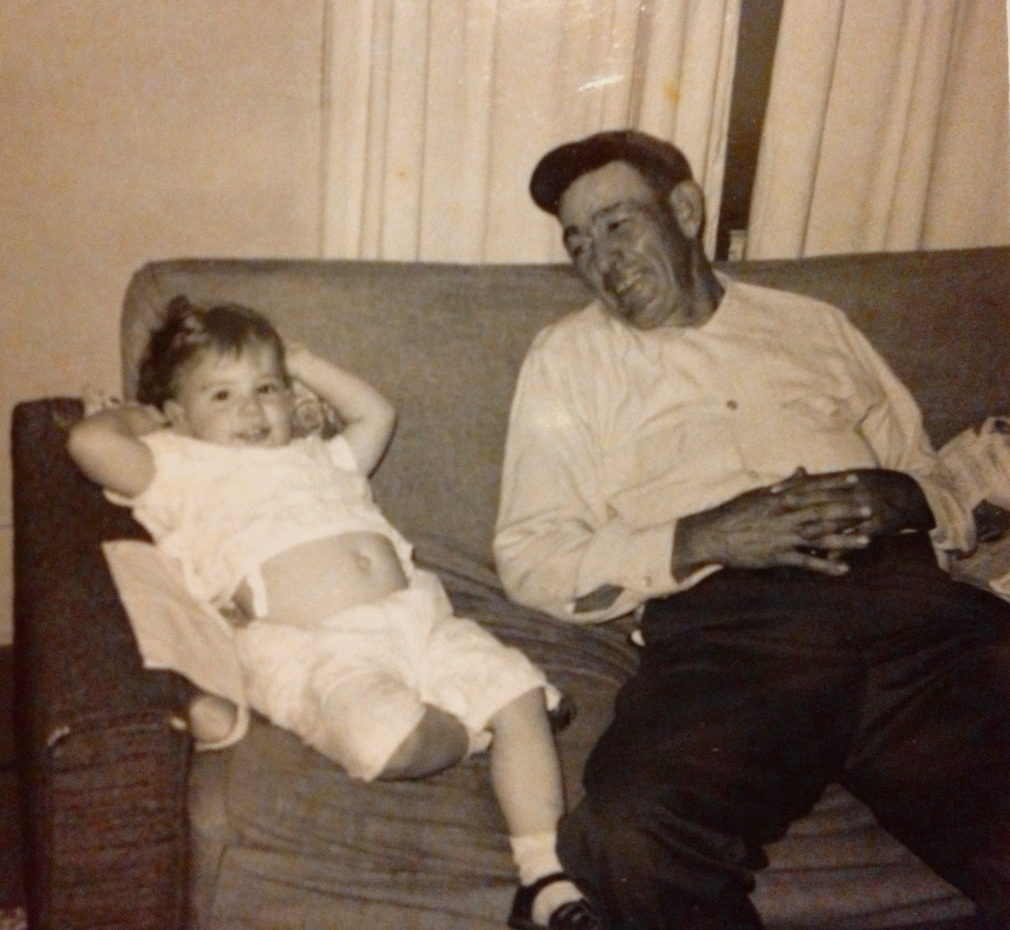
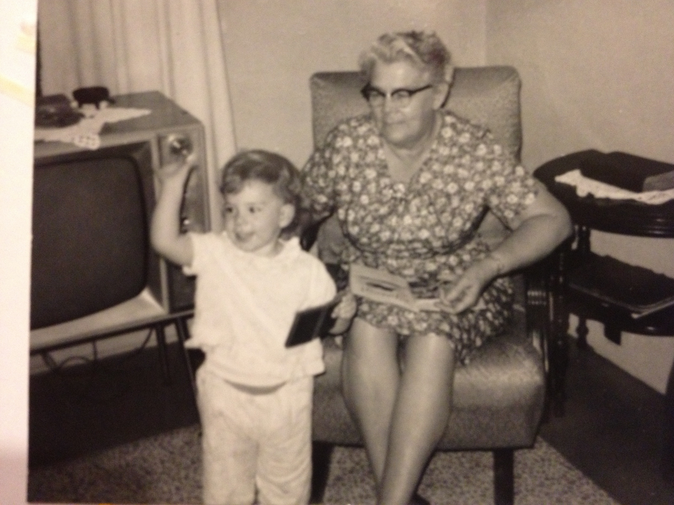
How It Started

Slide 3
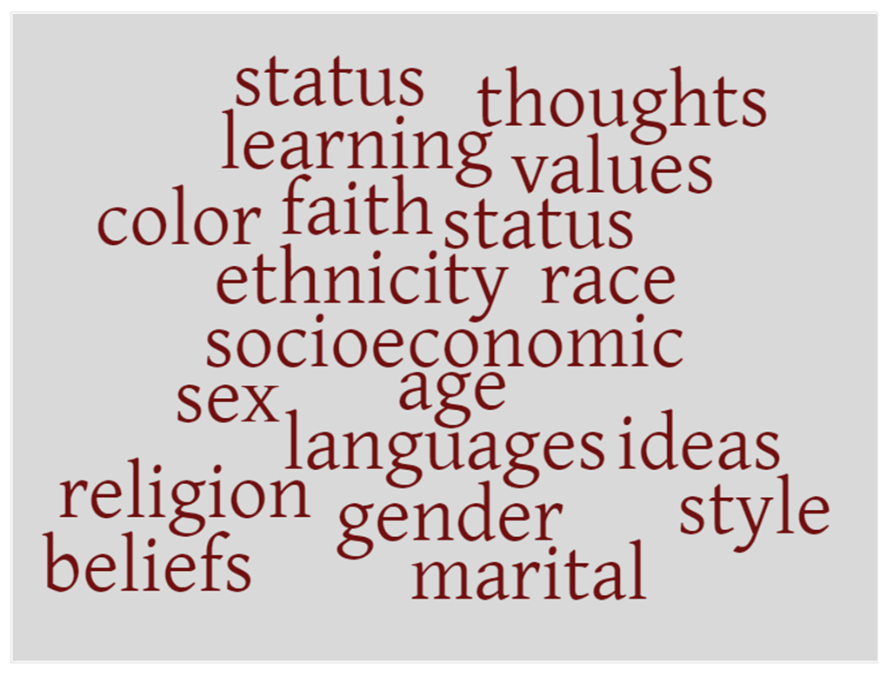
Value of Diversity
Notes:
The value of diversity celebrates the contributions of people of backgrounds, across age, ethnicity, race, color, disability, learning style, religion, faith, socioeconomic status, culture, marital status, languages spoken, sex, sexual orientation, and gender identity as well difference in ideas, thoughts, values, and beliefs.

Slide 4
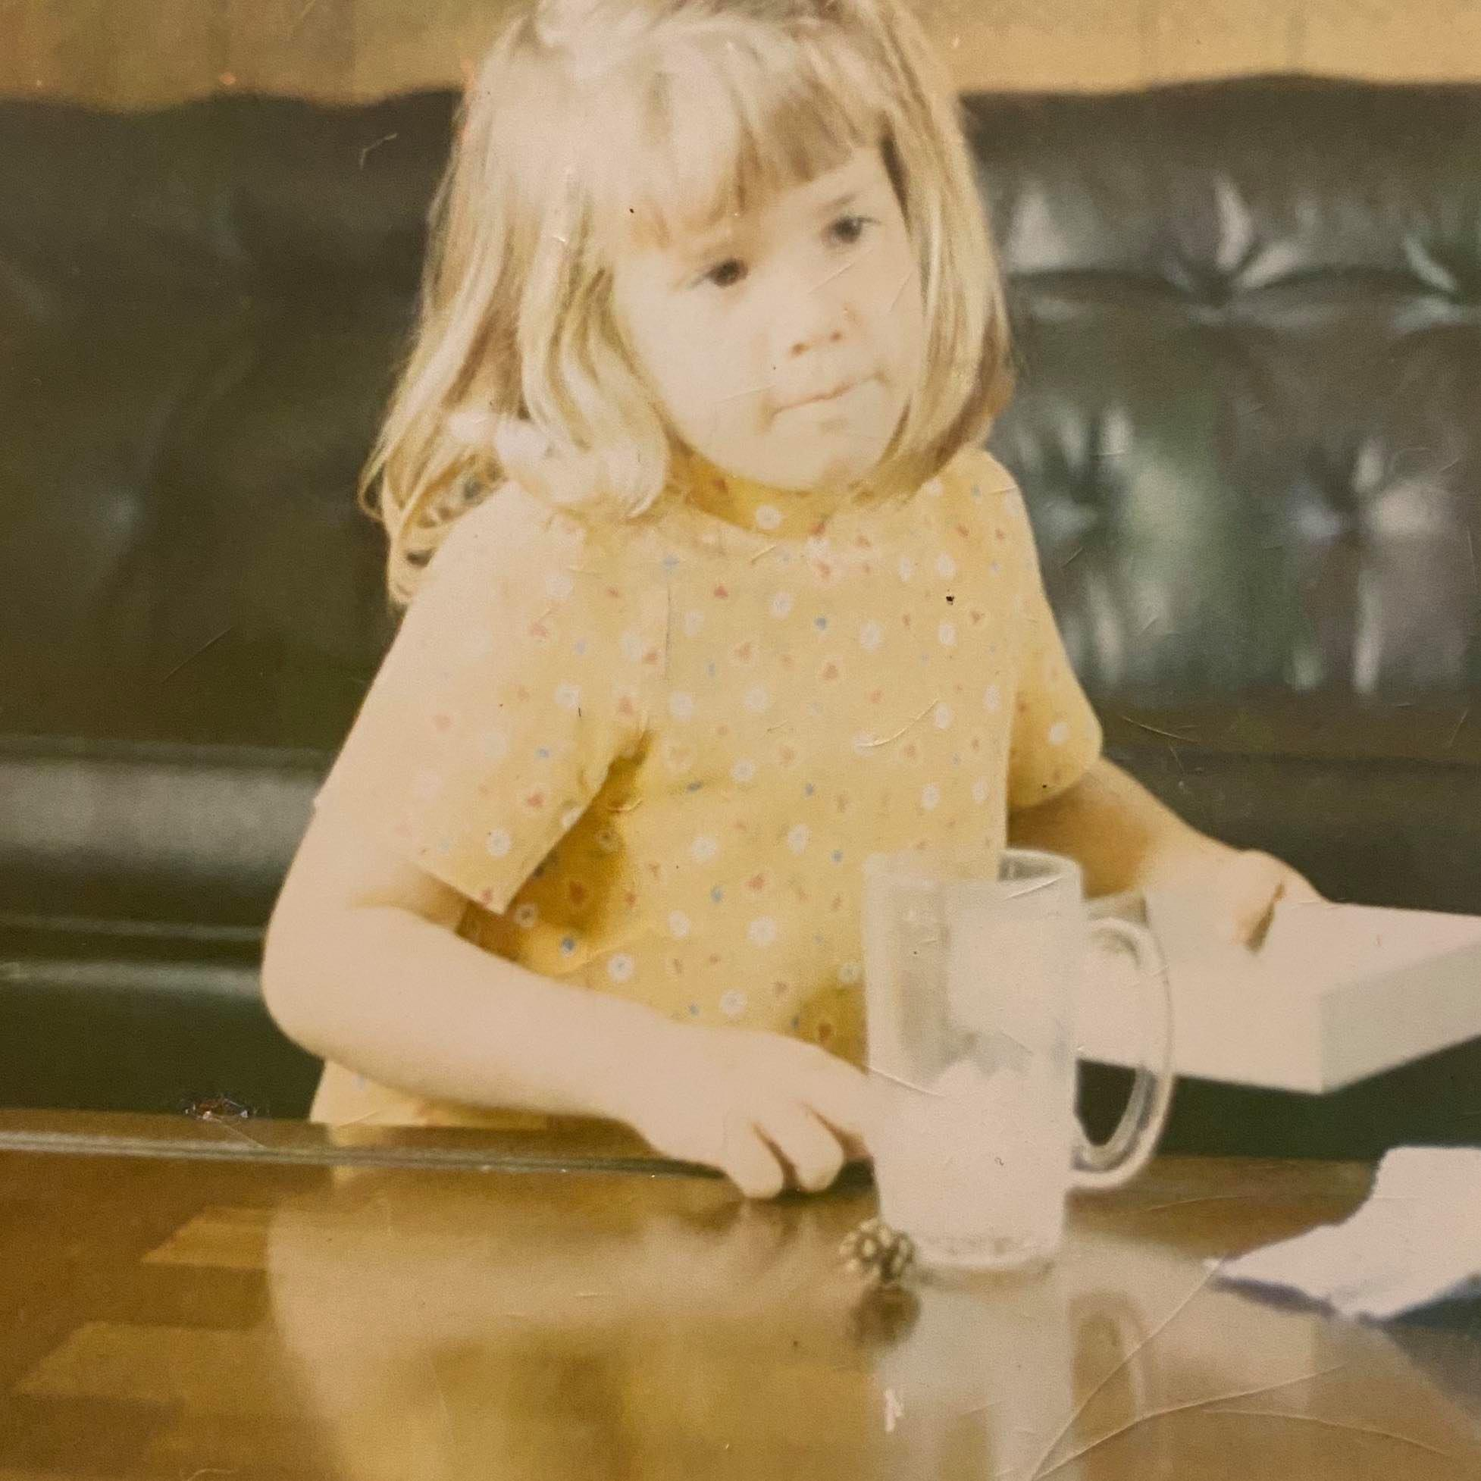
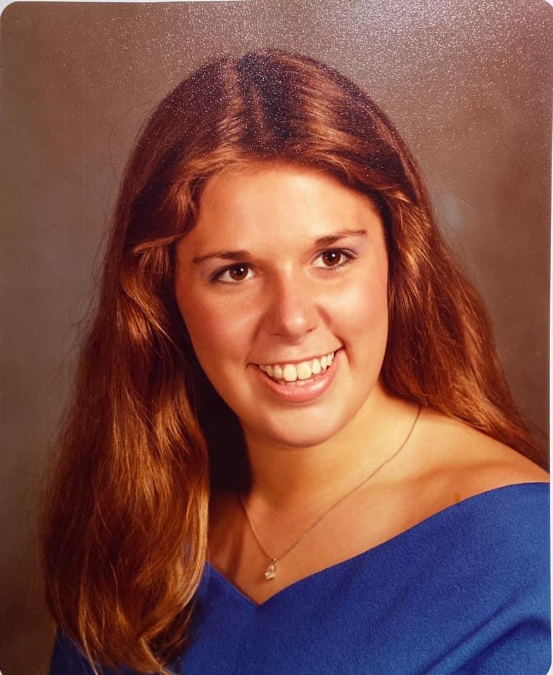
How It Continued

Slide 5
Value of Equity
Notes:
Equality means each individual or group of people is given the same resources or opportunities. Equity recognizes that each person has different circumstances and allocates the exact resources and opportunities needed to reach an equal outcome.

Slide 6
Value of Equity
Recognizing that individuals from certain groups have historically experienced barriers to employment, education, healthcare, and social justice. By practicing the value of equity, we commit to advancing equity in all aspects so that each person has the necessary access to resources, opportunities, networks, and support to thrive.
Rotary International Board of Directors ~ June 2021
Equity - Everyone has Equal Access
and an Equal Voice
Notes:
Equality means each individual or group of people is given the same resources or opportunities. Equity recognizes that each person has different circumstances and allocates the exact resources and opportunities needed to reach an equal outcome.

Slide 7
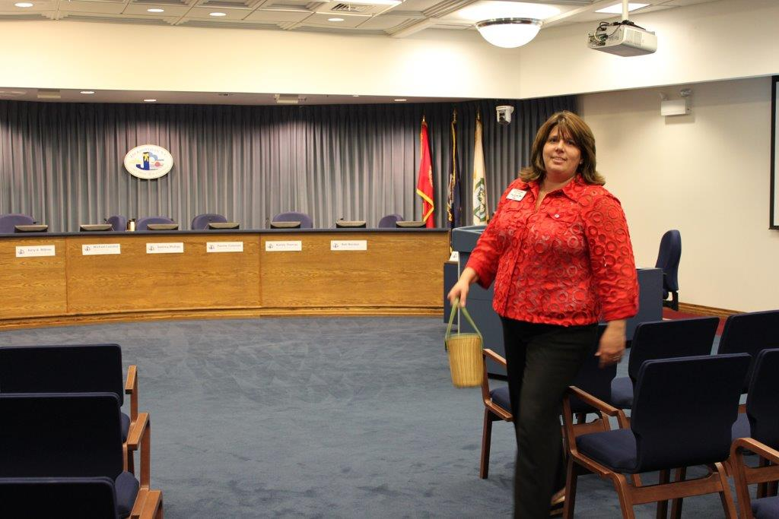
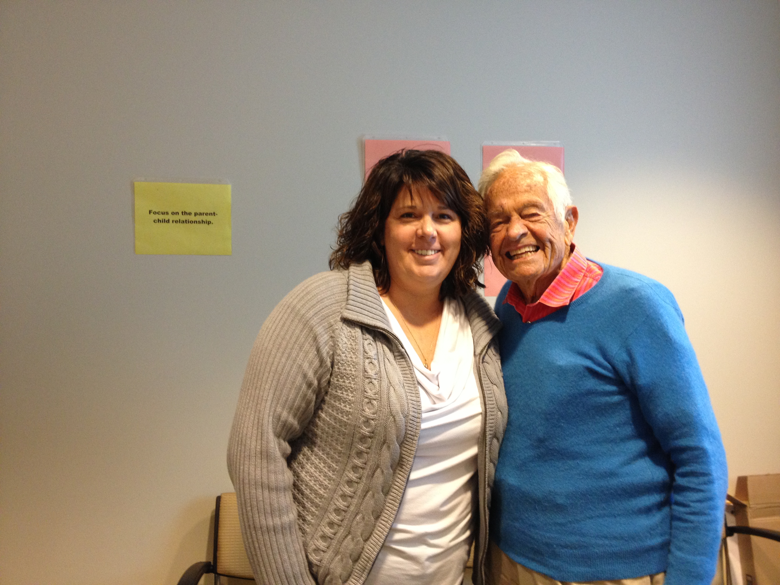
Value of Inclusion

Slide 8
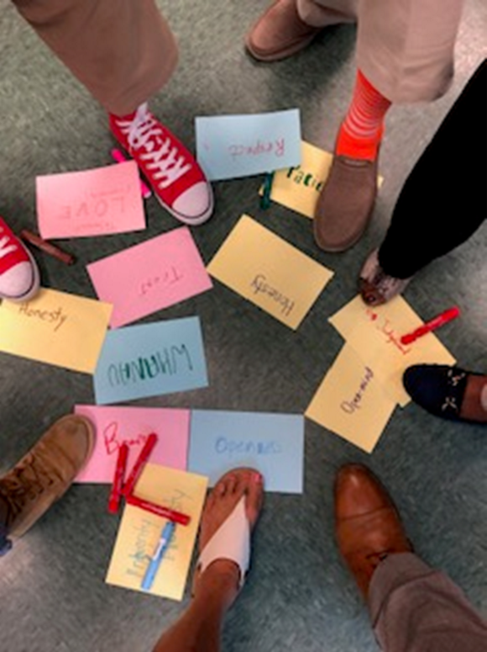
Value of Inclusion
Inclusion means that all people hold visible and invisible qualities that inherently make them unique, and the ideal state is to create an inclusive culture/world where each person knows they are valued and belong.

Slide 9
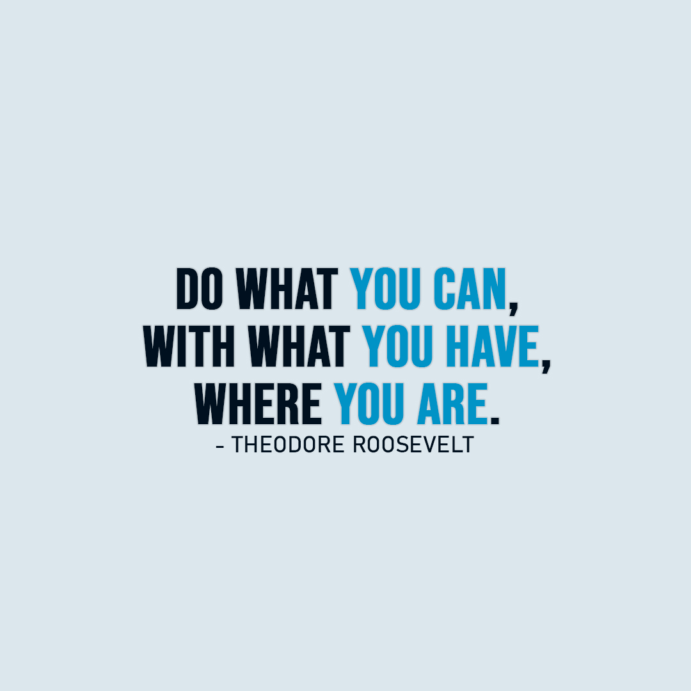
Being Inclusive Takes Initiative

Slide 10
Being Inclusive Takes Initiative
We believe that all people hold visible and invisible qualities that inherently make them unique, and we strive to create an inclusive culture where each person knows they are valued and belong.
In line with our value of integrity, we are committed to being honest and transparent about where we are in our DEI journey as an organization, and to continuing to learn and do better.
Rotary International Board of Directors ~ June 2021
Notes:
At its June meeting, the RI Board of Directors, with guidance from the DEI Taskforce, took additional steps to ensure our organization values and lives the principals of diversity, equity and inclusion by revisiting and strengthening Rotary's 2019 DEI statement. The result is a new Commitment to Diversity Equity and Inclusion adopted in June 2021:
At Rotary, we understand that cultivating a diverse, equitable, and inclusive culture is essential to realizing our vision of a world where people unite and take action to create lasting change.
We value diversity and celebrate the contributions of people of all backgrounds, across age, ethnicity, race, color, disability, learning style, religion, faith, socioeconomic status, culture, marital status, languages spoken, sex, sexual orientation, and gender identity as well as differences in ideas, thoughts, values, and beliefs.
Recognizing that individuals from certain groups have historically experienced barriers to membership, participation, and leadership, we commit to advancing equity in all aspects of Rotary, including in our community partnerships, so that each person has the necessary access to resources, opportunities, networks, and support to thrive.
We believe that all people hold visible and invisible qualities that inherently make them unique, and we strive to create an inclusive culture where each person knows they are valued and belong.
In line with our value of integrity, we are committed to being honest and transparent about where we are in our DEI journey as an organization, and to continuing to learn and do better.

Slide 11
Being Inclusive Takes Initiative
Chartered May 2021
22 Active Rotarians
Chartered January 2022
26 Rotarians

Slide 12
Being Inclusive Takes Initiative

Slide 13
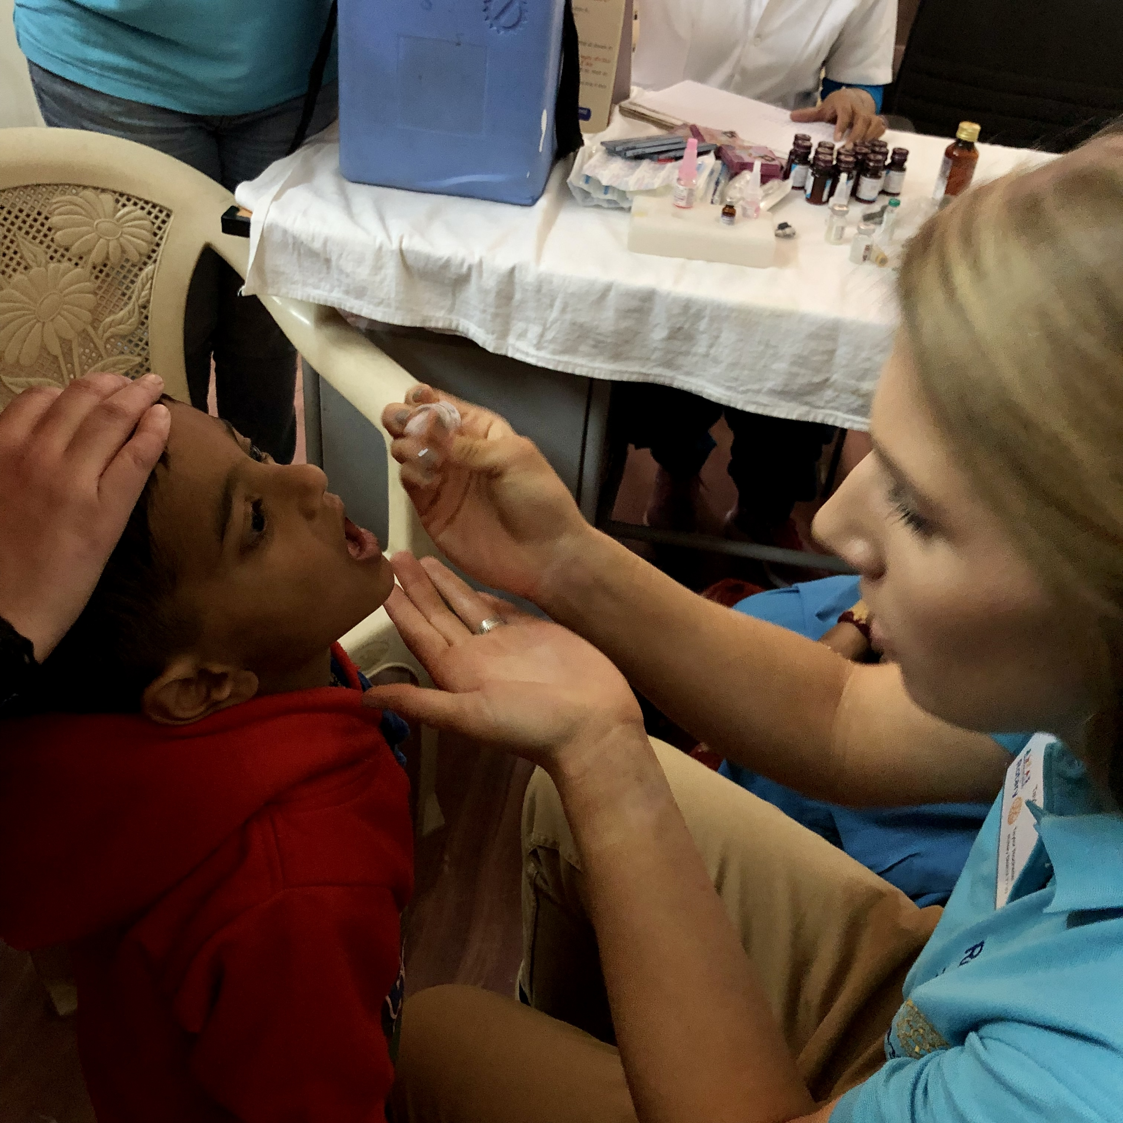
Thank you!
Whether you act or do nothing, you are shaping this world. Thank you for being a light bringer, a magic maker, a world shifter, a game changer.
YOU challenge me to be a better human.
~ Dawn Rochelle, Rotarian
Taylor Rochelle Alphin, age 26
Secretary, Rotary Club of Ending Child Abuse
National Immunization Day 2019
Interact 2010-14, President (14)
Rotary International Convention Attendee 2009
Notes:
Success is what happens to us
Significance is what happens through us.

