Slide 1
PUBLIC IMAGE COMMITTEE
DISTRICT NEWSLETTER

Slide 2
DISTRICT 7770 NEWSLETTER
WHAT IS IT?
WHERE IS IT?
HOW TO CONTRIBUTE TO IT
WHAT CONTENT SHOULD YOU CONTRIBUTE?

Slide 3
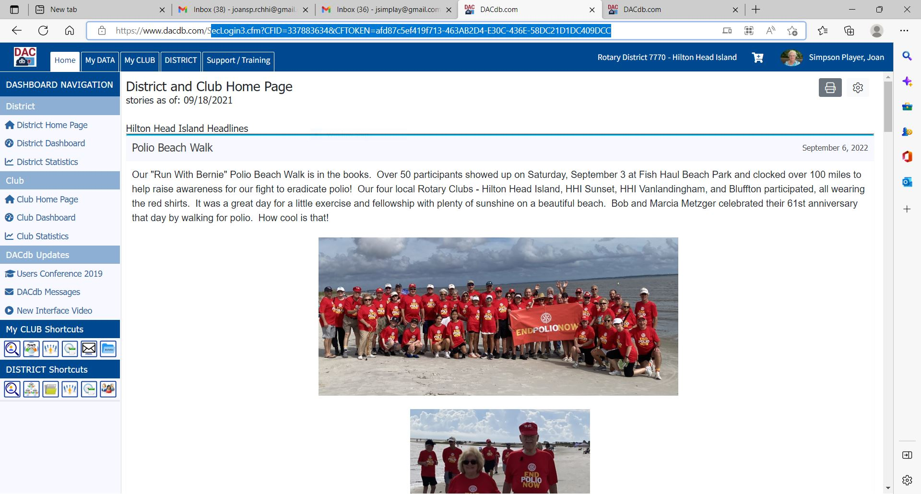

Slide 4
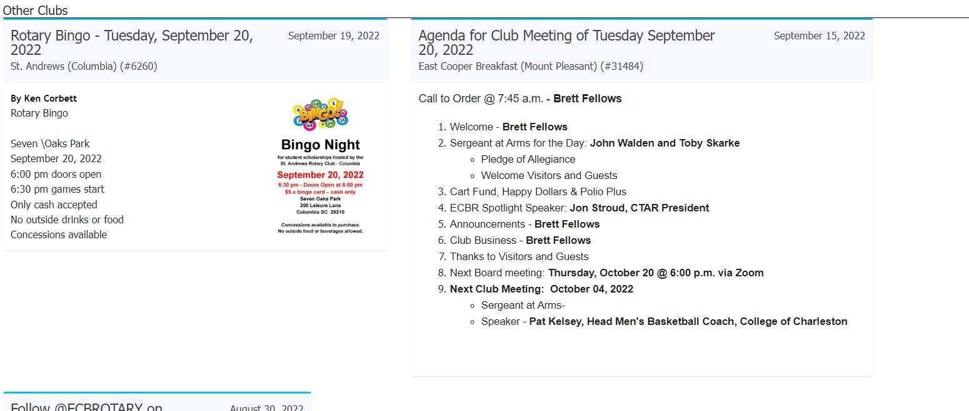

Slide 5
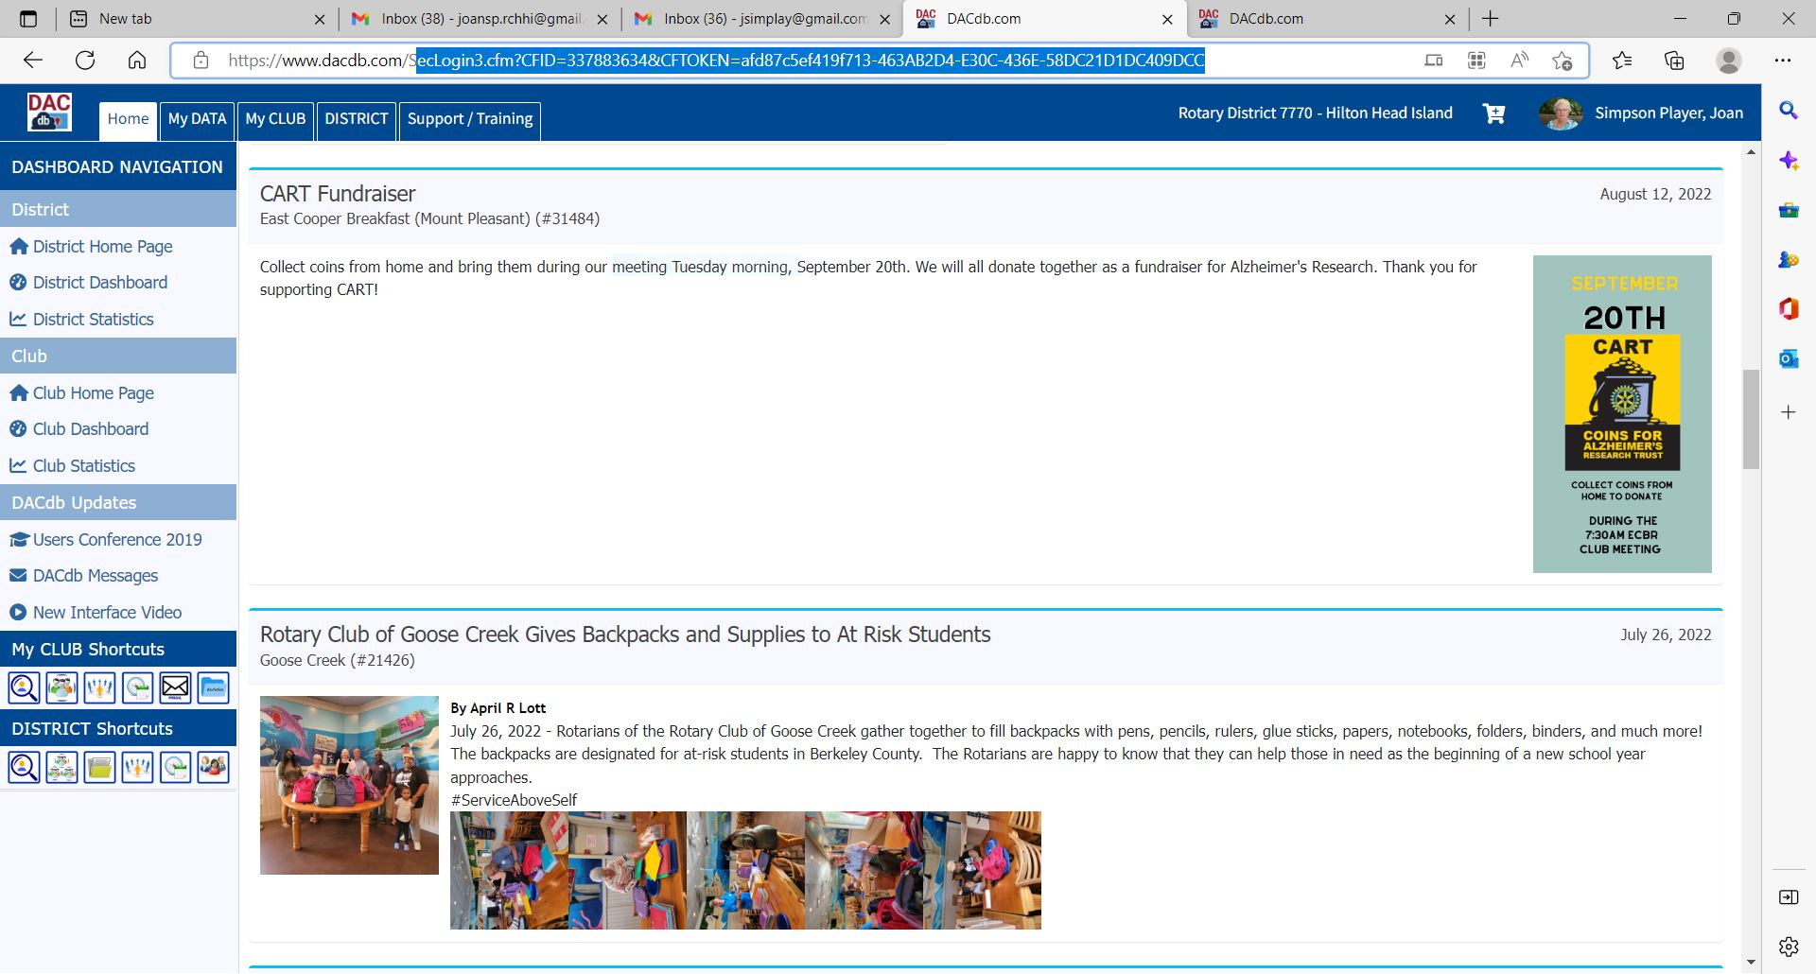
WHAT IS IT?
A webpage within DACdb that lists Clubs’ activities within District 7770
WHERE IS IT?
https://www.dacdb.com

Slide 6
HOW DO YOU ADD YOUR CLUB’S
NEWS TO THE DISTRICT NEWSLETTER?
Create a STORY in DACdb

Slide 7
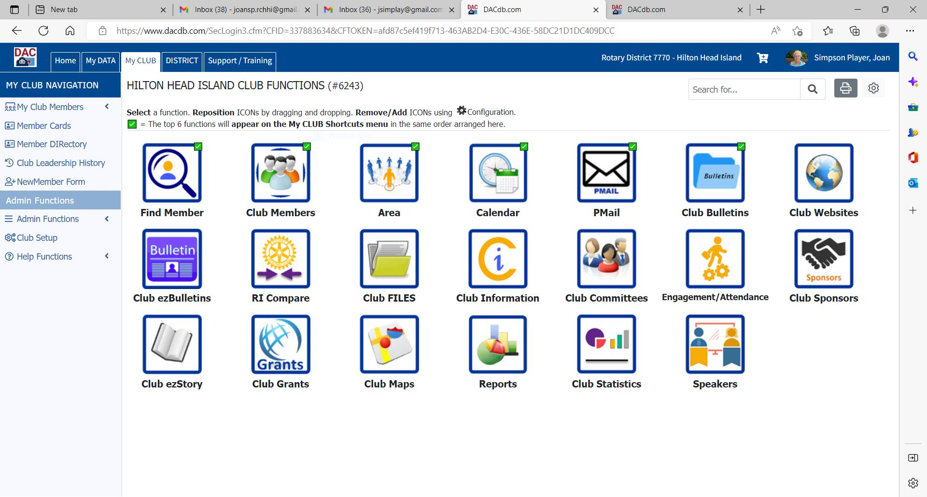

Slide 8
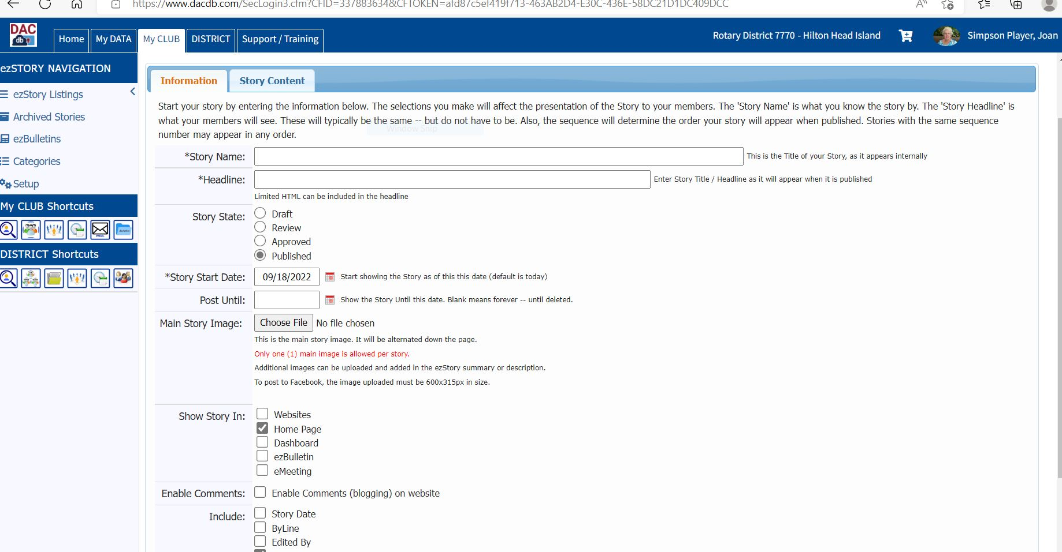

Slide 9
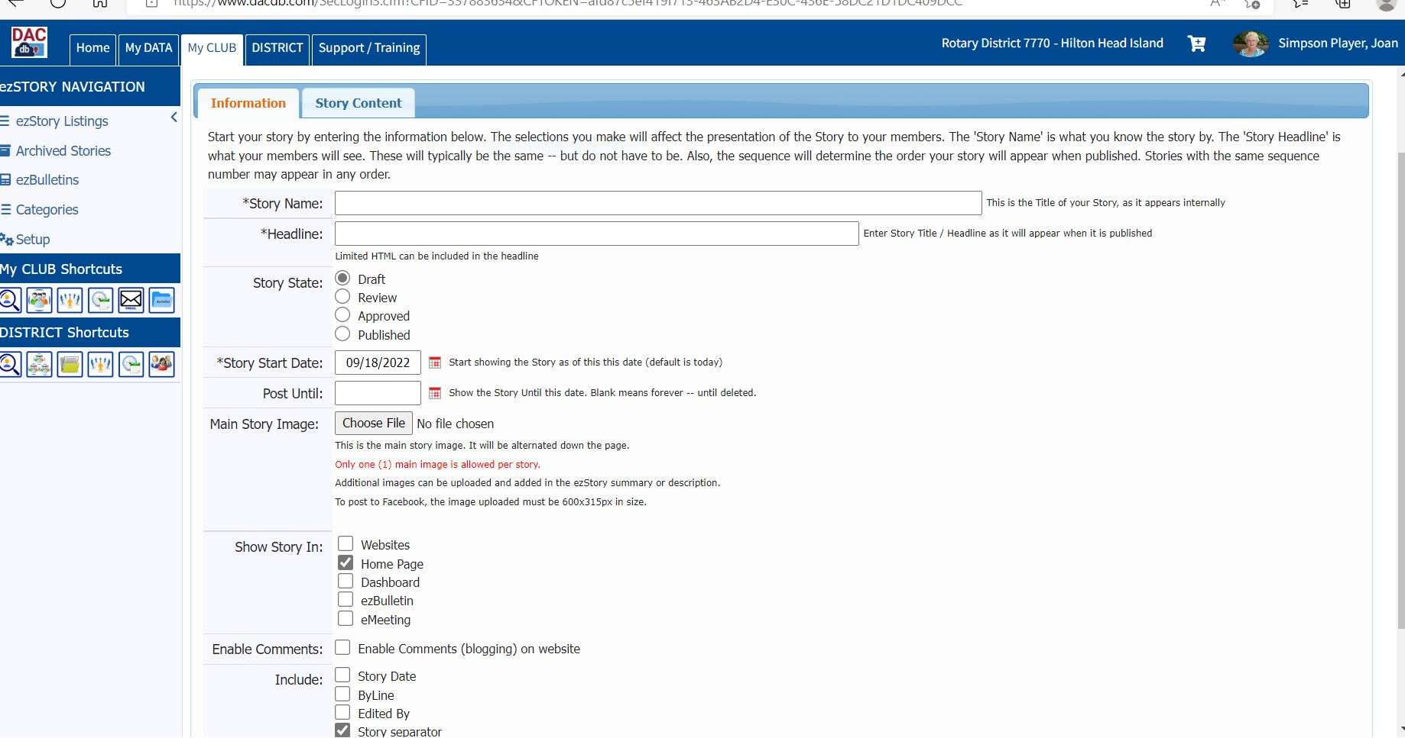

Slide 10
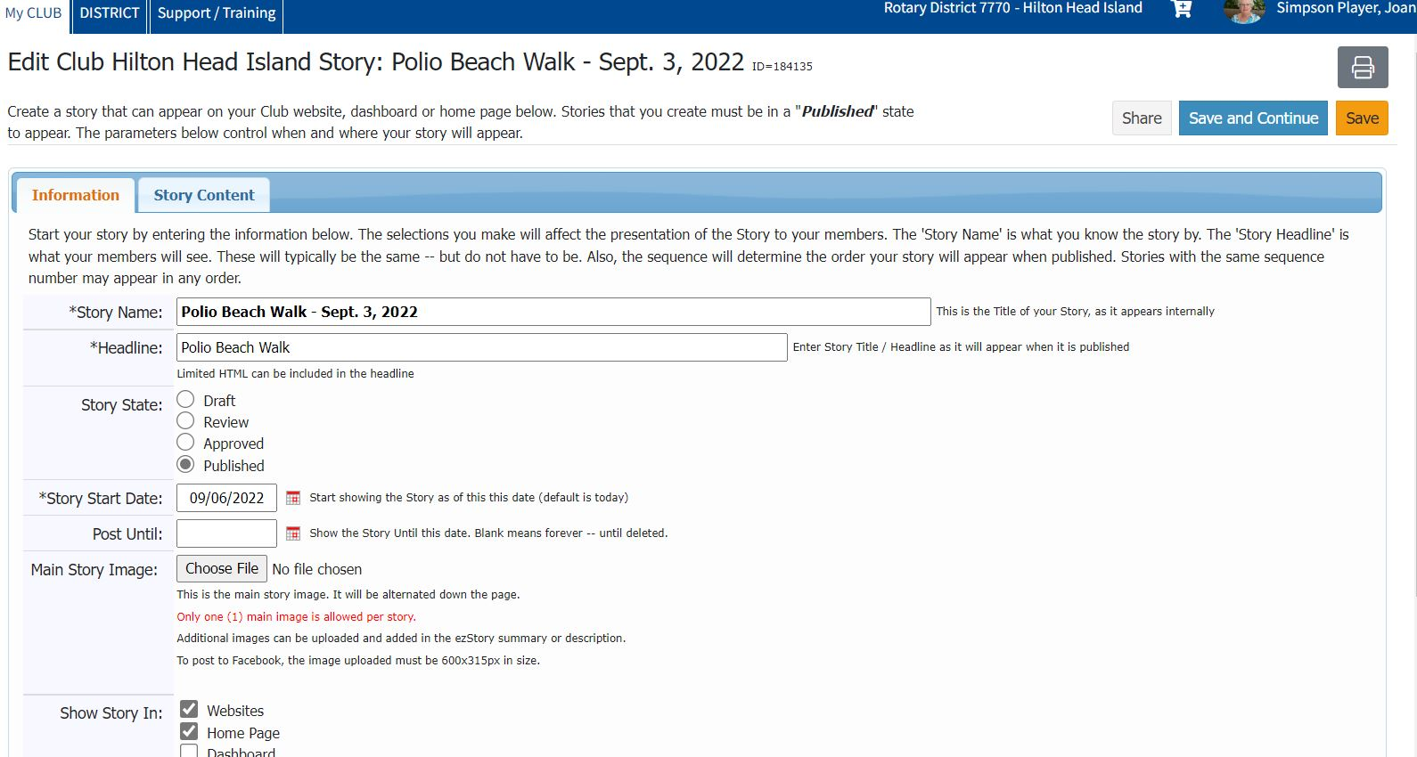

Slide 11
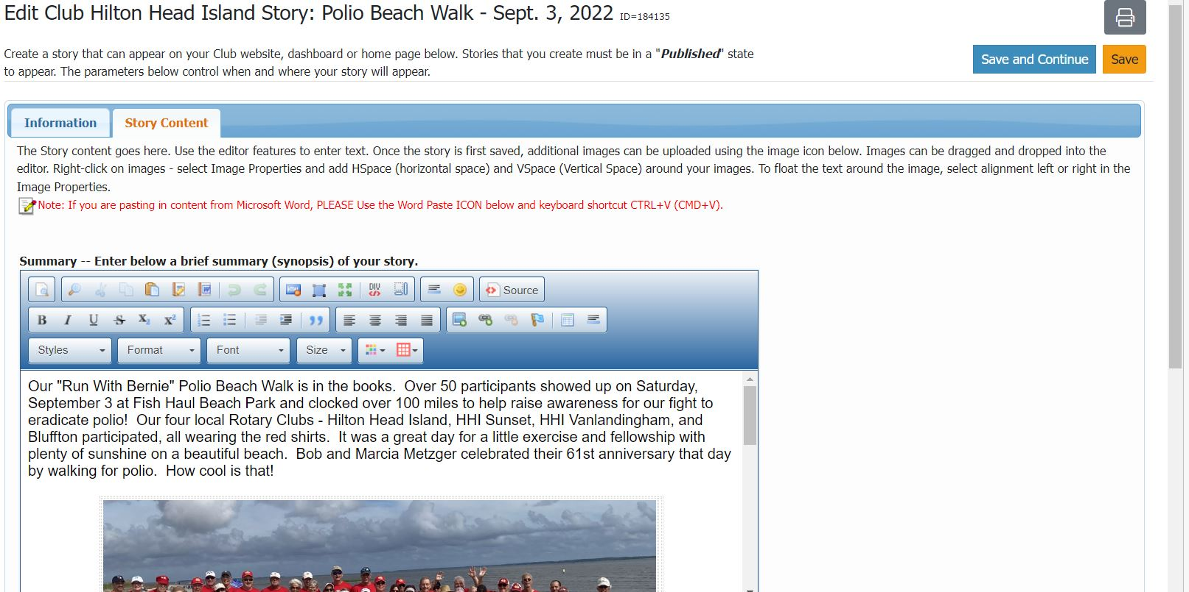

Slide 13
NEWSLETTER CONTENT
Stories that show Rotarians in Action
Interesting stories about your Club’s current activities, programs that you want others in the District to know about
Keep it simple and do include pictures
Limit to 1 or 2 stories per Club

Slide 14
THE DISTRICT NEWSLETTER WILL INCLUDE NEWS ABOUT THE ACTIVITIES OF ALL OF OUR CLUBS.
SO LET EVERYONE KNOW WHAT YOUR CLUB IS DOING!
THANK YOU FOR KEEPING OUR DISTRICT NEWSLETTER UP TO DATE AND INTERESTING!

