Slide 1
2025 Rotary Club of Indian Land Scholarship Application
Please print and complete application

Slide 2
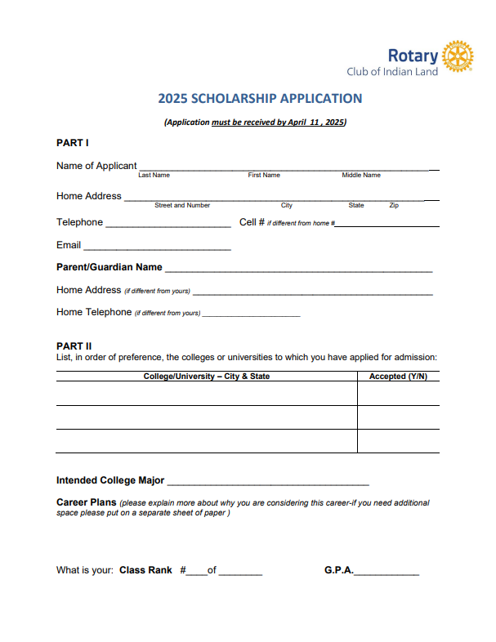

Slide 3
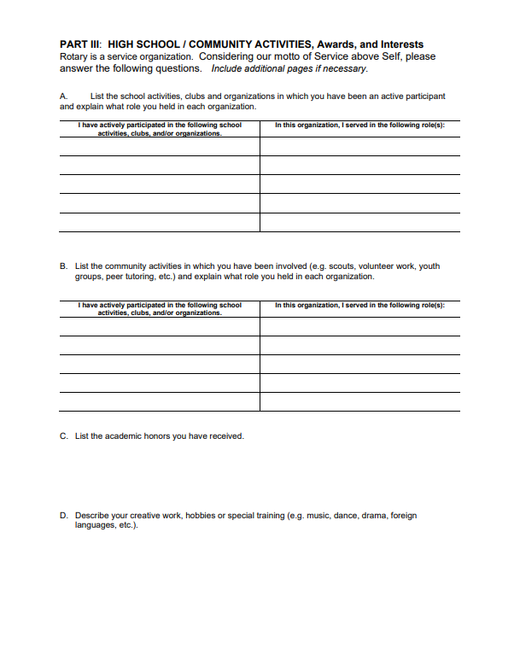

Slide 4
