Slide 1
Vocational Service
Rotary International

Slide 2
Vocational Service
Vocational Service is one of Rotary’s Avenues of Service.
Through Vocational Service we:
  Serve others by using our unique skills to address community needs
  Empower others through training and skill development
  Inspire others to act with integrity by following Rotary’s guiding principles

Slide 3
Defining Vocational Service
Vocational Service includes:
  Connecting our professions and professional networks with our Rotary club activities
  Using our expertise to address community problems and help others discover new vocational opportunities and interests
  Promoting Rotary’s commitment to integrity in our professional as well as personal lives

Slide 4
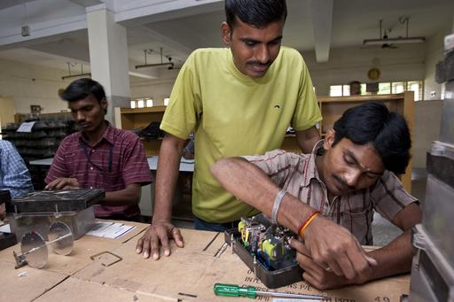
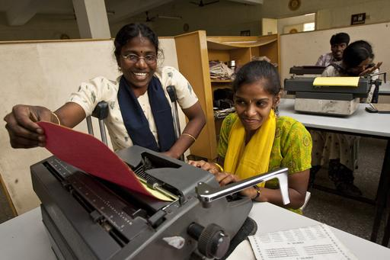
Responsibilities
  Professionals join a Rotary club as representatives of their particular business or profession.
  Rotarians have a dual responsibility: represent their vocation within their club and to exemplify the ideals of Rotary in their place of business.

Slide 5

Integrity and Ethics
  Rotary emphasizes integrity and high ethical standards. Two useful tools for assessing our performance in these areas are The Four-Way Test and the Rotarian Code of Conduct.

Slide 6
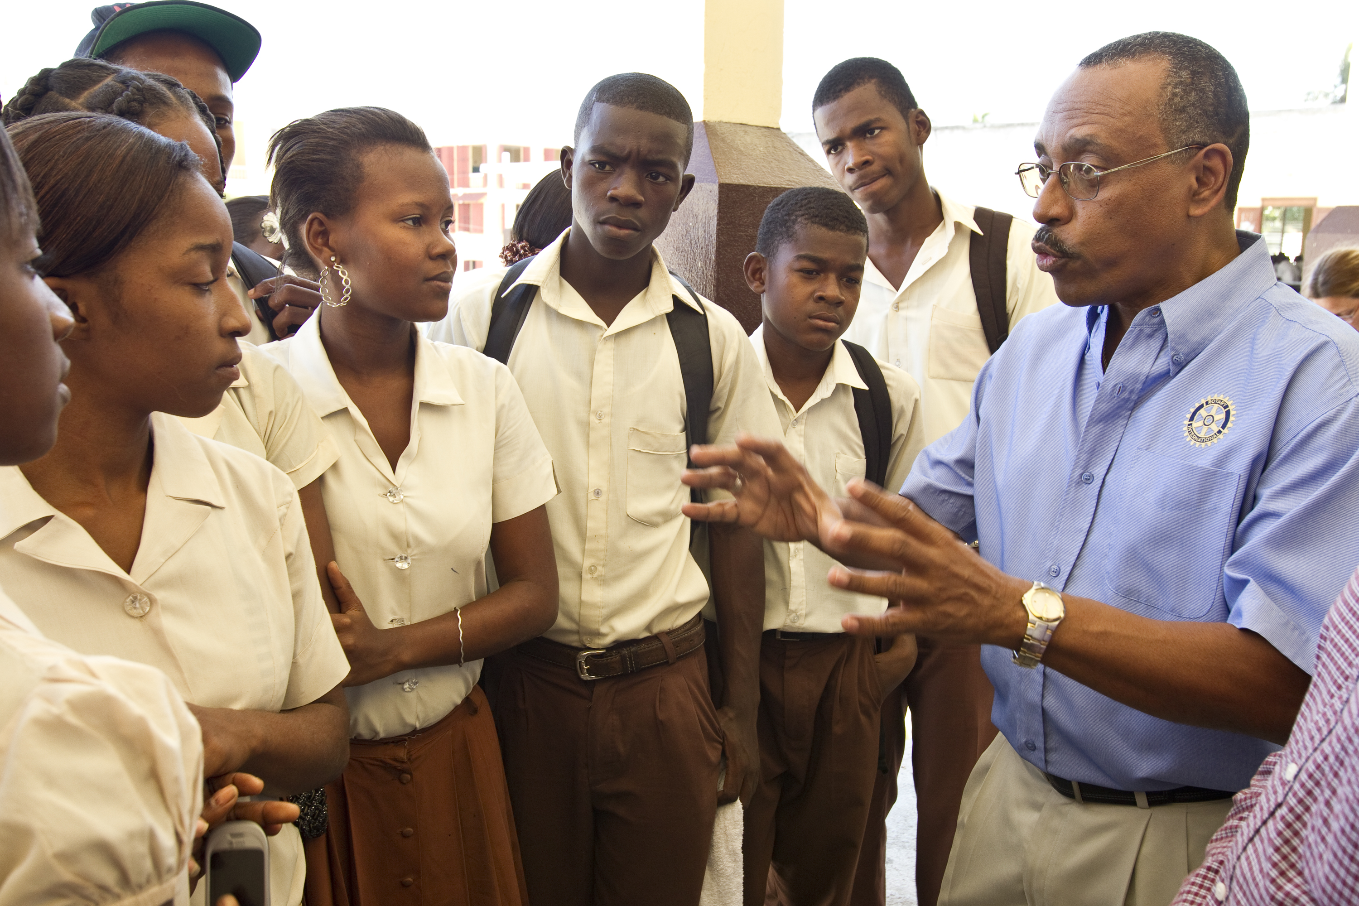
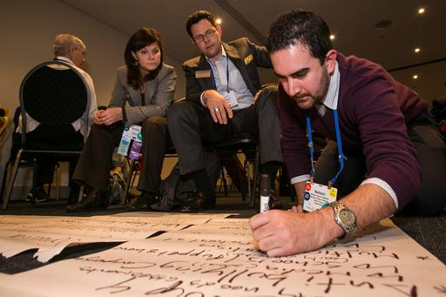
Vocational Service Project Ideas
Host a business networking event with non-Rotarian professionals in your community.
Offer career counseling for unemployed or underemployed adults.
Give career guidance to young people (for example, hold a career day or start a mentoring program).
Apply your professional skills to a project.

Slide 7
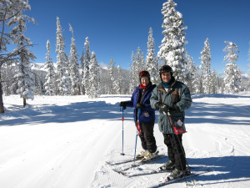

Join or Start a Rotary Fellowship
Rotary Fellowships are international groups of Rotarians who pursue a shared vocational or recreational interest.
Join a Rotary Fellowship related to your profession . If one doesn’t exist, consider organizing one.

Slide 8
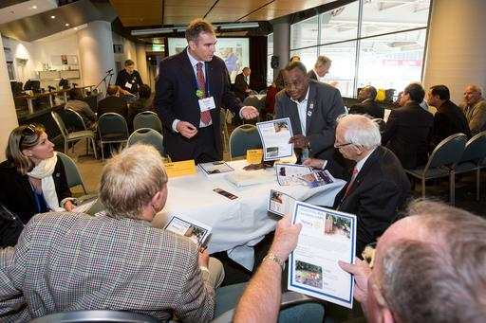
Join or Start a Rotarian Action Group
Rotarian Action Groups are international groups of Rotarians, Rotary program participants, and alumni who help clubs plan and implement projects in a particular area of service.
Join a Rotarian Action Group to use your skills to support Rotary projects around the world.

Slide 9
Vocational Service Update
The Vocational Service newsletter, a free quarterly e-publication, keeps Rotarians informed about:
Offering their professional skills to Rotary projects
Supporting the professional development of individuals and communities in need
Representing Rotary and promoting Rotary values in the workplace
Subscribe at www.rotary.org/newsletters

Slide 10
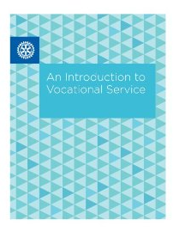
An Introduction to Vocational Service
This handy guide provides information, resources, and project ideas related to vocational service.
You can either download or purchase
a copy.

Slide 11
Additional Resources
Find support for a club vocational service project in Rotary Ideas.
Share your vocational service project successes on Rotary Showcase to inspire others and promote our collective efforts to improve communities around the world.
Learn how to organize a vocational training team to conduct training and build capacity in collaboration with Rotarians in other parts of the world, using Global Outlook: A Rotarian’s Guide to Vocational Service.

Slide 12
Support
Your district vocational service chair, appointed by your district governor, coordinates and promotes vocational service activities within the district.
To identify your district vocational service chair, and for questions, contact the Rotary Service Connections staff at rotary.service@rotary.org.

