Slide 1
District Grants
Rotary District 7730
2020-21

Slide 2
Congratulations to all Clubs that have Applied for and received a District matching Grant. Remember – The more you give, the more you get back.
Rotary District 7730

Slide 3
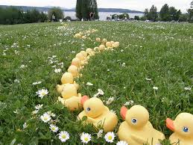
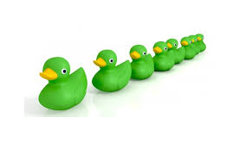
Rotary District 7730

Slide 4
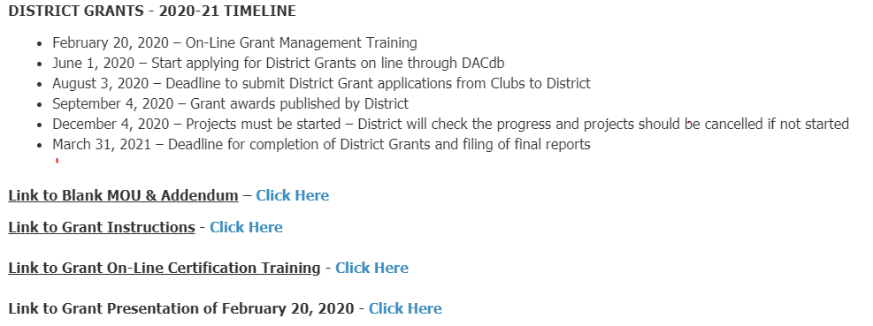
DACdb - Grants
District Grants Overview [2020-21]

Slide 5
GRANTS FUNDING MODEL Fund distribution for the 2020-21 Year
Annual Program Fund from 2017-18 (R B Richey DG) $227,542
50%
SHARE
50%
$113,771
$113,771
District Controlled
Trustees Controlled
District Designated Fund
50% (max)
World Fund
Other (Cash, DAF, Permanent Fund)
District Grants
$59,009*
Global Grants +
50% (min)
$57,282**
Global Grants (World Fund match to DDF and cash)
*$59,009 includes additional District Grant funds available per Trustee decision (10% of carry forward from 2017-18) and half of transfer from Endowment Fund of $396.
**Global Grants portion is $56,885 plus half of transfer from Endowment Fund of $396, .
Notes:
Now, how do we fund grant? Annual Programs Fund contributions are invested for a period of time and in the third year will be split 50/50 between the DDF (the District Designated Fund) and the World Fund.
Within the DDF, each district may elect to receive up to 50% of the available DDF for Rotary Foundation District Grants. At district’s direction, the remaining DDF—that is at least 50% as districts can choose to use up to a maximum of 50% for district grants— along with the World Fund, cash flow through from contributions, permanent fund earnings, named gifts, and donor advised funds will support Rotary Foundation Global Grants.
All club- and district- developed global grants will provide a World Fund match to DDF, cash and Donor Advised Funds, regardless of activity. The Foundation no longer provides a World Fund match for smaller, less strategic projects and activities that are undertaken by district grants.

Slide 6
What does the District Designated Fund (DDF) consist of?
Available DDF Funds Weighted 50%/50% on Annual Fund (SHARE) Giving based on:
-Your Annual Fund Contributions from three Rotary years ago (Works out to be about 12%)
-Your giving in the past Rotary year based on Per Capita Annual Fund Contributions for your Club for the last year

Slide 7
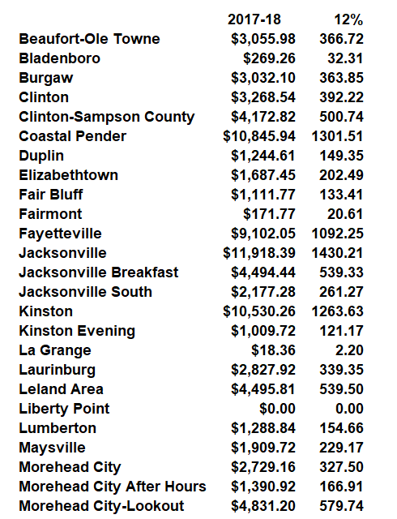
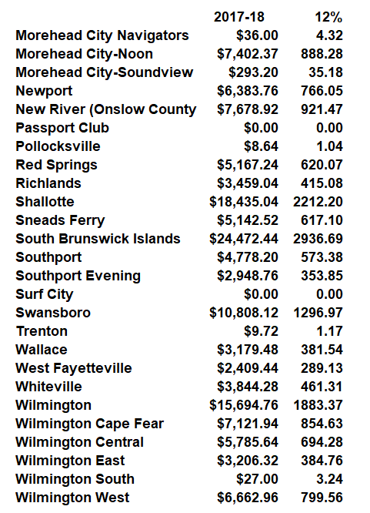
DISTRICT GRANT ELIGIBILITY TOTAL GIVING LEVELS FROM THE 2017-18 TOTALS

Slide 8
DISTRICT GRANT ELIGIBILITY PER CAPITA GIVING LEVELS
For 2020-2021 based on 2019-20 AF Giving
Club Per Capita Grant Eligibility
$25-$49 |  | $750
$50-$99 |  | $1,000
$100-$199 |  | $2,000
Over $200 |  | $2,500

Slide 9
District Designated Funds (DDF)
Available for the 2020-21 year
Total Available DDF - $59,009
(Contingency - $4,000)
Available for District Grants - 2020-21 -$55,009

Slide 10
District Designated Funds (DDF)
Distribution
-Total Available DDF - $55,009
-Total Grant Requests - $102,831
-Total Grants awarded - $89,097.89*
-Total Special Funding arranged by District Governor Dawn Rochelle for this 2020-21 year - $34,088.89
* Clubs with multiple Grants allotted up to the closest multiple of their allotment.

Slide 11
List of District Grants allotted for the 2020-21 year
Lead Club Name | Project Name | Grant amount
Beaufort-Ole Towne | Ten Eighteen Inc/ The Ross House | 866
Beaufort-Ole Towne (*) Morehead City Noon | Tipi Project | 4,388
Burgaw | Together We Read | 2,363
Clinton | Lake Waccamaw Boys Girls Home Child Advocacy Home | 1,750
Clinton | Sampson County History Museum Landscaping Project | 750
Clinton-Sampson County | Coronavirus Protection for Students | 2,500
Coastal Pender (*) Surf City | Alleviating Food Insecurity During COVID-19 | ,5800
District 7730 Passport | Passport 2020-21 Hunger and Literacy Project | 2,000
Fair Bluff | Library Civic Room Furnishings | 2,133
Fairmont | Project Lifesaver | 770
Fayetteville | Education in the Garden | 500
Fayetteville | Health for the underserved | 550
Fayetteville | Help for students | 500
Fayetteville | Oakridge Playground | 2,000
Fayetteville | Preserving health | 500
Jacksonville | Literacy Project | 2,500
Jacksonville | Opioid Gap Funding Project | 1,000

Slide 12
List of District Grants allotted for the 2020-21 year
Lead Club Name | Project Name | Grant amount
Jacksonville Breakfast | CCCC Foundation Scholarship | 1,250
Jacksonville Breakfast | Jacksonville Christmas Celebration and Flotilla | 1,500
Kinston | Internet Broadband Hotspots | 2,013
Leland Area 2 | Brunswick Family Assistance COVID | 1,000
Leland Area 1 | Lincoln Elementary Backpack Program | 1,250
Liberty Point Rotary Club | Off-Road Outreach Community Service Project | 1,000
Liberty Point Rotary Club | The Artisans Outreach Community Service Project | 1,000
Maysville | BASEBALL, RECREATION, AND COMMUNITY | 2,700
Morehead City | Ocracoke Dental Clinic | 1,250
Morehead City After Hours | Hope Mission Recovery Home | 1,666
New River (Onslow County) | Homeless Shelter to Bee | 775
New River (Onslow County) | Sturgeon City Security Gates | 600
New River (Onslow County) (*) Jacksonville South | To Bee or Not to Bee | 2000
Newport | Newport Rotary Club Halloween Hootenanny | 2,500
Red Springs | Santa's Helping Hand | 3,120
Richlands | Dictionary Project | 408
Shallotte 3 | E-readers for Seniors | 900
Shallotte 2 | Loads of Love | 1,320
Shallotte 1 | Residential Substance Abuse Program | 2,140

Slide 13
List of District Grants allotted for the 2020-21 year
Lead Club Name | Project Name | Grant amount
Sneads Ferry | Dixon High School Greenhouse Restoration | 1,750
South Brunswick Islands 1 | 1.First Tee of Coastal Carolinas Van | 3,000
South Brunswick Islands - 2 | 2. Summer Counts Reading Program | 1,500
South Brunswick Islands - 3 | 3. BCC Foundation Scholarship and Initiatives | 1,250
Southport | Computer for Kids | 1,500
Southport | Transitional Housing for the Homeless | 1,000
Swansboro | Calculator Project for Jamaica Partnership | 1,750
Wallace | Duplin Search & Rescue Dry Suites | 2,881
Whiteville | Dictionaries for third graders | 894
Whiteville | Downtown Whiteville Butterfly Mural Trail | 1,185
Wilmington | Access of Wilmington - Activity Buckets | 1,250
Wilmington | Nourish NC | 1,500
Wlmington | Salvation Army- Rent and Utility Assistance | 750
Wilmington Cape Fear | Community Annex Kitchen Development - Harrelson | 2,500
Wilmington Central | Blue Bags for Prostrate Cancer | 1,500
Wilmington East | NourishNC | 2,350
Wilmington West | Dictionaries for Third Graders | 2,383
Wilmington West | Little Free Libraries | 889

Slide 14
Questions?

