Slide 1


Slide 2


Slide 3

FUNDS OF THE ROTARY FOUNDATION

Slide 4
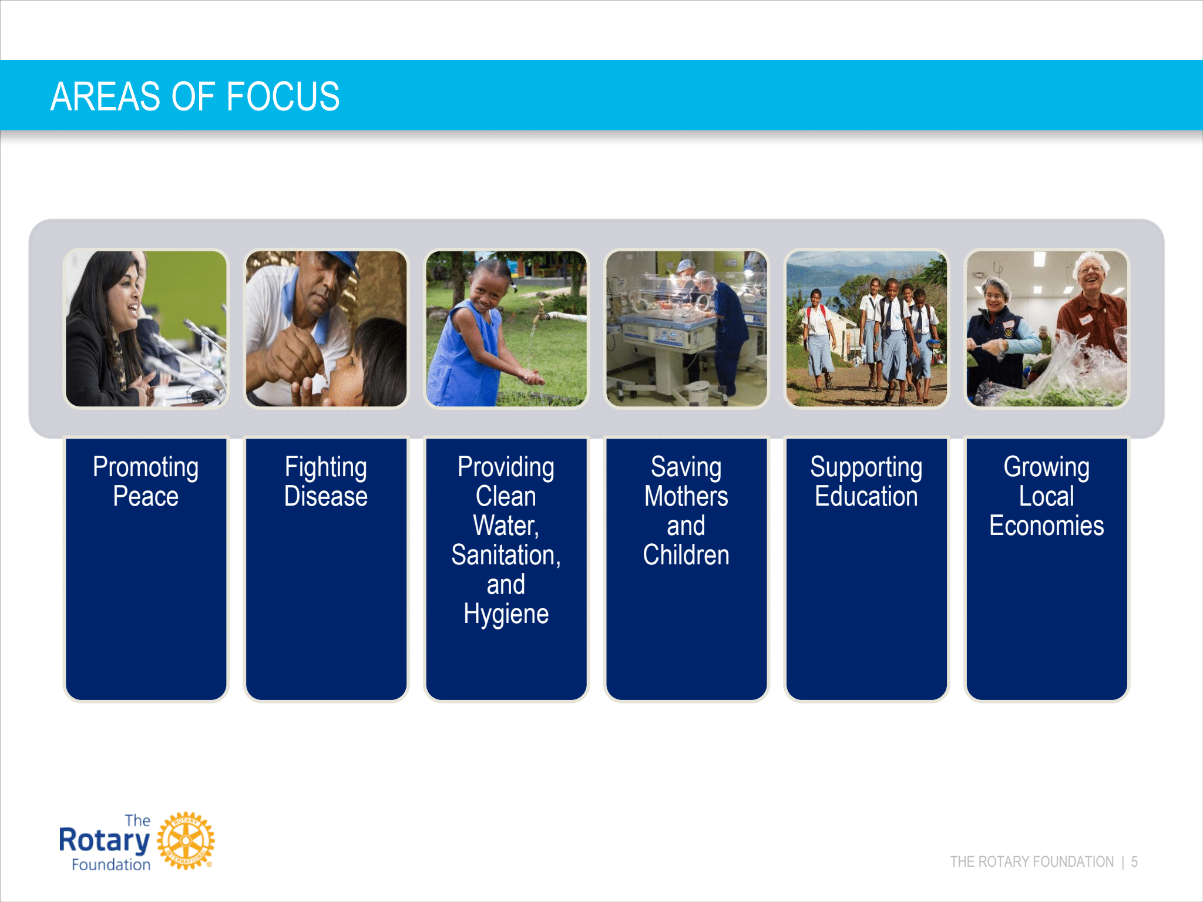

Slide 5
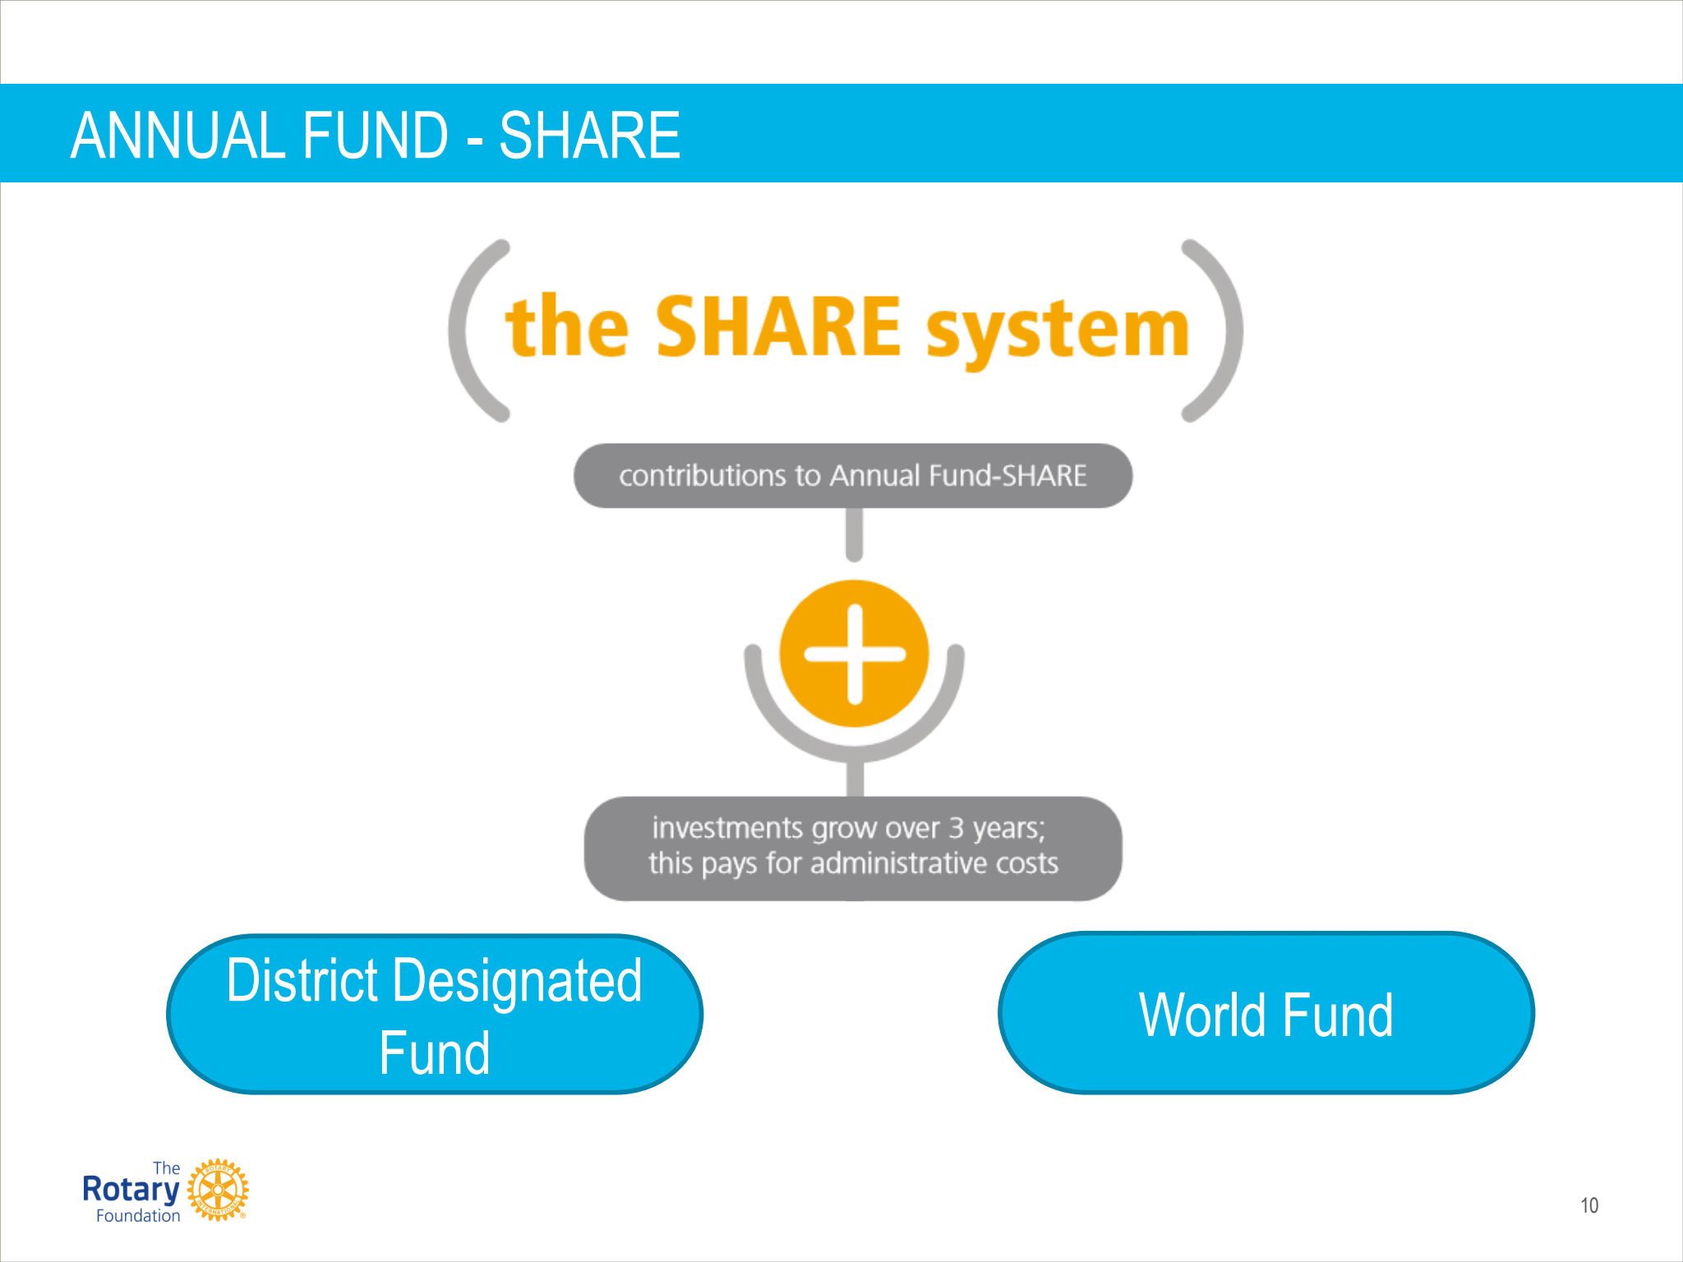

Slide 6
WHERE TO START?
Set Up Account on MyRotary.org
ry.org

Slide 7
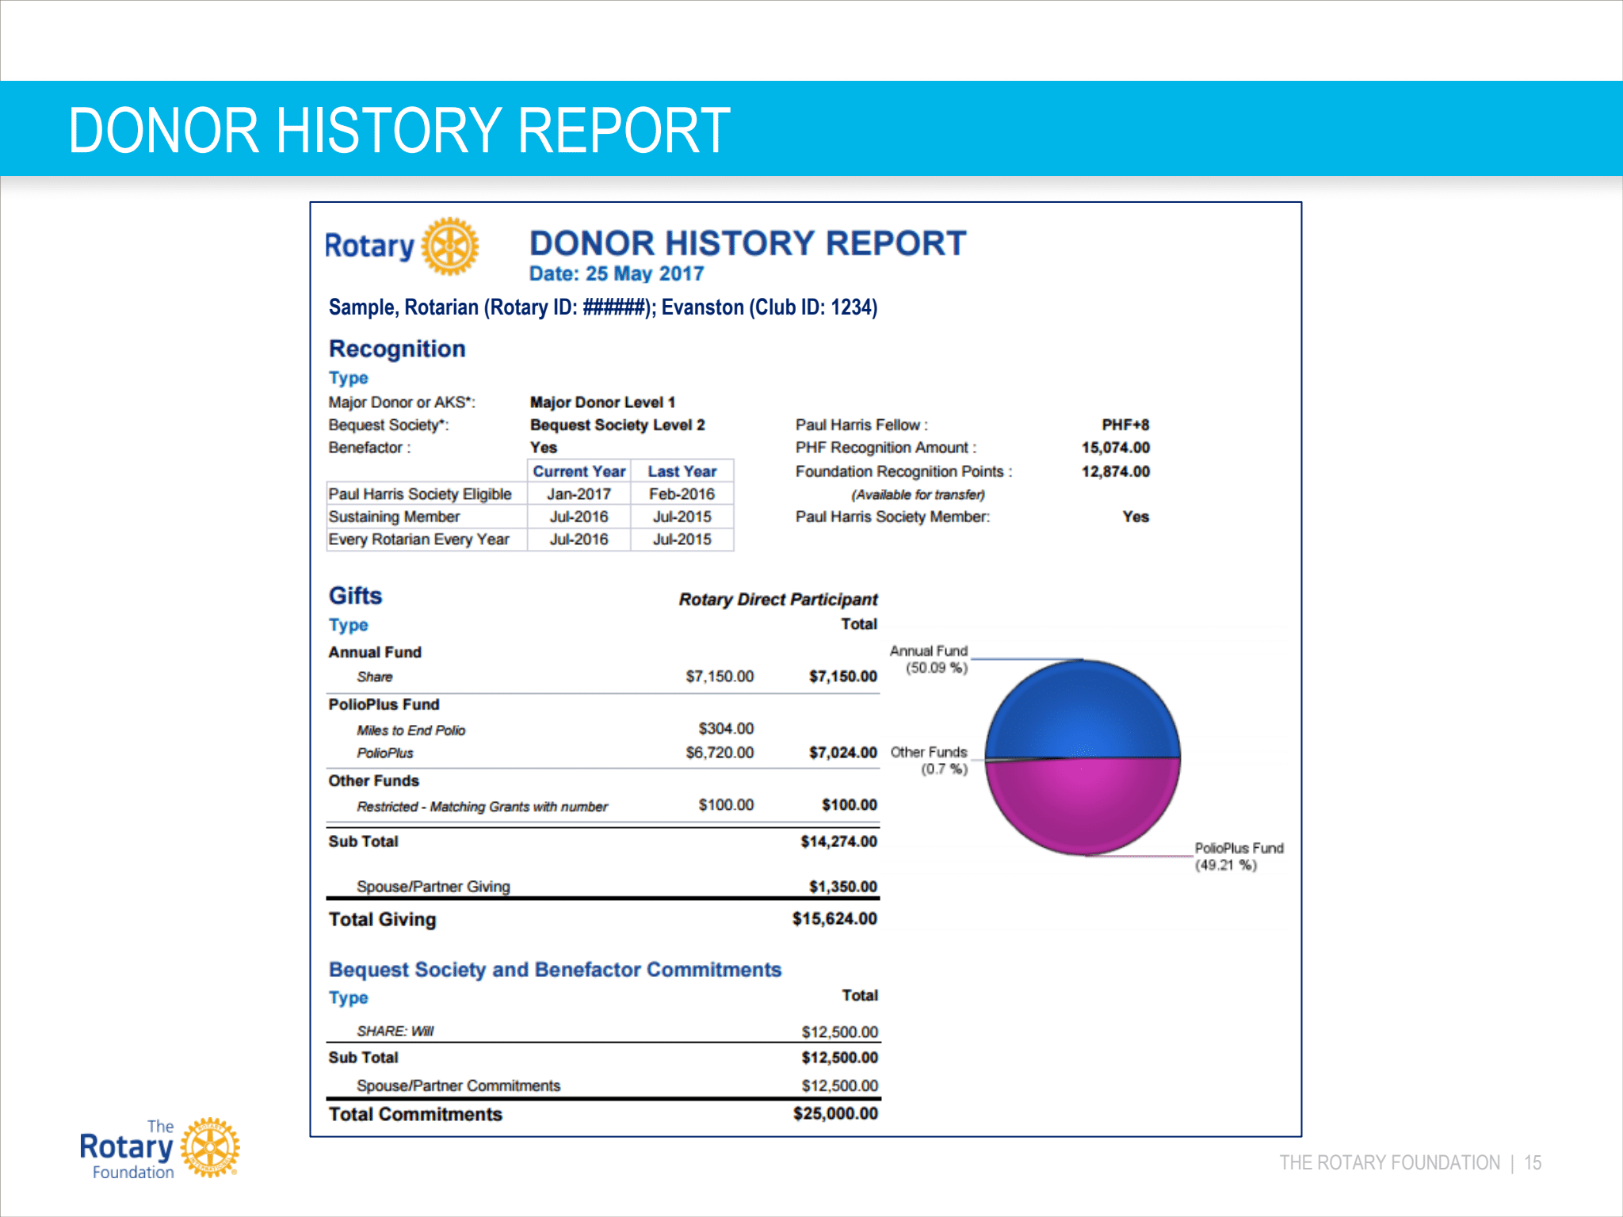
DONOR HISTORY REPORT
Notes:
MAJOR GIFTS Carl Davis Major Gifts Officer Zone 33 / Polio, Development and Partnershjips Tel 1.847.424.5343E-mail: carl.davis@rotary.org

Slide 8
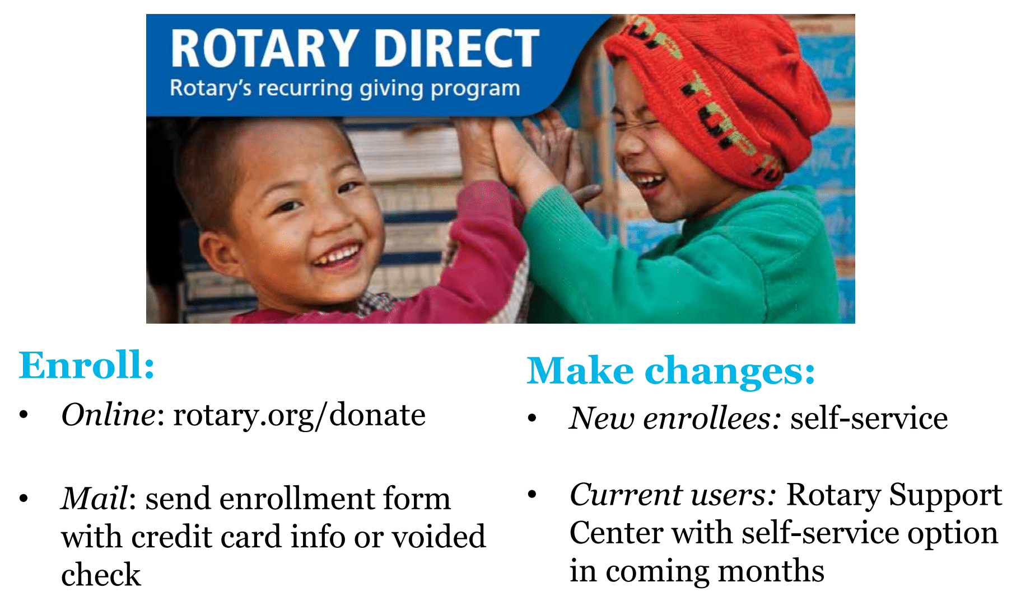
RECURRING GIVING

Slide 9

District 7730 Rotary Foundation Goals
2020-2021

Slide 10
District 7730 Rotary Foundation Goals 2020-2021
Every Club will contribute a portion of their Annual Fund and PolioPlus goal by December 31, 2020. No Zero Giving Clubs
Every club will enter an Annual Fund and PolioPlus goal in Rotary Club Central by 08/31/2020
Increase PHS members by 10%
Increase Rotary Direct participation by 30%
Every club will contribute at least $50 Per Capita to PolioPlus

Slide 11
Foundation Advocates
Name | Area | Club | Contact Number
TBD | Area 1
TBD | Area 2
Andrea Young | Area 3 | Wilmington West | 910-232-5979
Bill Wylie | Area 4 | South Brunswick Islands | 717-683-5035
Butch Blanchard | Area 5 | Whiteville | 910-641-7060
Ike Eisenbarth | Area 6 | Liberty Pointe | 910-480-0012
Steve Paes | Area 7 | Wallace | 910-271-2541
Paul Sugg | Area 8 | Kinston | 252-717-9576
Notes:
MAJOR GIFTS Carl Davis Major Gifts Officer Zone 33 / Polio, Development and Partnershjips Tel 1.847.424.5343E-mail: carl.davis@rotary.org

Slide 12
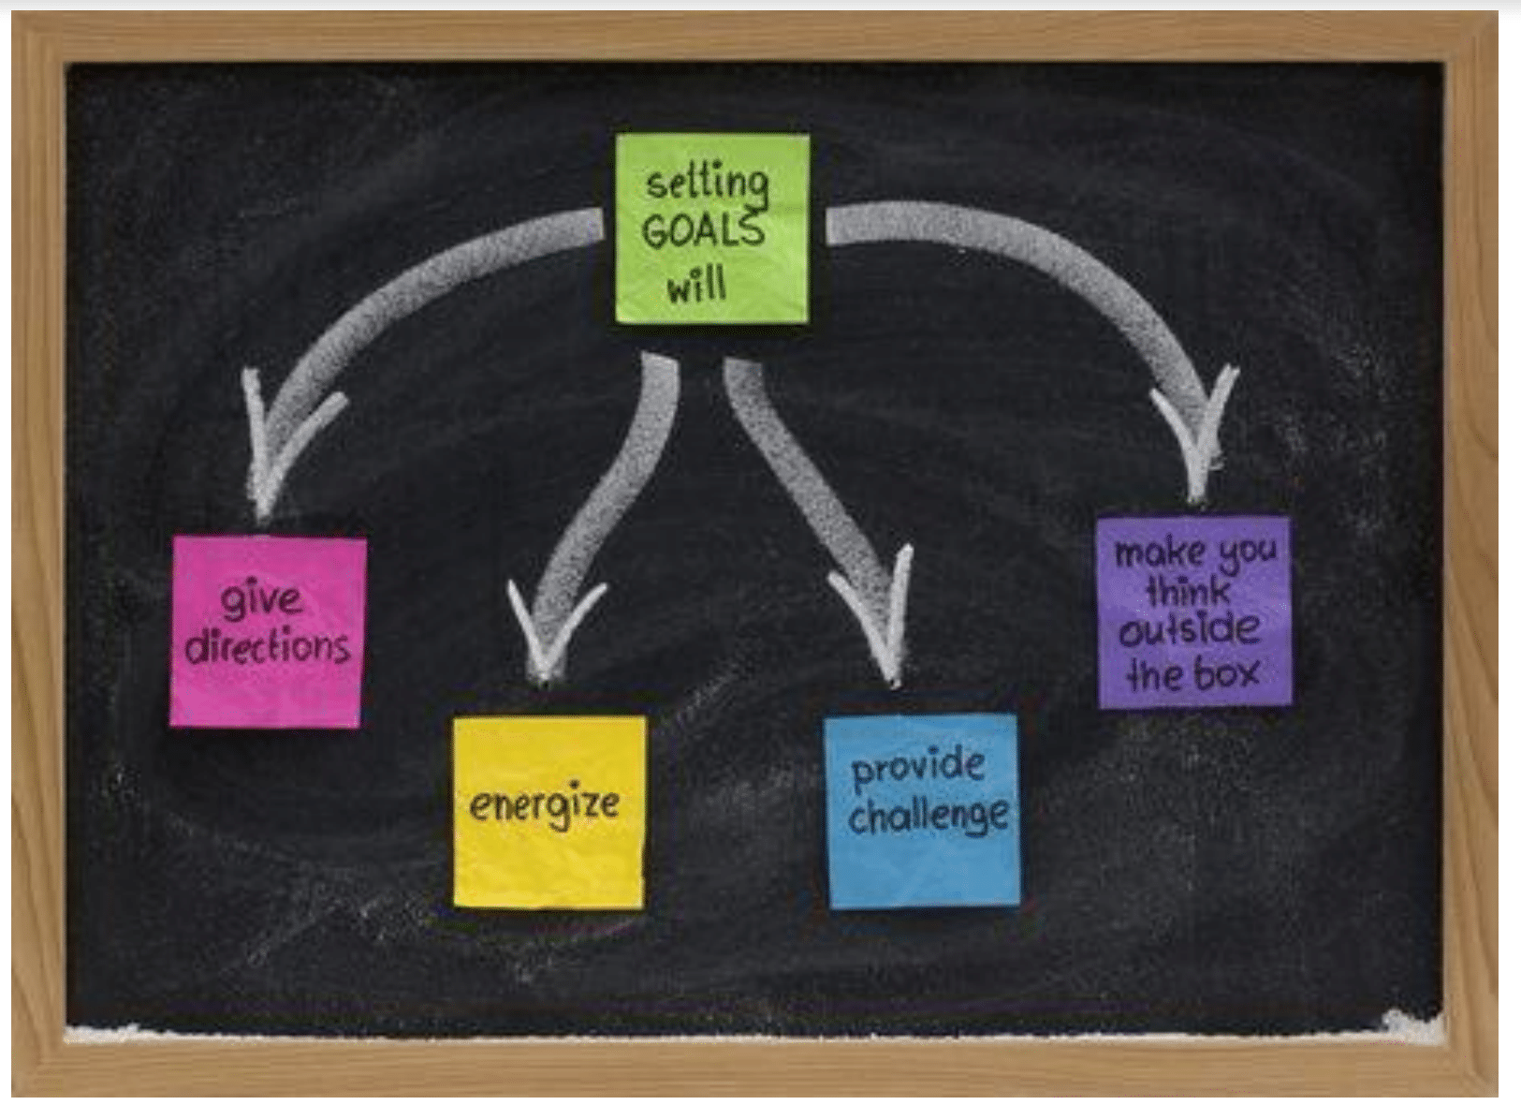
WHY SET GOALS?

Slide 13
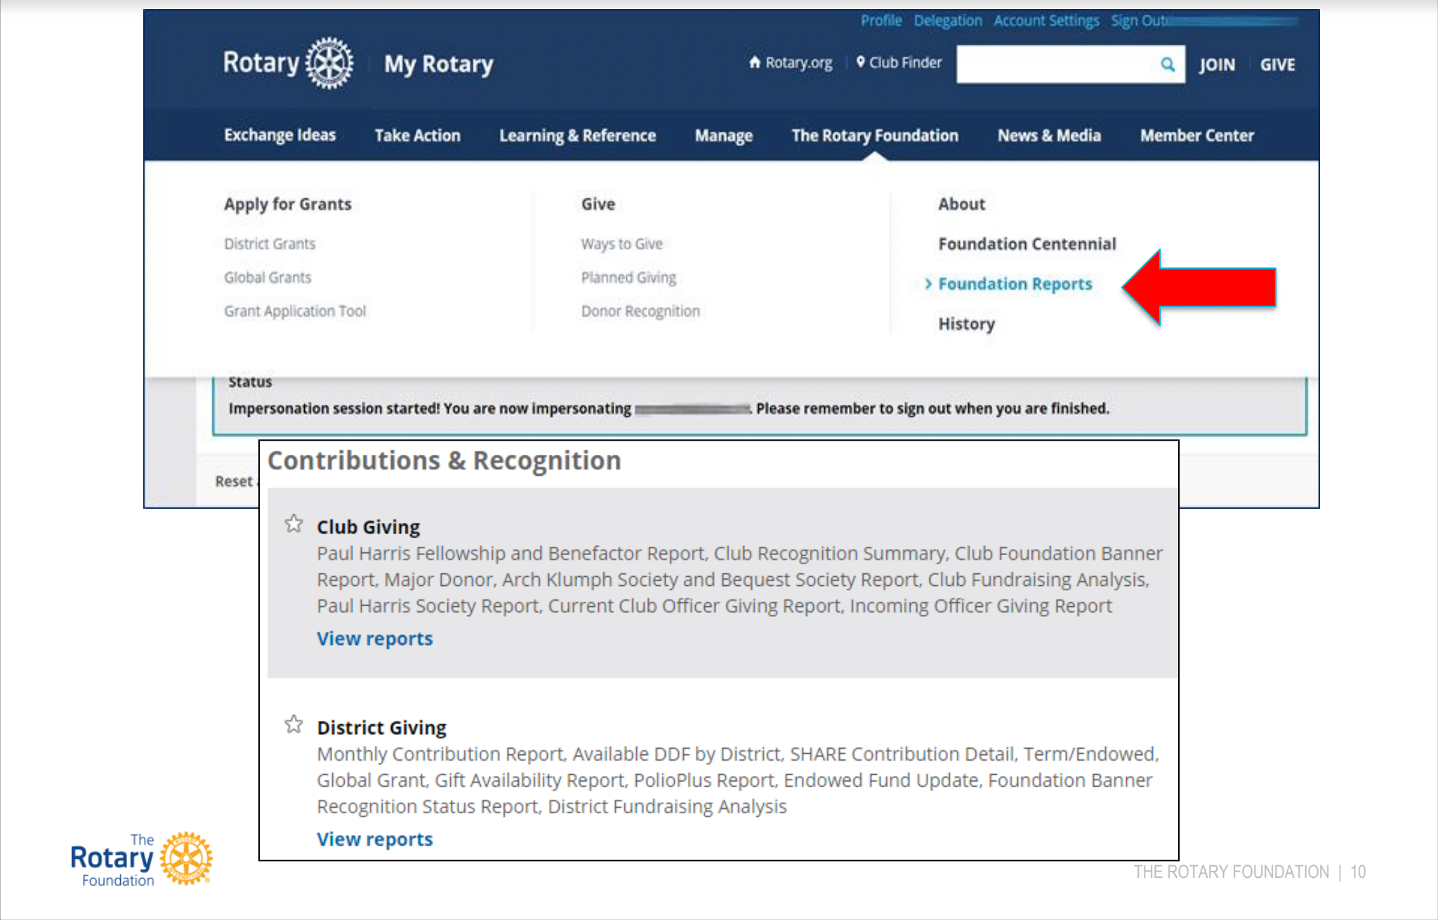
ACCESSING REPORTS

Slide 14
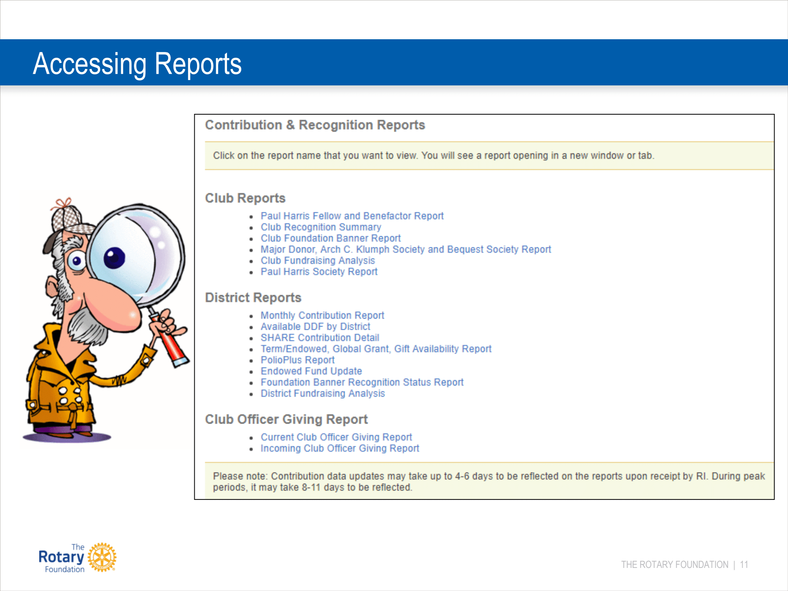
ACCESSING REPORTS

Slide 15
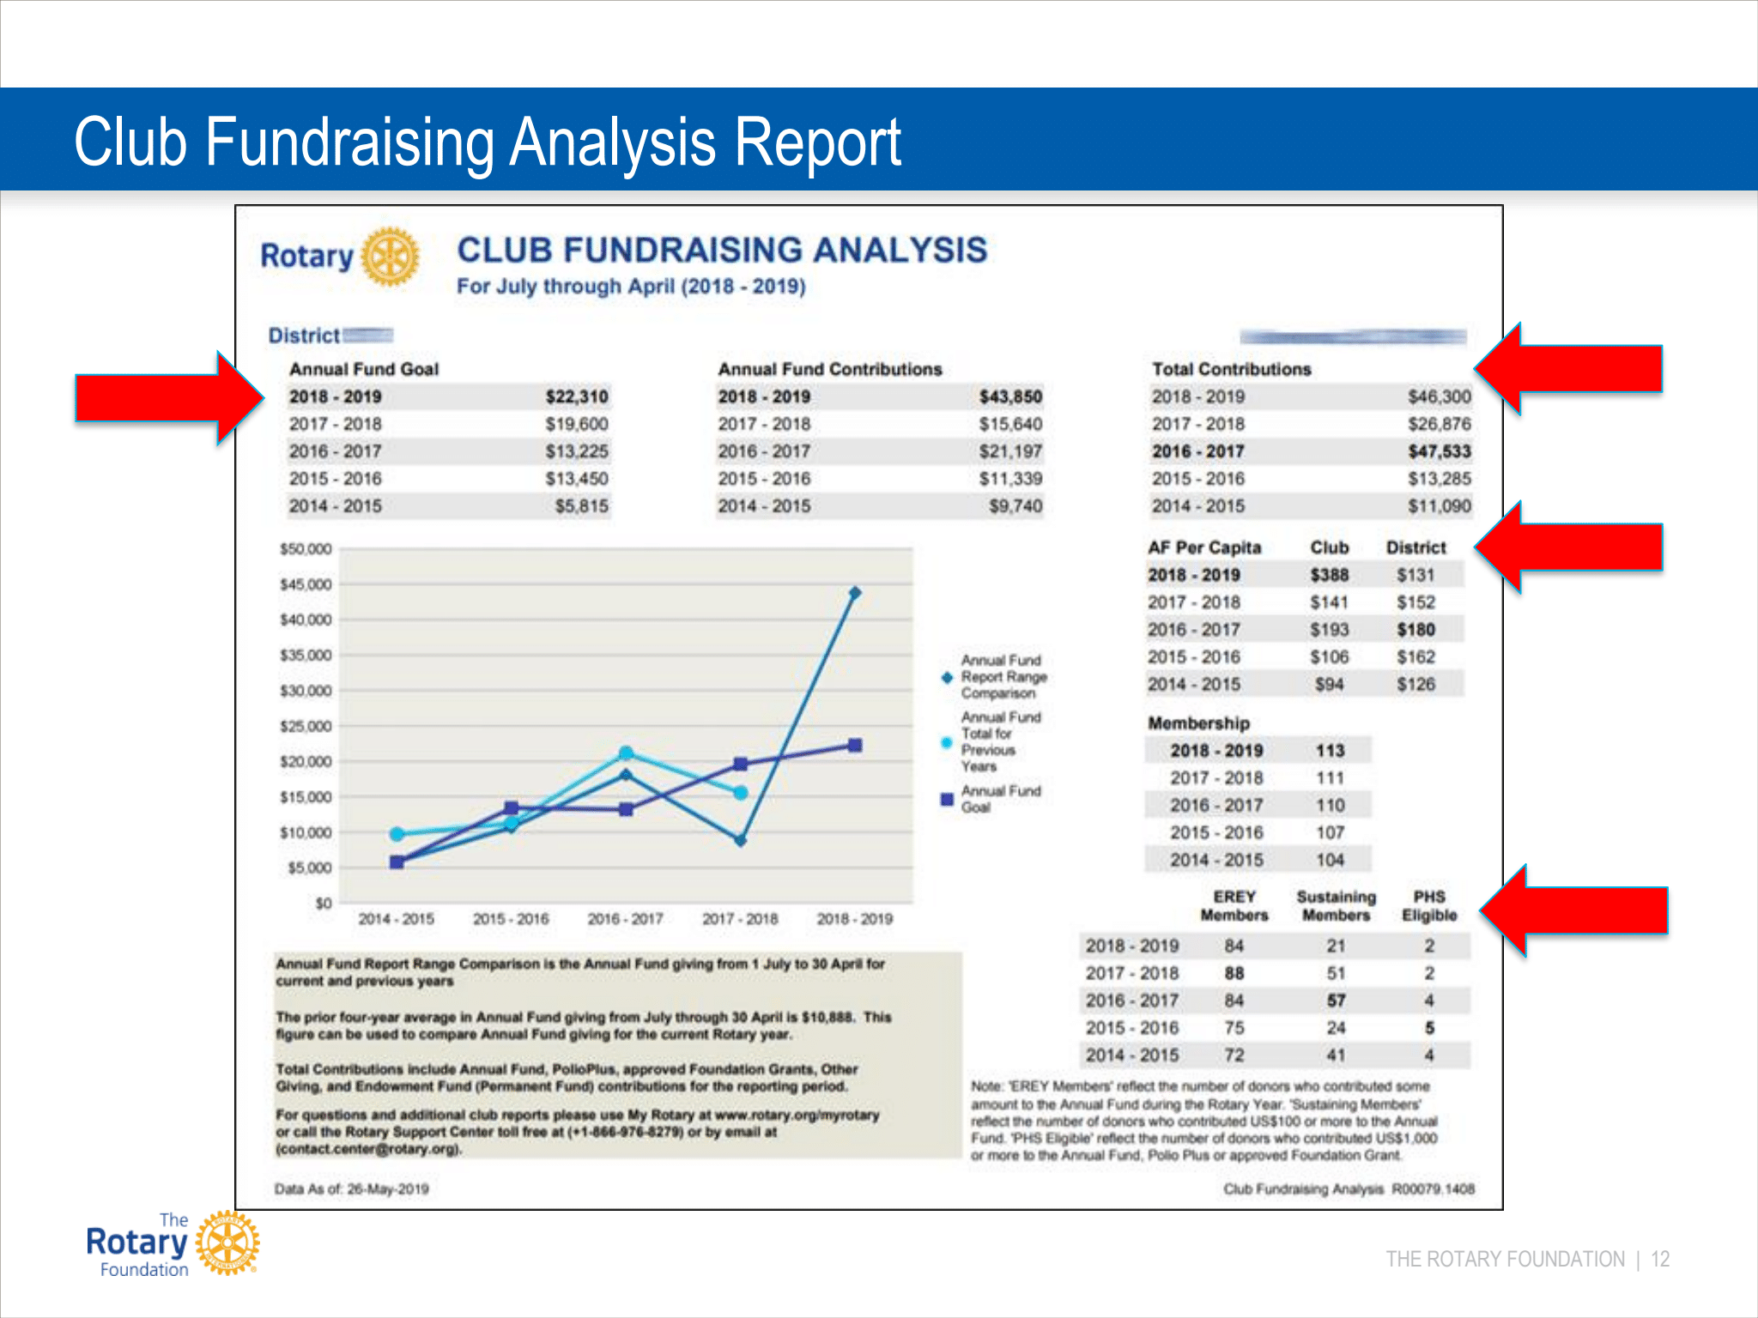
CLUB FUNDRAISING ANALYSIS REPORT

Slide 17
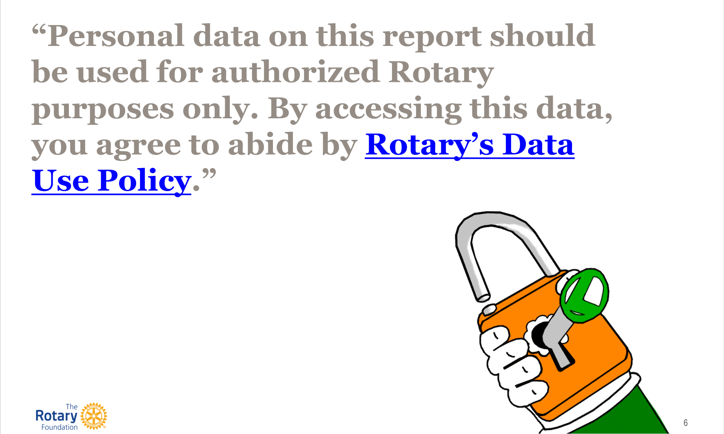
PROTECTING DONOR DATA

Slide 18
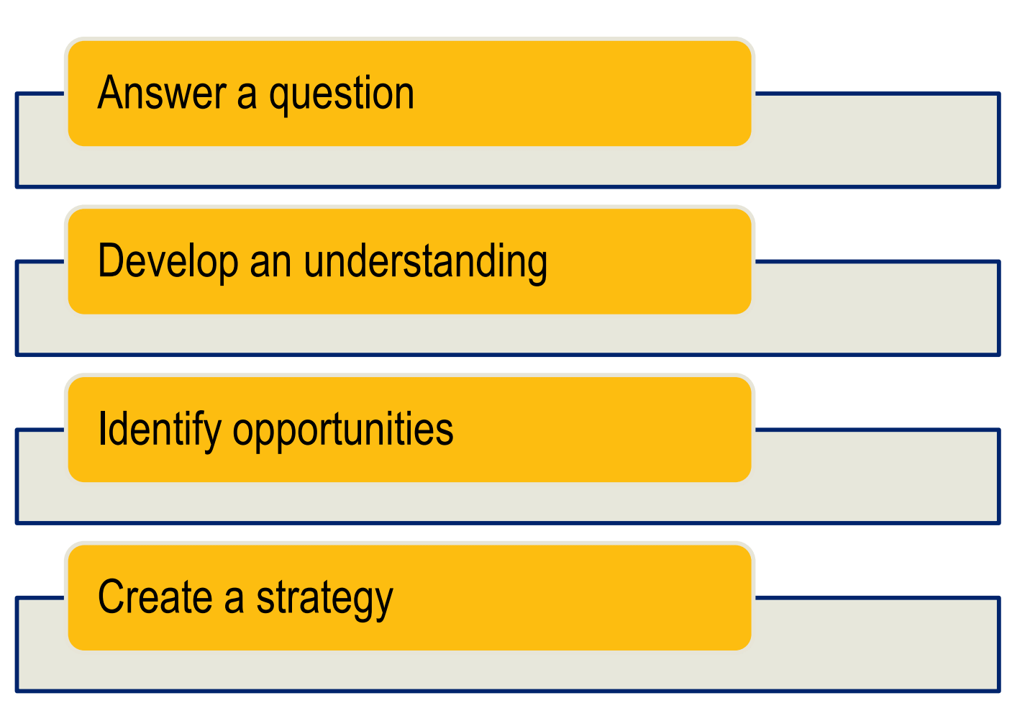
USE REPORTS TO. . .

Slide 19
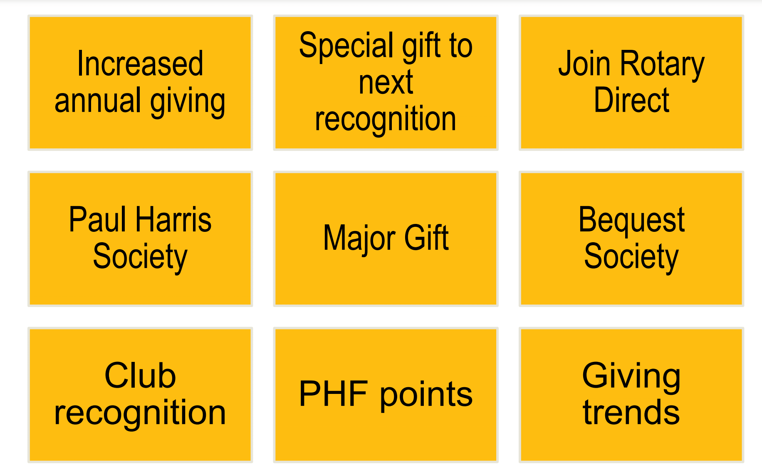
REPORTING TOOLS OPPORTUNITIES

Slide 20


Slide 21
Global Grants
Contact our Global Grants Chair
Nancy Barbee

Slide 22
Steve Hellesperk
District Grants Chair
District Grants

Slide 23
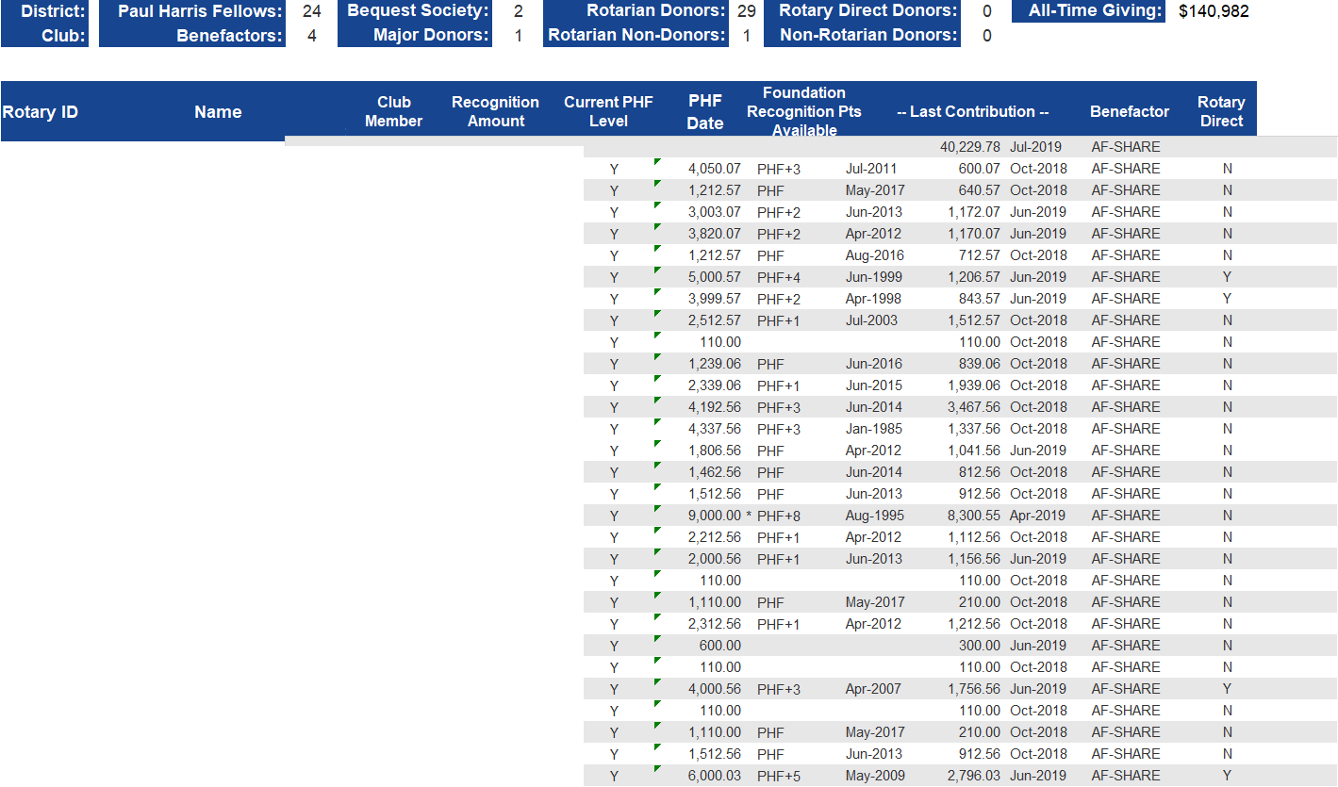
Club Recognition Summary

