Slide 1
SETTING GOALS IN ROTARY CLUB CENTRAL
KNOW YOUR ID!
Start with Rotary.org

Slide 2
CLUB PRESIDENTS HAVE SEVERAL TASKS ON ROTARY CLUB CENTRAL
SET FOUNDATION GIVING GOALS
SET MEMBERSHIP GOALS
Additional Club Goals

Slide 3
Rotary.org, My Rotary

Slide 4
Only the Club Presidents (PE,P,iPP) can set this year’s goals!

Slide 6
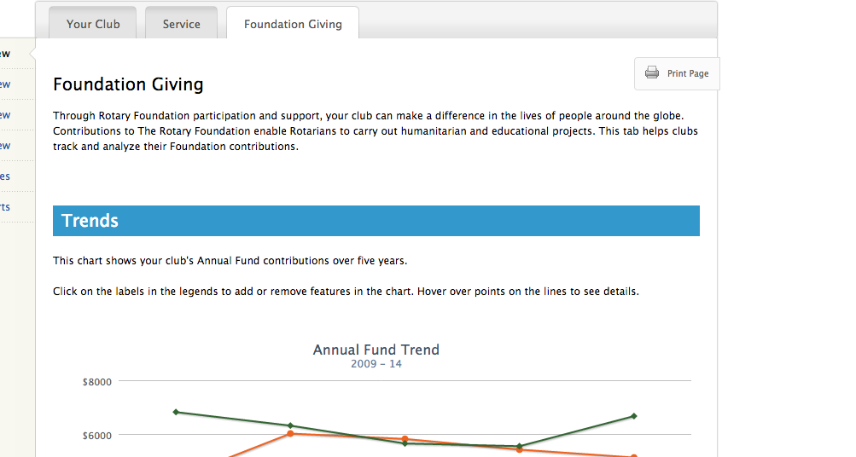
A
B
C

Slide 7
A
B
C

Slide 8
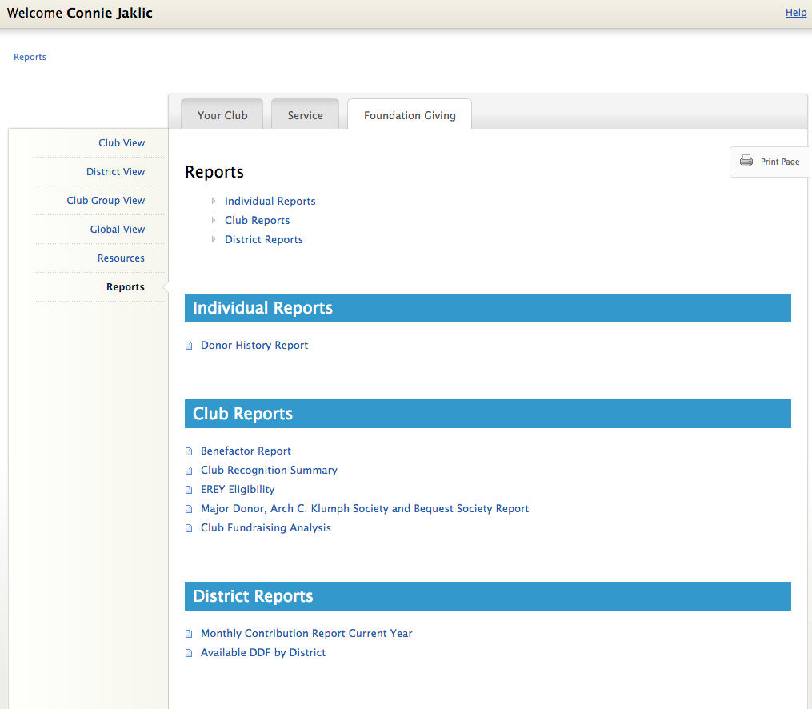

Slide 9
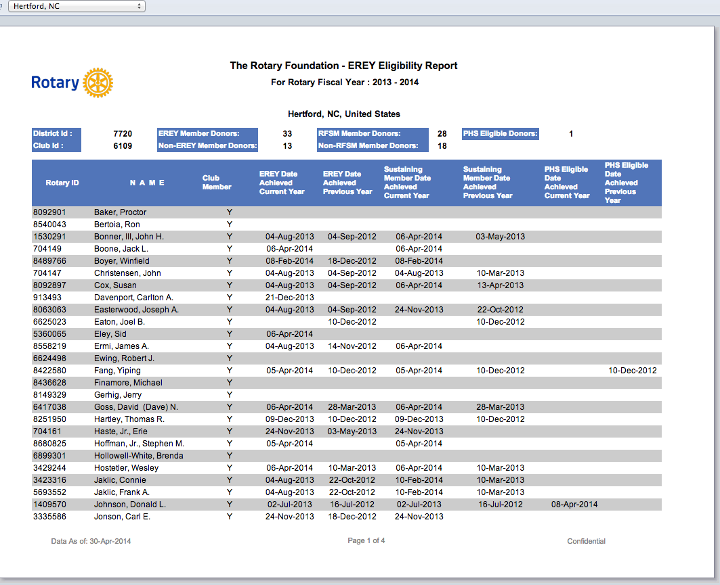
B=Hertford has 28 Sustaining members
B
A
A
A=Hertford has 1 PHS member

Slide 10
C= Every Rotarian, Every Year (EREY)
= 20 non sustaining members X $40/year (Best guestimate)
= $800
Total giving = $ 1000 (1 PHS)
$ 2800 (28 sustaining members x 100)
$ 800 (EREY)
$ 4600 Goal Total

Slide 11
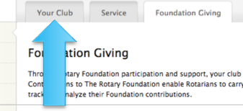
Click on: “Your Club”
SET MEMBERSHIP GOALS

Slide 12
SET MEMBERSHIP GOALS

Slide 13
THANK YOU!!

