Slide 1
Membership Graphs used in 2020 Summit
Graphs are by Area
If you would like more information please contact:
Stan Keeler
stankeeler@gmail.com

Slide 2
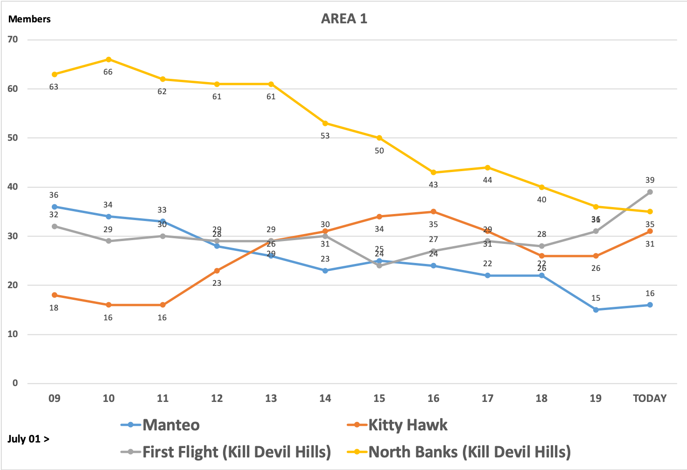
AREA 1

Slide 3
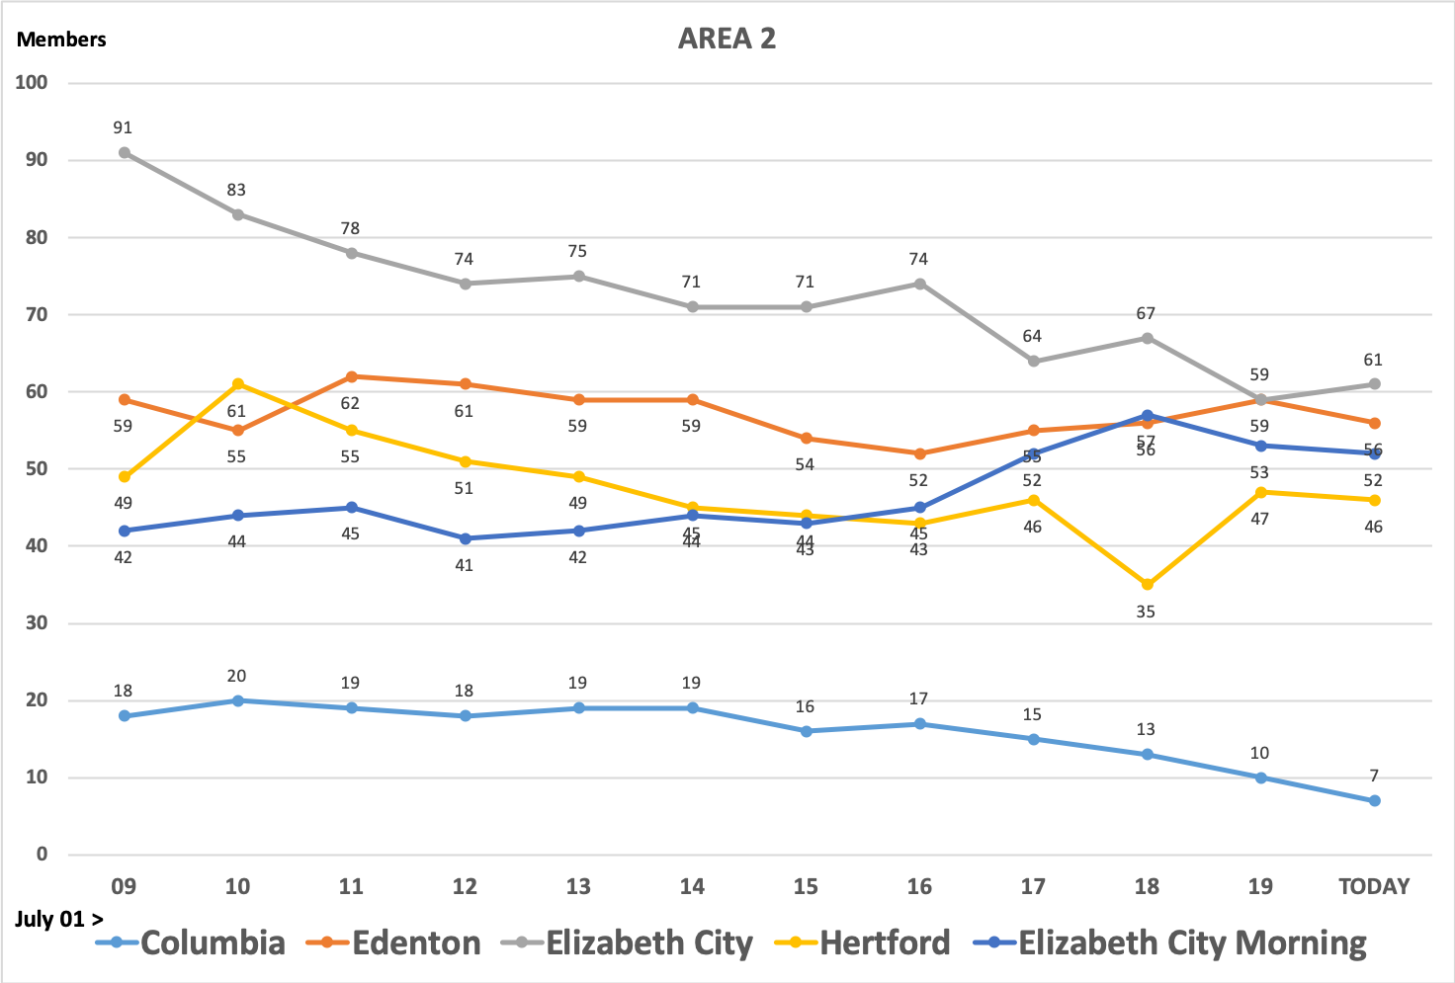
AREA 2

Slide 4
AREA 3

Slide 5
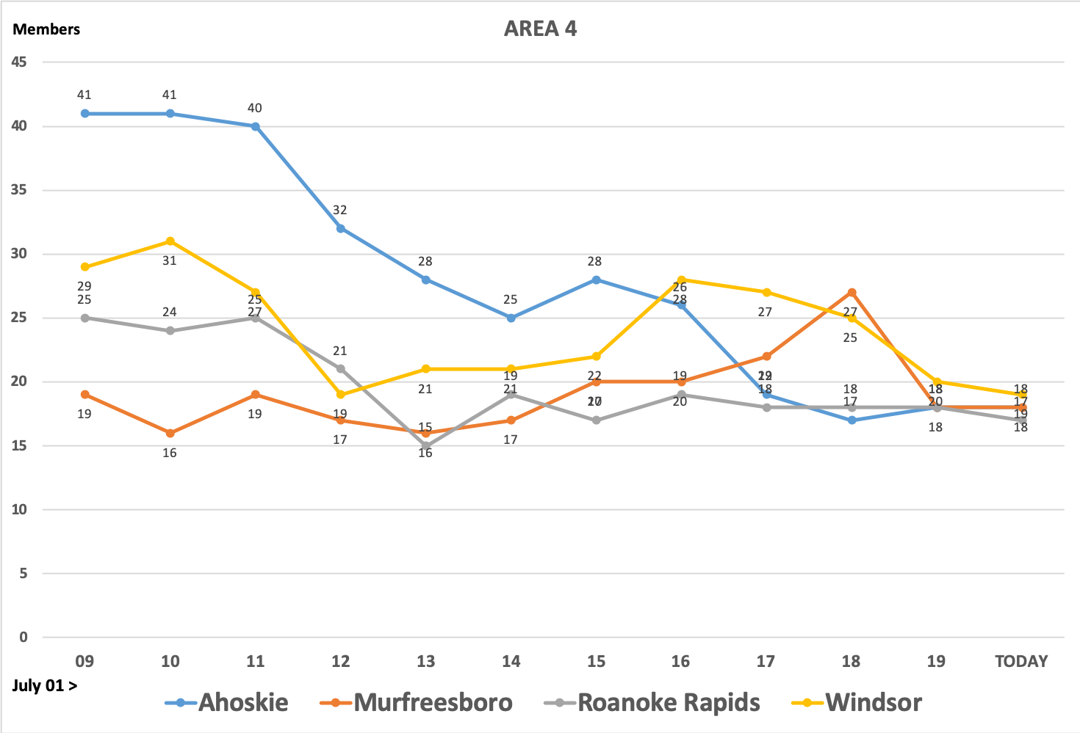
AREA 4

Slide 6
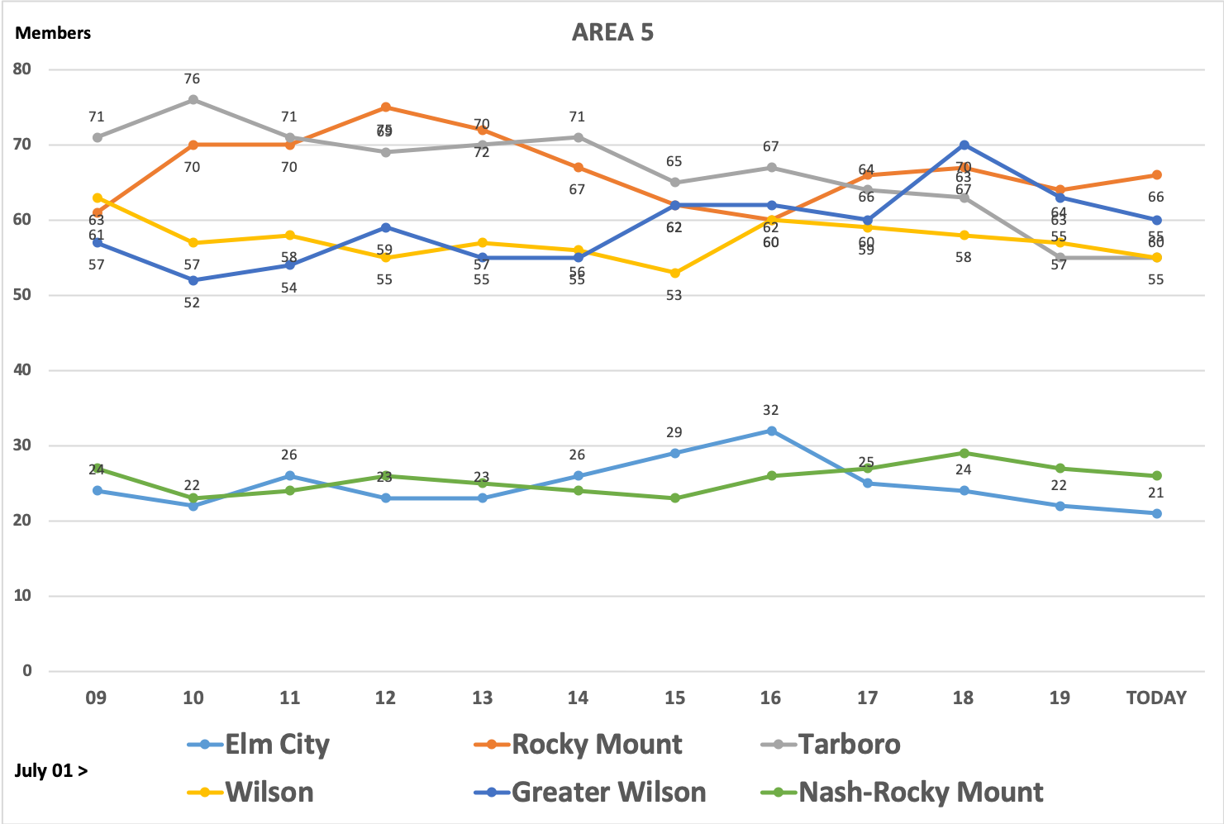
AREA 5

Slide 7
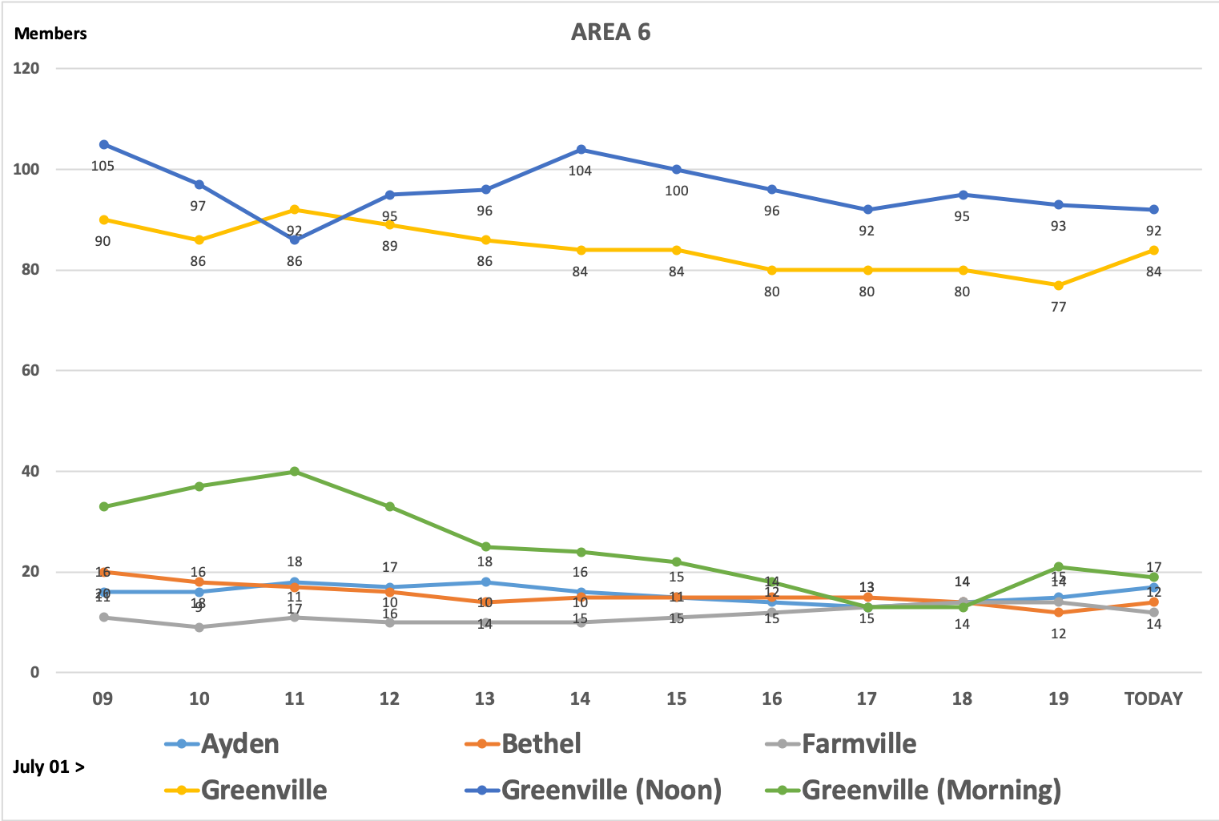
AREA 6

Slide 8
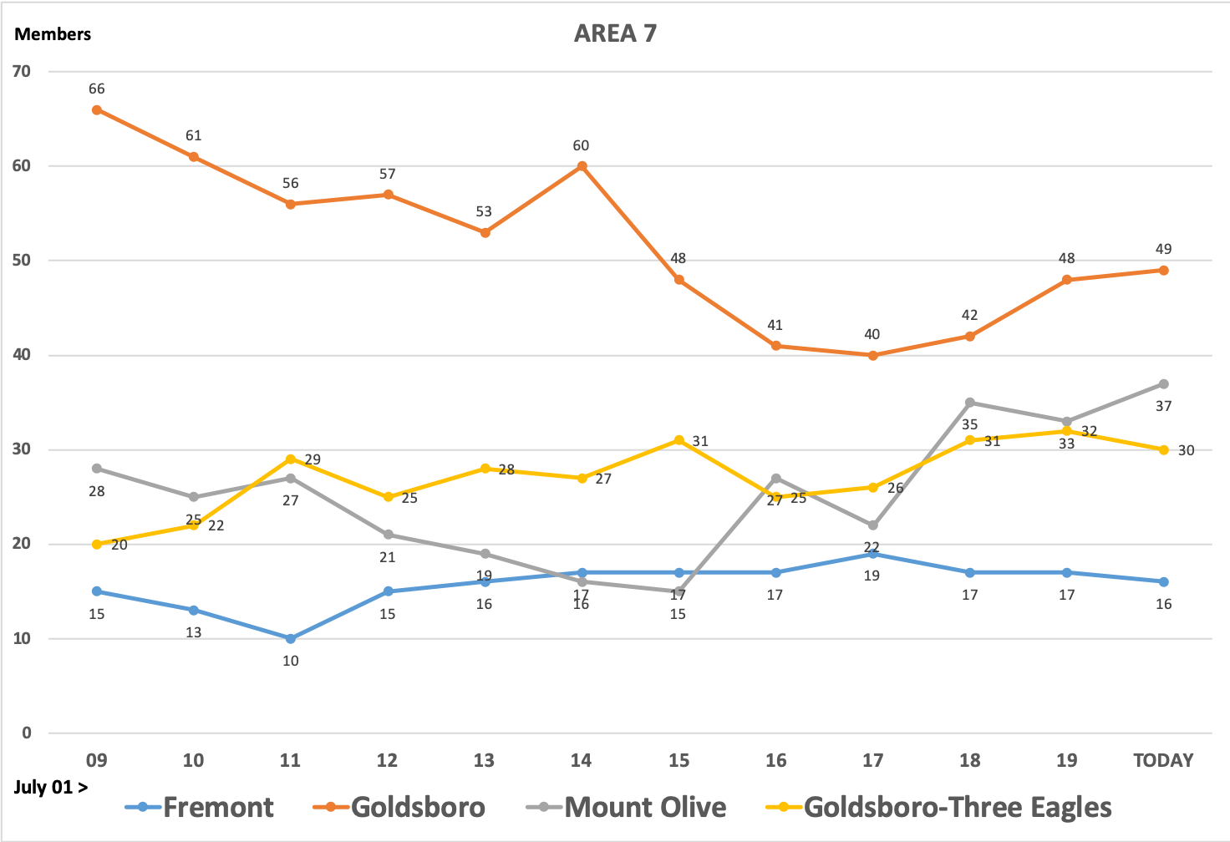
AREA 7

Slide 9
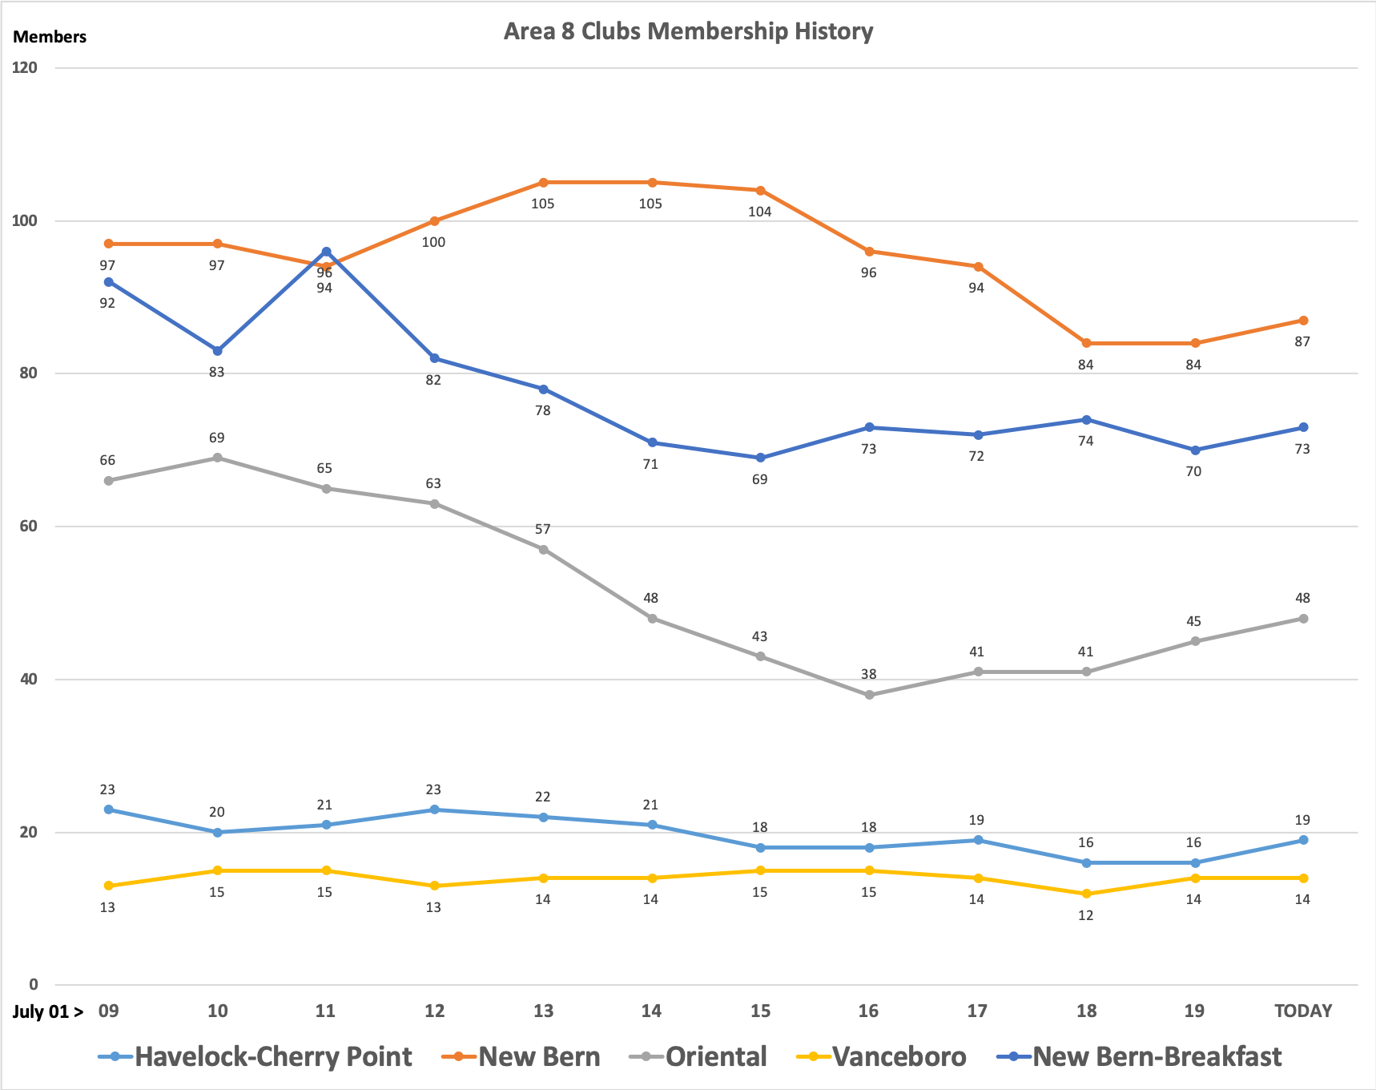
AREA 8

