Slide 1
Rotary Has Changed! Has Your Club?
TITLE
District Governor Elect Spencer Stanley
Supporting District Membership Chair PDG Stan Keeler!
Spring 2020

Slide 2
Mindset – Membership Organization
WE ARE A MEMBERSHIP ORGANIZATION
Everything else becomes easier once membership is working
Membership is our lifeline
Membership is our source of everything
SERVICE IS WHAT WE DO
It’s our product; our deliverable
Service is our “WHY”
But we need members to do it!
Notes:
2
Large Banners

Slide 3
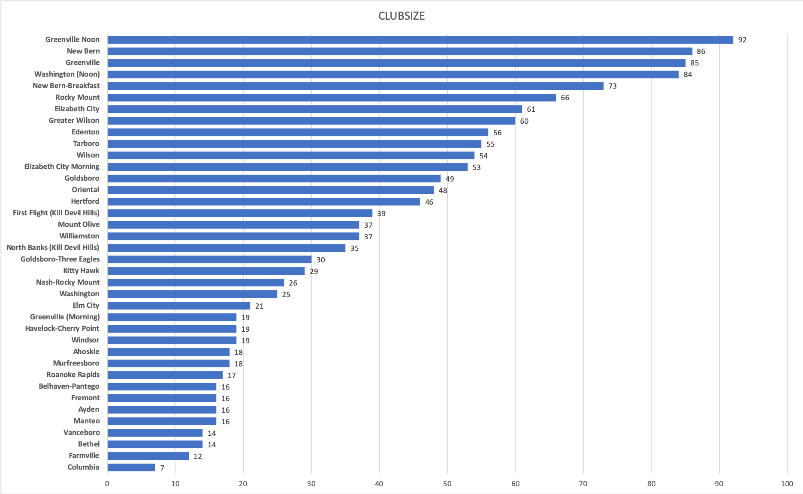
District 7720 Membership 2019

Slide 4
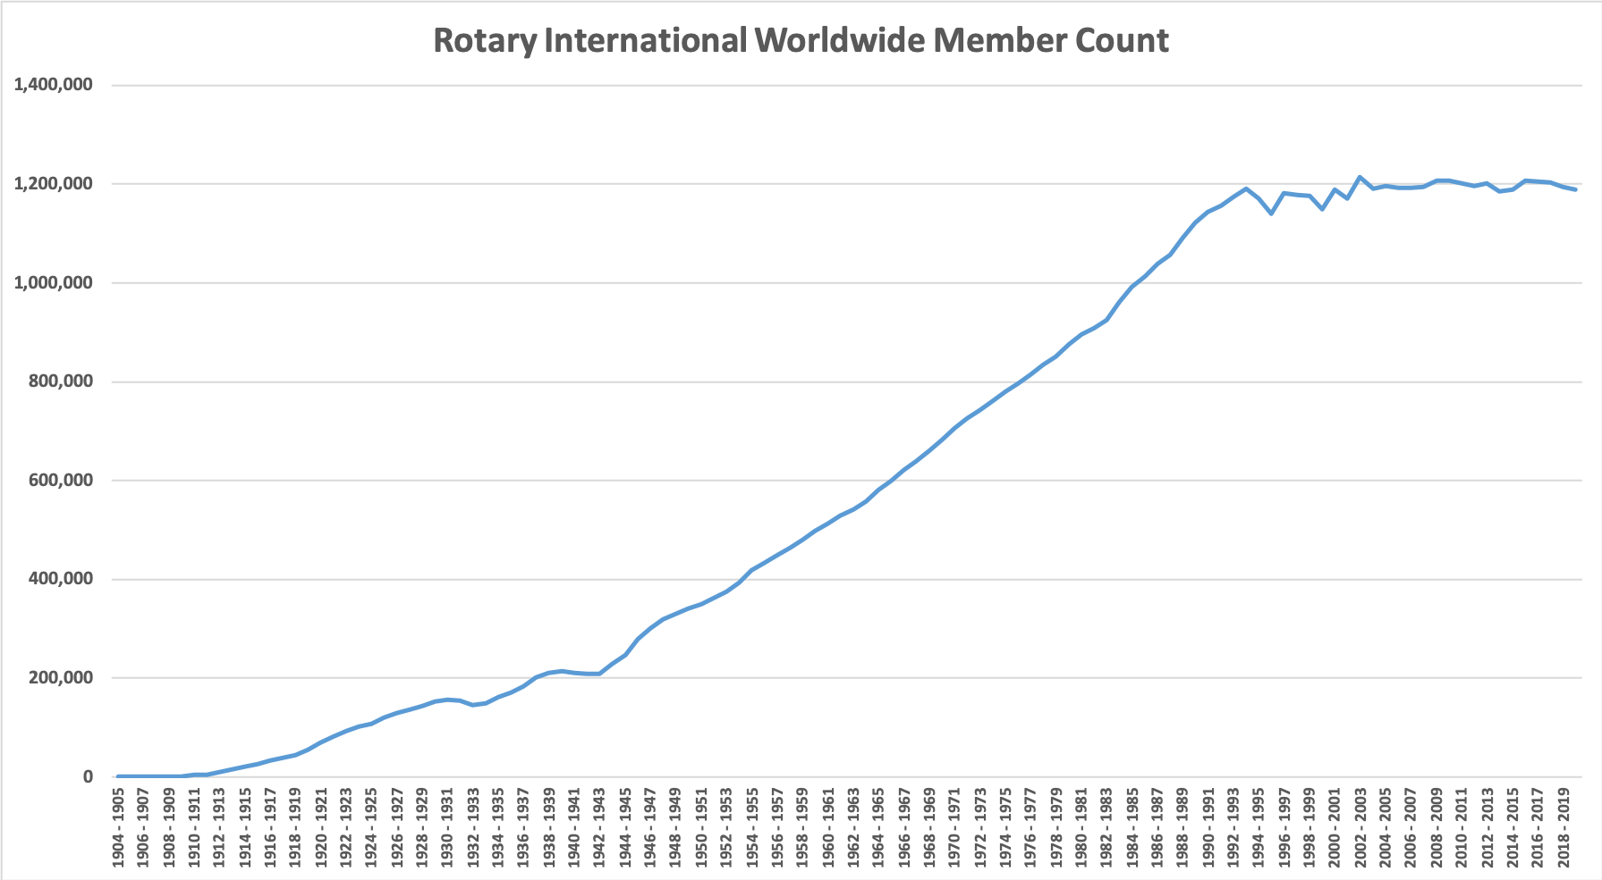
ROTARY INTERNATIONAL COMPLETE MEMBERSHIP HISTORY…

Slide 5
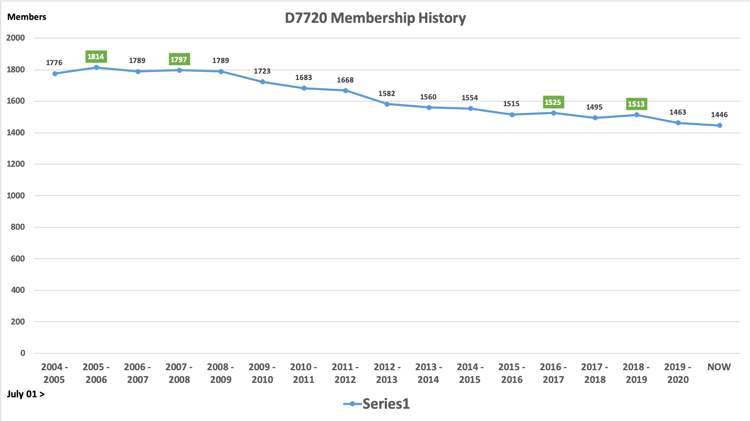
DISTRICT HISTORY…

Slide 6
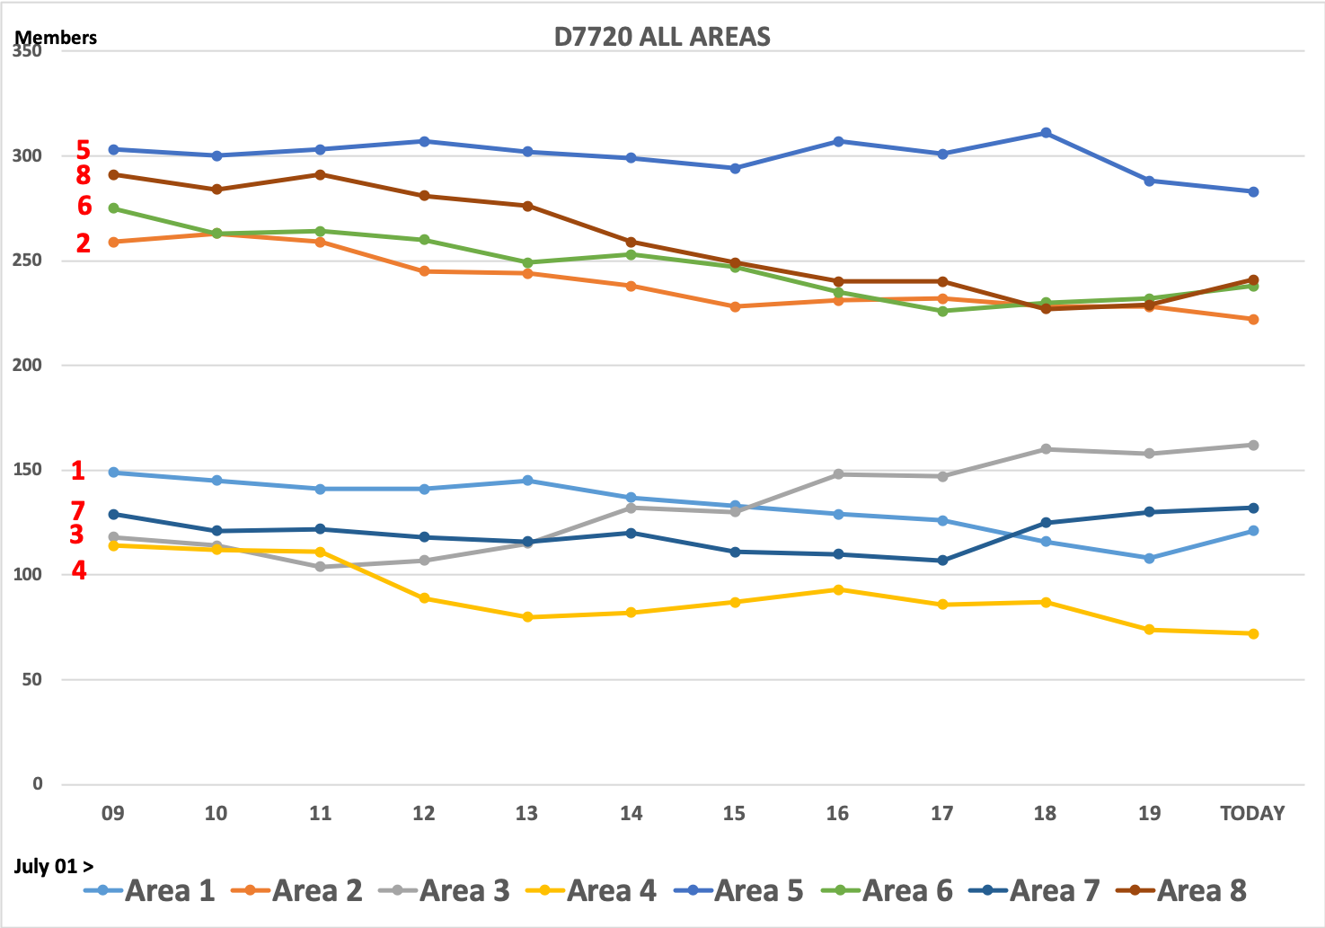
D7720 AREA MEMBERSHIP TRENDS 2009 > TODAY

Slide 7
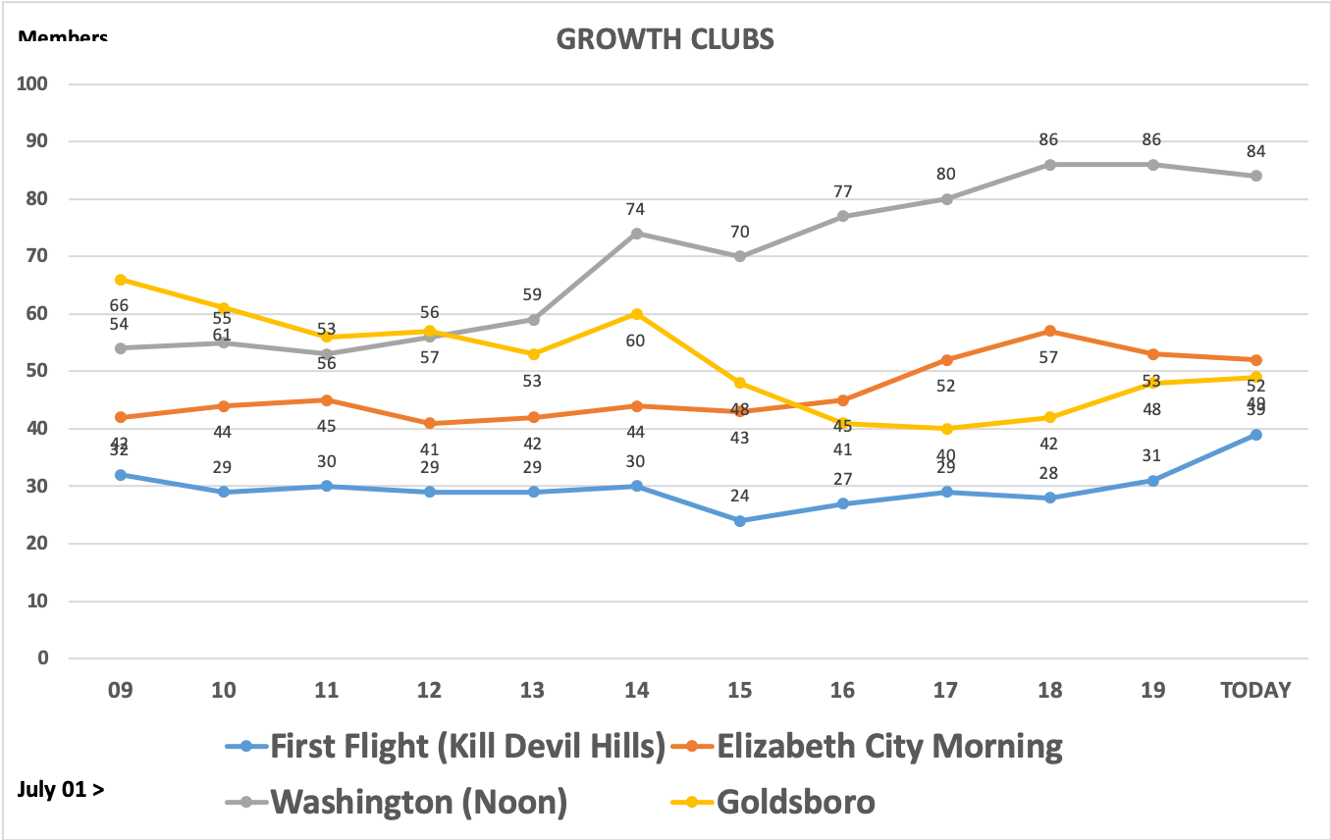
4 GROWTH CLUB EXAMPLES

Slide 8
You are the front line of the army fighting Rotary's biggest enemy
COMPLACENCY
Notes:
8

Slide 9
INTENTIONAL MEMBERSHIP STRATAGIES???
WE don't get it!
or WE don't care!
WE don't know how!
SOMEONE ELSE will do that?
Notes:
9
Large Banners

Slide 10
Clubs Need Moderate Membership Growth
You must plan for the attrition that WILL occur!
This takes intentionality – a “PLAN”!
Membership is a Club Responsibility!
If It Is To Be, It Is Up To YOU! (WITH HELP!)
Notes:
10
Large Banners

Slide 11
PLANNING: FAIL TO PLAN = PLAN TO FAIL
HAVE A PLAN / STRATEGIES
KEEP IT SIMPLE
EASY TO UNDERSTAND BY EVERY CLUB MEMBER
ATTAINABLE GOALS
ACTIONABLE
ACTION ITEMS THAT ARE DOABLE IN REAL LIFE
GOALS THAT ARE ACHIEVABLE
ACCOUNTABLE
CMC REPORTS TO CLUB BOARD EVERY MONTH
CMC REPORTS OUT TO DMC EVERY MONTH
IMPLEMENT YOUR PLAN

Slide 12
Setting The Stage
Hope is NOT a strategy
We must be intentional about membership growth
Rotary is a Membership Organization
Service is what we do – our product
Members are our customers
Our clubs must meet their needs, or they will vote with their feet
Without members, how will we deliver service?
Notes:
12
12
Large Banners

Slide 13
HOPE IS NOT A STRATAGEY!

Slide 14
Attracting Members
Not a podium announcement; a 1:1 personal ask
Must become CULTURE!
Every member responsible for attracting new members
The Object of Rotary is to encourage and foster the ideal of service as a basis of worthy enterprise and, in particular, to encourage and foster:
FIRST: The development of acquaintance as an opportunity for service;
Notes:
14
14
Large Banners

Slide 15
Attracting Members
#1 Proven Member Growth Method!
If you do nothing else, do this one strategy!
Guaranteed fastest way to grow the club
Takes some effort, but has the BIGGEST return
Must be done regularly – consistently for success
Notes:
15
15
Large Banners

Slide 16
Rotary Club Health Check
Health check image goes here
Notes:
16
16
Large Banners

Slide 17
RESOURCE GUIDE

Slide 18
THANK YOU!
Stan Keeler
District Membership Chair
630-803-6818
stankeeler@gmail.com
Spencer Stanley
District Governor Elect
252-833-4716
spencerrotary@gmail.com

