Slide 1
End Polio Now
District Fundraiser
Consider using the PolioPlus Society
Celebrate World Polio Day, October 24, 2023
Plan and carry out a district-wide polio fundraiser
Notes:
Chuck

Slide 2
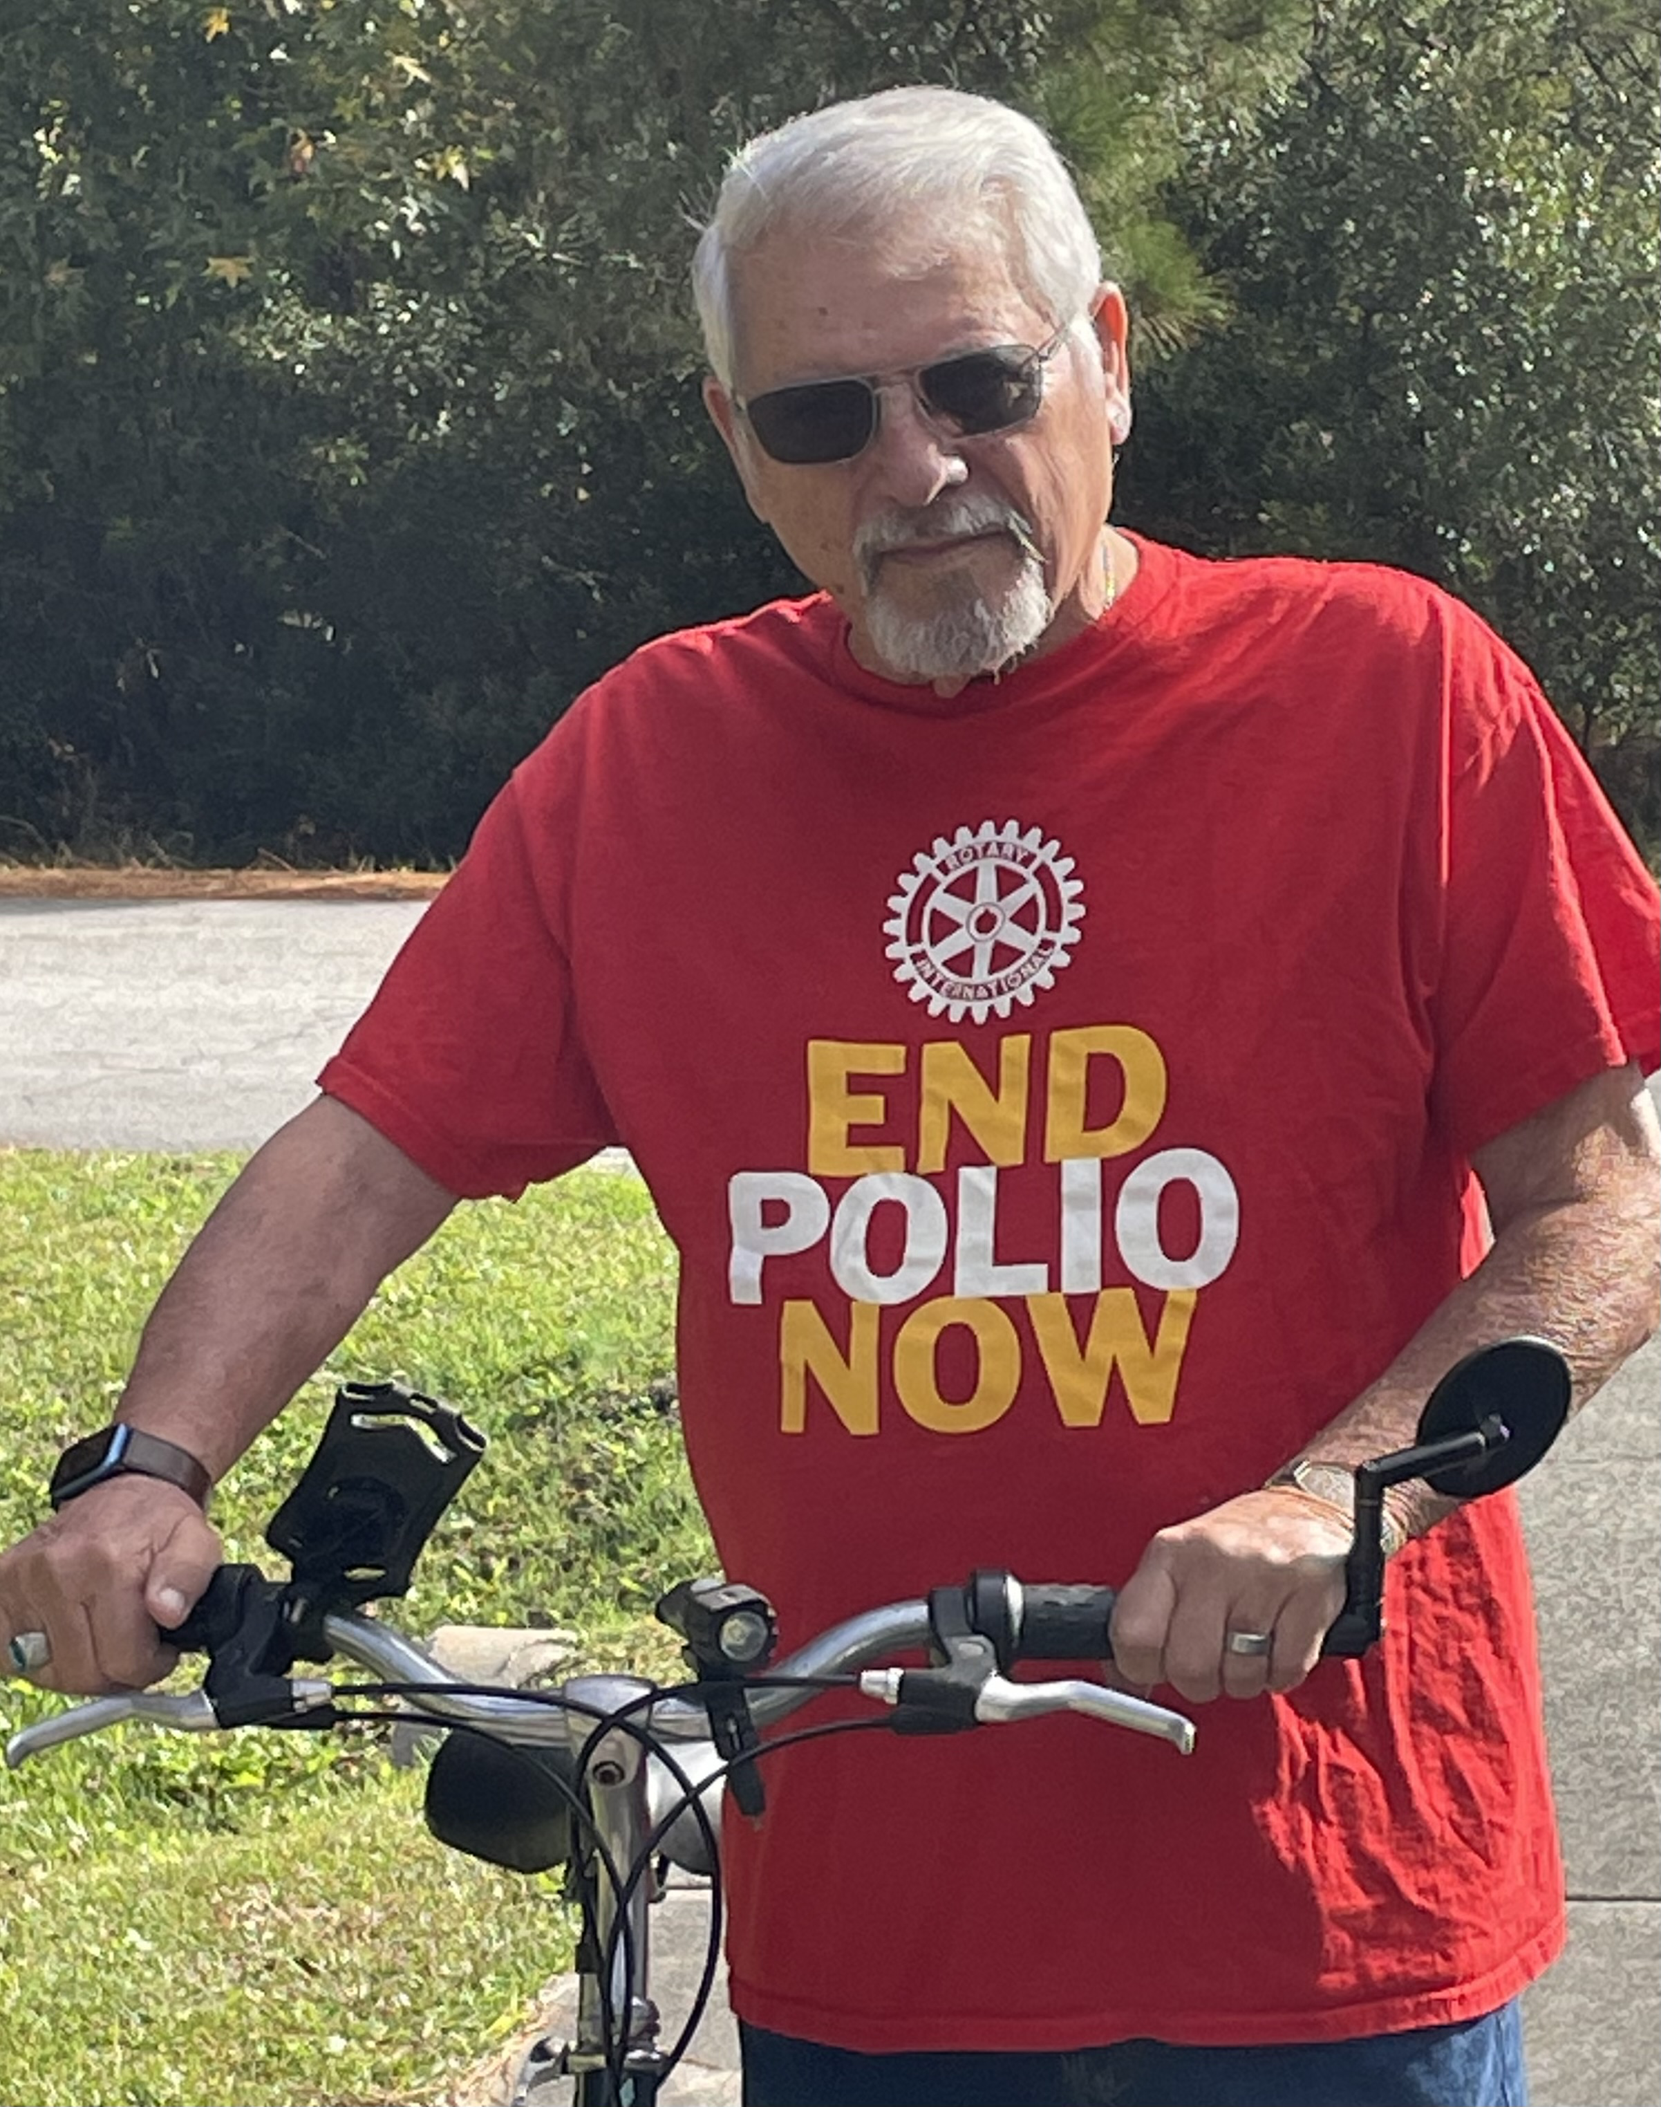
Ride with Tony
July 1, 2023
to
October 24, 2023
Notes:
Bernie

Slide 3
Ride with Tony, 2021)
Goals
Raise $’s and Awareness
Achieve Club & District Polio Goal
Have FUN!
Just Maybe Get a Bit Healthier
Notes:
Bernie

Slide 4
Ride with Tony
(July 1, 2023 to October 2023)
Everybody gets a FREE Polio
T-Shirt!
Teams report Miles & $’s Raised Monthly
Drawing for Prizes for Qualifying Teams
Notes:
Bernie

Slide 5
“Ride with Tony”
How Does it Work?
- Need a Team Captain:
- Encourage Members to secure Pledges, Contributions etc.
- Record Progress (Pledge/Contribution Form)
- Insure All $’s are sent to our Rotary Foundation for Polio
- Maintain Team Ongoing Miles
- Utilize Smart Devices (Fitbit, Garmin, iPhone, Apple Watch)
- Four Way Test is in Full Effect!
- Report Miles to Bryson Bateman jr. Monthly
( bateman10@Hotmail.com)
- Pledge/Contribution Form & Mileage Form will be
provided
Notes:
Les Wright
Les Wright - Today, in some nameless village a child greeted the new day unaware that during the night polio passed him over because he was immunized.

Slide 6
Ride with Tony
Take Photos
Post on Social Media with Hashtags:
#ridewithtony
#EndPolioNow
#RotaryDistrict7720
#DoGoodHaveFunTellSomeone
- Send Press Releases to local papers.
Notes:
Bernie

Slide 7
Success Story
Run with Bernie

Slide 8
Run with Bernie
District 7770 achieved
Polio Goals
18 of the 22
Run with Bernie Clubs
have achieved 100%
of their Club Polio Goals
District Actual $’s Raised $204,000
170% of Polio Goal
Notes:
Bernie

Slide 9
Why
We Give
Notes:
Bernie

Slide 10
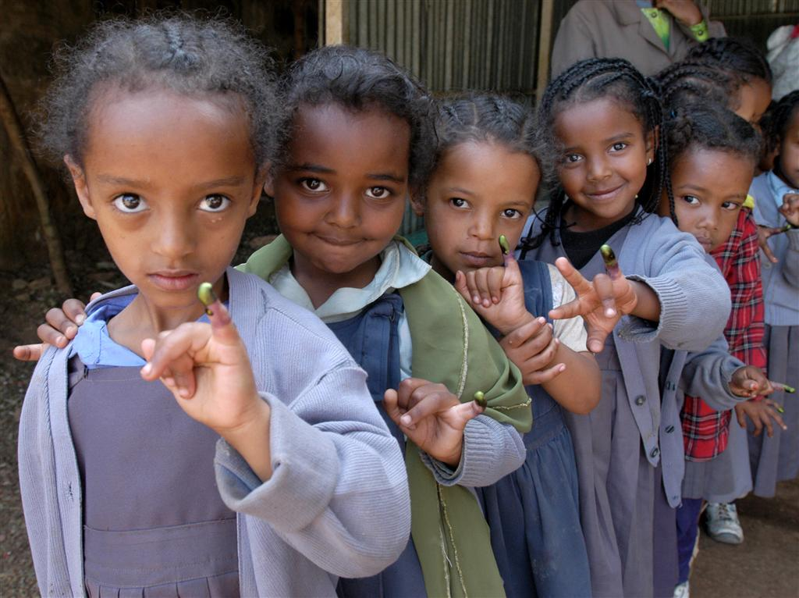
Notes:
Bernie

Slide 11
Questions?
Notes:
Chuck & Bernie

