Slide 1
Member Care Manual
“Supporting the membership journey”
Appendix L
Expanding Your Rotary Horizons Slide Presentation

Slide 2


Expanding Your Rotary Horizons
A snapshot of Rotary programs and resources

Slide 3
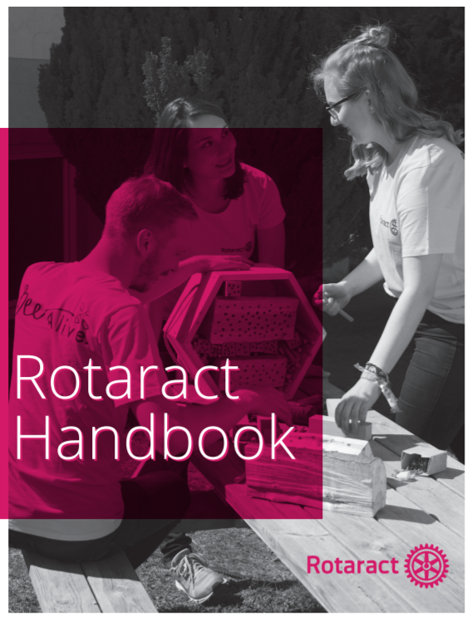

Rotaract (“Rotary in Action”)
Began in Charlotte NC as youth program in 1968
Now over 200,000 members in 11,000 clubs in 189 countries
Young professionals 18 and over
Typical club formats
  College/University-based
  Community-based
Elevated to independent status July 1, 2020
  Can be independent or Rotary Club(s) sponsored
  Paying dues and hosting global grants: July 1, 2022
Our District currently active Rotaract Clubs

Slide 4
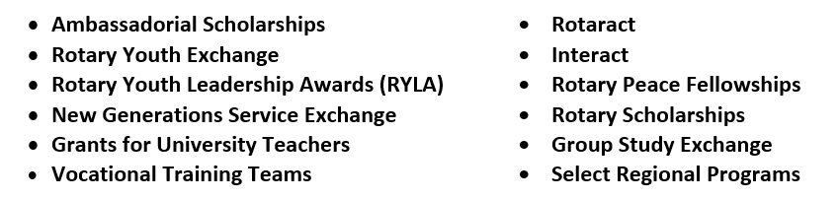
Rotary Alumni
Worldwide network to keep alumni connected to Rotary
Participants in one or more of these Rotary programs:
Alumni opportunity to network, mentor, speak and support projects
Club resource for meetings, service projects and potential new members

Slide 5


Rotary’s Youth Programs
(Under 18 years of age)
Rotary Youth Leadership Awards
Weekend conference for 9th graders typically held in May
Includes workshops and presentations on communications, problem solving, ethics and other general leadership skills
Rise Against Hunger meal packing event typically included
Rotary clubs sponsor high school students
Rotary Youth Exchange (building peace “one young person at a time”)
For youth ages 15-19
Both long term (academic year) and short term (up to three months) exchanges
Room, board and school fees provided (all others at own expense)
Rotary club sponsor required
Unique language and cultural learning experience
Read the Rotary Youth Protection Guide to learn more

Slide 6
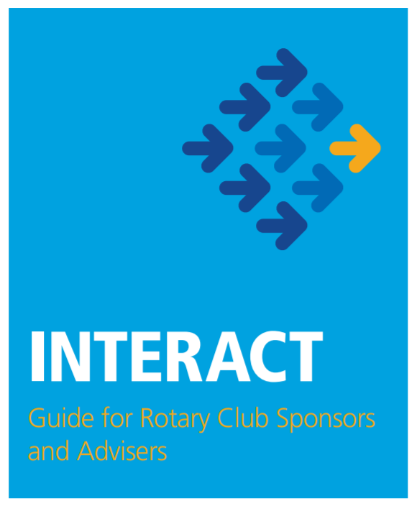

Interact (“International and Action”)
Evolved from Rotary’s history of supporting youth organizations
First club in Melbourne High School FL in 1962
Now over 340,000 members in 14,900 clubs in 145 countries
Young people ages 12-18
Sponsored by a Rotary Club
At least two community service projects annually
  One to further international understanding and goodwill
Our District currently active Interact Clubs

Slide 7

Rotary’s Peace Initiatives
70 year collaboration with the UN
Sponsorship of peace symposiums and forums globally
Peace Center program established in 2002
  Identify and train professional agents for peace
  Endowed through separate gifts to The Rotary Foundation
  Six Centers linked to seven universities globally
    50 Masters degree fellows annually
    Up to 20 professional development fellows in each program bi-annually
  Over 1300 alumni now working primarily in governmental and non-governmental organizations
Youth Peace in Action
  Largest local community-based peacebuilding initiative in Rotary history

Slide 8
Rotary Fellowships
Over 100 from which to choose:
International groups of members who share a common interest
  Recreational sports
  Hobbies
  Professions
Expand skills, foster vocational development & enhance the Rotary experience
Advance Rotary’s public image and identity
Incentivize active membership
Amateur radio
Antique autos
Badminton
Bees
Beer
Bird watching
Chess
Cycling
Empowering women
Environment
Golf
Hunting
Motorcycling
Music
Pickleball
Railroads
Rum
Scouting
Wine
Yoga
Visit www.rotary.org/fellowships for more information

Slide 9
Rotary Action Groups (RAG)
Global Rotary affiliated groups
  27 RAGs aligned to Rotary Areas of Focus
Experts in a particular field
Available to provide technical expertise to clubs
  Project planning and implementation
  Locating partners and resources
  Preparing grant applications
  Conducting community assessments
Anyone can join, but only Rotarians, Rotaractors or Rotary Peace Fellows can hold leadership roles
Peace
Refugees
Slavery Prevention
Addiction Prevention
Blindness Prevention
Blood Donation
Diabetes
Hearing
Malaria
Polio Survivors
Disaster Assistance
Endangered Species
Food Plant Solutions
Basic Education & Literacy
Clubfoot
Multiple Sclerosis
Mental Health
Hepatitis Eradication
Alzheimer's/Dementia
Visit www.rotary.org/actiongroups for more information

Slide 10
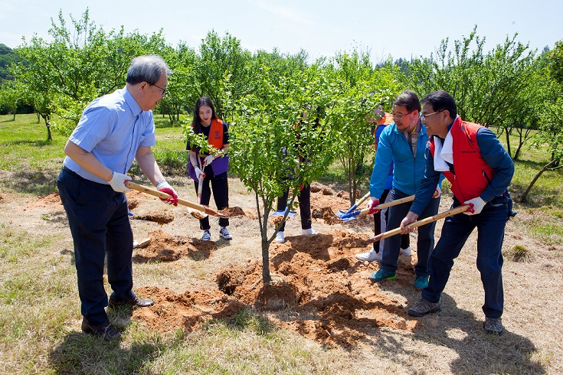
Rotary Showcase
Comprehensive database of worldwide Rotary projects
Browse by:
  Keyword
  Zone/District/Club
  Area of Focus
  Location
Showcase what your club is doing
Locate partner clubs for grants and other projects
Visit www.rotary.org/showcase for more information

Slide 11



Rotary Brand Center
Create powerful messages
Ensure proper and consistent use of Rotary’s brand
  Structure a proper club logo
  Utilize the Rotary logo correctly
Expand our reach
Create a positive public image in your community
Visit www.brandcenter.rotary.org for more information

Slide 12
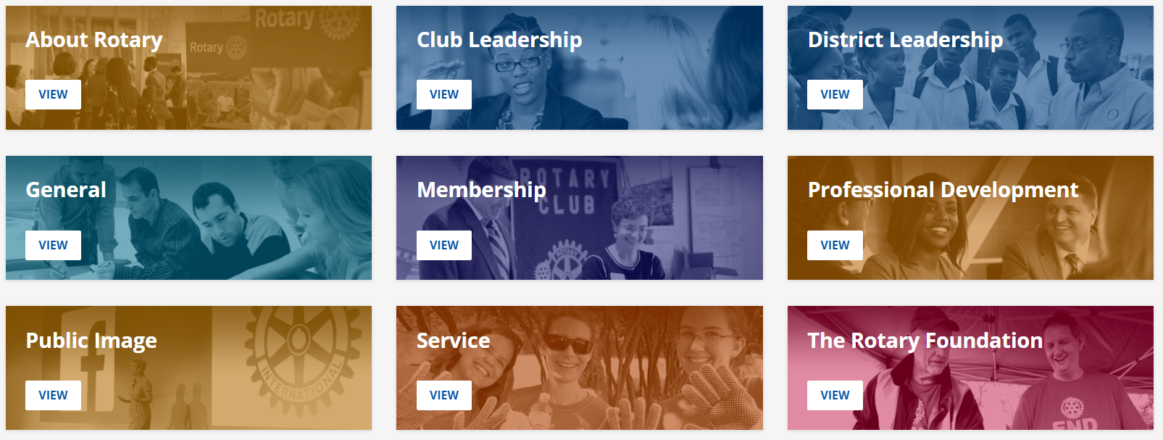
Rotary Learning Center
295 courses in English… and growing
  84 courses in Club Leadership alone
Interactive and engaging presentations
A great resource for expanding your Rotary knowledge and developing your skills
On-line training for your club leadership team
Resource for member personal and professional development
Visit www.learn.rotary.org for more information

Slide 13
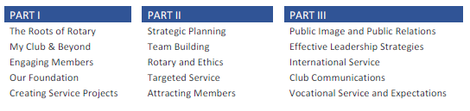

Rotary Leadership Institute
Rotary knowledge and leadership advanced training program
Develops leaders for your club and the district
Worldwide program
  We are in Mid-Atlantic Zone (14 Rotary districts)
  Delivered in three modules
  http://www.rli33.org/ for additional information and to register

Slide 14
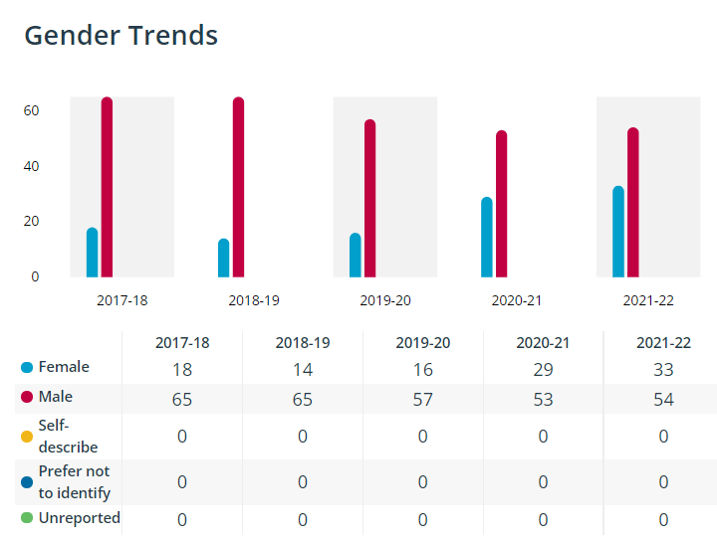
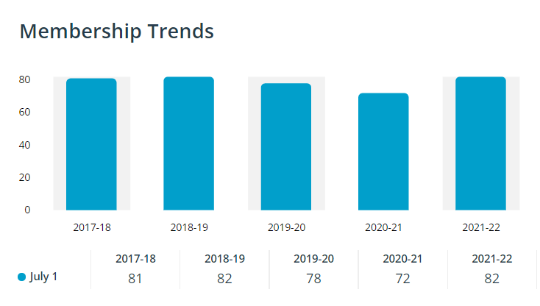
Rotary Club Central
Online tool for setting goals and tracking club progress
  Club Dashboard
  Goal Center
  Service Project Reporting
  Club Rating
Repository of historical club performance
  Report Generator
Resource links for club leaders
  “How to” library
  Links to club resources

Slide 15
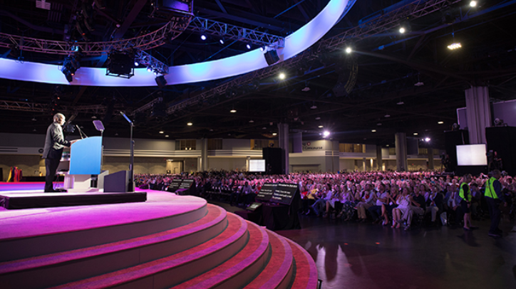

Rotary International Convention
Currently planned conventions
2023: 27-31 May, Melbourne, Australia
2024: 8-12 June, Singapore
2025: 21-25 June, Calgary, Canada
Learn more at Convention.rotary.org

